Slide 1

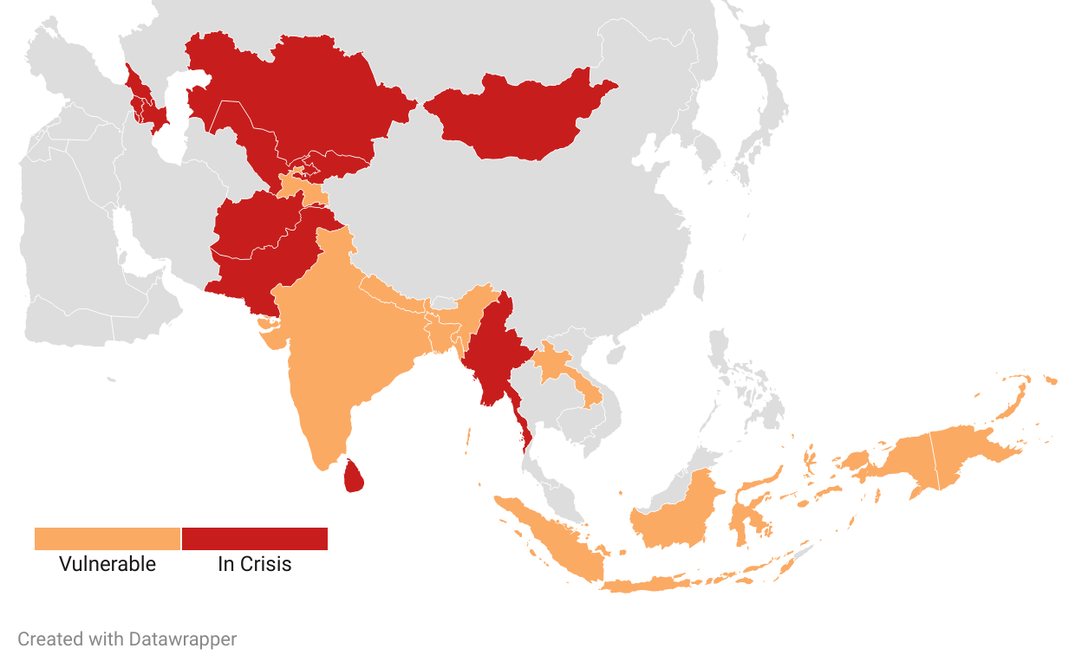
Food Security Tracker
June 2022 Edition
Food-related Commodity Prices¹
(Change in %)
 |  |  | MoM | YoY
Energy
Crude oil, average | ($/bbl) | ($/bbl) | -8% | 56%
Natural gas, US | ($/mmbtu) | ($/mmbtu) | 34% | 126%
Edible Oils
Palm oil |  | ($/mt) | -5% | 48%
Soybean oil |  | ($/mt) | 0% | 24%
Sunflower oil |  | ($/mt) | -4% | 44%
Grains
Maize |  | ($/mt) | 4% | 14%
Rice |  | ($/mt) | 2% | -13%
Wheat, US SRW |  | ($/mt) | 26% | 148%
Other Agriculture Products
Soybeans |  | ($/mt) | 0% | 11%
Sugar, world |  | ($/kg) | 3% | 14%
Cotton, A Index |  | ($/kg) | 10% | 71%
Fertilizers
Phosphate rock |  | ($/mt) | 40% | 143%
DAP |  | ($/mt) | 2% | 66%
TSP |  | ($/mt) | 8% | 62%
Urea |  | ($/mt) | 6% | 179%
Potassium chloride |  | ($/mt) | 0% | 178%
Logistics
Baltic Dry Index² |  |  | 22% | 6.5%

