Slide 1
Week 13: Deploying Deep Learning Models on Web and Smartphone Applications Using Streamlit API
Tuesday, April 4th, 2023

Slide 2


Developing Applications
Introduction
Deploying deep learning models
Creating maps
Allowing users to interact with applications
Provide an application by packaging it in a user-friendly manner
https://tinyurl.com/bdh36zyb, https://tinyurl.com/3fc9wby6

Slide 3
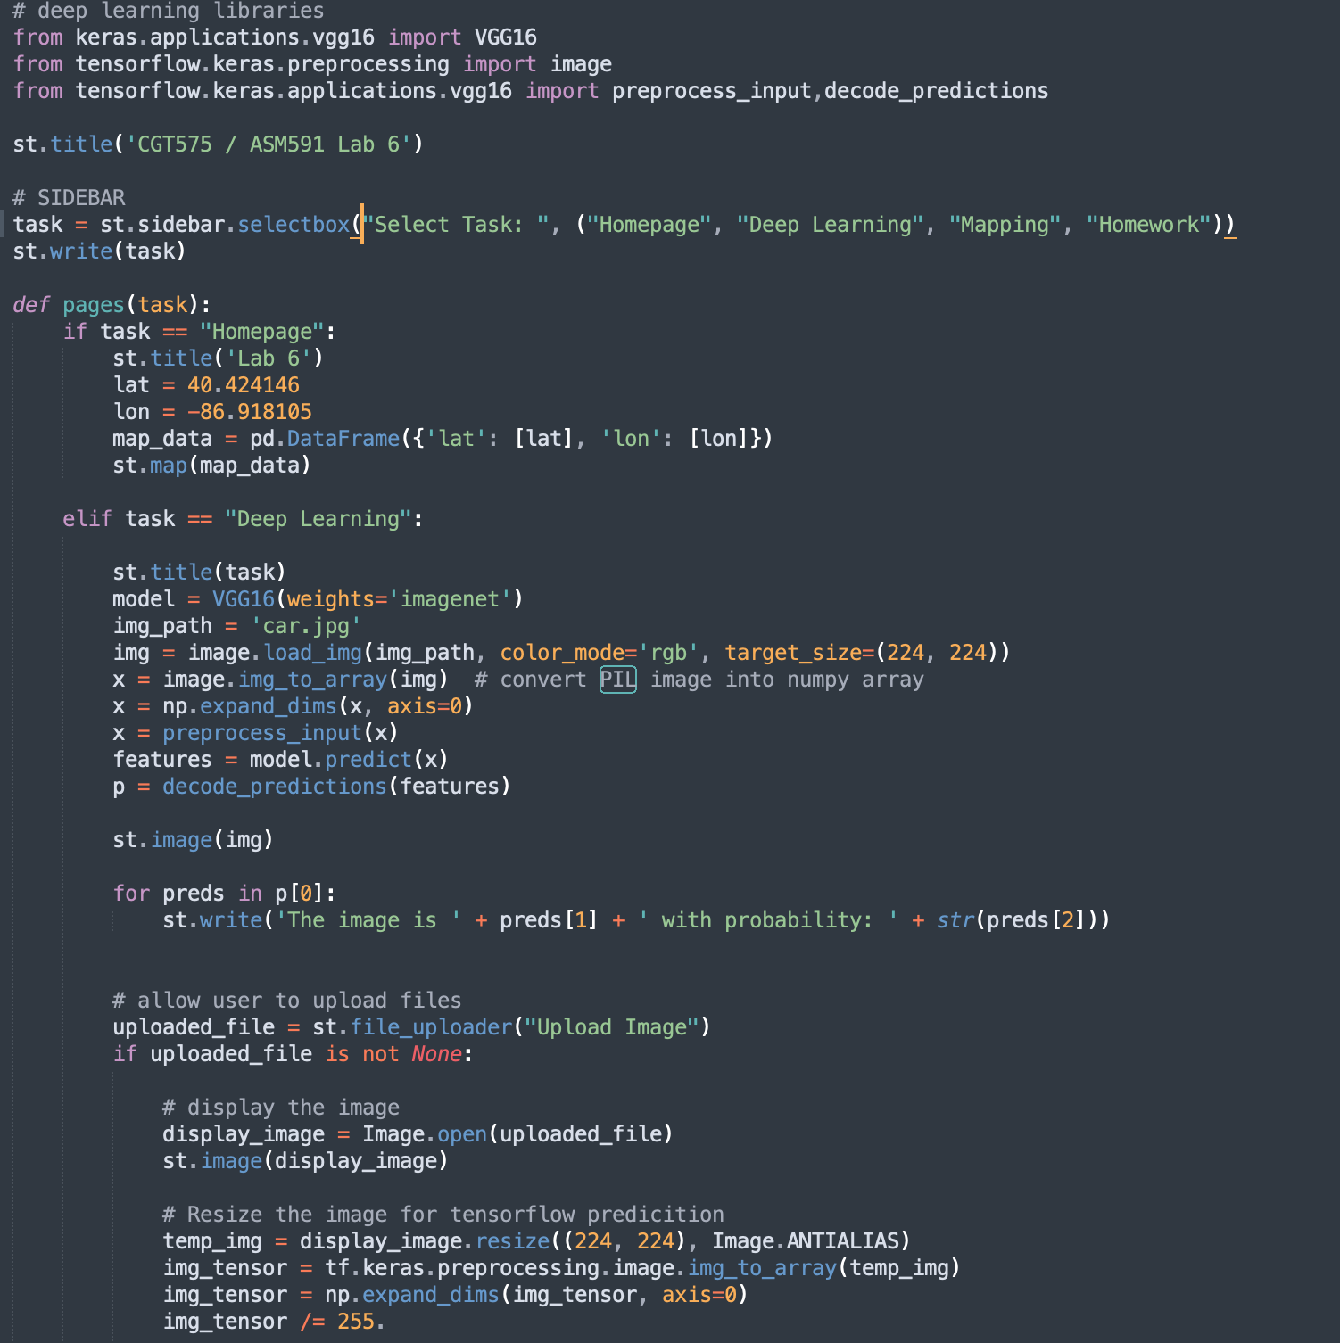
Python Indentation
Python is an indent sensitive language
If the code is incorrectly indented, you will encounter errors
Make sure you take care of the indentation
At the end of each objective, the entire code for a particular page is shown so make sure yours is indented correctly
Use backspaces and tabs to correct indentation if you encounter an error

Slide 4
Overview
Lab6: Application Development
Objective 1, 2
Objectives 3
Objectives 4
Objective 5
Setup
Deploy Deep Learning Models
Create Interactive Maps
Homework
Install required libraries
Load a pre-trained deep learning model
Show a map on the application
Allow users to upload images
Create the main.py file with starter code
Make a prediction by providing an input image
Use a marker on the map
Load one image from Lab5
Ensure a simple application is developed
Allow users to upload image files
Plot its geocoordinates on a map
Add 3 pages in the application
Make a prediction of the uploaded image

