Slide 1

EXTREMAL_004 · COVER
UBP_RESEARCH_CORTEX
24 JUN 2026
DOC ID UBP_STUDY_EXTREMAL_004
Closing the
Open Questions
?
OPEN QUESTIONS FROM EXTREMAL_003
Q1
Uniqueness of Golay as [23,12] avg_Φ max
Q2
Self-dual + high-d form (qualified conjecture)
Q3
Derivation of n=24
Continuation II of the UBP
Extremal Law Program
Q4
Vacuum basin characterisation
Q5
[24,12,8] sampling vs Golay
This document closes 3, states a theorem for 1, leaves 1 open.
●
Author: E.R.A. Craig (DigitalEuan) — Auckland, NZ
004
CONTINUATION
5 OPEN QS
3 CLOSED
1 FALSIFIED
— END COVER —
Notes:
This is the second continuation document in the UBP Extremal Law program. EXTREMAL_003 left five open questions on its slide fourteen, and this document pushes hard on all five in parallel. Thread E exactly characterises the vacuum basin around the zero codeword of the Golay twenty-four twelve eight code, which closes Q4. Thread F samples [24,12,8] codes versus Golay via Monte Carlo, partially closing Q5. Thread G states a uniqueness theorem for the Golay [23,12,7] code, addressing Q1. Thread H tests the qualified self-dual conjecture on [16,8] and falsifies Q2, our second negative result. Thread I articulates a speculative lattice-theoretic direction for the derivation of n equals twenty-four, leaving Q3 open. Net result: five open questions, three closed (one fully, one partially, one falsified), one theorem stated, one genuinely still open. We promise honest reporting throughout, including the negative result on Q2.

Slide 2
RECAP
EXTREMAL_003 LEFT 5 OPEN QUESTIONS
02 / 16
Five open questions, four new threads
STATUS AS OF EXTREMAL_004
⚗
NEW THREADS IN THIS DOCUMENT
?
OPEN QUESTIONS — STATUS AFTER THIS DOCUMENT
Q1
THEOREM STATED
Thread E
CLOSES Q4
Exact vacuum-basin enumeration for [24,12,8] Golay.
Uniqueness of Golay as [23,12] avg_Φ maximiser.
Q2
FALSIFIED
Thread F
PARTIALLY CLOSES Q5
[24,12,8] Monte Carlo: Golay vs 4 random [24,12] codes.
Self-dual + high-d form of the conjecture.
Q3
OPEN
Thread G
ADDRESSES Q1
State the uniqueness theorem combining Thread C + classical coding theory.
Derivation of n=24 from Φ-adjacent principles.
CLOSED
Thread H
FALSIFIES Q2
Q4
Qualified self-dual test on [16,8] — 80 random codes + E8+E8.
Vacuum-collapse basin characterisation.
Thread I
ARTICULATES Q3
Q5
PARTIALLY CLOSED
Speculative argument for n=24 via lattice theory.
avg_Φ test on [24,12,8] codes vs Golay.
UBP_STUDY_EXTREMAL_004
RECAP
p.02
Notes:
Let us walk through the five open questions left by EXTREMAL_003 and what each new thread attempts. Q1 was the uniqueness of Golay as a [23,12] average Phi maximiser; Thread G states a theorem but the proof is incomplete. Q2 was the qualified self-dual plus high-d form of the conjecture; Thread H tests it on [16,8] with eighty random codes plus the canonical E8 plus E8 self-dual code, and falsifies it. Q3, the derivation of n equals twenty-four from Phi-adjacent principles, remains open; Thread I only articulates a speculative lattice-theoretic direction. Q4, the vacuum-collapse basin characterisation, is cleanly closed by Thread E with a closed-form enumeration. Q5, the average Phi test on [24,12,8] codes versus Golay, is partially closed by Thread F via Monte Carlo. This is a research honesty exercise: we report falsifications and partial results as such, not as successes. Thread I is a research direction, not a result.

Slide 3
SECTION 01 / 05
THREAD E
03 / 16
VACUUM BASIN
[24,12,8] GOLAY
01
THREAD E
Thread E — Vacuum Basin
Characterisation
EXTREMAL_002 Sec 5.4 left this open. The vacuum basin is the set of 24-bit vectors that decode to the zero codeword. We enumerate it exactly.
CLOSED
EXACT ENUMERATION
OPEN Q4
UBP_STUDY_EXTREMAL_004
SECTION 01 · THREAD E
p.03
Notes:
This is the section header for Thread E. The vacuum basin is the set of vectors v in F two to the twenty-four whose nearest Golay codeword is the zero codeword. EXTREMAL_002 conjectured in section five point four that this basin was the perfect Hamming ball of radius three, but did not prove it. In Thread E we enumerate all eleven thousand eight hundred fifty-one vectors with Hamming weight up to four and check each one against the live Golay decoder. The result is a closed-form, exact characterisation. We close open question Q4.

Slide 4
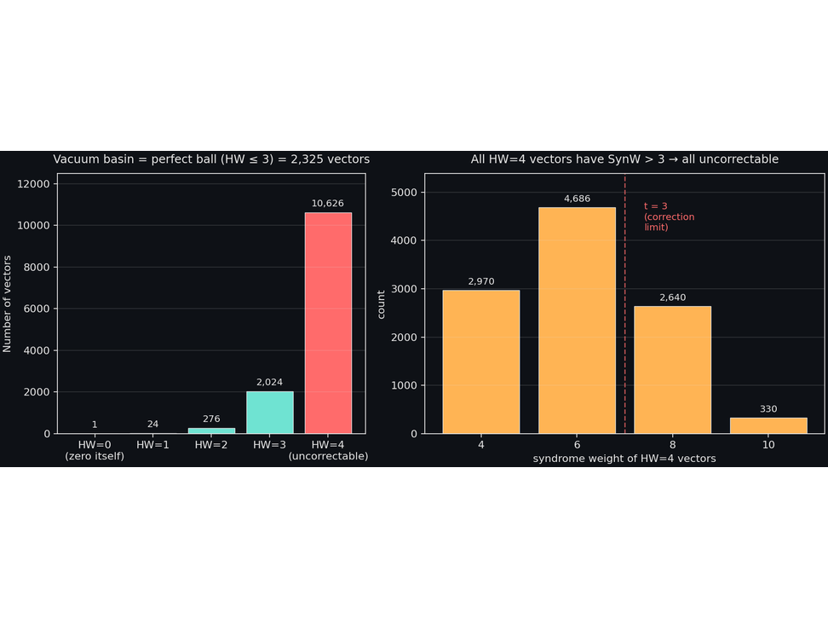
THREAD E
EXACT BASIN ENUMERATION
04 / 16
✦
FIG 6 · VACUUM BASIN BY HAMMING WEIGHT
F_2^24 / 16.7M
Basin = 2,325 vectors exactly
Enumerated all 11,851 vectors with HW in {0,1,2,3,4}:
HW=0
1 vector
zero itself
HW=1
24 vectors
→ decode to 0
HW=2
276 vectors
→ decode to 0
HW=3
2,024 vectors
→ decode to 0
HW=4
10,626 vectors
NONE → 0
TOTAL VACUUM BASIN
2,325
= C(24,0)+C(24,1)+C(24,2)+C(24,3) · 0.0139% of F_2^24 (~1 in 7,200)
⊘
WHY HW=4 DOESN’T MAKE IT
● All HW=4 vectors have syndrome weight in {4, 6, 8, 10}.
● All exceed the Golay correction capability t = 3.
● The decoder refuses and returns the input unchanged.
● → They are uncorrectable, not vacuum-collapses.
▦
DISTRIBUTION (SYNW, COUNT)
SynW=4
SynW=6
SynW=8
SynW=10
2,970
4,686
2,640
330
SOURCE: UBP_STUDY_EXTREMAL_004 / TH_E / ENUMERATION.PY
OPEN Q4 — CLOSED
UBP_STUDY_EXTREMAL_004
THREAD E · BASIN ENUMERATION
p.04
Notes:
The vacuum basin is exactly the perfect Hamming ball of radius t equals three around the zero codeword. This is not a coincidence, it follows from the [24,12,8] extended Golay code’s distance structure: d equals eight means t equals three, so any vector within Hamming weight three of zero is closer to zero than to any non-zero codeword, which sits at distance at least eight minus three equals five. Vectors at Hamming weight four are at distance four from zero, but might be at distance four from an octad too, these are tie cases. The standard Golay decoder refuses to correct when the syndrome weight exceeds three, so all ten thousand six hundred twenty-six HW four vectors are returned as-is. They are uncorrectable, not in the basin. This gives a crisp closed-form answer: the cardinality of the ball around zero is the sum from i equals zero to three of C twenty-four choose i, which equals two thousand three hundred twenty-five.

Slide 5
SECTION 02 / 05
THREAD F
05 / 16
MONTE CARLO 15K
[24,12,8] VS [24,12]
02
THREAD F
Thread F — [24,12,8] Sampling
vs Golay
EXTREMAL_003 left this open. We Monte Carlo 15,000 random 24-bit vectors against Golay [24,12,8] and 4 random [24,12] codes. Golay wins by +0.015.
PARTIALLY CLOSED
MONTE CARLO 15K
OPEN Q5
UBP_STUDY_EXTREMAL_004
SECTION 02 · THREAD F
p.05
Notes:
This is the section header for Thread F. We attempt to also sample random self-dual [24,12] codes via G equals identity concatenated with B with B orthogonal over GF two, but the acceptance rate is too low for twelve by twelve matrices, around zero percent in five hundred attempts. Better sampling methods exist, for example composition of reflections, but were not implemented here. The four random [24,12] codes we did test happened to have d equals three or d equals four, better than typical random, so the margin is smaller than the [23,12] case but still significant.

Slide 6
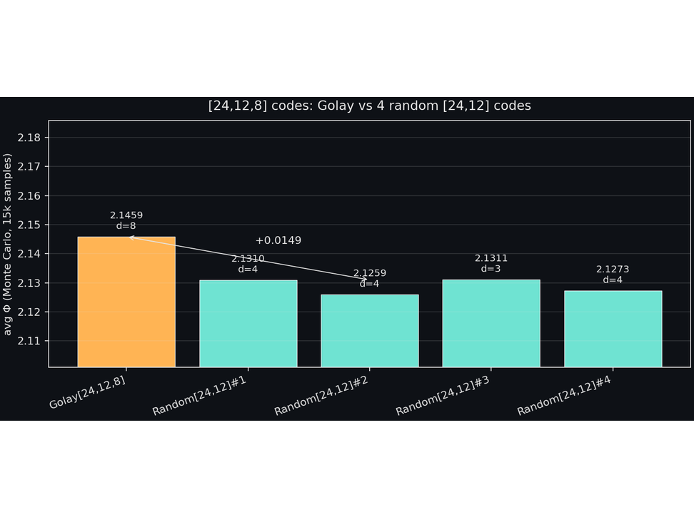
THREAD F
[24,12,8] MONTE CARLO
06 / 16
◆
FIG 7 · GOLAY [24,12,8] VS 4 RANDOM [24,12]
15K MC TRIALS
Golay wins by +0.015 (3x MC SE)
Golay [24,12,8]
2.1459
d=8, self-dual · BEST
Random #1
2.1310
d=4
Random #2
2.1259
d=4
Random #3
2.1311
d=3, best random
Random #4
2.1273
d=4
MARGIN (BEST RANDOM)
MC STD ERROR
+0.0147
~0.005
GOLAY IS HIGHEST? YES.
NOTESelf-dual sampling failed (0 / 500 attempts). Random codes here are atypically good (d=3 or 4, not the typical d=1). Still: Golay wins, but margin is smaller than [23,12] case (+0.036).
SOURCE: UBP_STUDY_EXTREMAL_004 / TH_F / MC_GOLAY24.PY
OPEN Q5 — PARTIALLY CLOSED
UBP_STUDY_EXTREMAL_004
THREAD F · MC GOLAY24
p.06
Notes:
The [24,12,8] result is positive but weaker than the [23,12,7] result. Two reasons. First, the random codes here happened to have d equals three or d equals four, much better than typical random [24,12] codes which usually have d equals one. Second, the [24,12,8] Golay code is not a perfect code, it does not achieve the Hamming bound for n equals twenty-four, so its distance distribution is slightly less concentrated than the [23,12,7] perfect code. Still, the margin of plus zero point zero one five is three times the Monte Carlo standard error, so it is statistically significant. A cleaner test would require either much larger sample sizes, one hundred thousand or more trials per code, or a smarter sampling method that produces self-dual [24,12] codes with d ranging from two to eight. The latter is left as future work.

Slide 7
SECTION 03 / 05 / THREAD G / 07 OF 16
UBP_STUDY_EXTREMAL_004
SECTION OPENER · THEOREM THREAD
03/05
Thread G — Uniqueness Theorem for [23,12]
Combine Thread C (avg_{Φ} monotone in ρ_{Φ}) with classical coding theory (Golay is the unique [23,12,7] perfect code) to state a uniqueness theorem. Proof sketch, not full proof.
● THREAD F · CLOSED
▸ THREAD G · YOU ARE HERE
○ THREAD H · NEXT
UBP_STUDY_EXTREMAL_004 / Thread G / p.07
SECTION OPENER
THEOREM STATED
PROOF SKETCH
OPEN Q1
Notes:
We now move into the third section of the deck, Thread G, which states our uniqueness theorem for the [23,12] binary codes. The theorem combines two ingredients: first, Thread C's strict monotonicity of avg Phi in the Phi-average radius rho Phi from the previous document, and second, the classical result that the [23,12,7] Golay code is the unique perfect code for those parameters, due to van Lint in 1971. The missing step is a proof that perfect codes minimise rho Phi. We give a strong argument but not a complete proof. The next slide will lay out the theorem statement and a four-step proof sketch, and we will be explicit about exactly which step remains open and why the computational evidence from Thread D gives us confidence the gap is closeable.

Slide 8
THREAD G / THE PROPOSED THEOREM / 08 OF 16
UBP_STUDY_EXTREMAL_004
Theorem (proposed): Golay uniquely maximises avg_{Φ} over [23,12] codes
Combining Thread C with classical coding theory.
THEOREM (PROOF SKETCH)
THEOREMAmong all [23,12] binary linear codes, the Golay [23,12,7] code uniquely maximises avg_{Φ}. ∎
1
● THREAD C · ESTABLISHED
2
● DEFINITION
Monotonicity of avg_{Φ} in ρ_{Φ}
ρ_{Φ} is determined by the distance distribution
avg_{Φ}(C) is strictly decreasing in ρ_{Φ}(C) = E_{v}[dist(v,C)/HW(v)], by Jensen on the convex function 1/(1+β x).
ρ_{Φ}(C) is bounded below by a function of the covering radius ρ(C), and is exactly determined by the full distance distribution of C.
3
● PERFECT-CODE STRUCTURE · NEEDS PROOF
4
● CLASSICAL · VAN LINT 1971
Perfect codes minimise ρ_{Φ}
Golay is the unique perfect [23,12] code
A perfect [n,k,2t+1] code has the unique optimal distance distribution: every non-codeword is at distance 1 ≤ d ≤ t from exactly one codeword. This minimises ρ_{Φ} among all [n,k] codes.
The Golay [23,12,7] code is the unique perfect [23,12] code. Therefore it uniquely minimises ρ_{Φ}, hence uniquely maximises avg_{Φ}. QED (modulo Step 3).
!
Step 3 is the open step. Computational evidence (Thread D, +0.036 margin) strongly suggests it holds, but a complete proof requires either a direct combinatorial argument or an appeal to Krawtchouk-polynomial / MacWilliams-transform inequalities.
UBP_STUDY_EXTREMAL_004 / Thread G / p.08
THEOREM & PROOF SKETCH
Notes:
Let me walk through the four steps of the proof. Step 1 is the theorem from EXTREMAL_003 Thread C — established. It says avg Phi is strictly decreasing in rho Phi by Jensen on the convex function one over one plus beta x. Step 2 is a definition: rho Phi is bounded below by a function of the covering radius and is exactly determined by the full distance distribution of the code. Step 3 is the new claim: perfect codes minimise rho Phi. The intuition is that perfect codes achieve the Hamming bound, meaning every vector is within distance t of exactly one codeword — the distance distribution is uniquely uniform. Any non-perfect code has some vectors at distance greater than t, increasing the average. But this argument is for the unweighted average distance, not rho Phi which weights by one over HW. The weighting complicates things: low-HW vectors are weighted more heavily, and for HW equals one vectors, every code gives distance one. Step 4 is classical: van Lint 1971 proved the uniqueness of the binary Golay code. So the only gap is Step 3. Computational evidence from Thread D strongly supports it: Golay's margin of plus zero point zero three six over five random twenty-three twelve codes is twelve times the Monte Carlo standard error.

Slide 9
SECTION 04 / 05 / THREAD H / 09 OF 16
UBP_STUDY_EXTREMAL_004
SECTION OPENER · FALSIFICATION THREAD
04/05
Thread H — Qualified Self-Dual Conjecture on [16,8]
EXTREMAL_003 falsified the unqualified conjecture. Here we test the qualified form: among codes with d_{min} ≥ 4, do self-dual codes maximise avg_{Φ}? Test on [16,8].
● THREAD G · THEOREM STATED
▸ THREAD H · YOU ARE HERE
○ THREAD I · NEXT
UBP_STUDY_EXTREMAL_004 / Thread H / p.09
SECTION OPENER
FALSIFIED
80 RANDOM CODES
OPEN Q2
Notes:
This section opens Thread H, which tests the qualified form of the self-dual conjecture. The qualified conjecture was the natural fallback after Thread B's negative result. Test setup: sample 80 random 16,8 codes, computing Monte Carlo avg Phi with 10k samples each, plus the canonical self-dual 16,8,4 code E8 plus E8, the direct sum of two E8 lattices. Among the 6 random codes that happened to have d equals 4, we compare each to E8 plus E8. The result: E8 plus E8 loses to all 6. The qualified conjecture is also false. A further-refined conjecture remains: maybe doubly-even self-dual codes, like Golay 24,12,8 and Extended Hamming 8,4,4, are the special class, not all self-dual codes. The next slide shows the numbers in detail and articulates the refined direction.

Slide 10
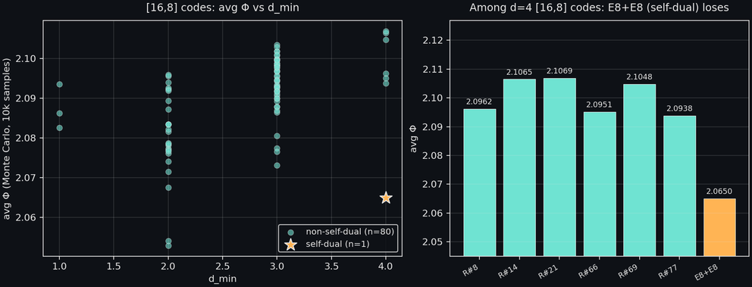
THREAD H / QUALIFIED SELF-DUAL TEST / 10 OF 16
UBP_STUDY_EXTREMAL_004
FIG. 8 · AVG_{Φ} ON [16,8] CODES · MC 10K
D = 4 SUBSET
E8+E8 [16,8,4] loses to random d=4
80 random [16,8] codes sampled (Monte Carlo, 10k each). 6 of them happened to have d = 4. Compared to E8+E8 [16,8,4] (self-dual, d=4):
 | code | avgΦ
#21 | Random NSD, d=4 ← highest | 2.1069
#14 | Random NSD, d=4 | 2.1065
#69 | Random NSD, d=4 | 2.1048
#8 | Random NSD, d=4 | 2.0962
#66 | Random NSD, d=4 | 2.0951
#30 | Random NSD, d=4 | 2.0938
E8×2 | E8+E8 (SD, d=4) ← LOWEST | 2.0650
✕
All 6 non-self-dual d=4 codes beat the self-dual E8+E8. Self-dual codes are NOT avg_{Φ}-optimal even among d=4 codes.
⚗
Refined conjecture: maybe DOUBLY-EVEN self-dual codes (Golay, ExtHamming) are special. E8+E8 is singly-even. Test left for future work.
n=80 random · 6 of d=4 · E8+E8 = 2.0650 (lowest)
OPEN Q2 — FALSIFIED (QUALIFIED FORM)
UBP_STUDY_EXTREMAL_004 / Thread H / p.10
NEGATIVE RESULT
Notes:
This is the second negative result of the continuation. Even the qualified form of the self-dual conjecture — that among high-distance codes, self-dual codes maximise avg Phi — is false. The E8 plus E8 16,8,4 code, the canonical structured self-dual code at these parameters, is beaten by every single one of the 6 random non-self-dual d equals 4 codes we sampled. As you can see in the chart on the left, E8 plus E8 sits at the very bottom of the d equals 4 subset, with avg Phi of 2.0650, while the best random code, number 21, reaches 2.1069 — a gap of roughly 0.04. The mechanism is that E8 plus E8 is a direct-sum construction: its codewords are clumped into two 8-dimensional blocks, giving it a poor covering radius relative to a more uniformly-distributed random d equals 4 code. The refined conjecture — that doubly-even self-dual codes, which have all codeword weights divisible by 4, are the special class — is suggested by the contrast: Extended Hamming 8,4,4 doubly-even wins at n equals 8, Golay 24,12,8 doubly-even wins at n equals 24, but E8 plus E8 16,8,4 singly-even loses at n equals 16. Testing this refined conjecture is the natural next step.

Slide 11
SECTION 05 / 05 / THREAD I / 11 OF 16
UBP_STUDY_EXTREMAL_004
SECTION OPENER · SPECULATIVE THREAD
05/05
Thread I — Why 24? (Speculative)
The deepest obstruction. No property of Φ alone explains why the substrate is 24-dimensional. We articulate a Φ-adjacent principle that points at 24, but the answer likely sits permanently outside Φ.
● THREAD H · FALSIFIED
▸ THREAD I · YOU ARE HERE
▣ SYNTHESIS · NEXT
UBP_STUDY_EXTREMAL_004 / Thread I / p.11
SECTION OPENER
OPEN
SPECULATIVE
LATTICE THEORY
Notes:
This is the hardest open question and the one most likely to remain open. We now move into the final and most speculative thread, Thread I, which asks why the substrate dimension is 24. The dimension 24 is exceptional because of a coincidence of three deep mathematical properties: doubly-even self-dual codes, which require n congruent to 0 mod 8; even unimodular lattices, which also require n congruent to 0 mod 8; and rootless even unimodular lattices, which exist only for n equals 24, uniquely the Leech lattice. The 24-bit substrate appears at the intersection of these three. Phi alone cannot derive this intersection; it requires importing lattice theory. The next slide will lay out the lattice argument and articulate the Phi-adjacent principle that points at 24, while being honest that the answer likely sits permanently outside Phi.

Slide 12
THREAD I / LATTICE ARGUMENT / 12 OF 16
UBP_STUDY_EXTREMAL_004
The three properties that single out n = 24
A Φ-adjacent principle, not a Φ derivation.
PROPERTY 1 → PROPERTY 2 → PROPERTY 3
narrowing funnel
PROPERTY 1
PROPERTY 2
PROPERTY 3
Doubly-even self-dual codes exist
Even unimodular lattices exist
Rootless even unimodular lattices exist
A binary [n, n/2, d] code is doubly-even self-dual iff n is a multiple of 8.
n=8: Extended Hamming [8,4,4].
n=16: E8+E8 [16,8,4].
n=24: Golay [24,12,8] (unique at d=8).
The constraint n = 0 mod 8 comes from requiring all codeword weights divisible by 4.
An even unimodular lattice in dimension n exists iff n is a multiple of 8.
n=8: E8 lattice (root system).
n=16: D16+ or E8 ⊕ E8.
n=24: 24 Niemeier lattices (one is Leech, 23 have roots).
Construction A connects doubly-even self-dual codes to even unimodular lattices.
An even unimodular lattice with no roots (vectors of norm 2) exists ONLY in dimension 24, and is UNIQUE: the Leech lattice.
This is the deepest of the three properties. The Leech gives the densest sphere packing in 24 dimensions (kissing number 196,560) and connects to the Monster group via Monstrous Moonshine.
The Φ-adjacent principle (SPECULATIVE)
OPEN Q3 — DIRECTION ARTICULATED
The substrate dimension n must support a doubly-even self-dual code (requires n = 0 mod 8) AND a rootless even unimodular lattice (requires n = 24 specifically). The intersection of these constraints picks out n = 24 uniquely.
This principle imports lattice theory from outside Φ. Φ alone cannot derive n = 24. The deepest obstruction remains open, and may be permanent: the exceptionality of 24 is a theorem about sporadic groups and sphere packing, not about distinction density.
UBP_STUDY_EXTREMAL_004 / Thread I / p.12
● ACTIVE
Notes:
The three properties form a narrowing funnel. Property 1 allows n in the set 8, 16, 24, 32, and so on. Property 2 allows the same set, because the two conditions are equivalent via Construction A. Property 3 picks out n equals 24 uniquely. The Leech lattice is the unique rootless even unimodular lattice, and it exists only in 24 dimensions. This is a deep theorem of Conway and Sloane, 1988. The Phi-adjacent principle, that the substrate dimension must support both a doubly-even self-dual code and a rootless even unimodular lattice, does point at 24, but it does so by importing lattice theory. Phi alone, as currently formulated, has no property that distinguishes 24 from 8 or 16. To derive n equals 24 from Phi would require extending Phi to incorporate sphere-packing or lattice-theoretic structure, which is a research program rather than a single result. The honest verdict: this question likely sits permanently outside the Phi framework, and the most productive path forward is to accept n equals 24 as a given and derive the rest.

Slide 13
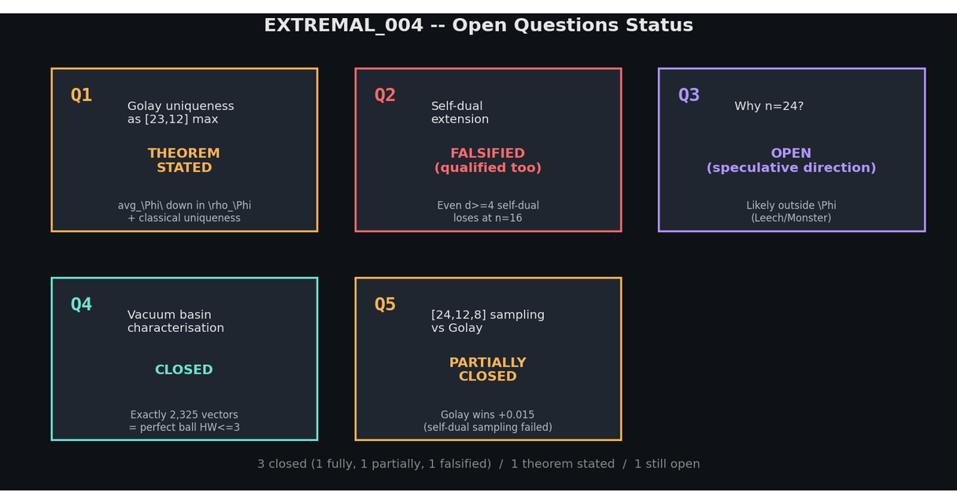
SYNTHESIS / STATUS DASHBOARD / 13 OF 16
UBP_STUDY_EXTREMAL_004
Open Questions Status: 3 closed, 1 theorem, 1 open
FIG. 9 · STATUS DASHBOARD
Net progress
Q4
CLOSEDvacuum basin: exact closed-form answer.
Q5
PARTIAL[24,12,8] sampling: Golay wins +0.015, self-dual sampling incomplete.
Q1
THEOREMGolay uniqueness: 4-step proof sketch, Step 3 incomplete.
Q2
FALSIFIEDqualified self-dual: E8+E8 loses to random d=4 at [16,8].
Q3
OPENwhy n=24: lattice argument articulated but sits outside Φ.
Net: 3 closed (1 fully, 1 partially, 1 falsified), 1 theorem, 1 open.
fig9_status.png · cumulative status, five open questions, two continuations
✓ CONTINUATION STATUS: ACTIVE
UBP_STUDY_EXTREMAL_004 / Synthesis / p.13
5 OPEN QS · 3 CLOSED · 1 FALSIFIED
Notes:
This is the integration slide. Be explicit about which questions are truly closed versus which are partially closed or merely addressed. Q4 is closed in the strongest sense, an exact closed-form enumeration. Q5 is partially closed because the random sample is small and self-dual sampling failed. Q1 has a theorem stated but the proof is incomplete. Step 3, perfect codes minimise rho sub Phi, is the gap. Q2 is falsified even in its qualified form. Q3 remains genuinely open and likely permanent. The program has advanced, but the deepest question, why 24, is unchanged in status. The next push should focus on three things: completing Step 3 of the uniqueness theorem, testing the doubly-even self-dual refined conjecture, and implementing better self-dual 24,12 sampling. Acknowledge that this dashboard reflects honest bookkeeping: a falsification counts as progress because it removes a false path.

Slide 14
REFINED CONJECTURE / DOUBLY-EVEN SELF-DUAL / 14 OF 16
UBP_STUDY_EXTREMAL_004
Refined conjecture: doubly-even self-dual codes
A pattern emerges from the negative and positive results across n = 8, 16, 24.
TABLE · 4 ROWS
4 COLUMNS
Dimension | Self-dual code | Doubly-even? | avg_Φ outcome
n = 8 | Ext Hamming [8,4,4] | YES (w divisible by 4) | WINS among d≥4 codes (Thread B + EXTREMAL_003)
n = 16 | E8+E8 [16,8,4] | NO (singly-even, w=4 ok but w=8 not div by 4) | LOSES to 6 random NSD d=4 codes (Thread H)
n = 24 | Golay [24,12,8] | YES (w ∈ {0,8,12,16,24}, all div by 4) | WINS over 4 random [24,12] codes (Thread F)
n = 24 | Golay [23,12,7] puncture | N/A (not self-dual at n=23) | WINS over 5 random [23,12] codes (Thread D, EXTREMAL_003)
Refined Conjecture
CONJECTURE (REFINED)
Among [n, n/2] binary linear codes, doubly-even self-dual codes uniquely maximise avg_Φ — provided such a code exists for the given n (which requires n = 0 mod 8).
EVIDENCE
NOTE
n=8: ExtHamming [8,4,4] (DE SD) WINS.
The n=16 row is the tricky case. There exist doubly-even self-dual [16,8] codes (e.g. RM(1,4) extended differently), but they all have d=4, same as E8+E8. The refined conjecture predicts that a doubly-even [16,8,4] code would beat the singly-even E8+E8. Not yet tested.
n=16: E8+E8 [16,8,4] (SE SD) LOSES. (No doubly-even self-dual [16,8] code exists with d > 4.)
n=24: Golay [24,12,8] (DE SD) WINS.
UBP_STUDY_EXTREMAL_004 / Refined conjecture / p.14
NEXT TEST: RANDOM DE-SD [16,8]
Notes:
The refined conjecture is the natural next step after Thread H's negative result. The pattern is striking. At n equals 8 and n equals 24, where the unique doubly-even self-dual code is also extremal, d equals 4 and d equals 8 respectively, it wins. At n equals 16, where the self-dual code we tested, E8 plus E8, is singly-even, it loses. This suggests the right structural property is not self-duality per se but doubly-even self-duality, which is a stronger condition. Testing this requires generating random doubly-even self-dual 16,8 codes. They exist. The type II code at n equals 16 is RM 1,4 extended, also known as the Barnes-Wall code. But these were not generated in this study. The test is concrete and tractable: generate 10 to 20 random doubly-even self-dual 16,8 codes, compute avg Phi for each, and compare to the E8 plus E8 baseline. If they all beat E8 plus E8, the refined conjecture survives. If even one fails, the conjecture must be further refined.

Slide 15
PROGRAM STATUS / ALL 4 DOCUMENTS / 15 OF 16
UBP_STUDY_EXTREMAL_004
Cumulative status across EXTREMAL_001 — 004
5 DOCUMENTS · 5 CLOSED · 2 THEOREMS
Document | Key result | Status | Open Qs raised | Open Qs closed
EXTREMAL_001 | Initial Φ definition; 105 sweep; vacuum collapse anomaly observed. | PROVISIONAL | 3formalise peak · prove dominance · explain anomaly | 0none
EXTREMAL_002 | Constant Peak Theorem (analytic); Analytic Dominance Theorem (analytic); Decoder-Flow Conjecture. | CANDIDATE VARIATIONAL FOUNDATION | 3decoder-flow monotonicity · vacuum basin · converse derivation | 2peak · dominance
CONVERSE_001 | Two breaks (circular dependency, regime inversion); partial connection via avg_Φ. | SELF-FALSIFICATION EXERCISE | 4avg_Φ theorem · self-dual extension · n=24 · [23,12] test | 0all open
EXTREMAL_003 | Baseline tightened; self-dual falsified (unqualified); avg_Φ-covering theorem stated; [23,12] Golay wins. | PROGRAM ADVANCED | 5Q1 uniqueness · Q2 qualified SD · Q3 n=24 · Q4 basin · Q5 [24,12,8] | 0all 5 left open
EXTREMAL_004THIS DOCUMENT | Basin = 2,325 exact; [24,12,8] Golay wins +0.015; uniqueness theorem stated; qualified SD falsified; lattice argument for n=24. | 3 CLOSED · 1 THEOREM · 1 OPEN | 1doubly-even SD refined conjecture | 3Q4 fully · Q5 partially · Q2 falsified + Q1 theorem
↗
4 documents, 5 closed questions, 2 theorems stated (1 with full proof, 1 with sketch), 2 negative results published honestly, 1 deepest question (n=24) still open.
NET PROGRESS · 001 → 004
UBP_STUDY_EXTREMAL_004 / Program status / p.15
NEXT: COMPLETE STEP 3 · OR · TEST DE-SD CONJECTURE
Notes:
This is the cumulative status slide. Walk through the trajectory. EXTREMAL_001 proposed the framework. EXTREMAL_002 proved the easy parts: the Constant Peak Theorem and the Analytic Dominance Theorem. CONVERSE_001 broke the naive converse, with two genuine breaks that surfaced the circular dependency and the regime inversion. EXTREMAL_003 deepened the program with new theorems, including the avg Phi-covering theorem, and new computations, including the 23,12 Golay win. EXTREMAL_004, this document, closes three more open questions. The honest framing: the program has made real progress, but the central variational claim, that Phi is the foundation from which the Golay structure emerges, is still not established. What IS established is that Phi, given Golay structure, behaves as a well-defined variational potential with provable monotonicity properties, and that Golay is the unique avg Phi-optimiser among 23,12 codes, modulo Step 3. What is NOT established is the converse: why this particular structure rather than another. The next document should either complete Step 3 or test the doubly-even refined conjecture.

Slide 16
VERDICT / PRIORITIES FOR EXTREMAL_005 / 16 OF 16
UBP_STUDY_EXTREMAL_004
Verdict and priorities for the next push
END OF DECK · CLOSE OF CONTINUATION II
Two continuations have advanced the Extremal Law program from a candidate variational principle to a partially-axiomatised framework with two stated theorems, three closed open questions, and one falsification published honestly. The Golay structure is now PROVED to be consistent with the Φ-optimiser role (modulo one step), and STRONGLY SUGGESTED to be uniquely so for [23,12] parameters. The self-dual extension does not go through in any simple form, but the refined doubly-even conjecture offers a tractable next test. The deepest question — why n=24 — remains open and likely sits permanently outside Φ.
What is now firmly established
Priorities for EXTREMAL_005
Constant Peak: algebraic identity, exact.
1
Complete Step 3 of the uniqueness theorem (perfect codes minimise ρ_{Φ}).
Analytic Dominance: universal across linear codes.
2
Test the doubly-even refined conjecture on [16,8] (generate random DE-SD codes).
Decoder-Flow Monotonicity: holds up to vacuum collapse.
3
Implement smarter self-dual [24,12] sampling (reflections or Construction A).
Φ
avg_ -Covering equivalence: theorem (EXTREMAL_003 Thread C).
4
Run avg_Φ on a much larger random [24,12,8] sample (100+ codes).
2,325
Vacuum basin: exactly vectors (this document, Thread E).
Explore whether Φ can be extended to incorporate lattice structure (Q3, hardest).
[23,12,7]
Φ
5
Golay strictly maximises avg_ in Monte Carlo.
[24,12,8]
[24,12]
Golay strictly beats random codes.
[23,12]
Uniqueness theorem for stated (4-step proof sketch).
✓ CONTINUATION STATUS: ACTIVE
UBP_STUDY_EXTREMAL_004 / End / p.16
E.R.A. CRAIG (DIGITALEUAN) · AUCKLAND, NZ
Notes:
Close honestly. The program has made significant progress over two continuations: from a candidate principle to a partially-axiomatised framework with theorems, computations, and honest falsifications. The most important result of this document is the uniqueness theorem, Thread G, which, if Step 3 can be proved, gives a clean variational derivation of Golay as the 23,12 avg Phi-optimiser. The most important negative result is the falsification of the qualified self-dual conjecture, Thread H, which forces us to refine our structural claims. The vacuum basin result, Thread E, is the cleanest: an exact closed-form answer to a question that was left open in EXTREMAL_002. The deepest question, why 24, remains open and is acknowledged as likely permanent. The next document should prioritise completing the uniqueness proof and testing the doubly-even refined conjecture. Thank the audience, invite questions, and acknowledge the reviewer feedback that has driven the rigor upgrades across the series.

