Slide 1
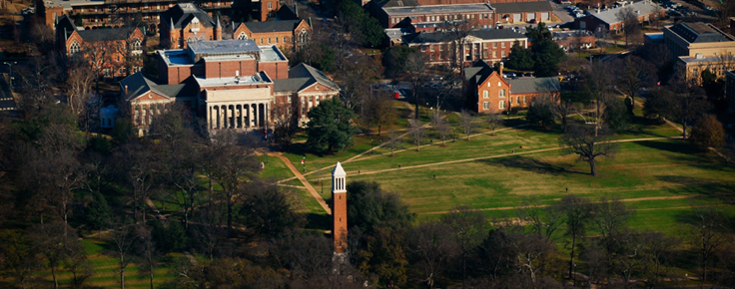


Slide 2
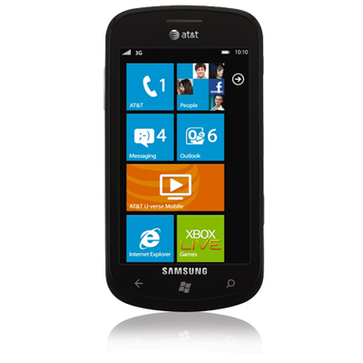


Digital Eyes Overview
Windows Mobile app that gives vocal directions within buildings.
App intended for those with vision impairment, those who are blind, or those who simply get lost easily.
App is geared towards university students finding classes on campus.
Uses phone camera to scan Microsoft tags at doors, entrances, and permanent fixtures to hear room numbers and other information about the building.
Users speak into phone’s microphone indicating room numbers or certain types of rooms they might want to visit and app gives audio directions to specified location.

Slide 3
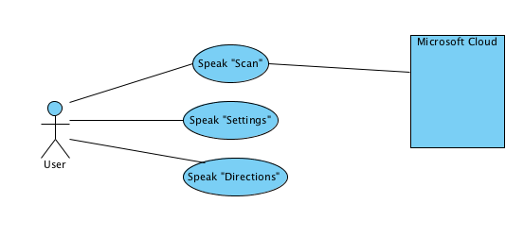
High Level Use Case Diagram

Slide 4
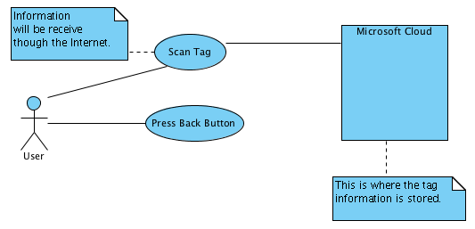
Speak “Scan” Use Case Diagram

Slide 5
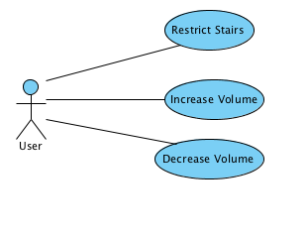
Speak “Settings” Use Case Diagram

Slide 6
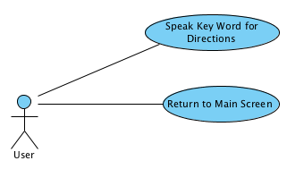
Speak “Directions” Use Case Diagram

Slide 7
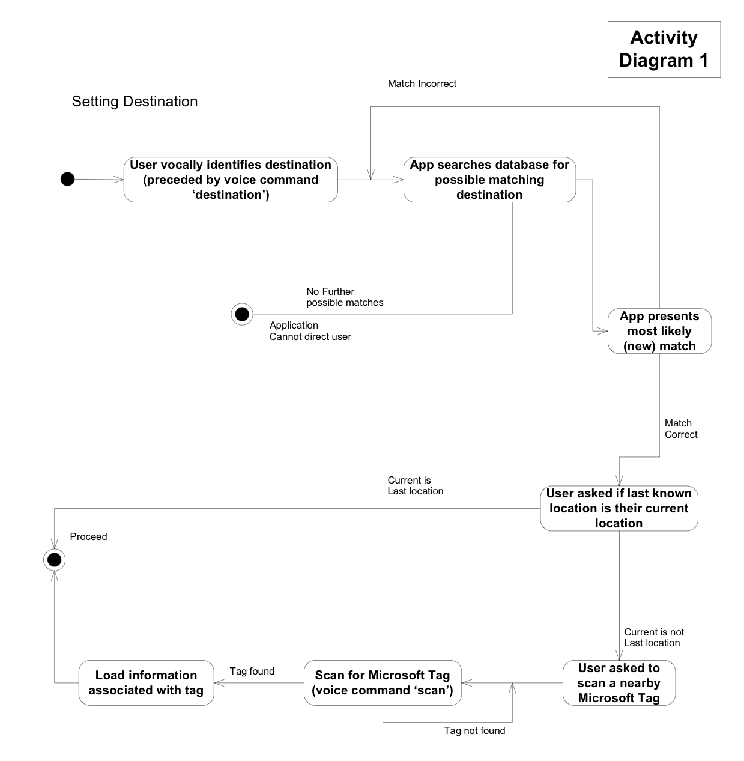
Overall Activity Diagram

Slide 8
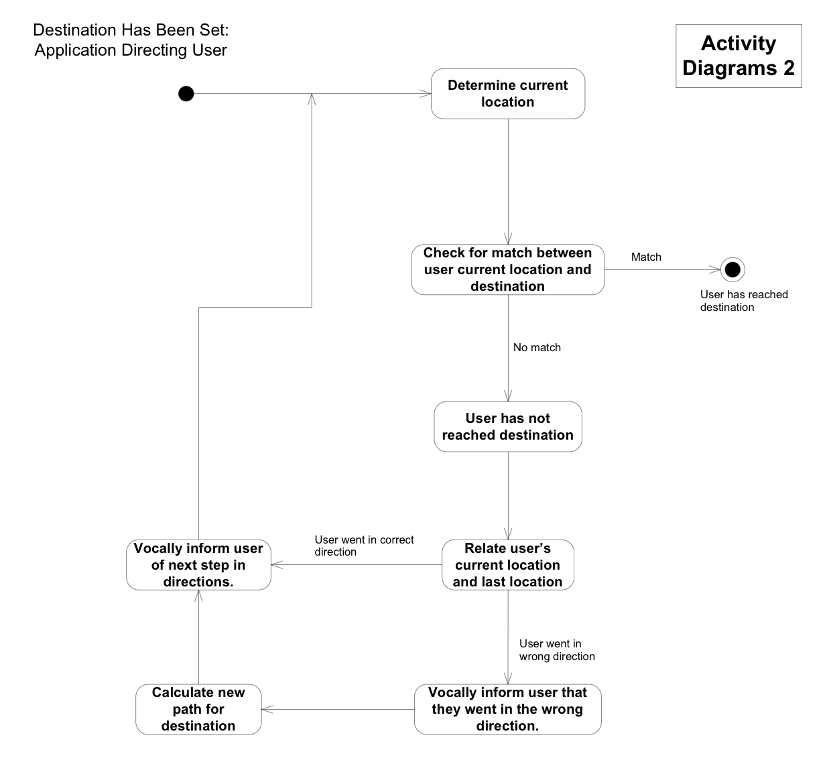
Activity Diagram for Path Calculation

Slide 9
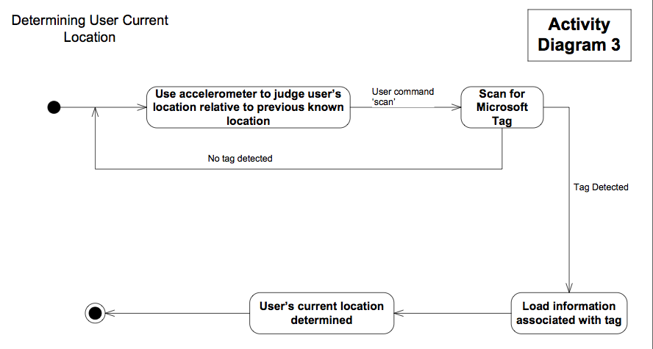
Activity Diagram for Determining Current Location of User

Slide 10
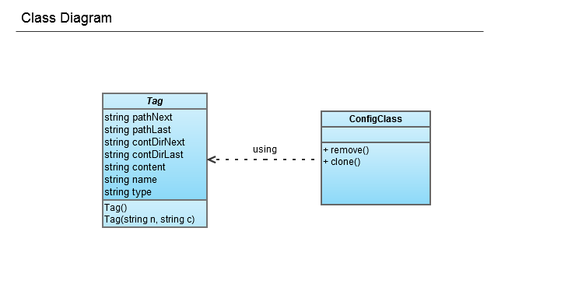
Overall Class Diagram

Slide 11
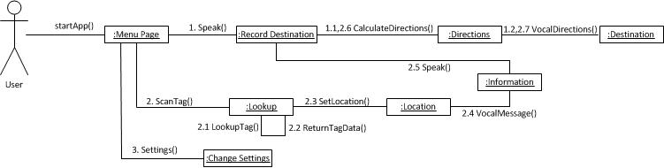
Collaboration Diagram

Slide 12
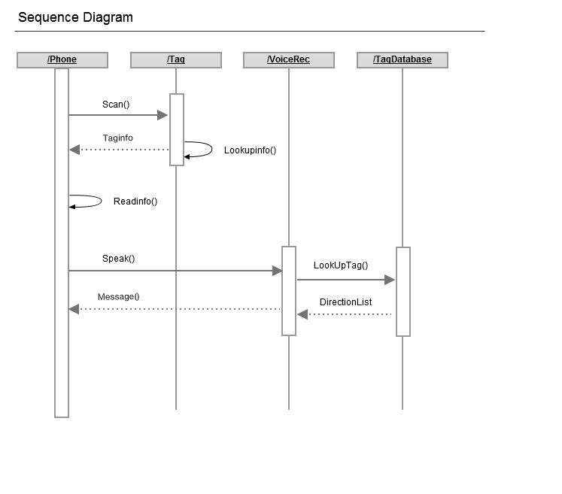
Sequence Diagram

Slide 13
Test Case # | 1
Use Case Name | Load Digital Eyes
Use Case Flow | Basic Flow
Objectives | Verify that the application loads.
Preconditions | User is familiar with basic phone functions.
Input | The user selects application on phone app screen.
Expected Results | Digital Eyes main app screen loads.
Tester Name | Southern Sweethearts
Test Date
Actual results | Pass
Additional Comments

Slide 14
Test Case # | 2
Use Case Name | Speak “Scan”
Use Case Flow | Basic Flow
Objectives | Verify that voice recognition works properly and follows the appropriate protocol for the scan function.
Preconditions | User has successfully loaded application and is familiar with the application.
Input | User speaks clearly “Scan” into the phone.
Expected Results | The phone recognizes the command and the Microsoft Tag Reader appears on the screen.
Tester Name | Southern Sweethearts
Test Date
Actual results | Pass
Additional Comments

Slide 15
Test Case # | 3
Use Case Name | Change “Settings”
Use Case Flow | Basic Flow
Objectives | Verify that the settings change according to user input.
Preconditions | User has successfully navigated to the settings screen.
Input | User chooses a different background color in given palette, changes text color and increases text size.
Expected Results | The phone recognizes the chosen changes and updates the new settings to the screen.
Tester Name | Southern Sweethearts
Test Date
Actual results | Pass
Additional Comments

Slide 16
Test Case # | 4
Use Case Name | Receive directions
Use Case Flow | Basic Flow
Objectives | Verify that directions are formed accurately..
Preconditions | User has successfully loaded the scan screen.
Input | User scans tag nearest their location and identifies destination.
Expected Results | The phone recognizes the scanned tag as well as the future destination and outputs directions to the screen while reading them aloud.
Tester Name | Southern Sweethearts
Test Date
Actual results | Pass
Additional Comments

Slide 17

Imagine Cup
Theme: Imagine a world where technology helps solve the toughest problems.
Competitions: Software Design and Windows Mobile 7

Slide 18
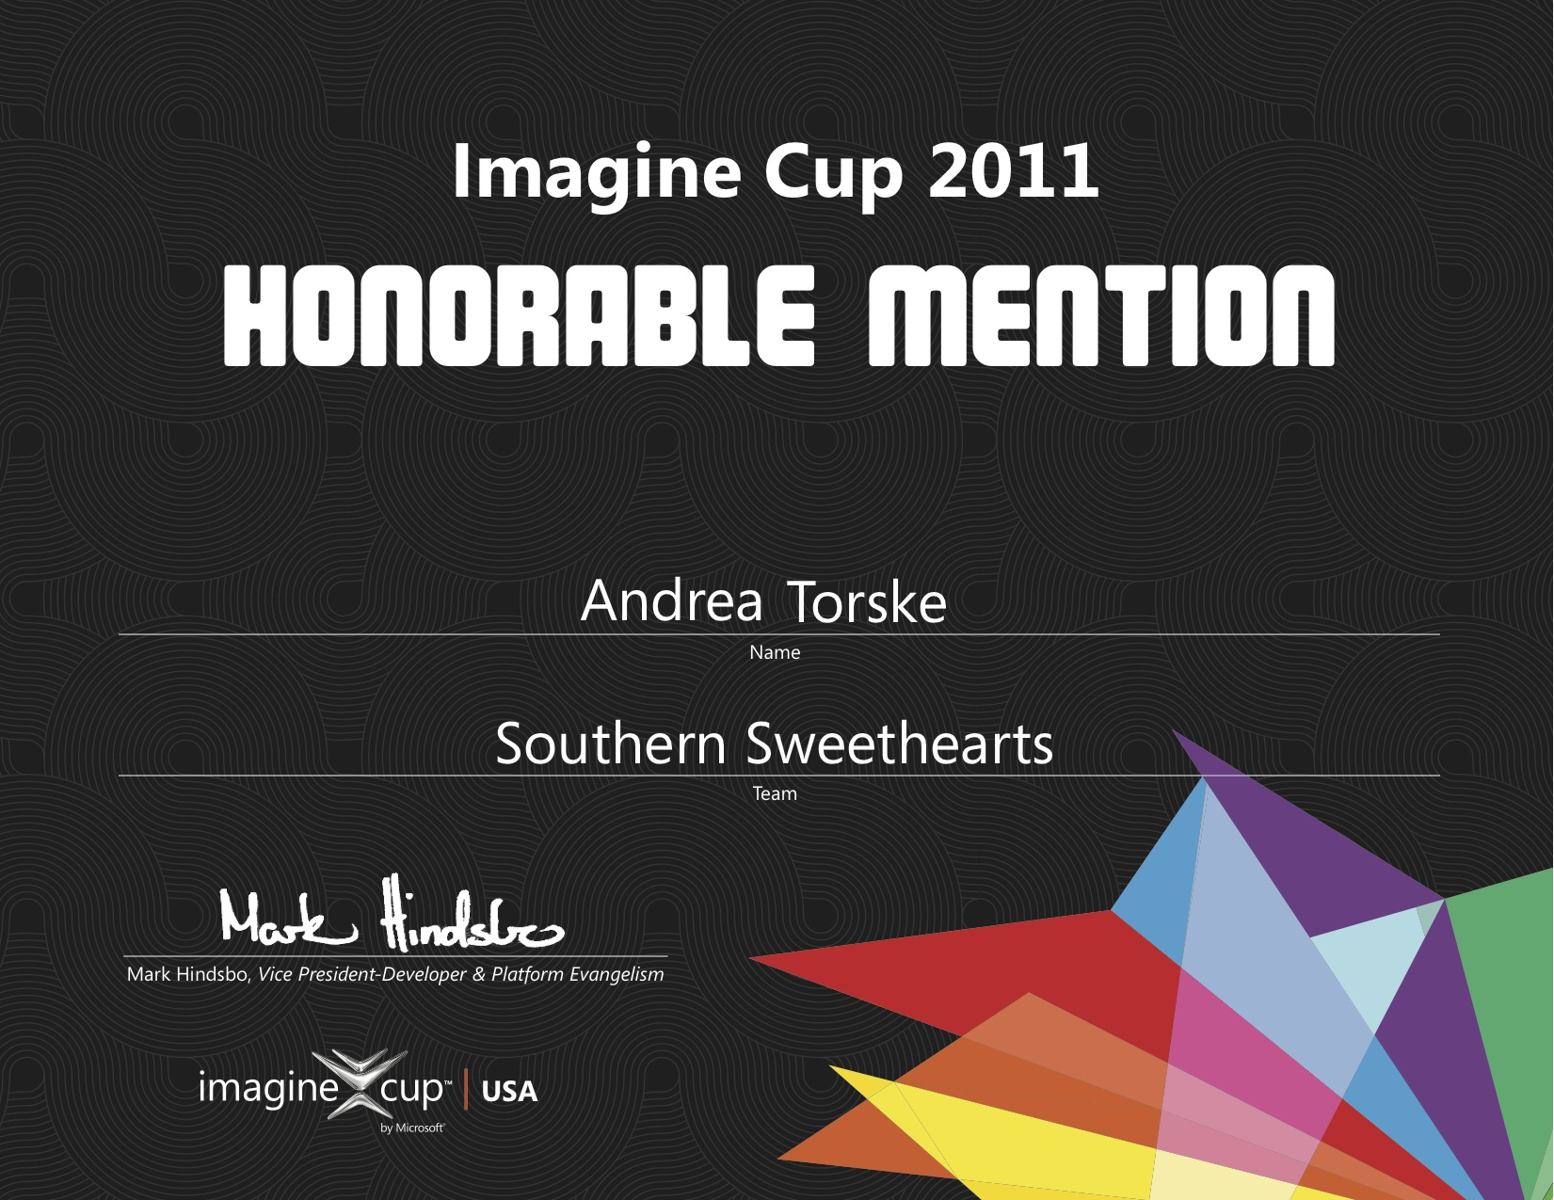

Slide 19

US Software Design Semi-Finalists
...and

Slide 20
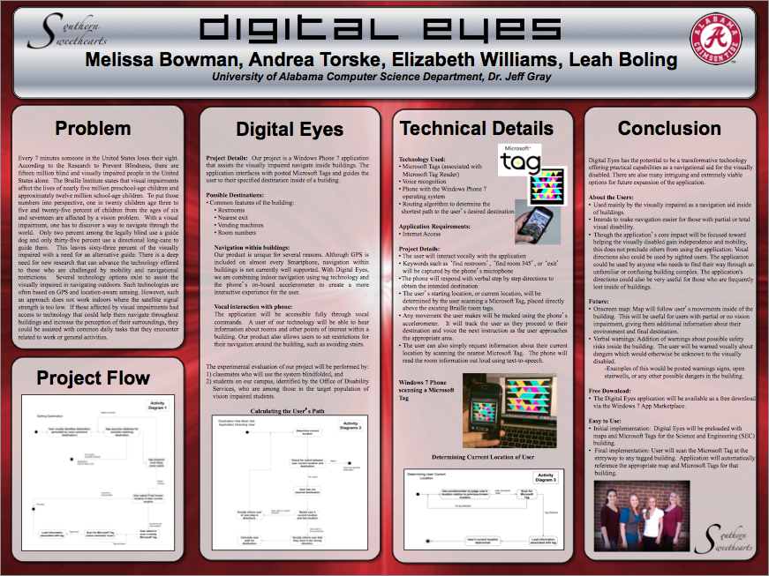

Slide 21
Lessons Learned
It takes multiple forms of identification to register an app in the app hub on Windows phones.
It is a long, difficult process to gain access to Microsoft tag info.
Windows Speech recognition is sketchy.
QR codes and MS tags are more similar than we thought!
Research more before design to make sure it can be implemented in the time frame.

Slide 22

Questions or Comments?
Elizabeth Williams
Andrea Torske
Leah Boling
Melissa Bowman

