Slide 1

Elizabeth Williams
Leah Boling
Andrea Torske
Melissa Bowman

Slide 2
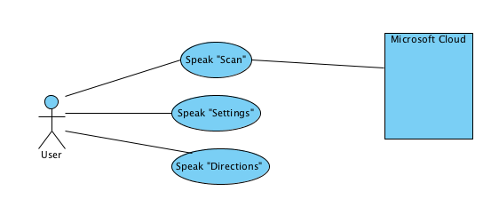
High Level Use Case Diagram

Slide 3
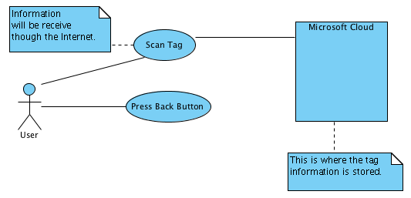
Speak “Scan” Use Case Diagram

Slide 4
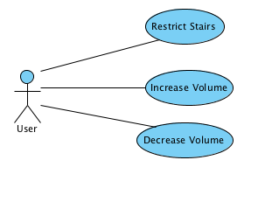
Speak “Settings” Use Case Diagram

Slide 5
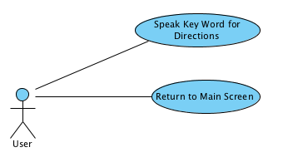
Speak “Directions” Use Case Diagram

Slide 6
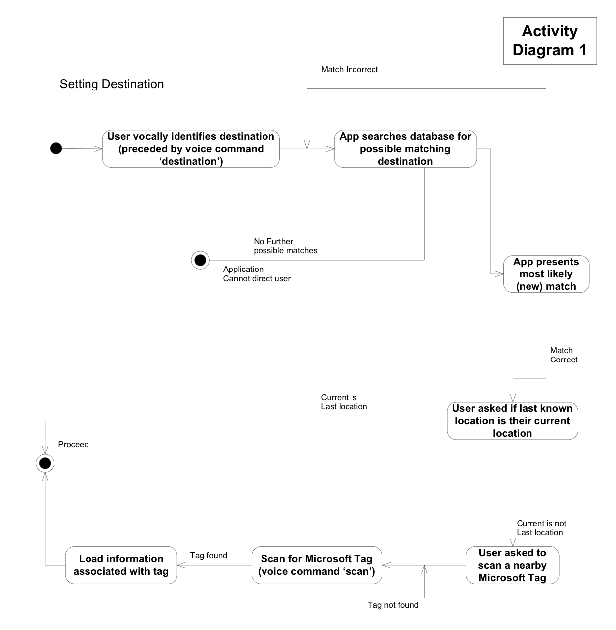
Overall Activity Diagram

Slide 7
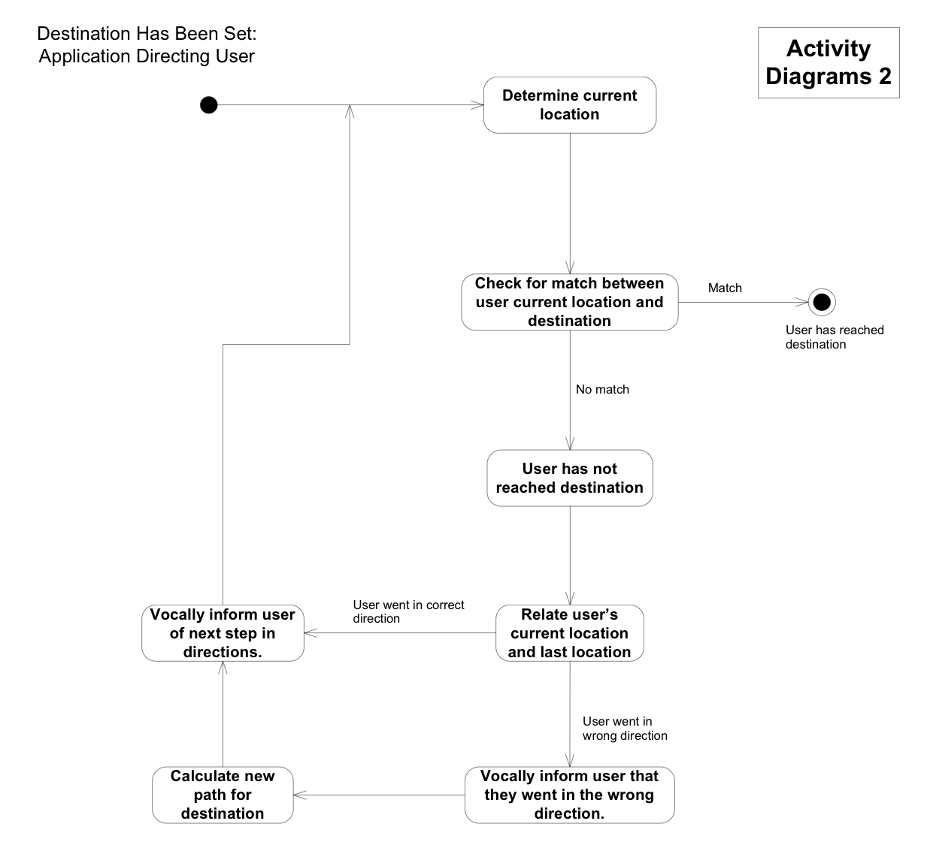
Activity Diagram for Path Calculation

Slide 8
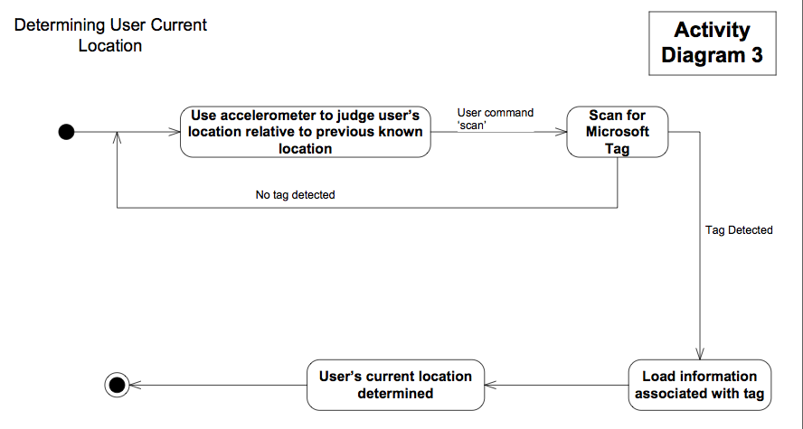
Activity Diagram for Determining Current Location of User

Slide 9
Classification of Functional Requirements
Functionality | Type
Gather information from Microsoft Tags | Essential
Read free-form text from Microsoft Tag scan | Essential
Speech to text capabilities | Essential
Text to speech capabilities | Essential
Use of accelerometer to determine distance | Desired
Display map of building on home screen | Optional
Ability to generalize for building other than the test building | Desired

Slide 10
Important Dates
03/21/11 | Project Design Due
03/07/11 | Windows Phone 7 Round 1
03/14/11 | Software Design Round 2
03/21/11 | Project Design Due
03/23/11 – 04/09/11 | Software Design Voting Period
03/28/11 – 04/27/11 | Windows Phone 7 Round 2 | Worldwide Finals Qualifying
04/06/11 | Project Progress Demos
04/11/11 | Undergrad Research Poster Competition
04/22/11 | Project Video due
04/25/2011 – 04/26/11 | Implementation due & Final Demos
07/08/11 – 07/13/11 | Windows Phone 7 Round 3 | Worldwide Finals

Slide 11

Questions or Comments?

