Slide 1

Digital_Fabrication_Studio.01
Media, Business, Platforms
Massimo Menichinelli massimo.menichinelli@aalto.fi
@openp2pdesign http://www.slideshare.net/openp2pdesign
10.09.2012

Slide 2
This afternoon:
* The Media ecosystem of Fabbing
* Platforms for Fabbing and projects
* Business models for Open projects

Slide 3
01.
The Media ecosystem for Digital Fabrication, Open Design and DIY

Slide 4
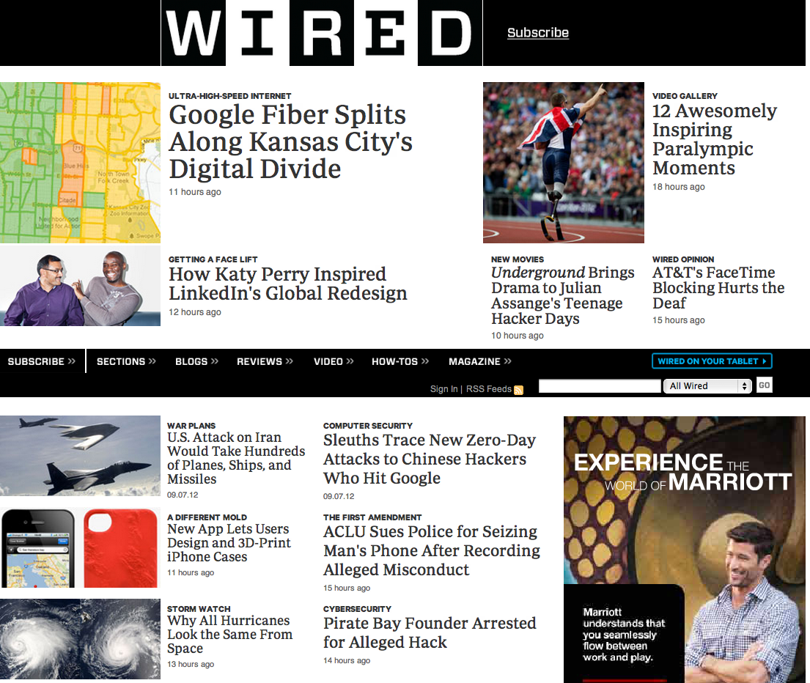
Wired
A monthly American magazine and on-line periodical (since 1993) that reports on how new and developing technology affects culture, the economy, and politics.
Source: http://www.wired.com/

Slide 5
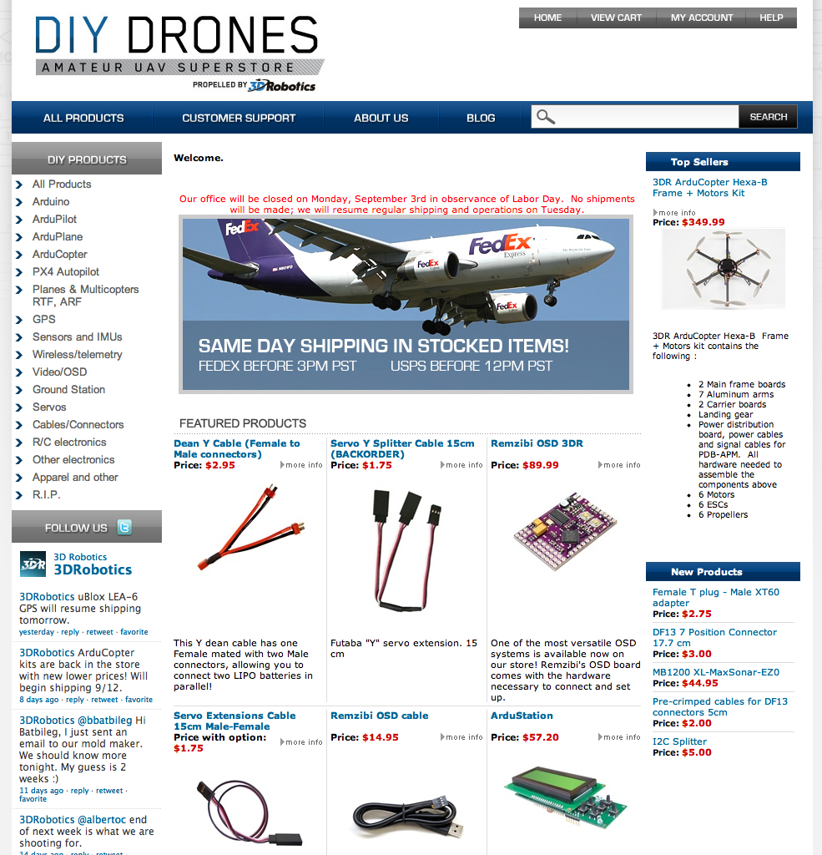
DIYDrones from Chris Anderson (Wired)
Funded in 2007, a store and an online community with 26,000 members.
Source: http://diydrones.com/ + https://store.diydrones.com/
http://diydrones.com/profiles/blogs/tour-of-the-new-3d-robotics-factory

Slide 6

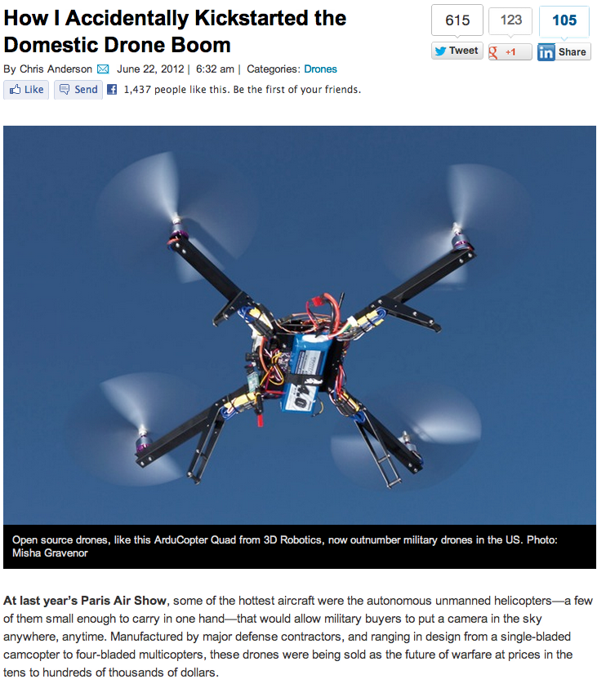
DIYDrones from Chris Anderson (Wired)
The role of Media in promoting DIY projects ...
Source: http://www.wired.com/dangerroom/2012/06/ff_drones

Slide 7
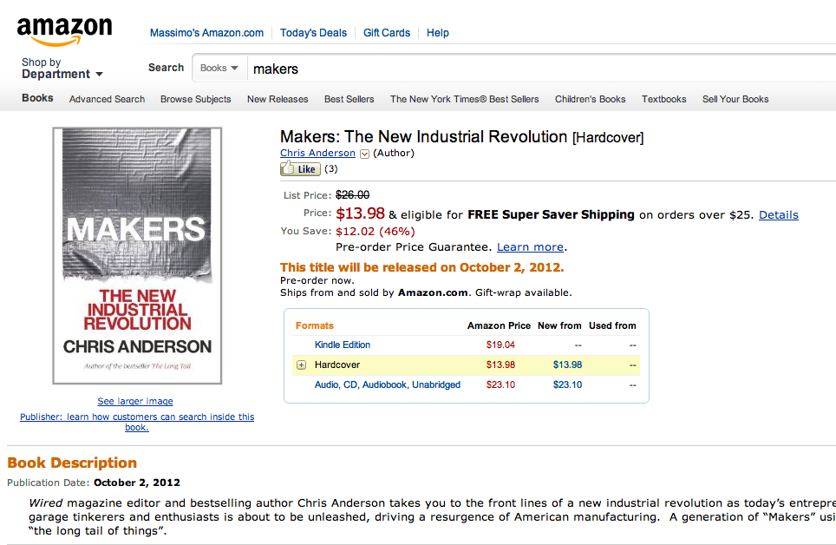
“Makers” from Chris Anderson
Not only magazine, but also books...
Source: http://www.amazon.com/Makers-The-New-Industrial-Revolution/dp/0307720950/

Slide 8
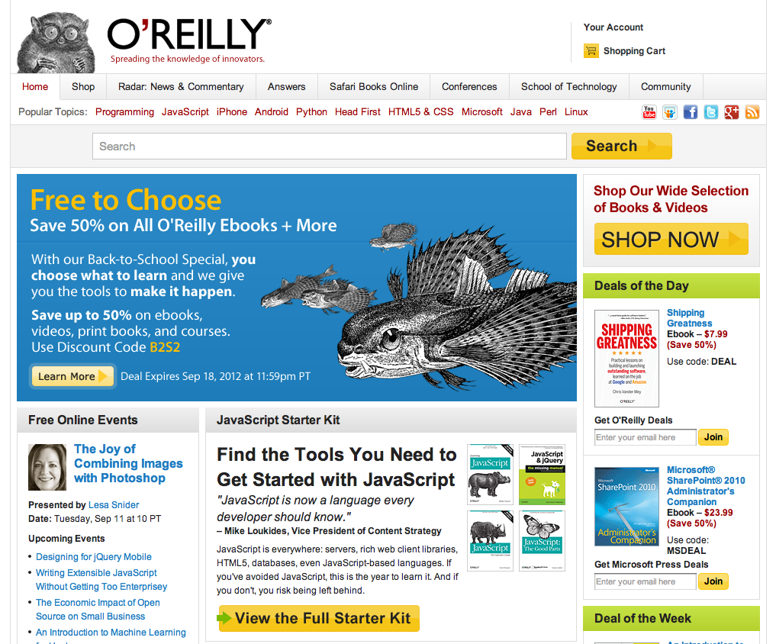
O'Reilly Media: Make
An American media company (since 1978) that publishes books and Web sites and produces conferences on computer technology topics.
Source: http://oreilly.com/

Slide 9
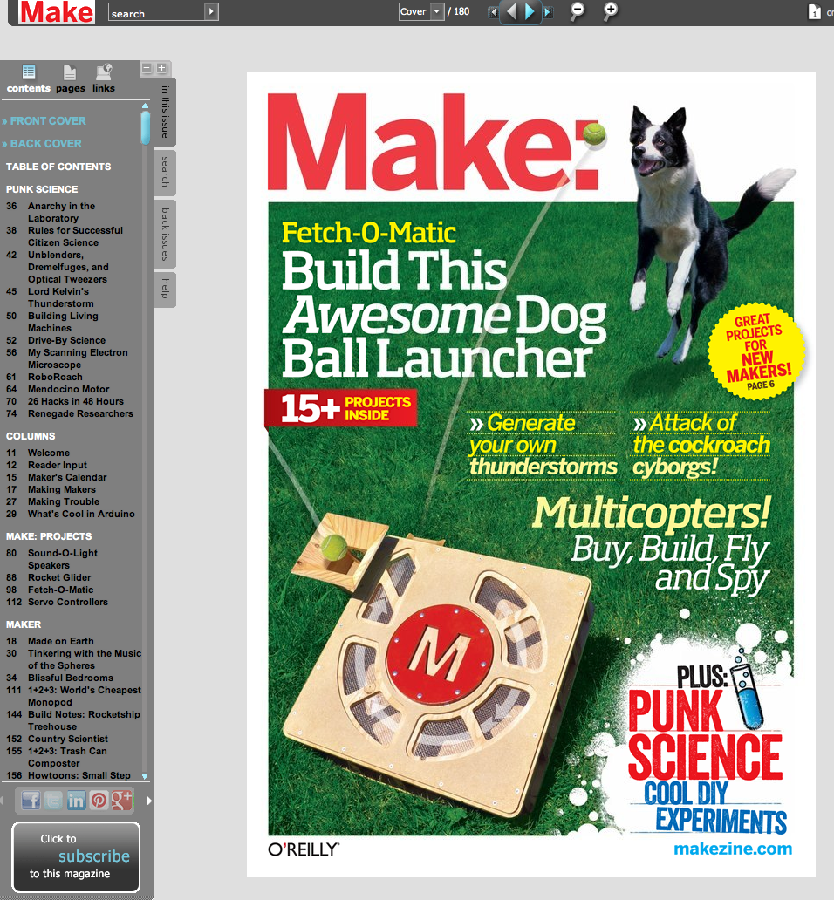
Make: a magazine
An American quarterly magazine published by O'Reilly Media which focuses on do it yourself (DIY) and/or DIWO (Do It With Others) projects.
Source: http://makezine.com/magazine/ + http://make-digital.com/make/

Slide 10
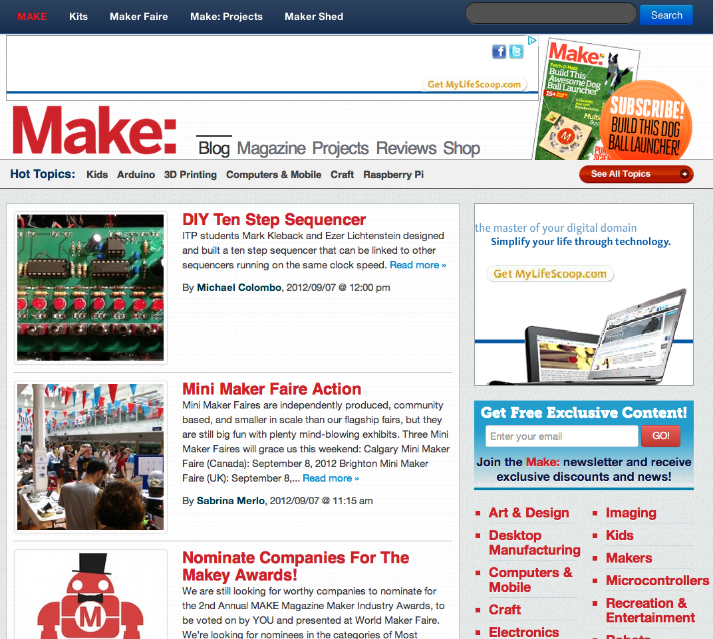
Make: a blog
Beside the magazine...
Source: http://blog.makezine.com/

Slide 11
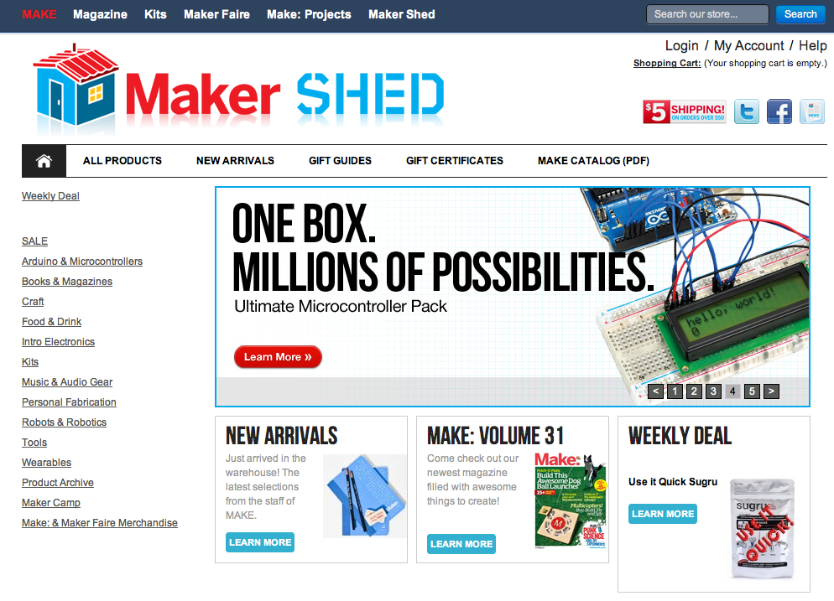
Make: an online store
Beside the magazine...
Source: http://www.makershed.com/

Slide 12
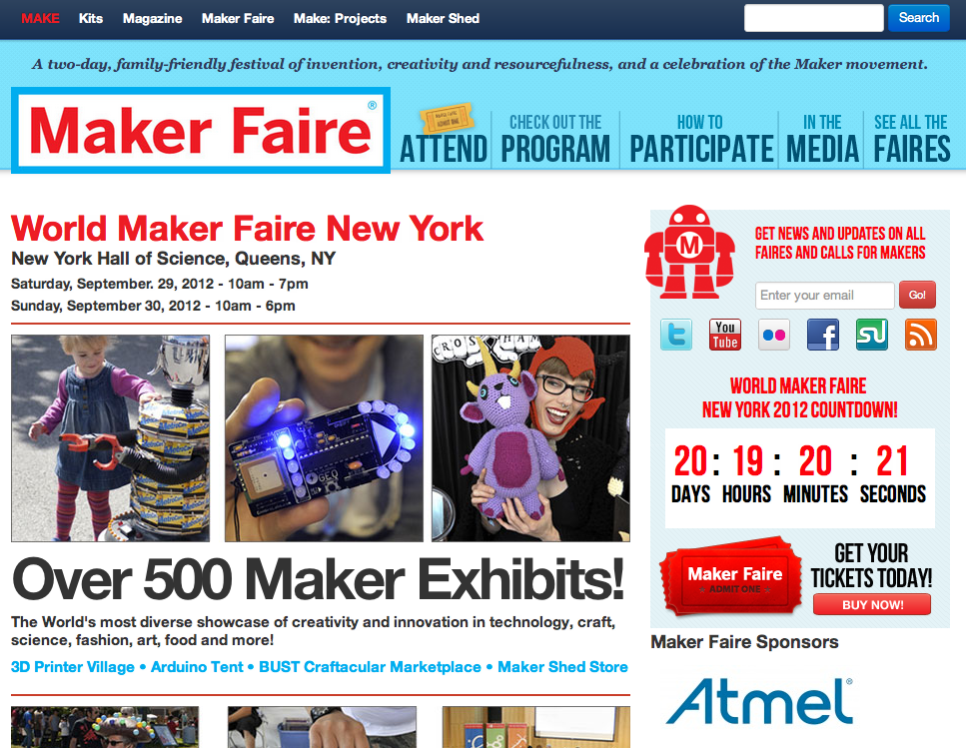
Make: a series of local faires
Beside the magazine ...
Source: http://makerfaire.com/

Slide 13
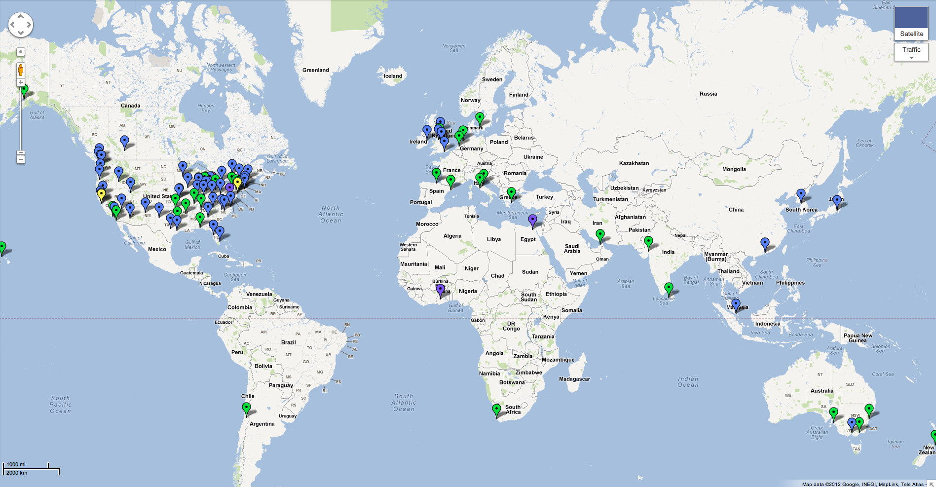
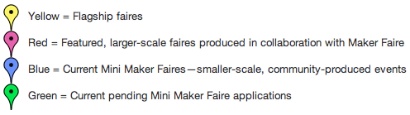
Make: a series of local faires
Beside the magazine ...
Source: http://makerfaire.com/map.csp

Slide 14
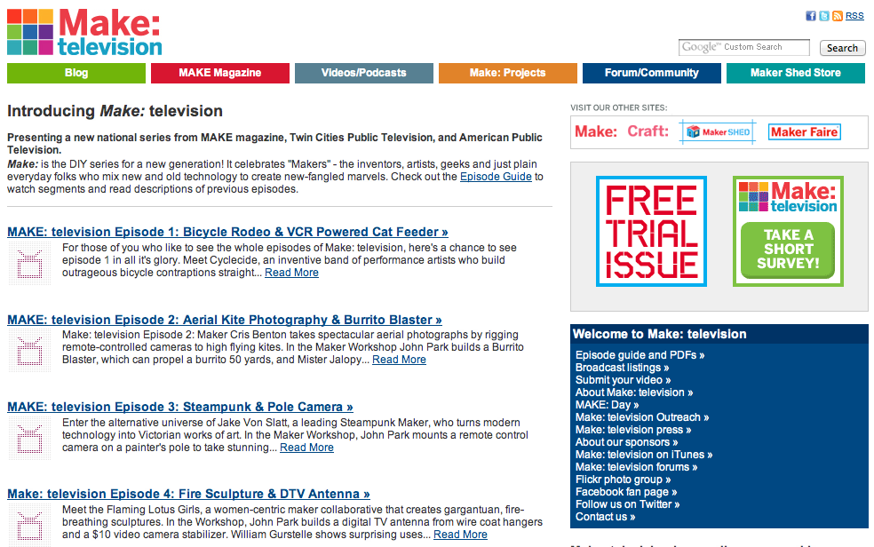
Make: a TV / online series
Make: television is a television show produced by Twin Cities Public Television and hosted by John Edgar Park which premiered in January 2009 on PBS stations.
Source: http://makezine.tv/

Slide 15
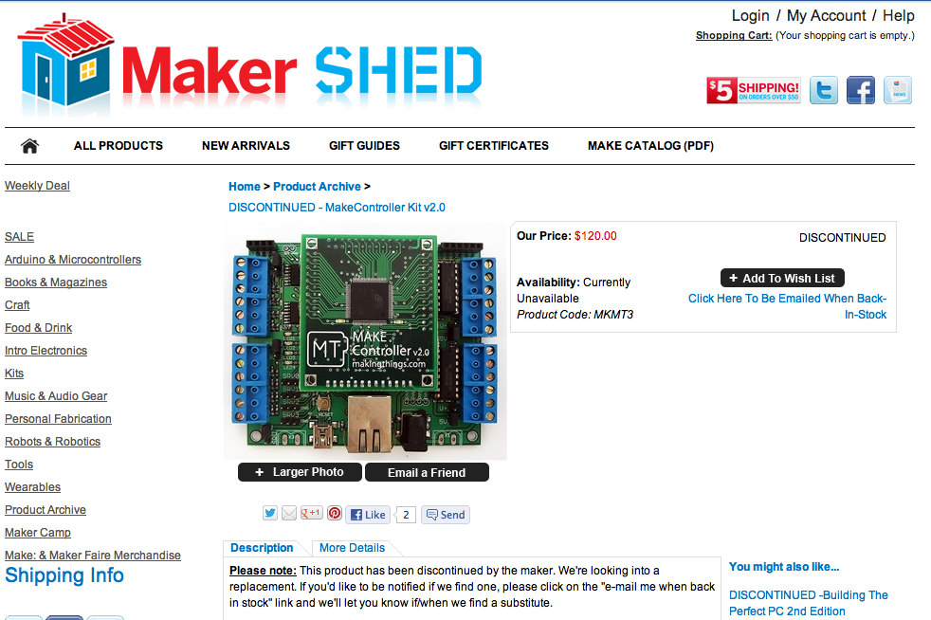
Make: a controller kit
Make teamed up with MakingThings, LLC, to produce the Make Controller Kit, an open hardware solution to create interactive applications.
Source: http://www.makershed.com/product_p/mkmt3.htm

Slide 16
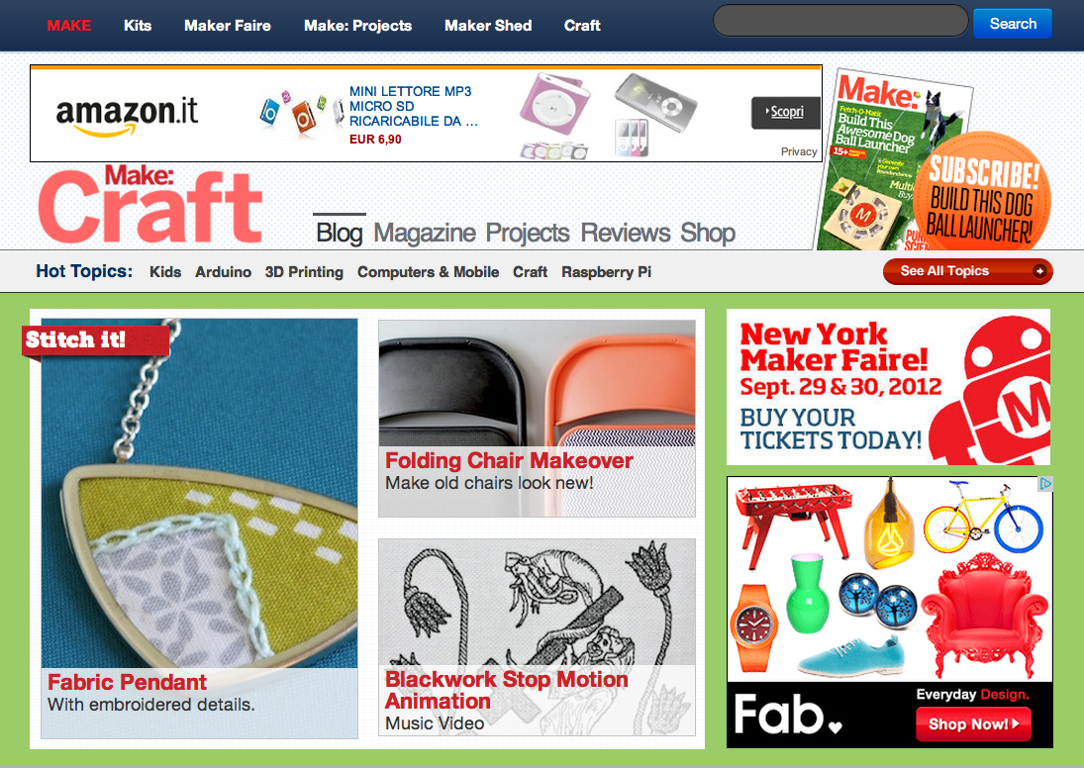
Make: Craft
A quarterly magazine published by O'Reilly Media which focused on do it yourself (DIY) projects like knitting, sewing, jewelry, metalworking, woodworking, until 2009.
Source: http://blog.makezine.com/craftzine/ http://en.wikipedia.org/wiki/Craft_(magazine)

Slide 17
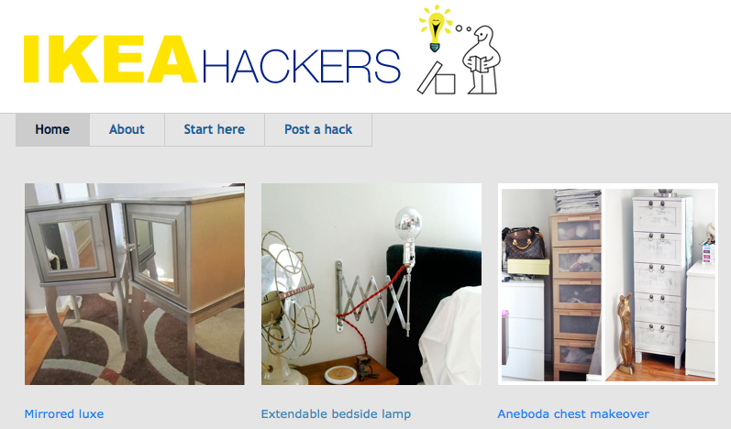
No idea for a project? Hack one!
IKEA products are cheap enough, there are many options and components that can be reused.
Source: http://www.ikeahackers.net/

Slide 18
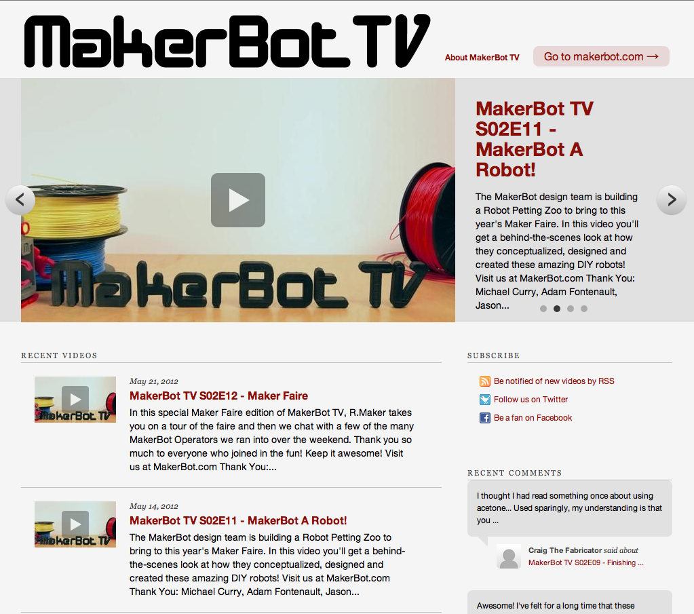
Makerbot TV
An online TV show produced by Makerbot, for promoting their 3D printers.
Source: http://makerbot.tv/

Slide 19
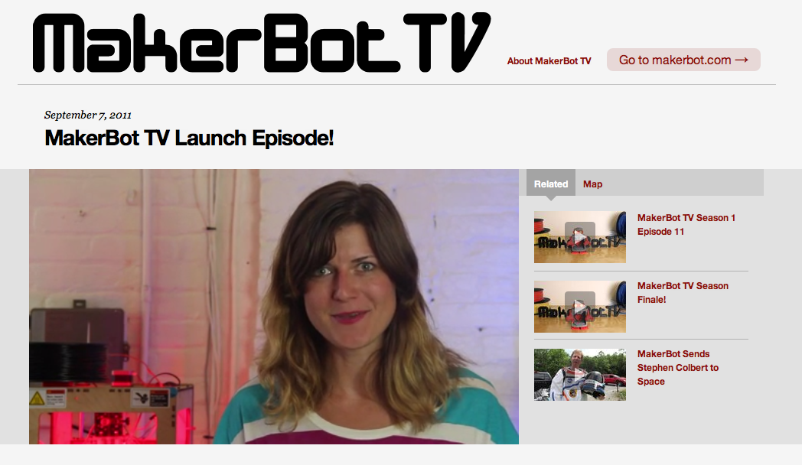
Makerbot TV
An online TV show produced by Makerbot, for promoting their 3D printers.
Source: http://makerbot.tv/LtHr/makerbot-tv-launch-episode/

Slide 20
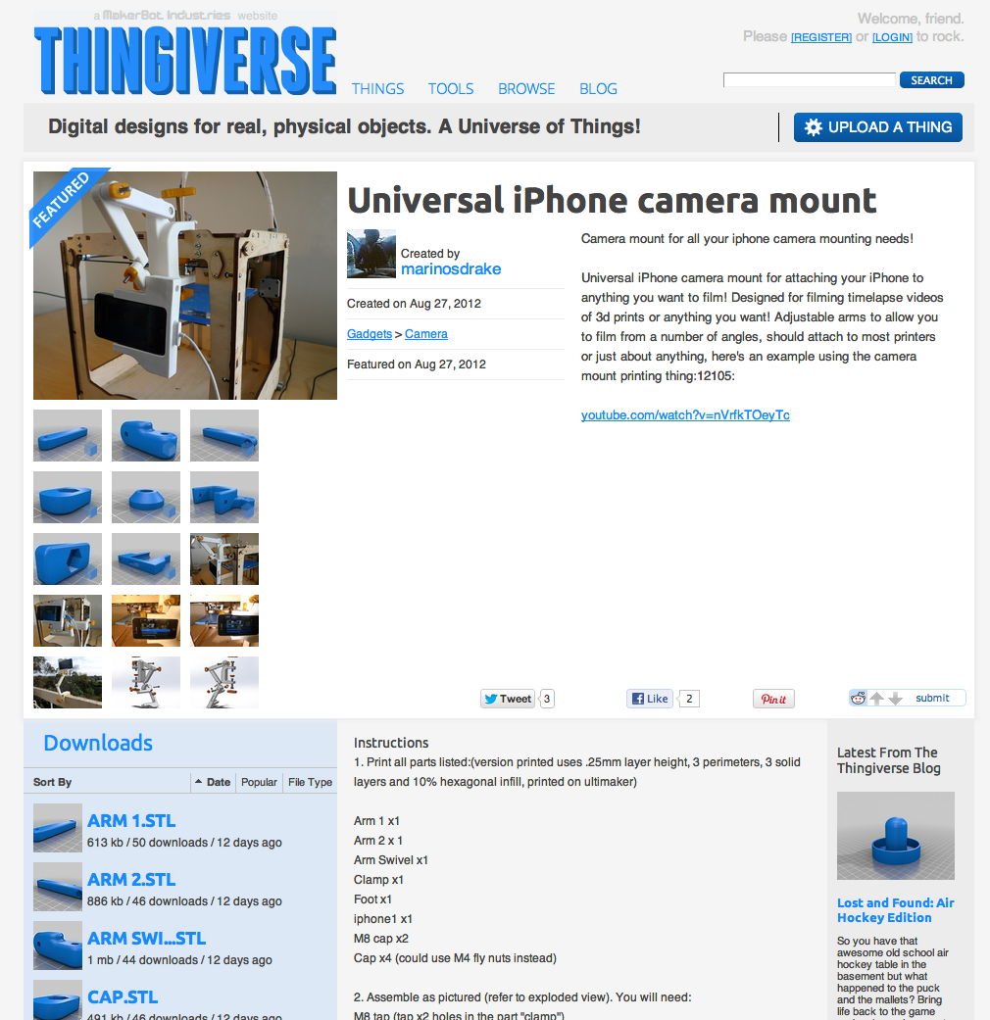
Thingiverse (from Makerbot)
A website for sharing 3D digital files that can be printed (with Makerbot printers).
Source: http://www.thingiverse.com/thing:29258

Slide 21
02.
Platforms Digital Fabrication, Open Design and DIY

Slide 22
A platform
= an extremely valuable and powerful ecosystem that quickly and easily scales, morphs, and incorporates new features (called planks), users, customers, vendors, and partners.
The most vibrant platforms embrace third-party collaboration. The companies behind these platforms seek to foster symbiotic and mutually beneficial relationships with users, customers, partners, vendors, developers, and the community at large. At their core, platforms today are primarily about consumer utility and communications.
Simon, P. (2011). The Age of the Platform: How Amazon, Apple, Facebook, and Google Have Redefined Business. Motion Publishing.

Slide 23
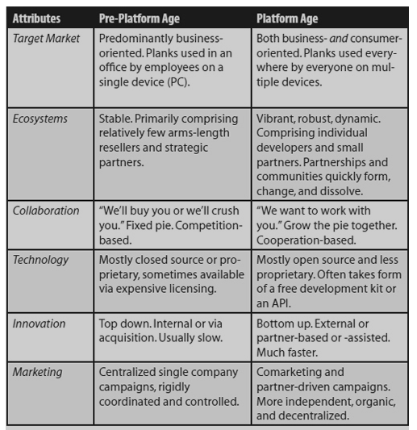
A platform
Simon, P. (2011). The Age of the Platform: How Amazon, Apple, Facebook, and Google Have Redefined Business. Motion Publishing.

Slide 24
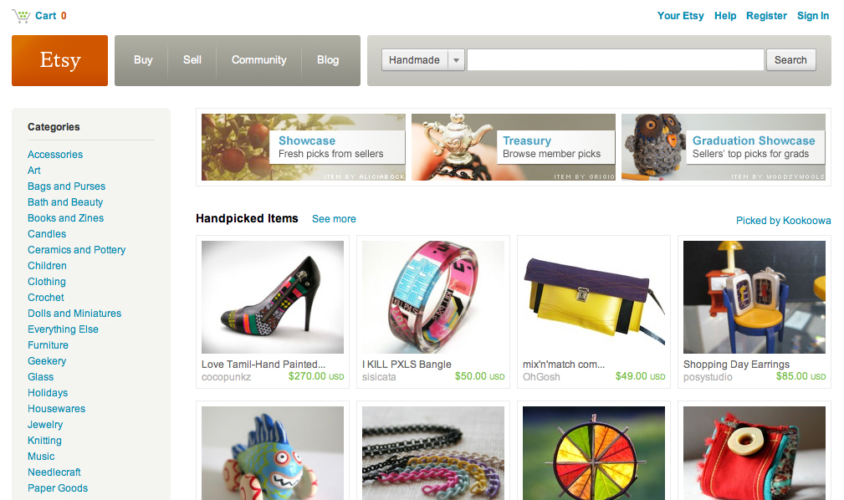
Etsy: a DIY / Crafts marketplace
The biggest marketplace for your DIY / Crafts projects.
Source: http://www.etsy.com/

Slide 25
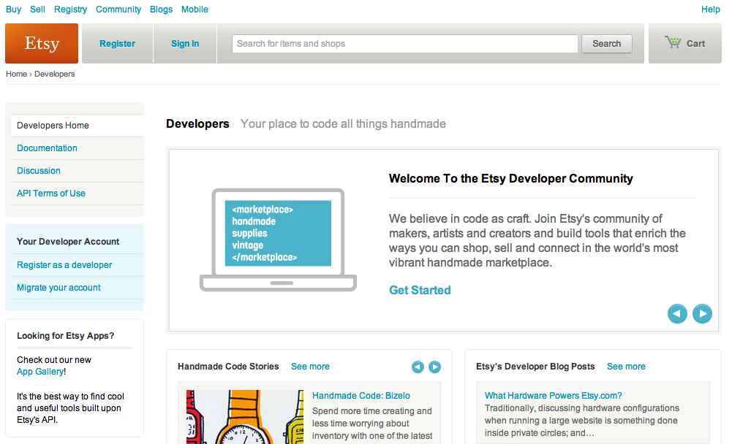
Etsy: a platform for DIY
With also open API for interacting with the platform!
Source: http://www.etsy.com/developers?ref=ft_dev

Slide 26
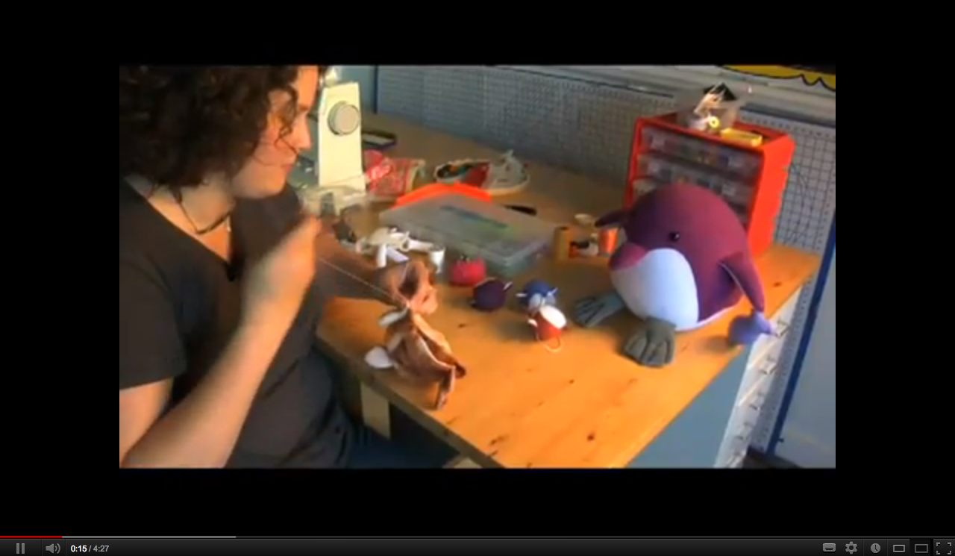
Etsy: a platform for DIY
The biggest marketplace for your DIY / Crafts projects.
Source: http://www.youtube.com/watch?v=RmXJXYHnWPo

Slide 27
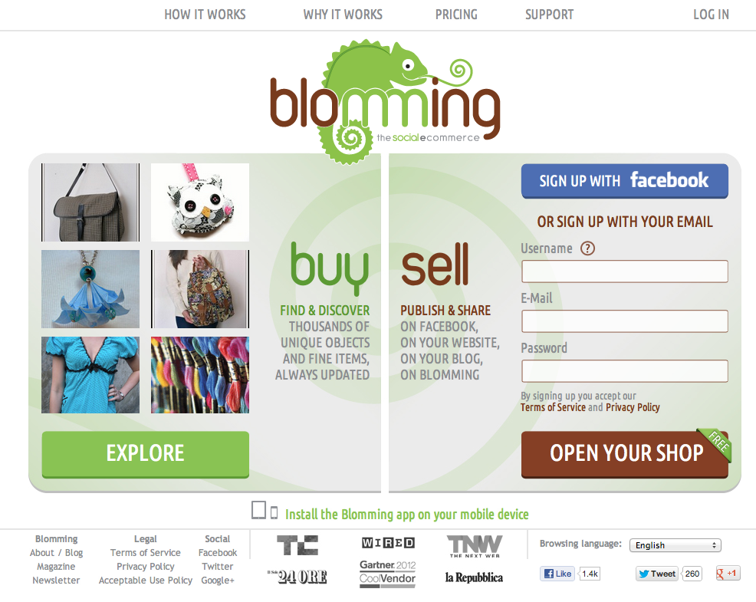
Blomming: another platform for DIY
A platform for embedding your e-commerce store in your own website.
Source: http://blomming.com/

Slide 28
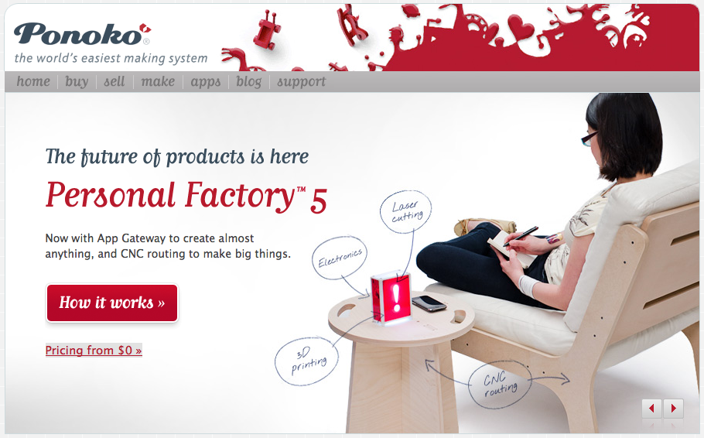
Ponoko (New Zealand)
Source: http://www.ponoko.com
Online service and marketplace (open your own shop) with laser cutting, cnc routing, 3D printing, electronic components through local hubs.
Source: http://www.ponoko.com

Slide 29
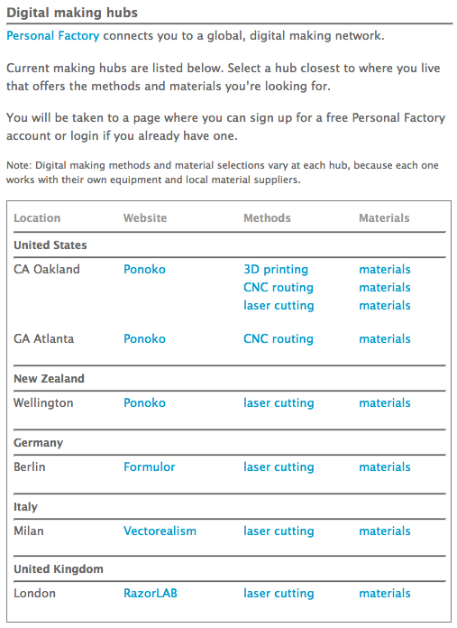
Ponoko (New Zealand)
Source: http://www.ponoko.com
Online service and marketplace (open your own shop) with laser cutting, cnc routing, 3D printing, electronic components through local hubs.
Source: http://blog.ponoko.com/digital-making-hubs/

Slide 30
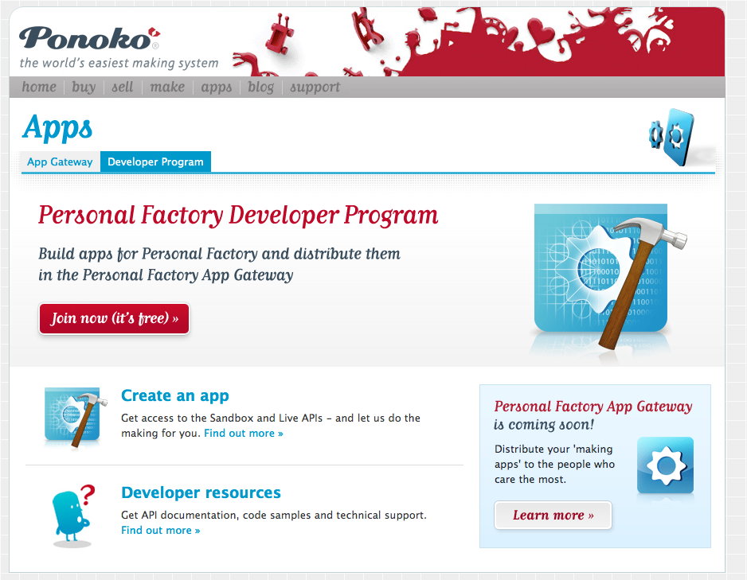
Ponoko (New Zealand)
Source: http://www.ponoko.com
Online service and marketplace (open your own shop) with laser cutting, cnc routing, 3D printing, electronic components through local hubs.
Source: http://www.ponoko.com/app-gateway/developer-program

Slide 31
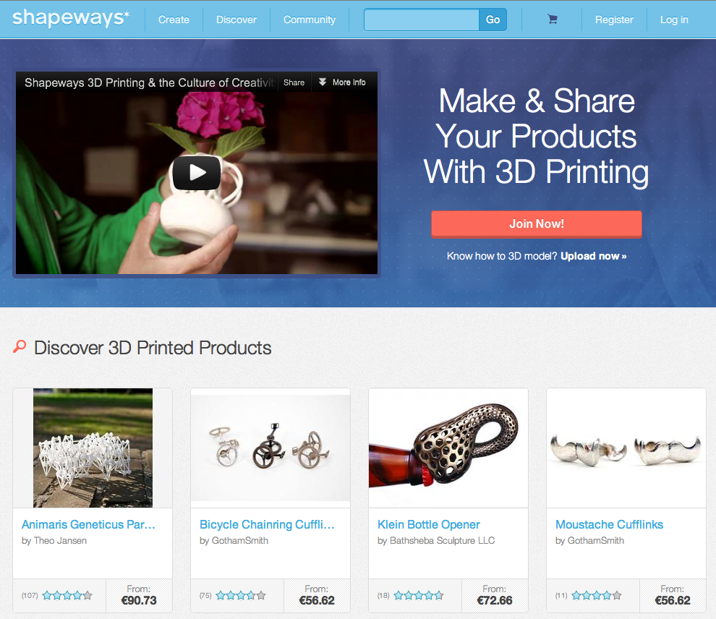
Shapeways (Netherlands/USA)
Source: http://www.shapeways.com
Online service and marketplace (open your own shop) with 3D printing.
Source: http://www.shapeways.com

Slide 32
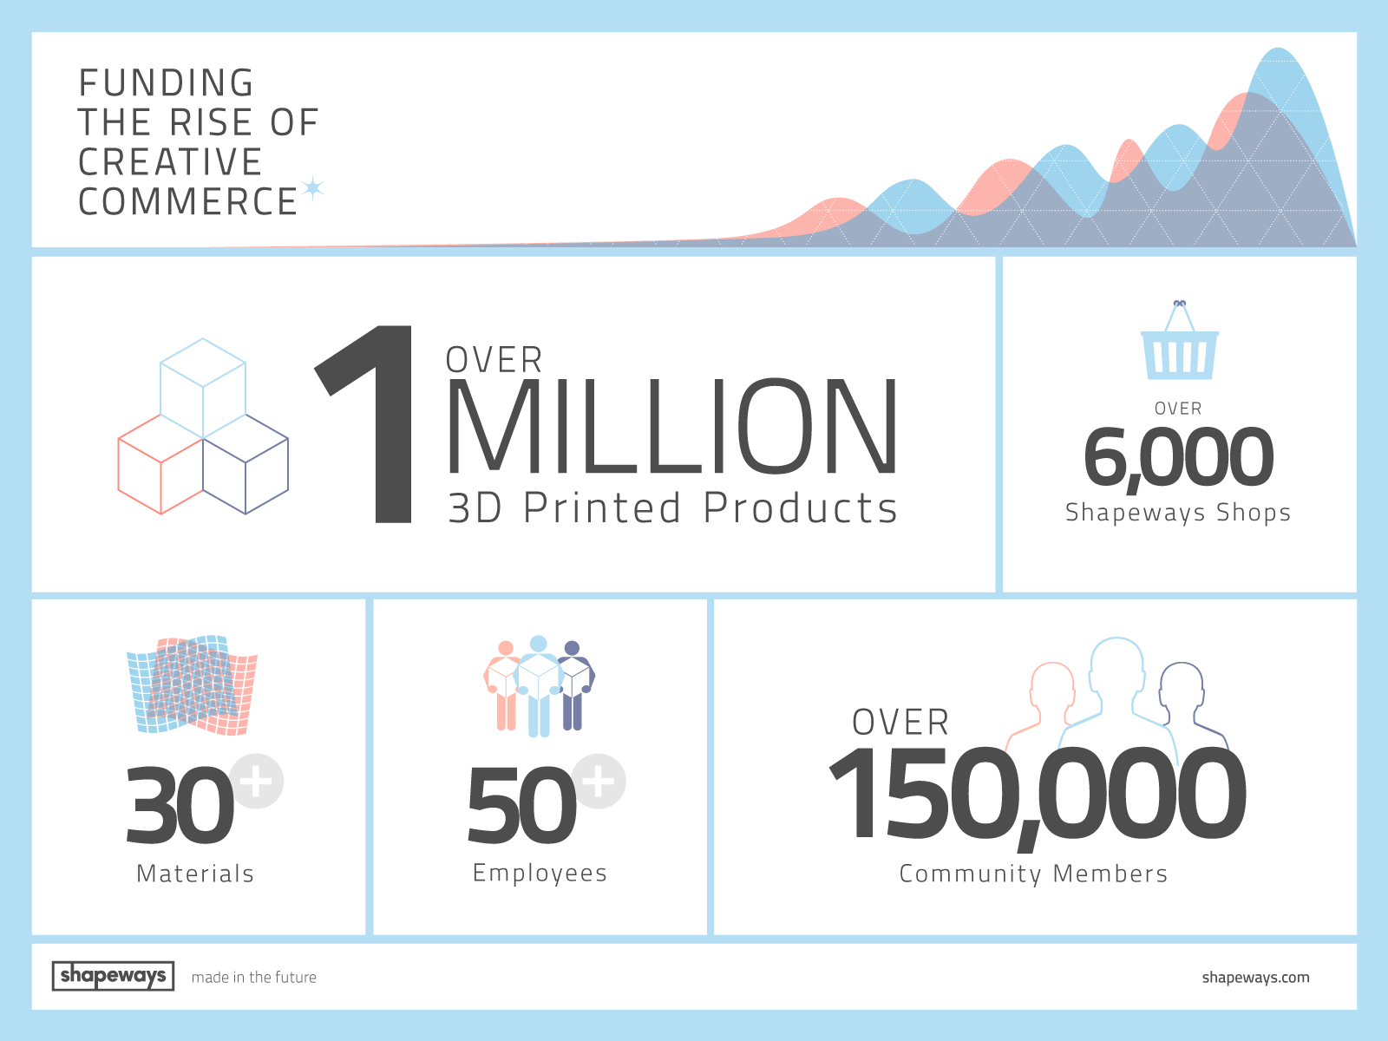
Shapeways (Netherlands/USA)
Source: http://www.shapeways.com
Online service and marketplace (open your own shop) with 3D printing.
Source: http://www.shapeways.com/blog/archives/1442-Funding-the-Rise-of-Creative-Commerce.html

Slide 33
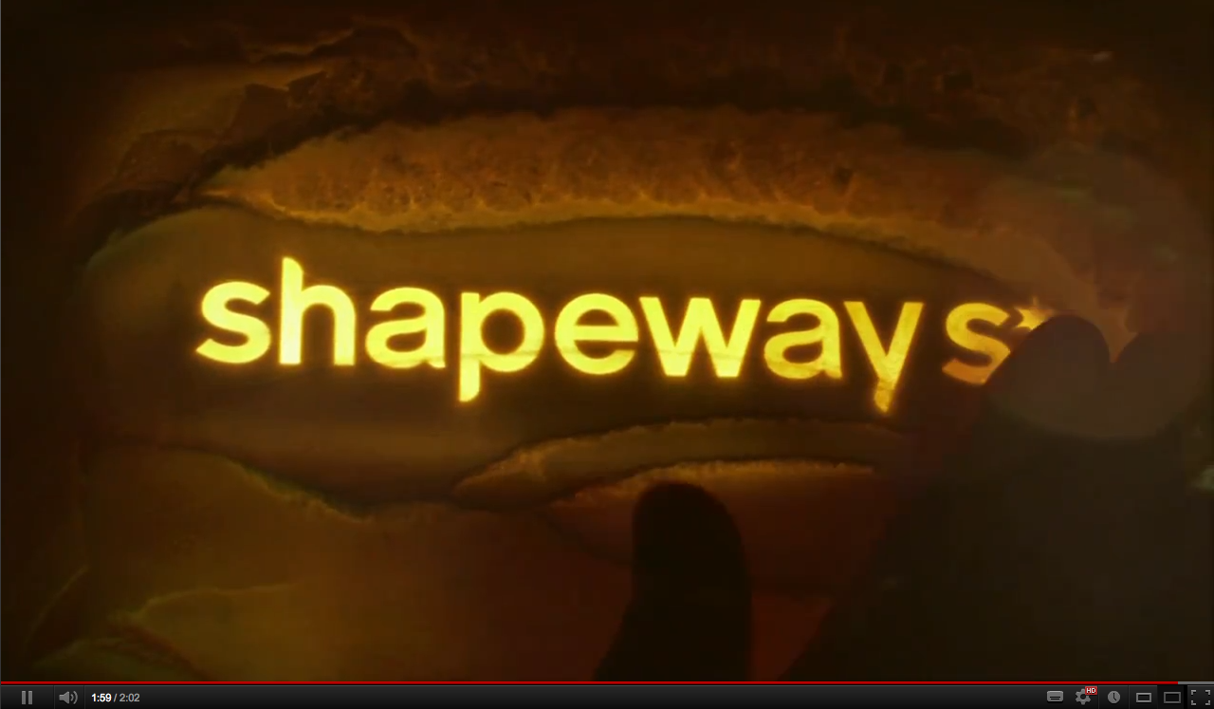
Shapeways (Netherlands)
Online service and marketplace (open your own shop) with 3D printing.
Source: http://www.youtube.com/watch?feature=player_embedded&v=qJuTM0Y7U1k

Slide 34
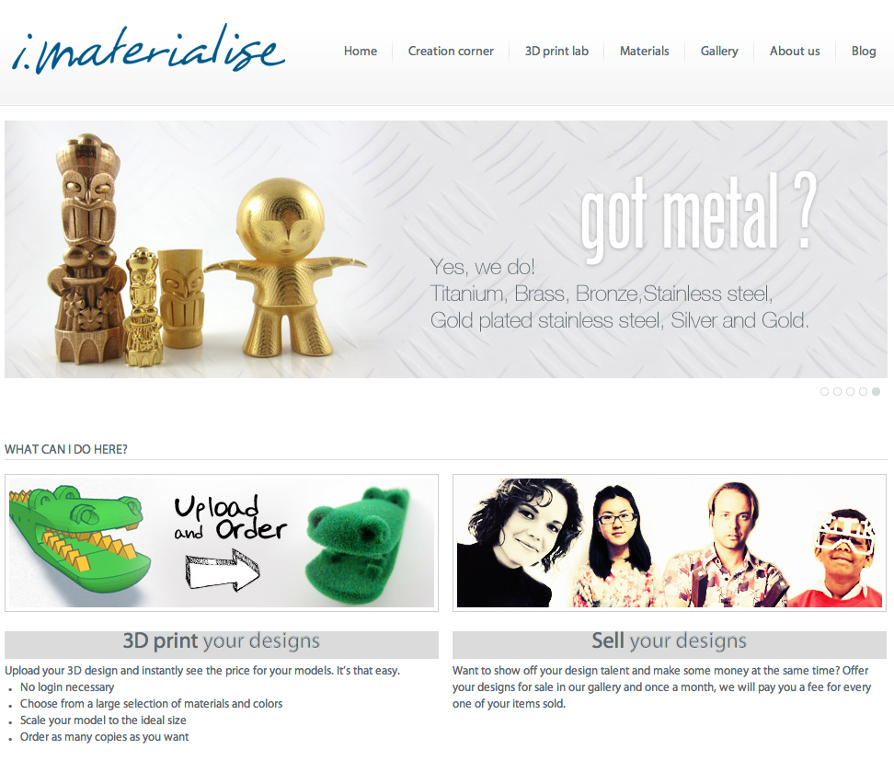
i.materialise (Belgium)
Source: http://i.materialise.com/
Online service and marketplace (open your own shop) with 3D printing.
Source: http://i.materialise.com/

Slide 35
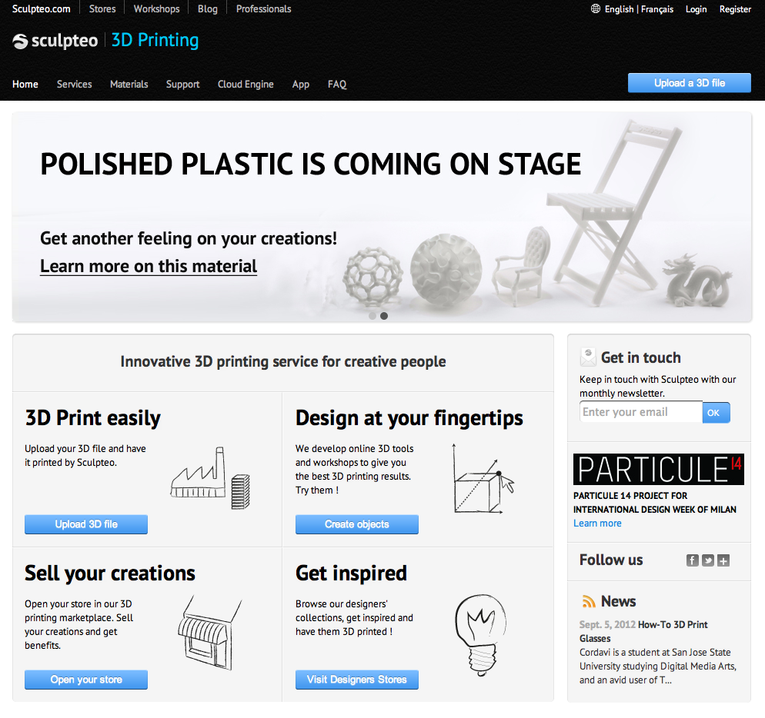
Sculpteo (France)
Online service and marketplace (open your own shop) with 3D printing.
Source: http://www.sculpteo.com/en/

Slide 36
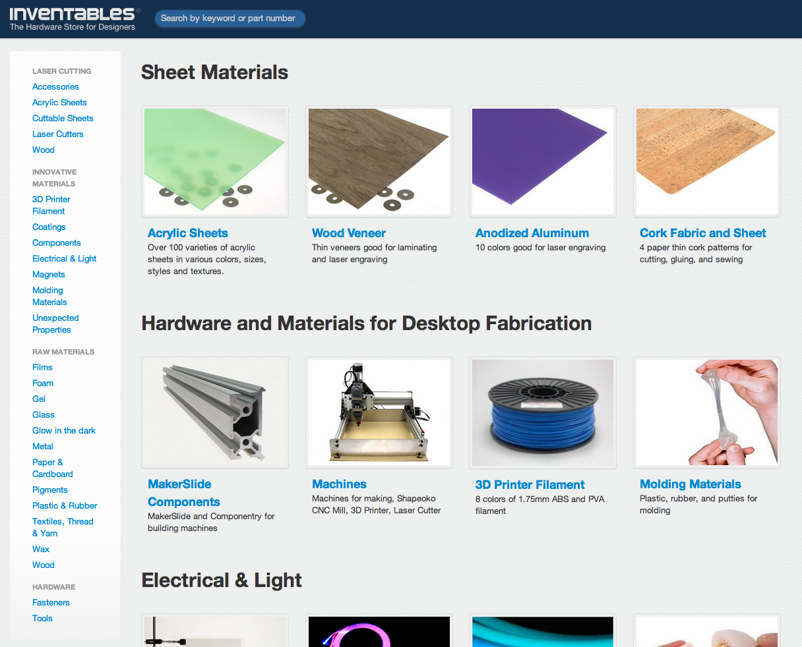
Inventables (USA)
Online store for materials, components and machines for digital fabrication and DIY.
Source: https://www.inventables.com/

Slide 37
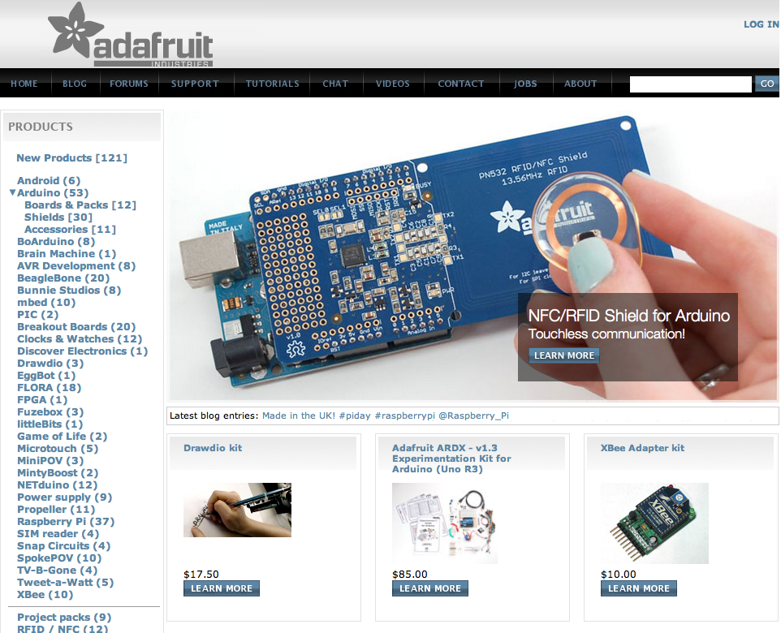
Adafruit (USA)
Online service and marketplace (open your own shop) with 3D printing.
Source: http://www.adafruit.com/

Slide 38
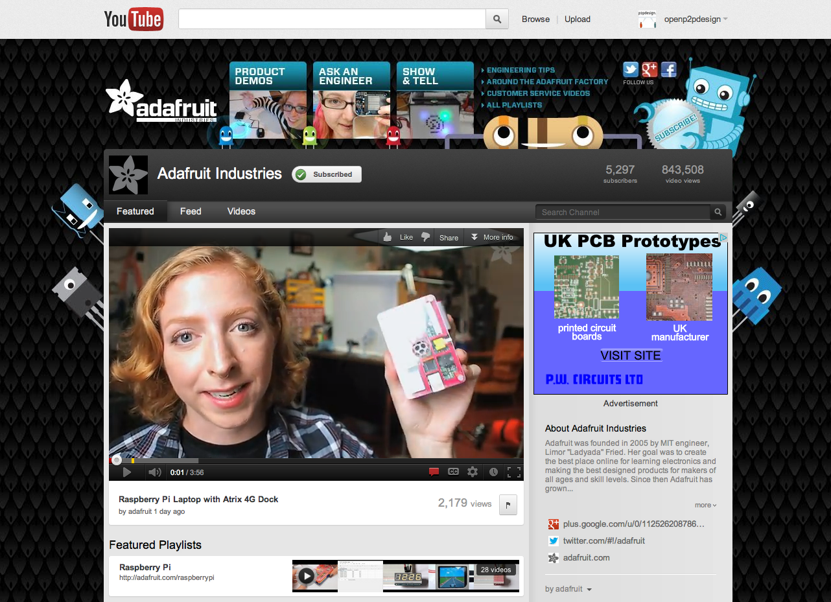
Adafruit (USA)
Online service and marketplace (open your own shop) with 3D printing.
Source: http://www.youtube.com/user/adafruit

Slide 39
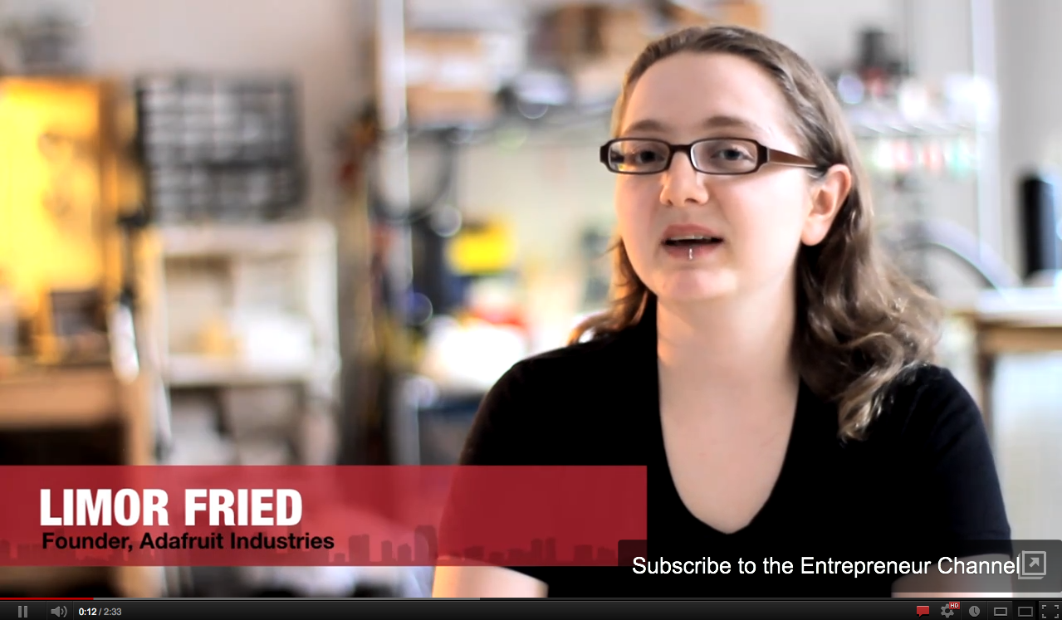
Adafruit (USA)
Online service and marketplace (open your own shop) with 3D printing.
Source: http://www.youtube.com/watch?v=qpYdt4hdEi8

Slide 40
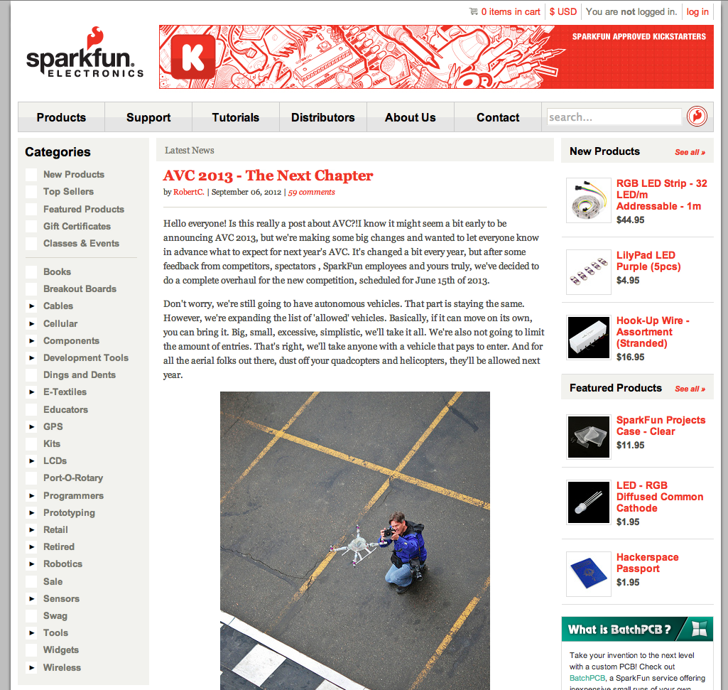
Sparkfun (USA)
Online service and marketplace (open your own shop) with 3D printing.
Source: http://www.youtube.com/user/adafruit

Slide 41
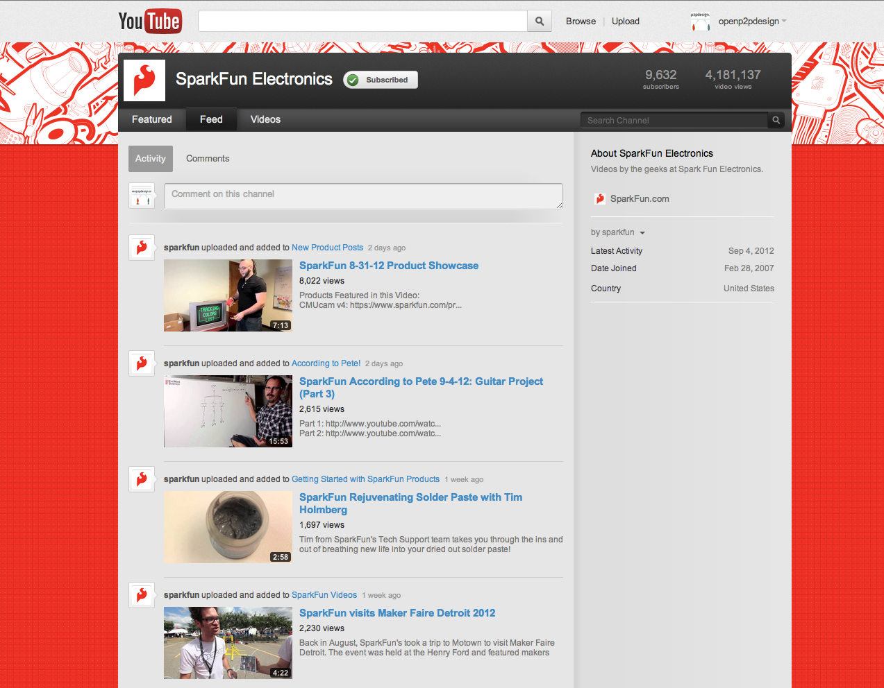
Sparkfun (USA)
Online service and marketplace (open your own shop) with 3D printing.
Source: http://www.youtube.com/user/sparkfun?feature=results_main

Slide 42
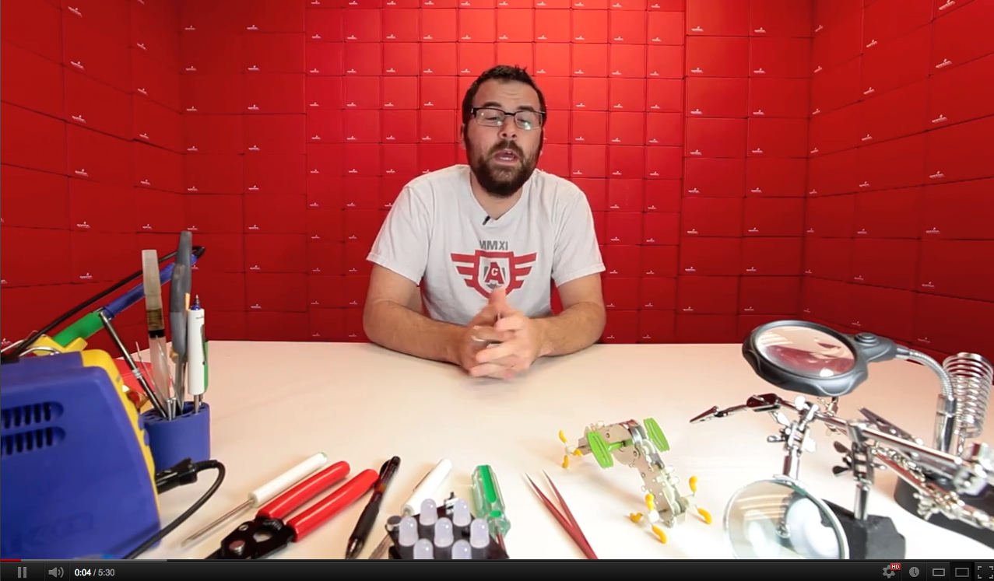
Sparkfun (USA)
Online service and marketplace (open your own shop) with 3D printing.
Source: http://youtu.be/dvvtRoBn4YM

Slide 43
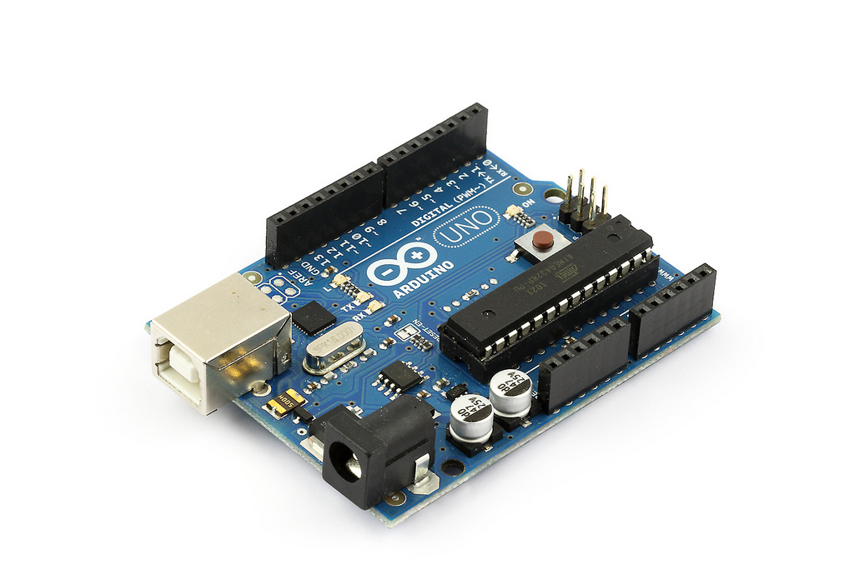
A physical platform: Arduino (Italy)
An Open single-board microcontroller and IDE designed to make the process of using electronics in multidisciplinary projects more accessible.
Source: http://arduino.cc

Slide 44
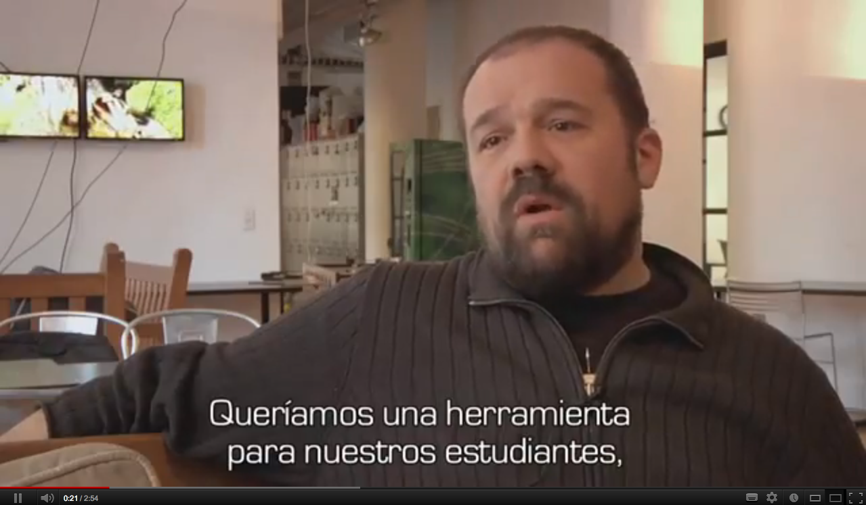
A physical platform: Arduino (Italy)
An Open single-board microcontroller and IDE designed to make the process of using electronics in multidisciplinary projects more accessible.
Source: http://www.youtube.com/watch?v=q2dieLFR9C8 Full documentary: http://vimeo.com/18539129

Slide 45
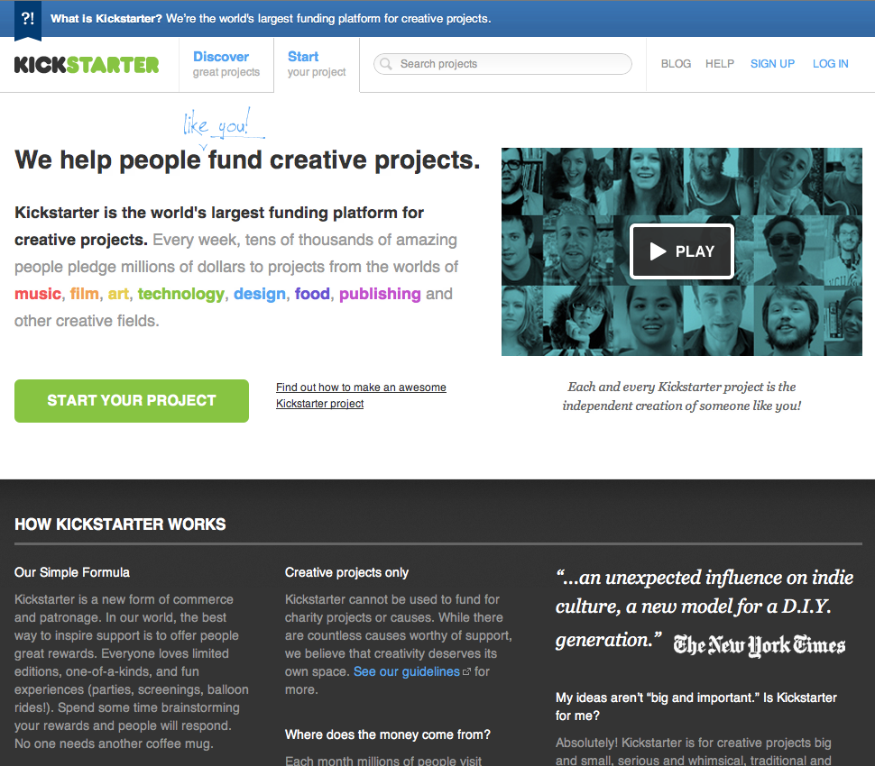
Crowdfunding: Kickstarter
Kickstarter is the world's largest funding platform for creative projects.
Source: http://www.kickstarter.com/start

Slide 46
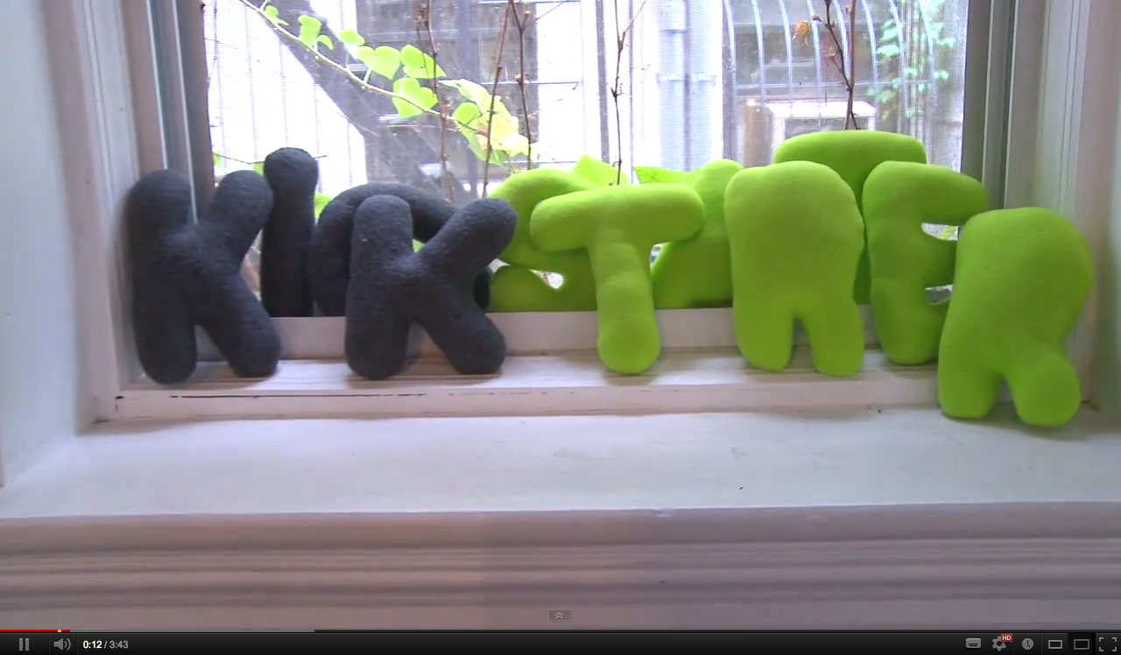
Crowdfunding: Kickstarter
Kickstarter is the world's largest funding platform for creative projects.
Source: http://www.youtube.com/watch?v=luOaNSZIsXc

Slide 47
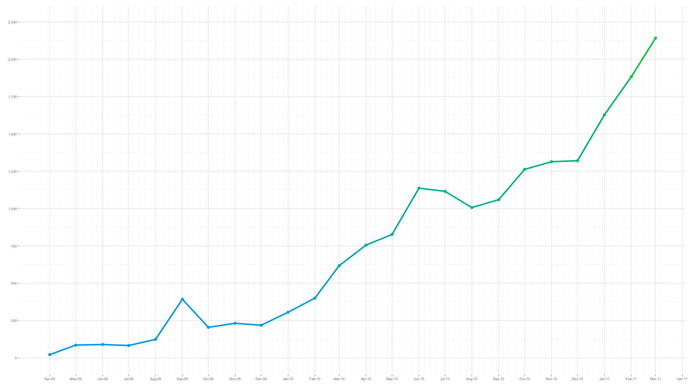
Crowdfunding: Kickstarter
Projects launched: activity between April 28, 2009 - April 27, 2011.
Source: http://www.kickstarter.com/blog/happy-birthday-kickstarter

Slide 48
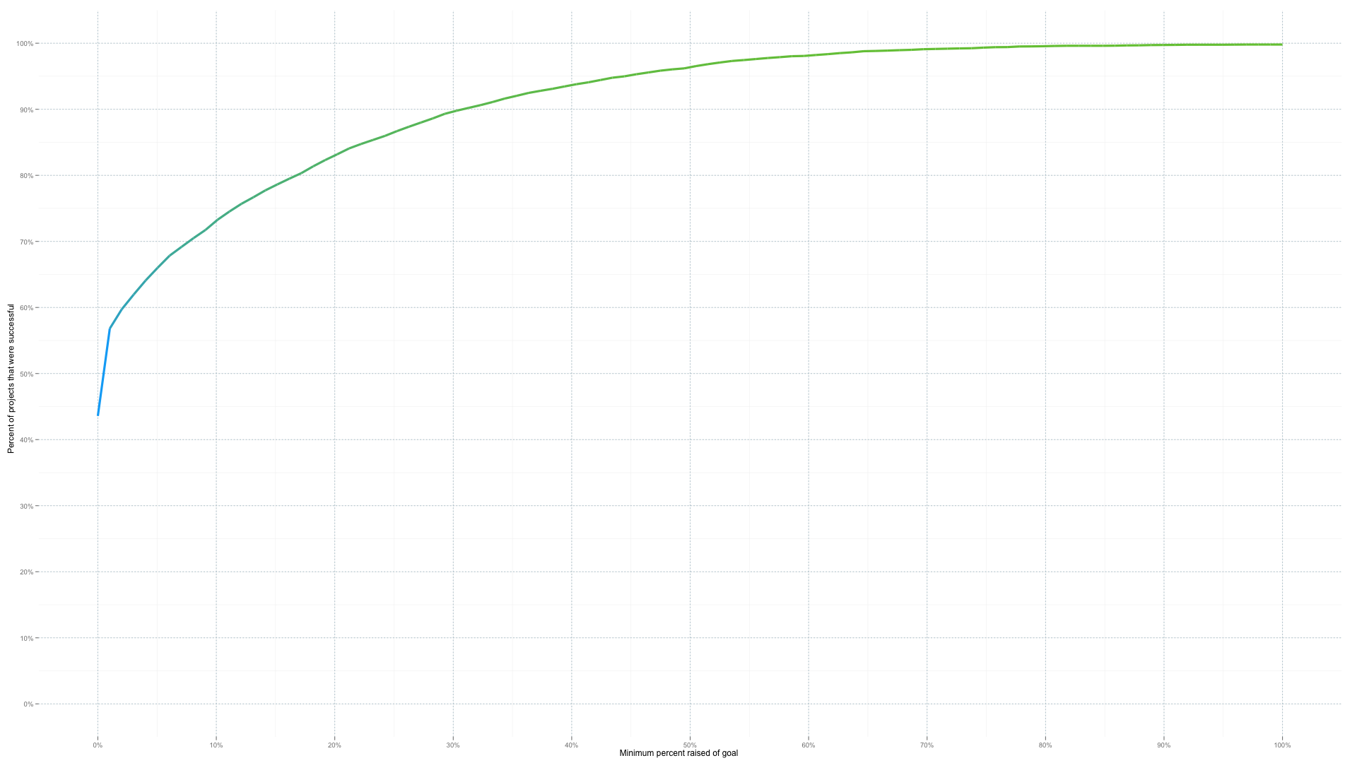
Crowdfunding: Kickstarter
Projects that reach 30% of their funding goal succeed more than 90% of the time. As the line turns green, the percent of projects that succeed approaches 100%.
Source: http://www.kickstarter.com/blog/happy-birthday-kickstarter

Slide 49
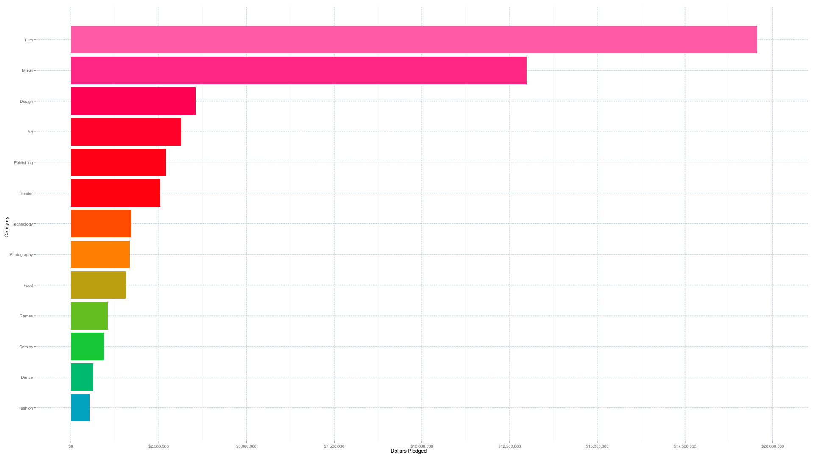
Crowdfunding: Kickstarter
Film leads the pack with nearly $20 million in pledges and Music follows with more than $13 million. 10 of the 13 categories have seen more than $1 million.
Source: http://www.kickstarter.com/blog/happy-birthday-kickstarter

Slide 50
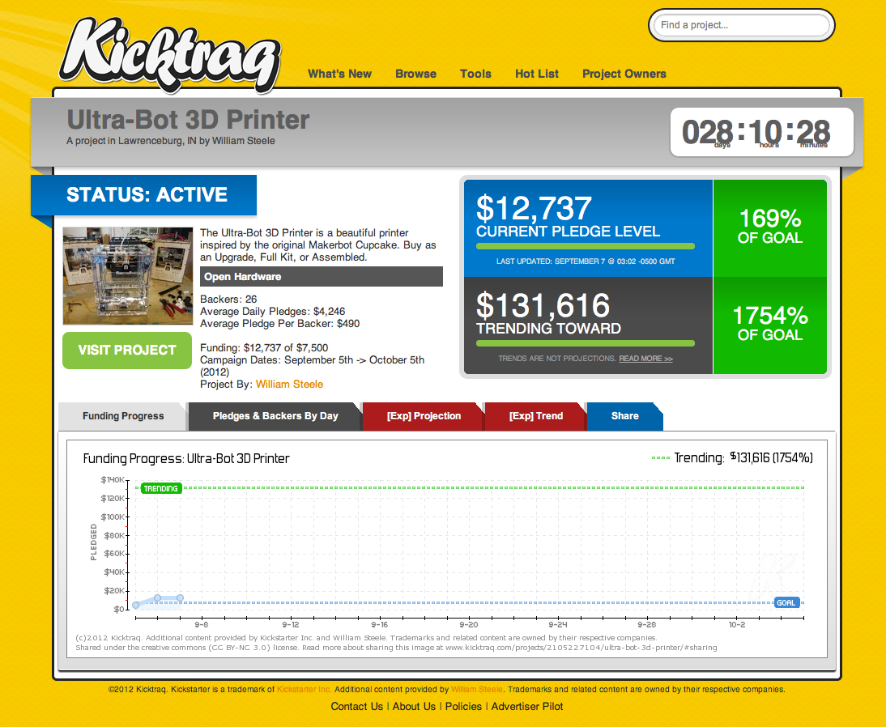
Kicktraq: analytics for Kickstarter
Kickstarter is the world's largest funding platform for creative projects.
Source: http://www.kicktraq.com/ http://www.kicktraq.com/projects/2105227104/ultra-bot-3d-printer/

Slide 51
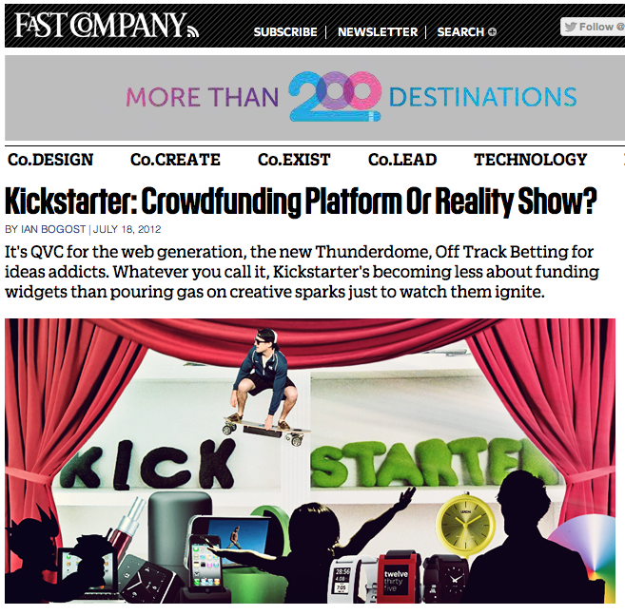
Kickstarter: is it rather a Medium?
On Kickstarter, we sell / fund more an experience than a product!
Source: http://www.fastcompany.com/1843007/kickstarter-crowdfunding-platform-or-reality-show

Slide 52
Lessons from / for Kickstarter
* Design for Simplicity: reduce the functionalities / components
* Design for scale: identify your possible supply chain and plan how to scale the production
* Treat it like a job: it requires full time energy, and probably also a team work
* Befriend fellow hackers: develop the project in hackerspaces or fablabs
* Leverage your backers: use them not just for collecting money!
Some lessons from successful projects... “design for manufacturing”
Source: http://www.wired.com/design/2012/08/how-kickstarter-project-hexy-got-made/

Slide 53
Lessons from / for Kickstarter
* Set a spot-on funding goal — not too big, not too small: set your Kickstarter goal near $10,000: 38% of projects met their goals
* Don’t take too long to raise your money: The average Kickstarter campaign lasts for 30 days, with 35% of success
* Produce a slick video to get attention: The nearly foolproof way to raise money on Kickstarter is to get the attention of the crowdfunding site’s staff (89% success)
* Make at least 1,000 Facebook friends: Founders with 1,000 Facebook friends or more can have a success up to 40%
Some lessons from successful projects...
Source: http://www.wired.com/business/2012/07/kickstarter/

Slide 54
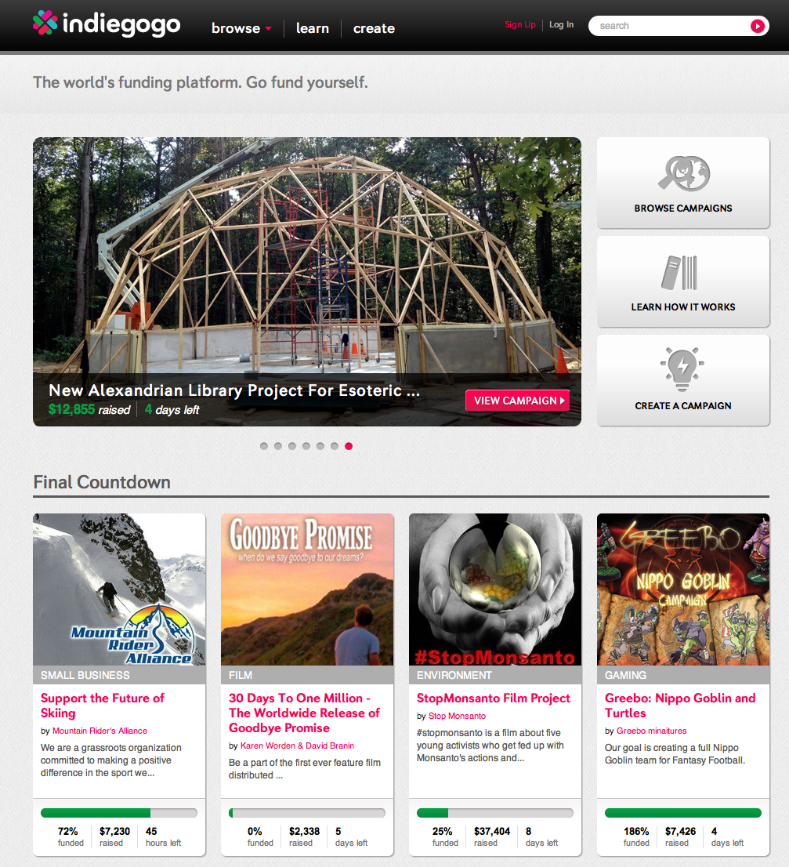
Crowdfunding: Indiegogo
A crowdfunding platform based in California, it has hosted over 100,000 funding campaigns in areas such as music, charity, small business and film.
Source: http://www.indiegogo.com/

Slide 55
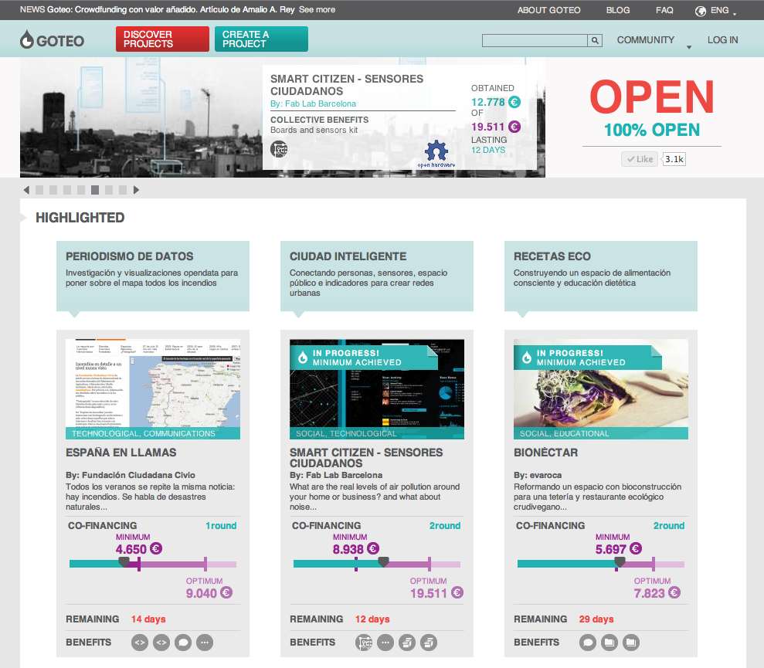
Crowdfunding for Open projects: Goteo
A crowdfunding platform based in California, it has hosted over 100,000 funding campaigns in areas such as music, charity, small business and film.
Source: http://goteo.org/?lang=en

Slide 56
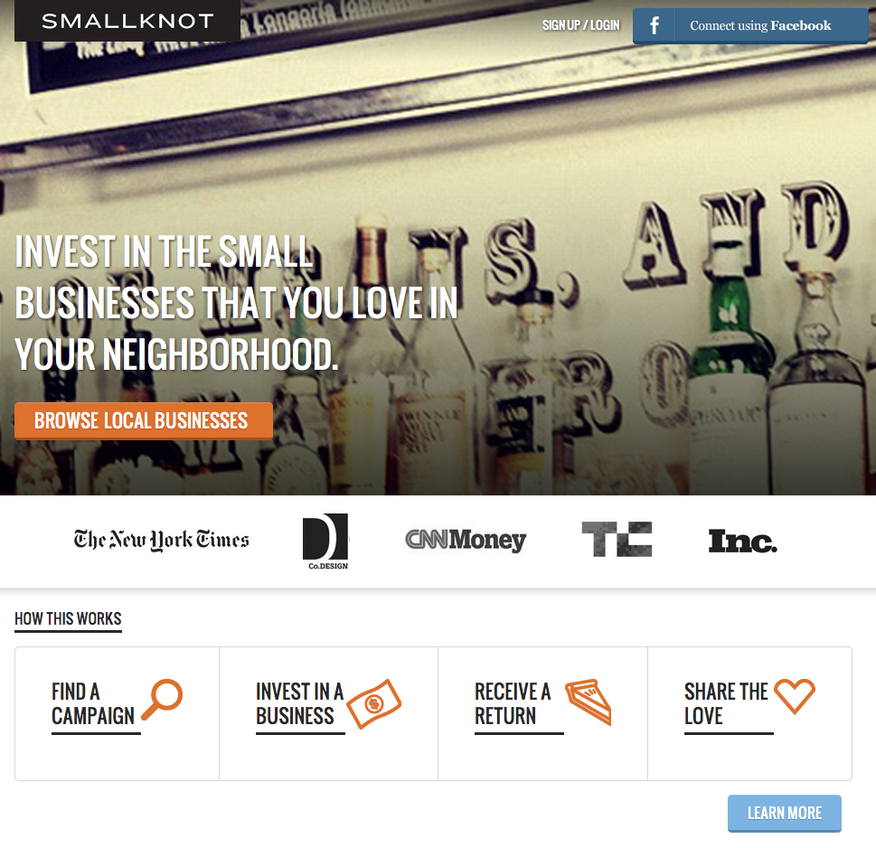
Crowdfunding for local business: Smallknot
A new trend in crowdfunding: fund local projects and business to strenghten your local community.
Source: http://www.smallknot.com/

Slide 57

Crowdfunding for local business: LuckyAnt
A new trend in crowdfunding: fund local projects and business to strenghten your local community.
Source: http://www.luckyant.com/

Slide 58

Crowdfunding for local business: Brickstarter
A new trend in crowdfunding: fund local projects and business to strenghten your local community. This is a Finnish example under development.
Source: http://brickstarter.org/an-introduction-to-brickstarter/

Slide 59

Crowdfunding for Finland: Mesenaatti.me
Mesenaatti.me is the first open-for-everyone Finnish crowdfunding platform.
Source: http://mesenaatti.me/en/

Slide 60

GitHub: coding for the social networks
The most popular platform for code development, and especially open source: a personal open source place + social network.
Source: https://github.com/

Slide 61

Sourceforge: coding for the organization
The most popular platform for open source projects with 3.4 million developers that create over 324,000 projects: coding for an organization.
Source: http://sourceforge.net/

Slide 62

GitHub as a platform: Gittip
On Kickstarter, we sell / fund more an experience than a product!
Source: https://www.gittip.com/

Slide 63

GitHub: Goteo as open source Crowdfunding
The most popular platform for code development, and especially open source: a personal open source place + social network.
Source: https://github.com/Goteo/Goteo

Slide 64

Upverter: design hardware, with GitHub
Upverter is a design and collaboration platform for students, engineers, designers, makers and hackers for making hardware online.
Source: http://upverter.com

Slide 65
03.
The business of Digital Fabrication, Open Design and DIY

Slide 66

And designers can be entrepreneurs
New platforms for crowdsourcing allow you to fund your projects, and digital fabrication and FabLabs could be useful for manufacturing them.
Source: http://www.kickstarter.com/projects/danprovost/glif-iphone-4-tripod-mount-and-stand

Slide 67

And designers can be entrepreneurs
New platforms for crowdsourcing allow you to fund your projects, and digital fabrication and FabLabs could be useful for manufacturing them.
Source: http://www.kickstarter.com/projects/1104350651/tiktok-lunatik-multi-touch-watch-kits

Slide 68

But “Open” alone is not enough
Open Source is a good strategy, but your project needs to be meaningful for enough people!
Source: http://www.kickstarter.com/projects/1833785894/100k-stray-toasthed-pull-toys

Slide 69

You need to interact with the market
… and this is exactly what new services and platforms enable!
Source: http://www.threadless.com/

Slide 70
Open Hardware: a rising market
2009: 13 companies above $ 1 m. (totale: $ 50 m.). $ 1 billion by 2015.
Source: http://blog.makezine.com/archive/2010/05/million-dollar-baby-businesses-de.html

Slide 71

SparkFun
“In 2010, SparkFun had revenues of about $18.4MM. As of April of 2011, we have around 120 employees, up from 87 a year ago.”
“We hope to grow by 50% this year (2011) to around $28MM in sales. We expect to be in the 30-50MM range in the next 3-5.”
Source: http://www.sparkfun.com/news/599

Slide 72

A long tail of users / projects...
Number of items sold
Top hits
Long tail
Number of projects
Another big player, a marketplace for your DIY / Crafts projects (exploiting the long tail effect).
Source: http://en.wikipedia.org/wiki/Power_law

Slide 73
Etsy: exploiting the long tail
Users: +8 milioni / Active shops: +800,000
Products: 8.5 milions.
Source: http://www.etsy.com/press/kit/

Slide 74

Makers can create a startup: Makerbot
Started from an hackerspace (and from RepRap, even financially).
Source: http://www.flickr.com/photos/kellycdb/6168020183/
http://commons.wikimedia.org/wiki/Category:Wood
Notes:
Possiamo avere anche makers che si riuniscono e fondano una startup, come nel caso della stampante 3D open source Makerbot. La Makerbot é talmente di successo che ha recentemente ricevuto 10 milioni di dollari da Venture Capital.

Slide 75


The market of 3D printing
3D printing market has grown by 24.1% in 2011.
Forecasts: $3.1 billions (2016) $5.2 billions (2020).
(Wohlers Associates, 2011)
Sustainable business
--> $10 Milions from VC
Not yet sustainable
--> $5 Milions from VC
Source: http://wohlersassociates.com/press54.htm

Slide 76

Big corporations: 3D Systems
Not only hackers or startups are in this field, but even big and old companies.
Source: http://www.3dsystems.com/
Notes:
Non dimentichiamocelo, possiamo avere anche grandi multinazionali come 3D Systems, che nel 2011 ha guadagnato 160 milioni di dollari.

Slide 77
Digital Fabrication: not just machines
There are many ways for making money with digital fabrication...
Source: http://investor.3dsystems.com/
Notes:
Un aspetto interessante é che solo 28% di questi milioni derivano dalla vendita di stampanti 3D, un altro 31% deriva dalla vendita di materiali e ben il 41% dalla vendita di servizi. Sono quindi 3 possibili direzioni per fare soldi nel mondo dei bit e atomi.

Slide 78

A typical closed innovation system
This is the typical evolution of a closed company...
Source: http://en.wikipedia.org/wiki/Timeline_of_Microsoft_Windows

Slide 79

An open innovation system
And newer pictures are too big for a slide :-)
Source: http://futurist.se/gldt/

Slide 80

Open Innovation vs. Closed Innovation
Firms can and should use external ideas as well as internal ideas, and internal and external paths to market, as the firms look to advance their technology.
Source: http://en.wikipedia.org/wiki/Open_innovation http://shar.es/HN3Ua

Slide 81
Open Innovation vs. Open Source
“Open innovation is sometimes conflated with open source methodologies for software development. There are some concepts that are shared between the two, such as the idea of greater external sources of information to create value. However, open innovation explicitly incorporates the business model as the source of both value creation and value capture. This latter role of the business model enables the organization to sustain its position in the industry value chain over time. While open source shares the focus on value creation throughout an industry value chain, its proponents usually deny or downplay the importance of value capture.”
Source: Chesbrough, H., 2011. Open Services Innovation: Rethinking Your Business to Grow and Compete in a New Era 1st ed., Jossey-Bass.

Slide 82
Look for what is becoming a commodity
A commodity is a good for which there is demand, but which is supplied without qualitative differentiation across a market. [...] the market treats it as equivalent or nearly so no matter who produces it.
Source: http://en.wikipedia.org/wiki/Commodity
Commoditization (also called commodification) occurs as a goods or services market loses differentiation across its supply base, often by the diffusion of the intellectual capital necessary to acquire or produce it efficiently. […] a unique, branded product into a market based on undifferentiated products.
Source: http://en.wikipedia.org/wiki/Commoditization

Slide 83
Hardware and Software, becoming commodities
* ('50s-'70s) Hardware is the product, software is for free: mainframes
--> Hacker ethic of sharing information
* ('80s-'90s) Hardware is commodity, software is the product and it's proprietary: personal computers
--> Microsoft emerges
* ('00s-...) Even software is a commodity, so let's sell services and get data from users: open source, web 2.0, services around software, software as service, the cloud
--> web 2.0 emerges

Slide 84
Manufacturing and Design, becoming commodities
* ('90s-'00s) Manufacturing becomes a commodity and slowly disappears in the West (thanks to China)
* ('10s-...) Now it's even more a commodity
(thanks to Fabbing)
* ('00s-...) Professional design is slowly becoming a commodity (thanks to Fast Fashion, Ikea, design schools bubble, Shanzai)
--> Where is value now, in Design and Manufacturing?

Slide 85


Fabbing + designers = $$$ + Open Design
Big corporations love shopping Design companies for selling their content with 3D printers.
Source: http://www.freedomofcreation.com/home/3d-systems-acquires-freedom-of-creation

Slide 86

But even makers may be giving content away...
The same strategy of giving content to the users of the 3D printers has been adopted by Makerbot.
Source: http://www.thingiverse.com/

Slide 87

Fabbing + designers = $$$ + Open Design
But even anybody could become a user, so let's buy a design software and offer it to them.
Source: http://blog.3dsystems.com/2011/05/3d-systems-partners-with-alibre.html
http://www.alibre.com/

Slide 88

And users innovate (even in non open way)
Not developed by a company...
Source: http://en.wikipedia.org/wiki/Skateboard

Slide 89
Users innovate – a lot!
“We find this previously unmeasured type of household sector innovation to be quite large: 6.2% of UK consumers - 2.9 million individuals - have engaged in consumer product innovation during the prior 3 years. In aggregate, consumers’ annual product development expenditures are 2.3 times larger than the annual consumer product R&D expenditures of all firms in the UK combined. “
Eric A. Von Hippel, Jeroen De Jong, Steven Flowers
Comparing Business and Household Sector Innovation in Consumer Products: Findings from a Representative Study in the UK
http://papers.ssrn.com/sol3/papers.cfm?abstract_id=1683503

Slide 90
03.
Business models for Open projects

Slide 91
Business models of Open Source (software)
Non-monetary incentives:
* problem solving
* ethical questions
* education + learning
* reputation --> social interactions + jobs
--> it's not just about money! Also a gift economy

Slide 92

A gift economy
A mode of exchange where valuable goods and services are regularly given without any explicit agreement for immediate or future rewards.
Source: http://en.wikipedia.org/wiki/Gift_economy

Slide 93

A gift economy: focus on social networks
Flows of good and services are important only for mantaining and improving social networks in the community.
Source: http://en.wikipedia.org/wiki/Gift_economy

Slide 94
Business models of Open Source (software)
Monetary incentives:
* selling software (as open or even with dual licensing)
* offering services (customisation, support, ...)
* paid developer work
* donation
* software as service (freemium, ...)
* embedding software into hardware
--> … it's not just only volunteer work! Also a market economy

Slide 95

A market economy
Decisions regarding investment, production and distribution are based on supply and demand and the prices are determined in a free price system.
Source: http://en.wikipedia.org/wiki/Market_economy http://en.wikipedia.org/wiki/Market_economy

Slide 96

A market economy: barter
A method of exchange by which goods or services are directly exchanged for other goods or services without using a medium of exchange, such as money.
Source: http://en.wikipedia.org/wiki/Barter

Slide 97


A market economy: money as medium
The main functions of money are distinguished as: a medium of exchange; a unit of account; a store of value.
Source: http://commons.wikimedia.org/wiki/Category:Coins

Slide 98
Business models of Open Source (software)
Red Hat
first open source company expected to break through the $1bn mark in 2011.Source: http://www.channelregister.co.uk/2011/03/24/redhat_q4_f2011_numbers/
Cost of developing Linux
The Linux Foundation (LF) (2008): $10.8 billion to build the Linux community distribution Fedora 9 in today’s dollars with today’s software development costs.
$1.4 billion to develop the Linux kernel alone.
Source: http://www.linuxfoundation.org/sites/main/files/publications/estimatinglinux.html

Slide 99


Note: Open Business is not completely open
* identity (brand) is fixed and is a warranty certificate
* existing business ecosystems may not be open
* knowledge, expertise, tools, resources are not always “open”
Source: http://www.blender.org/blenderorg/blender-foundation/logo/ http://www.arduino.cc

Slide 100
The levels of openness in Open Hardware
1. Closed: any hardware for which the creator of the hardware will not release any information.
2. Open Interface: all the documentation on how to make a piece of hardware perform the function for which it is designed is available (minimum level of openness).
3. Open Design: in which enough detailed documentation is provided that a functionally compatible device could be created by a third party.
4. Open Implementation: the complete bill of materials necessary to construct the device is available.
Patrick McNamara defined 4 possible levels of Openness in Open Hardware.
Source: http://www.osbr.ca/ojs/index.php/osbr/article/view/379/340

Slide 101
The business models of Open Hardware
* Services and expertise (customization, consulting)
* Manufacturing of owned or third party Open Hardware
* Manufacturing of proprietary hardware based on Open Hardware
* Dual-licensing
* Proprietary hardware designs based on Open Hardware
* Proprietary software tools for developing Open Hardware
* ... and …
Source: http://www.openp2pdesign.org/2011/open-design/business-models-for-open-hardware/

Slide 102

Business Model Canvas: prototype
Not a business plan, no numbers, don't worry: prototype ideas!
Source: http://www.businessmodelgeneration.com/canvas http://youtu.be/QoAOzMTLP5s
http://en.wikipedia.org/wiki/Business_Model_Canvas

Slide 103
Business models for FabLabs
* Enabler: launch new Labs and support services
* Education: a global distributed model of education through Fab Labs (Fab Academy + peer-to-peer learning)
* Incubator: provide infrastructure for entrepreneurs to turn their Fab Lab creations into sustainable local businesses.
* Replicated / Network: provide a product, service or curriculum that operates by utilizing the infrastructure, staff and expertise of a local Fab Lab
Source: http://www.openp2pdesign.org/2011/fabbing/business-models-for-fab-labs/
http://www.fablab.is/w/index.php/Proposal#Overall_Goals_within_the_Fab_ecosystem

Slide 104

The business models of Open Hardware
Proprietary hardware tools for learning how to develop Open Hardware.
Source: http://kits.sparklelabs.com/

Slide 105

The business models of Open Hardware
Offering free services for building a greater user base.
Source: http://www.adafruit.com/jobs/

Slide 106


The business models of Open Hardware
+ =
Partnership between hardware and fabbing companies
Source: http://www.ponoko.com/make-and-sell/electronics

Slide 107

The business models of Open Hardware
Funding Open Hardware projects in exchange for documentation
Source: http://bildr.org/

Slide 108

The business models of Open Hardware
Piracy as a learning and market building strategy: Shanzai
Source: http://www.flickr.com/photos/ttstam/4177935719/

Slide 109

The business models of Open Hardware
Piracy as a learning and market building strategy: Shanzai
Source: http://vimeo.com/26980501

Slide 110

The business models of Open Hardware
Brick and mortar stores: Makerbot, the Botcave
Source: http://www.makerbot.com/blog/2010/11/26/makerbot-botcave-store-opens-today/

Slide 111

The business models of Open Hardware
Renting spaces for co-working / funding spaces by a community: hackerspaces.
Source: http://hackerspaces.org/wiki/NYC_Resistor

Slide 112

The business models of Open Hardware
Microcredit / peer-to-peer lending / crowdfunding: Open Hardware Bank
Source: http://www.oshwbank.org/

Slide 113

Similar models for DIY Craft... Sewing Cafes
Renting spaces for co-working: Sewing Cafes
Source: http://sweatshopparis.blogspot.com/

Slide 114

Similar models for DIY Craft... Sewing Cafes
Source: http://www.sweatshopparis.com/index.php?/project/concept/
Renting spaces for co-working: Sewing Cafes
Source: http://sweatshopparis.blogspot.com/

Slide 115

Open Money: making digital a physical medium
Source: http://www.sweatshopparis.com/index.php?/project/concept/
Money is now being redesigned by many open source projects, where the governance of the flows of digital money is designed by the software: Bitcoin.
Source: http://en.wikipedia.org/wiki/Bitcoin
http://www.wired.com/magazine/2011/11/mf_bitcoin/

Slide 116

Open Money: making digital a physical medium
Source: http://www.sweatshopparis.com/index.php?/project/concept/
Money is now being redesigned by many open source projects, where the governance of the flows of digital money is designed by the software: Bitcoin.
Source: http://www.youtube.com/watch?v=Um63OQz3bjo

Slide 117

Open Money: it still needs business models
Source: http://www.sweatshopparis.com/index.php?/project/concept/
But redesigning money is only half of the solution: we need to understand its dynamics, and the possible business models it generates.
Source: http://en.wikipedia.org/wiki/Bitcoin
http://www.wired.com/magazine/2011/11/mf_bitcoin/

Slide 118
Crowdsourcing, mass-collaboration and work
“If crowdsourcing runs on people’s “spare cycles”—their downtime not claimed by work or family obligations—that quantity is now in surplus. […] Crowdsourcing is proving to be highly efficient at identifying and exploiting those “spare cycles”.”
Source: Howe, J., 2008. Crowdsourcing: Why the Power of the Crowd Is Driving the Future of Business 1st ed., Crown Business.
“First the 'human resource' is not just inside the boundaries of your company. The world is your resource. This is more than outsourcing. Companies can now tap into vast pools of labour."
Source: Tapscott, D. & Williams, A.D., 2006. Wikinomics: How Mass Collaboration Changes Everything, Portfolio Hardcover.

Slide 119

… and a lesson from the past
In 1914 Ford doubled the wages, enabling his workers to afford the cars they were producing. Ford explained the policy as profit-sharing rather than wages.
Source: http://en.wikipedia.org/wiki/Henry_Ford

Slide 120

When everything is peaking...
Even renewable resources like wood are peaking.. What and how are we going to manufacture when everybody will be able to do it?
Source: http://ecoalfabeta.blogosfere.it/2011/03/il-picco-del-legno.html

Slide 121

… reinventing an open wheel is not enough
Will just making open an unstainable past be sustainable?
Source: http://www.theoscarproject.org/

Slide 122

New language, business for the new media
Every new technology takes time to develop its own uses, languages and business models.
Source: http://en.wikipedia.org/wiki/Car

Slide 123

New language, business for the new media
Every new technology takes time to develop its own uses, languages and business models.
Source: http://en.wikipedia.org/wiki/Car

Slide 124
… blocks of an Open, DIY and P2P Economy
* open business for design, energy, materials, tools
* open business that consider information as abundant but materials and energy as scarce resources
* open money (but well designed and linked to energy and materials)
* API and Open Data between open businesses
* Open processes + distributed testing of business models

Slide 125

Business Model Design (democratized)
Not a business plan, no numbers, don't worry:
just prototype ideas!
Source: http://www.businessmodelgeneration.com/book

Slide 126

Business Model Canvas: prototype
Not a business plan, no numbers, don't worry: prototype ideas!
Source: http://www.businessmodelgeneration.com/canvas
http://en.wikipedia.org/wiki/Business_Model_Canvas

Slide 127
Thank you!!
Massimo Menichinelli
Aalto Media Factory massimo.menichinelli@aalto.fi
@openp2pdesign http://www.slideshare.net/openp2pdesign
10.09.2012

