Slide 1

Digital_Fabrication_Studio.03
Intellectual Property, Open Design, Metadesign
Massimo Menichinelli massimo.menichinelli@aalto.fi
@openp2pdesign http://www.slideshare.net/openp2pdesign
12.09.2012

Slide 2
Today:
* Digital Fabrication
* FabLabs
* Other spaces and services
* The business of Digital Fabrication
* Our projects

Slide 3
01.
Intellectual Property: interactions between bits and atoms

Slide 4
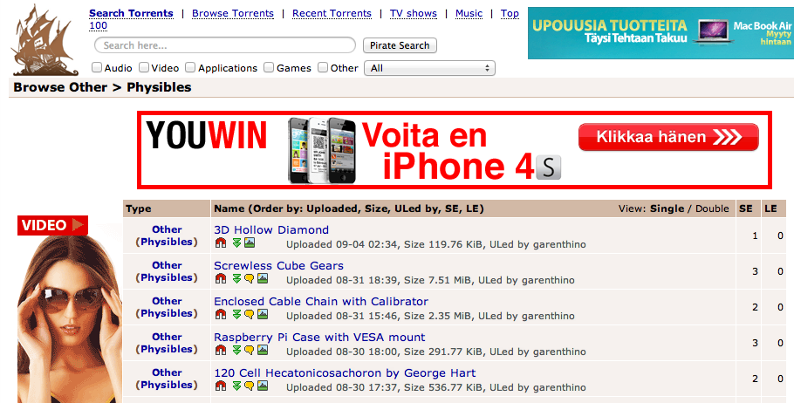
Close to the Napster of 3D Printing
A South Korean court ruled that both Apple and Samsung infringed on one another’s intellectual property and owe each other damages.
Source: http://thepiratebay.se/browse/605

Slide 5
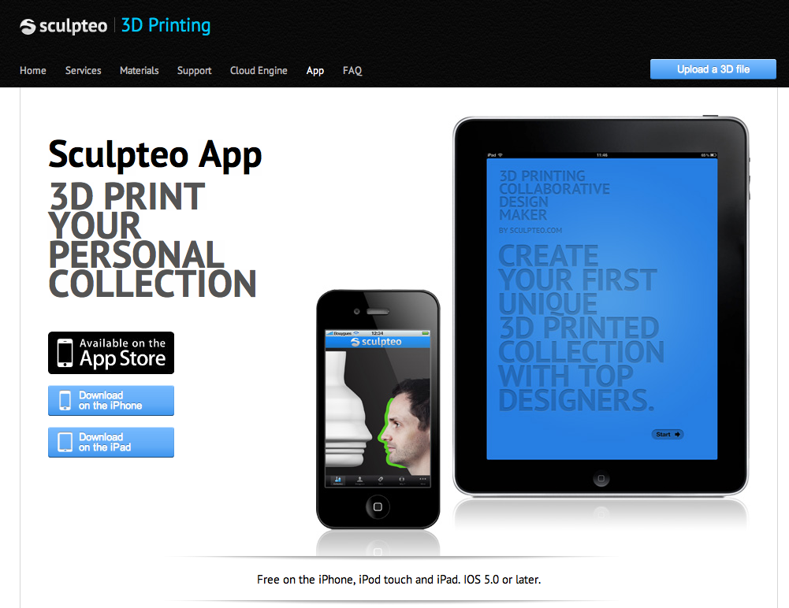
Digital Fabrication and copying...
BugLabs has been much more successful in offering completely open products.
Source: http://www.sculpteo.com/en/app/

Slide 6
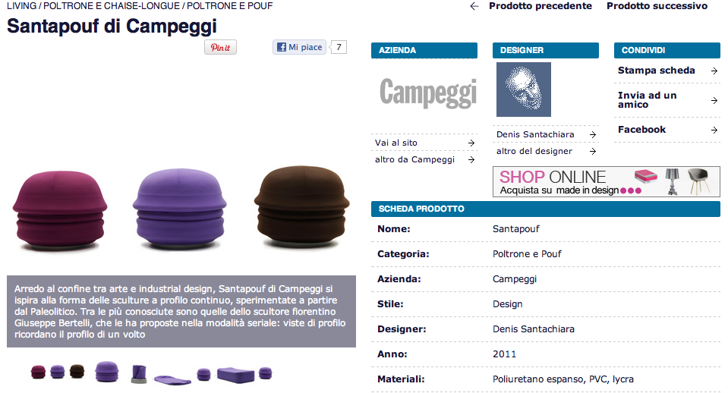
Digital Fabrication and copying...
BugLabs has been much more successful in offering completely open products.
Source: http://atcasa.corriere.it/catalogo/prodotti/Campeggi/Santapouf.shtml

Slide 7
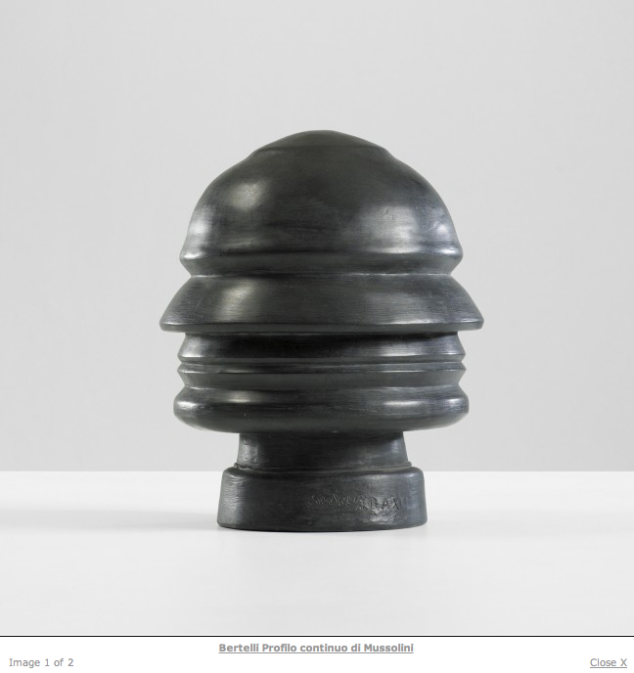
Digital Fabrication and copying...
BugLabs has been much more successful in offering completely open products.
Source: http://www.liveauctioneers.com/item/8263457

Slide 8
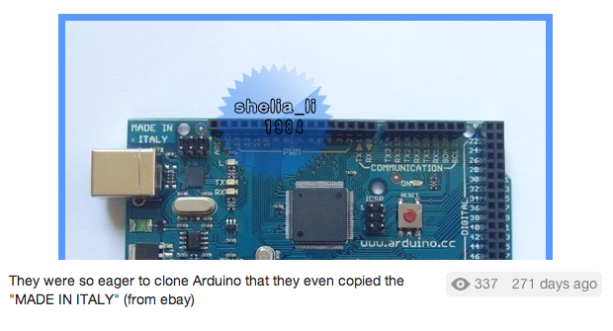
Digital Fabrication and copying... even the details
BugLabs has been much more successful in offering completely open products.
Source: http://twitpic.com/7t9879

Slide 9
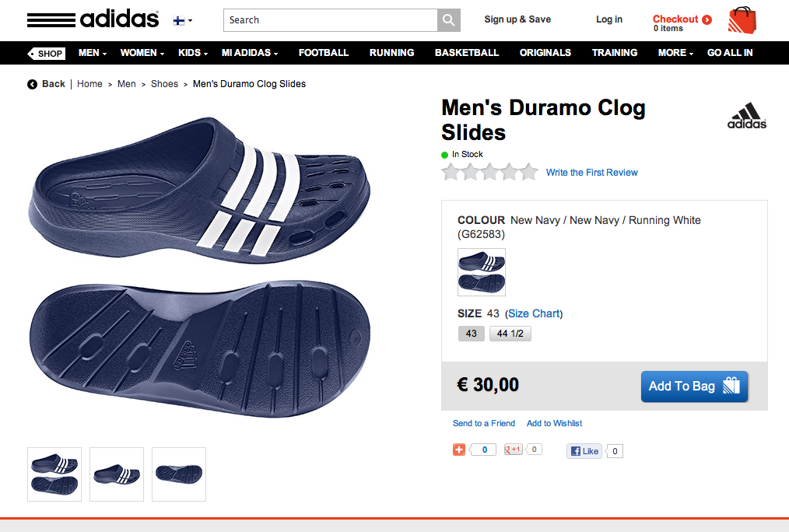
Fashion Design and copying... “piracy” ?
BugLabs has been much more successful in offering completely open products.
Source: http://www.adidas.fi/Men%27s-Duramo-Clog-Slides/G62583_640,fi_FI,pd.html

Slide 10
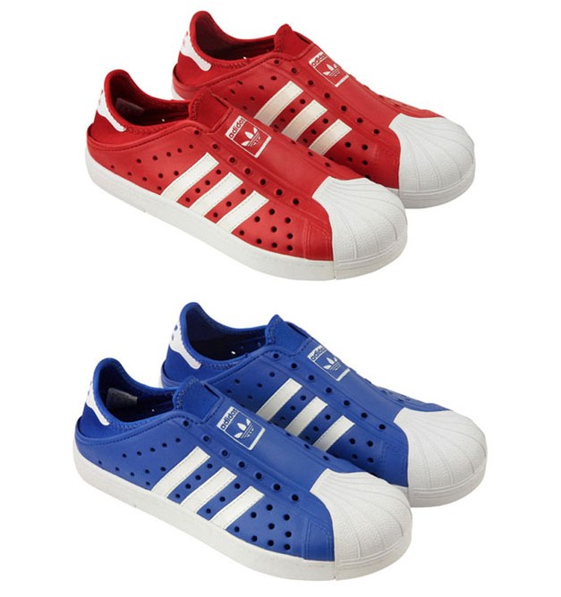
Fashion Design and copying... “piracy” ?
BugLabs has been much more successful in offering completely open products.
Source: http://www.refinedhype.com/hyped/entry/adidas-beachstar-sandal

Slide 11
Copyright ...
Copyright essentially attaches to every original creative work that is fixed in a tangible medium. This includes most things that are written, drawn, or designed. However, the copyright only protects the actual writing, drawing, or design itself, not the idea that it expresses.
Source: http://www.publicknowledge.org/it-will-be-awesome-if-they-dont-screw-it-up
Copyright =
* the right to copy (the rights to let or stop copying)
* the author's rights (the rights to be credited)

Slide 12
Patent ...
Patent protection is not granted automatically. An inventor must apply for a patent on her invention at the Patent and Trademark Office (PTO). The invention must be new, useful, and non-obvious. In making the application, the inventor must disclose information that would allow others to practice the invention. Finally, patent protection is significantly shorter in duration than copyright protection.
Once an object has been patented, all copies, regardless of the copier’s knowledge of the patent, infringe upon that patent. Simply stated, if you are using a 3D printer to reproduce a patented object, you are infringing on the patent.
Source: http://www.publicknowledge.org/it-will-be-awesome-if-they-dont-screw-it-up

Slide 13
Copyright, Patent and originality ...
In the world of copyright law, this intuition is correct. When a child in Seattle writes an ode to his pet dog, that work is protected by copyright. If, two years later, another child in Atlanta writes an identical ode to her pet dog (unaware of the first ode), the second work is also protected by copyright. This is possible because copyright allows for independent creation, even if the same work was independently created twice (or even more than twice). While a work must be original in order to receive copyright protection, the work does not need to be unique in the world.
Source: http://www.publicknowledge.org/it-will-be-awesome-if-they-dont-screw-it-up
However, and relevantly for reproducing 3D objects, patent law does have a novelty requirement. Patent law does not allow for parallel creation. Once an invention is patented every unauthorized reproduction of that invention is an infringement, whether the reproducer is aware of the original invention or not.
Source: http://www.publicknowledge.org/it-will-be-awesome-if-they-dont-screw-it-up

Slide 14
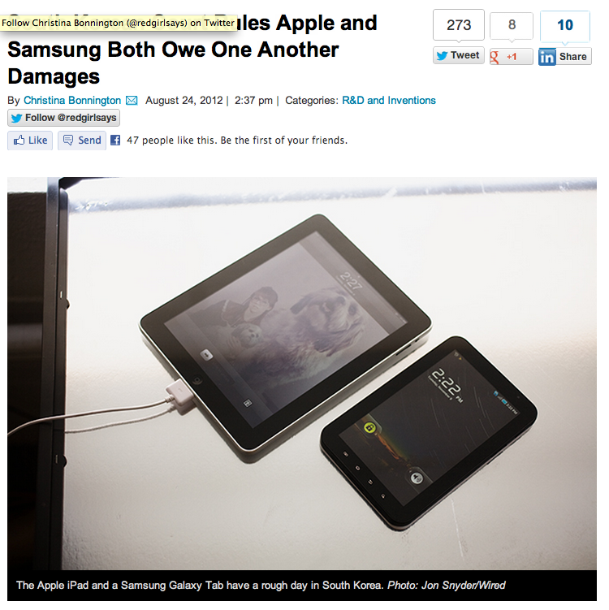
Watch out when you enter this game...
A South Korean court ruled that both Apple and Samsung infringed on one another’s intellectual property and owe each other damages.
Source: http://www.wired.com/gadgetlab/2012/08/s-korea-court-rules-damages/

Slide 15
Trademark ...
Trademark developed as a way to protect consumers, giving them confidence that a product marked with a manufacturer’s symbol was actually made and backed by that manufacturer. As a result, trademark is not designed to protect intellectual property per se. Intellectual property protection is instead a side effect of needing to protect the integrity of the mark.
Source: http://www.publicknowledge.org/it-will-be-awesome-if-they-dont-screw-it-up
Because trademark protection is specifically geared towards preventing consumer confusion in the marketplace, trademark infringement is described in terms of “use in commerce.” Unlike patent or copyright, it is not copying a trademark that creates a trademark violation. Instead, it is using that trademark in commerce (thus potentially confusing a consumer as to the origin of the product) that results in a violation.
Source: http://www.publicknowledge.org/it-will-be-awesome-if-they-dont-screw-it-up

Slide 16
Trade Dress
Trademark protection can extend beyond a logo affixed to a product to include the design of the product itself. However, in order to extend protection to product design, courts have required that trade dress acquire a distinct association with a specific manufacturer. Acquiring this type of distinctiveness takes time, and must be proven by survey results or some other proof of association in the eyes of the general public. As a result most product designs, even unique designs intended “to render the product more useful or more appealing,” will not be protected as trade dress.
Source: http://www.publicknowledge.org/it-will-be-awesome-if-they-dont-screw-it-up

Slide 17
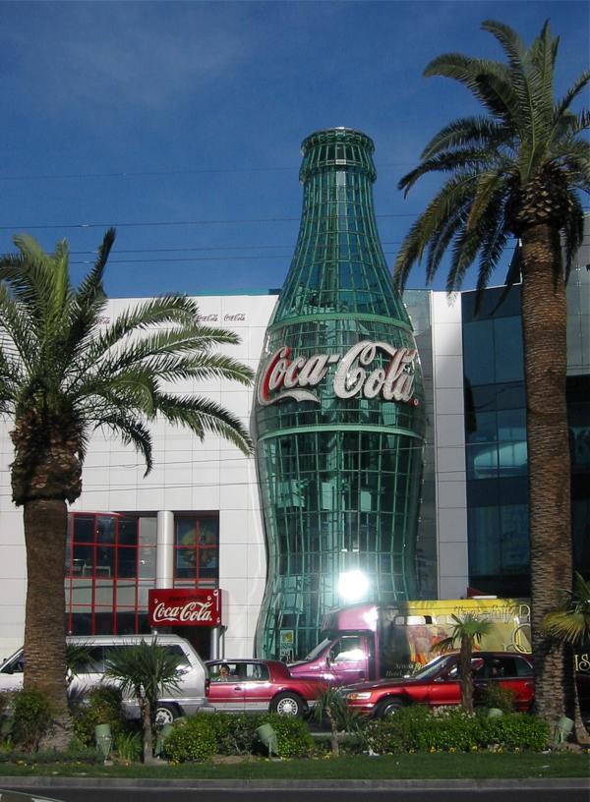
Trade Dress, an example
A very recognizable shape...
Source: http://en.wikipedia.org/wiki/Coca_cola

Slide 18
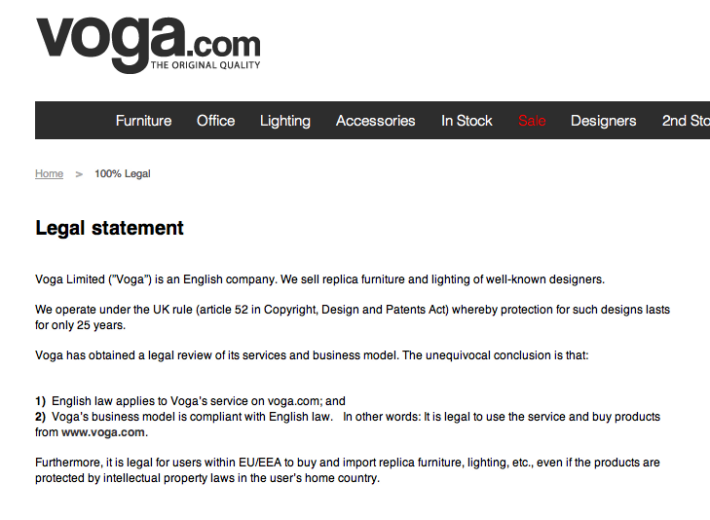
Be careful: every country has its laws...
A South Korean court ruled that both Apple and Samsung infringed on one another’s intellectual property and owe each other damages.
Source: http://www.voga.com/is-it-legal/
http://www.core77.com/blog/business/scandinavian_design_piracy_company_utilizes_uk_copyright_loophole_22318.asp

Slide 19
Licensing your project ...
The main benefit of product licensing is that you do not have all of the risk and headaches that necessarily come with running your own business. It is quite true that you could make a lot more money if you sold your own idea (if you did not screw things up at any number of places along the way).
Source: http://www.core77.com/blog/columns/product_licensing_in_an_era_of_open_innovation_22953.asp
Young designers often gasp when hearing that a good royalty rate might be 5% of wholesale cost (around 2% of retail price)—"but it is MY idea!" Seasoned designers understand that a designed product (not to mention one that is not engineered, sourced, and fully developed and tested) is but a small part of the business equation.
Source: http://www.core77.com/blog/columns/product_licensing_101_so_lets_talk_money_23366.asp

Slide 20




11. License: 01 – Review conditions
Source:
http://creativecommons.org/
Attribution: Licensees may copy, distribute, display and perform the work and make derivative works based on it only if they give the author or licensor the credits in the manner specified by these.
Non commercial: Licensees may copy, distribute, display, and perform the work and make derivative works based on it only for noncommercial purposes.
No Derivate Works: Licensees may copy, distribute, display and perform only verbatim copies of the work, not derivative works based on it.
Share alike: Licensees may distribute derivative works only under a license identical to the license that governs the original work.

Slide 21
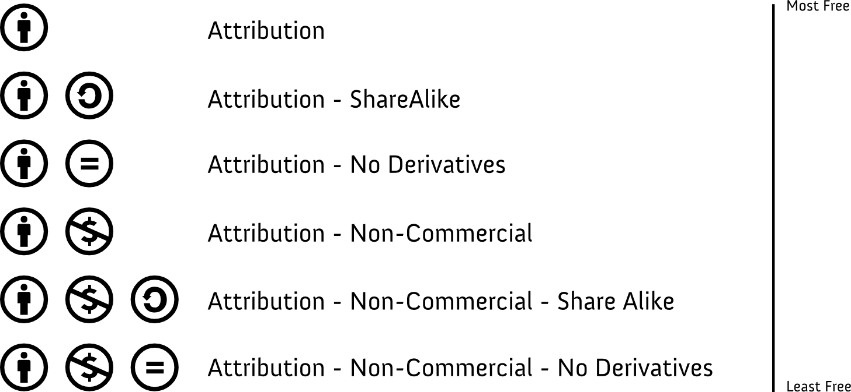
11. License: 02 – Select license
Source:
http://creativecommons.org/

Slide 22

Everything is a Remix #01
BugLabs has been much more successful in offering completely open products.
Source: http://vimeo.com/14912890

Slide 23
Everything is a Remix #02
BugLabs has been much more successful in offering completely open products.
Source: http://vimeo.com/19447662

Slide 24
Everything is a Remix #03
BugLabs has been much more successful in offering completely open products.
Source: http://vimeo.com/25380454

Slide 25
Everything is a Remix #04
BugLabs has been much more successful in offering completely open products.
Source: http://vimeo.com/36881035

Slide 26
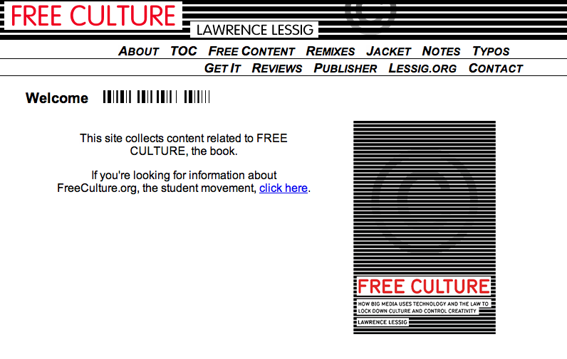
For a further reading on the topic ...
BugLabs has been much more successful in offering completely open products.
Source: http://www.free-culture.cc/

Slide 27
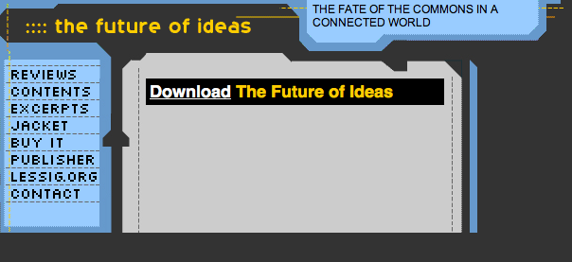
For a further reading on the topic ...
BugLabs has been much more successful in offering completely open products.
Source: http://www.the-future-of-ideas.com/download/

Slide 28
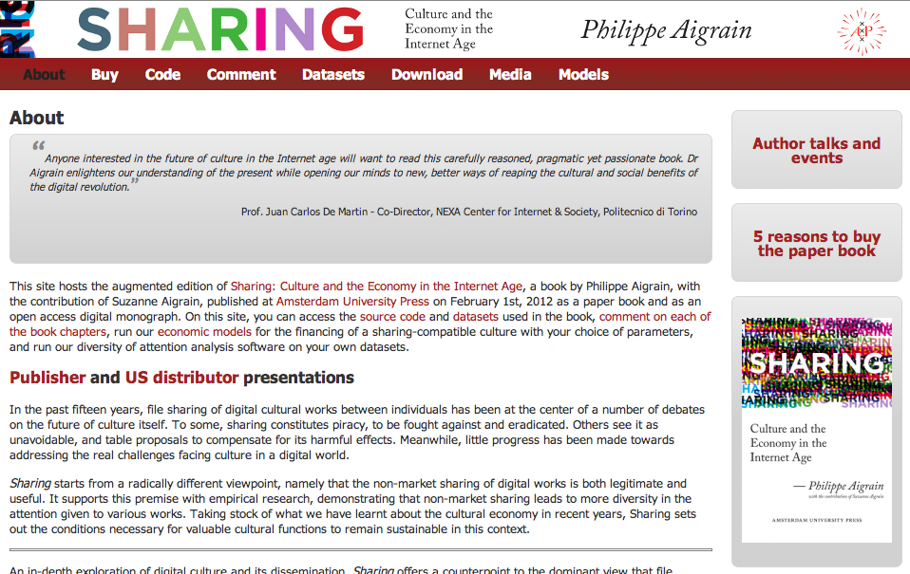
For a further reading on the topic ...
An in-depth exploration of digital culture and its dissemination, Sharing offers a counterpoint to the dominant view that file sharing is piracy.
Source: http://www.sharing-thebook.com/content/about

Slide 29
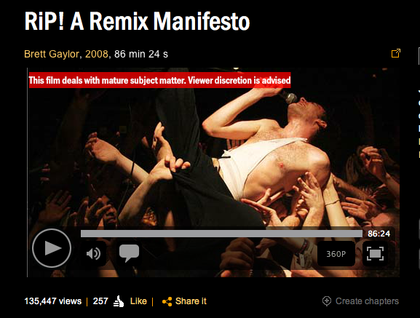
For a further watching on the topic ...
BugLabs has been much more successful in offering completely open products.
Source: http://ripremix.com/ http://www.nfb.ca/film/rip_a_remix_manifesto/

Slide 30
02.
Exercise: choose a Creative Commons license for your project, and add it to the Readme.md file.

Slide 31
03.
Open Design: mass collaboration enabled by the Internet and other tools

Slide 32
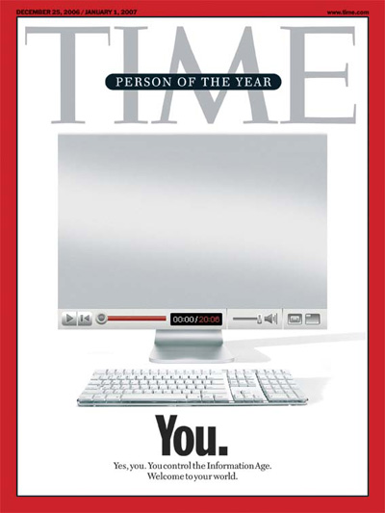
Web 2.0: User-generated content + comment
So successful that they just announced a partnership with Ford Car.
Source: http://www.time.com/time/magazine/article/0,9171,1570810,00.html

Slide 33
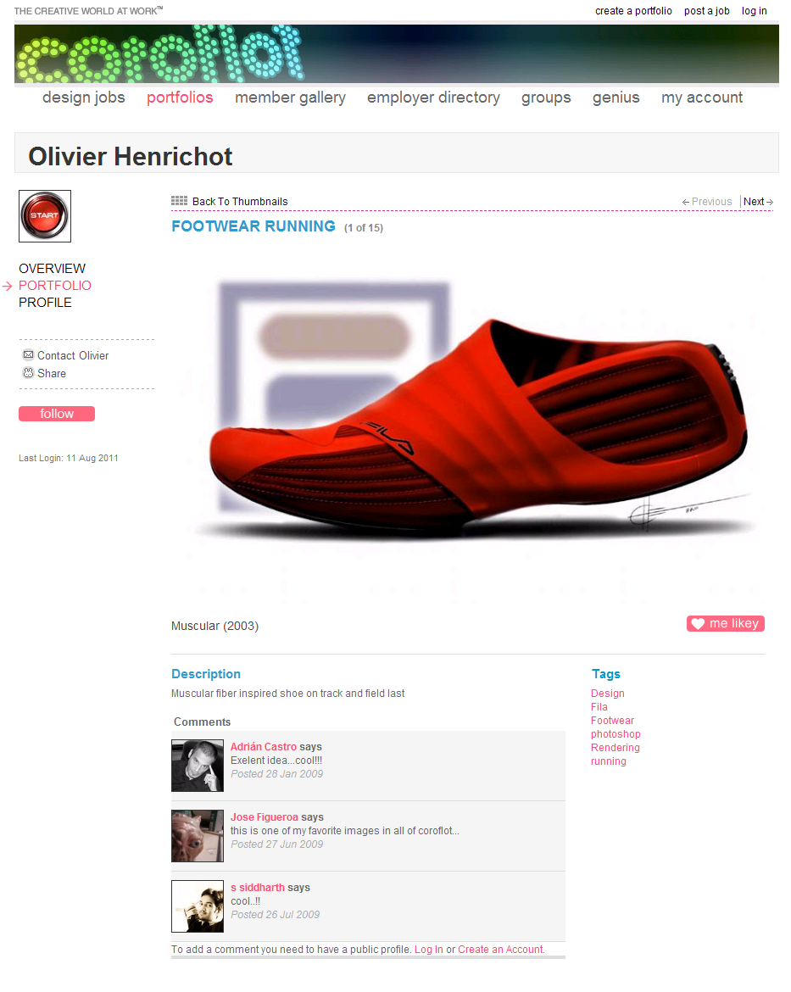
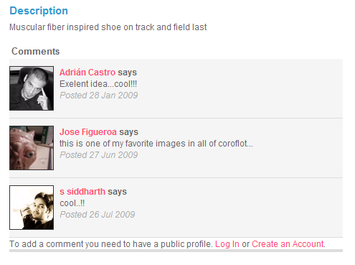
Web 2.0: User-generated content + comment
So successful that they just announced a partnership with Ford Car.
Source: http://www.coroflot.com/heo/FOOTWEAR-RUNNING/1

Slide 34
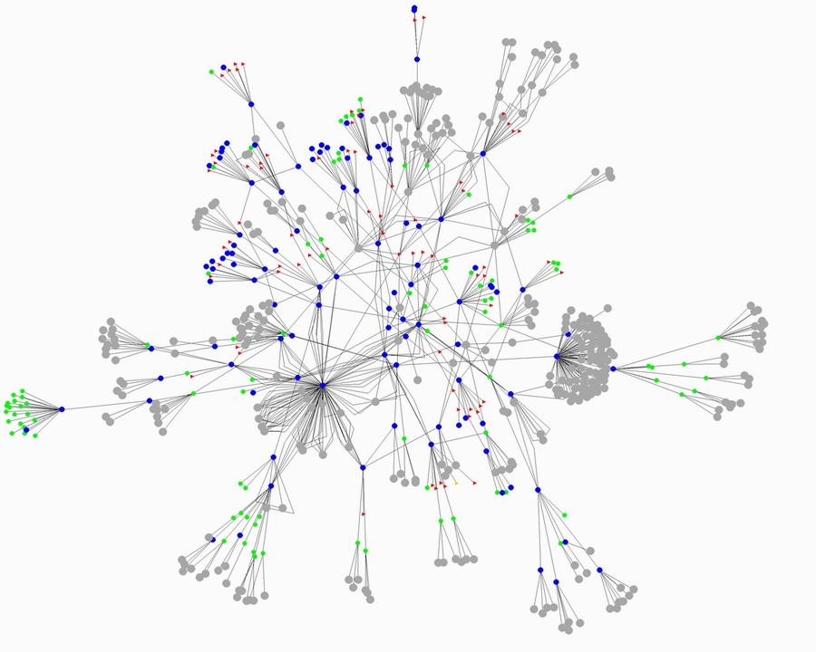
Peer-to-Peer: A new architecture of interactions
So successful that they just announced a partnership with Ford Car.
Source: http://home.comcast.net/~gregory.bray/

Slide 35
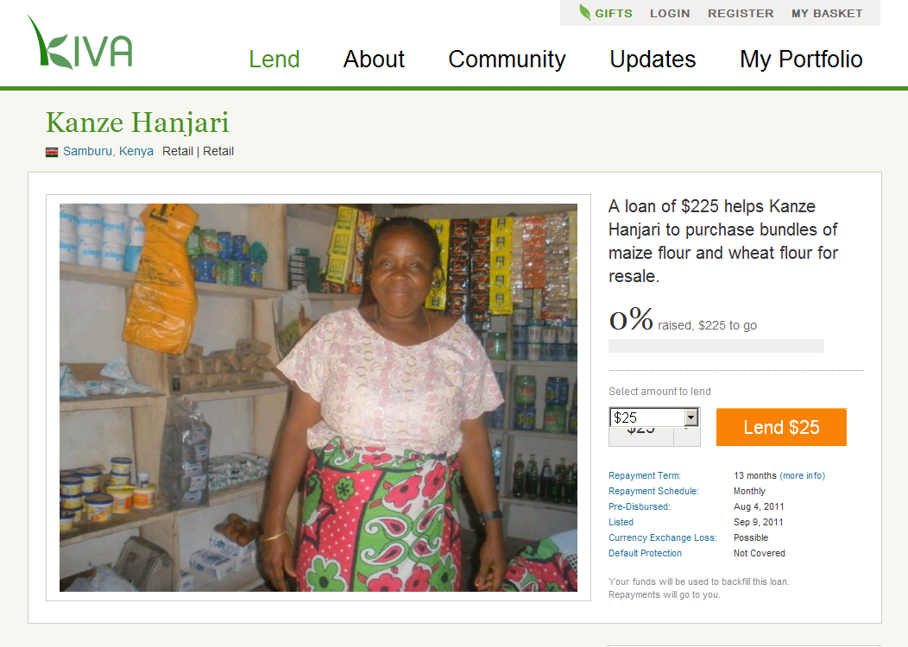
Peer-to-Peer: A new kind of service (design)
So successful that they just announced a partnership with Ford Car.
Source: http://www.kiva.org/lend/333427

Slide 36
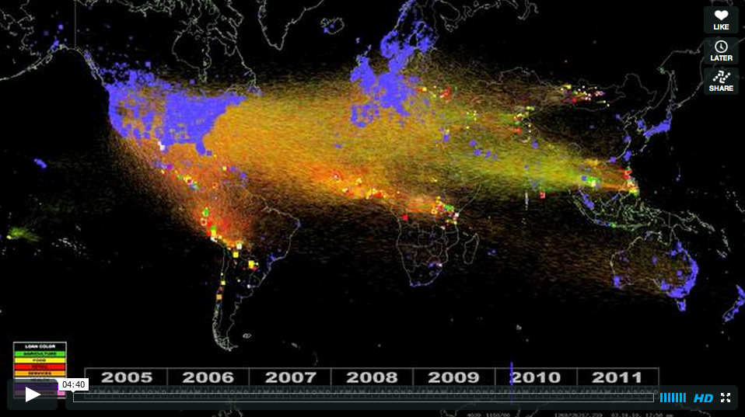
Peer-to-Peer: A new kind of service (design)
So successful that they just announced a partnership with Ford Car.
Source: http://vimeo.com/28413747

Slide 37
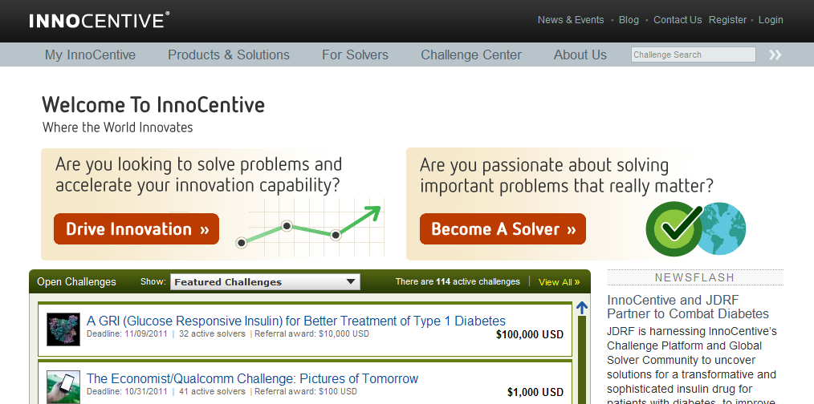
Crowdsourcing: Outsourcing to the online crowd
So successful that they just announced a partnership with Ford Car.
Source: http://www.innocentive.com/

Slide 38
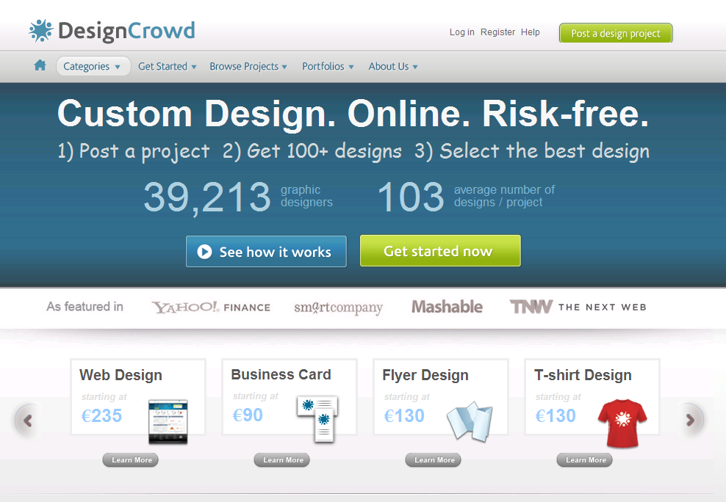
Crowdsourcing: Outsourcing to the online crowd
So successful that they just announced a partnership with Ford Car.
Source: http://www.designcrowd.com/

Slide 39
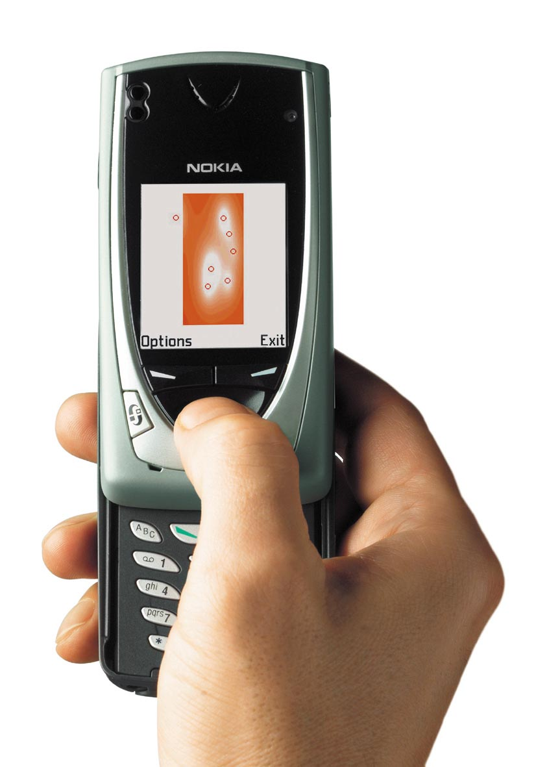
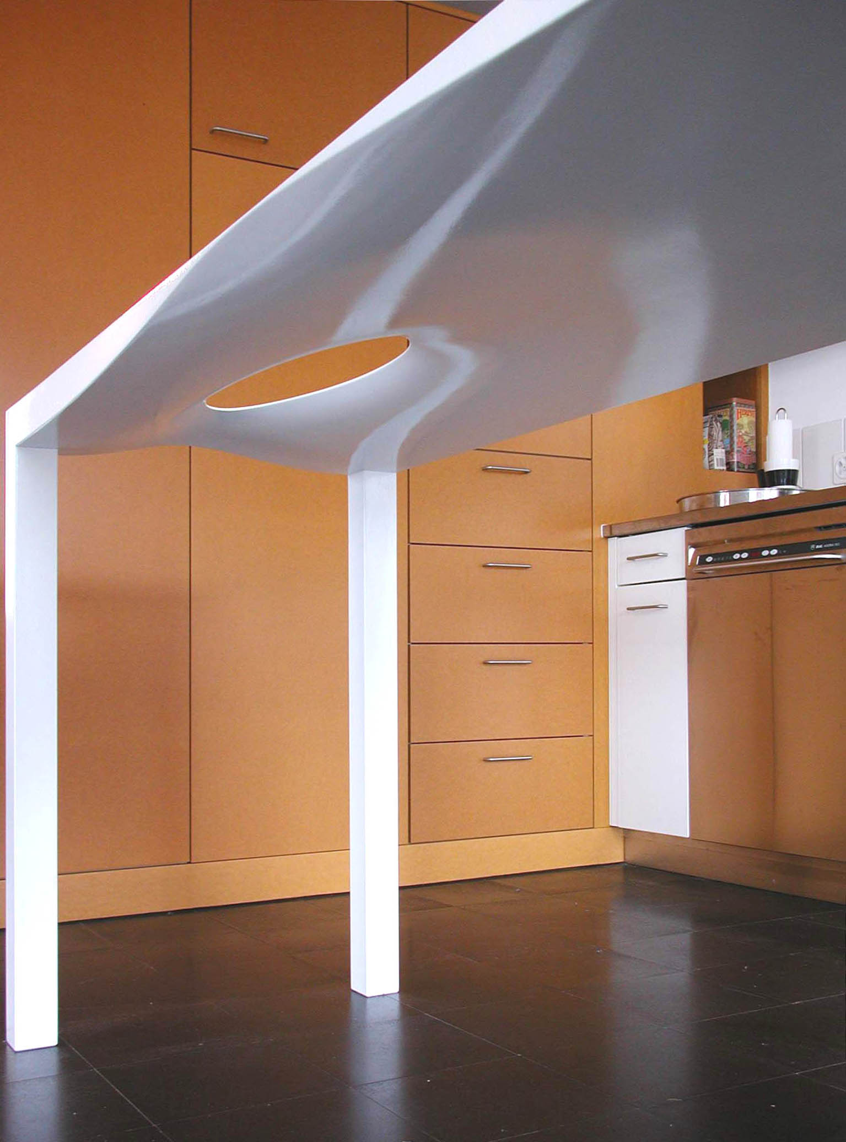
Mobile: Single user designing, no collaboration
It is not only a matter of tool: not only on a PC!
Source: http://www.mshape.com/

Slide 40
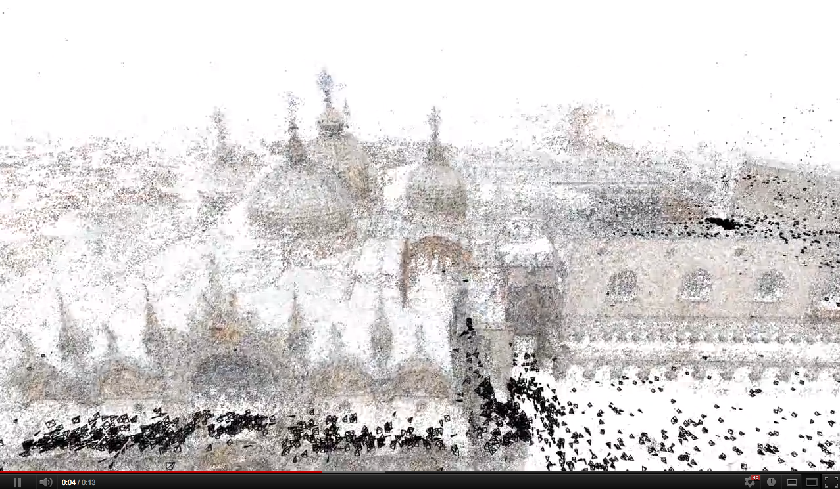
Mobile: Smart Mobs, Ubiquitous Computing
We could even (re)build a design from noncoordinated users.
Source: http://grail.cs.washington.edu/rome/ http://youtu.be/HrgHFDPJHXo

Slide 41
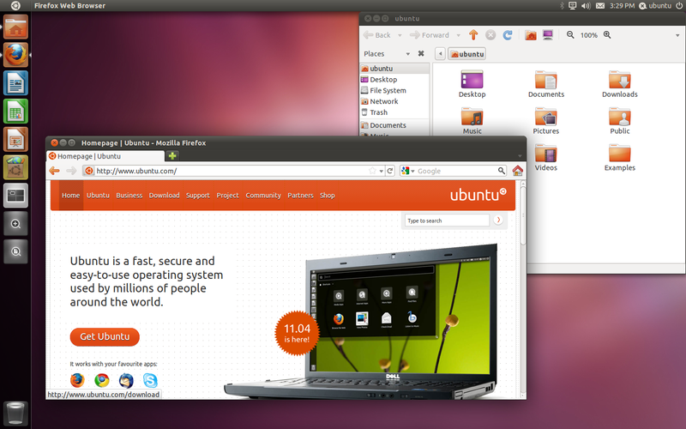
Open Source: open collaborative development
Source: http://en.wikipedia.org/wiki/Ubuntu_%28operating_system%29
So successful that they just announced a partnership with Ford Car.
Source: http://www.buglabs.net/ford-buglabs

Slide 42
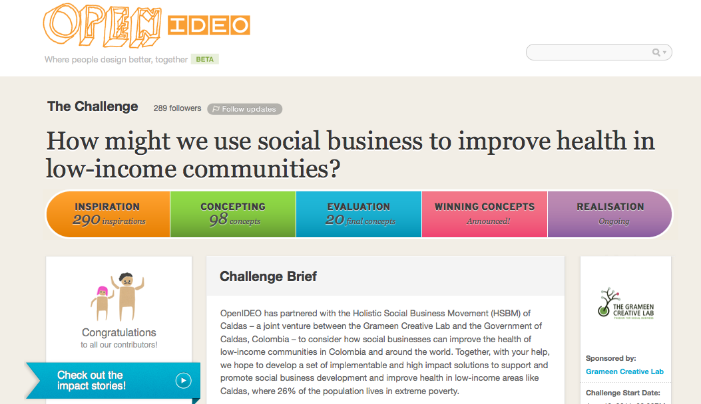
And hybrid models... like OpenIDEO
Crowdsourcing 50% + Web 2.0 30% + Open Source 20%.
Source: http://www.openideo.com/

Slide 43
What is Open Source? A generic definition
A (software) project published with a license that facilitates its access + modifying + sharing in a collaborative way.
A (software) project developed collaboratively by a community, based not on hierarchy but on reputation.

Slide 44
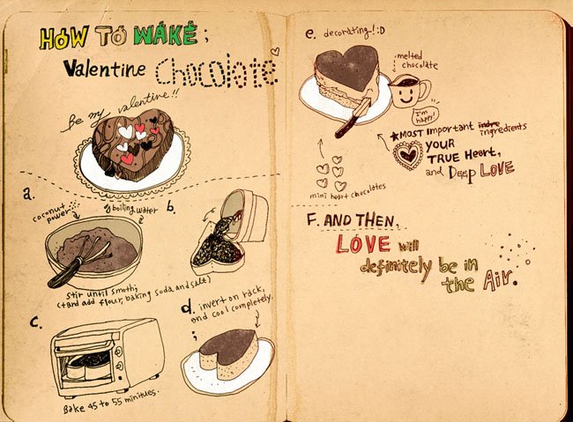
Why Open Source in Software?
Source Code (human readable) --> Binary Code (machine readable)
Source: http://www.flickr.com/photos/nyoin/3342043239/

Slide 45

Why Open Source in Software?
So successful that they just announced a partnership with Ford Car.
Source: http://www.flickr.com/photos/exlibris/2997090116/

Slide 46


Why Open Source in Software?
So successful that they just announced a partnership with Ford Car.
Source: http://www.flickr.com/photos/ladymixy-uk/3650120464/

Slide 47
Open Source Everywhere...
“Software is just the beginning … open source is doing for mass innovation what the assembly line did for mass production. Get ready for the era when collaboration replaces the corporation.”
Thomas Goetz, Wired November 2003
Source: http://www.wired.com/wired/archive/11.11/opensource.html
Open Source as promising way to organise communities.
Source: http://www.buglabs.net/ford-buglabs

Slide 48
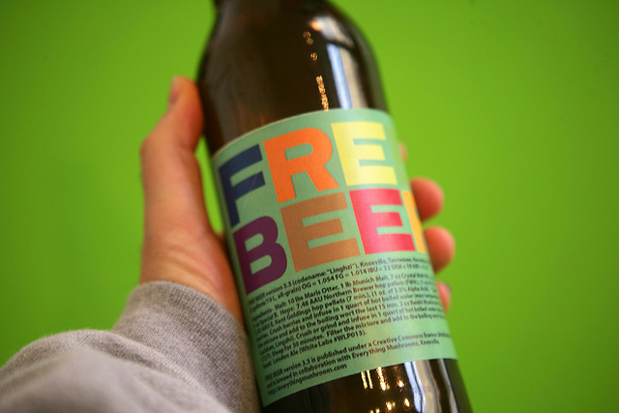
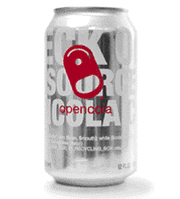
Open Drinks
So successful that they just announced a partnership with Ford Car.
Source: http://en.wikipedia.org/wiki/OpenCola_(drink) http://en.wikipedia.org/wiki/Free_Beer
http://www.flickr.com/photos/16038409@N02/2327138220/in/photostream

Slide 49
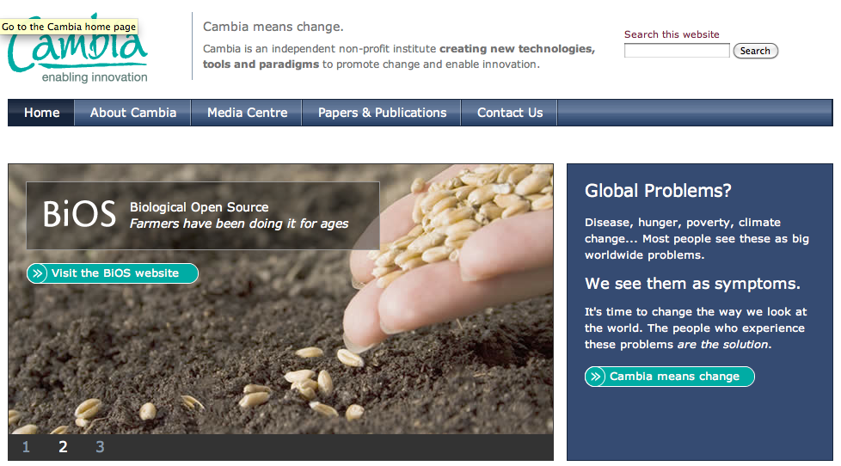
Open Source Everywhere... Open Biotechnology
So successful that they just announced a partnership with Ford Car.
Source: http://www.cambia.org/

Slide 50

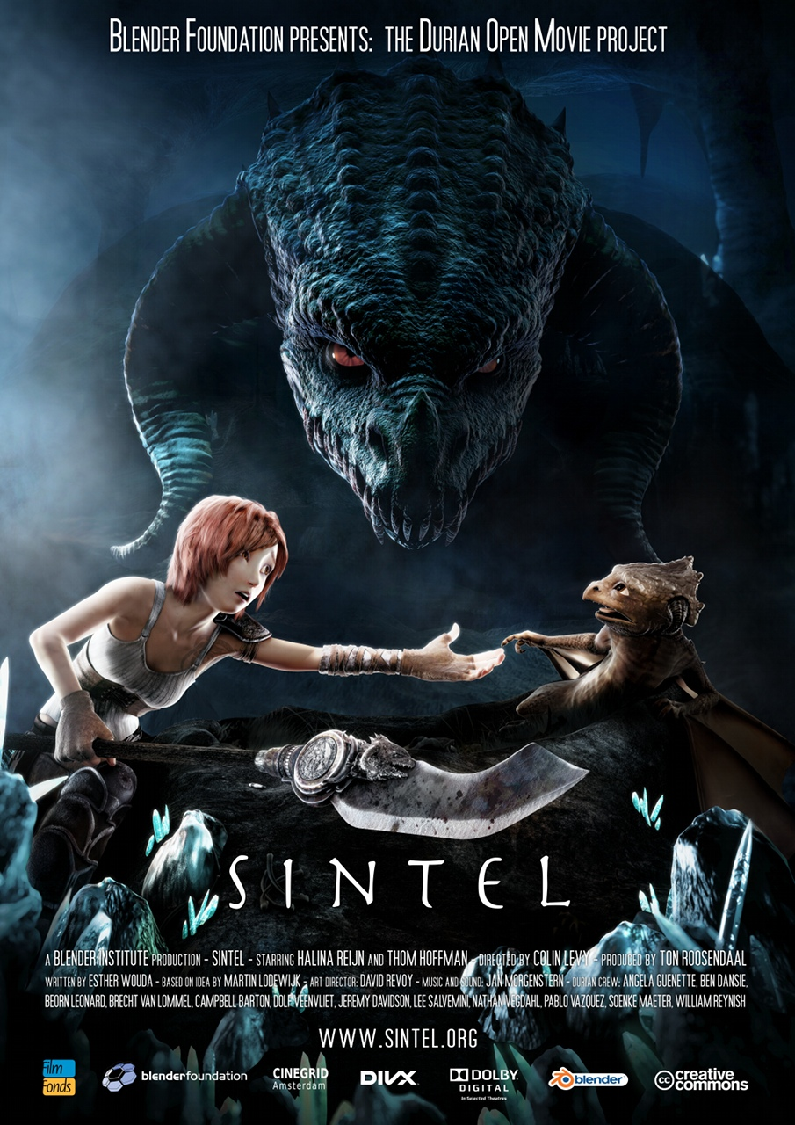

Open Movies + Videogames
Done with and for Blender (Open Source 3D modeling software).
Source: http://www.elephantsdream.org/ http://www.bigbuckbunny.org/ http://www.sintel.org/

Slide 51
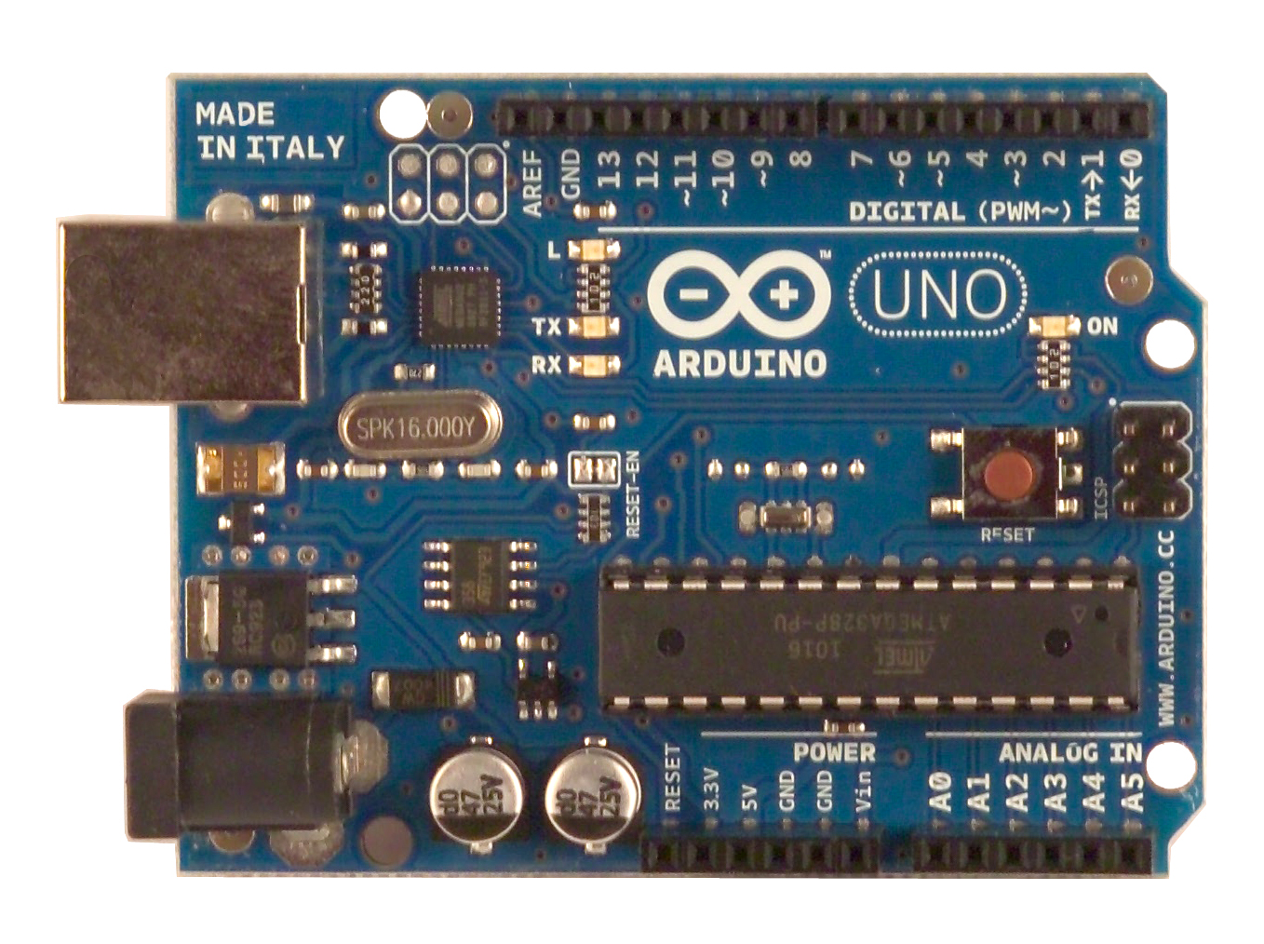
Open Hardware
So successful that they just announced a partnership with Ford Car.
Source: http://arduino.cc

Slide 52
What is Open Design? A generic definition
a project published with a license that facilitates its sharing and that can be “compiled” or “manufactured” locally.
* sharing
* collaboration
* open licenses
* code --> artifact
Open Design refers to every kind of design projects that can be shared in a digital format over a network.

Slide 53
Open Typography
ABCDEFGHIJKLMNOPQRSTUVWXYZ
abcdefghijklmnopqrstuvwxyz
ÈÉÊËĒĔĖĘĚȄȨȆḔḖḘḚḜẸẺẼỀẾỂỄỆ
èéêěèéêëēĕėęěȅȩȇḕḕḗḗḙḛḝẹẻẽềếểễềếểễ
o̊őo̍o̖o̗o̘o̙o̜o̹o̝o̞o̟o̠ọoooo̧ǫo̩o̪o̫o̬oo̯oo̱o̼o̒o
“‹«.:?!©*¶§&/(‖)[¦]{|}€†‡@®™¿¡;,»›”
¤¢$£€¥₡₢₣₤#01234567891⁄41⁄23⁄4%₦₧
The first open source font (2001) by Victor Gaultney, with a specific license: SIL Open Font License (OFL).
Source: http://scripts.sil.org/cms/scripts/page.php?site_id=nrsi&item_id=Gentium

Slide 54
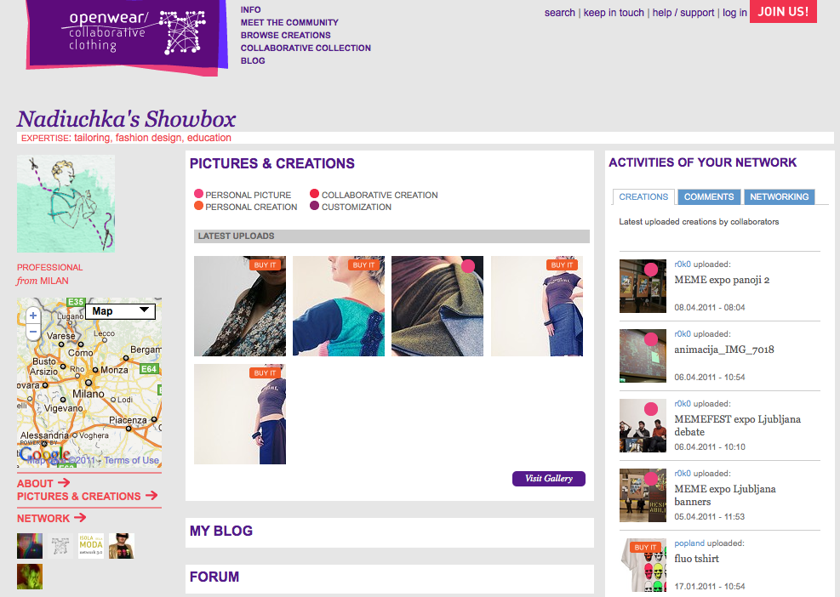
Open Fashion Design
So successful that they just announced a partnership with Ford Car.
Source: http://www.openwear.org/

Slide 55
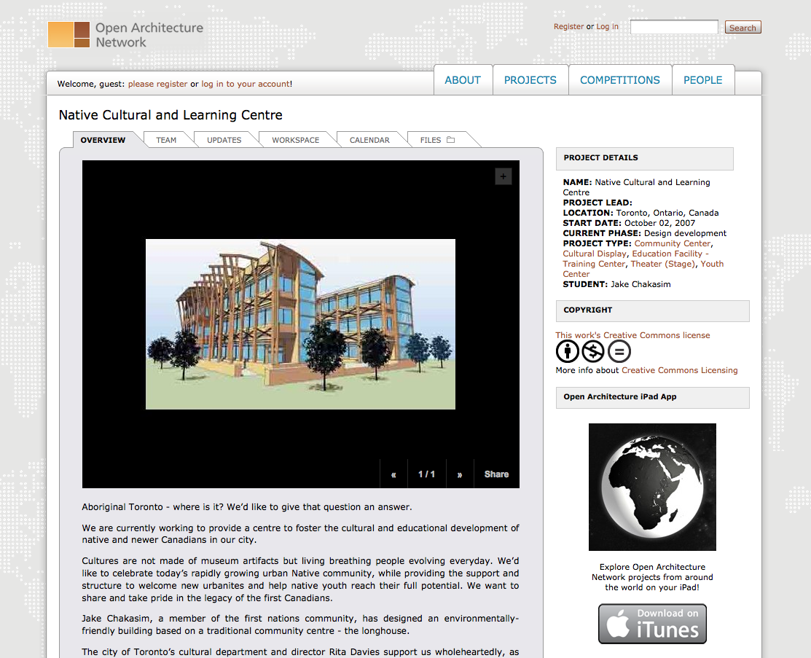
Open Architecture
So successful that they just announced a partnership with Ford Car.
Source: http://openarchitecturenetwork.org/

Slide 56
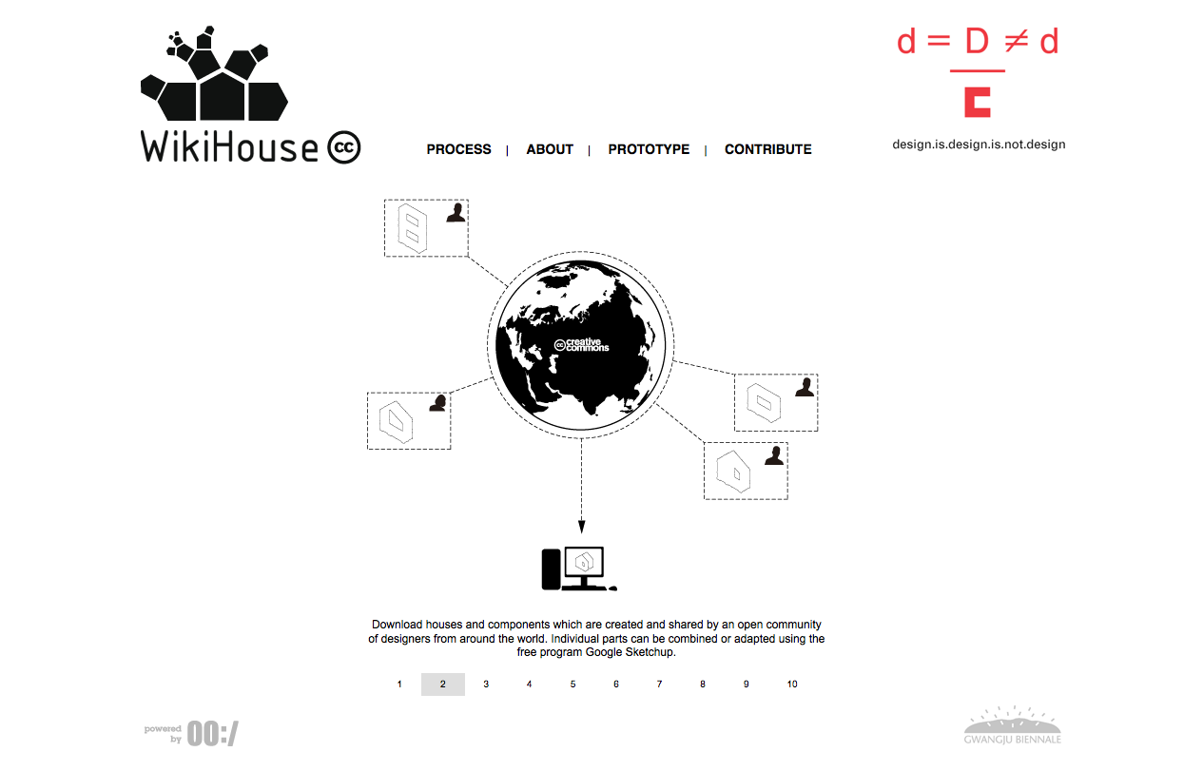
Open Architecture
So successful that they just announced a partnership with Ford Car.
Source: http://www.wikihouse.cc/

Slide 57
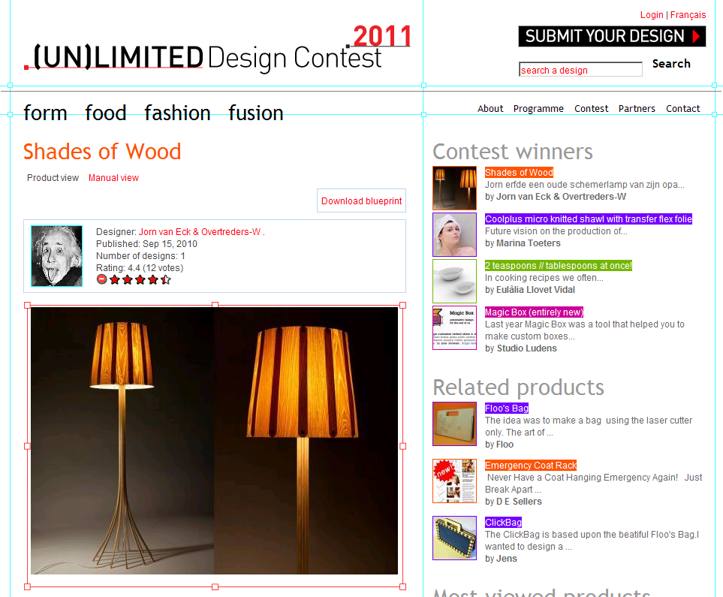
(Open) Design competitions
Digital fabrication and FabLabs open new possibilities for Design competitions and Open Design.
Source: http://unlimiteddesigncontest.org/

Slide 58
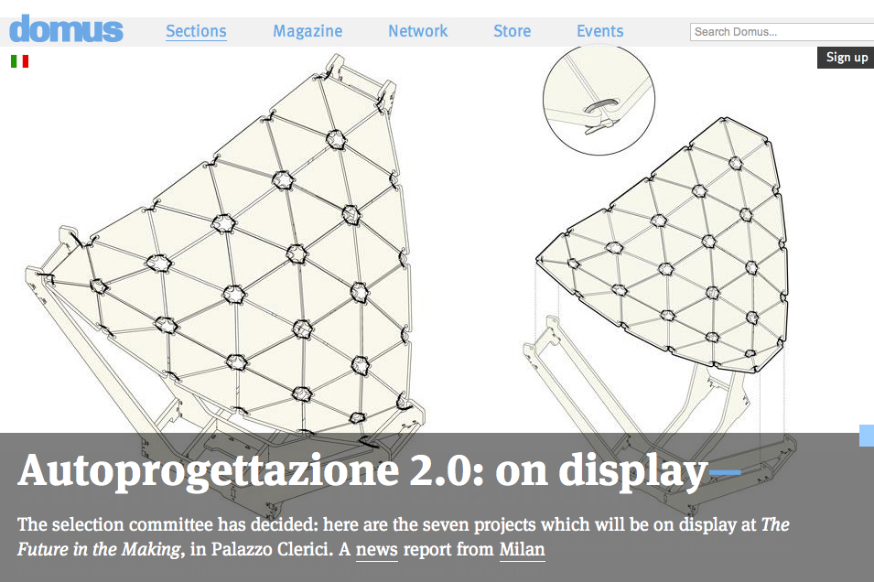
(Open) Design competitions
Digital fabrication and FabLabs open new possibilities for Design competitions and Open Design.
Source: http://www.domusweb.it/en/upcoming-event/call-for-ideas-autoprogettazione-20--/
http://www.domusweb.it/en/news/autoprogettazione-20-on-display/

Slide 59
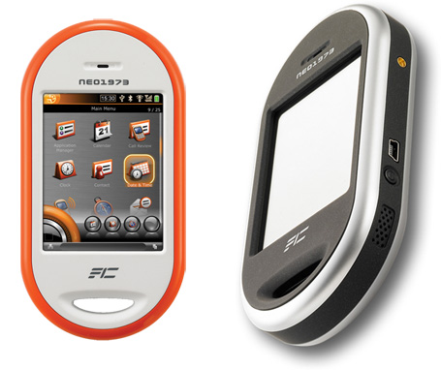
Develop (open) products and services
OpenMoko was the first product to be completely open: open hardware, open source software, open design.
Source: http://wiki.openmoko.org/wiki/Main_Page

Slide 60
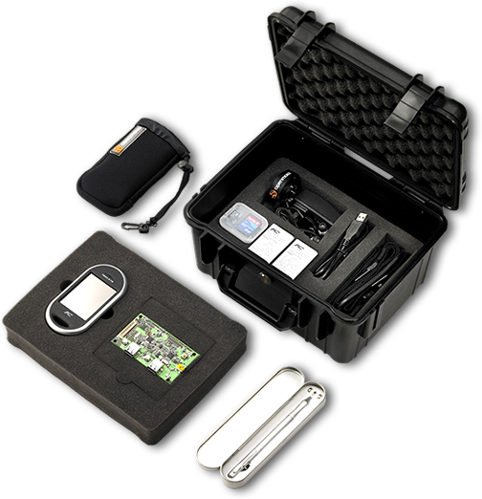
Develop (open) products and services
OpenMoko was the first product to be completely open: open hardware, open source software, open design.
Source: http://wiki.openmoko.org/wiki/Main_Page

Slide 61
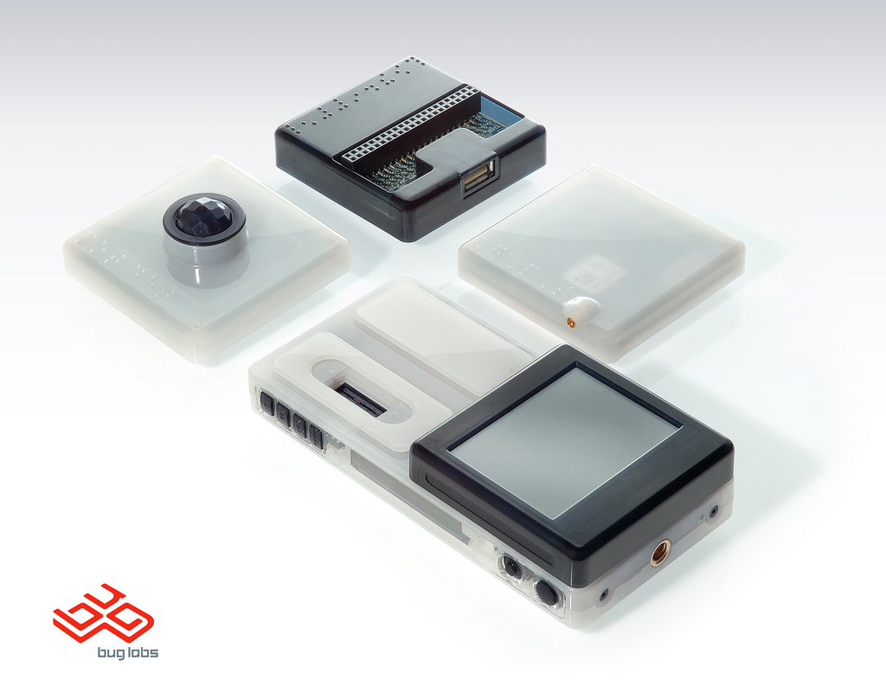
Open: Hardware, Software, Design
BugLabs has been much more successful in offering completely open products.
Source: http://www.buglabs.net/

Slide 62
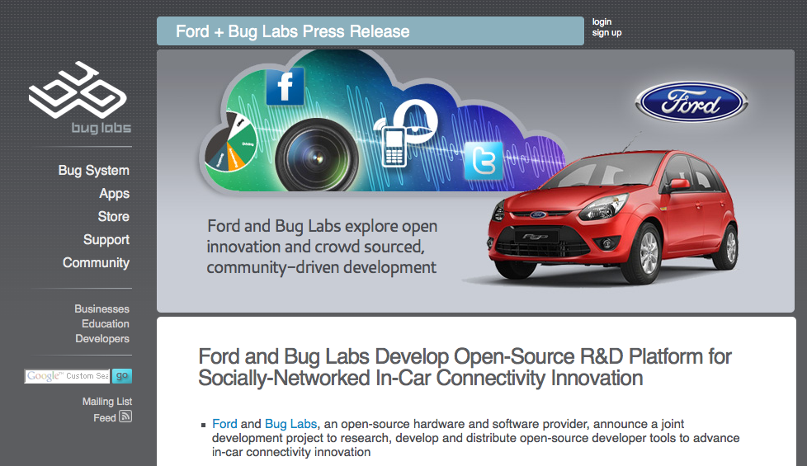
BugLabs + Ford
So successful that they just announced a partnership with Ford Car.
Source: http://www.buglabs.net/ford-buglabs

Slide 63
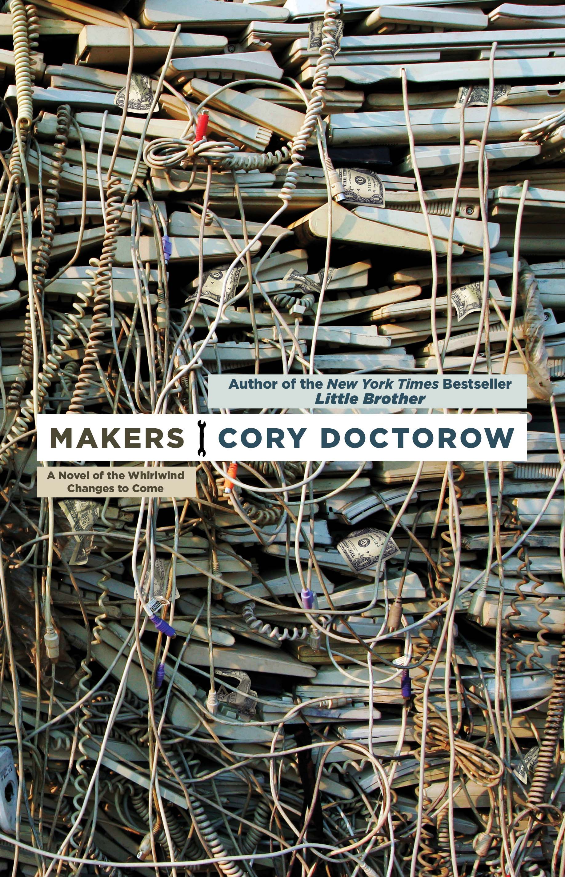
Open Design: (almost) already successful
When you have a sci-fi novel from a popular autor about open design and makers, they are not underground any longer.
Source: http://craphound.com/makers/download/

Slide 64
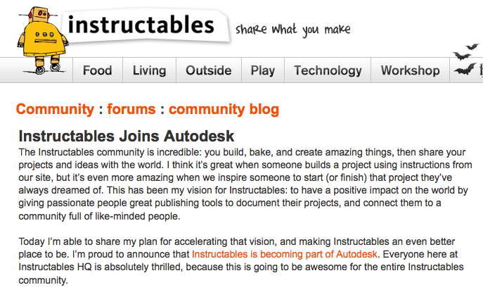
Open Design: (almost) already successful
And when probably the biggest CAD design software house buys an open design community, there must be money ahead!
Source: http://www.instructables.com/community/Instructables-Joins-Autodesk/
http://techcrunch.com/2011/08/01/autodesk-acquires-diy-community-instructables/

Slide 65
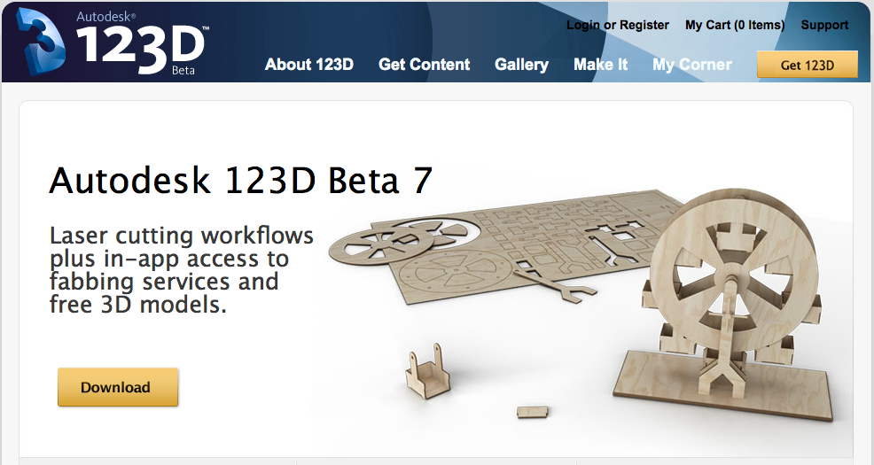
Open Design: (almost) already successful
Source: http://www.123dapp.com/
And when probably the biggest CAD design software house offers freeware software for makers, there must be money ahead!
Source: http://www.123dapp.com/

Slide 66
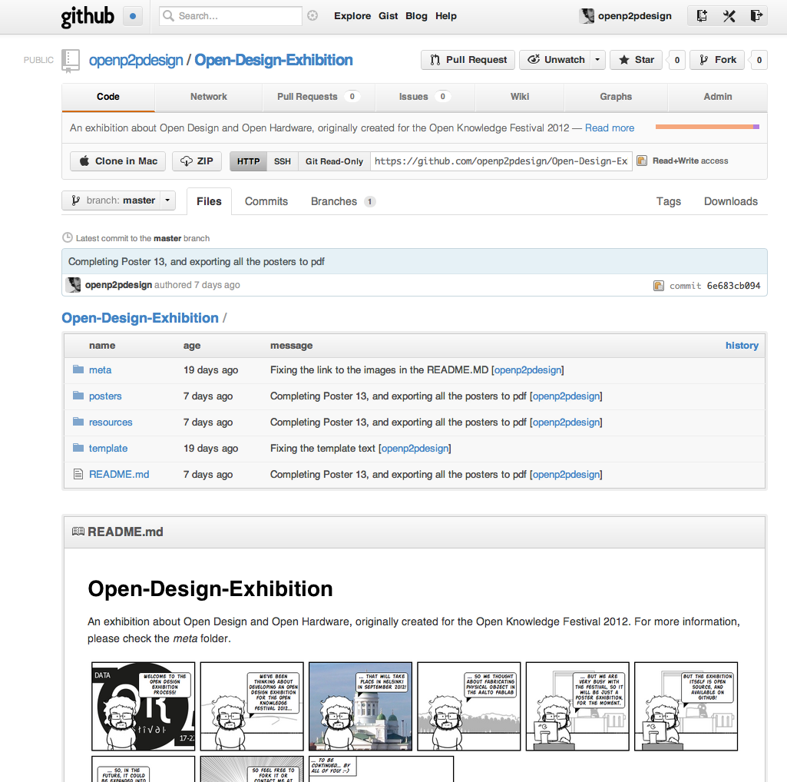
More on the Open Design Exhibition!
Source: http://www.123dapp.com/
And when probably the biggest CAD design software house offers freeware software for makers, there must be money ahead!
Source: https://github.com/openp2pdesign/Open-Design-Exhibition

Slide 67
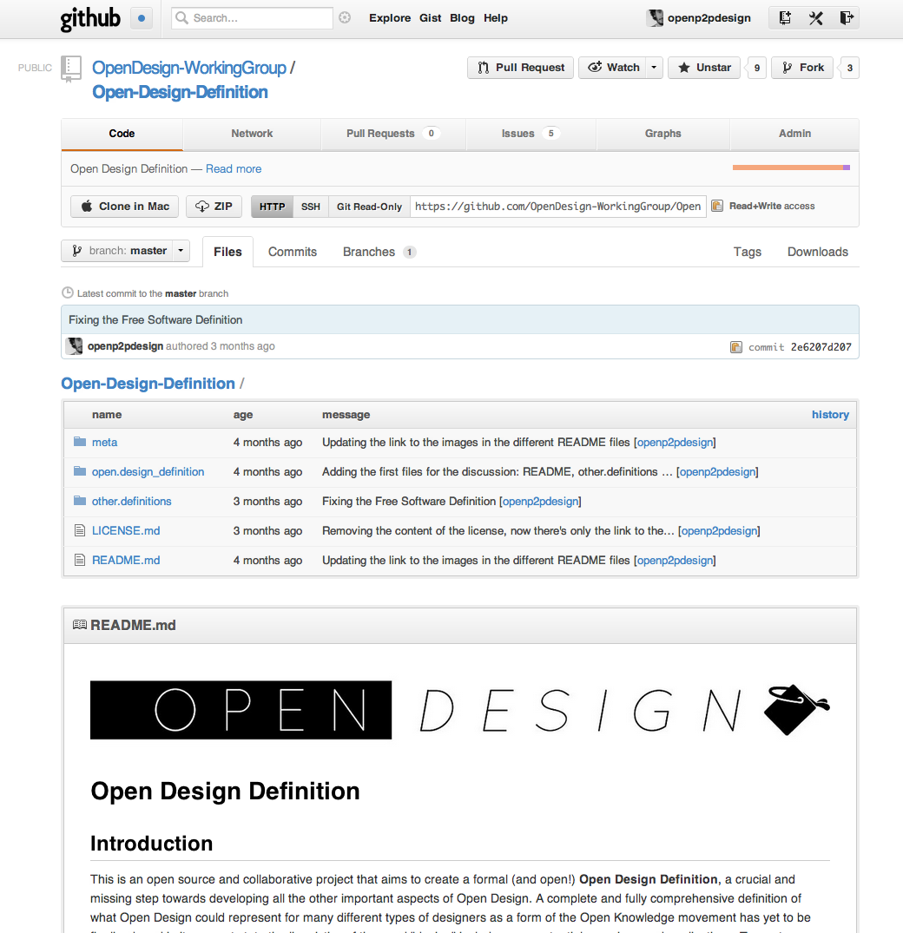
… and participate in the Open Design Definition!
Source: http://www.123dapp.com/
And when probably the biggest CAD design software house offers freeware software for makers, there must be money ahead!
Source: https://github.com/OpenDesign-WorkingGroup/Open-Design-Definition

Slide 68
OpenMoko's failure
“OpenMoko found that the cost of producing 3G smartphones was prohibitively high for independent device makers and it was simply not possible to do without using proprietary firmware.”
“The mobile industry is increasingly embracing open source, [...] but the motivation is faster and cheaper development, not user empowerment.”
--> An Open project can't go alone without:
* building a collaborative system with other players (even “not open” ones)
* decide to open only when it's the best option
So successful that they just announced a partnership with Ford Car.
Source: http://arstechnica.com (http://bit.ly/3LyLh6)
Source: http://www.buglabs.net/ford-buglabs

Slide 69
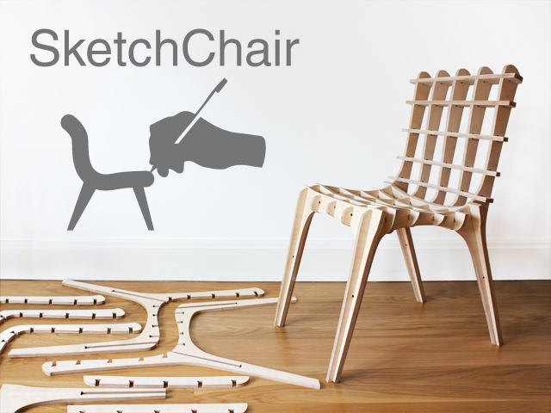
Sketch Chair: Open Design as code
So successful that they just announced a partnership with Ford Car.
Source: http://www.sketchchair.cc/
Source: http://www.buglabs.net/ford-buglabs

Slide 70
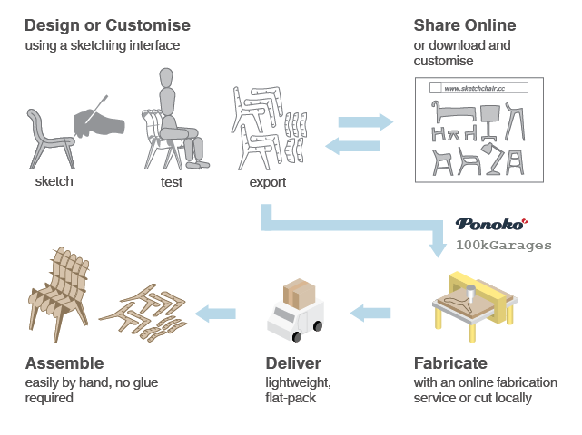
Sketch Chair: Open Design as code
So successful that they just announced a partnership with Ford Car.
Source: http://www.sketchchair.cc/
Source: http://www.buglabs.net/ford-buglabs

Slide 71

The current status of Open Design: going mainstream
Source:
http://craphound.com/makers/download/
http://www.wired.com/magazine/2010/01/ff_newrevolution/
So successful that they just announced a partnership with Ford Car.
Source: http://www.buglabs.net/ford-buglabs

Slide 72



The current status of Open Design: going mainstream
Source:
http://opendesignnow.org/
http://www.droog.com/projects/events/design-for-download/
http://www.droog.com/blog/category/design-for-download-2/
So successful that they just announced a partnership with Ford Car.
Source: http://www.buglabs.net/ford-buglabs

Slide 73
The current status of Open Design
* single persons or small groups design a project and then just publish it online
* lack of new tools, processes, systems that enable designers and users in developing open design projects
--> where is the collaboration?
--> where are the open processes?
--> where are the communities?
So successful that they just announced a partnership with Ford Car.
Source: http://www.buglabs.net/ford-buglabs

Slide 74
The current status of Open Design
From: torvalds@klaava.Helsinki.FI (Linus Benedict Torvalds)
Newsgroups: comp.os.minix
Subject: What would you like to see most in minix?
Summary: small poll for my new operating system
Message-ID:
Date: 25 Aug 91 20:57:08 GMT
Organization: University of Helsinki
Hello everybody out there using minix -
I'm doing a (free) operating system (just a hobby, won't be big and
professional like gnu) for 386(486) AT clones. This has been brewing
since april, and is starting to get ready. I'd like any feedback on
things people like/dislike in minix, as my OS resembles it somewhat
(same physical layout of the file-system (due to practical reasons)
among other things).
I've currently ported bash(1.08) and gcc(1.40), and things seem to work.
This implies that I'll get something practical within a few months, and
I'd like to know what features most people would want. Any suggestions
are welcome, but I won't promise I'll implement them :-)
Linus (torvalds@kruuna.helsinki.fi)
Source: http://www.cs.cmu.edu/~awb/linux.history.html
So successful that they just announced a partnership with Ford Car.
Source: http://www.buglabs.net/ford-buglabs

Slide 75

… the experience of a user of Open Source software
Source: http://sourceforge.net/
So successful that they just announced a partnership with Ford Car.
Source: http://www.buglabs.net/ford-buglabs

Slide 76

… the big picture of Open Source: the process
So successful that they just announced a partnership with Ford Car.
Source: http://code.google.com/p/codeswarm/
http://vimeo.com/1093745

Slide 77

… the big picture of Open Source: the process
So successful that they just announced a partnership with Ford Car.
Source: http://code.google.com/p/gource/
http://youtu.be/aPk1BqK8zzI

Slide 78

… the big picture of Open Source: the process
So successful that they just announced a partnership with Ford Car.
Source: http://www.michaelogawa.com/research/storylines/

Slide 79
A more systemic definition of Open Design
A collaborative distributed system of design & manufacturing
* sharing
* collaboration
* open licenses
* open / distributed projects with commons based peer production governance
* open and distributed manufacturing technologies
A system of agents that:
* use
* design
* manufacture
* market
* distribute
* manage the end-of-life
* ...

Slide 80
04.
Metadesign: designing the design processes and tools

Slide 81


05. Open Design Activity Poster

Slide 82


What can we do for Open Design projects? Metadesign
Metadesign is the design of the design tools, processes and systems
* research and share design knowledge
* research and share business models
* research and share financial and environmental sustainability
* design and share design tools
* design and share design processes
* facilitate design & manufacturing & end-of-life systems
* facilitate the distributed creativity
For designers
For communities
For users
For enterprises

Slide 83
Open P2P Design and openp2pdesign.org come from...
* March 2005, Milan (Polytechnic)
* a master degree thesis in industrial + service design
* Design researchers were studying Design+Locality:
* Spark! Design and Locality (Europe) http://www2.uiah.fi/virtu/spark/index.html
* Me.Design (Italy) http://www.sistemadesignitalia.it/sdi/ricerche/medesign/index.php
--> How can we design for a locality and its community?
--> How can we enable the participation of a community in the design process?

Slide 84


Designing Open Collaborative projects: Thinkcycle
First open and collaborative design process (2000-2007)
Source: http://www.thinkcycle.org (now closed) http://web.media.mit.edu/~nitin/thesis/

Slide 85


P2P Service Design: Open Health (RED - Design Council)
First p2p public services by design (2004-2006)
Source: http://www.designcouncil.info/mt/RED/ (now inactive) http://www.participle.net/

Slide 86

April 2006, Master Degree Thesis
Reti Collaborative.
Il design per una auto-organizzazione Open Peer-to-Peer
(Collaborative Networks.
Design for an Open Peer-to-Peer
self-organization)
Tutor: Ezio Manzini
Politecnico di Milano, Faculty of Design
You can download it here:
http://www.openp2pdesign.org/source

Slide 87

September 2008, a shorter book
There's also a short (and updated) version in English (and Spanish and Italian) too!
openp2pdesign.org_1.1
http://www.issuu.com/openp2pdesign
http://www.scribd.com/openp2pdesign
http://stores.lulu.com/openp2pdesign

Slide 88
Where should we use Open P2P Design?
* for community-centered projects
* for community-based services / businesses
* for projects that are distributed in a territory / locality
* for complex projects
* for participatory processes
* for open processes and projects
In Open Design, Open Innovation, Open Business, Open Government...

Slide 89
Why Open P2P Design?
* mass-collaboration/crowdsourcing --> change in the role of designers
* being subjected to mass collaboration --> designing it
* communities generate innovations --> more opportunities for designers
--> designers can be enablers / facilitators of distributed creativity
--> designers still have more knowledge and expertise, just now they are part of collaborative networks
--> designers could even adopt open strategies

Slide 90
And the Design research and practice is changing
Design by author -->
Design by marketing -->
User-centred Design -->
User-experience Design -->
Activity-centred Design -->
Co-Design --> …
* Researching how to design better projects for the people that use them

Slide 91
What does Open P2P Design design?
}
Activity Theory +
Service Design (+ Activity Theory) +
Action Planning (Urbanism) +
Social Network Analysis +
...
--> Open Source Software development process + P2P dynamics
Self-reflexive (metadesign): activity self-analysis + design -->
* analyse and design the design activity itself
* easier to participate and to suggest changes
* shared understanding of the collaborative process
Activity

Slide 92

Activity Theory
Activity theory is an approach in psychology that aims to understand individual / social entities, through an analysis of the genesis, structure, and processes of their activities.
Source: http://www.helsinki.fi/cradle/chat.htm http://www.helsinki.fi/cradle/activitysystem.htm

Slide 93
Metadesign with Open P2P Design ?
Analysis +
Concept design +
Prototyping +
Manufacturing +
Distribution +
Support +
End of life +
...
}
Design process:
A systemic activity comprising set of actions (sub-activities), with their own tools, roles, rules

Slide 94
What about the source code for Open P2P Design?
}
Participation matrix +
Activity analysis +
Social Network Analysis +
Storyboard +
System map +
Service blueprint +
Motivation matrix +
Activity description +
…
Design project +
Process Design
}
Community analysis
}
Activity Design
}
Open Design

Slide 95

Open P2P Design Process (Participation Matrix)

Slide 96

A toolkit for the Open P2P Design methodology
Download it here:
http://www.issuu.com/openp2pdesign
http://www.scribd.com/openp2pdesign
http://www.openp2pdesign.org/source

Slide 97
01. The context of the project
01.01 Choose a community, and choose one of its activities that may have problems we want to solve with our Open Design project, that is a collaborative design activity:
....................................................................................................................................................................................................................................................................................................................................................................................................................................................................................................................................................................
or
01.01 Choose a community, and choose an existing activity, in order to see how it can be improved through opening it to an open community around a collaborative activity
....................................................................................................................................................................................................................................................................................................................................................................................................................................................................................................................................................................

Slide 98
02. Define the project
02.01 Which is the local context in which our project is being developed and then realized?
....................................................................................................................................................................................................................................................................................................................................................................................................................................................................................................................................................................................................................................................................................................................................................................................
02.02 Which is the community we design with and for this project?
....................................................................................................................................................................................................................................................................................................................................................................................................................................................................................................................................................................................................................................................................................................................................................................................

Slide 99
02. Define the project
02.03 Which is the problem / opportunity we may find within this community we want to design with/for?
..............................................................................................................................
......................................................................................................................................................................................................................................................................................................................................................................................................................................................................................................................................................................................................................................................
02.04 Which is the reason, our motivations, our mission, that move us to design this project with open and p2p dynamics?
....................................................................................................................................................................................................................................................................................................................................................................................................................................................................................................................................................................................................................................................................................................................................................................................

Slide 100
02. Define the project
02.05 How do we see the future of this community? Which is the vision we have that our collaborative process will achieve in the community and for us?
....................................................................................................................................................................................................................................................................................................................................................................................................................................................................................................................................................................................................................................................................................................................................................................................
02.06 What do we want to change and communicate with this collaborative process? Which are our values and the values of the project?
....................................................................................................................................................................................................................................................................................................................................................................................................................................................................................................................................................................................................................................................................................................................................................................................

Slide 101

03. Process: Activities and participation

Slide 102
04. Activity Analysis
01. Which is the activity we are analysing here?
.........................................................................................................................................
.........................................................................................................................................
.........................................................................................................................................
.........................................................................................................................................
02. Who is the subject of this activity? Who does carry out this activity?
...........................................................................................................................................................................................................................................................................................................................................................................................................................
03. Through the activity, the subject is working actively on an object. What is this object?
...........................................................................................................................................................................................................................................................................................................................................................................................................................

Slide 103
04. Activity Analysis
04. Which are the rules that this subject has to follow within the activity?
.........................................................................................................................................
.........................................................................................................................................
.........................................................................................................................................
05. How is the activity organized among the people? How is the work divided? Which are the roles?
.........................................................................................................................................
.........................................................................................................................................
.........................................................................................................................................
06. Which are the artifacts (materials, tools, communications, knowledge) that are needed in order to run the activity?
.........................................................................................................................................
.........................................................................................................................................
.........................................................................................................................................

Slide 104
04. Activity Analysis
07. Which is the bigger context (the bigger community where this collaborative community takes place) where this activity runs?
.........................................................................................................................................
.........................................................................................................................................
.........................................................................................................................................
07.01 Which are the reputation levels that are present in this activity? How do people structure reputation?
.........................................................................................................................................
.........................................................................................................................................
.........................................................................................................................................
07.02 Which kind of participation is available to the participants? Top-down / emergent bottom-up / a marketplace service that let people establish p2p connections?
.........................................................................................................................................
.........................................................................................................................................
.........................................................................................................................................

Slide 105
04. Activity Analysis
08. What does the activity gets in the end? Which are the results, objectives, outcomes the activity looks for?
.........................................................................................................................................
.........................................................................................................................................
.........................................................................................................................................
09. Are there any contradictions (that is, sources of possible changes) within one of the previous elements? [Primary contradictions]
.........................................................................................................................................
.........................................................................................................................................
.........................................................................................................................................
10. Are there any contradictions (that is, sources of possible changes) between two (or more) of the previous elements? [Secondary contradictions]
.........................................................................................................................................
.........................................................................................................................................
.........................................................................................................................................

Slide 106
04. Activity Analysis
11. Are there any contradictions (sources of possible changes) between the existing results, objectives, outcomes and probably new ones, coming from outside? [Tertiary contradictions]
.........................................................................................................................................
.........................................................................................................................................
.........................................................................................................................................
12. Are there any contradictions (sources of possible changes) between this activity and its neighbor activities? [Quaternary contradictions]
.........................................................................................................................................
.........................................................................................................................................
.........................................................................................................................................
13. Which are the possible changes that these contradictions can bring?
.........................................................................................................................................
.........................................................................................................................................
.........................................................................................................................................

Slide 107
05. Activity Design: Open Design Activity
01. Which is the activity we are analysing here?
.........................................................................................................................................
.........................................................................................................................................
.........................................................................................................................................
.........................................................................................................................................
02. Who is the subject of this activity? Who does carry out this activity?
...........................................................................................................................................................................................................................................................................................................................................................................................................................
03. Through the activity, the subject is working actively on an object. What is this object?
...........................................................................................................................................................................................................................................................................................................................................................................................................................

Slide 108
05. Activity Design: Open Design Activity
04. Which are the rules that this subject has to follow within the activity?
.........................................................................................................................................
.........................................................................................................................................
.........................................................................................................................................
05. How is the activity organized among the people? How is the work divided? Which are the roles?
.........................................................................................................................................
.........................................................................................................................................
.........................................................................................................................................
06. Which are the artifacts (materials, tools, communications, knowledge) that are needed in order to run the activity?
.........................................................................................................................................
.........................................................................................................................................
.........................................................................................................................................

Slide 109
05. Activity Design: Open Design Activity
07. Which is the bigger context (the bigger community where this collaborative community takes place) where this activity runs?
.........................................................................................................................................
.........................................................................................................................................
.........................................................................................................................................
07.01 Which are the reputation levels that are present in this activity? How do people structure reputation?
.........................................................................................................................................
.........................................................................................................................................
.........................................................................................................................................
07.02 Which kind of participation is available to the participants? Top-down / emergent bottom-up / a marketplace service that let people establish p2p connections?
.........................................................................................................................................
.........................................................................................................................................
.........................................................................................................................................

Slide 110
05. Activity Design: Open Design Activity
08. What does the activity gets in the end? Which are the results, objectives, outcomes the activity looks for?
.........................................................................................................................................
.........................................................................................................................................
.........................................................................................................................................
--> We (obviously) don't design contradictions but we should look for them continuously, in order to understand when and where the collaborative Open Design activity could be changed and improved.

Slide 111



06. System Map
The System Map is very useful to visualize and design interactions as flows between people. Its elements are:
* material flows
* information flows
* financial flows
+ roles
+ border of the system
Source: http://www.mepss.nl/index.php?p=tool&l4=W21

Slide 112

06. System Map

Slide 113

07. Motivation Matrix
The Motivation Matrix is useful for analysing, designing, visualizing interactions as motivations between the roles of the Open Design activity.
Source: http://www.servicedesigntools.org/tools/20 http://servicedesign.wikispaces.com/Motivation+Matrix

Slide 114

08. Blueprint
Service Blueprints are used in torder to design and visualize processes and specifications of the Activity when it happens inside an organization (Enterprise, Public Administration, Party ...) or there is a place where it meets people from outside.
Source: http://www.face.ubiobio.cl/webfile/media/42/version%20-8-1/mariaperez.pdf
http://www.servicedesigntools.org/tools/35

Slide 115

08. Blueprint
Source: http://www.flickr.com/photos/brandonschauer/3363169836/

Slide 116

09. Storyboard
Storyboards are graphic organizers such as a series of illustrations or images displayed in sequence for the purpose of pre-visualizing a motion picture, animation. They enable analysing, designing, visualizing interactions through time as a story.
Source: http://www.servicedesigntools.org/tools/13
http://en.wikipedia.org/wiki/Storyboard http://www.flickr.com/photos/ninga/473316247/

Slide 117



10. Let's design the Reputation Levels
Explicit and tacit knowledge is what shapes the Collaborative Activity and the Community: an open and p2p horizontal structure, as the result of the interactions, reputation and their history:
information --> knowledge --> action --> reputation --> organization
Source: http://en.wikipedia.org/wiki/Legitimate_peripheral_participation
The structure / weight of interactions

Slide 118

11. License
In order to be able to design or to modify the project in a collaborative way, we need a legal License that let us:
* share and distribute the project
* modify the project
* create a new project from another one
The License is
* a legal tool and a social contract that manage the results and the goals
Source:
http://en.wikipedia.org/wiki/Creative_commons
http://en.wikipedia.org/wiki/Public_domain
http://creativecommons.org/

Slide 119

Open P2P Design Workshop, Singapore, NTU
With Roger Pitiot
25-27 November 2009, NTU University
Singapore Design Festival
http://www.openp2pdesign.org/projects/past-projects/open-p2p-design-workshop-seoul-singapore-2009/

Slide 120

01. Community Analysis

Slide 121


02. Participation Matrix
“First version of the Participation Matrix, we do everything by ourselves”
“Second version, now the students manufacture and manage the product, we just help them distributing it”

Slide 122

03. Open Design Activity

Slide 123

04. System Map rev. 20
“Feedback from students and survey results from customers, now available to read by concept designers.”

Slide 124

04. System Map rev.21
“everyone gets paid now!”

Slide 125

Storyboard: can be generated with software!
So successful that they just announced a partnership with Ford Car.
Source: http://www.kesiev.com/stripthis/

Slide 126

Storyboard: can be generated with software!
So successful that they just announced a partnership with Ford Car.
Source: https://github.com/OpenDesign-WorkingGroup/Open-Design-Definition/tree/master/meta

Slide 127
Thank you!!
Massimo Menichinelli
Aalto Media Factory massimo.menichinelli@aalto.fi
@openp2pdesign http://www.slideshare.net/openp2pdesign
12.09.2012

