Slide 1

Digital_Fabrication_Studio.02
Projects and Information - managing and retrieving information from databases and objects
Massimo Menichinelli massimo.menichinelli@aalto.fi
@openp2pdesign http://www.slideshare.net/openp2pdesign

Slide 2
Today:
* Content Management Systems
* Version Control Systems
* QR Codes
* Blueprints

Slide 3
01.
Content Management Systems: web interfaces to databases

Slide 4
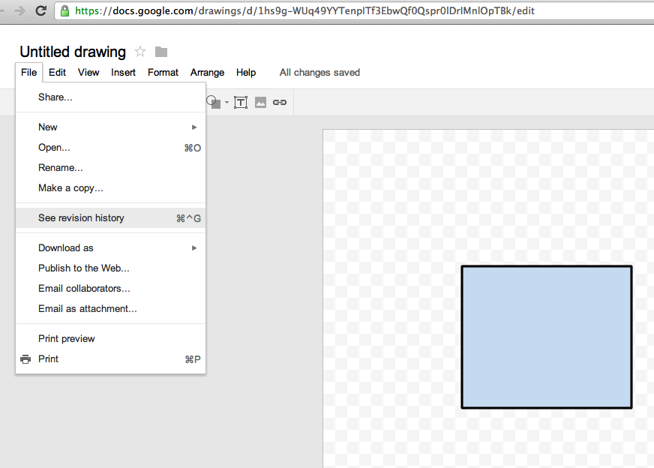
Versioning: you've already seen it on Google Docs...
Even Google Docs has a very simple versioning system available. It is an important mechanism for keeping track of the history of a project.
Source: http://docs.google.com/

Slide 5
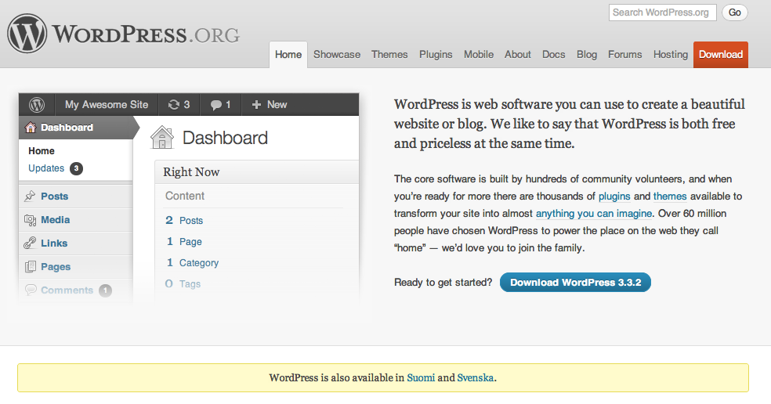
Blog: Wordpress.org
The easiest way to manage content (and a bit of versioning).
Source: http://wordpress.org/
Notes:
Un progetto digitale da maker, invece, riassume i due precedenti casi: si ha un controllo manuale di uno specifico materiale ma con l'aiuto di una dimensione di dati e di strumenti digitali spesso creati o modificati dallo stesso maker che permetttono un controllo ancora maggiore.

Slide 6
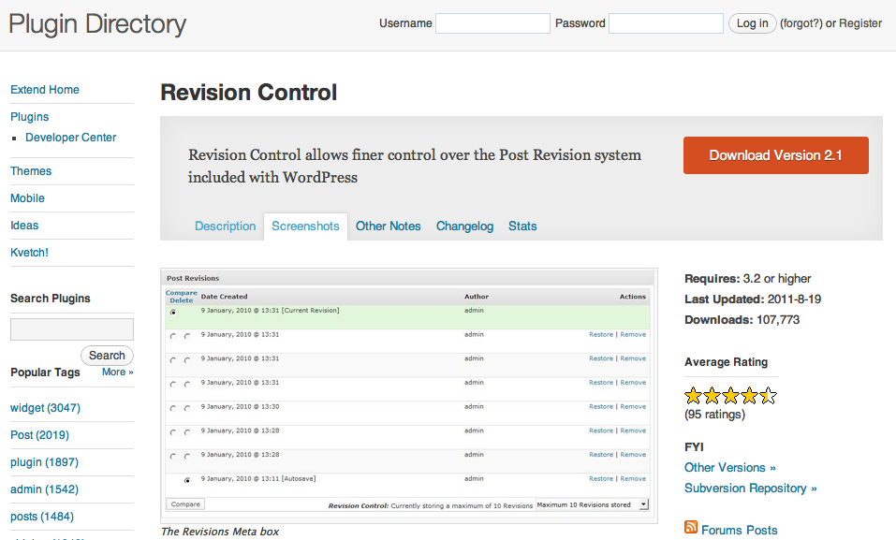
Blog: Wordpress.org (+ plugin)
Revision Control allows finer control over the Post Revision system included with WordPress.
Source: http://wordpress.org/extend/plugins/revision-control/
Notes:
Un progetto digitale da maker, invece, riassume i due precedenti casi: si ha un controllo manuale di uno specifico materiale ma con l'aiuto di una dimensione di dati e di strumenti digitali spesso creati o modificati dallo stesso maker che permetttono un controllo ancora maggiore.

Slide 7
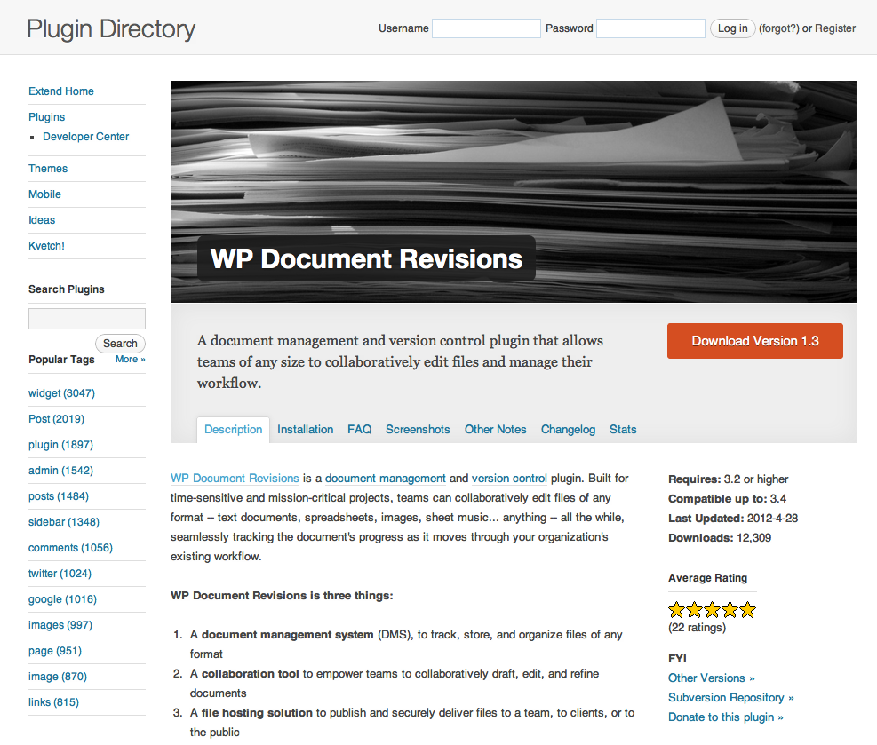
Blog: Wordpress.org (+ plugin)
A document management and version control plugin that allows teams of any size to collaboratively edit files and manage their workflow.
Source: http://wordpress.org/extend/plugins/wp-document-revisions/
Notes:
Un progetto digitale da maker, invece, riassume i due precedenti casi: si ha un controllo manuale di uno specifico materiale ma con l'aiuto di una dimensione di dati e di strumenti digitali spesso creati o modificati dallo stesso maker che permetttono un controllo ancora maggiore.

Slide 8
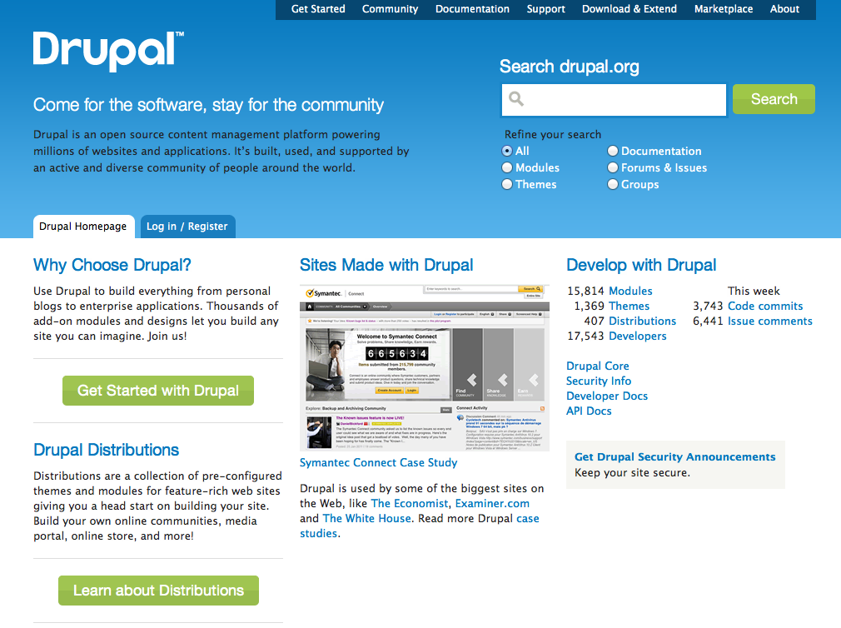
CMS: Drupal.org
Drupal contains basic features common to a cms: user account registration and maintenance, menu management, RSS-feeds, page layout customization...
Source: http://wordpress.org/extend/plugins/wp-document-revisions/
Notes:
Un progetto digitale da maker, invece, riassume i due precedenti casi: si ha un controllo manuale di uno specifico materiale ma con l'aiuto di una dimensione di dati e di strumenti digitali spesso creati o modificati dallo stesso maker che permetttono un controllo ancora maggiore.

Slide 9
CMS: Drupal.org (+modules)
You can extend the versioning system of Drupal with these modules:
* http://drupal.org/project/revisioning
* http://drupal.org/project/revision_fu
* http://drupal.org/project/revisionreference
* http://drupal.org/project/block_revisions
* http://drupal.org/project/diff_revision
* http://drupal.org/project/revision_all
* http://drupal.org/project/user_revision
* http://drupal.org/project/user_diff
Notes:
Un progetto digitale da maker, invece, riassume i due precedenti casi: si ha un controllo manuale di uno specifico materiale ma con l'aiuto di una dimensione di dati e di strumenti digitali spesso creati o modificati dallo stesso maker che permetttono un controllo ancora maggiore.

Slide 10
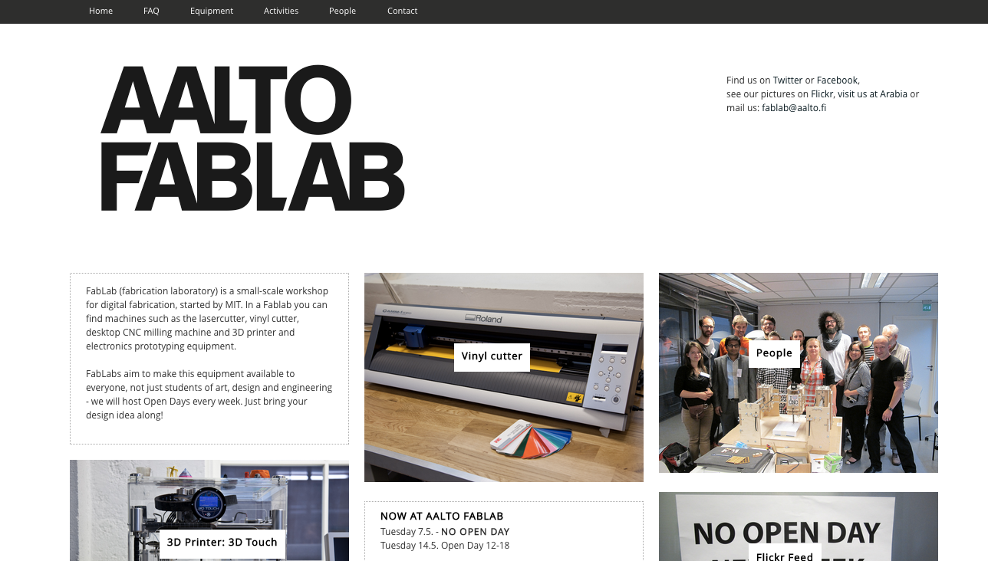
CMS: Drupal.org -> fablab.aalto.fi
Our website is based on Drupal...
Source: http://fablab.aalto.fi
Notes:
Un progetto digitale da maker, invece, riassume i due precedenti casi: si ha un controllo manuale di uno specifico materiale ma con l'aiuto di una dimensione di dati e di strumenti digitali spesso creati o modificati dallo stesso maker che permetttono un controllo ancora maggiore.

Slide 11
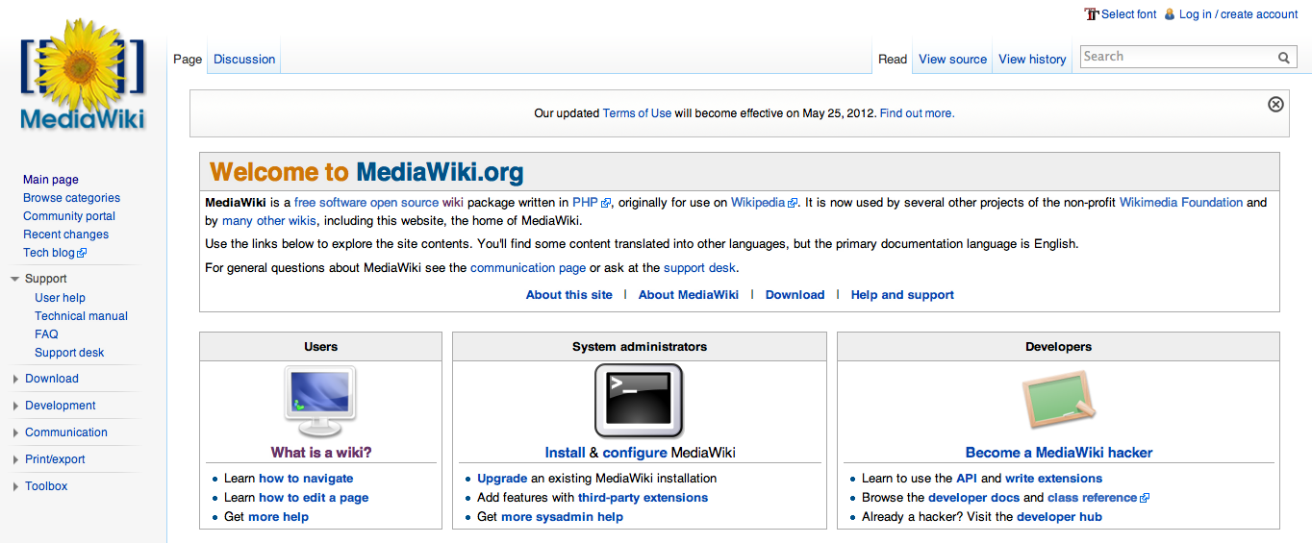
Wiki: Mediawiki.org
MediaWiki is a free software open source wiki package written in PHP, originally for use on Wikipedia.
Source: http://www.mediawiki.org/wiki/MediaWiki
Notes:
Un progetto digitale da maker, invece, riassume i due precedenti casi: si ha un controllo manuale di uno specifico materiale ma con l'aiuto di una dimensione di dati e di strumenti digitali spesso creati o modificati dallo stesso maker che permetttono un controllo ancora maggiore.

Slide 12
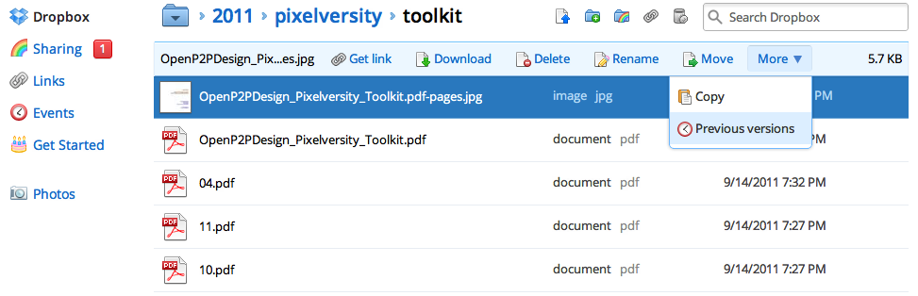
Backup: DropBox
DropBox has a limited versioning system, that goes back to 30 days only.
Source: https://www.dropbox.com/help/11
Notes:
Un progetto digitale da maker, invece, riassume i due precedenti casi: si ha un controllo manuale di uno specifico materiale ma con l'aiuto di una dimensione di dati e di strumenti digitali spesso creati o modificati dallo stesso maker che permetttono un controllo ancora maggiore.

Slide 13
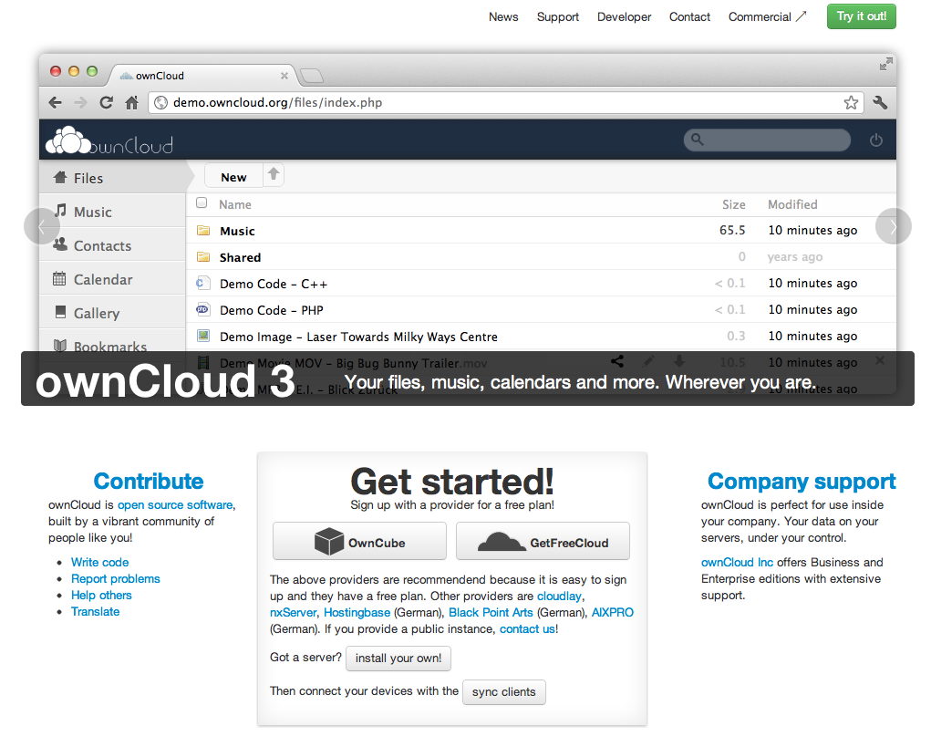
Backup: ownCloud
An open source version of DropBox, in case you have a server available.
Source: http://owncloud.org/
Notes:
Un progetto digitale da maker, invece, riassume i due precedenti casi: si ha un controllo manuale di uno specifico materiale ma con l'aiuto di una dimensione di dati e di strumenti digitali spesso creati o modificati dallo stesso maker che permetttono un controllo ancora maggiore.

Slide 14
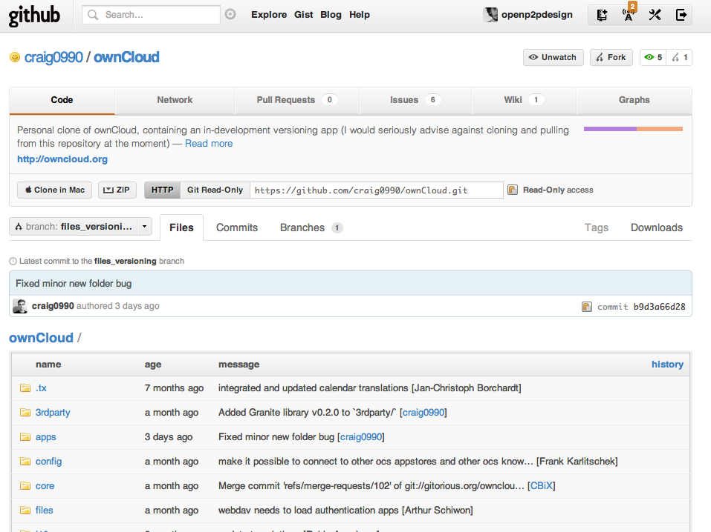
Backup: ownCloud (with versioning)
“Personal clone of ownCloud, containing an in-development versioning app (I would seriously advise against cloning and pulling from this repository at the moment)”
Source: https://github.com/craig0990/ownCloud
Notes:
Un progetto digitale da maker, invece, riassume i due precedenti casi: si ha un controllo manuale di uno specifico materiale ma con l'aiuto di una dimensione di dati e di strumenti digitali spesso creati o modificati dallo stesso maker che permetttono un controllo ancora maggiore.

Slide 15
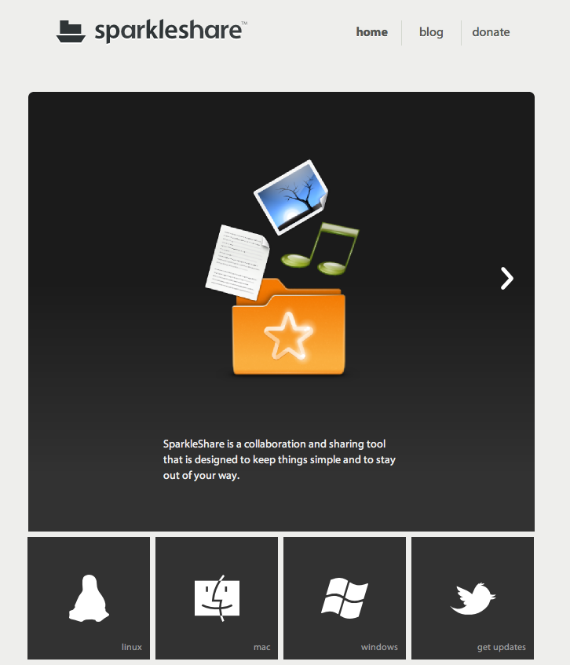
Backup: Sparkleshare
An open source version of DropBox, in case you have a server available (based on Git!).
Source: http://sparkleshare.org/
Notes:
Un progetto digitale da maker, invece, riassume i due precedenti casi: si ha un controllo manuale di uno specifico materiale ma con l'aiuto di una dimensione di dati e di strumenti digitali spesso creati o modificati dallo stesso maker che permetttono un controllo ancora maggiore.

Slide 16
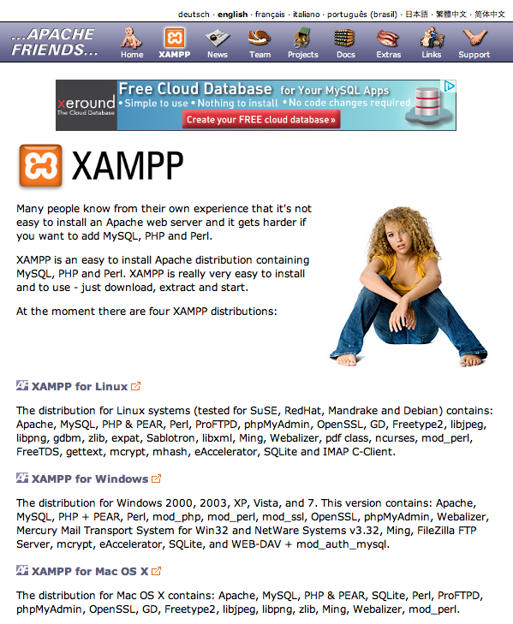
Need a local server? XAMPP
If you want to use Wordpress, Drupal, MediaWiki locally on your computer.
Source: http://www.apachefriends.org/en/xampp.html
Notes:
Un progetto digitale da maker, invece, riassume i due precedenti casi: si ha un controllo manuale di uno specifico materiale ma con l'aiuto di una dimensione di dati e di strumenti digitali spesso creati o modificati dallo stesso maker che permetttono un controllo ancora maggiore.

Slide 17
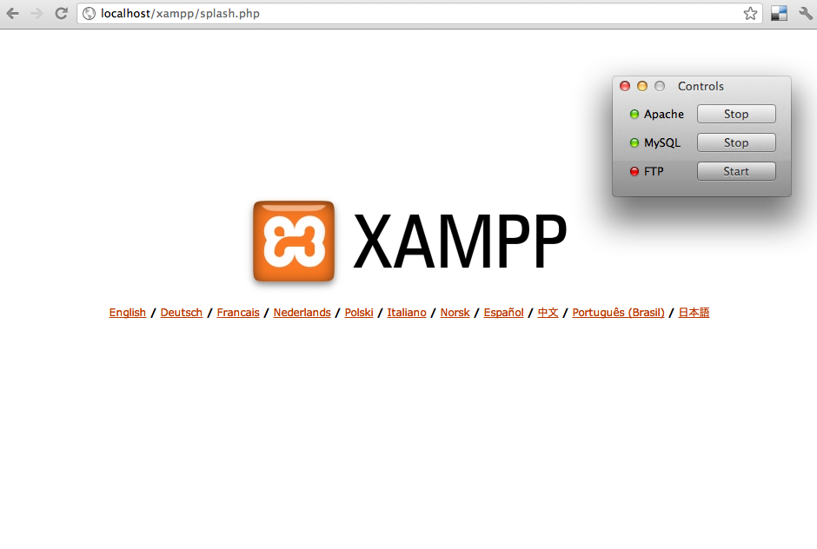
Your local server, http://localhost/
Look for the htdocs folder in your XAMPP application, all the files accessible through http://localhost should be there.
Source: http://localhost/
Notes:
Un progetto digitale da maker, invece, riassume i due precedenti casi: si ha un controllo manuale di uno specifico materiale ma con l'aiuto di una dimensione di dati e di strumenti digitali spesso creati o modificati dallo stesso maker che permetttono un controllo ancora maggiore.

Slide 18
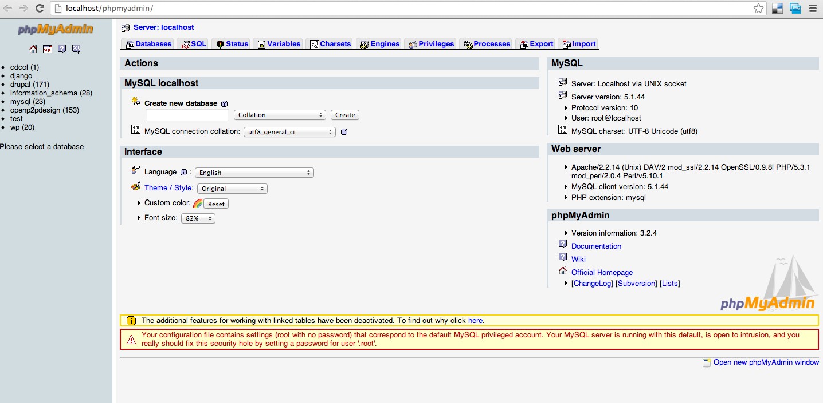
Your local database, http://localhost/phpmyadmin
You can easily create a database with PhpMyAdmin (but you will probably have to change the password for installing MediaWiki).
Source: http://localhost/phpmyadmin/
Notes:
Un progetto digitale da maker, invece, riassume i due precedenti casi: si ha un controllo manuale di uno specifico materiale ma con l'aiuto di una dimensione di dati e di strumenti digitali spesso creati o modificati dallo stesso maker che permetttono un controllo ancora maggiore.

Slide 19
02.
Version Control Systems: managing the history of a project

Slide 20
02.01
Version Control Systems:
Subversion (SVN)

Slide 21
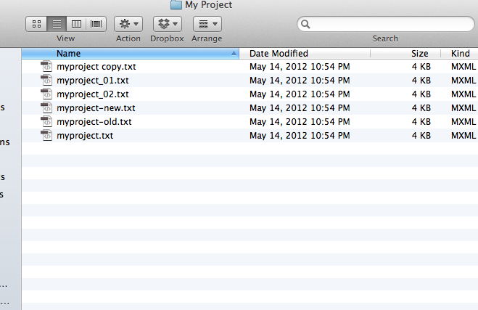
Control? Organization?
Something very common, that I don't want to see in this course!!

Slide 22
Version Control Systems
A version (or revision) control system is a system that tracks incremental versions (or revisions) of files and directories over time. It allows you to explore the changes which resulted in each of those versions and facilitates the arbitrary recall of the same.
* Backup and Restore
* Synchronization
* Short-term undo + Long-term undo
* Track Changes
* Track Ownership
* Branching and merging
* not in real time!
Source: http://svnbook.red-bean.com/en/1.6/svn.basic.version-control-basics.html

Slide 23
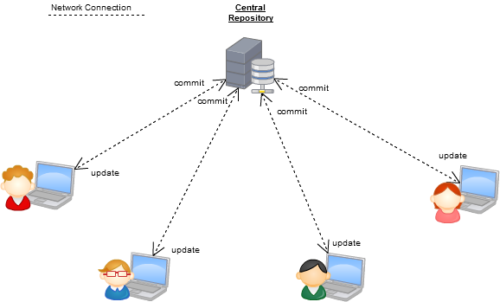
Server/client-based Version Control System
Server
Client
Client
Client
Client
The first architecture to appear, you need to be connected and you need a server (unless you want to work alone on your computer).
Source: http://www.kalekold.net/index.php?post=13
http://betterexplained.com/articles/a-visual-guide-to-version-control/

Slide 24
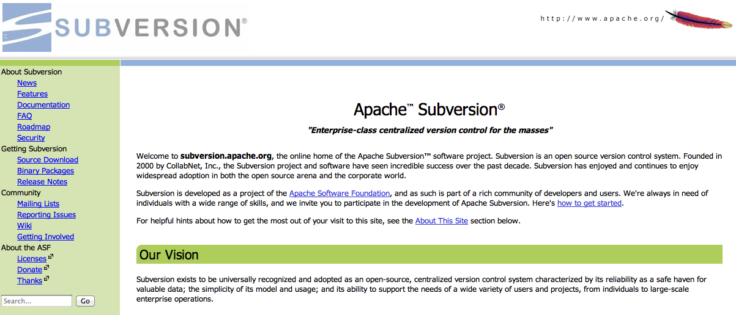
Version Control System: Subversion (SVN)
Subversion manages files and directories, and the changes made to them, over time. Think of it as a sort of “time machine” of changes.
Source: http://subversion.apache.org/

Slide 25
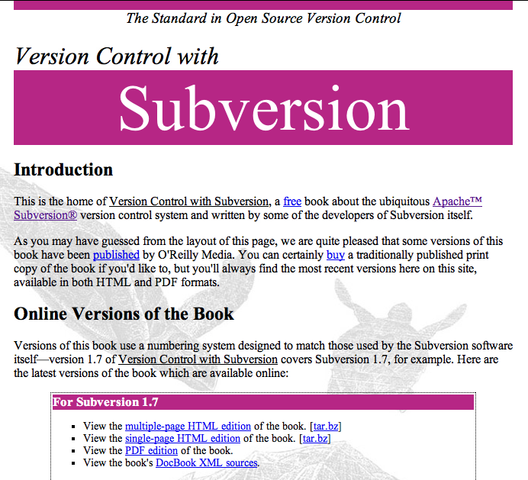
An introduction to SVN
An open source book about using SVN.
Source: http://svnbook.red-bean.com/

Slide 26
Version Control System: the vocabulary (01)
* Change: A change (or diff) represents a specific modification to a document under version control.
* Checkout : A check-out (or co) is the act of creating a local working copy from the repository. A user may specify a specific revision or obtain the latest. Also refers to the same files.
* Commit : A commit (checkin, ci) is the action of writing or merging the changes made in the working copy back to the repository. Also refers to the same files.
* Head : The most recent commit.
Source: http://en.wikipedia.org/wiki/Revision_control

Slide 27
Version Control System: the vocabulary (02)
* Conflict
A conflict occurs when different parties make changes to the same document. A user must resolve the conflict by combining the changes, or by selecting one change.
* Merge
A merge or integration is an operation in which two sets of changes are applied to a file or set of files.
* Update
An update (or sync) merges changes made in the repository (by other people, for example) into the local working copy.
* Working copy
The working copy is the local copy of files from a repository, at a specific time or revision. Conceptually, it is a sandbox.
Source: http://en.wikipedia.org/wiki/Revision_control

Slide 28
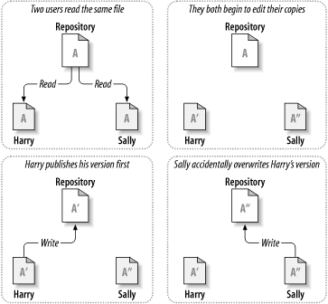
Versioning: the problem
How will the system allow users to share information, but prevent them from accidentally overwriting?
Source: http://svnbook.red-bean.com/en/1.6/svn.basic.version-control-basics.html

Slide 29
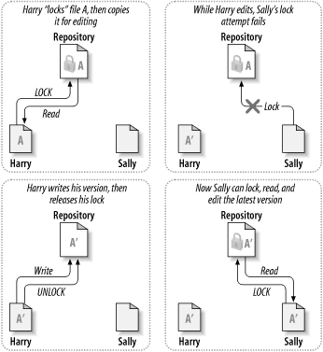
Versioning: the lock-modify-unlock solution
In this model, the repository allows only one person to change a file at a time, by locking it.
Source: http://svnbook.red-bean.com/en/1.6/svn.basic.version-control-basics.html

Slide 30
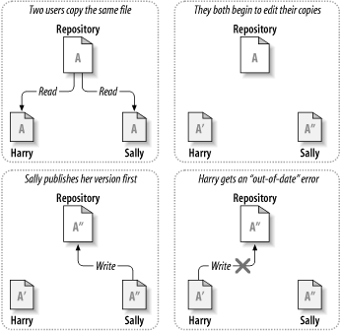
Versioning: the copy-modify-merge solution (01)
In this model, each user's client contacts the project repository and creates a personal working copy. The private copies are merged together into a new version.
Source: http://svnbook.red-bean.com/en/1.6/svn.basic.version-control-basics.html

Slide 31
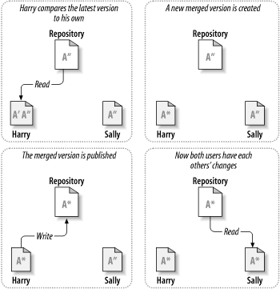
Versioning: the copy-modify-merge solution (02)
In this model, each user's client contacts the project repository and creates a personal working copy. The private copies are merged together into a new version.
Source: http://svnbook.red-bean.com/en/1.6/svn.basic.version-control-basics.html

Slide 32
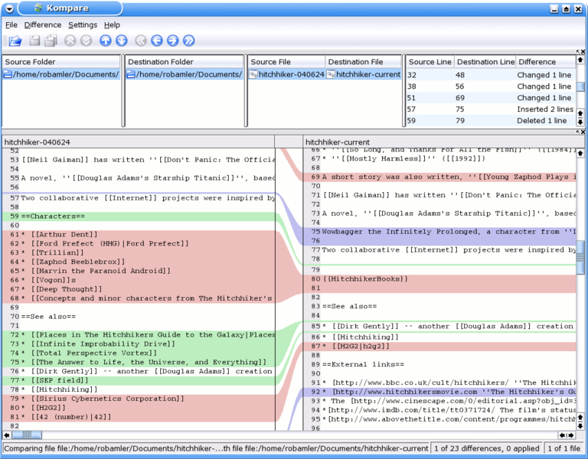
Diff: how to understand the changes
The best way of understanding what has changed is to compare different revisions with a diff software.
Source: http://en.wikipedia.org/wiki/Diff
http://en.wikipedia.org/wiki/Kompare

Slide 33
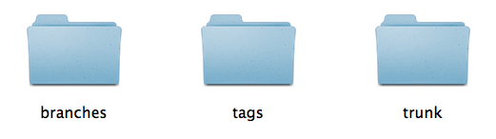
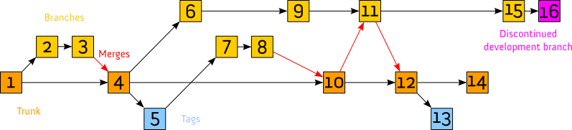
A typical SVN project
Development happens in trunk, testing alternatives in branches and storing good versions (1.0, 1.1,...) in tags.
Source: http://en.wikipedia.org/wiki/Apache_Subversion

Slide 34

Example: a spool for the RepRap Mendel
The second version of the RepRap, the first to be easier to build and calibrate.
Source: http://reprap.org/wiki/Mendel

Slide 35
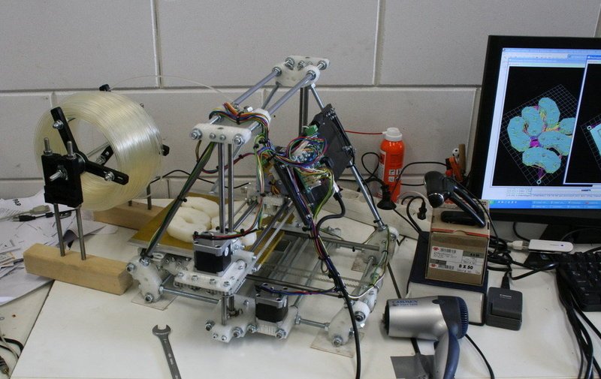
A spool for the RepRap Mendel: an improvement
A spool added for handling the plastic wire and published on Thingiverse.
Source: http://www.thingiverse.com/thing:3866

Slide 36
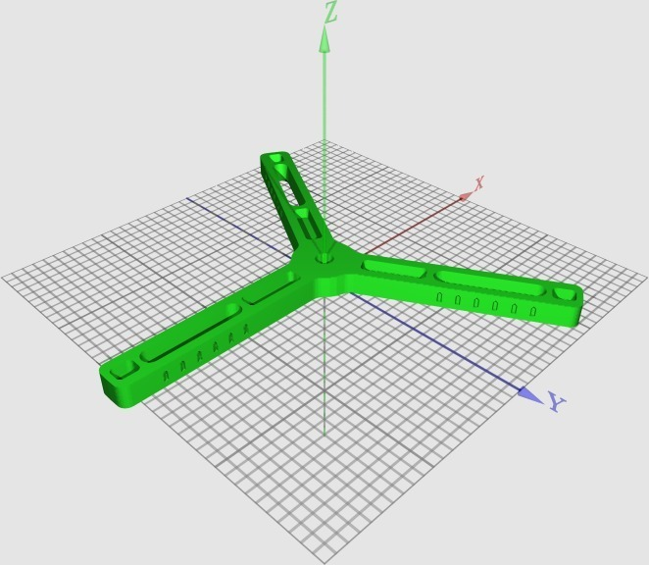
A spool for the RepRap Mendel: an improvement (01)
“Well i wanted to have a very simple, but bearing based spool system.” Camiel
Source: http://www.thingiverse.com/thing:3866

Slide 37
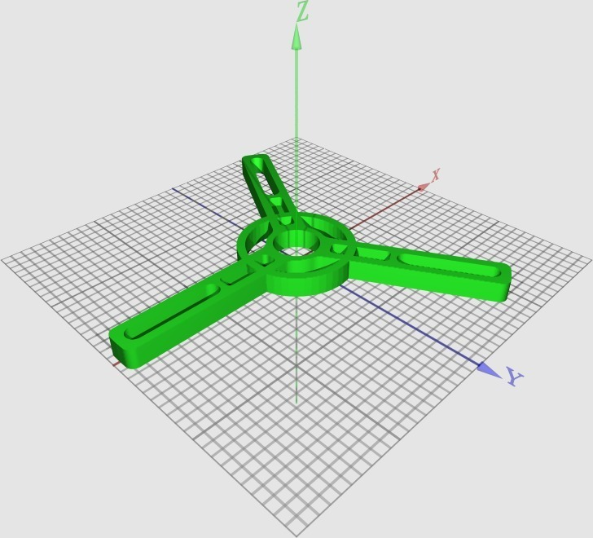
A spool for the RepRap Mendel: an improvement (02)
“I have changed the design to put the bearings in the spool itself. This way you can be more flexible in what you use to support the axle. ” Brokentoaster
Source: http://www.thingiverse.com/thing:3962

Slide 38
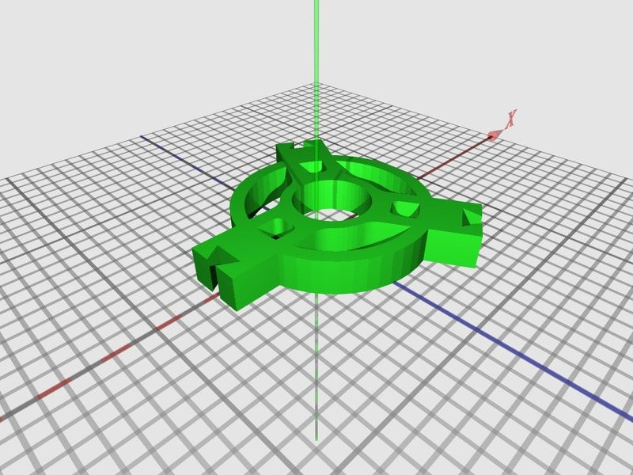
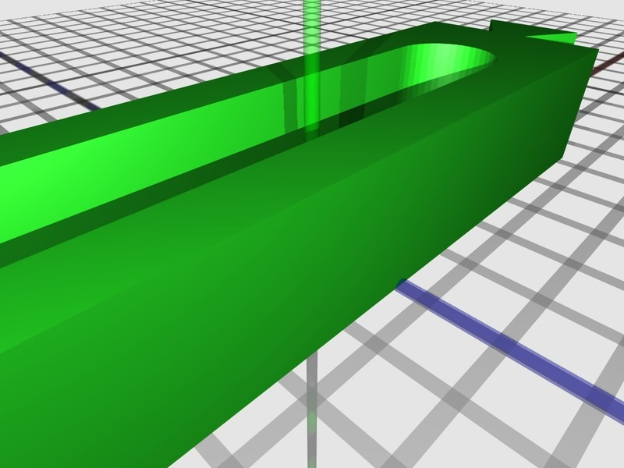
A spool for the RepRap Mendel: an improvement (03)
“I liked BrokenToaster's idea of a bearing-driven filament spool holder, but that version was too big to fit on a Makerbot print bed. [...]” Randyy
Source: http://www.thingiverse.com/thing:4337

Slide 39
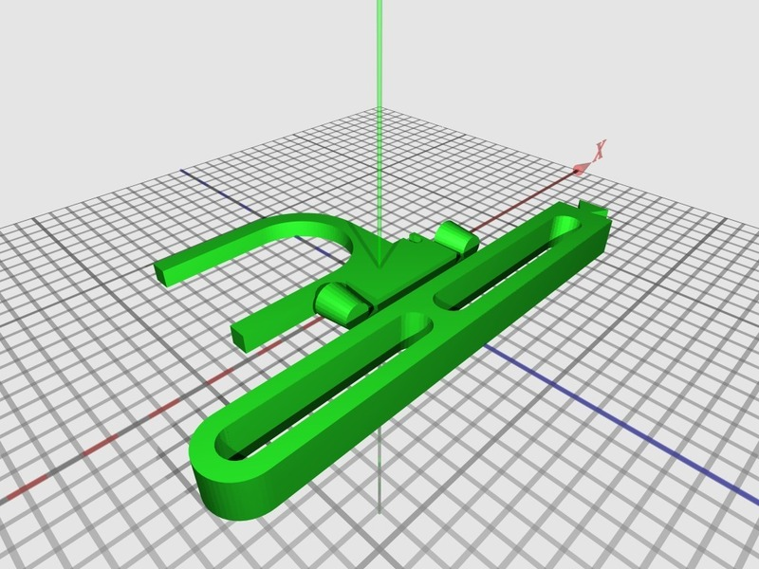
A spool for the RepRap Mendel: an improvement (04)
“This takes advantage of the larger print area on RepRaps by printing the arm as one piece, […] also saving material.” Fil
Source: http://www.thingiverse.com/thing:11250

Slide 40
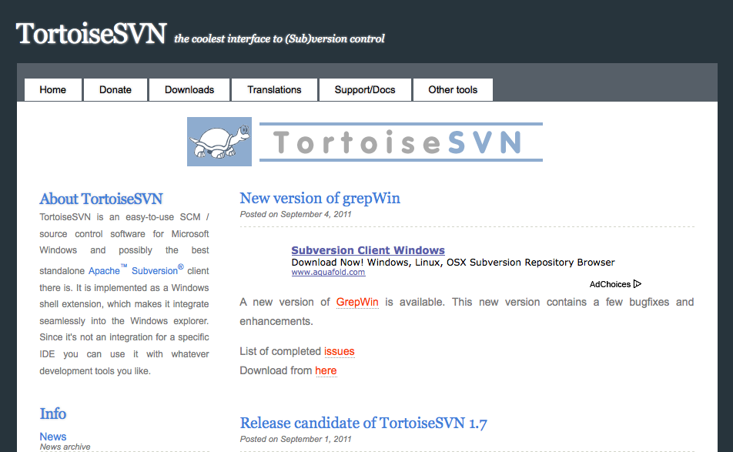
SVN Client + File comparison: TortoiseSVN (Win)
The most popular SVN client on Windows, it can also compare images.
Source: http://tortoisesvn.net/

Slide 41
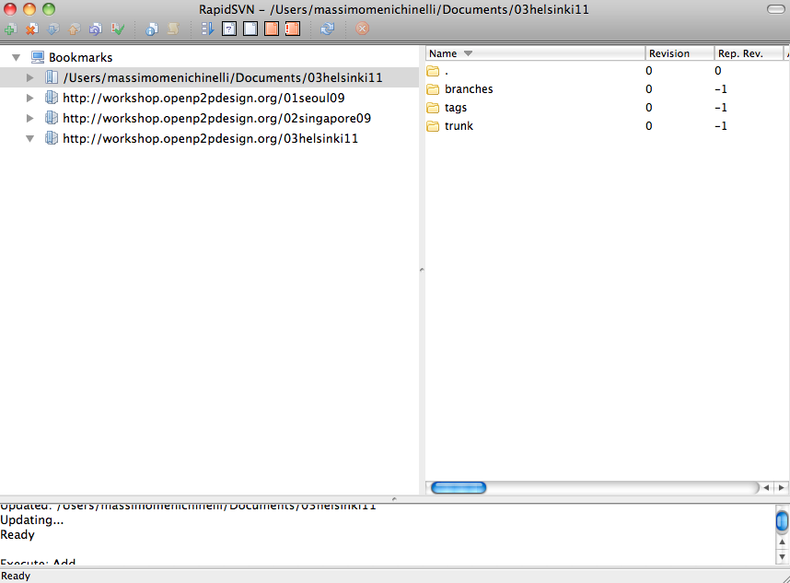
SVN Client: RapidSVN (Windows, Mac, Linux)
Open Source and multi-platform, but without file comparison.
Source: http://www.rapidsvn.org/

Slide 42
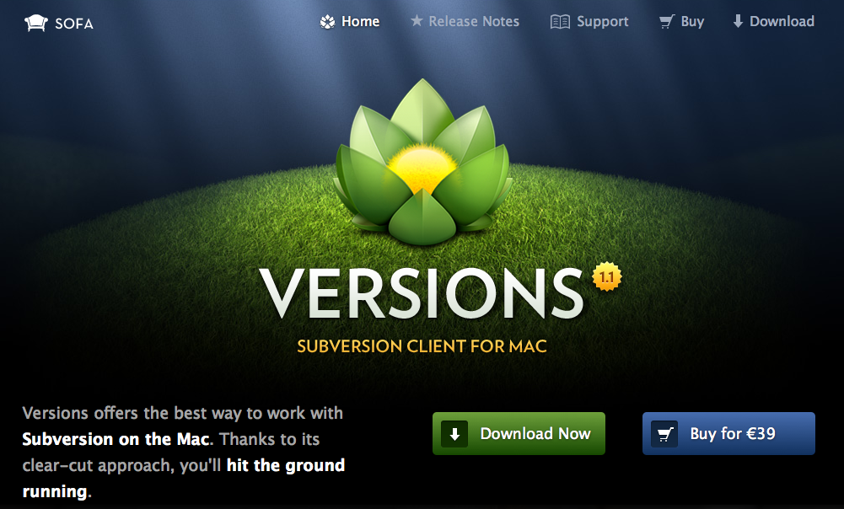
SVN Client: Versions (Mac)
Free trial for one month...
Source: http://www.versionsapp.com/

Slide 43
02.02
Version Control Systems:
Git and Mercurial (Hg)

Slide 44
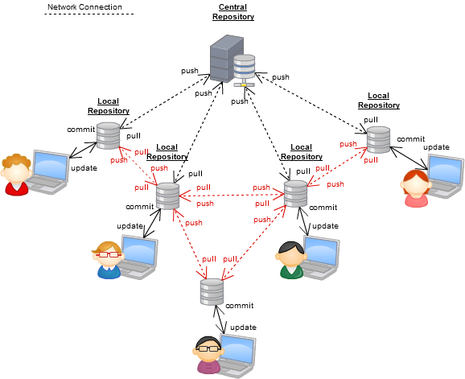
Distributed Version Control System
A more recent architecture, more evoluted and popular. It usually tracks the state of the files, not just the changes.
Source: http://www.kalekold.net/index.php?post=13
http://betterexplained.com/articles/intro-to-distributed-version-control-illustrated/

Slide 45
Version Control System: the vocabulary (03)
Distributed Version Control Systems add new terms to the vocabulary:
* Clone: create a working copy on your computer from another repository.
* Push : send a change to another repository (may require permission), even to your server.
* Pull : download the latest changes from an online repository.

Slide 46
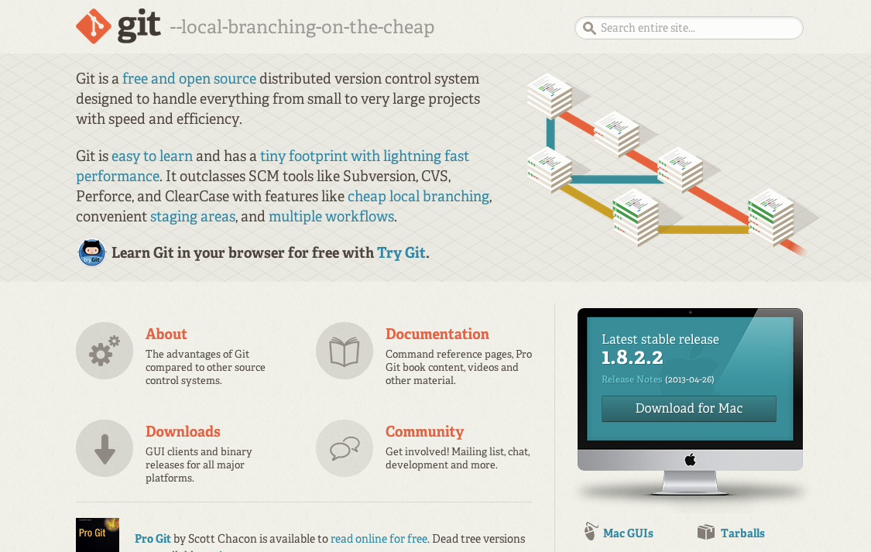
Distributed Version Control System: Git
Developed by Linus Torvalds, for improving the distributed development of the Linux Kernel.
Source: http://git-scm.com/

Slide 47
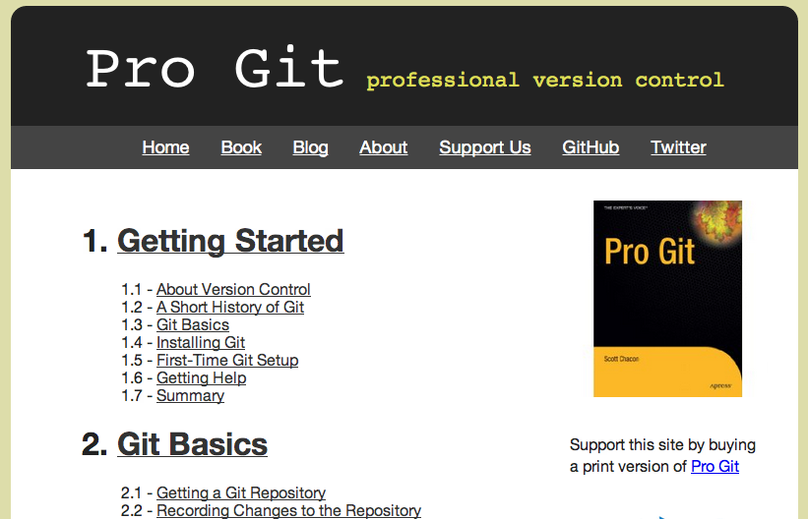
An introduction to Git
An open source book about using Git.
Source: http://progit.org/book/

Slide 48
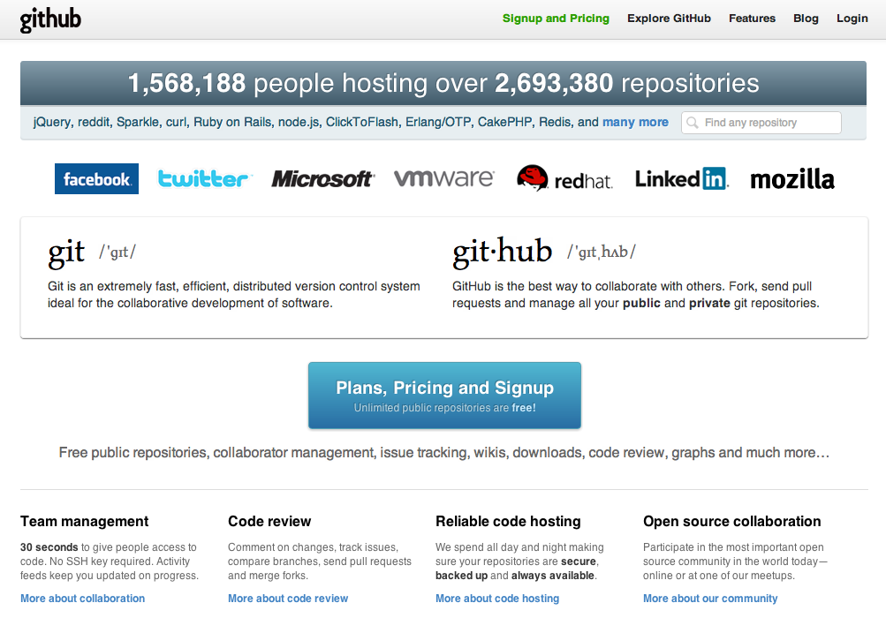
Git project hosting: GitHub.com
The most popular (and refined) Git hosting available now, free plans for open source projects (you have to pay for private spaces).
Source: https://github.com/

Slide 49
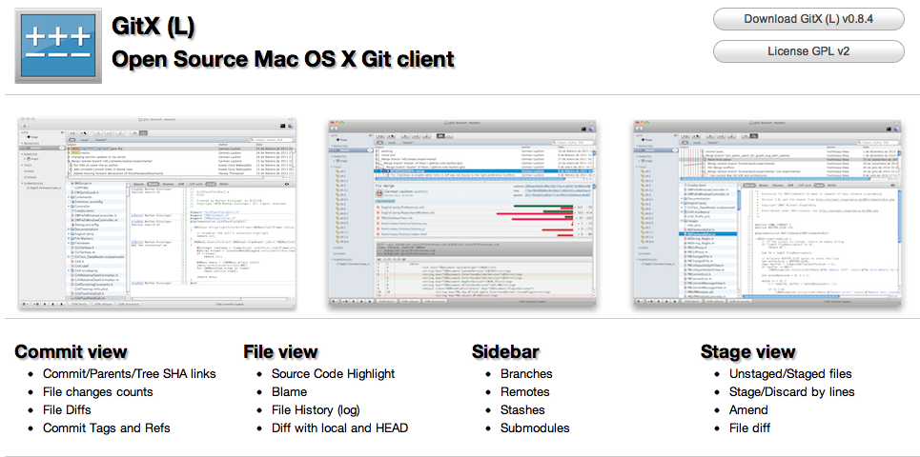
Git Client: GitX (Mac)
Actually, more than one GitX can be found...
Source: http://gitx.laullon.com/

Slide 50
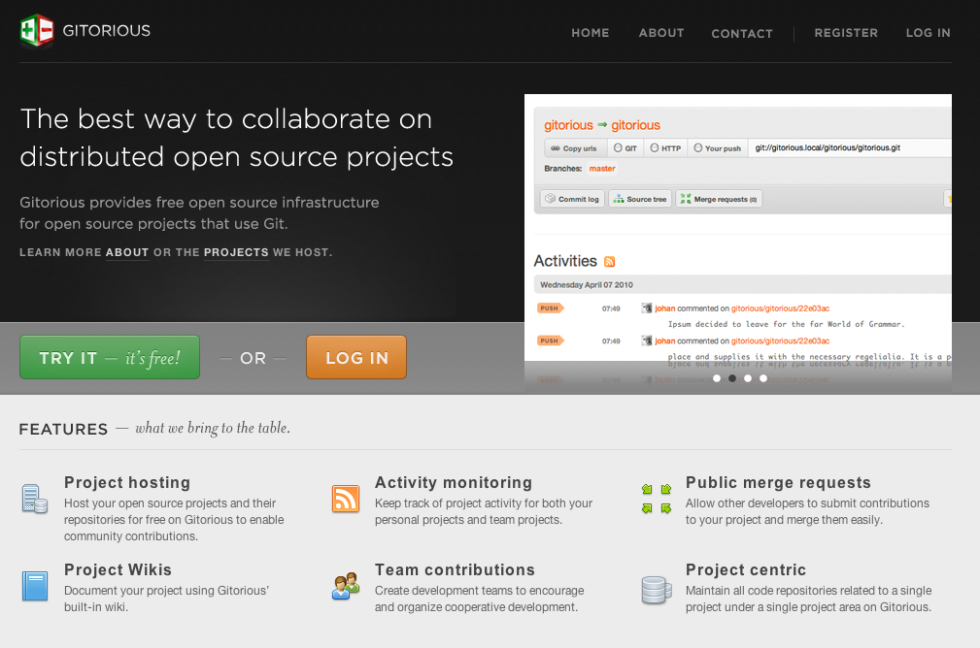
Git project hosting: Gitorius.org
Free plans, and open source software itself.
Source: http://www.gitorious.org/

Slide 51
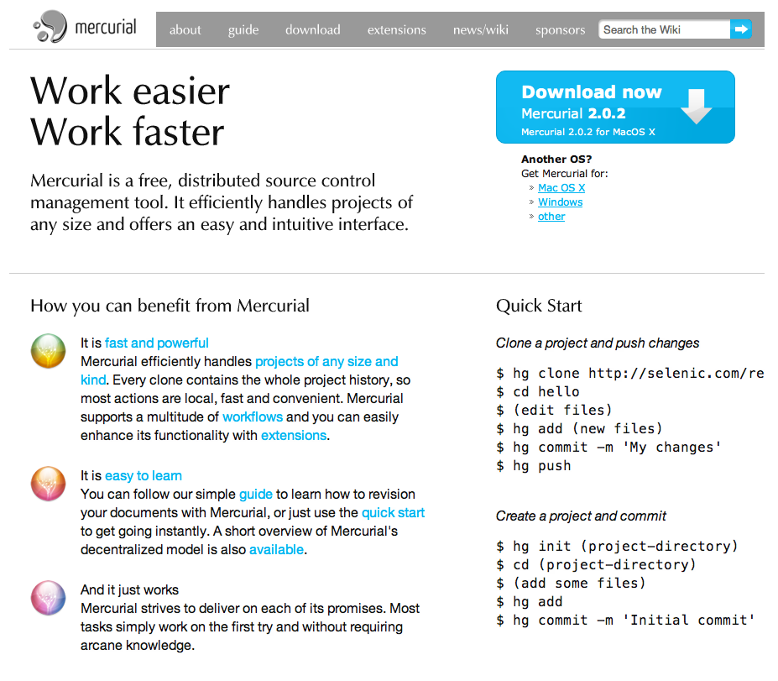
Distributed Version Control System: Mercurial (hg)
Open Source and distributed as Git, usually the most used in FabLabs.
Source: http://mercurial.selenic.com/

Slide 52
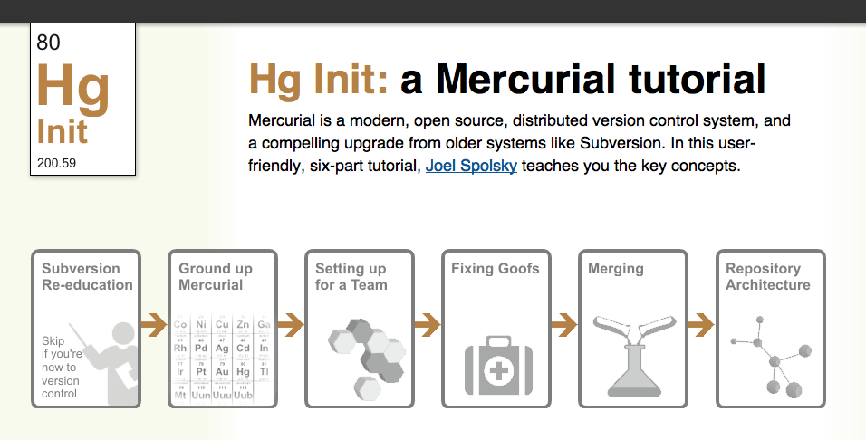
An introduction to Mercurial
A complete and easy introduction to using Mercurial.
Source: http://hginit.com/

Slide 53
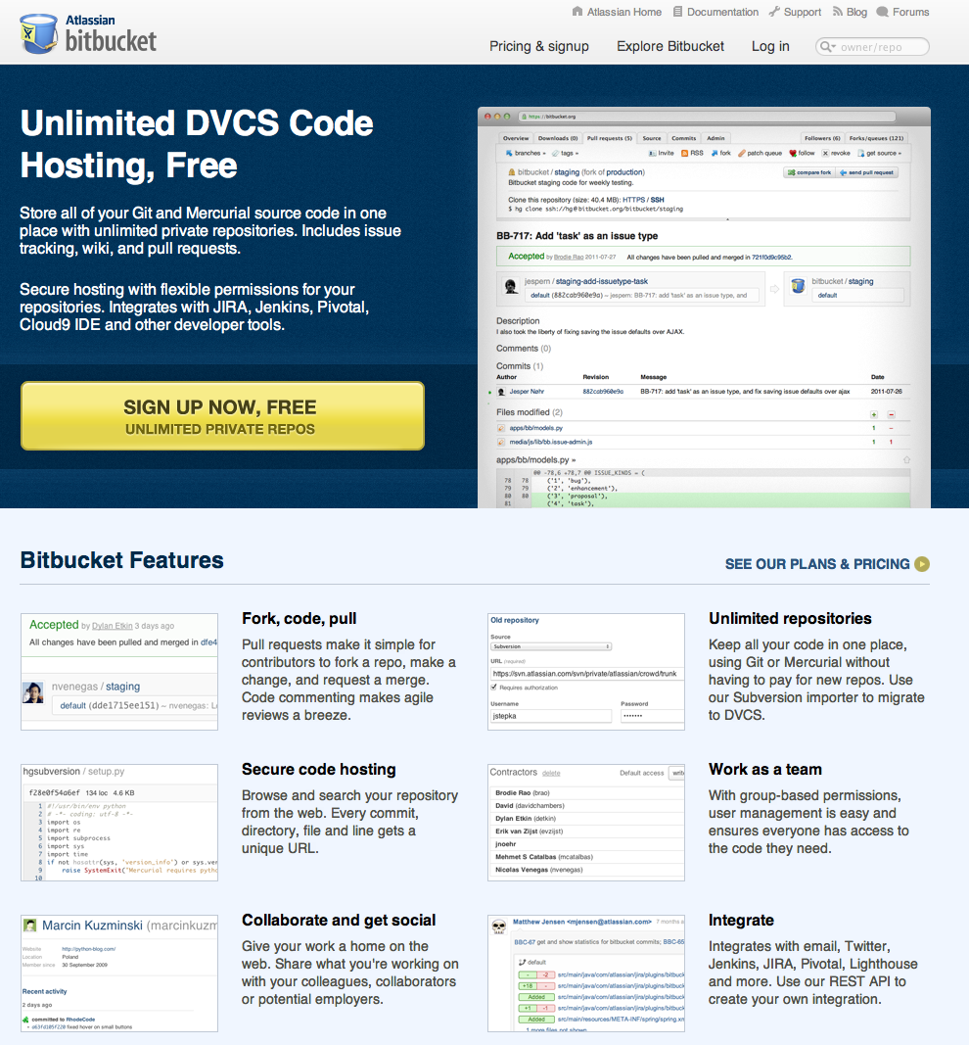
Git / Hg project hosting: Bitbucket.org
For both Git and Hg, free plan also for private projects.
Source: https://bitbucket.org/

Slide 54
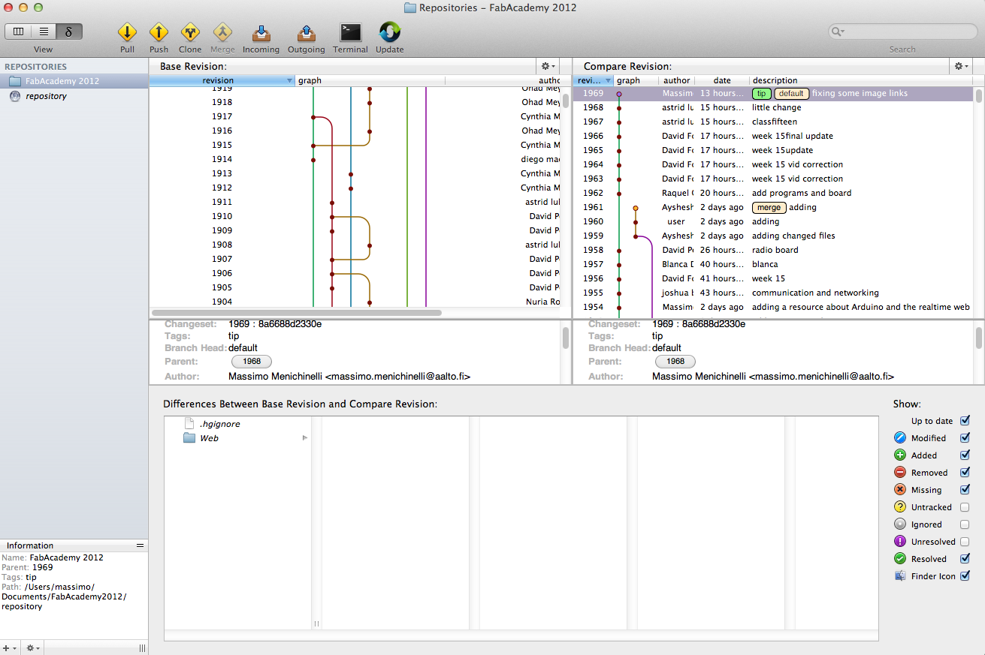
Mercurial (hg) client: MacHg
Much better than the terminal for starting, and it has Mercurial packaged (no need to install it separately).
Source: http://jasonfharris.com/machg/

Slide 55
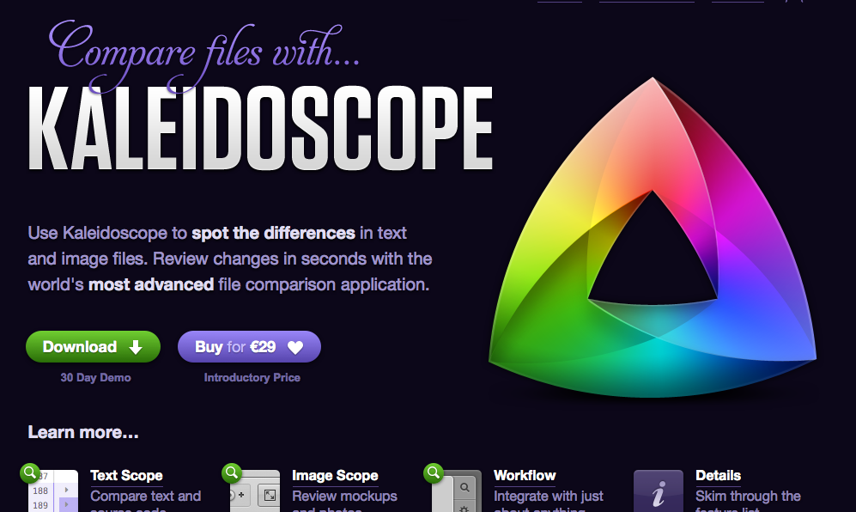
File comparison: Kaleidoscope (Mac)
Free trial for one month...
Source: http://www.kaleidoscopeapp.com/

Slide 56
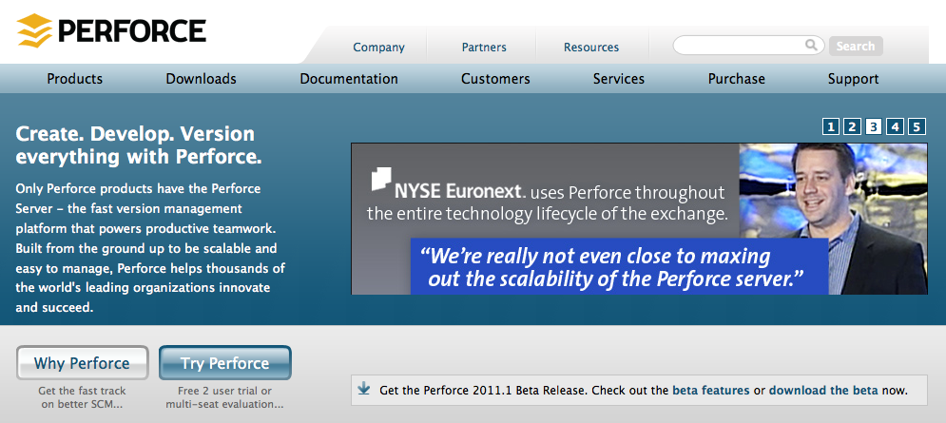
File comparison: Perforce P4Merge (Win, Mac, Linux)
Perforce is another version control system, but it is interesting for its visual diff applications (freeware).
Source: http://www.perforce.com/product/components/perforce_visual_merge_and_diff_tools

Slide 57
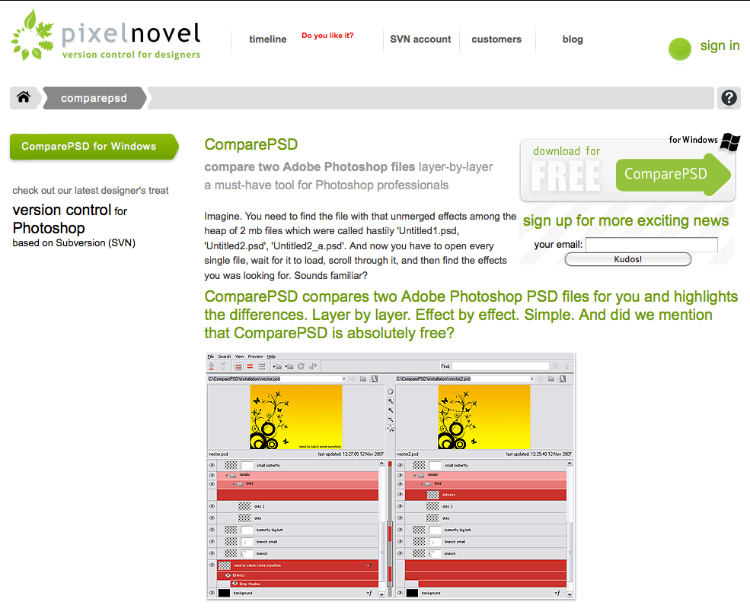
File comparison: ComparePSD (Windows)
Freeware for Windows, can compare Photoshop .psd files.
Source: http://pixelnovel.com/comparepsd/

Slide 58
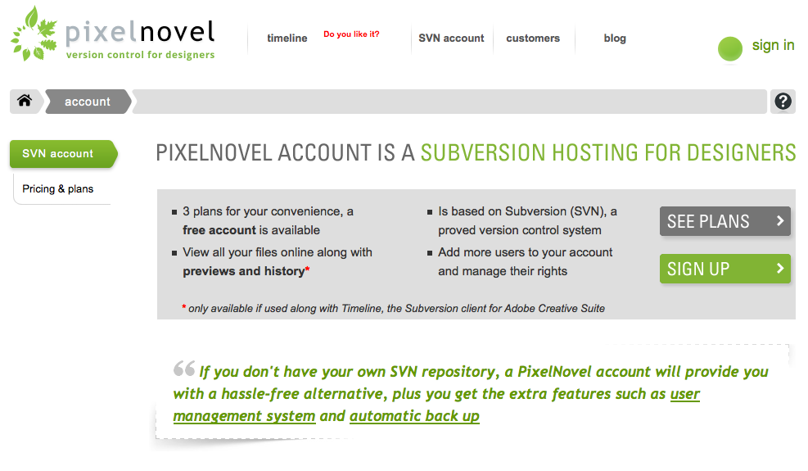
Subversion hosting service: Pixelnovel
Integrated with Photoshop: free plan (100 MB) and better paid plans.
Source: http://pixelnovel.com/svn-account/

Slide 59
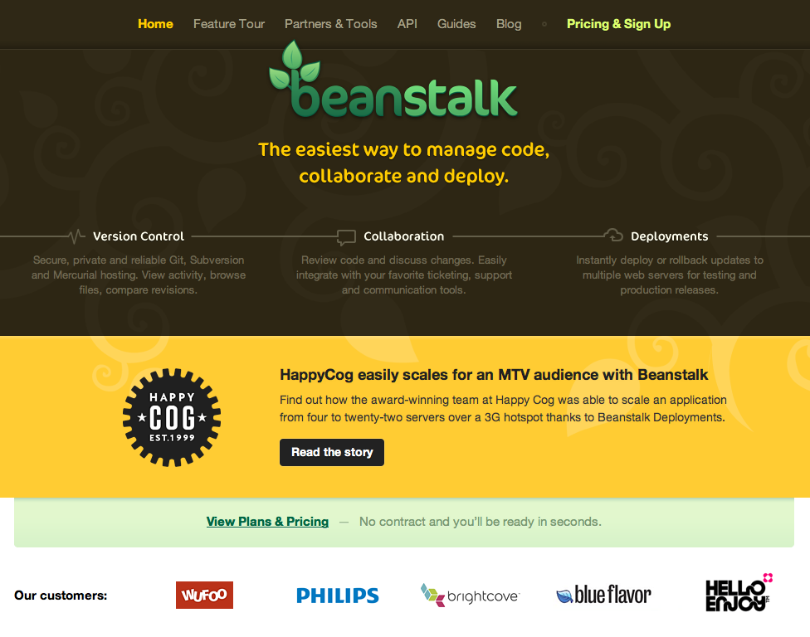
SVN / Git / Hg hosting service: Beanstalk
Paid plans (with free trial).
Source: http://beanstalkapp.com/

Slide 60
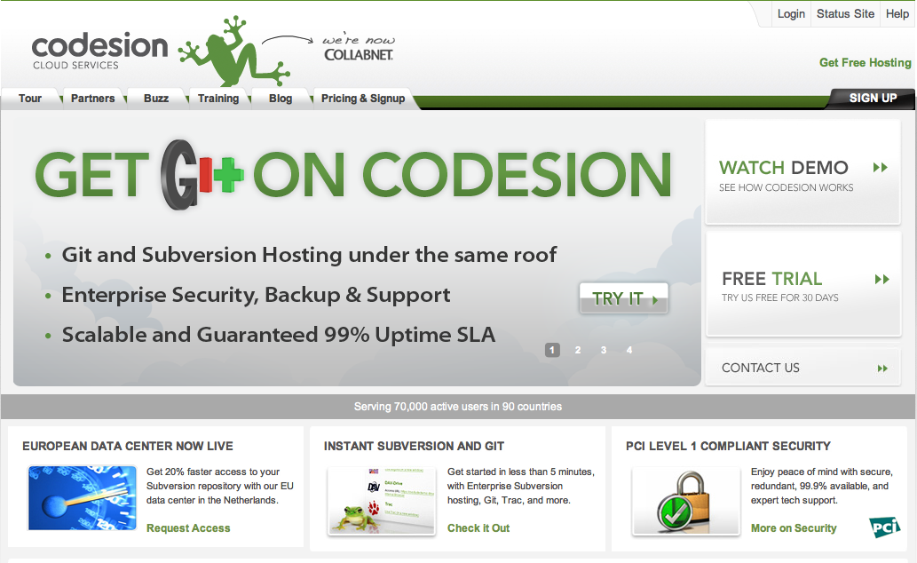
SVN / Git hosting service: Codesion
Paid plans (with free trial).
Source: http://codesion.com/

Slide 61

SVN / Git / Hg hosting service: Google Code
Free for open source projects.
Source: http://code.google.com/projecthosting/

Slide 62
03.
QR Code: bits about a project from its atoms

Slide 63

Retrieving the source code of an object
What about retrieving the information about a project, in order to be able to modify it? If we work with Arduino, there is this software from IDEO.
Source: http://labs.ideo.com/2012/03/15/arduino-tool-that-connects-each-board-to-its-own-source/

Slide 64

Dead Drops: local (really!) information
‘Dead Drops’ is an anonymous, offline, peer to peer file-sharing network in public space. USB flash drives are embedded into walls accessible to anybody.
Source: http://deadrops.com/

Slide 65

Dead Drops: how to find them
‘Dead Drops’ is an anonymous, offline, peer to peer file-sharing network in public space. USB flash drives are embedded into walls accessible to anybody.
Source: http://deaddrops.com/dead-drops/db-map/

Slide 66

Spime: sp(ace) + (ti)me of an object
Spime is a neologism for a currently theoretical object that can be tracked through space and time throughout the lifetime of the object.
Source: http://mitpress.mit.edu/catalog/item/default.asp?tid=10603&ttype=2
http://en.wikipedia.org/wiki/Spime

Slide 67

Evrythng.com
EVRYTHNG is a software engine for creating Active Digital Identities, unique online profiles for objects to make them part of the Web and digitally connected.
Source: http://evrythng.com/

Slide 68

Tales of things (.com)
Tales of Things allows just that with a quick and easy way to link any media to any object via small printable tags known as QR codes.
Source: http://www.talesofthings.com/

Slide 69

Q(uick)R(esponse) Code
QR Code is the trademark for a type of matrix / 2D barcode that can encode four standardized kinds of data (numeric, alphanumeric, byte/binary, Kanji).
Source: http://en.wikipedia.org/wiki/Qr_code

Slide 70
QR Code: data storage
The amount of data that can be stored in the QR Code symbol depends on the datatype (mode, or input character set), version (1,...,40, indicating the overall dimensions of the symbol), and error correction level (L[ow], M[edium], Q[uality], H[igh]). The maximum storage capacities are:
* Numeric only: max. 7,089 characters (0, 1, 2, 3, 4, 5, 6, 7, 8, 9)
* Alphanumeric: max. 4,296 characters (0–9, A–Z [upper-case only], space, $, %, *, +, -, ., /, :)
* Binary/byte: max. 2,953 characters (8-bit bytes) (23624 bits)
* Kanji/Kana: max. 1,817 characters
Source: http://en.wikipedia.org/wiki/Qr_code

Slide 71

QR Code: data storage
The more information is encoded, the finer the details of the code.
Source: http://en.wikipedia.org/wiki/Qr_code

Slide 72

QR Code: error tolerance and customization
You can “hack” a QR Code thanks to its tolerance to errors.
Source: http://whomwah.com/2008/03/12/more-fun-with-qr-codes-and-the-bbc-logo/
http://contentdeveloper.com/2010/01/how-to-customize-qr-codes-with-your-brands-identity/

Slide 73

QR Codes: not just printed paper
You can create QR codes with existing materials, objects and building blocks...
Source: http://www.arcfn.com/2009/01/qr-codes-in-lego.html

Slide 74

QR Codes: not just printed paper
You can create QR codes with existing materials, objects and building blocks...
Source: http://www.visualnews.com/2011/12/15/a-qr-code-built-from-everyday-objects/

Slide 75

QR Codes: not just printed paper
You can create QR codes with existing materials, objects and building blocks...
Source: http://www.elenabelmann.blogspot.com/2011/02/objekt-als-informationstrager.html

Slide 76

QR Codes: an easy way to create them
Many online free services will create QR Codes for you starting from many different kinds of information.
Source: http://qrcode.littleidiot.be/

Slide 77

QR Codes: an easy way to create (and decode) them
Many online free services will create QR Codes for you starting from many different kinds of information.
Source: http://www.patrick-wied.at/static/qrgen/

Slide 78

QR Codes: an easy way to create them
Many online free services will create QR Codes for you starting from many different kinds of information.
Source: http://www.qrstuff.com/

Slide 79

QR Codes: an easy way to create them
Many online free services will create QR Codes for you starting from many different kinds of information.
Source: http://www.qrhacker.com/

Slide 80

QR Codes: an easy way to create a stencil
… and there are even libraries for creating stencil of QR Codes that you can laser cut!
Source: http://blog.makezine.com/2011/07/20/qr-stenciler/

Slide 81

QR Codes: you can track the position as well
As you can link an identity to an object with a QR Code, then we can track where this identity moves.
Source: http://www.springwise.com/government/croatia-postage-stamps-trackable-qr-code/

Slide 82

QR Codes: you can add related information
You can provide related information and build apps and services around an object!
Source: http://www.springwise.com/lifestyle_leisure/cigarette-packages-qr-codes-reveal-nearby-place-smoke/

Slide 83

QR Codes: you can add related information
You can provide the instruction manual of an object!
Source: http://www.steelcase.com/en/products/category/seating/task/leap/pages/qr-codes.aspx
http://www.fastcodesign.com/1665090/an-office-chair-with-built-in-video-instruction-manual

Slide 84

QR Codes: you can add the source code!
… and finally you can even provide directly the source code of an object, not just a link to its source online!
Source: http://supermechanical.com/rev/
http://www.springwise.com/style_design/future-repairs-tables-digital-blueprints-etched-surface/

Slide 85

QR Codes: you can add the source code!
… and finally you can even provide directly the source code of an object, not just a link to its source online!
Source: http://supermechanical.com/rev/
http://www.springwise.com/style_design/future-repairs-tables-digital-blueprints-etched-surface/

Slide 86

Bar Codes: retrieving information through design!
… you can even use codes and existing objects to design a new system based on retrieving information!
Source: http://www.designboom.com/weblog/cat/16/view/22271/barcode-band-scans-its-way-to-new-music.html
http://vimeo.com/41132461

Slide 87

QR Codes: which bits?
We are embedding information on an object, and we use a device for retrieving it... but which kind of information?
Source: http://www.pcworld.com/article/248843/beware_of_malicious_qr_codes.html

Slide 88

Virus: a dangerous information
Some kind of information (like viruses) can modify, deform and damage an object...
Source: http://www.platform21.nl/page/3915/en
http://www.nextnature.net/2009/04/ikea-lamp-catches-elephantiasis-virus/

Slide 89

Sound: a dangerous information
Some kind of information (like sound) can modify, deform and damage an object...
Source: http://www.dezeen.com/2012/07/13/noize-chairs-by-estudio-guto-requena/
http://vimeo.com/45568573

Slide 90

QR Code: you can even print it (in 3D)
If you have a 3D printer that can print at least two different materials....
Source: http://www.thingiverse.com/thing:12104

Slide 91

QR Code: for real walls
Not only Dead Drops can be used for embedding information on a wall!
Source: http://www.springwise.com/lifestyle_leisure/qr-code-stickers-turn-real-world-objects-digital-conversations/
https://qrawr.com/

Slide 92

After QR Code, Augmented Reality?
AR can be useful for adding a layer of bits on a space or object, and we can possibly think about its source code...
Source: http://amzn.to/KUwNk6

Slide 93
04.
Blueprints – suggestions for the documentation of the projects

Slide 94

Ok, the blueprints...
We need all the possible documentation for being able to replicate the project in other FabLabs.
Source: http://commons.wikimedia.org/wiki/Category:Blueprints

Slide 95

Patents (?)
A very formal way of representing a project, but it could be useful.
Source: http://bit.ly/K3YgxN

Slide 96

Instructions (process): Instructables.com
You can explain in a simple way the whole process...
Source: http://www.instructables.com/id/Create-a-3D-printed-3D-fractal/?ALLSTEPS

Slide 97

Instructions (process): IKEA
You can provide simple instructions...
Source: http://www.ikea.com/ms/en_US/customer_service/assembly/A/A80095184.pdf
http://www.ikea.com/ms/en_US/customer_service/assembly_instructions.html

Slide 98

Instructions (process) for dummies: IKEA
… simple intructions that can be understood by any culture!
Source: http://www.ikea.com/ms/en_US/customer_service/assembly/A/A80095184.pdf
http://www.ikea.com/ms/en_US/customer_service/assembly_instructions.html

Slide 99

Even videos...
Nowadays it is almost impossible to find a tutorial that it is not made with a video! Even researchers present their papers with a video.
Source: http://youtu.be/dfNByi-rrO4

Slide 100
Thank you!!
Massimo Menichinelli
Aalto Media Factory massimo.menichinelli@aalto.fi
@openp2pdesign http://www.slideshare.net/openp2pdesign

