Slide 1

Digital_Fabrication_Studio.03
Intellectual Property, Open Design
Massimo Menichinelli massimo.menichinelli@aalto.fi
@openp2pdesign http://www.slideshare.net/openp2pdesign

Slide 2
Today:
* IP for Digital Fabrication
* Mass-collaboration + Open Design

Slide 3
01.
Intellectual Property: different ways of protecting your work

Slide 4
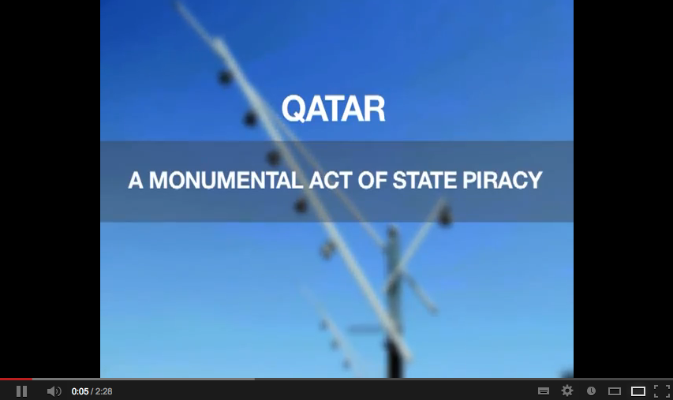
Design and Piracy
Even design have to face piracy...
Source: http://youtu.be/RB7X6uti-_0
http://www.qatarfakes.com/

Slide 5
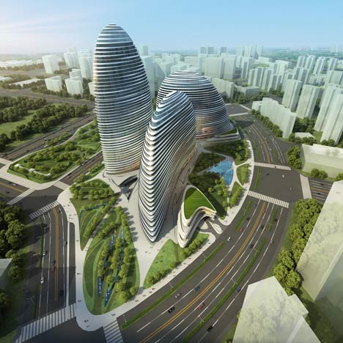
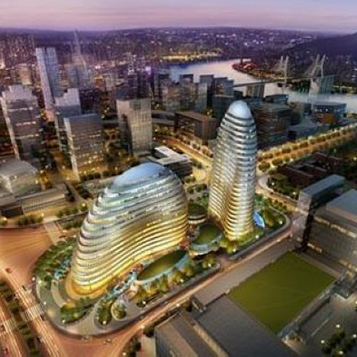
Architectural design and Piracy
Even architecture have to face piracy...
Source: http://www.dezeen.com/2013/01/02/zaha-hadid-building-pirated-in-china/

Slide 6
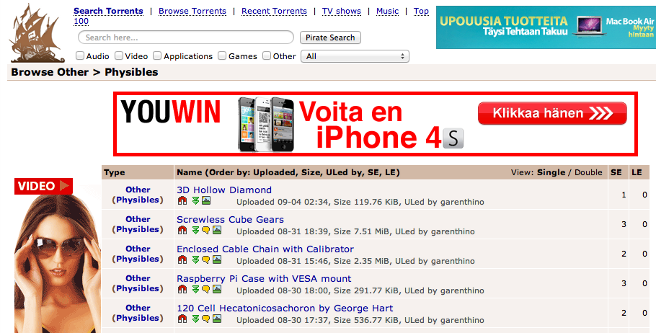
Close to the Napster case of 3D Printing
There is a rising debate about 3D printing as the next possible source of piracy... so there could be even more laws and restrictions!
Source: http://thepiratebay.se/browse/605

Slide 7
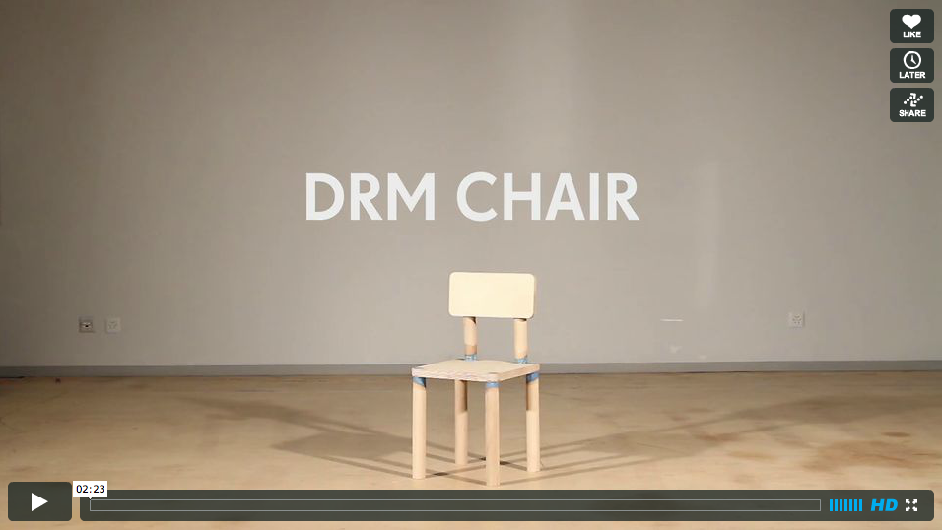
DRM and Design
A group of designers have built a chair with a DRM system -- after being sat on eight times, it self-destructs.
Source: http://www.wired.co.uk/news/archive/2013-03/03/drm-chair

Slide 8
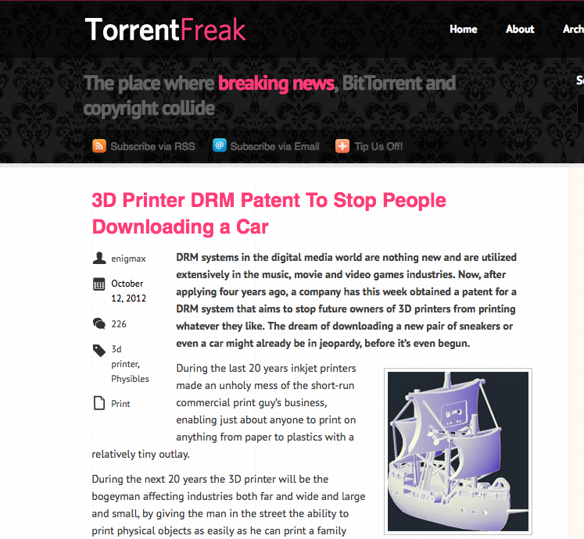
DRM and Design
Digital Rights Management could be a strategy for “protecting” design...
Source: https://torrentfreak.com/3d-printer-drm-patent-to-stop-people-downloading-a-car-121012/

Slide 9
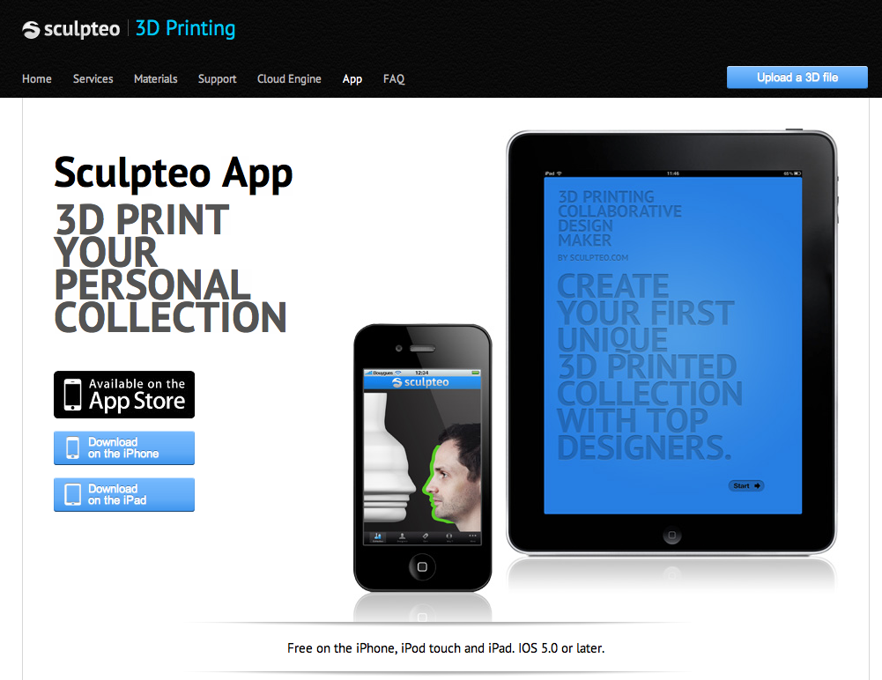
Digital Fabrication and copying...
But fabbing is only experiencing the same phenomena of design and manufacturing...
Source: http://www.sculpteo.com/en/app/

Slide 10
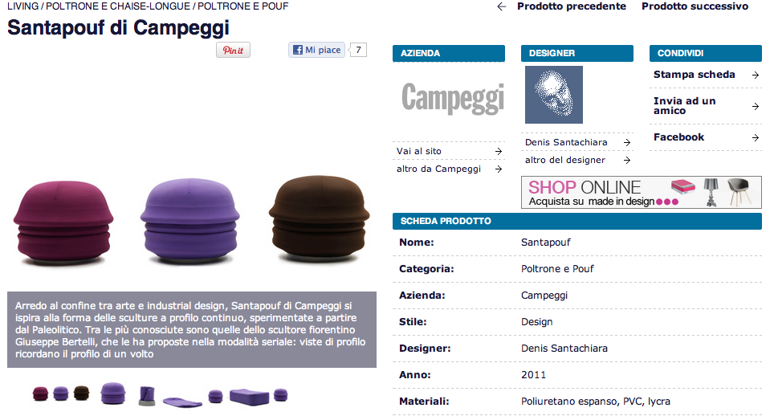
Digital Fabrication and copying...
But fabbing is only experiencing the same phenomena of design and manufacturing...
Source: http://atcasa.corriere.it/catalogo/prodotti/Campeggi/Santapouf.shtml

Slide 11
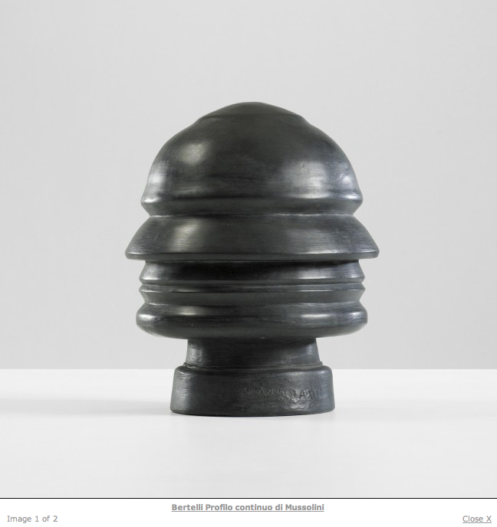
Digital Fabrication and copying...
But fabbing is only experiencing the same phenomena of design and manufacturing... So who copies who?
Source: http://www.liveauctioneers.com/item/8263457

Slide 12
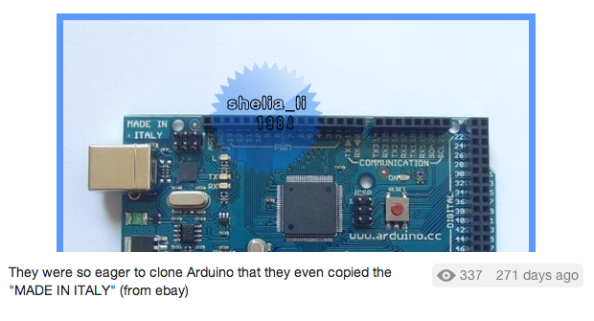
Digital Fabrication and copying... even the details
But fabbing is only experiencing the same phenomena of design and manufacturing... even details are copied!
Source: http://twitpic.com/7t9879

Slide 13
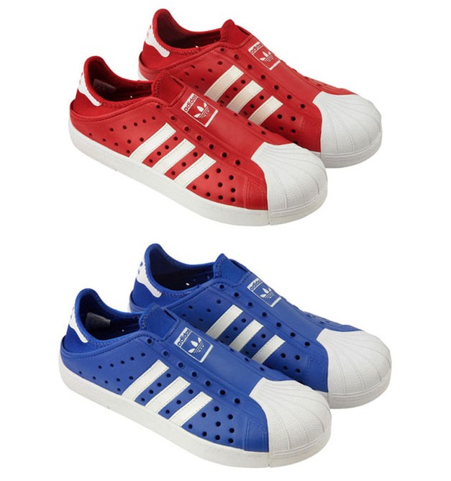
Fashion Design and copying... “piracy” ?
Copying in Fashion Design is a common practice, because only the trademark is protected.. and that's how we they set trends!
Source: http://www.refinedhype.com/hyped/entry/adidas-beachstar-sandal

Slide 14
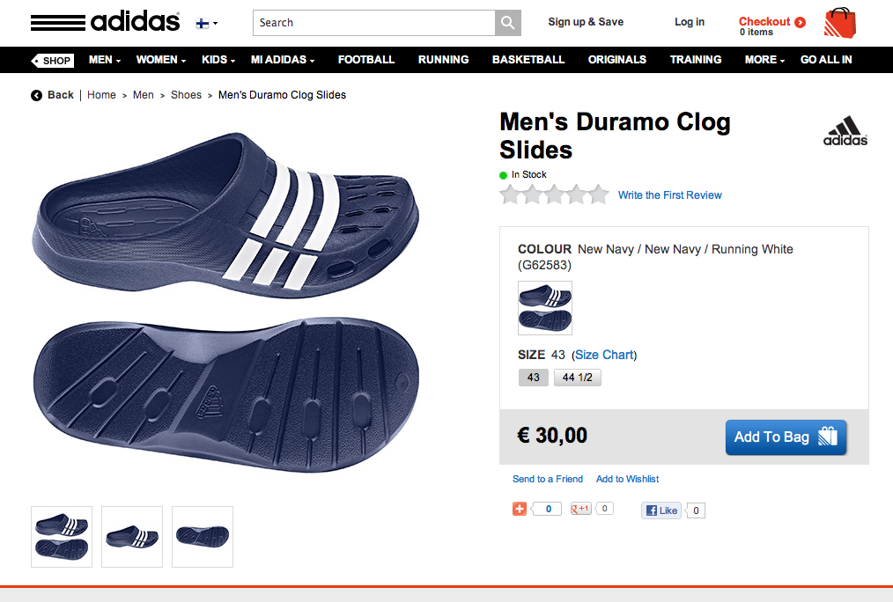
Fashion Design and copying... “piracy” ?
Copying in Fashion Design is a common practice, because only the trademark is protected.. and that's how we they set trends!
Source: http://www.adidas.fi/Men%27s-Duramo-Clog-Slides/G62583_640,fi_FI,pd.html

Slide 15
Copyright ...
Copyright essentially attaches to every original creative work that is fixed in a tangible medium. This includes most things that are written, drawn, or designed. However, the copyright only protects the actual writing, drawing, or design itself, not the idea that it expresses.
Source: http://www.publicknowledge.org/it-will-be-awesome-if-they-dont-screw-it-up
Copyright =
* the right to copy (the rights to let or stop copying)
* the author's rights (the rights to be credited)

Slide 16
Patent ...
Patent protection is not granted automatically. An inventor must apply for a patent on her invention at the Patent and Trademark Office (PTO). The invention must be new, useful, and non-obvious. In making the application, the inventor must disclose information that would allow others to practice the invention. Finally, patent protection is significantly shorter in duration than copyright protection.
Once an object has been patented, all copies, regardless of the copier’s knowledge of the patent, infringe upon that patent. Simply stated, if you are using a 3D printer to reproduce a patented object, you are infringing on the patent.
Source: http://www.publicknowledge.org/it-will-be-awesome-if-they-dont-screw-it-up

Slide 17
Copyright, Patent and originality ...
In the world of copyright law, this intuition is correct. When a child in Seattle writes an ode to his pet dog, that work is protected by copyright. If, two years later, another child in Atlanta writes an identical ode to her pet dog (unaware of the first ode), the second work is also protected by copyright. This is possible because copyright allows for independent creation, even if the same work was independently created twice (or even more than twice). While a work must be original in order to receive copyright protection, the work does not need to be unique in the world.
Source: http://www.publicknowledge.org/it-will-be-awesome-if-they-dont-screw-it-up
However, and relevantly for reproducing 3D objects, patent law does have a novelty requirement. Patent law does not allow for parallel creation. Once an invention is patented every unauthorized reproduction of that invention is an infringement, whether the reproducer is aware of the original invention or not.
Source: http://www.publicknowledge.org/it-will-be-awesome-if-they-dont-screw-it-up

Slide 18
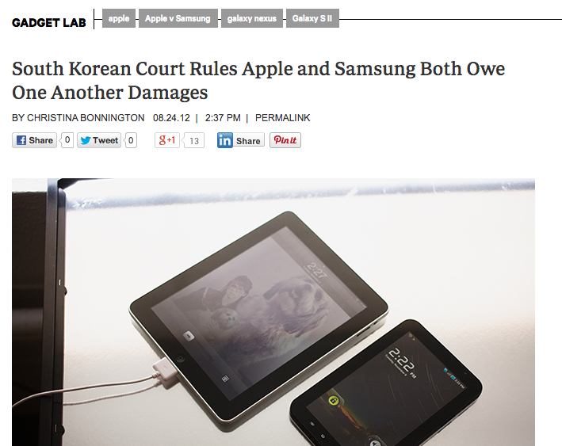
Watch out when you enter this game...
A South Korean court ruled that both Apple and Samsung infringed on one another’s intellectual property and owe each other damages.
Source: http://www.wired.com/gadgetlab/2012/08/s-korea-court-rules-damages/

Slide 19
Trademark ...
Trademark developed as a way to protect consumers, giving them confidence that a product marked with a manufacturer’s symbol was actually made and backed by that manufacturer. As a result, trademark is not designed to protect intellectual property per se. Intellectual property protection is instead a side effect of needing to protect the integrity of the mark.
Source: http://www.publicknowledge.org/it-will-be-awesome-if-they-dont-screw-it-up
Because trademark protection is specifically geared towards preventing consumer confusion in the marketplace, trademark infringement is described in terms of “use in commerce.” Unlike patent or copyright, it is not copying a trademark that creates a trademark violation. Instead, it is using that trademark in commerce (thus potentially confusing a consumer as to the origin of the product) that results in a violation.
Source: http://www.publicknowledge.org/it-will-be-awesome-if-they-dont-screw-it-up

Slide 20
Trade Dress
Trademark protection can extend beyond a logo affixed to a product to include the design of the product itself. However, in order to extend protection to product design, courts have required that trade dress acquire a distinct association with a specific manufacturer. Acquiring this type of distinctiveness takes time, and must be proven by survey results or some other proof of association in the eyes of the general public. As a result most product designs, even unique designs intended “to render the product more useful or more appealing,” will not be protected as trade dress.
Source: http://www.publicknowledge.org/it-will-be-awesome-if-they-dont-screw-it-up

Slide 21
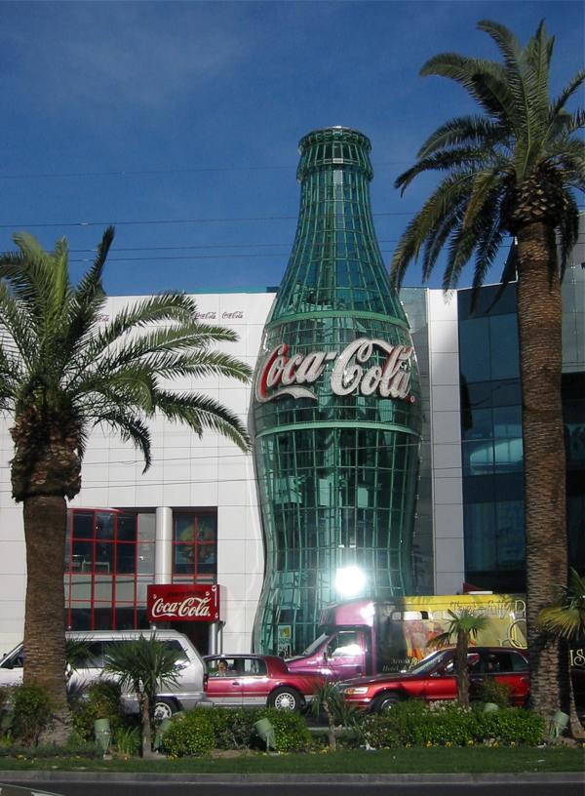
Trade Dress, an example
A very recognizable shape...
Source: http://en.wikipedia.org/wiki/Coca_cola

Slide 22
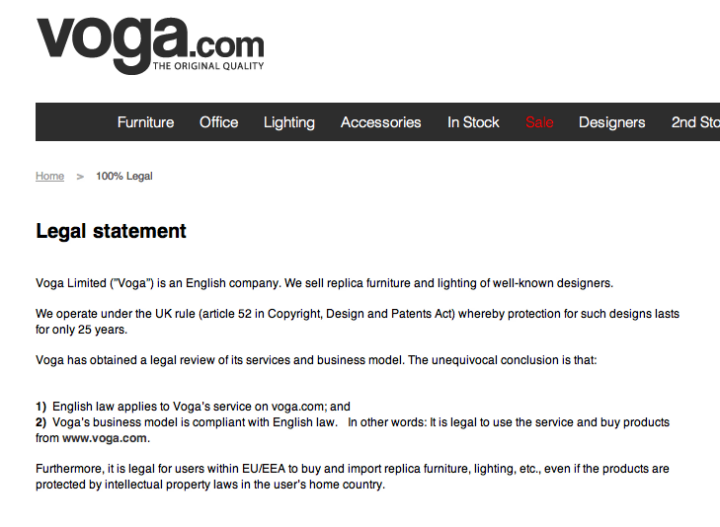
Be careful: every country has its laws...
In UK copyright only lasts 25 years after the creation ...
Source: http://www.voga.com/is-it-legal/
http://www.core77.com/blog/business/scandinavian_design_piracy_company_utilizes_uk_copyright_loophole_22318.asp

Slide 23
Licensing your project ...
The main benefit of product licensing is that you do not have all of the risk and headaches that necessarily come with running your own business. It is quite true that you could make a lot more money if you sold your own idea (if you did not screw things up at any number of places along the way).
Source: http://www.core77.com/blog/columns/product_licensing_in_an_era_of_open_innovation_22953.asp
Young designers often gasp when hearing that a good royalty rate might be 5% of wholesale cost (around 2% of retail price)—"but it is MY idea!" Seasoned designers understand that a designed product (not to mention one that is not engineered, sourced, and fully developed and tested) is but a small part of the business equation.
Source: http://www.core77.com/blog/columns/product_licensing_101_so_lets_talk_money_23366.asp

Slide 24
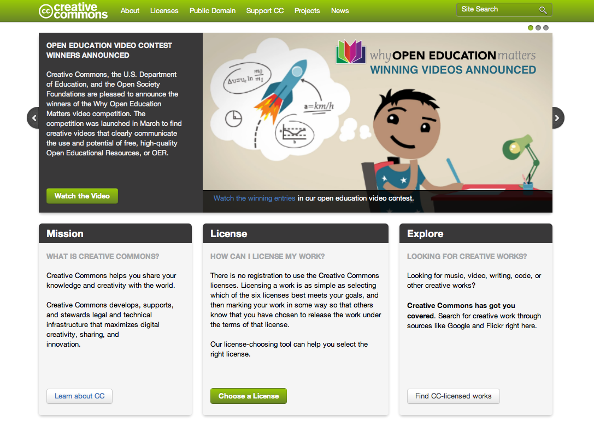
Creative Commons: licensing the sharing
How to publish your content while at the same time
enabling sharing and protecting your author rights.
Source: http://creativecommons.org/

Slide 25




License: Review conditions
Attribution: Licensees may copy, distribute, display and perform the work and make derivative works based on it only if they give the author or licensor the credits in the manner specified by these.
Non commercial: Licensees may copy, distribute, display, and perform the work and make derivative works based on it only for noncommercial purposes.
No Derivate Works: Licensees may copy, distribute, display and perform only verbatim copies of the work, not derivative works based on it.
Share alike: Licensees may distribute derivative works only under a license identical to the license that governs the original work.

Slide 26
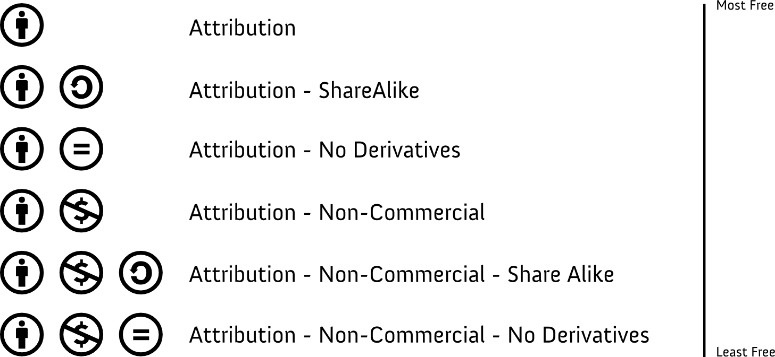
License: Select license
Source:
http://creativecommons.org/

Slide 27
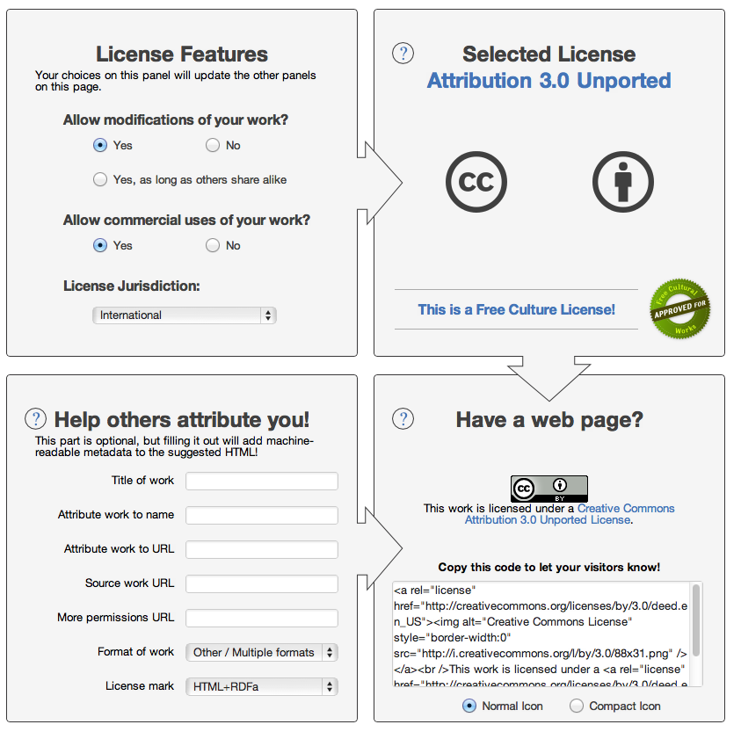
Creative Commons: licensing the sharing
How to publish your content while at the same time
enabling sharing and protecting your author rights.
Source: http://creativecommons.org/

Slide 28
Creative Commons: licensing the sharing
How to publish your content while at the same time
enabling sharing and protecting your author rights.
Source: http://creativecommons.org/

Slide 29

Everything is a Remix #01
More about the complex field of Intellectual Property
Source: http://vimeo.com/14912890

Slide 30
Everything is a Remix #02
More about the complex field of Intellectual Property
Source: http://vimeo.com/19447662

Slide 31
Everything is a Remix #03
More about the complex field of Intellectual Property
Source: http://vimeo.com/25380454

Slide 32
Everything is a Remix #04
More about the complex field of Intellectual Property
Source: http://vimeo.com/36881035

Slide 33
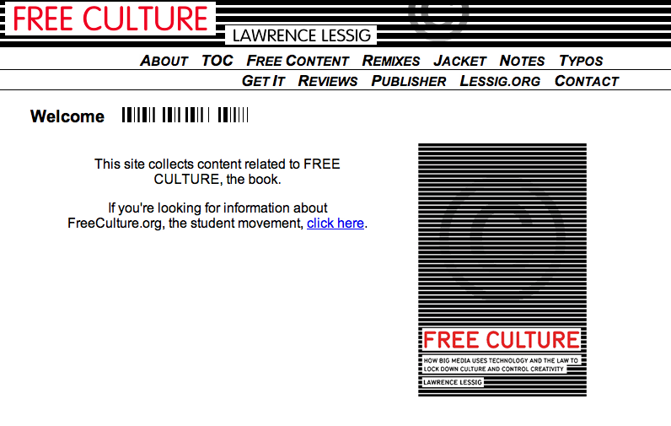
For a further reading on the topic ...
An open and free book about Free Culture and Open Knowledge.
Source: http://www.free-culture.cc/

Slide 34
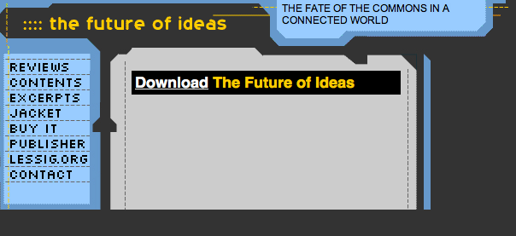
For a further reading on the topic ...
An open and free book about Free Culture and Open Knowledge.
Source: http://www.the-future-of-ideas.com/download/

Slide 35
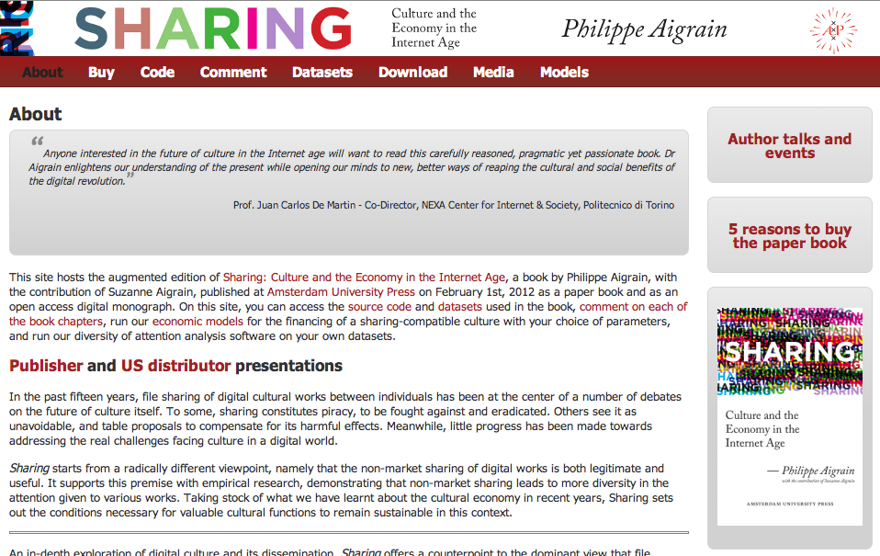
For a further reading on the topic ...
An in-depth exploration of digital culture and its dissemination, Sharing offers a counterpoint to the dominant view that file sharing is piracy.
Source: http://www.sharing-thebook.com/content/about

Slide 36
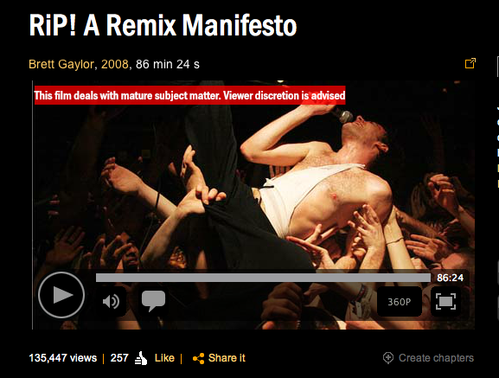
For a further watching on the topic ...
An open and free documentary about intellectual property and remix.
Source: http://ripremix.com/ http://www.nfb.ca/film/rip_a_remix_manifesto/

Slide 37
02.
Open Design: mass collaboration enabled by the Internet and other tools

Slide 38
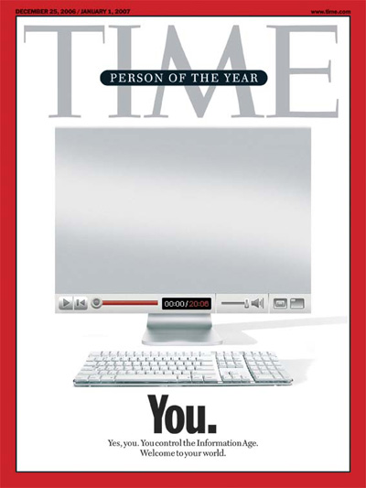
Web 2.0
A new model of mass collaboration, based on user-generated content and commenting.
Source: http://www.time.com/time/magazine/article/0,9171,1570810,00.html

Slide 39
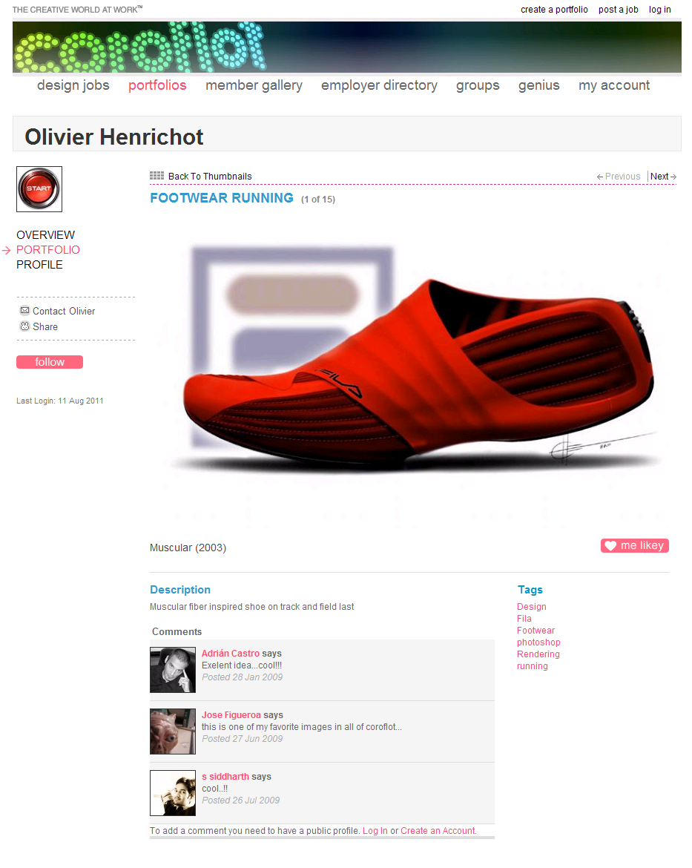
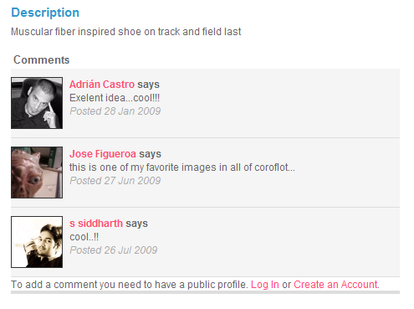
Web 2.0
And the same model can be applied to Design.
Source: http://www.coroflot.com/heo/FOOTWEAR-RUNNING/1

Slide 40
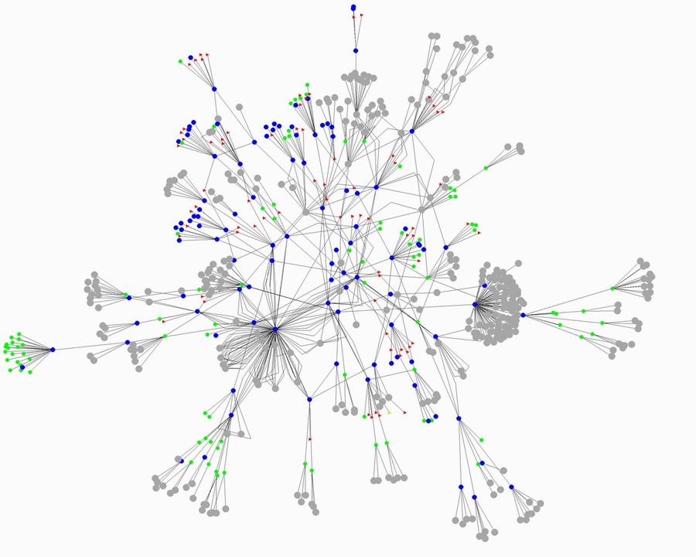
Peer-to-Peer
More than about file sharing, peer-to-peer defines new dynamics between people.
Source: http://home.comcast.net/~gregory.bray/

Slide 41
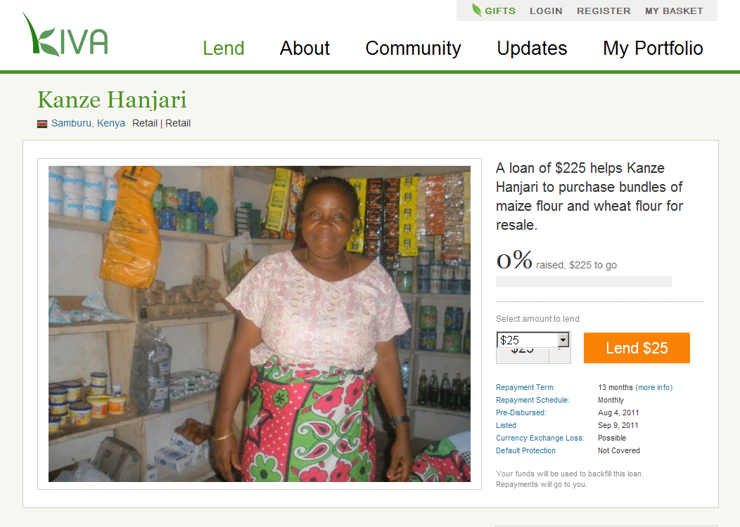
Peer-to-Peer
And the same model can be applied to Design.
Source: http://www.kiva.org/lend/333427

Slide 42
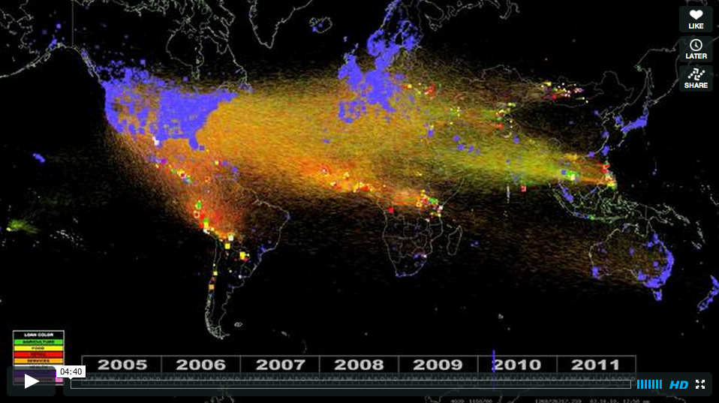
Peer-to-Peer
And the same model can be applied to Design, with important results!
Source: http://vimeo.com/28413747

Slide 43
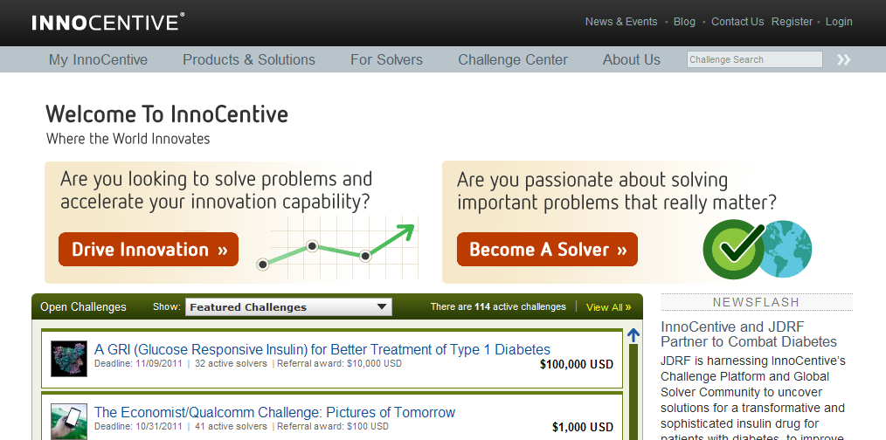
Crowdsourcing
Outsourcing a project or a task to an online crowd, more about competition than collaboration.
Source: http://www.innocentive.com/

Slide 44
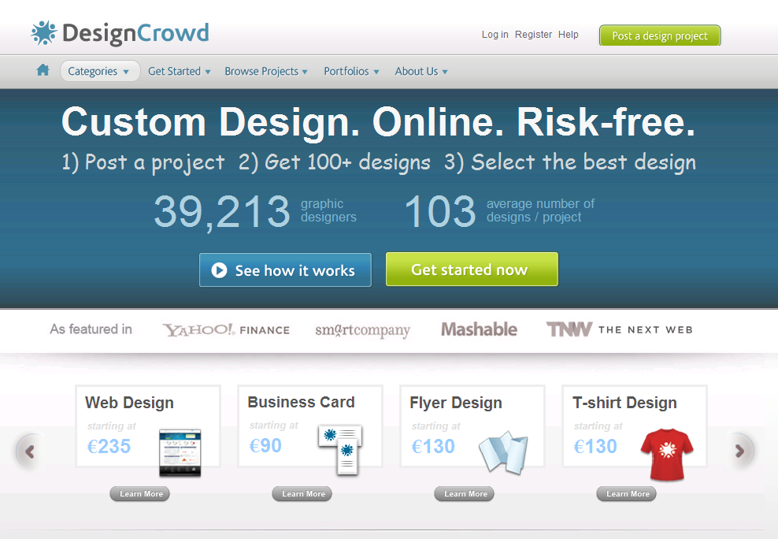
Crowdsourcing
And the same model can be applied to Design, with critica results!!
Source: http://www.designcrowd.com/

Slide 45
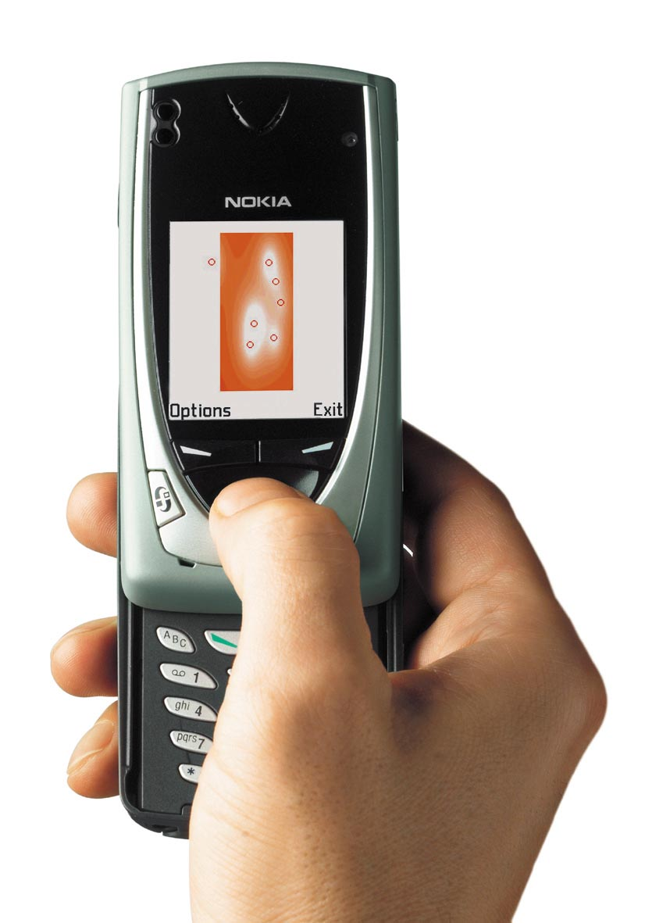
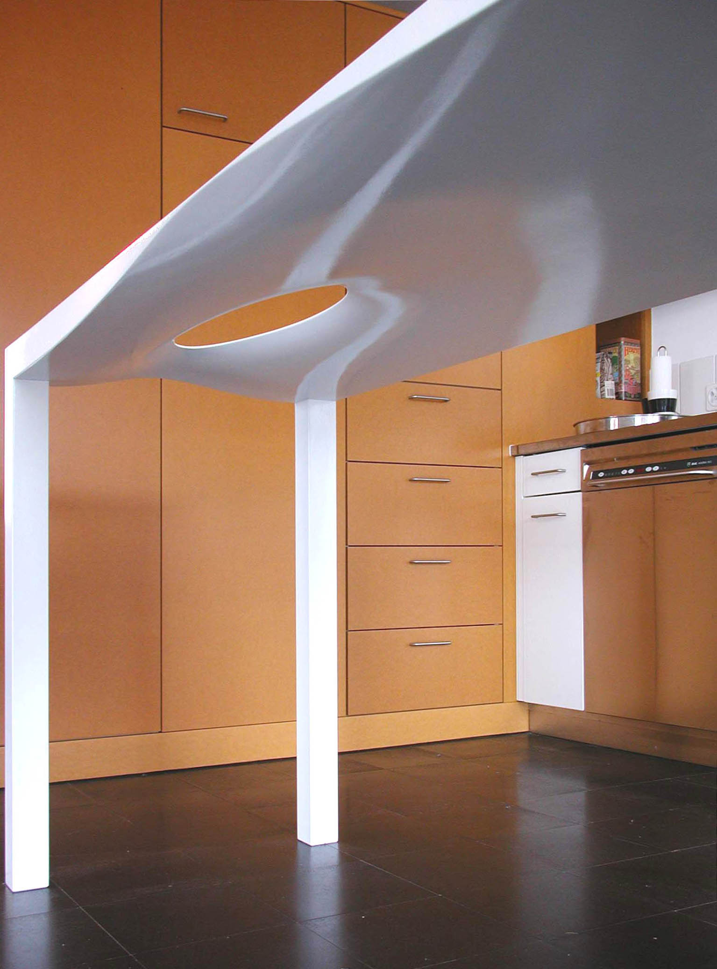
Mobile: Single user designing, no collaboration
Collaboration is not only based on a single tool: not only on a PC!
Source: http://www.mshape.com/

Slide 46
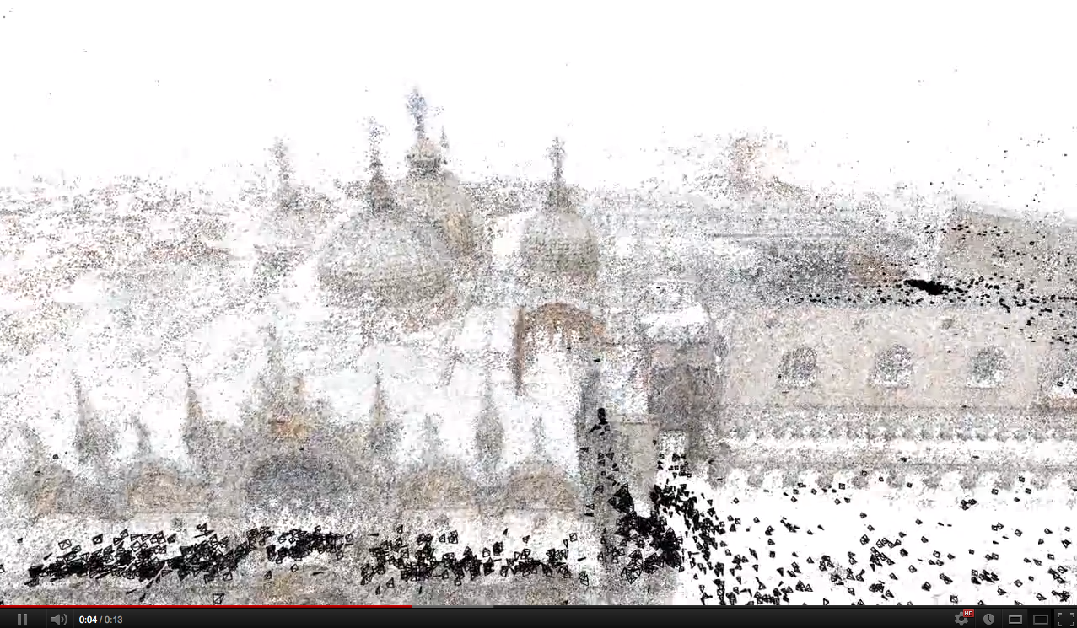
Mobile: Smart Mobs, Ubiquitous Computing
We could even (re)build a design from noncoordinated users.
Source: http://grail.cs.washington.edu/rome/ http://youtu.be/HrgHFDPJHXo

Slide 47
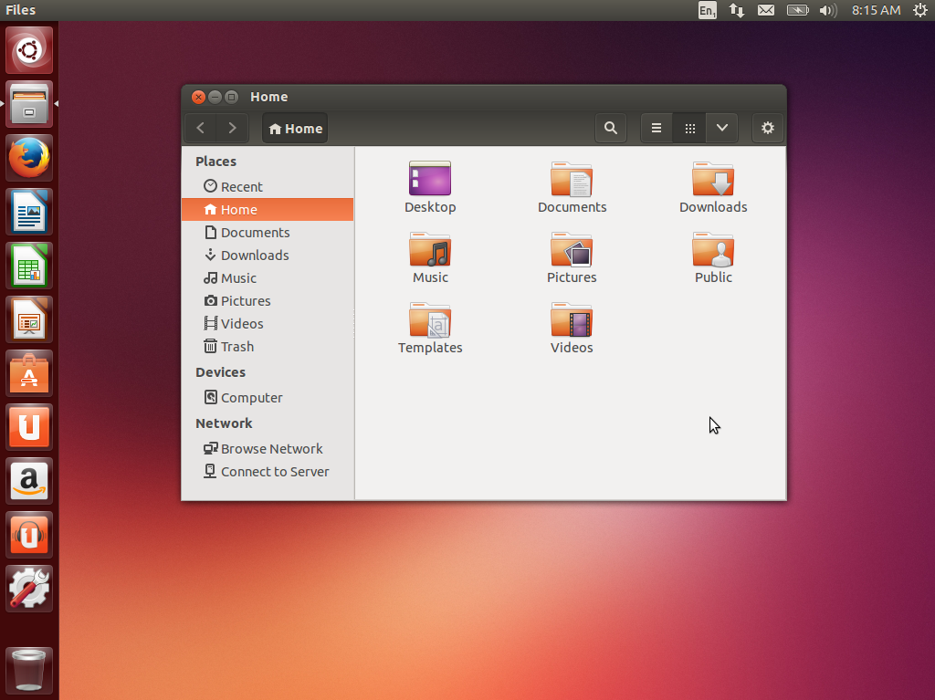
Open Source: open collaborative development
Source: http://en.wikipedia.org/wiki/Ubuntu_%28operating_system%29
The most complete and promising model for mass-collaboration on the Internet.
Source: http://commons.wikimedia.org/wiki/Ubuntu

Slide 48
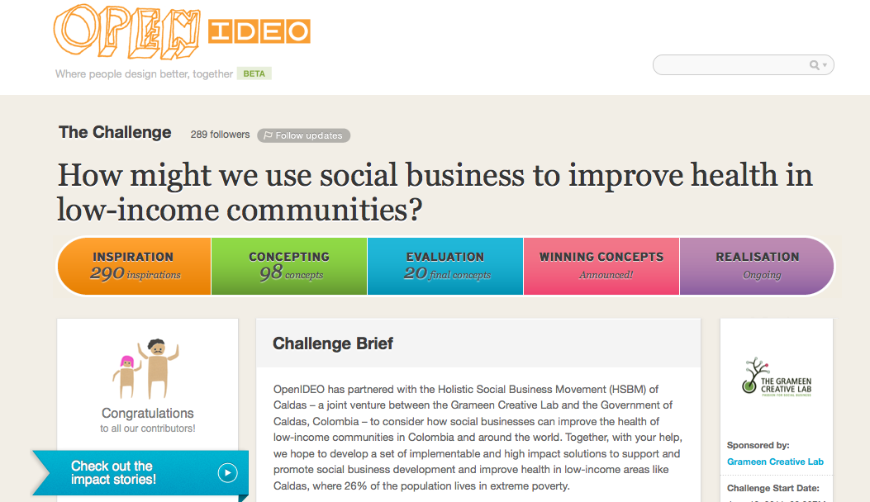
And hybrid models... like OpenIDEO
Crowdsourcing 50% + Web 2.0 30% + Open Source 20%.
Source: http://www.openideo.com/

Slide 49
What is Open Source? A generic definition
A (software) project published with a license that facilitates its access + modifying + sharing in a collaborative way.
A (software) project developed collaboratively by a community, based not on hierarchy but on reputation.

Slide 50
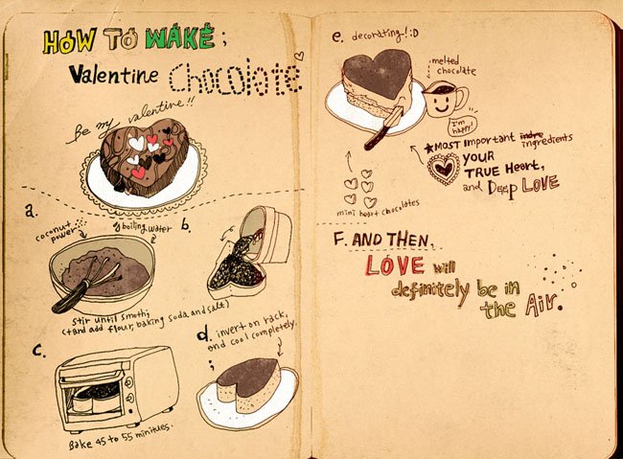
Why Open Source in Software?
Source Code (human readable) --> Binary Code (machine readable)
Source: http://www.flickr.com/photos/nyoin/3342043239/

Slide 51

Why Open Source in Software?
Source Code (human readable) --> Binary Code (machine readable)
Source: http://www.flickr.com/photos/exlibris/2997090116/

Slide 52


Why Open Source in Software?
Source Code (human readable) --> Binary Code (machine readable)
Source: http://www.flickr.com/photos/ladymixy-uk/3650120464/

Slide 53
Open Source Everywhere...
“Software is just the beginning … open source is doing for mass innovation what the assembly line did for mass production. Get ready for the era when collaboration replaces the corporation.”
Thomas Goetz, Wired November 2003
Source: http://www.wired.com/wired/archive/11.11/opensource.html
Open Source as promising way to organise communities.

Slide 54
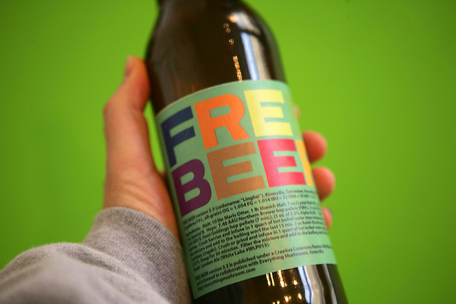
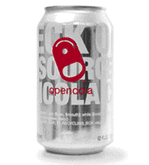
Open Drinks
Started as an example or for marketing, now an important field of experimentation!
Source: http://en.wikipedia.org/wiki/OpenCola_(drink) http://en.wikipedia.org/wiki/Free_Beer
http://www.flickr.com/photos/16038409@N02/2327138220/in/photostream

Slide 55
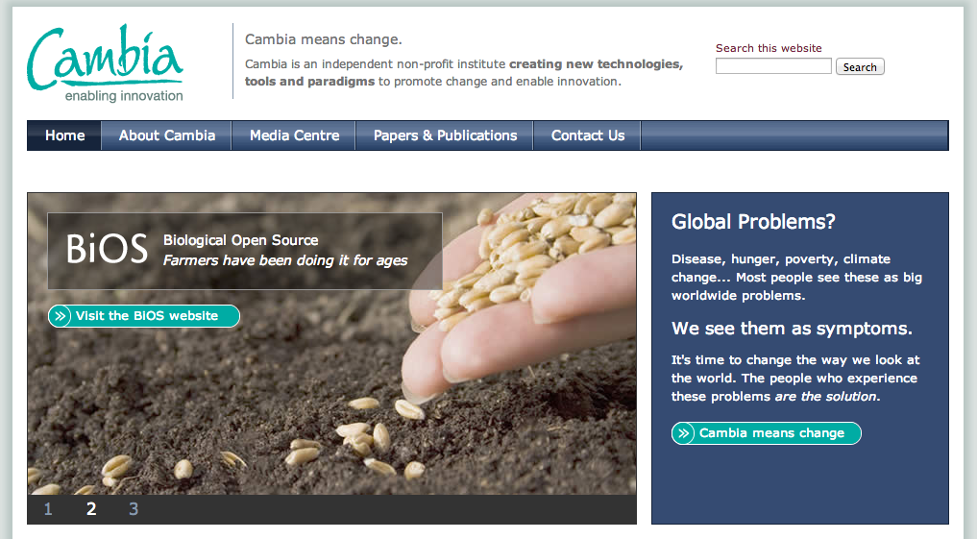
Open Biotechnology
Applied in many different scientific researches.
Source: http://www.cambia.org/

Slide 56



Open Movies + Videogames
Done with and for Blender (Open Source 3D modeling software).
Source: http://www.elephantsdream.org/ http://www.bigbuckbunny.org/ http://www.sintel.org/

Slide 57
What is Open Design? A generic definition
a project published with a license that facilitates its sharing and that can be “compiled” or “manufactured” locally.
* sharing
* collaboration
* open licenses
* code --> artifact
Open Design refers to every kind of design projects that can be shared in a digital format over a network.

Slide 58
Open Typography
ABCDEFGHIJKLMNOPQRSTUVWXYZ
abcdefghijklmnopqrstuvwxyz
ÈÉÊËĒĔĖĘĚȄȨȆḔḖḘḚḜẸẺẼỀẾỂỄỆ
èéêěèéêëēĕėęěȅȩȇḕḕḗḗḙḛḝẹẻẽềếểễềếểễ
o̊őo̍o̖o̗o̘o̙o̜o̹o̝o̞o̟o̠ọoooo̧ǫo̩o̪o̫o̬oo̯oo̱o̼o̒o
“‹«.:?!©*¶§&/(‖)[¦]{|}€†‡@®™¿¡;,»›”
¤¢$£€¥₡₢₣₤#01234567891⁄41⁄23⁄4%₦₧
The first open source font (2001) by Victor Gaultney, with a specific license: SIL Open Font License (OFL).
Source: http://scripts.sil.org/cms/scripts/page.php?site_id=nrsi&item_id=Gentium

Slide 59
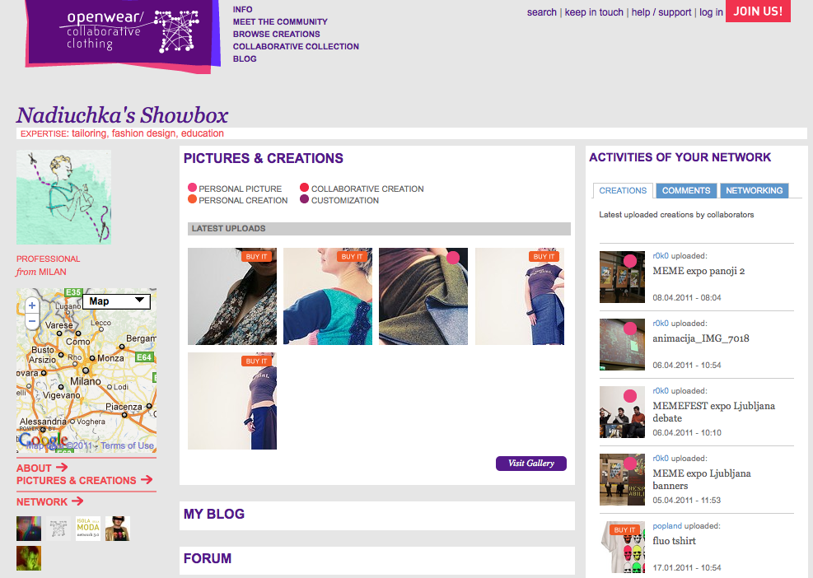
Open Fashion Design
Open Fashion Design projects and brands.
Source: http://www.openwear.org/

Slide 60
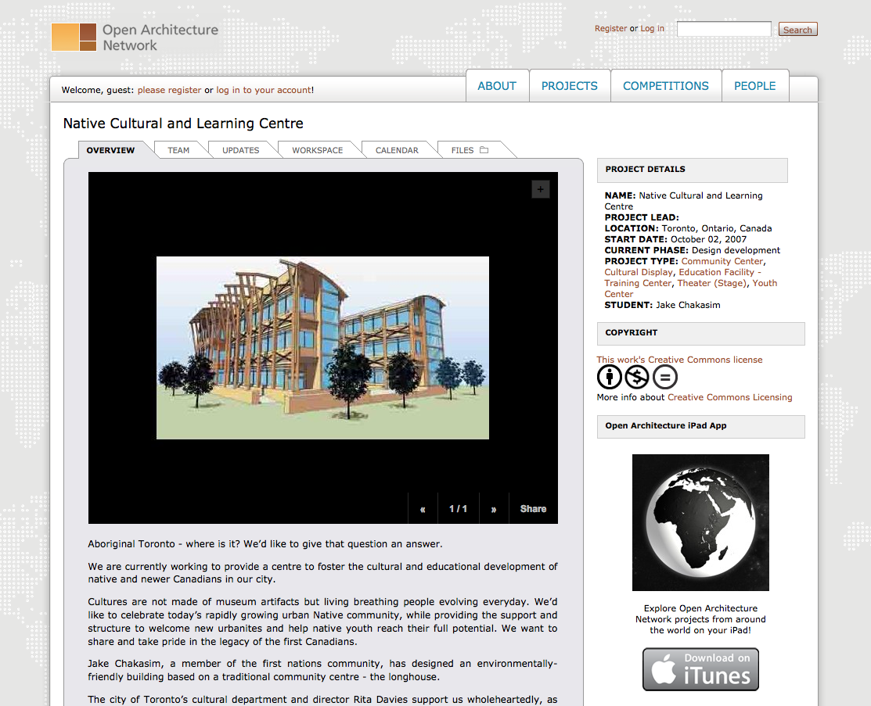
Open Architecture
Not as advanced as Open product design, but still part of an ongoing experimentation.
Source: http://openarchitecturenetwork.org/

Slide 61
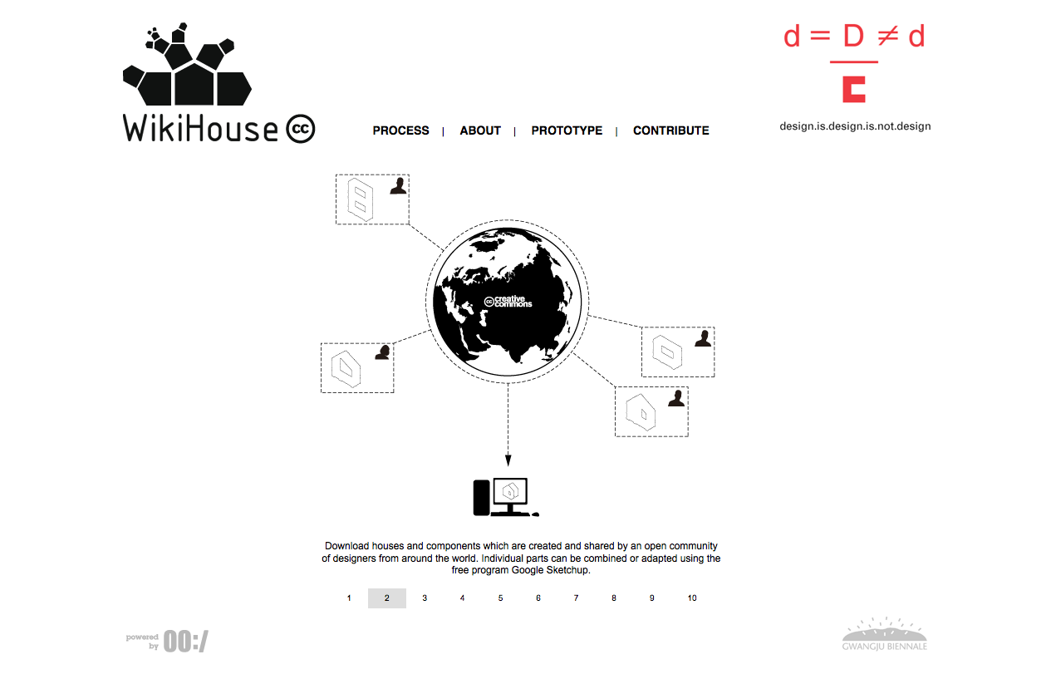
Open Architecture
Not as advanced as Open product design, but still part of an ongoing experimentation.
Source: http://www.wikihouse.cc/

Slide 62
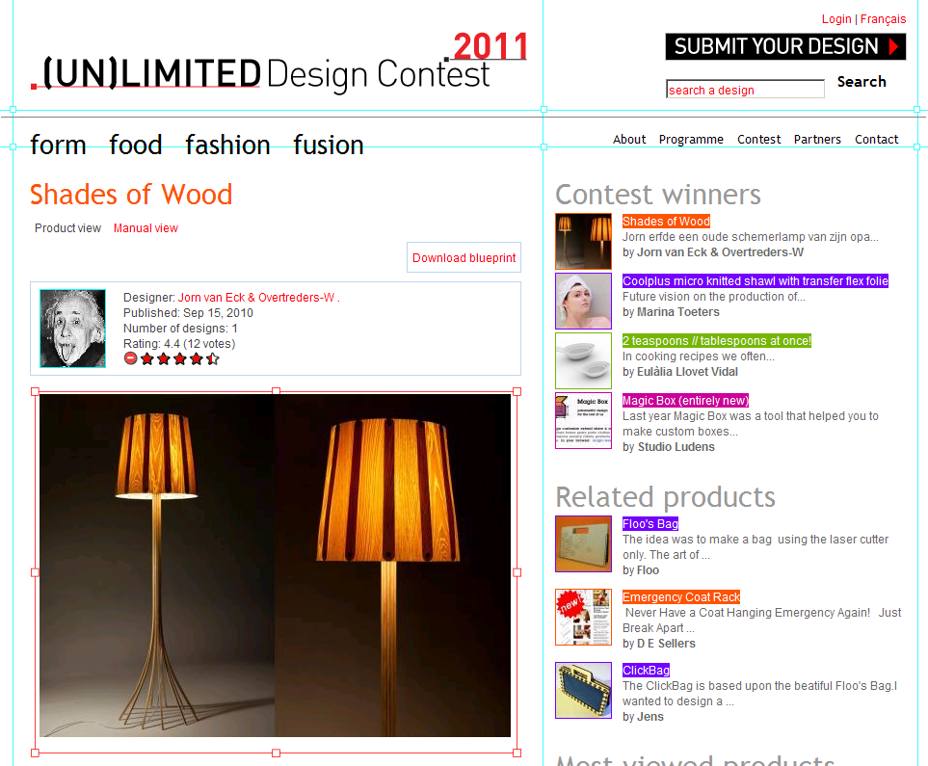
(Open) Design competitions
Digital fabrication and FabLabs open new possibilities for Design competitions and Open Design.
Source: http://unlimiteddesigncontest.org/

Slide 63
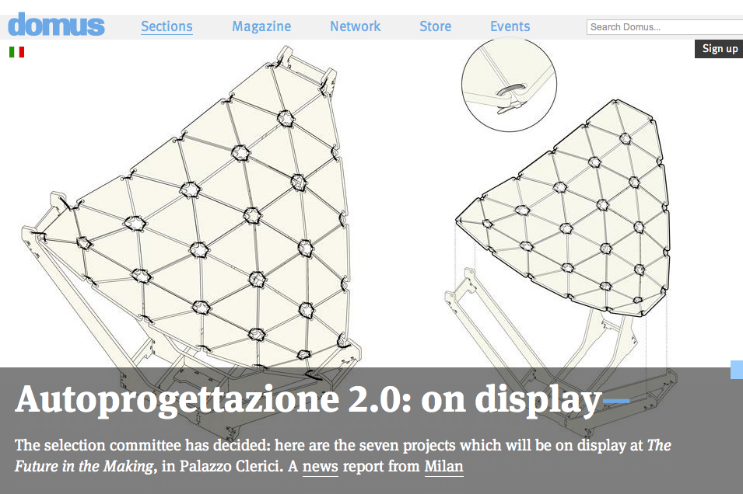
(Open) Design competitions
Digital fabrication and FabLabs open new possibilities for Design competitions and Open Design.
Source: http://www.domusweb.it/en/upcoming-event/call-for-ideas-autoprogettazione-20--/
http://www.domusweb.it/en/news/autoprogettazione-20-on-display/

Slide 64
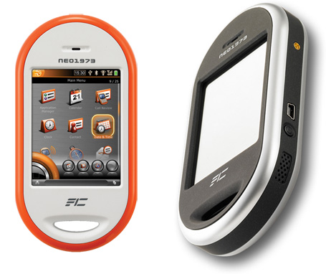
Completely Open: Hardware, Software, Design
OpenMoko was the first product to be completely open: open hardware, open source software, open design.
Source: http://wiki.openmoko.org/wiki/Main_Page

Slide 65
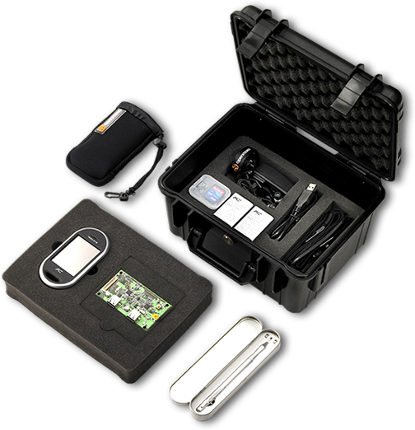
Completely Open: Hardware, Software, Design
OpenMoko was the first product to be completely open: open hardware, open source software, open design.
Source: http://wiki.openmoko.org/wiki/Main_Page

Slide 66
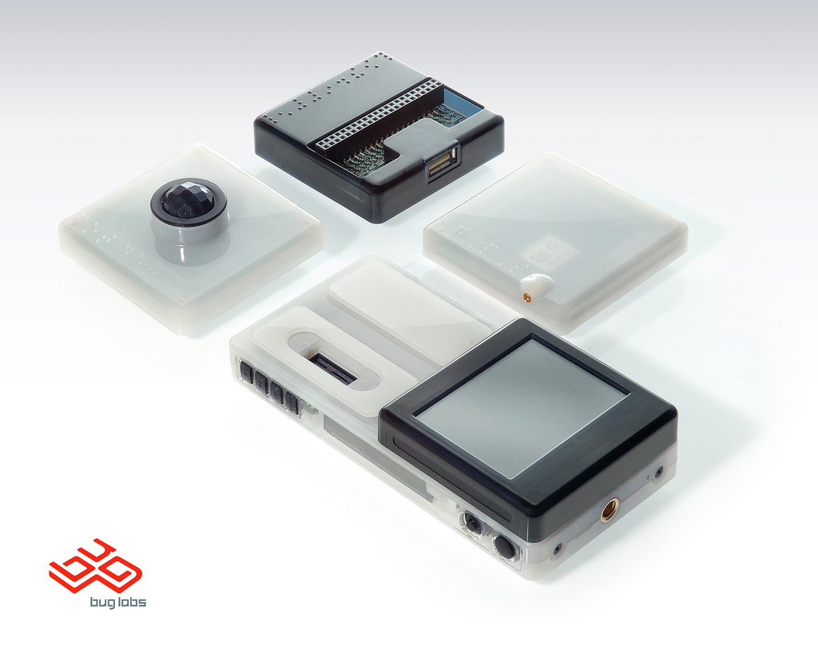
Completely Open: Hardware, Software, Design
BugLabs has been much more successful in offering completely open products.
Source: http://www.buglabs.net/

Slide 67
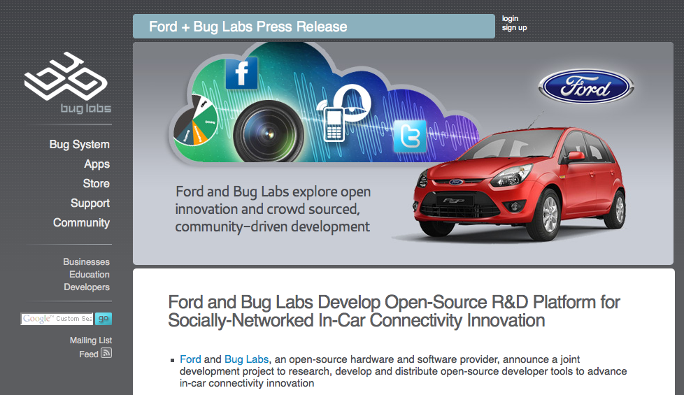
BugLabs + Ford
So successful that they just announced a partnership with Ford Car.
Source: http://www.buglabs.net/ford-buglabs

Slide 68
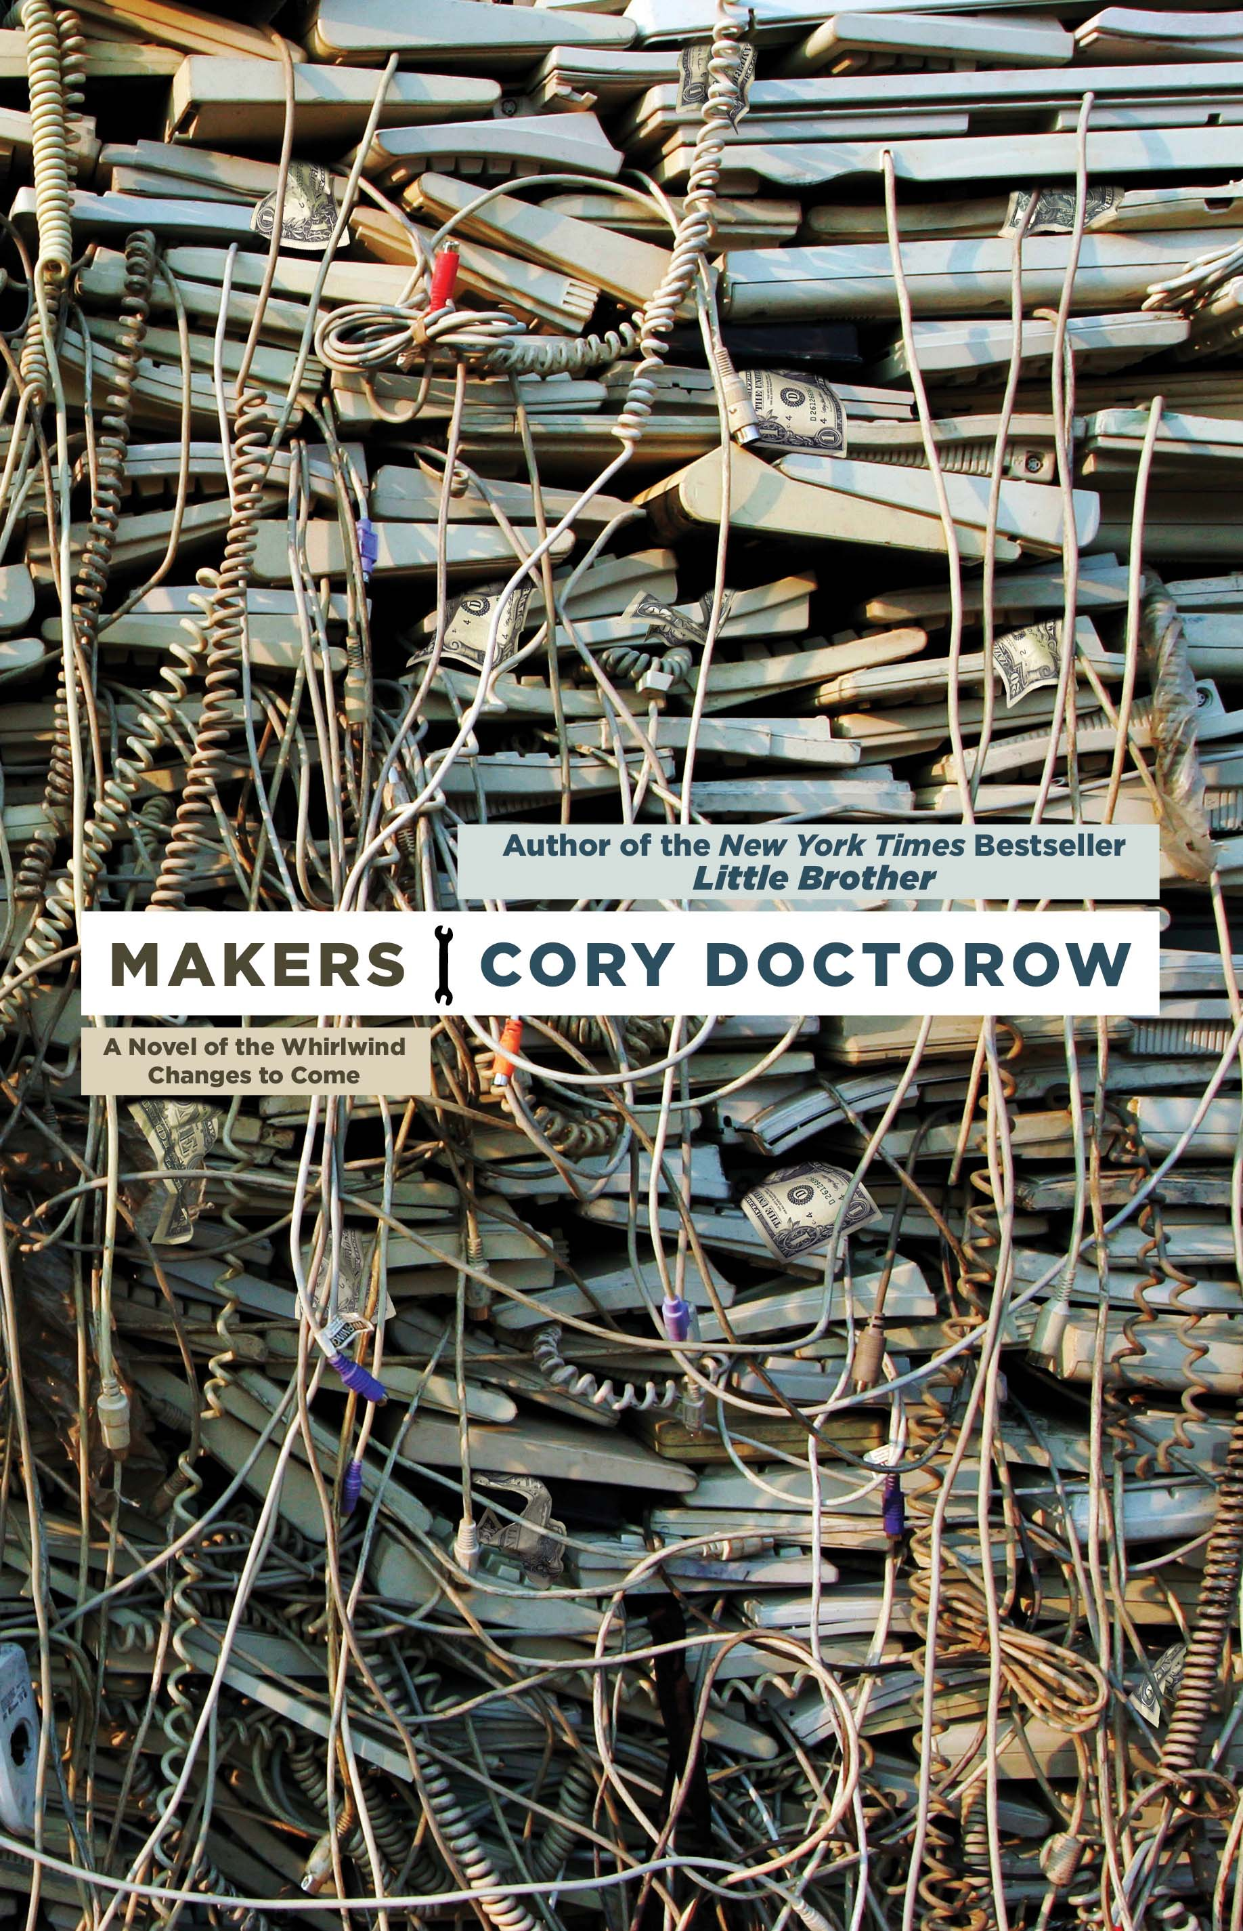
Open Design: (almost) already successful
When you have a sci-fi novel from a popular autor about open design and makers, they are not underground any longer.
Source: http://craphound.com/makers/download/

Slide 69
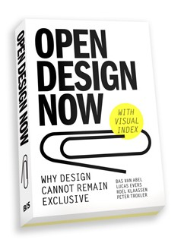


Open Design: (almost) already successful
Source: http://opendesignnow.org/ http://www.droog.com/projects/events/design-for-download/
When a famous design company and the national organization of design embrace Open Design ...

Slide 70

Open Design: (almost) already successful
And when probably the biggest CAD design software house buys an open design community, there must be money ahead!
Source: http://www.instructables.com/community/Instructables-Joins-Autodesk/
http://techcrunch.com/2011/08/01/autodesk-acquires-diy-community-instructables/

Slide 71

Open Design: (almost) already successful
Source: http://www.123dapp.com/
And when probably the biggest CAD design software house offers freeware software for makers, there must be money ahead!
Source: http://www.123dapp.com/

Slide 72

Sketch Chair: Open Design as code
What is Open Design, if the chair is designed by a software?
Source: http://www.sketchchair.cc/

Slide 73

Sketch Chair: Open Design as code
What is Open Design, is it manufacturing and supply chain process?
Source: http://www.sketchchair.cc/

Slide 74

Sea Chair: Open Design as process
What is Open Design, is it manufacturing and process documentation?
Source: http://www.studioswine.com/sea-chair

Slide 75

Sea Chair: Open Design as process
What is Open Design, is it manufacturing and process documentation?
Source: http://vimeo.com/58461689

Slide 76

Sea Chair: Open Design as process
What is Open Design, is it manufacturing and process documentation?
Source: http://www.studioswine.com/sea-chair-open-source

Slide 77

… and participate in the Open Design Definition!
Source: http://www.123dapp.com/
A collaborative and open source Definition project, on GitHub!
Source: https://github.com/OpenDesign-WorkingGroup/Open-Design-Definition

Slide 78
The current status of Open Design
* single persons or small groups design a project and then just publish it online
* lack of new tools, processes, systems that enable designers and users in developing open design projects
--> where is the collaboration?
--> where are the open processes?
--> where are the communities?

Slide 79
The current status of Open Design
From: torvalds@klaava.Helsinki.FI (Linus Benedict Torvalds)
Newsgroups: comp.os.minix
Subject: What would you like to see most in minix?
Summary: small poll for my new operating system
Message-ID:
Date: 25 Aug 91 20:57:08 GMT
Organization: University of Helsinki
Hello everybody out there using minix -
I'm doing a (free) operating system (just a hobby, won't be big and
professional like gnu) for 386(486) AT clones. This has been brewing
since april, and is starting to get ready. I'd like any feedback on
things people like/dislike in minix, as my OS resembles it somewhat
(same physical layout of the file-system (due to practical reasons)
among other things).
I've currently ported bash(1.08) and gcc(1.40), and things seem to work.
This implies that I'll get something practical within a few months, and
I'd like to know what features most people would want. Any suggestions
are welcome, but I won't promise I'll implement them :-)
Linus (torvalds@kruuna.helsinki.fi)
Just at the beginning of mass collaboration
Source: http://www.cs.cmu.edu/~awb/linux.history.html

Slide 80

The experience of a user of Open Source software
The surface experience with open source software: not only finished products that can be downloaded and used!
Source: http://sourceforge.net/

Slide 81

… the big picture of Open Source: the process
But there's a big process of collaboration behind the final product!
Source: http://code.google.com/p/codeswarm/
http://vimeo.com/1093745

Slide 82

… the big picture of Open Source: the process
But there's a big process of collaboration behind the final product!
Source: http://code.google.com/p/gource/
http://youtu.be/aPk1BqK8zzI

Slide 83

… the big picture of Open Source: the process
But there's a big process of collaboration behind the final product!
Source: http://www.michaelogawa.com/research/storylines/

Slide 84
A more systemic definition of Open Design
A collaborative distributed system of design & manufacturing
* sharing
* collaboration
* open licenses
* open and distributed manufacturing technologies
A system of agents that:
* use
* design
* manufacture
* market
* distribute
* manage the end-of-life

Slide 85
Thank you!!
Massimo Menichinelli
Aalto Media Factory massimo.menichinelli@aalto.fi
@openp2pdesign http://www.slideshare.net/openp2pdesign

