Slide 1

Digital_Fabrication_Studio.01
Fabbing and Fab Labs - history, concepts, fields of application
Massimo Menichinelli massimo.menichinelli@aalto.fi
@openp2pdesign http://www.slideshare.net/openp2pdesign

Slide 2
This morning:
* Digital Fabrication
* FabLabs
* Other spaces

Slide 3
01.
Digital Fabrication: interactions between bits and atoms

Slide 4
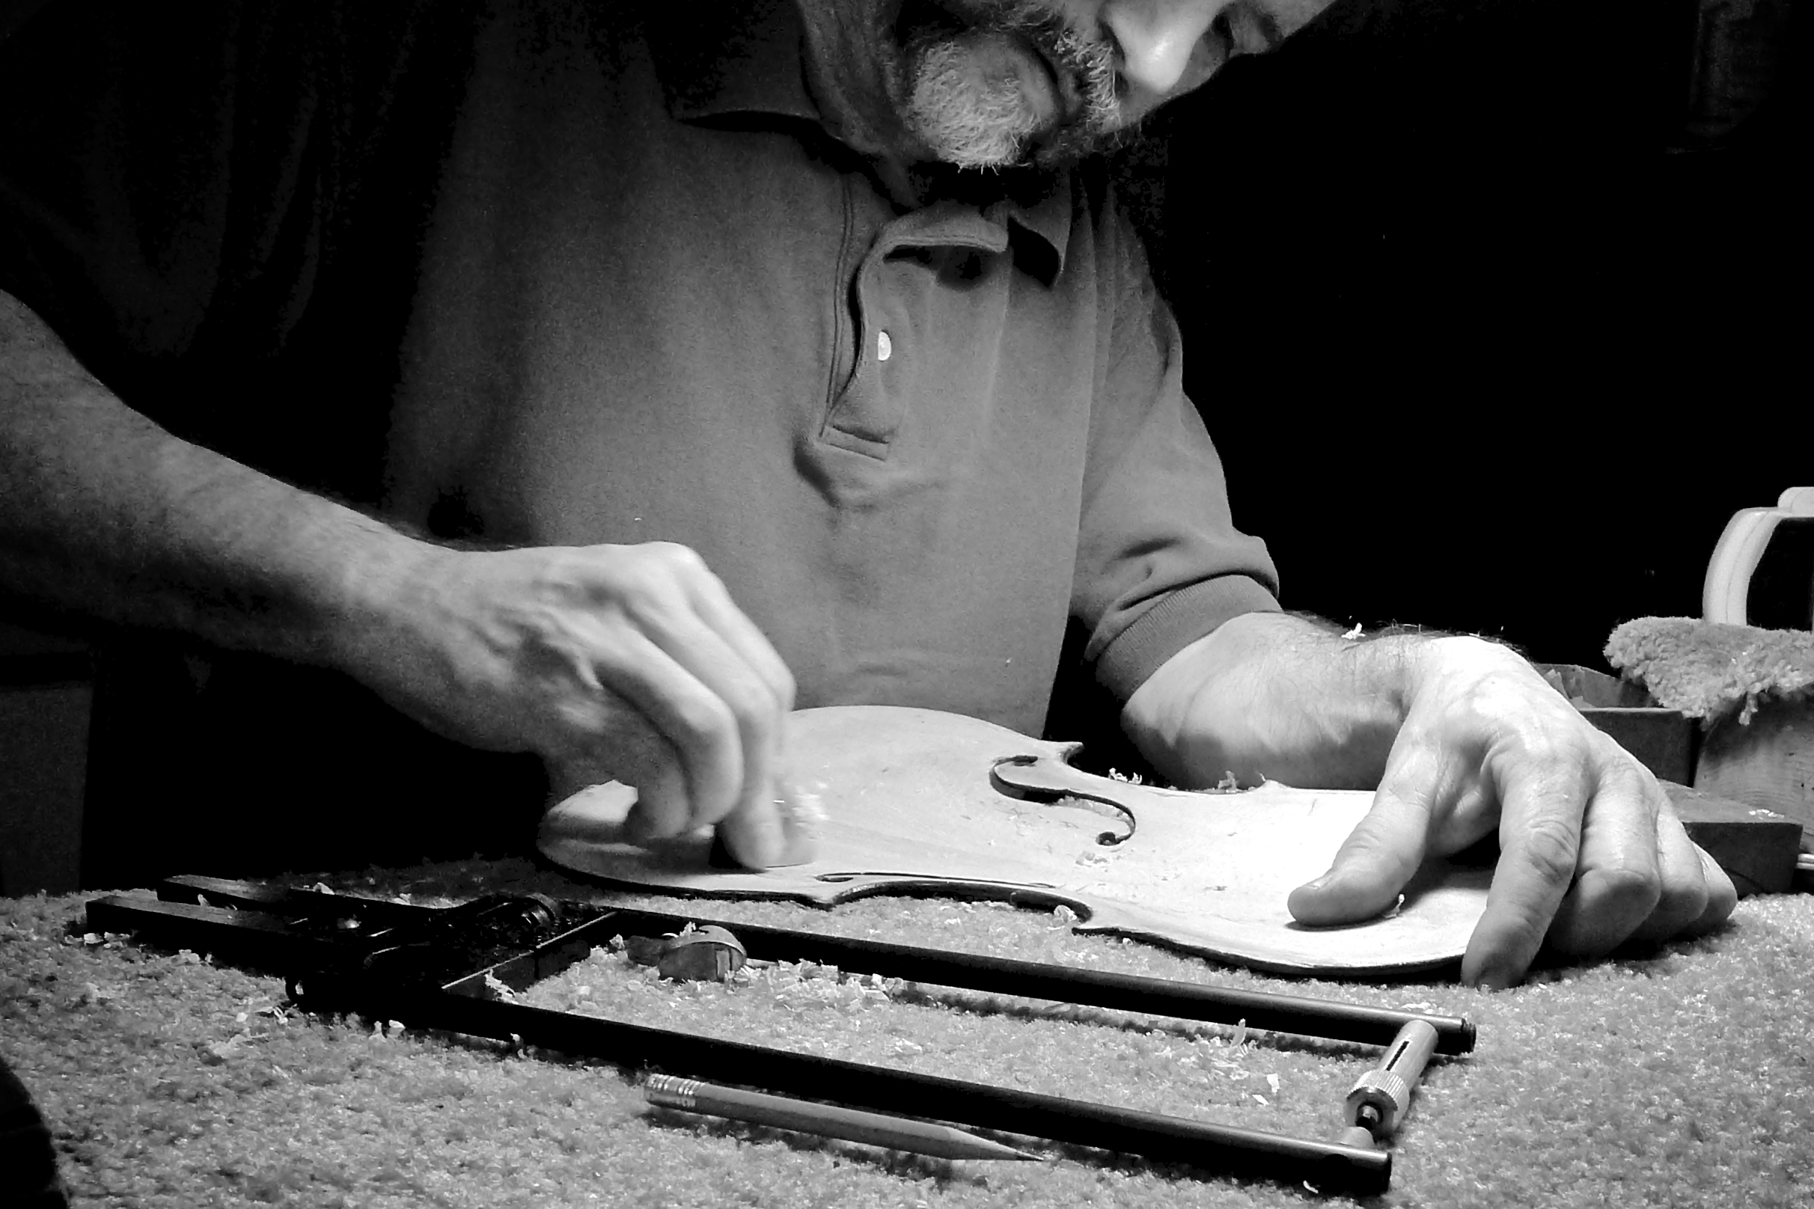
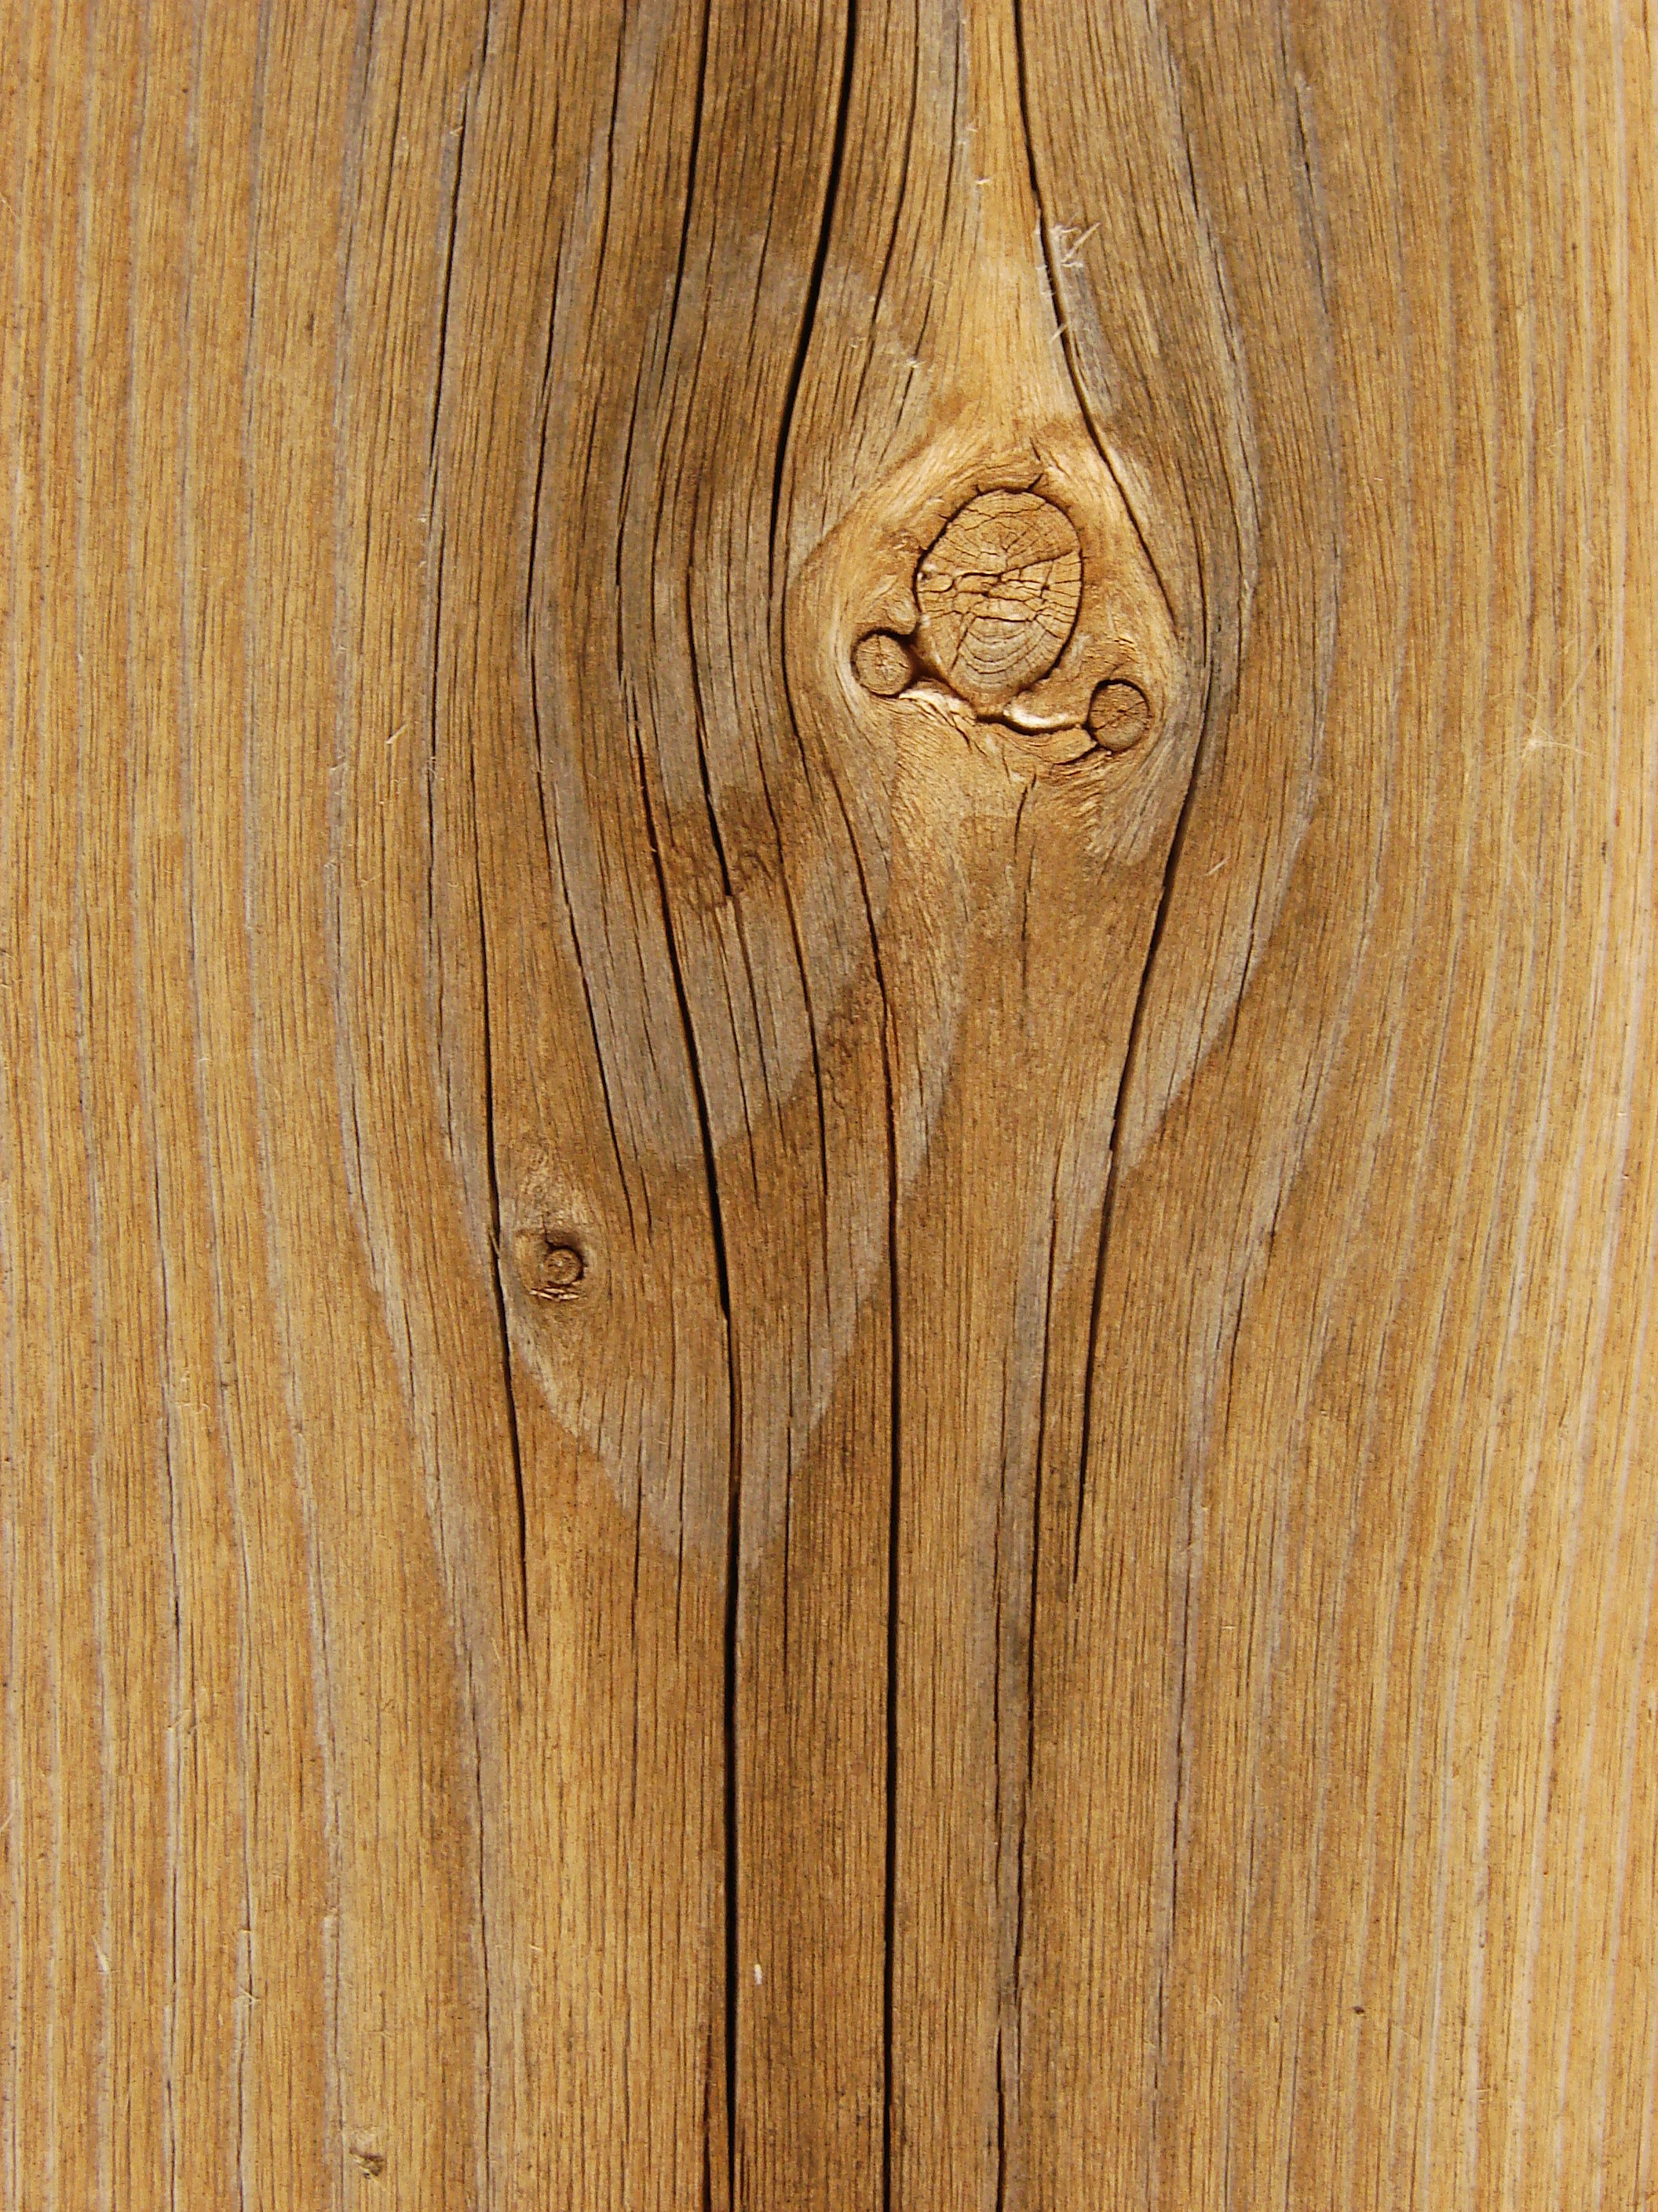
A craft project
“This exact material (atoms) and my perception and experience (bits)”
Source: http://www.flickr.com/photos/kellycdb/6168020183/
http://commons.wikimedia.org/wiki/Category:Wood
Notes:
Per un progetto artigianale, ad esempio, la materia é ció che l'artigiano ha a portata di mano: e sará quindi sempre speciale. L'informazione usata per progettare e produrre deriva dalla propria esperienza e dalla percezione dello specifico materiale.

Slide 5
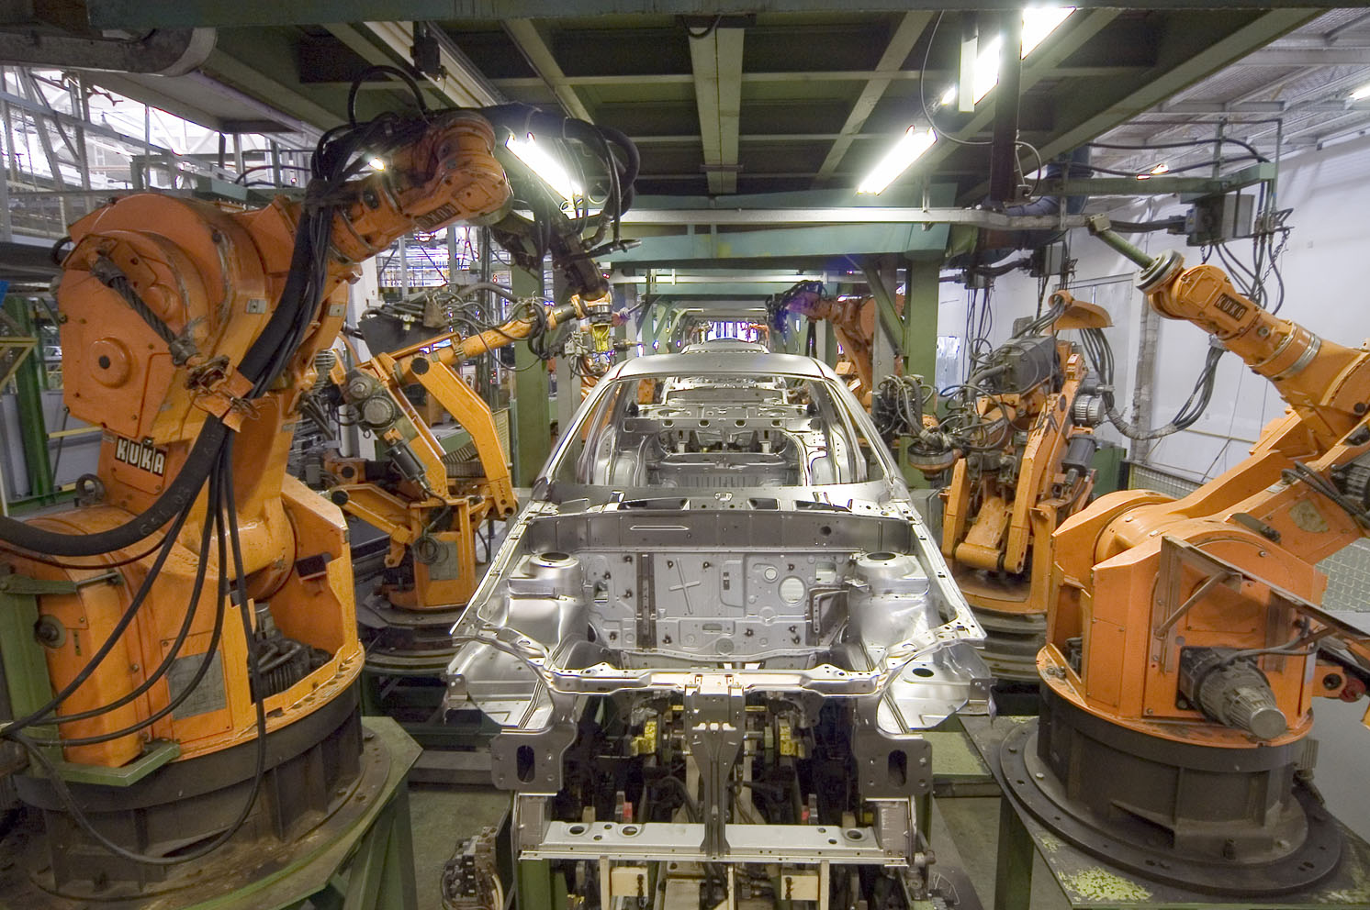
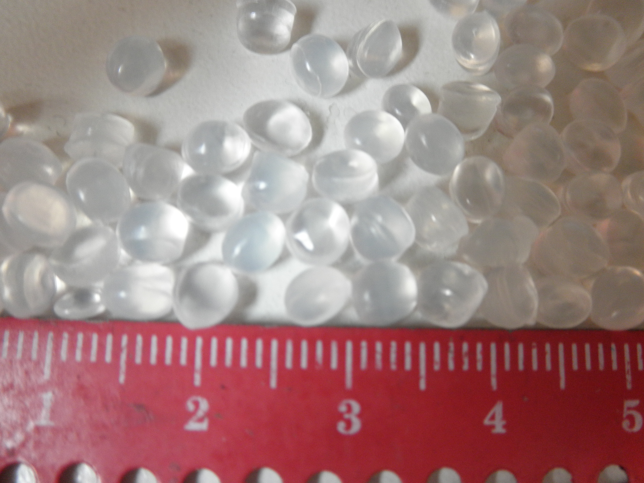
An industrial project
“A standardized material (atoms) described only by numerical values (bits)”
Source: http://commons.wikimedia.org/wiki/Category:KUKA
http://commons.wikimedia.org/wiki/Category:Polyethylene
Notes:
Per un progetto industriale, la materia diventa standardizzata e quantificata in valori esatti, che attraverso formule possono essere trasformati in progetti che macchine automatizzate produrranno con limitato controllo umano.

Slide 6
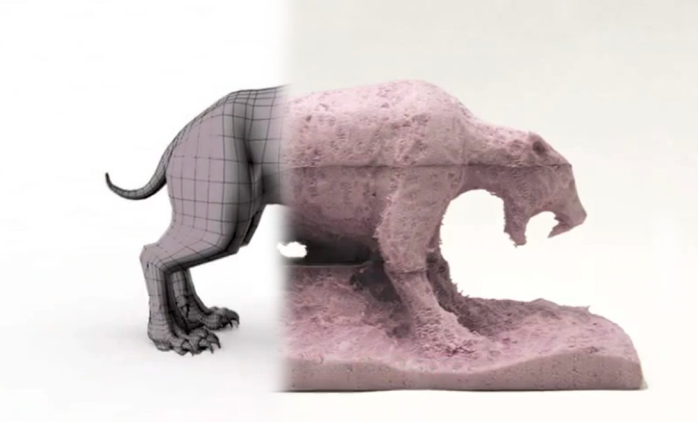
A digital fabrication (fabbing) project
“My experience, perception and digital information (bits) shape this exact material and its values (atoms)”
Source: http://web.media.mit.edu/~amitz/Amit_Zoran_home_page/the_freeD.html
Notes:
Un progetto digitale da maker, invece, riassume i due precedenti casi: si ha un controllo manuale di uno specifico materiale ma con l'aiuto di una dimensione di dati e di strumenti digitali spesso creati o modificati dallo stesso maker che permetttono un controllo ancora maggiore.

Slide 7
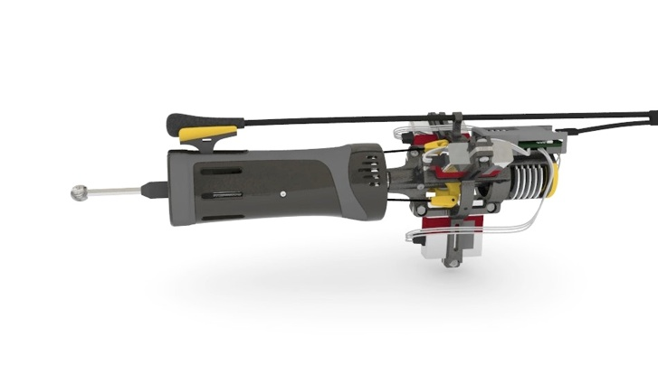
A digital fabrication (fabbing) project
“... and I will probably design and make my own tools” [metadesign]
Source: http://web.media.mit.edu/~amitz/Amit_Zoran_home_page/the_freeD.html
Notes:
Un progetto digitale da maker, invece, riassume i due precedenti casi: si ha un controllo manuale di uno specifico materiale ma con l'aiuto di una dimensione di dati e di strumenti digitali spesso creati o modificati dallo stesso maker che permetttono un controllo ancora maggiore.

Slide 8
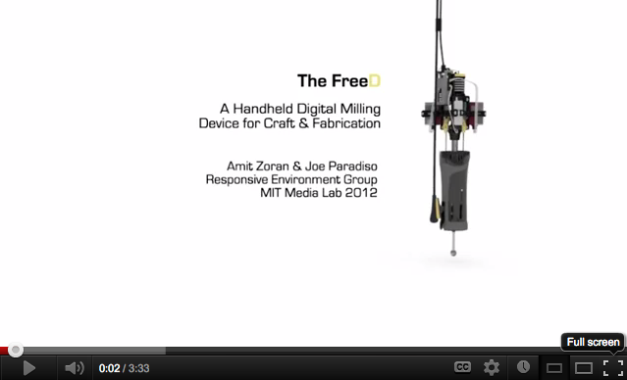
A digital fabrication (fabbing) project
“... and I will probably design and make my own tools” [metadesign]
Source: http://www.youtube.com/watch?feature=player_embedded&v=TxHiTjapTqg
Notes:
Un progetto digitale da maker, invece, riassume i due precedenti casi: si ha un controllo manuale di uno specifico materiale ma con l'aiuto di una dimensione di dati e di strumenti digitali spesso creati o modificati dallo stesso maker che permetttono un controllo ancora maggiore.

Slide 9
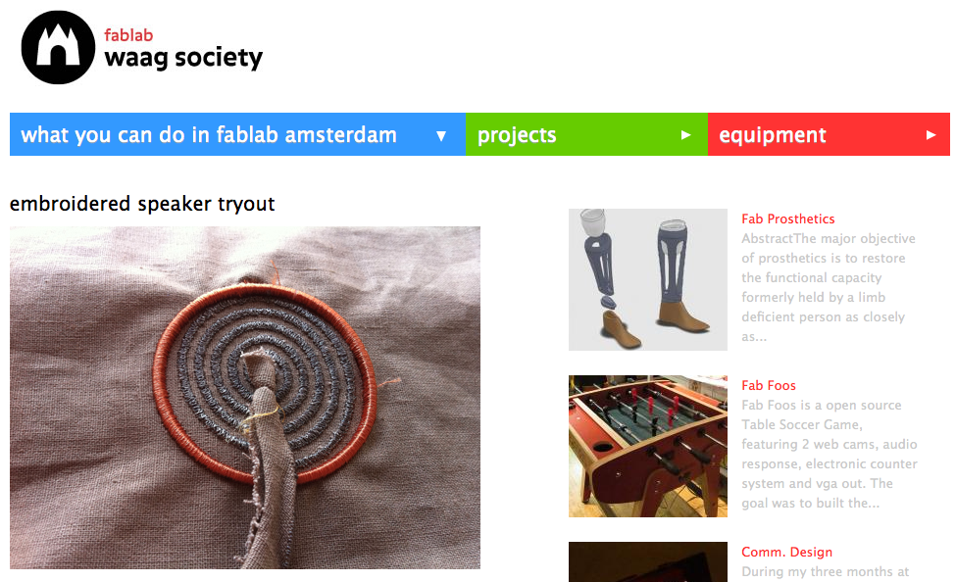
Bits + atoms = information + materials
Developing projects at the intersections between bits and atoms
Source: http://fablab.waag.org/node/3847
Notes:
CBA:
Explores how the content of information relates to tis physical representation
Esplora come il contenuto dell'informazione si relazioni con la sua rappresentazioen fisica
1.0 computer → connected to → machines cnc
2.0 machines → that makes → machines (1-2 anni) reprap
3.0 codes → materials (in 5 anni, mattoncini lego digitali) lego
4.0 program → materials
Like protein folding (the material has the information for taking a shape).. there is no machine
In 20 anni ribosome

Slide 10
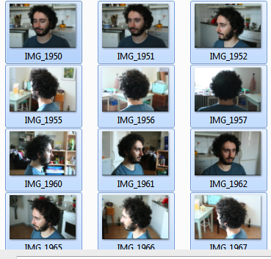
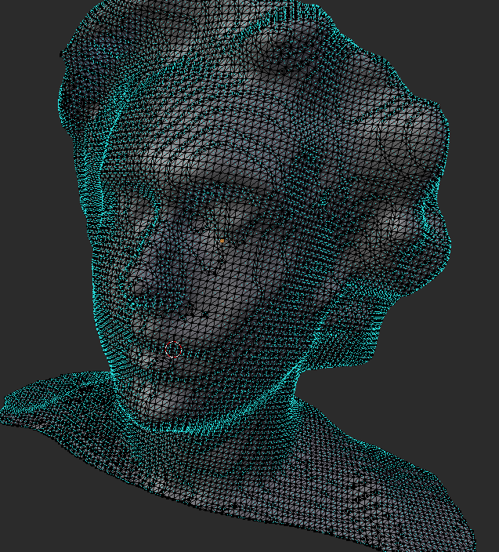
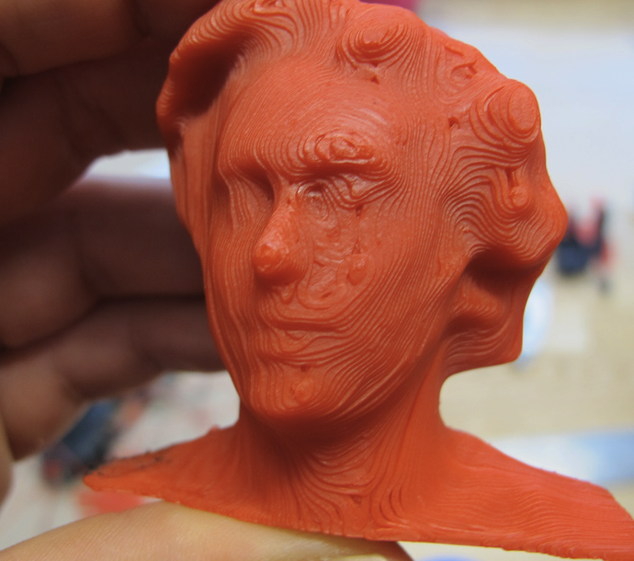
Bits and atoms – two directions
{
{
From atoms to bits
(getting data - representation)
From bits to atoms
(build the data - representation)

Slide 11
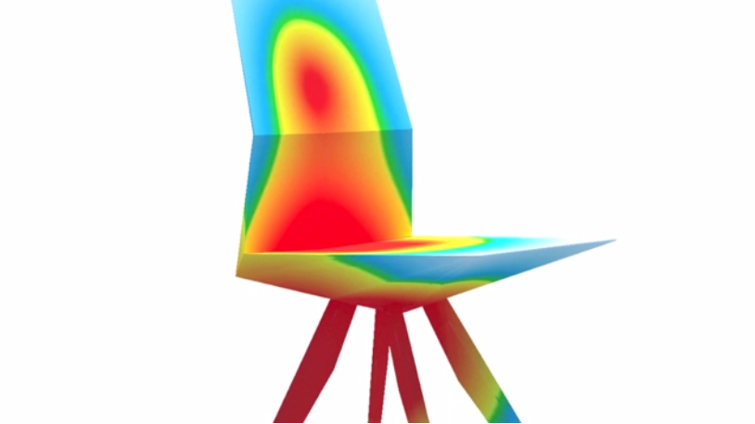
Bits and atoms: an application
As an individual sits in the chair, information about the flow of forces from his or her weight is depicted on visualization screens throughout the space.
Source: http://www.designboom.com/weblog/cat/16/view/20419/audi-r18-ultra-chair.html
http://vimeo.com/40877183

Slide 12
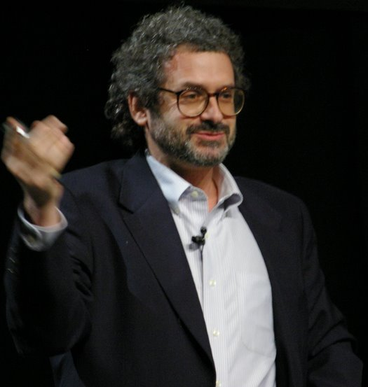

Digital Fabrication and bits+atoms: CBA @ MIT
… not the center for rapid prototyping: “investigating the interface between computer science and physical science”
Source: http://cba.mit.edu/
http://en.wikipedia.org/wiki/Neil_Gershenfeld
Notes:
CBA:
Explores how the content of information relates to tis physical representation
Esplora come il contenuto dell'informazione si relazioni con la sua rappresentazioen fisica
Come mettere l'informazione nella materia
Ribosome is like lego,
A programmable digital machine (that makes machines)
The program is not a description of something, it is something. And the computer is a tool

Slide 13
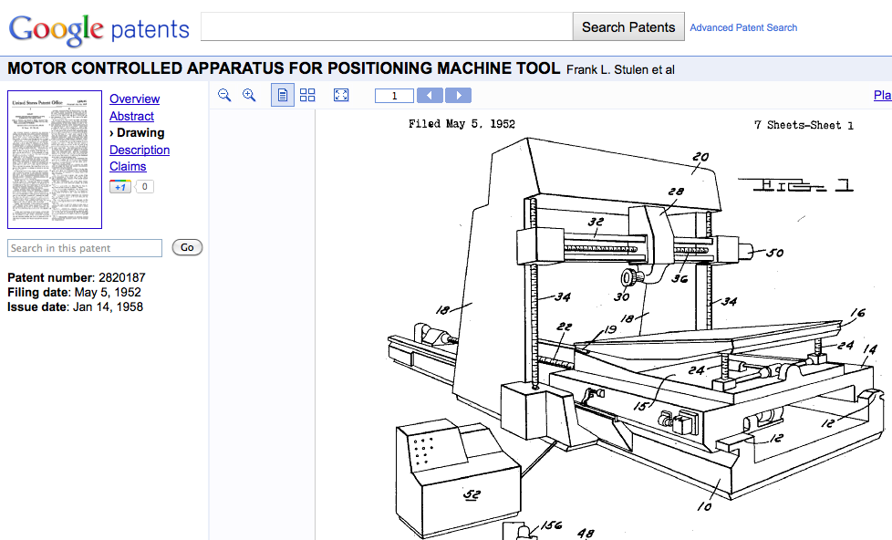
Fab.01: Machines attached to a computer
1950s: first computer numerical control (CNC) machines, attached to computers
Source: http://www.google.com/patents?id=rRpqAAAAEBAJ&printsec=drawing&zoom=4#v=onepage&q&f=false

Slide 14

Fab.02: Machines that make machines
2005: RepRap (open source) 3D printer that replicates itself (and that generated an ecosystem of 3D printers)
Source: http://www.reprap.org/

Slide 15
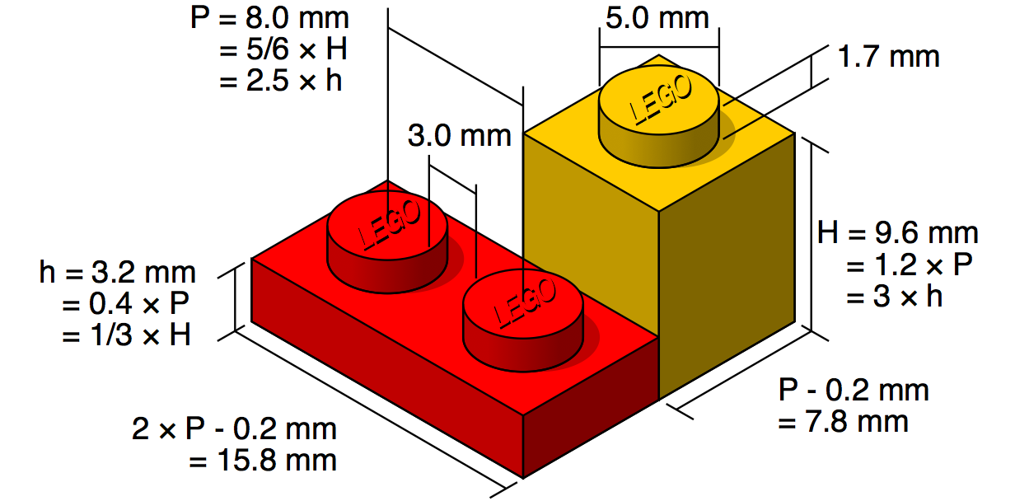
Fab.03: Materials with embedded code
Materials with an embedded code that help shaping them.
Source: http://en.wikipedia.org/wiki/Lego

Slide 16
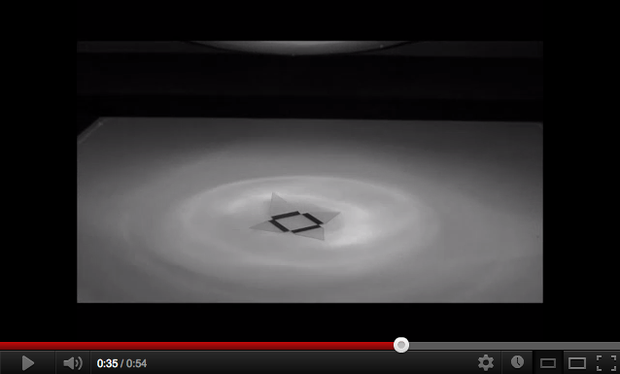
Fab.03: Materials with embedded code
North Carolina State University: a simple way to convert two-dimensional patterns into three-dimensional (3-D) objects using only light.
Source: http://news.ncsu.edu/releases/wmsdickeyfolding/
http://www.youtube.com/watch?v=NKRWZG67dtQ

Slide 17
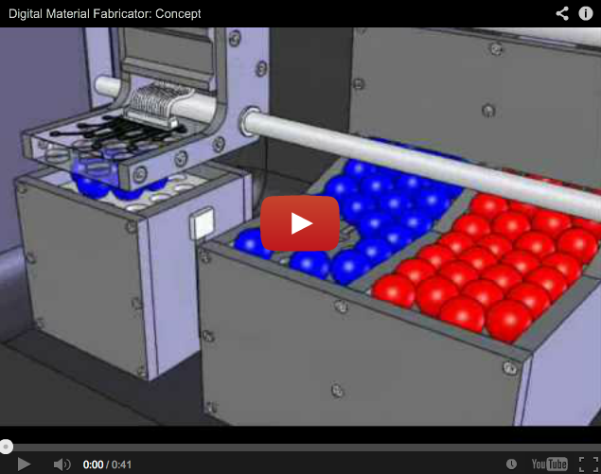
Fab.03: Voxels + Digital Material Fabricator
In the digital domain, a 3D object is composed voxels. Each voxel location is occupied (1) or not (0), so 3D space is digital (discrete) not analog (continuous).
Source: http://creativemachines.cornell.edu/Rapid_Assembler
http://youtu.be/-szjlhVMGh4

Slide 18
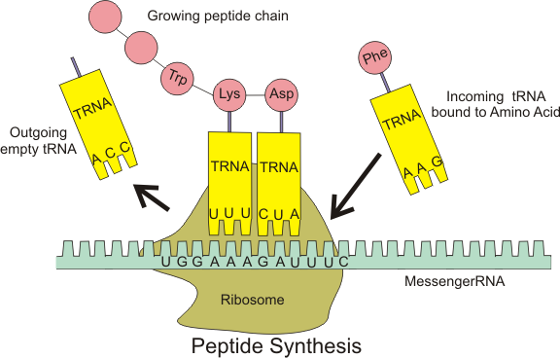
Fab.04: Materials with embedded program
Materials that have code, data and programs for self-manufacturing / auto-assembly.
Source: http://en.wikipedia.org/wiki/Ribosome

Slide 19
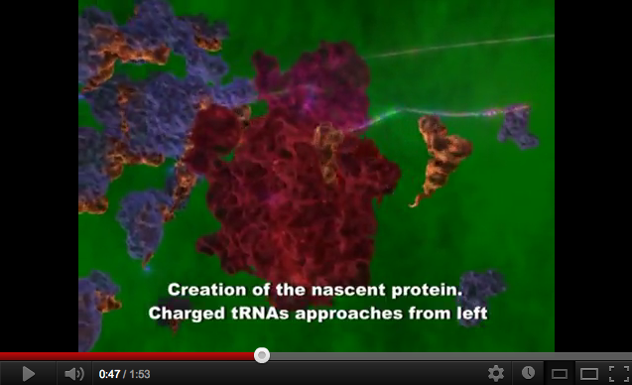
Fab.04: Materials with embedded program
Materials that have code, data and programs for self-manufacturing / auto-assembly.
Source: http://www.youtube.com/watch?v=Jml8CFBWcDs
http://www.youtube.com/watch?v=1PSwhTGFMxs

Slide 20
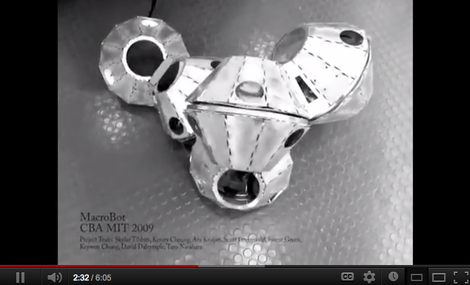
Fab.04: Materials with embedded program
Materials that have code, data and programs for self-manufacturing / auto-assembly.
Source: http://www.ted.com/talks/skylar_tibbits_can_we_make_things_that_make_themselves.html
http://youtu.be/emW1TQ290ec?t=2m10s http://www.sjet.us/SJET-MIT.html

Slide 21
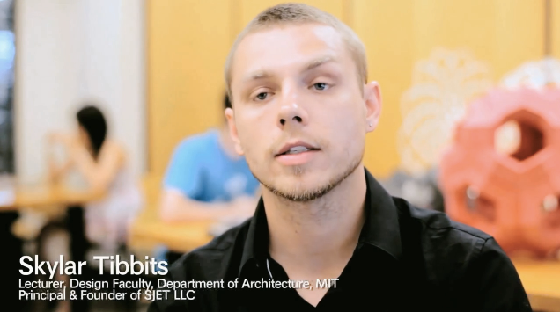
Fab.04: Materials with embedded program
Materials that have code, data and programs for self-manufacturing / auto-assembly.
Source: http://www.fastcompany.com/3006145/mits-new-self-assembly-lab-building-paradigm-shift-4-d-manufacturing

Slide 22
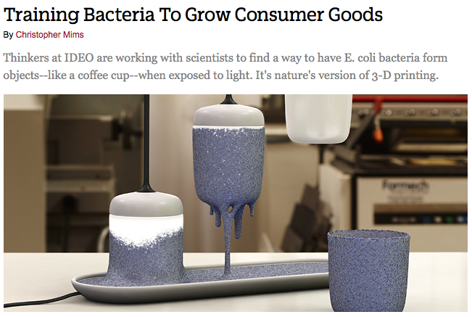
Fab.04: coming to the Design world, soon
Even IDEO is already researching how to manufacture products starting from bacteria that create shapes through self-organization.
Source: http://www.fastcompany.com/biomimicry/training-bacteria-to-grow-consumer-goods

Slide 23
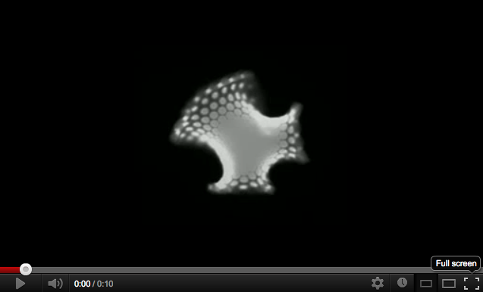
Fab.04: coming to the Design world, soon
[…] spreading a pattern on a responsive material to control how it deforms when exposed to a stimulus [...]
Source: http://www.newscientist.com/blogs/nstv/2012/03/plant-mimicking-gel-could-morph-into-any-3d-shape.html
http://www.youtube.com/watch?v=J7MyjOTynK0

Slide 24
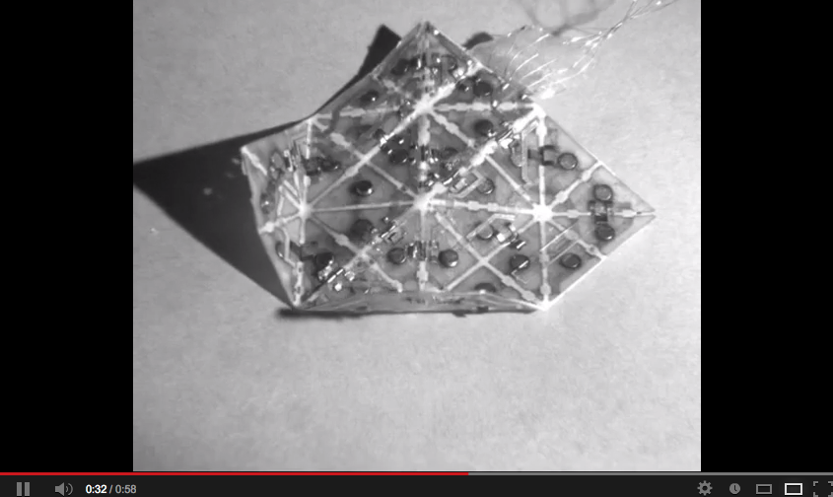
Fab.04: Programmable Matter
Researchers at Harvard and MIT have reshaped the landscape of programmable matter by devising self-folding sheets that rely on the ancient art of origami.
Source: http://news.harvard.edu/gazette/story/2010/06/shape-shifting-sheets-automatically-fold-into-multiple-shapes/
http://youtu.be/Pg8VAVWkz3k

Slide 25
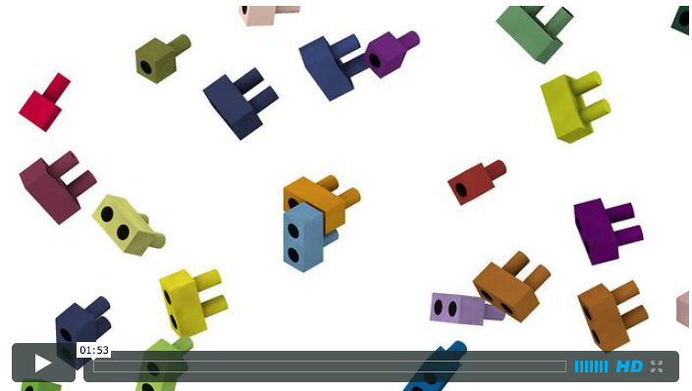
Fab.04: DNA bricks
Complex 3D structures by using short synthetic DNA strands (“DNA bricks”). Bricks with hundreds of distinct sequences self-assemble into prescribed 3D shapes.
Source: http://m.sciencemag.org/content/338/6111/1177.abstract
http://wyss.harvard.edu/viewpressrelease/101/ http://wyss.harvard.edu/viewpage/408/

Slide 26
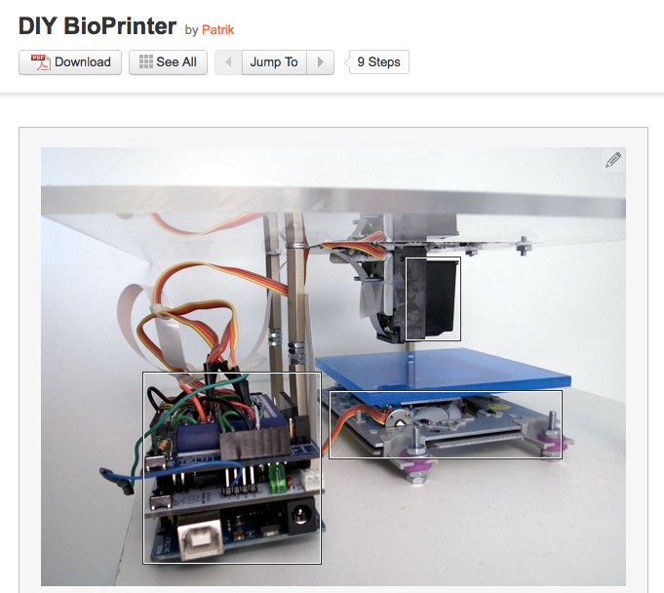
Fabbing: not just learning from biology...
A new bioprinter developed at a hackerspace can print living cells for less than the cost of an iPod touch.
Source: http://www.instructables.com/id/DIY-BioPrinter/
http://www.wired.com/design/2013/01/diy-bio-printer/

Slide 27
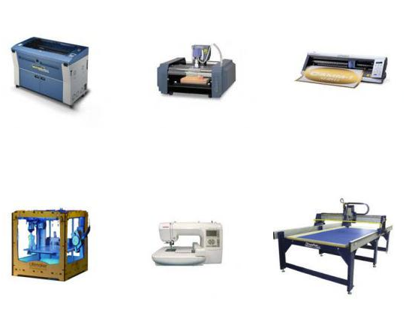
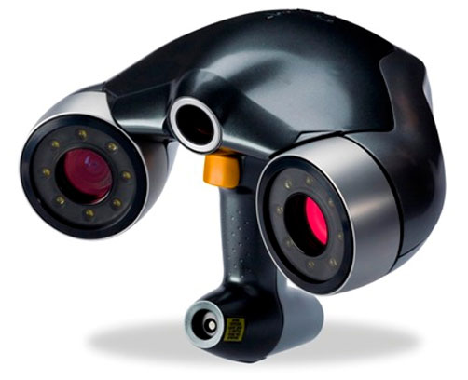
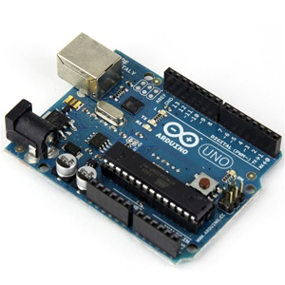
But coming back to Fab 1.0 / 2.0 in 2012
Laser cutting
CNC milling
Vinyl cutter
3D Scanner
Digital sewing / embroidery machine
3D printing
CNC milling
Electronics
This is what you usually can find in a FabLab, at the moment.
Source: adapted from http://fablab.waag.org/machines

Slide 28
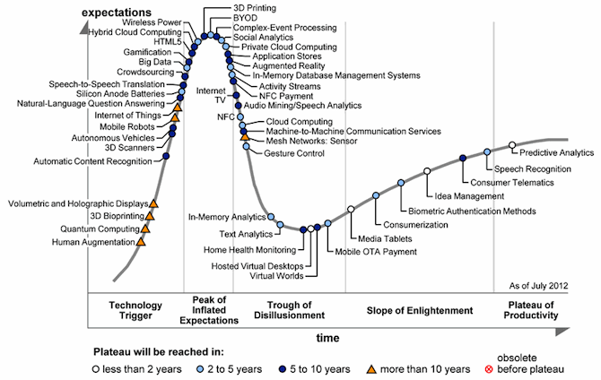
At the peak of enthusiasm, far from productivity
3D Printing has been steadily climbing to the peak of 'Inflated Expectations' over the past few years and now sits on top, poised for the drop.
Source: http://www.shapeways.com/blog/archives/1582-3D-Printing-Hits-the-Peak-of-the-Gartner-Hype-Cycle-for-Emerging-Technologies.html

Slide 29
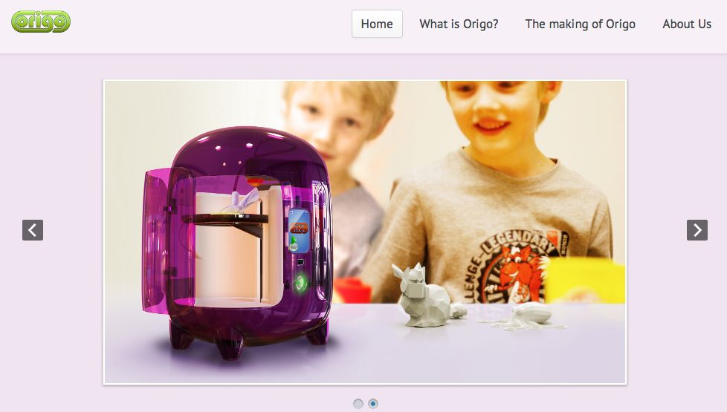
Democratization of Digital Fabrication
“Hello, I am Origo. I am a 3D printer for ten year olds.”
Source: http://www.origo3dprinting.com/

Slide 30
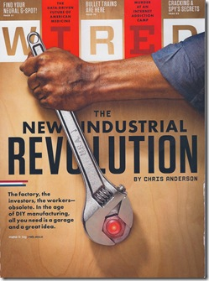
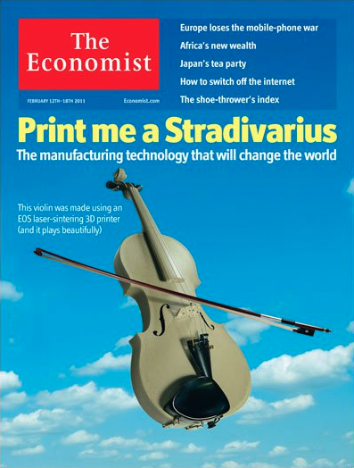
… and Digital Fabrication became famous
Digital Fabrication / distributed manufacturing as a viable tool / strategy for business.
Source: http://www.wired.com/magazine/2010/01/ff_newrevolution/
http://econ.st/tnr97E

Slide 31
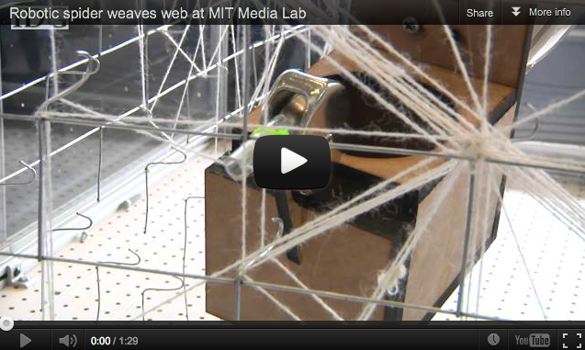
And build your own machine...
Not only cutting and printing, also weaving...
Source: http://www.fastcodesign.com/1669627/holy-crap-this-mit-robot-might-one-day-weave-a-building
http://youtu.be/JgeFLGfvrEM

Slide 32
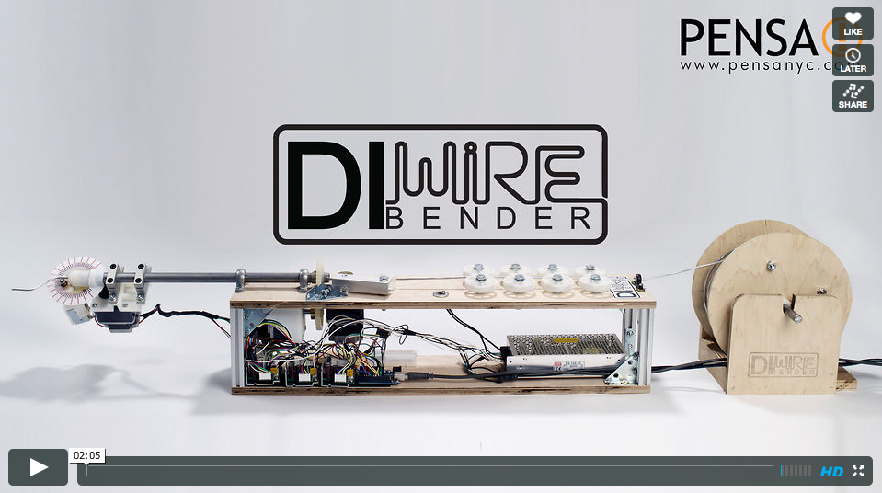
And build your own machine...
Not only cutting and printing, also bending...
Source: http://www.core77.com/blog/digital_fabrication/add_pensas_diwire_bender_to_your_diyer_arsenal_22383.asp
http://vimeo.com/41425580

Slide 33
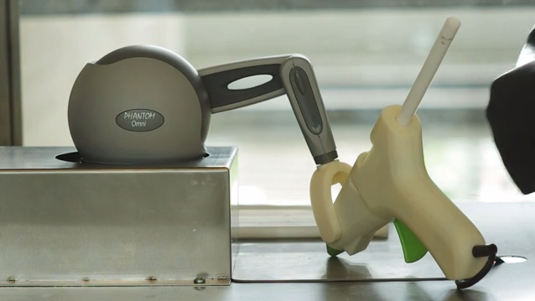
… between digital and hand work...
HAPTIC INTELLIGENTSIA is a human 3D printing machine that allows the user to tactually perceive the virtual object and to directly transform it into the physical.
Source: http://www.fastcodesign.com/1665529/a-hybrid-machine-joins-3-d-printing-and-human-handicraft-video#3
http://vimeo.com/32538081

Slide 34
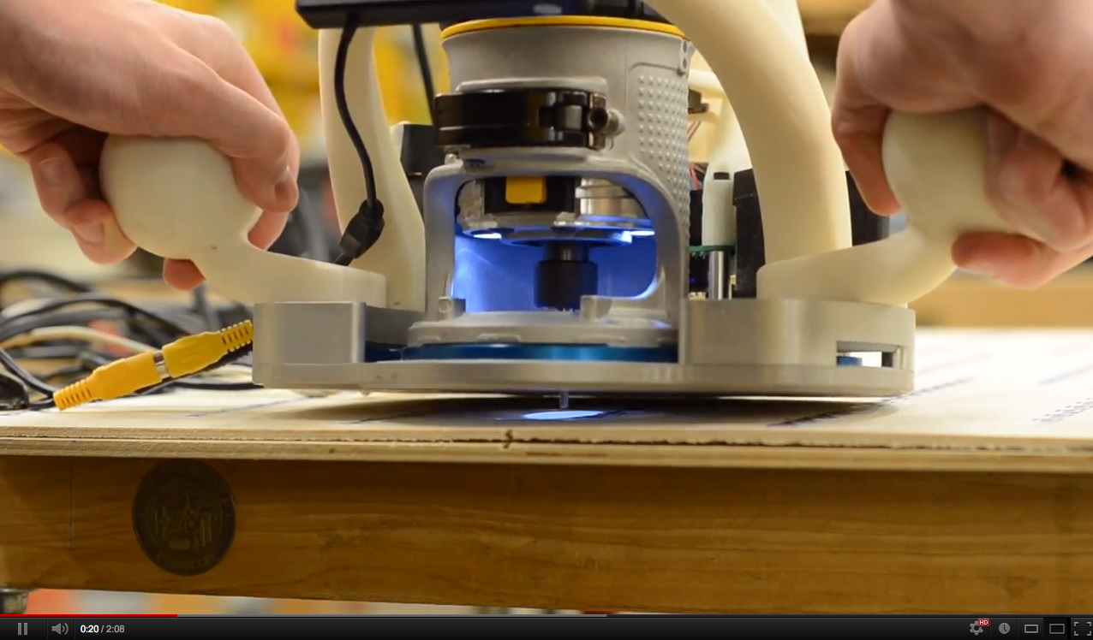
… between digital and hand work...
A frame and a tool: the frame is positioned manually by the user and can adjust the position of the tool to correct for error in the user's coarse positioning.
Source: http://www.alecrivers.com/positioncorrectingtools/
http://youtu.be/-UmL7xZZSUk

Slide 35
02.
FabLabs: spaces for collaborative use of digital fabrication technologies

Slide 36
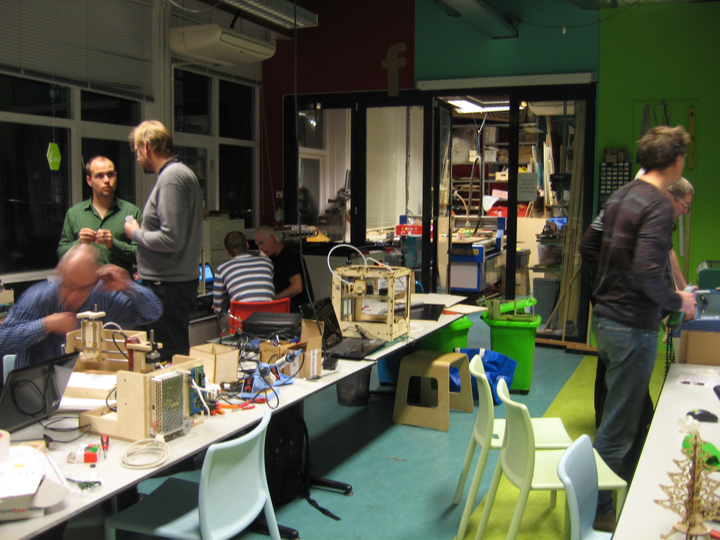
A space that democratizes digital fabrication
Exploring collaboratively the interactions between bits and atoms, rather than making (almost) anything...
Source: http://www.flickr.com/photos/protospace/5199454304/

Slide 37
Conditions for being a FabLab
Conditions:
* public access to the fab lab
* support and subscribe to the fab lab charter
* share a common set of tools and processes
* participate in the global fab lab network (no isolation)
The Fab Lab conformity rating is a code that describes how closely a lab meets the conditions for use of the Fab Lab label. It is a quick summary of the lab "now", can change over time. The conformity rating is self-assessed or community-assessed.
Source: http://wiki.fablab.is/wiki/ConditionsForFabLabLabel

Slide 38
Fab Charter
* Mission: fab labs are a global network of local labs, enabling invention by providing access for individuals to tools for digital fabrication.
* Access: you can use the fab lab to make almost anything (that doesn't hurt anyone); you must learn to do it yourself, and you must share use of the lab with other uses and users
* Education: training in the fab lab is based on doing projects and learning from peers; you're expected to contribute to documentation and instruction
* Responsibility: you're responsible for:
* safety: knowing how to work without hurting people or machines
* cleaning up: leaving the lab cleaner than you found it
* operations: assisting with maintaining, repairing, and reporting on tools, supplies, and incidents
* Secrecy: designs and processes developed in fab labs must remain available for individual use although intellectual property can be protected however you choose
* Business: commercial activities can be incubated in fab labs but they must not conflict with open access, they should grow beyond rather than within the lab, and they are expected to benefit the inventors, labs, and networks that contribute to their success.
August 30, 2007
Source: http://fab.cba.mit.edu/about/charter/

Slide 39
Fab Charter
What is a fab lab?
Fab labs are a global network of local labs, enabling invention by providing access to tools for digital fabrication
What's in a fab lab?
Fab labs share an evolving inventory of core capabilities to make (almost) anything, allowing people and projects to be shared
What does the fab lab network provide?
Operational, educational, technical, financial, and logistical assistance beyond what's available within one lab
Who can use a fab lab?
Fab labs are available as a community resource, offering open access for individuals as well as scheduled access for programs
What are your responsibilities?
  safety: not hurting people or machines
  operations: assisting with cleaning, maintaining, and improving the lab
  knowledge: contributing to documentation and instruction
Who owns fab lab inventions?
Designs and processes developed in fab labs can be protected and sold however an inventor chooses, but should remain available for individuals to use and learn from
How can businesses use a fab lab?
Commercial activities can be prototyped and incubated in a fab lab, but they must not conflict with other uses, they should grow beyond rather than within the lab, and they are expected to benefit the inventors, labs, and networks that contribute to their success
draft: October 20, 2012
Source: http://fab.cba.mit.edu/about/charter/

Slide 40
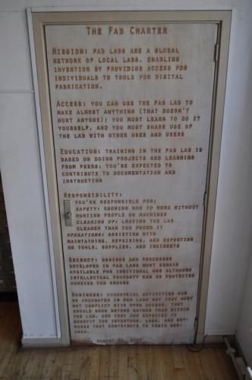
Fab Charter (Amsterdam, Netherlands)
The Fab Charter is always visible in a FabLab
Source: http://fablab.waag.org/archive/fabcharter

Slide 41
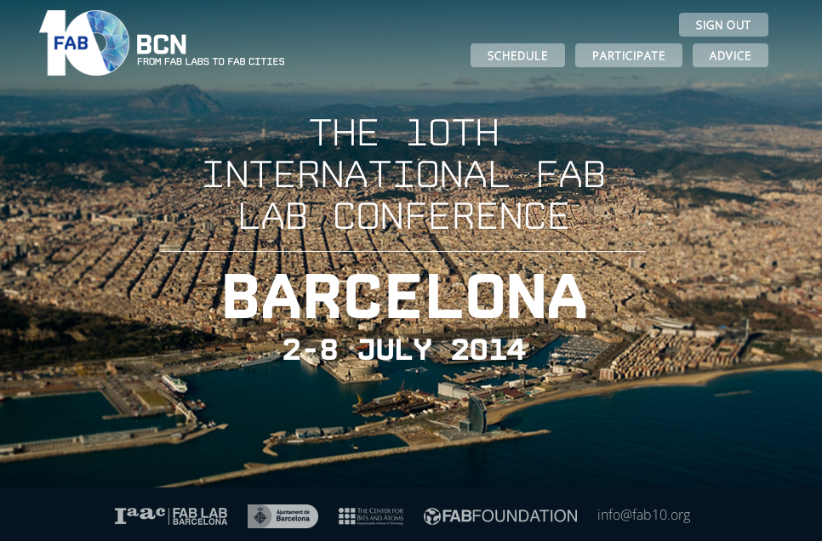
FabN : the yearly meeting
Every year in August in a different continent.
Source: https://www.fab10.org/en/home

Slide 42
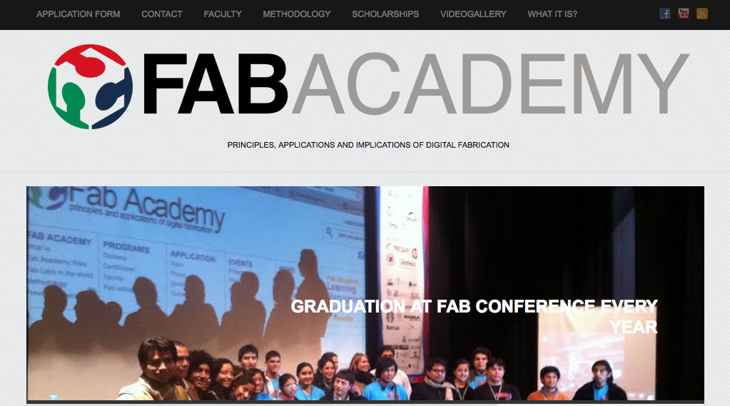
Fab Academy
The Fab Academy began as an outreach project from the CBA, and has since spread to Fab Labs around the world.
Source: http://fabacademy.org/

Slide 43
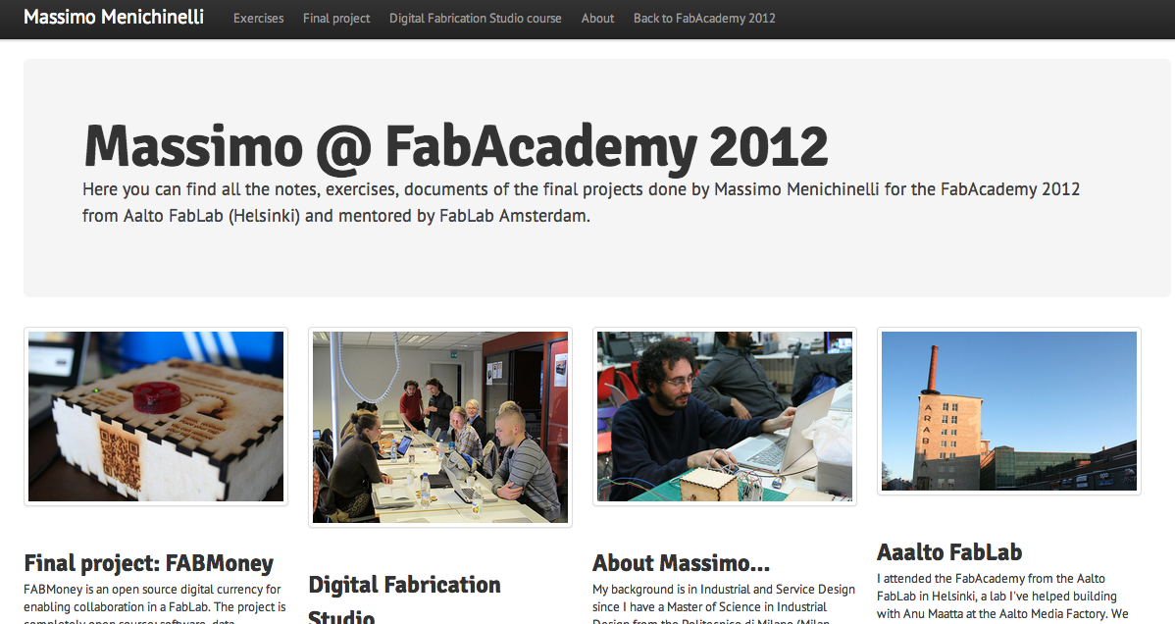
Fab Academy: my experience
An example of documentation...
Source: http://academy.cba.mit.edu/2012/students/menichinelli.massimo/index.html

Slide 44
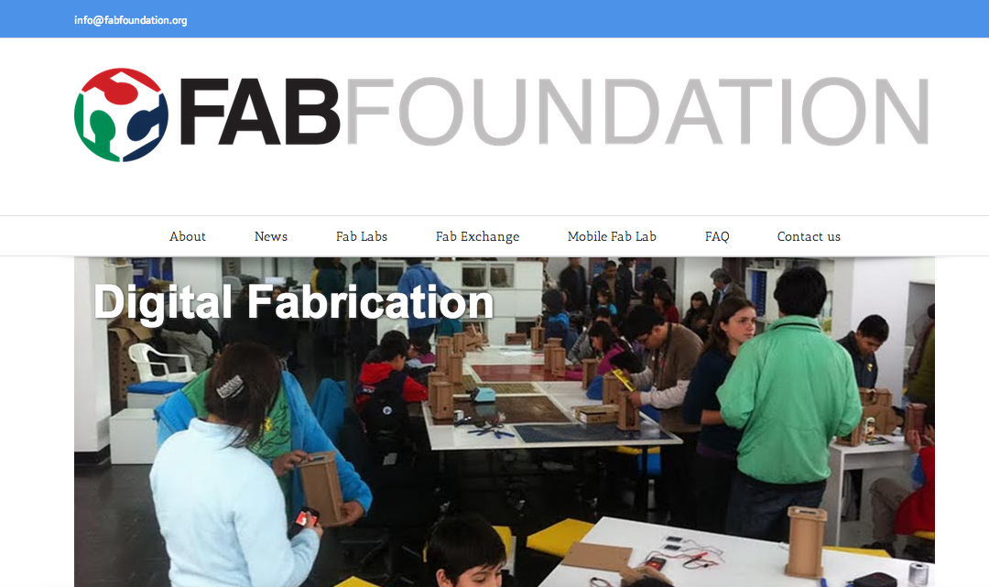
Fab Foundation
The Fab Foundation was formed February 9, 2009 to facilitate and support the growth of the international fab lab network.
Source: http://www.fabfoundation.org/

Slide 45
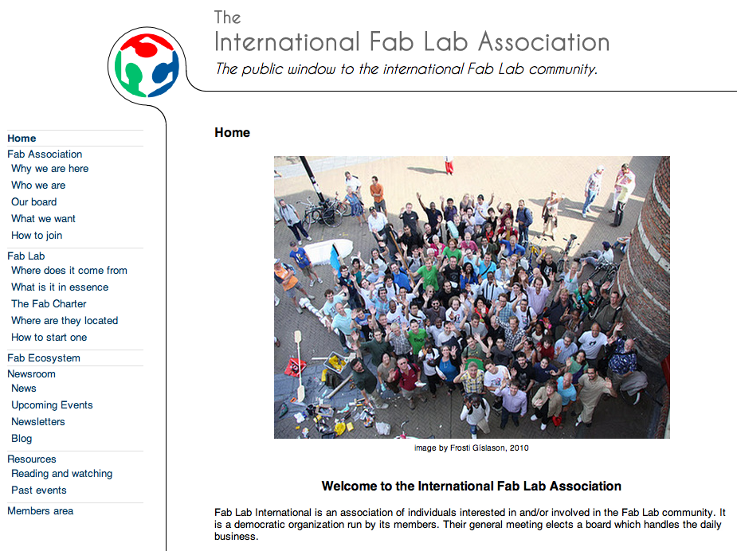
The International Fab Lab Association
On the 4th of July 2011, the International Fab Lab Association was established. It is an association with members, a Board and an Academic Council, etc.
Source: http://fablabinternational.org/
http://fablabinternational.blogspot.com/

Slide 46
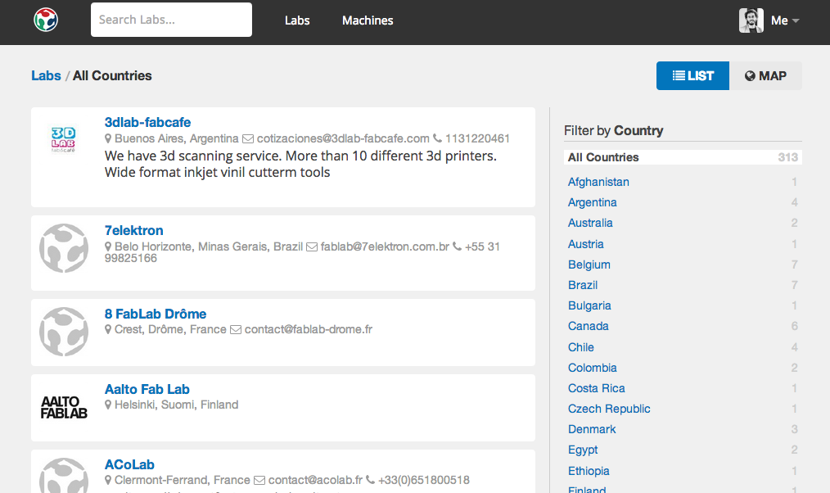
From Fab Foundation: fablabs.io
The official platform for mapping the international network of FabLabs.
Source: https://www.fablabs.io/

Slide 47
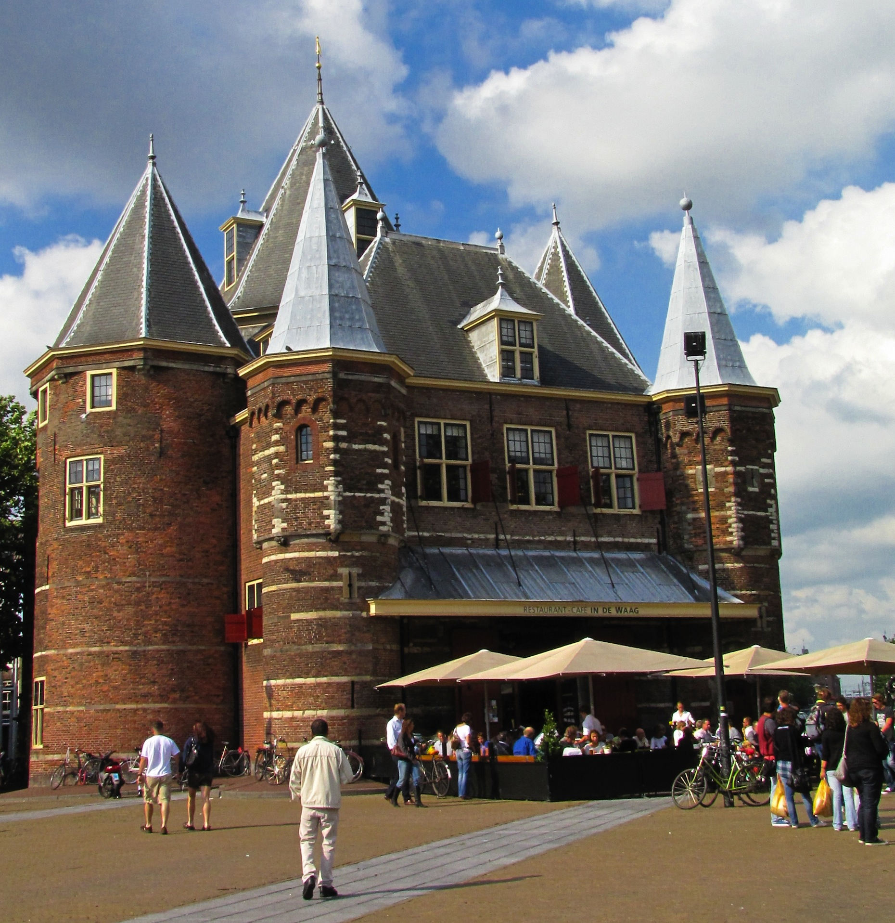
Fab Lab Amsterdam (Netherlands)
Fablab Amsterdam is hosted by Waag Society, a non profit organisation active in the field of social innovation through creative technology.
Source: http://fablab.waag.org/
http://www.flickr.com/photos/37873897@N06/4973326149/

Slide 48
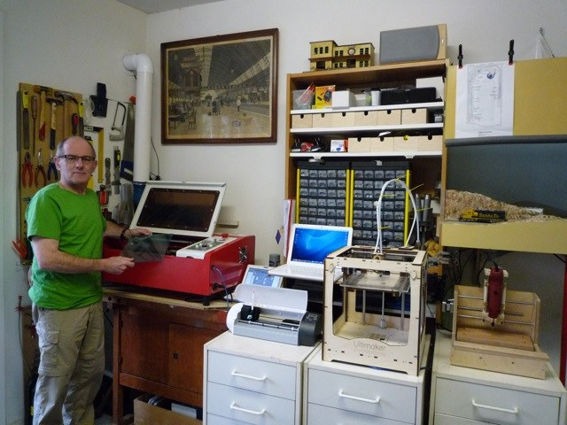
Mini Fab Lab (Utrecht, Netherlands)
A FabLab in your room for 3500 €.
Source: http://www.minifablab.nl/

Slide 49
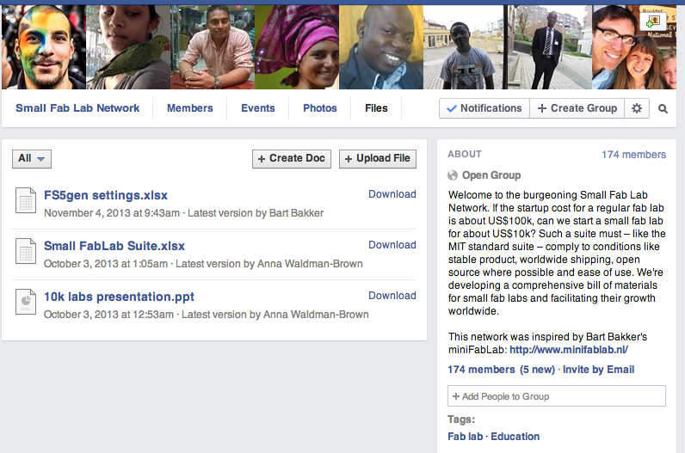
Mini Fab Lab / 10k: the community
Welcome to the burgeoning Small Fab Lab Network. If the startup cost for a regular fab lab is about US$100k, can we start a small fab lab for about US$10k?
Source: https://www.facebook.com/groups/smallfablab/

Slide 50
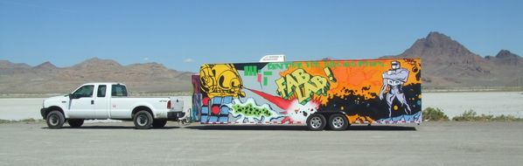
Mobile Fab Lab
In USA, Europe, South Africa...
Source: http://en.wikipedia.org/wiki/Mobile_fab_lab

Slide 51
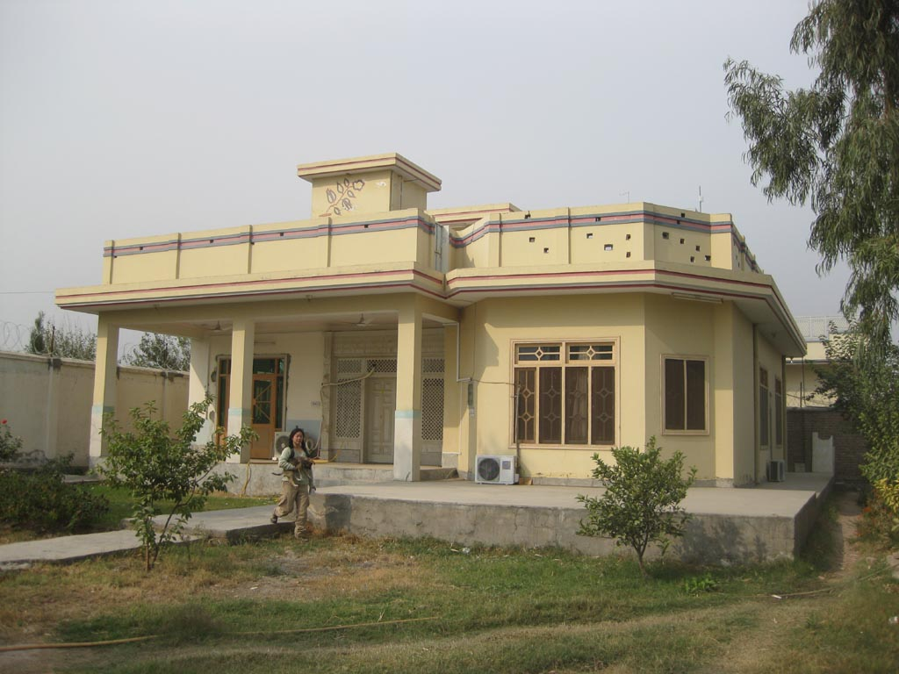
Fab Lab Afghanistan (Jalalabad, Afghanistan)
Not only in USA or Europe ...
Source: http://www.fablab.af/

Slide 52

Fab Lab Afghanistan: FabFi, a project
An open-source, FabLab-grown system using common building materials and off-the-shelf electronics to transmit wireless ethernet signals.
Source: http://fabfi.fabfolk.com/

Slide 53

FabLab Barcelona (Spain)
From the Institute for Advanced Architecture of Catalonia (IAAC).
Source: http://fablabbcn.org/

Slide 54

FabLab Barcelona: FabLab House, a project
The Fab Lab House is a self-sufficient dwelling produced
to take part in the Solar Decathlon Europe 2010.
Source: http://www.fablabhouse.com/

Slide 55


A FabLab and its local context
A city with a long tradition of organic / generative architecture and experimental building technologies.
Source: http://en.wikipedia.org/wiki/Casa_Batlló

Slide 56

Green FabLab Barcelona
A fablab that researches sustainable technologies with and for digital fabrication.
Source: http://greenfablab.org/

Slide 57

The future: Barcelona FabCity
“Toni Vives [...], Head of the Department the Urban Habitat in the Office of the Mayor of Barcelona and member of the IAAC Board of Directors, presented the city’s plan to become a “Fab City” with multiple Fab Labs in neighborhoods around Barcelona.”
Source: http://www.iaacblog.com/blog/2011/iaac-at-fab-7-in-lima-peru/

Slide 58

Fab Lab Brand: no trademark (until recently)
So far, and except some countries (Netherlands) where is managed by the local association.
Source: http://fab.cba.mit.edu/about/logos/index.html

Slide 59

Fab Lab and Brand: a possible strategy?
Do you recognize this brand? It tried to open a FabLab in Madrid to show how it cares about creativity.
Source: http://www.flickr.com/photos/journal-du-design/3895643669/

Slide 60

Absolut Lab (Madrid, Spain)
A huge FabLab sponsored by Absolut Vodka, that was closed few months after its opening...
Source:http://www.franciscosegarra.com/absolut-lab-proyecto-interiorismo/

Slide 61
03.
FabLabs and Fabbing: applications and examples

Slide 62

A space for DIY projects
The first value offer is a space for people to develop (and learn) their own projects.
Source: Scott Beale / Laughing Squid http://laughingsquid.com
http://www.flickr.com/photos/laughingsquid/133324021/

Slide 63

No idea for a project? Hack one!
IKEA products are cheap enough, there are many options and components that can be reused.
Source: http://www.ikeahackers.net/

Slide 64

Generative Design
Not only for Open Design! Even for Generative Design, Mass-customisation, ...
Source: http://www.platform-net.com/
Generative Design projects need digital fabrication technologies for being manufactured.
Source: http://www.n-e-r-v-o-u-s.com/

Slide 65

Generative Design
Not only for Open Design! Even for Generative Design, Mass-customisation, ...
Source: http://www.platform-net.com/
Generative Design projects need digital fabrication technologies for being manufactured.
Source: https://www.youtube.com/watch?v=aWWkB31QXck

Slide 66

Physical Data Visualization
Digital Fabrication can be used for rendering visible and physical intangible data and concepts.
Source: http://www.realitat.com/microsonic/

Slide 67

Physical Data Visualization
Not only for Open Design! Even for Generative Design, Mass-customisation, ...
Source: http://www.platform-net.com/
Digital Fabrication can be used for rendering visible and physical intangible data and concepts.
Source: http://www.realitat.com/microsonic/

Slide 68

Mass Customization
Mass customization can be enabled in an easier way with digital fabrication technologies (and places for interacting with customers).
Source: http://nikeid.nike.com/nikeid/

Slide 69

Custom Prosthetics
Building customized prosthetics, at home!
Source: http://youtu.be/WoZ2BgPVtA0
http://www.core77.com/blog/digital_fabrication/wrex_3d_printed_magic_arms_and_the_future_of_pediatric_prosthetics_23101.asp

Slide 70

Custom Low-cost Prosthetics
Building low-cost customized prosthetics, at home, from FabLab Amsterdam.
Source: http://www.lowcostprosthesis.org/

Slide 71

Shorter and more sustainable supply chains
Visualizing and redesigning supply chains, through open source and open data software.
Source: http://www.sourcemap.com

Slide 72

Instead, what cannot we do?
The rise of 3D printed weapons, but you cannot build them in a FabLab (it's against the Fab Charter).
Source: http://defensedistributed.com/

Slide 73

Instead, what cannot we do?
The rise of 3D printed weapons, but you cannot build them in a FabLab (it's against the Fab Charter).
Source: http://www.wired.com/dangerroom/2012/08/3d-weapons/
http://www.wired.com/design/2012/08/rapid-fire-rapid-prototypes/

Slide 74

Instead, what cannot we do?
The rise of 3D printed weapons, but you cannot build them in a FabLab (it's against the Fab Charter).
Source: https://www.youtube.com/watch?v=Spm_zrjedzk

Slide 75

Fabbing and Media
Digital Fabrication can be used in different media: photography of failed 3D prints.
Source: http://cunicode.com/beautiful-failures/

Slide 76

Fabbing and Media
Digital Fabrication can be used in different media: video of failed 3D prints.
Source: http://cunicode.com/beautiful-failures/ http://vimeo.com/42537804

Slide 77

Fabbing and Media
Digital Fabrication can be used in different media: book of failed 3D prints.
Source: http://cunicode.com/beautiful-failures/ http://www.blurb.com/books/3248225

Slide 78

Same project, different media
Digital Fabrication can be also thought as a medium for converting one project to a different format.
Source: http://www.3ders.org/articles/20120820-theo-jansen-3d-printed-strandbeests-here-are-the-lego-and-bamboo-version.html
http://youtu.be/HSKyHmjyrkA

Slide 79

Same project, different media
Digital Fabrication can be also thought as a medium for converting one project to a different format.
Source: http://www.3ders.org/articles/20120820-theo-jansen-3d-printed-strandbeests-here-are-the-lego-and-bamboo-version.html
http://youtu.be/pZr-zyHRBn4

Slide 80

Same project, different media
Digital Fabrication can be also thought as a medium for converting one project to a different format.
Source: http://www.3ders.org/articles/20120820-theo-jansen-3d-printed-strandbeests-here-are-the-lego-and-bamboo-version.html

Slide 81

Same project, different media
Digital Fabrication can be also thought as a medium for converting one project to a different format.
Source: http://www.3ders.org/articles/20120820-theo-jansen-3d-printed-strandbeests-here-are-the-lego-and-bamboo-version.html
http://youtu.be/NfutNEauniE

Slide 82
04.
Other spaces and services: making digital fabrication even more accessible

Slide 83

Hackerspaces / Makerspaces
Hackerspaces are open community labs with machine shops, workshops and/or studios where hackers can share resources and knowledge.
Source: http://hackerspaces.org/wiki/List_of_Hacker_Spaces

Slide 84

Helsinki Hacklab
The local hackerspace...
Source: http://helsinki.hacklab.fi/

Slide 85

Sewing Café
A coworking space with sewing and embroidery machine (usually pay per hour)
Source: http://www.thesewingcafe.co.uk/

Slide 86

Techshop (USA)
A network of commercial spaces with many tools and technologies and paid support services (only in USA).
Source: http://techshop.ws/

Slide 87

Techshop (USA)
Ford employees who invent something that the company ends up patenting receive a free three-month membership to TechShop.
Source: http://www.wired.com/design/2012/05/ford-techshop/

Slide 88

100k Garages (USA)
100kGarages is a place for people who have designs (or just ideas) to connect with digital fabricators ("Fabbers") who can help make these ideas.
Source: http://100kgarages.com/

Slide 89

Maker Factory
The same service as 100kgarages, but open source …
Source: http://makerfactory.com/

Slide 90

3D Hubs
The same service as 100kgarages, but for 3D printers...
Source: http://www.3dhubs.com/

Slide 91

Seoul (South Korea)
No FabLabs or similar places, but many small manufacturers that will produce you small-scale series very quickly.

Slide 92

Living Labs (USA, Europa)
Spaces for co-designing products and services with users... not necessarily with digital fabrication.
Source: http://www.openlivinglabs.eu/

Slide 93

National Additive Manufacturing Innovation Institute (USA)
The institute will ensure that the U.S. manufacturing sector is a key pillar in an enduring and thriving economy.
Source: http://www.whitehouse.gov/the-press-office/2012/08/16/we-can-t-wait-obama-administration-announces-new-public-private-partners

Slide 94

Anywhere...
A vending machine with 2 3D printers at Virginia Tech’s College of Engineering.
Source: http://youtu.be/c1MhNlGi-5I

Slide 95
Thank you!!
Massimo Menichinelli
Aalto Media Factory massimo.menichinelli@aalto.fi
@openp2pdesign http://www.slideshare.net/openp2pdesign

