Slide 1

Digital_Fabrication_Studio.00
Introduction to the course
Massimo Menichinelli massimo.menichinelli@aalto.fi
@openp2pdesign http://www.slideshare.net/openp2pdesign

Slide 2
About Massimo...
MSc in Industrial Design, Politecnico di Milano (Milan,Italy)
Doctoral Candidate at Media Lab Helsinki (Department of Media)
FabAcademy guru! (FabBootCamp 2012 @ FabLab Barcelona)
FabAcademy guru! (FabAcademy2012 @ FabLab Amsterdam)
Many years of workshops & lectures (Italy, Spain, Finland, Germany, South Korea, Singapore, Mexico, Colombia,...)
Experience in Industrial Design, Service Design, Interior Design, Web Design...
Worked at the development of 3+ FabLabs (Aalto FabLab, Muse FabLab, OpenDot...)
* Linkedin: http://fi.linkedin.com/in/massimomenichinelli
* My website: http://www.openp2pdesign.org
* Twitter: https://twitter.com/openp2pdesign

Slide 3
25438 Digital Fabrication Studio
Slides, dates, news:
https://noppa.aalto.fi/noppa/kurssi/25438/esite
Questions:
massimo.menichinelli@aalto.fi

Slide 4
25438 Digital Fabrication Studio #01
22nd April 2014 9:00 - 12:00: Digital Fabrication and FabLabs: the current ecosystem and its possibilities.
22nd April 2014 13:00 - 16:00: Media, business, platforms: their role in the digital fabrication ecosystem
23rd April 2014 9:00 - 10:30: Information management for a digitally fabricated project.
23rd April 2014 13:00 - 16:00: Version control systems: Git+GitHub
24th April 2014 10:30 – 12:00: Intellectual property and Open Design for a digitally fabricated project.
24th April 2014 13:00 - 16:00: Version control systems: Git+GitHub

Slide 5
25438 Digital Fabrication Studio #02
25th April 2014 9:00 - 12:00: Laser cutting: technology, processes and design techniques.
Homework: Design and fabricate a laser cut box or interlocking object.
28th April 2014 9:00 - 12:00: 3D Scanning: technology, processes and design techniques.
Homework: Develop and refine a 3D scan of yourself.
29th April 2014 9:00 - 12:00: CNC Milling: technology, processes and design techniques.
Homework: Mill your previous 3D scan.

Slide 6
25438 Digital Fabrication Studio #03
30th April 2014 9:00 - 12:00: Molding and casting: possibilities, processes and design techniques.
Homework: Create a mold and a final object out of it.
02nd May 2014 9:00 - 12:00: 3D Printing: technology, processes and design techniques.
Homework: Design or modify a small object and print it in 3D.

Slide 7
25438 Digital Fabrication Studio #04
5th May 2014: Project development: concept
6th May 2014: Project development: concept
7th May 2014 9:00 - 12:00: Project revision: Concept
8th May 2014 9:00 - 12:00: Project development: project + prototype
9th May 2014 9:00 - 12:00: Project development: project + prototype
= I will follow your project online + remote presentation for revision

Slide 8
25438 Digital Fabrication Studio #05
12th May 2014 9:00 - 12:00: Project revision: project + prototype
13th May 2014: Project development: prototyping
14th May 2014: Project development: Final version
15th May 2014: Project development: Final version
16th May 2014: Final project development + presentation
= I will follow your project online + remote presentation for revision

Slide 9
Recommended bibliography
* Gershenfeld, N. (2000). When Things Start to Think. Holt Paperbacks.
* Gershenfeld, N. (2005). FAB: The Coming Revolution on Your Desktop--From Personal Computers to Personal Fabrication. Basic Books.
* Hudson, J. (2011). Process 2nd Edition: 50 Product Designs from Concept to Manufacture (2nd ed.). Laurence King Publishers.
* Sterling, B. (2005). Shaping Things (1st ed.). The MIT Press.
* Thompson, R. (2011). Prototyping and low-volume production. London: Thames & Hudson.
* Thwaites, T. (2011). The Toaster Project: Or a Heroic Attempt to Build a Simple Electric Appliance from Scratch. Princeton Architectural Press.
* Reas, C., & McWilliams, C. (2010). Form+Code in Design, Art, and Architecture (1st ed.). Princeton Architectural Press

Slide 10
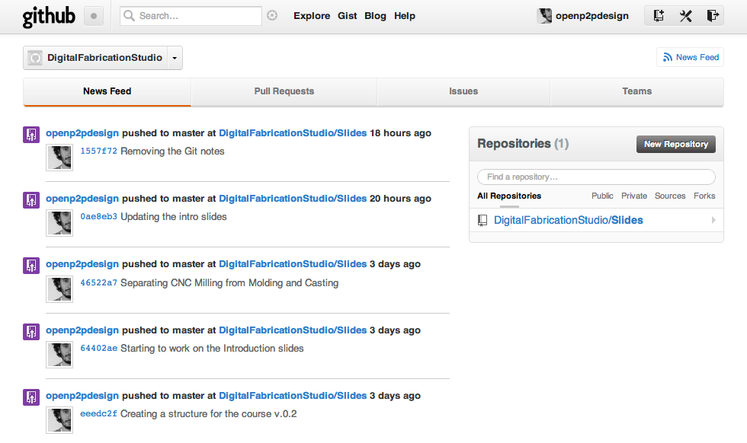
Digital Fabrication Studio @ GitHub
Where you will find the slides, all the material, and where you will work and document your project!
Source: https://github.com/organizations/DigitalFabricationStudio
Notes:
Un progetto digitale da maker, invece, riassume i due precedenti casi: si ha un controllo manuale di uno specifico materiale ma con l'aiuto di una dimensione di dati e di strumenti digitali spesso creati o modificati dallo stesso maker che permetttono un controllo ancora maggiore.

Slide 11
Assignments for this course
* Small exercises for practicing with the technologies.
+
* A final project for understanding and managing the design process and tools.
* A physical object.
* A digital documentation of the process of designing an manufacturing the object on GitHub / BitBucket
* A final presentation (Pdf.) of your project and its development.

Slide 12
Evaluation of this course
* Your final project (quality, complexity/time needed)
* The quality of the physical object.
* The quality digital documentation of the process of designing and manufacturing the object.
* The quality of the presentation of your final project.
* Your collaboration with everybody in this course (me and you)

Slide 13
Suggestions for this course
* Think about a simple project: it doesn't have to save the world, just make you learn digital fabrication and it has to be completed on time
* fail early, fail often: we are all prototyping (your projects, this course, this lab...)
* you can use the lab even outside of the course hours
* you decide how much time to spend for testing and how much time for developing the project; I will help you, don't worry!

Slide 14
Suggestions for this course
* explore: a 100% original project is not required (does it exist?), learn from others and just don't reinvent the wheel
* but be careful with intellectual property! Only use resources you can work and redistribute freely. Ask for help
* I will evaluate the project but especially if you have learnt the process, the tools and if you have collaborated or helped each other!
* Always document and publish on GitHub, it is where I will see if you have worked or not. It is mandatory for passing the course!

Slide 15
Licensing your work
* We are going to use GitHub for Open Source projects, so everything will be accessible to everybody. If it's an issue, you will use BitBucket.
* So publish / share only what you think anybody else can have access to. Do not share what you want to keep private / secret (or if you don't have rights to)
* You can choose a specific Creative Commons license for your project and exercises.

Slide 16
Thank you!!
Massimo Menichinelli
Aalto Media Factory massimo.menichinelli@aalto.fi
@openp2pdesign http://www.slideshare.net/openp2pdesign

