Slide 1

Digital_Fabrication_Studio.03
Software – how to design a project for digital fabrication
Massimo Menichinelli massimo.menichinelli@aalto.fi
@openp2pdesign http://www.slideshare.net/openp2pdesign
07.05.2012
Aalto Media Factory
Helsinki

Slide 2
Today:
* Geometries and file formats
* Softwares available in the lab

Slide 3
01.
Geometries and file formats: modeling techniques and formal representations

Slide 4
2D: Raster graphics
A raster graphics image, or bitmap, is a dot matrix data structure representing a generally rectangular grid of pixels, or points of color, viewable via a monitor, paper, or other display medium.
A bitmap corresponds bit-for-bit with an image displayed on a screen, generally in the same format used for storage in the display's video memory, or maybe as a device-independent bitmap. A bitmap is technically characterized by the width and height of the image in pixels and by the number of bits per pixel (a color depth, which determines the number of colors it can represent).
Source: http://en.wikipedia.org/wiki/Raster_graphics

Slide 5
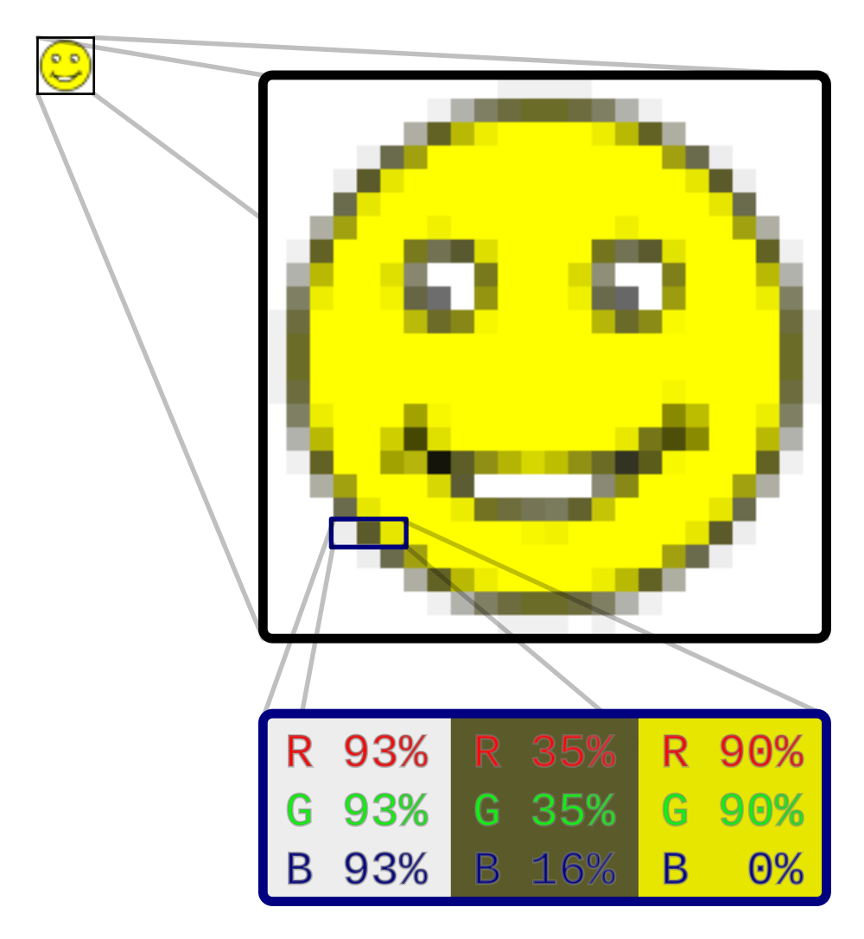
2D: Raster graphics
The structure of a bitmap image.
Source: http://en.wikipedia.org/wiki/Raster_graphics

Slide 6
2D: Vector graphics
Vector graphics is the use of geometrical primitives such as points, lines, curves, and shapes or polygon(s), which are all based on mathematical expressions, to represent images in computer graphics. "Vector", in this context, implies more than a straight line.
Vector graphics is based on images made up of vectors (also called paths, or strokes) which lead through locations called control points. Each of these points has a definite position on the x and y axes of the work plan.
Source: http://en.wikipedia.org/wiki/Vector_graphics

Slide 7
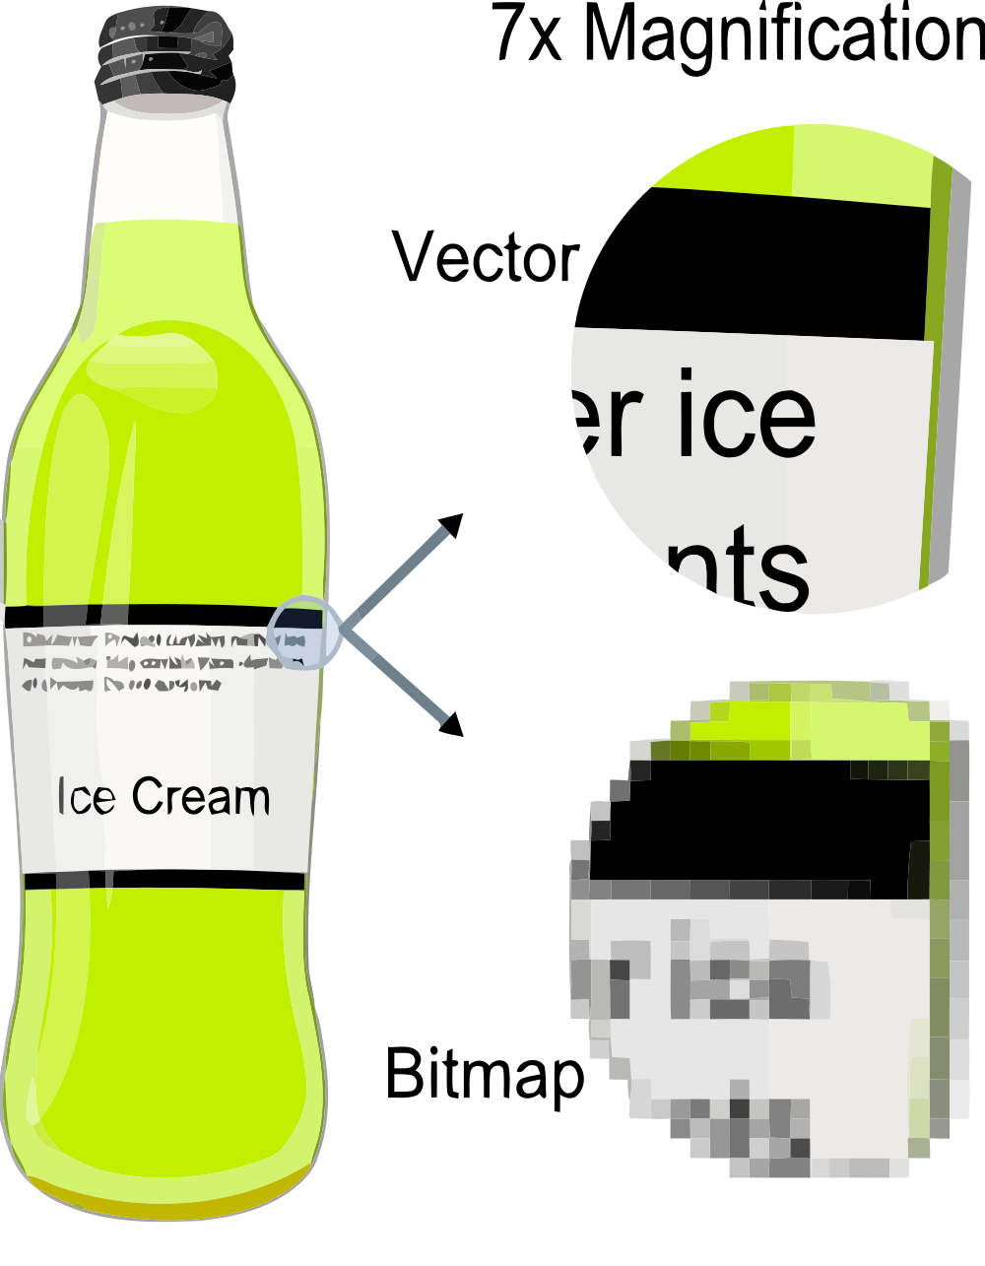
2D: Vector graphics
Each track can be assigned a color, a shape, a thickness and also a fill. This does not affect the size of the files in a substantial way..
Source: http://en.wikipedia.org/wiki/Vector_graphics

Slide 8
3D: Solid (parametric) modeling
The use of solid modeling techniques allows for the automation of several difficult engineering calculations that are carried out as a part of the design process. Simulation, planning, and verification of processes such as machining and assembly were one of the main catalysts for the development of solid modeling.
A central problem in all these applications is the ability to effectively represent and manipulate three-dimensional geometry in a fashion that is consistent with the physical behavior of real artifacts.
Source: http://en.wikipedia.org/wiki/Solid_modeling

Slide 9
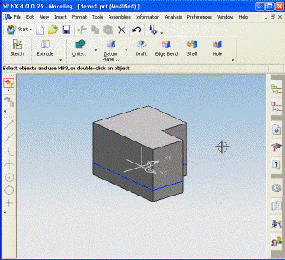
3D: Solid (parametric) modeling
Components have finite size and well behaved boundaries, and their dimentions can be changed through parameters.
Source: http://en.wikipedia.org/wiki/Solid_modeling

Slide 10
3D: NURBS modeling
Non-uniform rational basis spline (NURBS) is a mathematical model commonly used in computer graphics for generating and representing curves and surfaces which offers great flexibility and precision for handling both analytic (surfaces defined by common mathematical formulae) and modeled shapes.
NURBS surfaces are functions of two parameters mapping to a surface in three-dimensional space. The shape of the surface is determined by control points.
Source: http://en.wikipedia.org/wiki/Nurbs

Slide 11
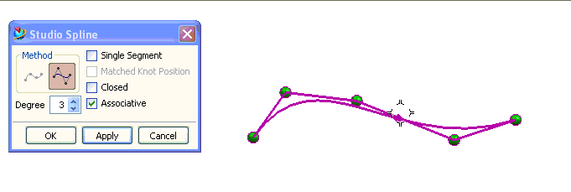
3D: NURBS modeling
Edit points and control points for NURBS modeling.
Source: http://en.wikipedia.org/wiki/Nurbs

Slide 12
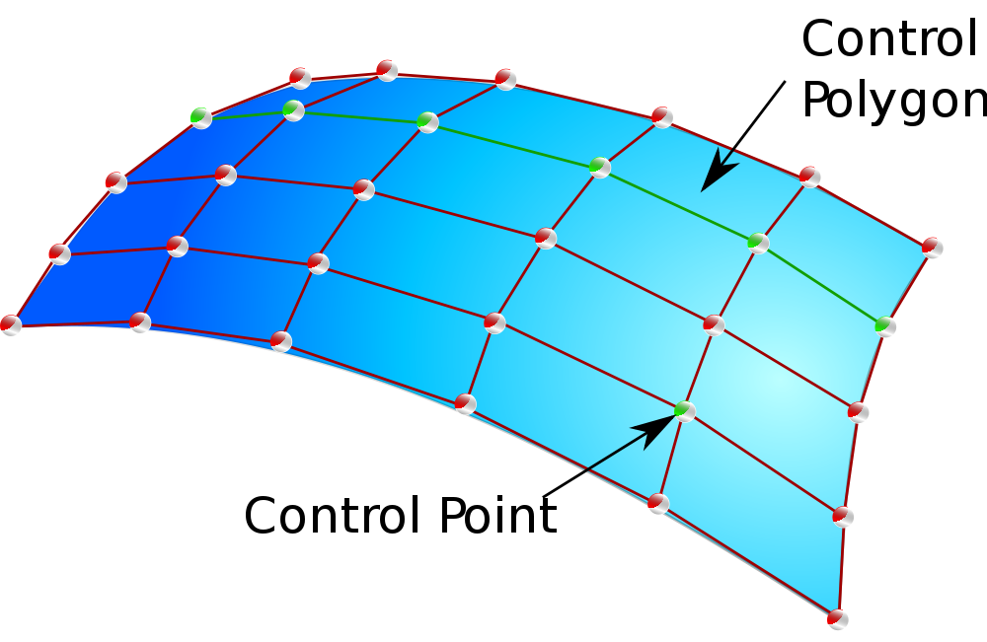
3D: NURBS modeling
Control points on a NURBS surface.
Source: http://en.wikipedia.org/wiki/Nurbs

Slide 13
3D: Mesh modeling
A polygon mesh or unstructured grid is a collection of vertices, edges and faces that defines the shape of a polyhedral object in 3D computer graphics and solid modeling. The faces usually consist of triangles, quadrilaterals or other simple convex polygons, since this simplifies rendering, but may also be composed of more general concave polygons, or polygons with holes.
Source: http://en.wikipedia.org/wiki/Polygon_mesh

Slide 14
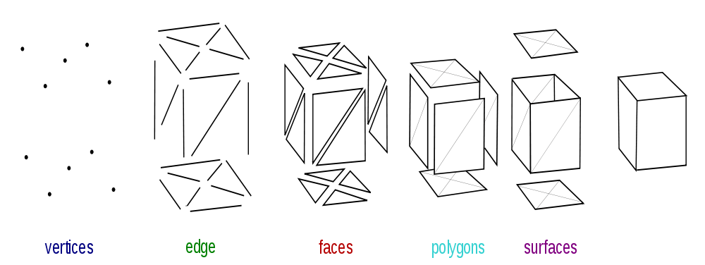
3D: Mesh modeling
Objects created with polygon meshes must store different types of elements. These include vertices, edges, faces, polygons and surfaces.
Source: http://en.wikipedia.org/wiki/Polygon_mesh

Slide 15
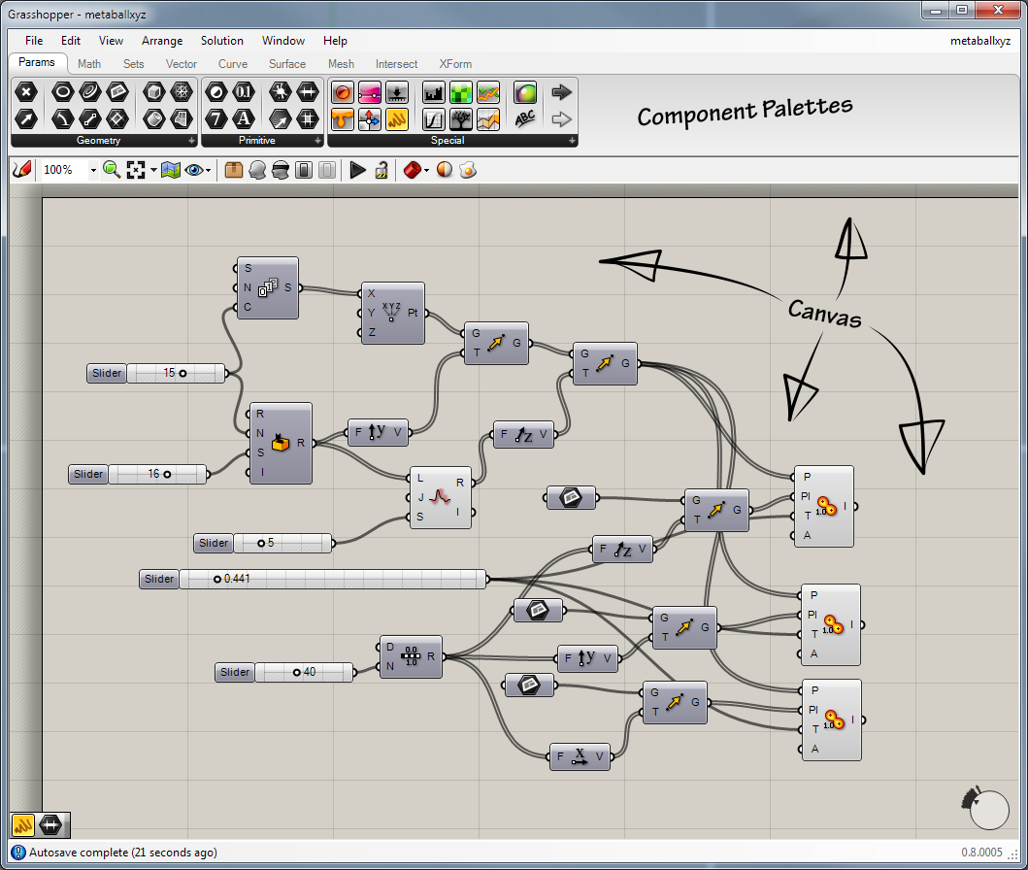
Node-based modeling
Data is passed from component to component via connecting wires which always connect an output grip with an input grip.
Source: http://en.wikipedia.org/wiki/Grasshopper_3d

Slide 16
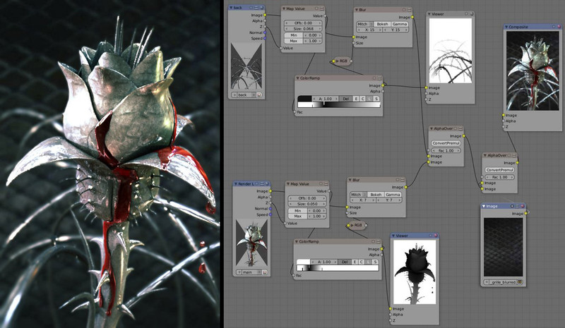
Node-based modeling
Data can be imported and it is always stored in parameters, which can either be free-floating or attached to a component as input/outputs objects.
Source: http://www.blender.org/development/release-logs/blender-242/blender-composite-nodes/

Slide 17
Code
A code is a rule for converting a piece of information (for example, a letter, word, phrase, or gesture) into another form or representation (one sign into another sign), not necessarily of the same type.
In computer science, source code is any collection of computer instructions (possibly with comments) written using some human-readable computer language, usually as text. The source code is translated at some point to machine code that the computer can directly read and execute. An interpreter translates to machine code and executes it on the fly when the program is run, while a compiler translates the program in advance to machine code that it stores as executable files.
Source: http://en.wikipedia.org/wiki/Code
http://en.wikipedia.org/wiki/Software_code´

Slide 18
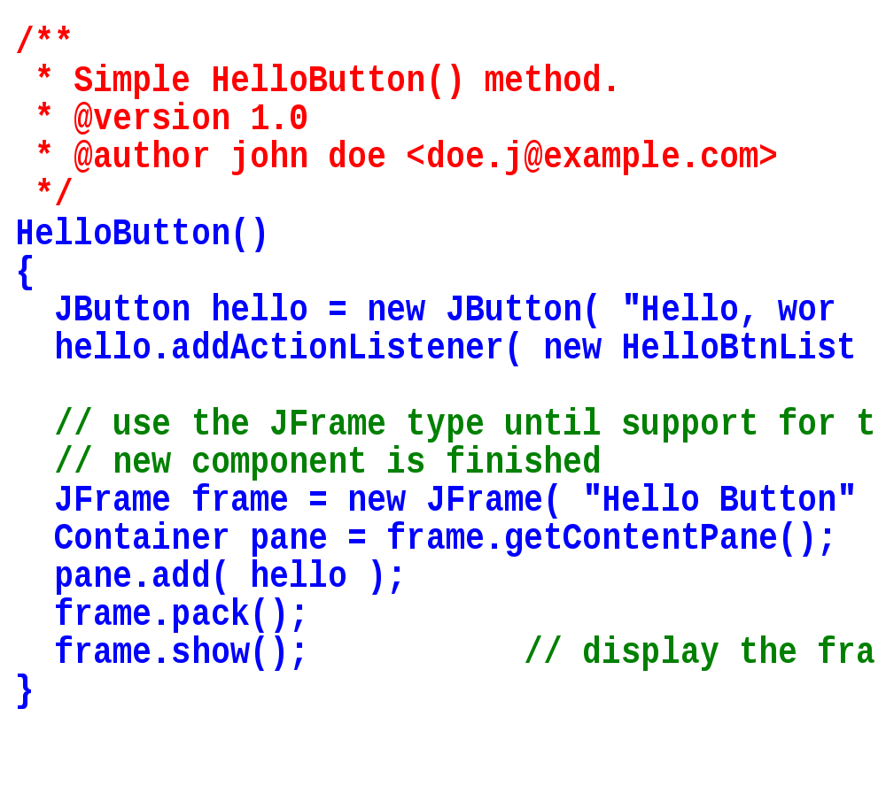
Code
Human-readable code and comments.
Source: http://en.wikipedia.org/wiki/Code
http://en.wikipedia.org/wiki/Software_code´

Slide 19
.SVG
Scalable Vector Graphics (SVG) is a family of specifications of an XML-based file format for two-dimensional vector graphics, both static and dynamic (i.e. interactive or animated). The SVG specification is an open standard that has been under development by the World Wide Web Consortium (W3C) since 1999.
SVG images and their behaviors are defined in XML text files. This means that they can be searched, indexed, scripted, and, if required, compressed. As XML files, SVG images can be created and edited with any text editor.
All major modern web browsers have at least some degree of support and render SVG markup directly.
Source: http://en.wikipedia.org/wiki/Svg

Slide 20
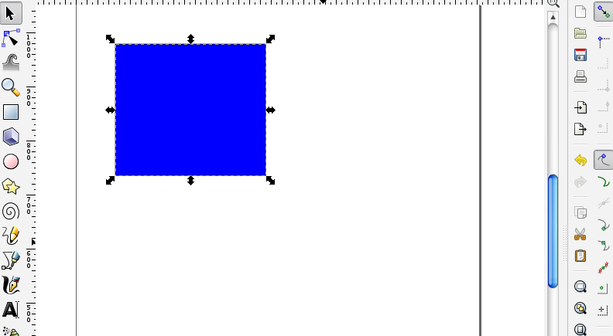
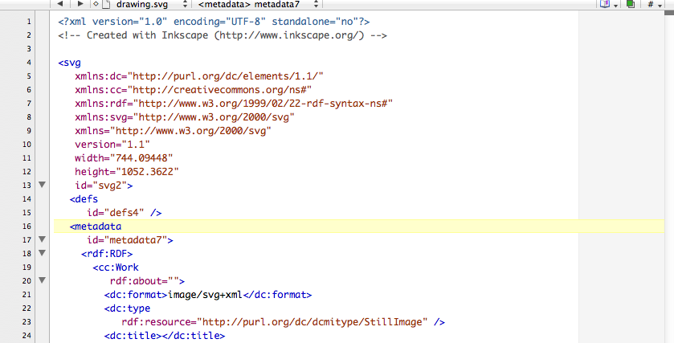
.SVG
And this is why it is a standard for the web...
Source: http://en.wikipedia.org/wiki/Svg

Slide 21
G-code
G-code is the common name for the most widely used computer numerical control (CNC) programming language, which has many implementations. Used mainly in automation, it is part of computer-aided engineering. G-code is sometimes called G programming language.
In fundamental terms, G-code is a language in which people tell computerized machine tools what to make and how to make it. The "what" and "how" are mostly defined by instructions on where to move to, how fast to move, and through what path to move.
Source: http://en.wikipedia.org/wiki/Gcode

Slide 22
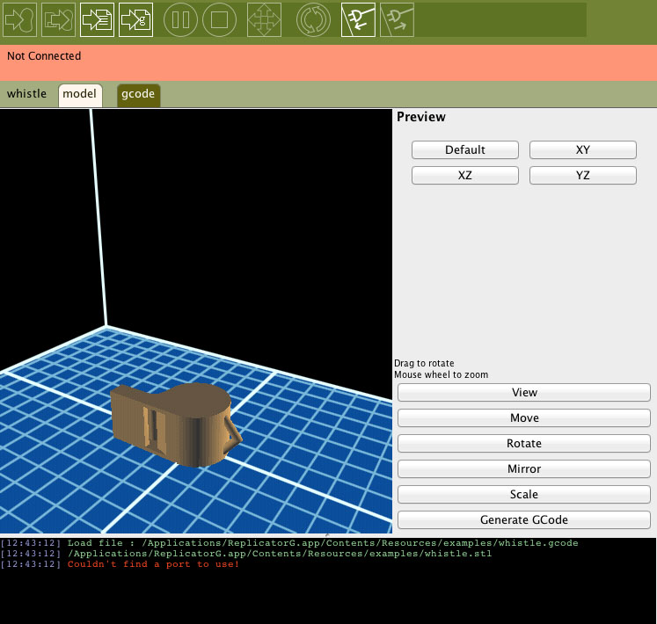
G-code
G-codes are also called preparatory codes, and are any word in a CNC program that begins with the letter "G".
Source: http://en.wikipedia.org/wiki/Gcode

Slide 23
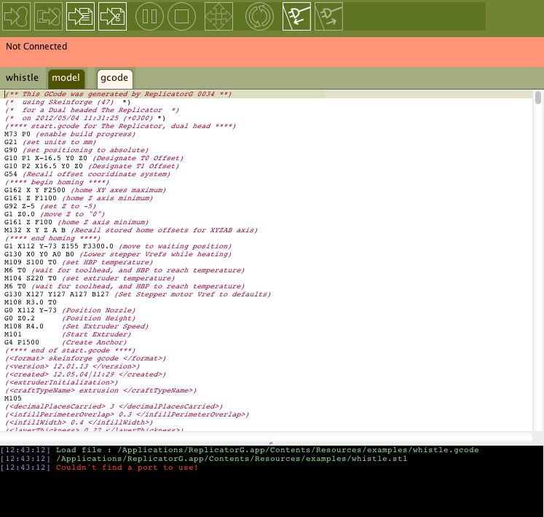
G-code
G-codes are also called preparatory codes, and are any word in a CNC program that begins with the letter "G".
Source: http://en.wikipedia.org/wiki/Gcode

Slide 24
.OBJ
A geometry definition file format first developed by Wavefront Technologies. The file format is open and has been adopted by other 3D graphics application vendors.
The OBJ file format is a simple data-format that represents 3D geometry alone — namely, the position of each vertex, the UV position of each texture coordinate vertex, normals, and the faces that make each polygon defined as a list of vertices, and texture vertices.
Materials that describe the visual aspects of the polygons are stored in external .mtl files.
Source: http://en.wikipedia.org/wiki/Wavefront_.obj_file

Slide 25
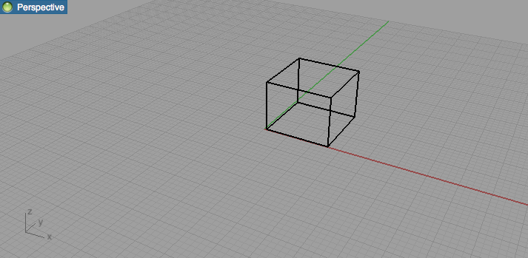
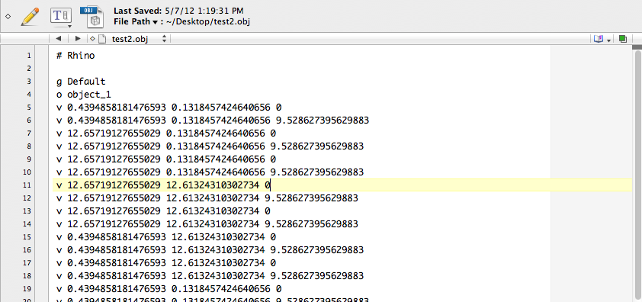
.OBJ
You may probably need to edit it by hand, one day...
Source: http://en.wikipedia.org/wiki/Wavefront_.obj_file

Slide 26
.IGES / .IGS
The Initial Graphics Exchange Specification (IGES) (pronounced eye-jess) is a file format which defines a vendor neutral data format that allows the digital exchange of information among Computer-aided design (CAD) systems.
Using IGES, a CAD user can exchange product data models in the form of circuit diagrams, wireframe, freeform surface or solid modeling representations. Applications supported by IGES include traditional engineering drawings, models for analysis, and other manufacturing functions.
Source: http://en.wikipedia.org/wiki/IGES

Slide 27
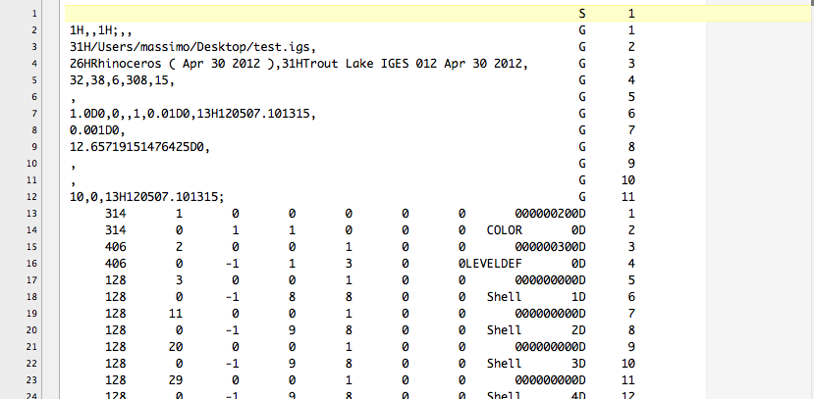
.IGES / .IGS
You may probably need to edit it by hand, one day...
Source: http://en.wikipedia.org/wiki/IGES

Slide 28
.DXF
AutoCAD DXF (Drawing Interchange Format, or Drawing Exchange Format) is a CAD data file format developed by Autodesk for enabling data interoperability between AutoCAD and other programs.
Versions of AutoCAD from Release 10 (October 1988) and up support both ASCII and binary forms of DXF. Earlier versions support only ASCII.
As AutoCAD has become more powerful, supporting more complex object types, DXF has become less useful. Certain object types, including ACIS solids and regions, are not documented.
Source: http://en.wikipedia.org/wiki/Dxf

Slide 29
.STL
STL (Standard Tessellation Language) is a file format native to the stereolithography CAD software created by 3D Systems. This file format is supported by many other software packages; it is widely used for rapid prototyping and computer-aided manufacturing. STL files describe only the surface geometry of a three dimensional object without any representation of color, texture or other common CAD model attributes.
The STL format specifies both ASCII and binary representations. Binary files are more common, since they are more compact.
Source: http://en.wikipedia.org/wiki/STL_(file_format)

Slide 30
… and much more file formats!

Slide 31
02.
Softwares: what tools are available in this FabLab

Slide 32
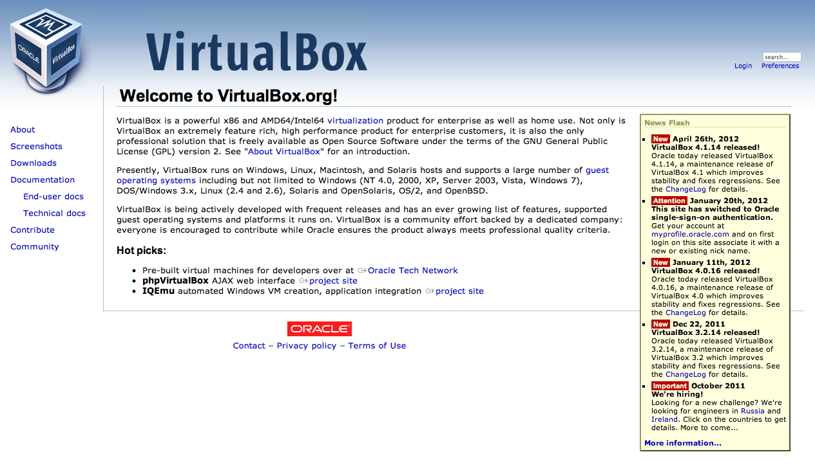
Mac and Win, but also... VirtualBox
VirtualBox is a powerful x86 and AMD64/Intel64 virtualization product for enterprise as well as home use and it is open source.
Source: https://www.virtualbox.org/
Notes:
CBA:
Explores how the content of information relates to tis physical representation
Esplora come il contenuto dell'informazione si relazioni con la sua rappresentazioen fisica
Come mettere l'informazione nella materia
Ribosome is like lego,
A programmable digital machine (that makes machines)
The program is not a description of something, it is something. And the computer is a tool

Slide 33
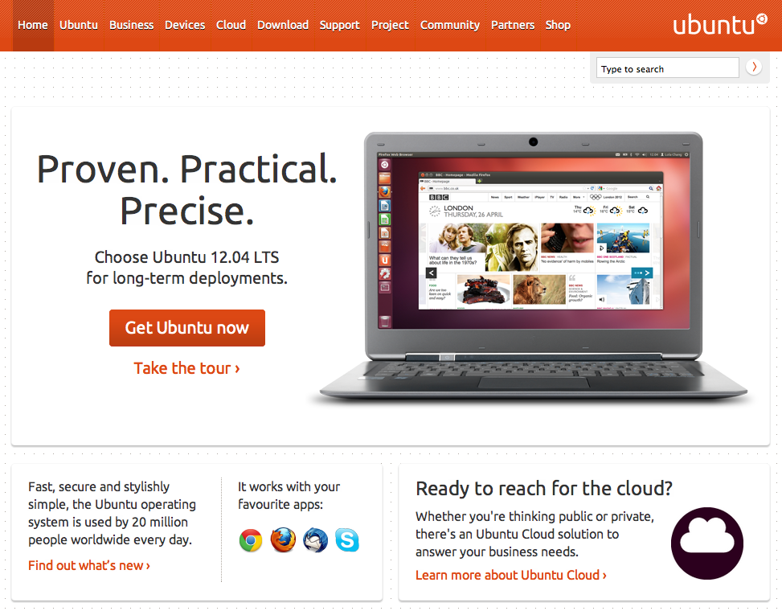
Ubuntu, with a virtual machine
Ubuntu is a computer operating system based on the Debian Linux distribution and distributed as free and open source software.
Source: http://www.ubuntu.com/
Notes:
CBA:
Explores how the content of information relates to tis physical representation
Esplora come il contenuto dell'informazione si relazioni con la sua rappresentazioen fisica
Come mettere l'informazione nella materia
Ribosome is like lego,
A programmable digital machine (that makes machines)
The program is not a description of something, it is something. And the computer is a tool

Slide 34
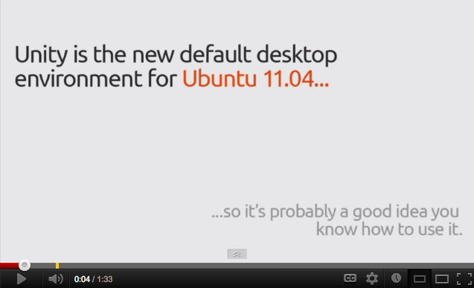
Ubuntu Unity: the new desktop environment
Founded in 2010, the Unity project has gone on to deliver a consistent user experience for desktop and netbook users alike.
Source: http://www.youtube.com/watch?v=fAcdFd0MmH0
http://unity.ubuntu.com/
Notes:
CBA:
Explores how the content of information relates to tis physical representation
Esplora come il contenuto dell'informazione si relazioni con la sua rappresentazioen fisica
Come mettere l'informazione nella materia
Ribosome is like lego,
A programmable digital machine (that makes machines)
The program is not a description of something, it is something. And the computer is a tool

Slide 35
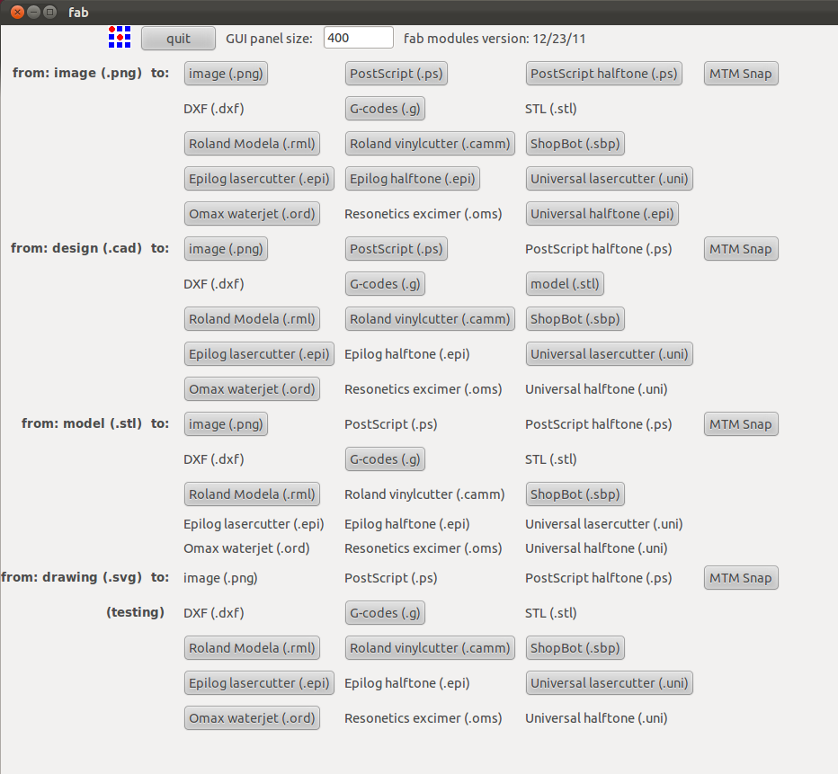
Fab Modules
Fab Modules are developed by the MIT CBA with the Fab Network. Available for experimental / personal use; commercial licenses are available from MIT.
Source: http://kokompe.cba.mit.edu/dist/index.html
Notes:
CBA:
Explores how the content of information relates to tis physical representation
Esplora come il contenuto dell'informazione si relazioni con la sua rappresentazioen fisica
Come mettere l'informazione nella materia
Ribosome is like lego,
A programmable digital machine (that makes machines)
The program is not a description of something, it is something. And the computer is a tool

Slide 36
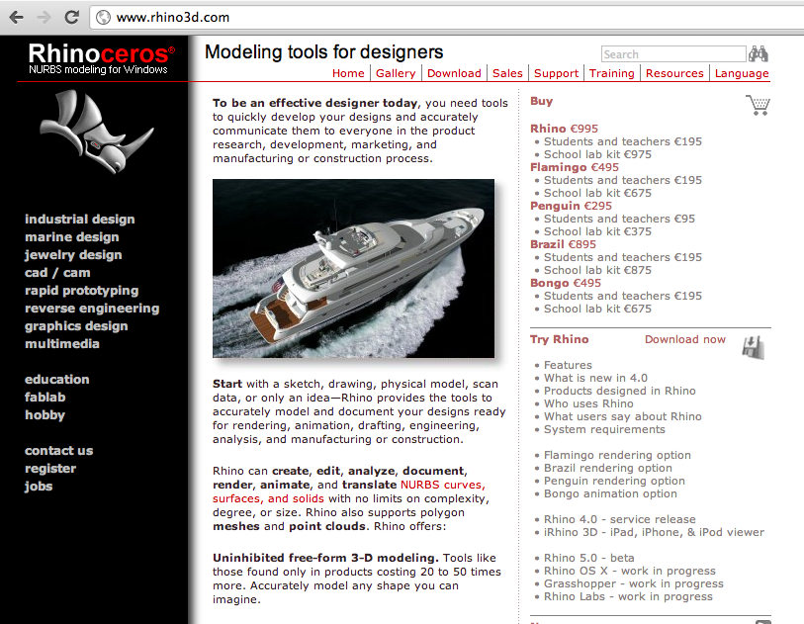
Rhinoceros 3D
Rhinoceros (Rhino) is a stand-alone, commercial NURBS-based 3-D modeling tool, developed by Robert McNeel & Associates.
Source: http://www.rhino3d.com/
Notes:
CBA:
Explores how the content of information relates to tis physical representation
Esplora come il contenuto dell'informazione si relazioni con la sua rappresentazioen fisica
Come mettere l'informazione nella materia
Ribosome is like lego,
A programmable digital machine (that makes machines)
The program is not a description of something, it is something. And the computer is a tool

Slide 37
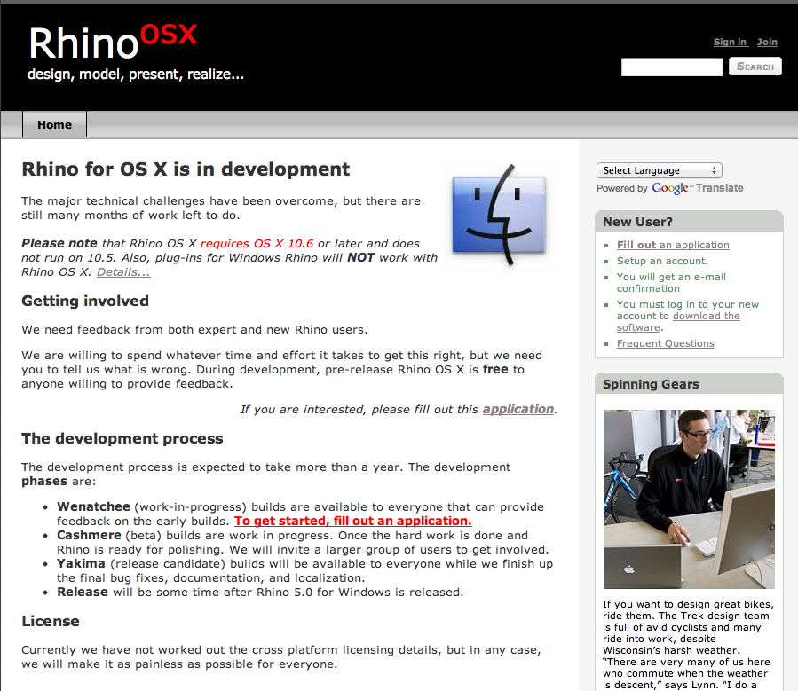
Rhinoceros 3D for Mac
Under development, but still available for free (registration required).
Source: http://mac.rhino3d.com/
Notes:
CBA:
Explores how the content of information relates to tis physical representation
Esplora come il contenuto dell'informazione si relazioni con la sua rappresentazioen fisica
Come mettere l'informazione nella materia
Ribosome is like lego,
A programmable digital machine (that makes machines)
The program is not a description of something, it is something. And the computer is a tool

Slide 38
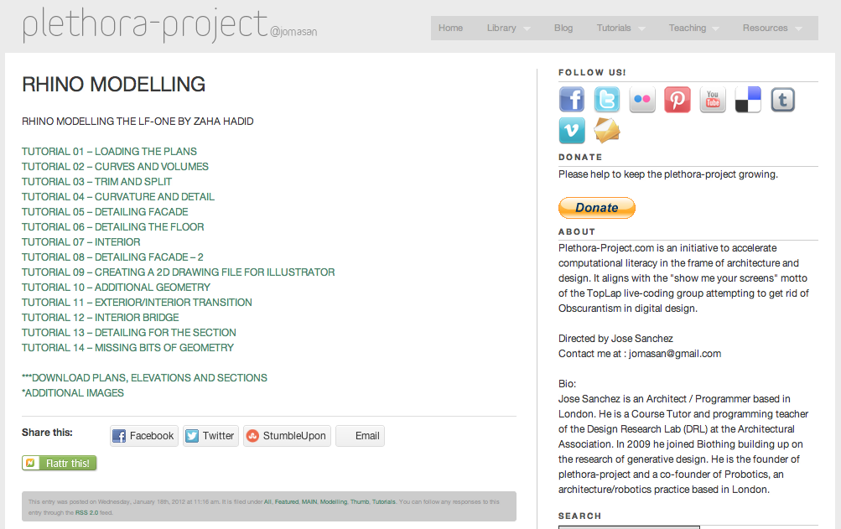
Rhinoceros 3D: Tutorials
Video Tutorials about Rhinoceros
Source: http://www.plethora-project.com/2012/01/18/rhino-modeling-the-lf-one-by-zaha-hadid/
Notes:
CBA:
Explores how the content of information relates to tis physical representation
Esplora come il contenuto dell'informazione si relazioni con la sua rappresentazioen fisica
Come mettere l'informazione nella materia
Ribosome is like lego,
A programmable digital machine (that makes machines)
The program is not a description of something, it is something. And the computer is a tool

Slide 39
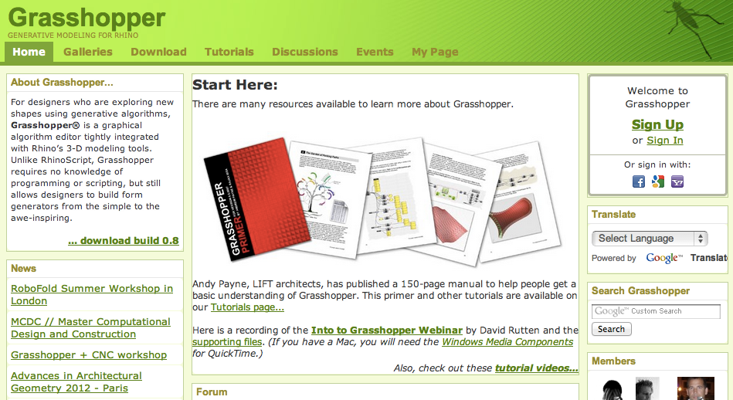
Grasshopper for Rhinoceros 3D (Win)
Grasshopper is a graphical algorithm editor tightly integrated with Rhino’s 3-D and it requires no knowledge of programming or scripting.
Source: http://www.grasshopper3d.com/
Notes:
CBA:
Explores how the content of information relates to tis physical representation
Esplora come il contenuto dell'informazione si relazioni con la sua rappresentazioen fisica
Come mettere l'informazione nella materia
Ribosome is like lego,
A programmable digital machine (that makes machines)
The program is not a description of something, it is something. And the computer is a tool

Slide 40
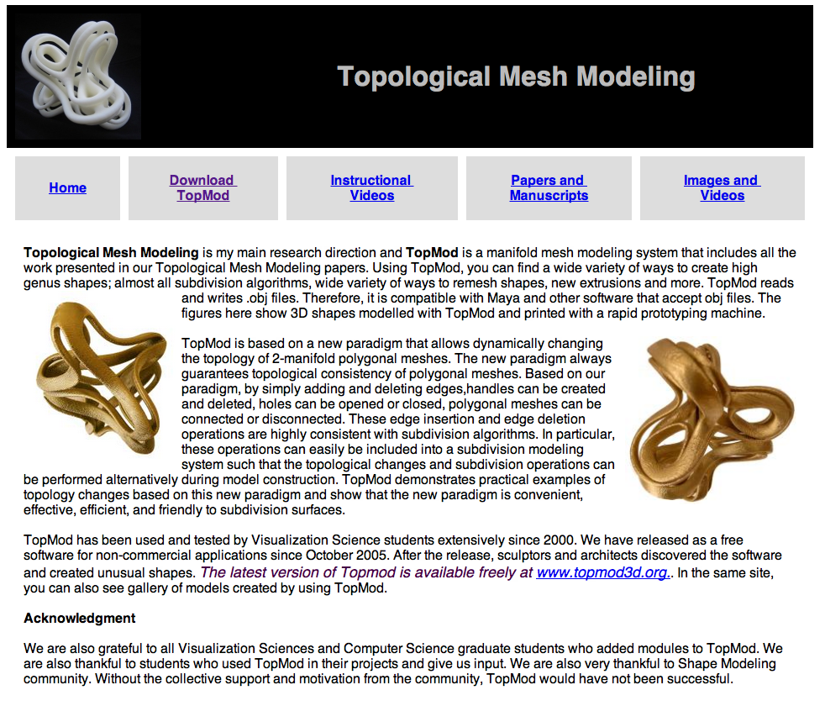
TopMod
Open Source software for modeling very complex geometries.
Source: http://www.viz.tamu.edu/faculty/ergun/research/topology/
Notes:
CBA:
Explores how the content of information relates to tis physical representation
Esplora come il contenuto dell'informazione si relazioni con la sua rappresentazioen fisica
Come mettere l'informazione nella materia
Ribosome is like lego,
A programmable digital machine (that makes machines)
The program is not a description of something, it is something. And the computer is a tool

Slide 41
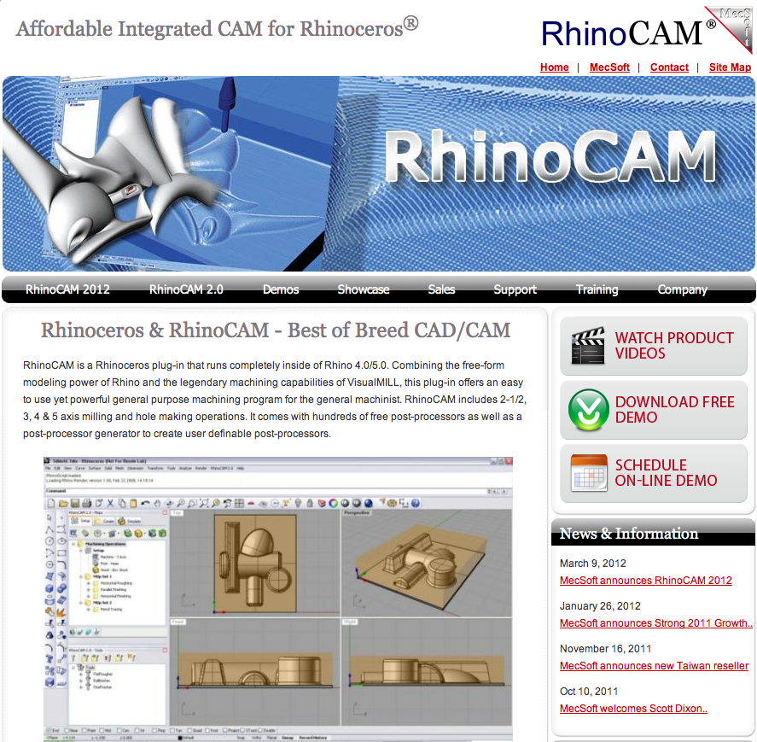
RhinoCAM (Not available now)
… not the center for rapid prototyping: “investigating the interface between computer science and physical science”
Source: http://www.rhinocam.com/
Notes:
CBA:
Explores how the content of information relates to tis physical representation
Esplora come il contenuto dell'informazione si relazioni con la sua rappresentazioen fisica
Come mettere l'informazione nella materia
Ribosome is like lego,
A programmable digital machine (that makes machines)
The program is not a description of something, it is something. And the computer is a tool

Slide 42
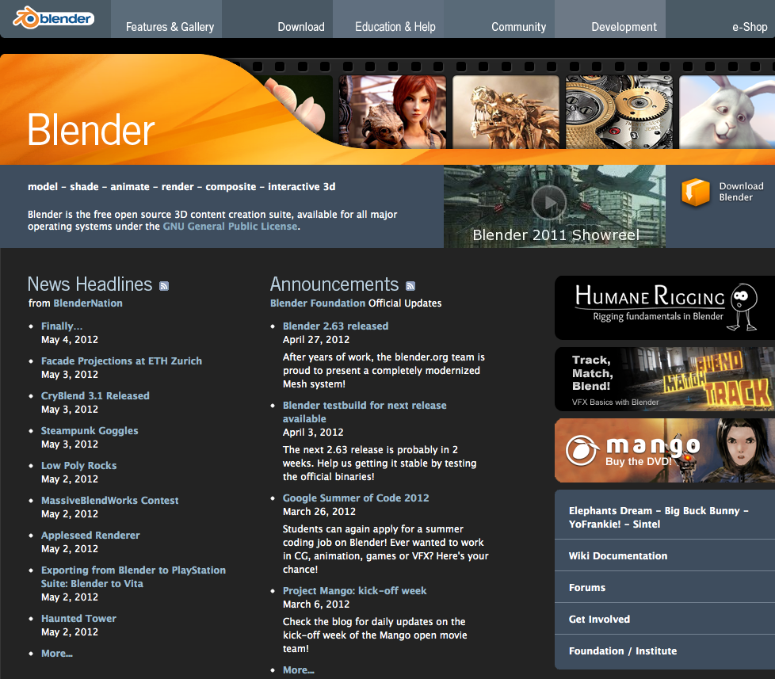
Blender
3D modeling, UV unwrapping, texturing, rigging/ skinning, fluid / smoke / particle simulation, animating, rendering, video editing / compositing, game engine.
Source: http://www.blender.org/
Notes:
CBA:
Explores how the content of information relates to tis physical representation
Esplora come il contenuto dell'informazione si relazioni con la sua rappresentazioen fisica
Come mettere l'informazione nella materia
Ribosome is like lego,
A programmable digital machine (that makes machines)
The program is not a description of something, it is something. And the computer is a tool

Slide 43
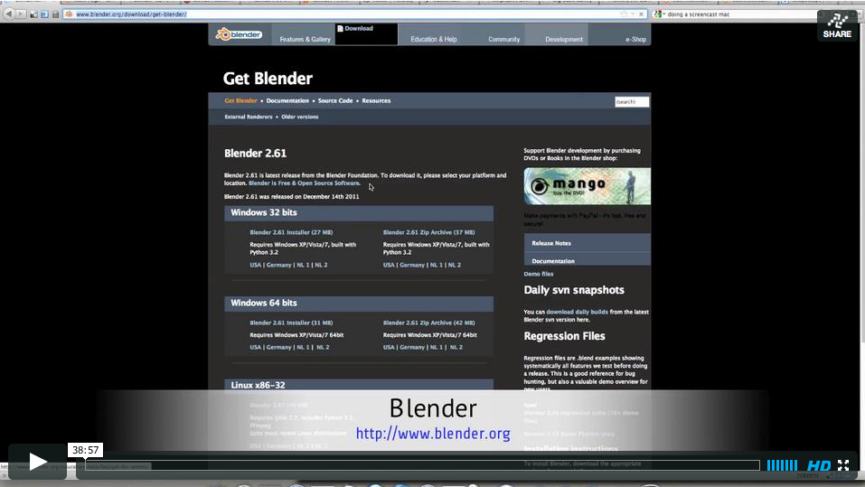
Blender: there's a video introduction available
3D modeling, UV unwrapping, texturing, rigging/ skinning, fluid / smoke / particle simulation, animating, rendering, video editing / compositing, game engine.
Source: https://vimeo.com/41312301
Notes:
CBA:
Explores how the content of information relates to tis physical representation
Esplora come il contenuto dell'informazione si relazioni con la sua rappresentazioen fisica
Come mettere l'informazione nella materia
Ribosome is like lego,
A programmable digital machine (that makes machines)
The program is not a description of something, it is something. And the computer is a tool

Slide 44
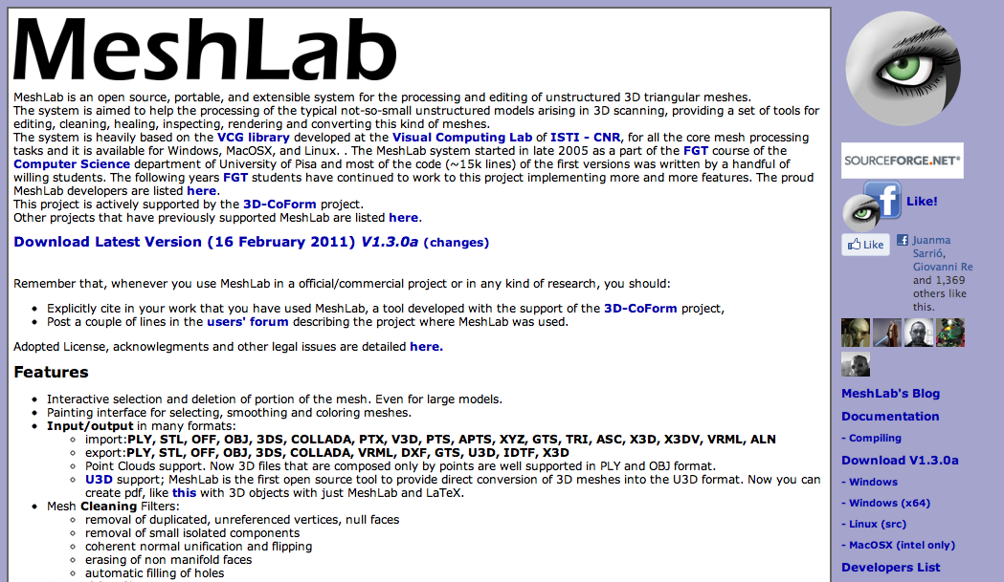
Meshlab
MeshLab is an open source system for the processing and editing of unstructured 3D triangular meshes with tools for editing, cleaning, healing, inspecting.
Source: http://meshlab.sourceforge.net/
Notes:
CBA:
Explores how the content of information relates to tis physical representation
Esplora come il contenuto dell'informazione si relazioni con la sua rappresentazioen fisica
Come mettere l'informazione nella materia
Ribosome is like lego,
A programmable digital machine (that makes machines)
The program is not a description of something, it is something. And the computer is a tool

Slide 45
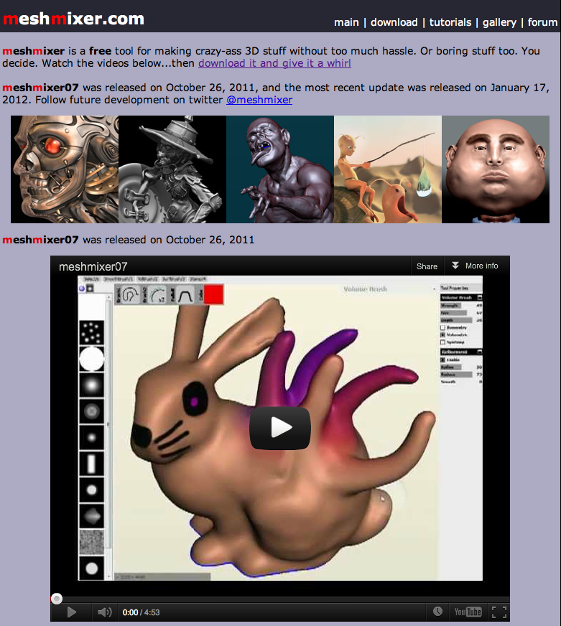
Meshmixer
Meshmixer is a free tool for making crazy-ass 3D stuff without too much hassle.
Source: http://www.meshmixer.com/
Notes:
CBA:
Explores how the content of information relates to tis physical representation
Esplora come il contenuto dell'informazione si relazioni con la sua rappresentazioen fisica
Come mettere l'informazione nella materia
Ribosome is like lego,
A programmable digital machine (that makes machines)
The program is not a description of something, it is something. And the computer is a tool

Slide 46
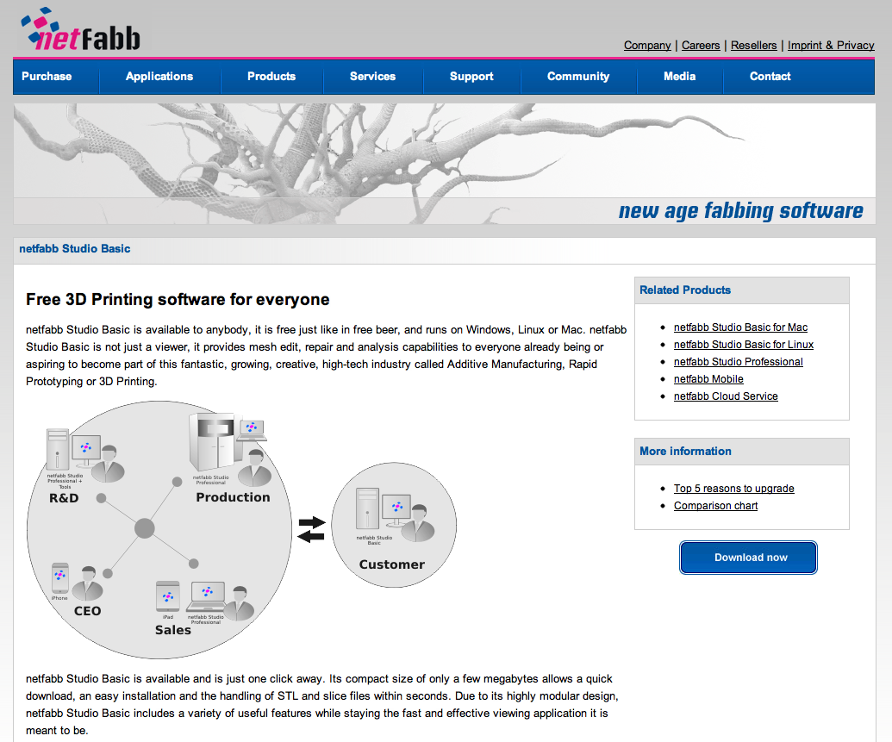
Netfabb Studio Basic
Netfabb Studio Basic is freeware and runs on Windows, Linux or Mac. It is not just a viewer, it provides mesh edit, repair and analysis.
Source: http://www.netfabb.com/basic.php
Notes:
CBA:
Explores how the content of information relates to tis physical representation
Esplora come il contenuto dell'informazione si relazioni con la sua rappresentazioen fisica
Come mettere l'informazione nella materia
Ribosome is like lego,
A programmable digital machine (that makes machines)
The program is not a description of something, it is something. And the computer is a tool

Slide 47
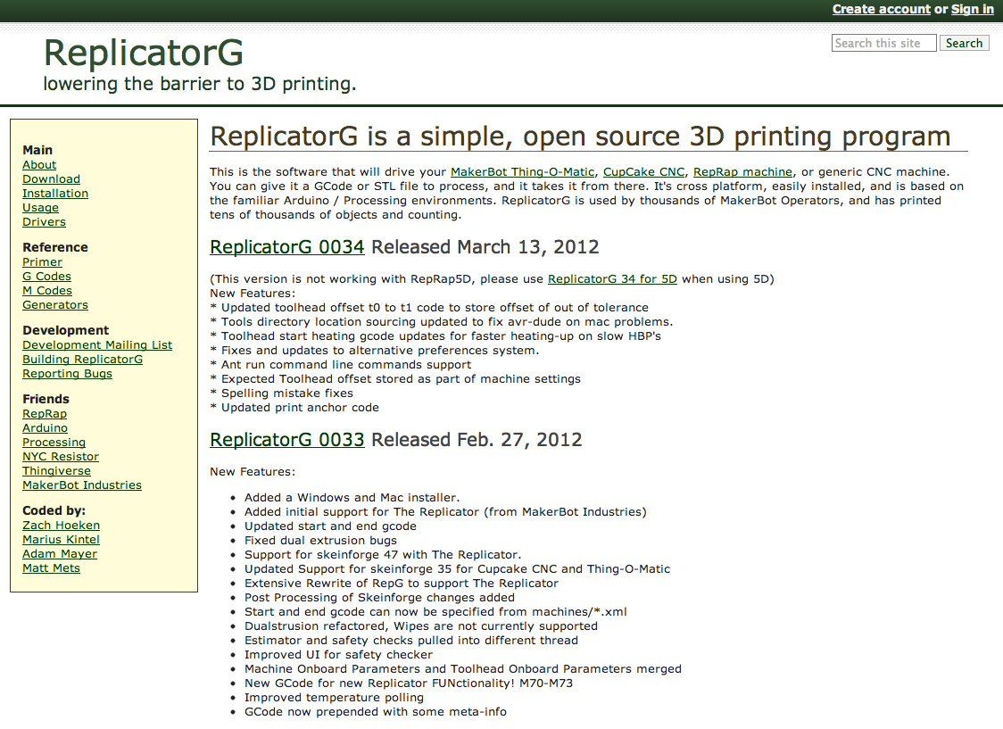
Replicator G
This is the software that will drive your MakerBot Thing-O-Matic, CupCake CNC, RepRap machine, or generic CNC machine.
Source: http://replicat.org/
Notes:
CBA:
Explores how the content of information relates to tis physical representation
Esplora come il contenuto dell'informazione si relazioni con la sua rappresentazioen fisica
Come mettere l'informazione nella materia
Ribosome is like lego,
A programmable digital machine (that makes machines)
The program is not a description of something, it is something. And the computer is a tool

Slide 48
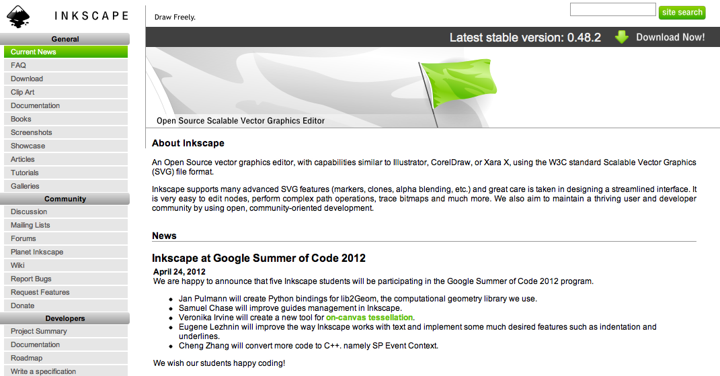
Inkscape
An Open Source vector graphics editor, with capabilities similar to Illustrator, CorelDraw, using the W3C standard Scalable Vector Graphics (SVG) file format.
Source: http://inkscape.org/
Notes:
CBA:
Explores how the content of information relates to tis physical representation
Esplora come il contenuto dell'informazione si relazioni con la sua rappresentazioen fisica
Come mettere l'informazione nella materia
Ribosome is like lego,
A programmable digital machine (that makes machines)
The program is not a description of something, it is something. And the computer is a tool

Slide 49
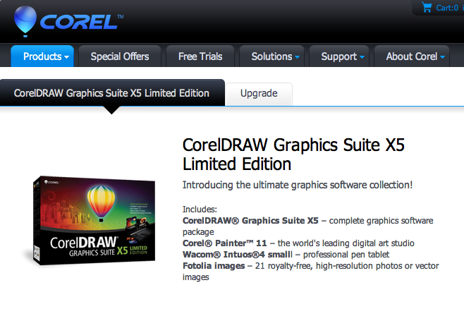
Corel Draw Graphics Suite X5
CorelDRAW Graphics Suite X5 is a fully integrated graphic design software suite that helps you creatively express ideas for any media.
Source: http://www.corel.com/corel/product/index.jsp?pid=prod4130071
Notes:
CBA:
Explores how the content of information relates to tis physical representation
Esplora come il contenuto dell'informazione si relazioni con la sua rappresentazioen fisica
Come mettere l'informazione nella materia
Ribosome is like lego,
A programmable digital machine (that makes machines)
The program is not a description of something, it is something. And the computer is a tool

Slide 50
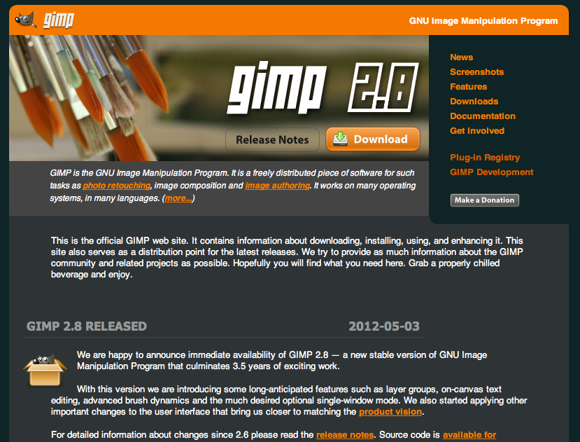
GIMP
GIMP (GNU Image Manipulation Program) is a free and open source software image retouching and editing tool and is freely available for Win, Mac, Linux.
Source: http://www.gimp.org/
Notes:
CBA:
Explores how the content of information relates to tis physical representation
Esplora come il contenuto dell'informazione si relazioni con la sua rappresentazioen fisica
Come mettere l'informazione nella materia
Ribosome is like lego,
A programmable digital machine (that makes machines)
The program is not a description of something, it is something. And the computer is a tool

Slide 51
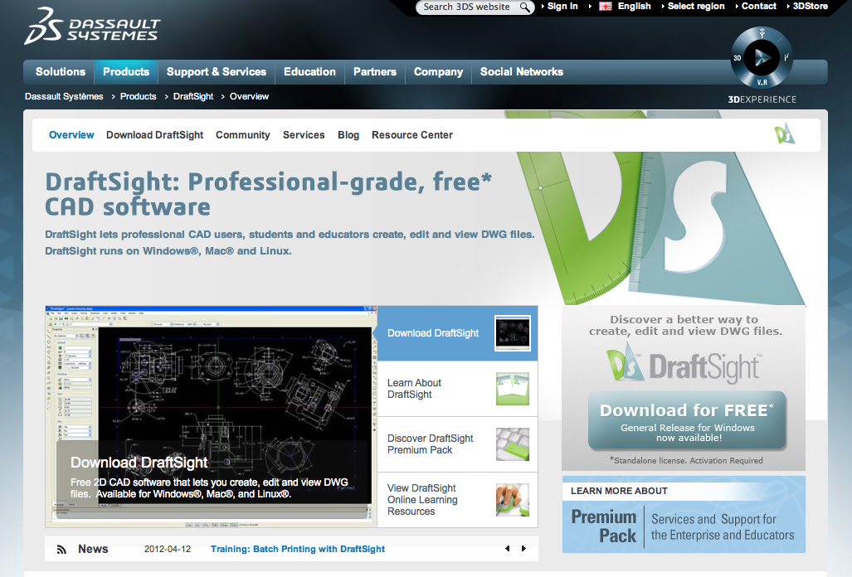
DraftSight
DraftSight lets professional CAD user create, edit and view DWG files. DraftSight runs on Windows, Mac and Linux.
Source: http://www.3ds.com/products/draftsight/overview/
Notes:
CBA:
Explores how the content of information relates to tis physical representation
Esplora come il contenuto dell'informazione si relazioni con la sua rappresentazioen fisica
Come mettere l'informazione nella materia
Ribosome is like lego,
A programmable digital machine (that makes machines)
The program is not a description of something, it is something. And the computer is a tool

Slide 52
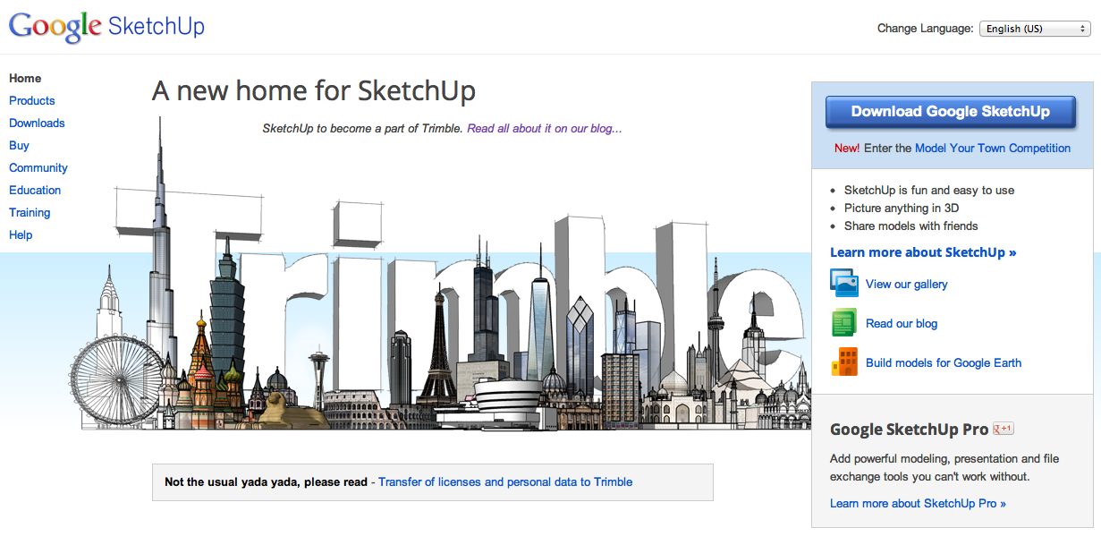
SketchUp
SketchUp is a 3D modeling program marketed by Trimble Navigation and designed for ease of use.
Source: http://sketchup.google.com/
Notes:
CBA:
Explores how the content of information relates to tis physical representation
Esplora come il contenuto dell'informazione si relazioni con la sua rappresentazioen fisica
Come mettere l'informazione nella materia
Ribosome is like lego,
A programmable digital machine (that makes machines)
The program is not a description of something, it is something. And the computer is a tool

Slide 53
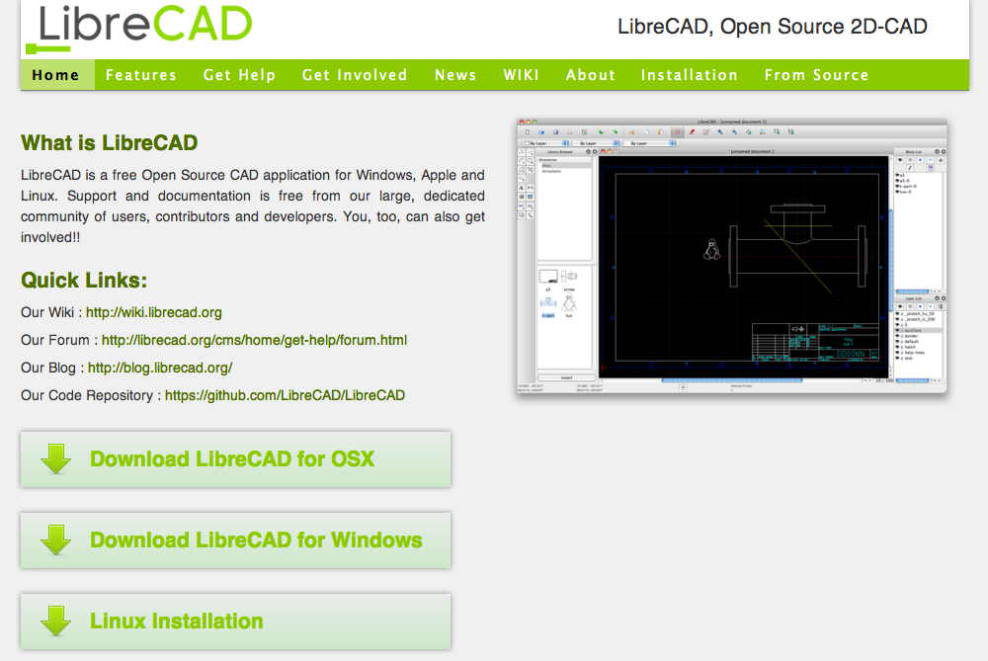
LibreCad
LibreCAD is a free Open Source CAD application for Windows, Apple and Linux.
Source: http://librecad.org/cms/home.html
Notes:
CBA:
Explores how the content of information relates to tis physical representation
Esplora come il contenuto dell'informazione si relazioni con la sua rappresentazioen fisica
Come mettere l'informazione nella materia
Ribosome is like lego,
A programmable digital machine (that makes machines)
The program is not a description of something, it is something. And the computer is a tool

Slide 54
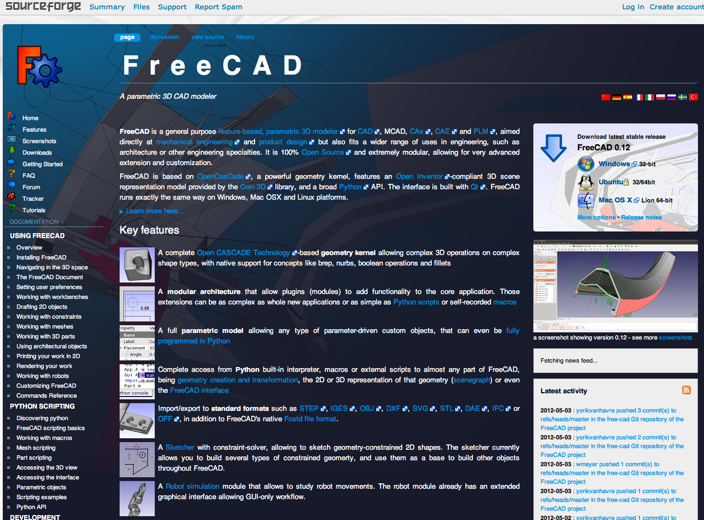
Free CAD
FreeCAD is a general purpose feature-based, parametric 3D modeler for CAD, MCAD, CAx, CAE and PLM, aimed at mechanical engineering and product design.
Source: http://sourceforge.net/apps/mediawiki/free-cad/index.php?title=Main_Page
Notes:
CBA:
Explores how the content of information relates to tis physical representation
Esplora come il contenuto dell'informazione si relazioni con la sua rappresentazioen fisica
Come mettere l'informazione nella materia
Ribosome is like lego,
A programmable digital machine (that makes machines)
The program is not a description of something, it is something. And the computer is a tool

Slide 55
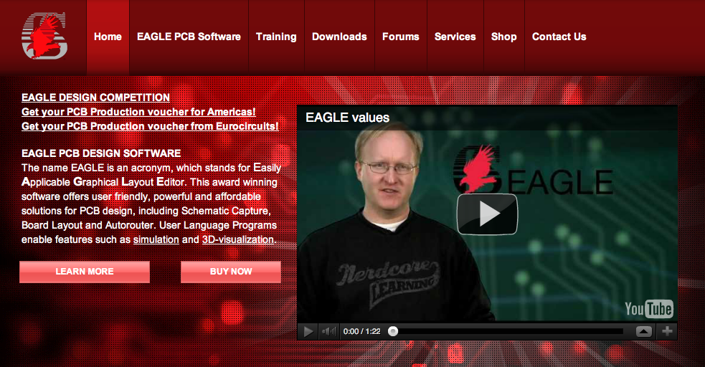
Eagle CAD
This software offers user friendly, powerful and affordable solutions for PCB design, including Schematic Capture, Board Layout and Autorouter.
Source: http://www.cadsoftusa.com/
Notes:
CBA:
Explores how the content of information relates to tis physical representation
Esplora come il contenuto dell'informazione si relazioni con la sua rappresentazioen fisica
Come mettere l'informazione nella materia
Ribosome is like lego,
A programmable digital machine (that makes machines)
The program is not a description of something, it is something. And the computer is a tool

Slide 56
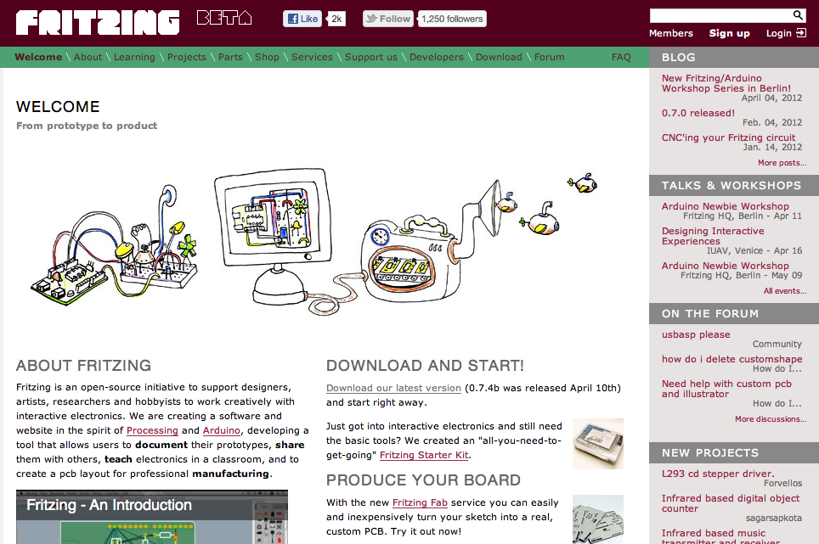
Fritzing
Fritzing is an open-source initiative to support designers, artists, researchers and hobbyists to work creatively with interactive electronics.
Source: http://fritzing.org/
Notes:
CBA:
Explores how the content of information relates to tis physical representation
Esplora come il contenuto dell'informazione si relazioni con la sua rappresentazioen fisica
Come mettere l'informazione nella materia
Ribosome is like lego,
A programmable digital machine (that makes machines)
The program is not a description of something, it is something. And the computer is a tool

Slide 57
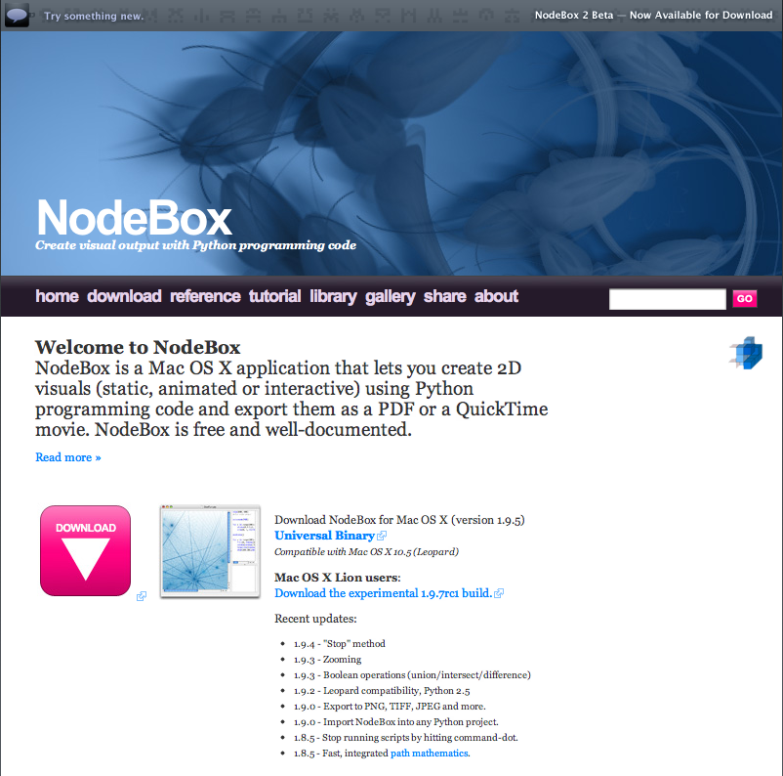
Nodebox
NodeBox lets you create 2D visuals (static, animated or interactive) using Python programming code and export them as a PDF / QuickTime movie.
Source: http://www.nodebox.net/code/index.php/Home
Notes:
CBA:
Explores how the content of information relates to tis physical representation
Esplora come il contenuto dell'informazione si relazioni con la sua rappresentazioen fisica
Come mettere l'informazione nella materia
Ribosome is like lego,
A programmable digital machine (that makes machines)
The program is not a description of something, it is something. And the computer is a tool

Slide 58
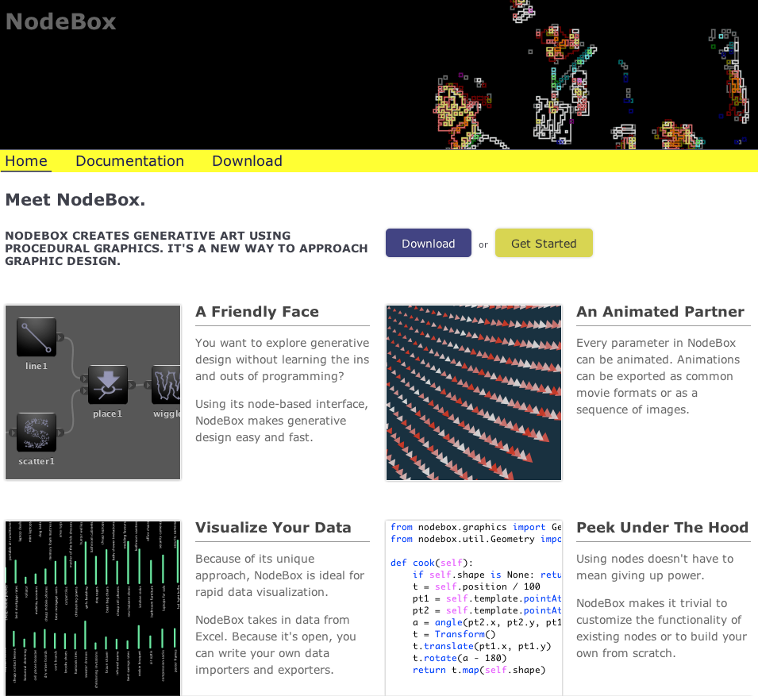
NodeBox 2
NodeBox 2 creates generative art and design through a node-based system.
Source: http://beta.nodebox.net/
Notes:
CBA:
Explores how the content of information relates to tis physical representation
Esplora come il contenuto dell'informazione si relazioni con la sua rappresentazioen fisica
Come mettere l'informazione nella materia
Ribosome is like lego,
A programmable digital machine (that makes machines)
The program is not a description of something, it is something. And the computer is a tool

Slide 59
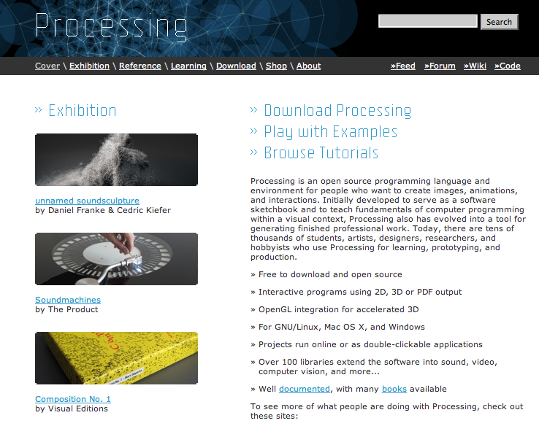
Processing
Processing is an open source programming language and environment for people who want to create images, animations, and interactions.
Source: http://www.processing.org/
Notes:
CBA:
Explores how the content of information relates to tis physical representation
Esplora come il contenuto dell'informazione si relazioni con la sua rappresentazioen fisica
Come mettere l'informazione nella materia
Ribosome is like lego,
A programmable digital machine (that makes machines)
The program is not a description of something, it is something. And the computer is a tool

Slide 60
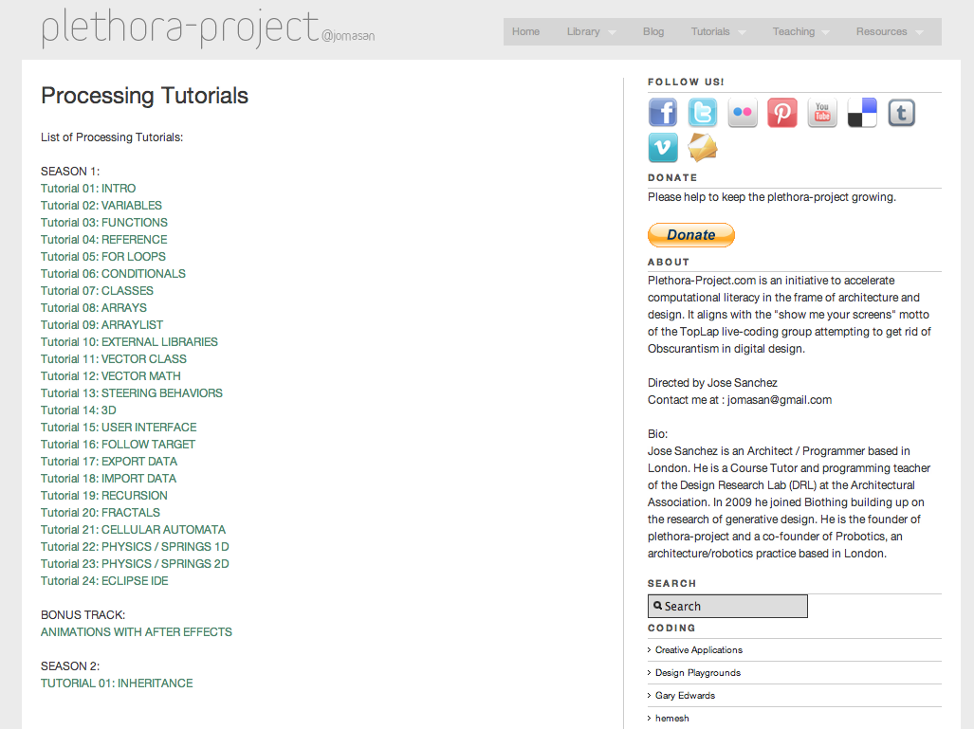
Processing: Tutorials
Video Tutorials about Processing
Source: http://www.plethora-project.com/2011/09/12/processing-tutorials/
Notes:
CBA:
Explores how the content of information relates to tis physical representation
Esplora come il contenuto dell'informazione si relazioni con la sua rappresentazioen fisica
Come mettere l'informazione nella materia
Ribosome is like lego,
A programmable digital machine (that makes machines)
The program is not a description of something, it is something. And the computer is a tool

Slide 61
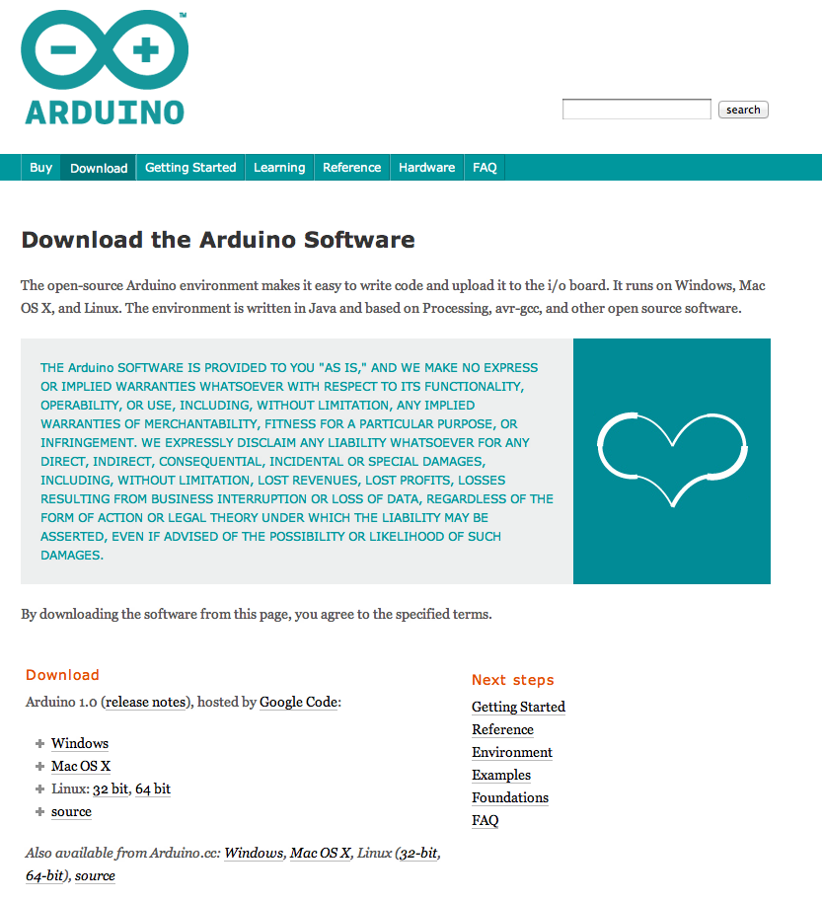
Arduino IDE
The open-source Arduino environment makes it easy to write code and upload it to the i/o board. It runs on Windows, Mac OS X, and Linux.
Source: http://arduino.cc/en/Main/Software
Notes:
CBA:
Explores how the content of information relates to tis physical representation
Esplora come il contenuto dell'informazione si relazioni con la sua rappresentazioen fisica
Come mettere l'informazione nella materia
Ribosome is like lego,
A programmable digital machine (that makes machines)
The program is not a description of something, it is something. And the computer is a tool

Slide 62
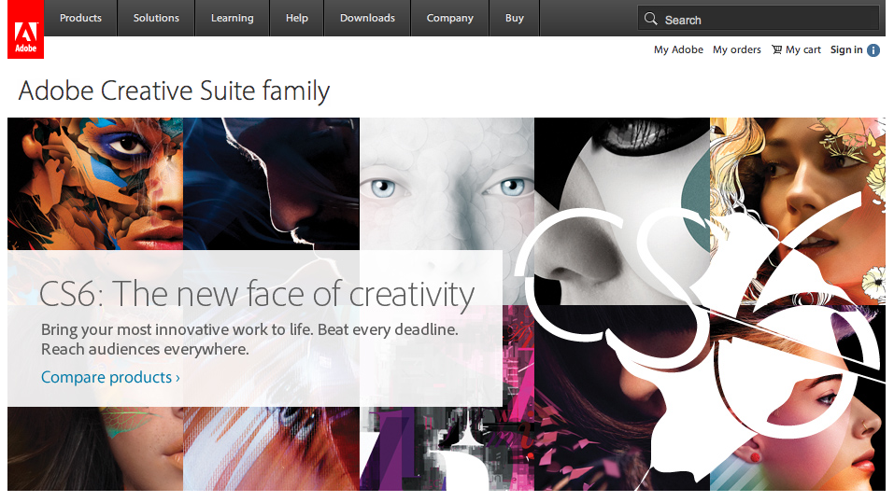
Adobe Creative Suite 5
Adobe Creative Suite (CS) is a collection of graphic design, video editing, and web development applications made by Adobe Systems.
Source: http://www.adobe.com/en/products/creativesuite.html
Notes:
CBA:
Explores how the content of information relates to tis physical representation
Esplora come il contenuto dell'informazione si relazioni con la sua rappresentazioen fisica
Come mettere l'informazione nella materia
Ribosome is like lego,
A programmable digital machine (that makes machines)
The program is not a description of something, it is something. And the computer is a tool

Slide 63
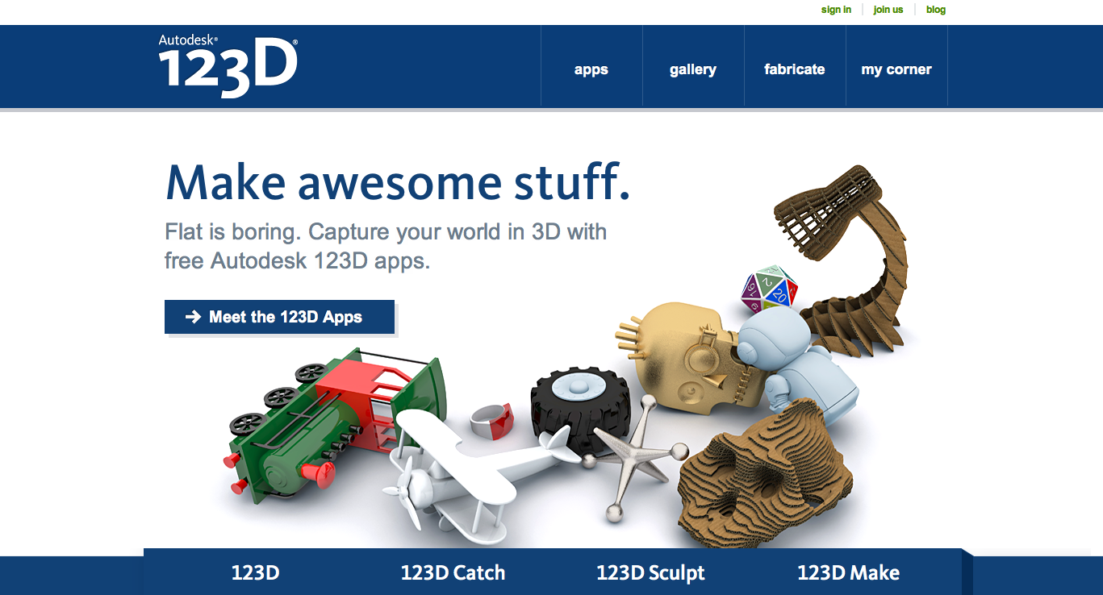
123D App
Sculpting on the iPad, slicing models, 3D scanning... made easy!
Source: http://www.123dapp.com/
Notes:
CBA:
Explores how the content of information relates to tis physical representation
Esplora come il contenuto dell'informazione si relazioni con la sua rappresentazioen fisica
Come mettere l'informazione nella materia
Ribosome is like lego,
A programmable digital machine (that makes machines)
The program is not a description of something, it is something. And the computer is a tool

Slide 64
… and much more software!

Slide 65
Thank you!!
Massimo Menichinelli
Aalto Media Factory massimo.menichinelli@aalto.fi
@openp2pdesign http://www.slideshare.net/openp2pdesign
07.05.2012
Aalto Media Factory
Helsinki

