Slide 1
The Digital Latin Library
Organized by the Publications & Research Committee

Slide 2

https://digitallatin.org @digitallatin
Samuel J. Huskey
huskey@ou.edu
University of Oklahoma

Slide 3
Our Panel
Introduction and Survey of the DLL
Hugh Cayless (Duke), “What does a (digital) critical edition look like?”
Robert A. Kaster (Princeton), “Is There an Editor in this Text?”
Cynthia Damon (University of Pennsylvania), “Pragmatic or Pure? Two Experiments in Editing”
Virginia K. Felkner (University of Oklahoma), “Automatically Encoding Critical Editions of Latin Texts”

Slide 4
Background

Slide 5
Funding from Andrew W. Mellon Foundation
2012–2013
Planning Grant 2012–2013
2013–2015
Implementation Grant I 2013–2015
2015–2018
Implementation Grant II 2015–2018
Donald Waters
Helen Cullyer

Slide 6
Planning Grant Team
Roger Bagnall
Adam Blistein
Hugh Cayless
Kathleen Coleman
Cynthia Damon
Tom Elliott
Michael Gagarin
James Ginther
Sander Goldberg
Jeffrey Henderson
Sam Huskey
Robert A. Kaster
John Miller
Jim O’Donnell
Diana Robin
Alex Ward

Slide 7
Advisory Board
Adam Kosto (MAA)
Jeffrey Witt (RSA)
Robert A. Kaster (SCS)
Michael Gagarin (SCS)
Donald Mastronarde (SCS)
James Ginther (MAA)
Noreen Humble (RSA)
Sallie Spence (MAA)

Slide 8

Host Institution
Samuel J. Huskey, Department of Classics and Letters
June Abbas, School of Library and Information Studies
Chris Weaver, School of Computer Science

Slide 9
Research Outcomes
Eleven articles or chapters in books
Twenty-five conference presentations
Five master’s theses in Computer Science
Guidelines for Encoding Critical Editions for the Library of Digital Latin Texts
One sample critical edition
One application for viewing digital critical editions
An international seminar on textual criticism in the digital age
A workshop on encoding critical editions in TEI XML

Slide 10
Two Projects
The Digital Latin Library Catalog
The Library of Digital Latin Texts

Slide 11
DLL Catalog
A Linked Open Data resource for finding and using Latin texts.
https://catalog.digitallatin.org

Slide 12
Goals for the DLL Catalog
To create authority records for authors and editors of Latin texts
To create work authorities for all Latin texts
To catalog all editions of Latin texts
To publish Linked Open Data

Slide 13

DLL Catalog: Status
3,229 authority records for authors and editors
5,261 work authorities
2,470 items in the catalog
Video library on editing and textual criticism: https://digitallatin.org/digital-latin-library/video-library
Data openly available through the website at https://catalog.digitallatin.org and in JSON-LD on GitHub at https://github.com/DigitalLatin/linked-open-data

Slide 14
Items in the Catalog
PHI Latin Texts
Biblioteca Italiana
Perseus Digital Library
Digital Library of Late-antique Latin Texts
500+ Teubner volumes from HathiTrust

Slide 15
Coming in 2019:
Musisque deoque
Poeti d’Italia
All editions in Engelmann’s Bibliotheca Scriptorum Classicorum, vol. 2: “Scriptores Latini” (Leipzig 1882)

Slide 16
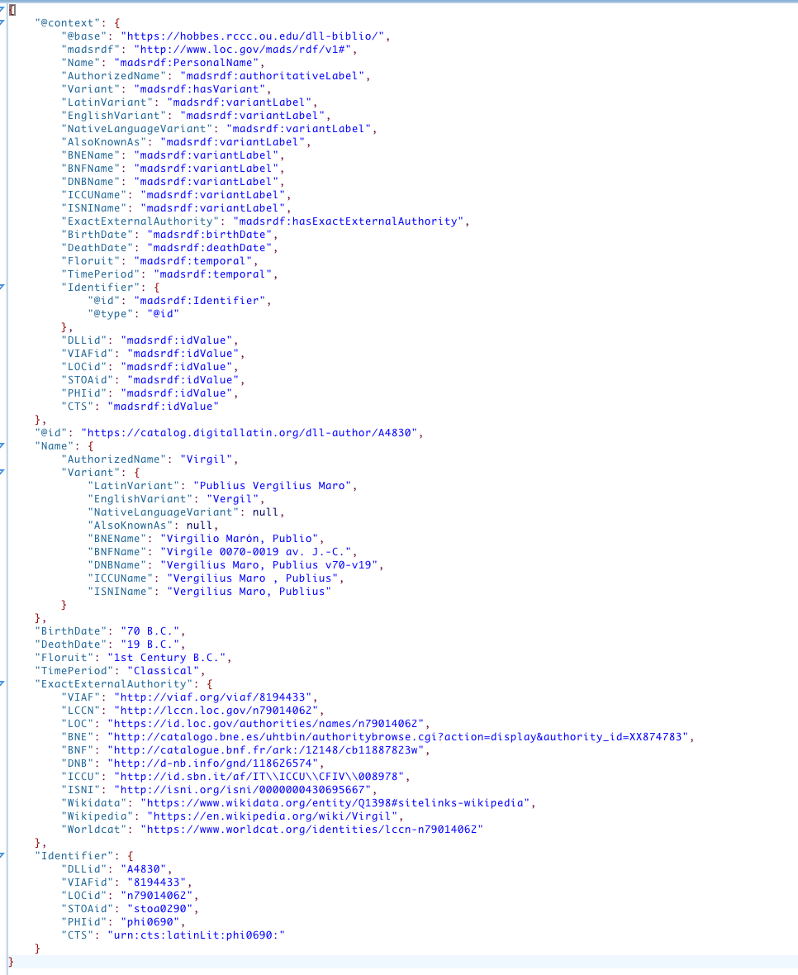
Linked Open Data
https://catalog.digitallatin.org/dll-author/a4830/?format=json
https://github.com/DigitalLatin/linked-open-data

Slide 17
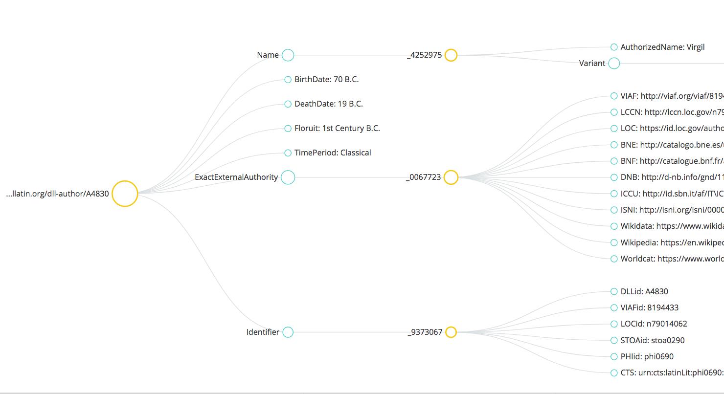

Slide 18
Library of Digital Latin Texts
A platform for publishing born-digital critical editions of Latin texts

Slide 19
Affiliated Organizations
Society for Classical Studies
Medieval Academy of America
Renaissance Society of America

Slide 20
LDLT Goals
Data model
Applications for working with LDLT data
Policies and procedures for operations and publication

Slide 21
What is an LDLT Edition?
A critical edition of a Latin text or texts
Peer-reviewed scholarship
A publication
Textual data encoded in XML according to specific guidelines
Published in a version-controlled repository with auxiliary materials (images, collation tables, notes, correspondence, etc.)
Available for use under an open license

Slide 22
A custom-designed interface that highlights the unique characteristics of a specific text
A web page
A codex
Available only to paying customers
What an LDLT Edition is NOT:

Slide 23
Data Model
Samuel J. Huskey & Hugh A. Cayless. (2018, December 4). DigitalLatin/guidelines: v1.2.1 (Version v1.2.1). Zenodo. http://doi.org/10.5281/zenodo.1945712
Customization of Text Encoding Initiative Standard (http://www.tei-c.org/index.xml)
Inheritance from Epidoc standard for inscriptions and documentary papyri (https://sourceforge.net/p/epidoc/wiki/Home/)
Current html version: https://digitallatin.github.io/guidelines/LDLT-Guidelines.html

Slide 24
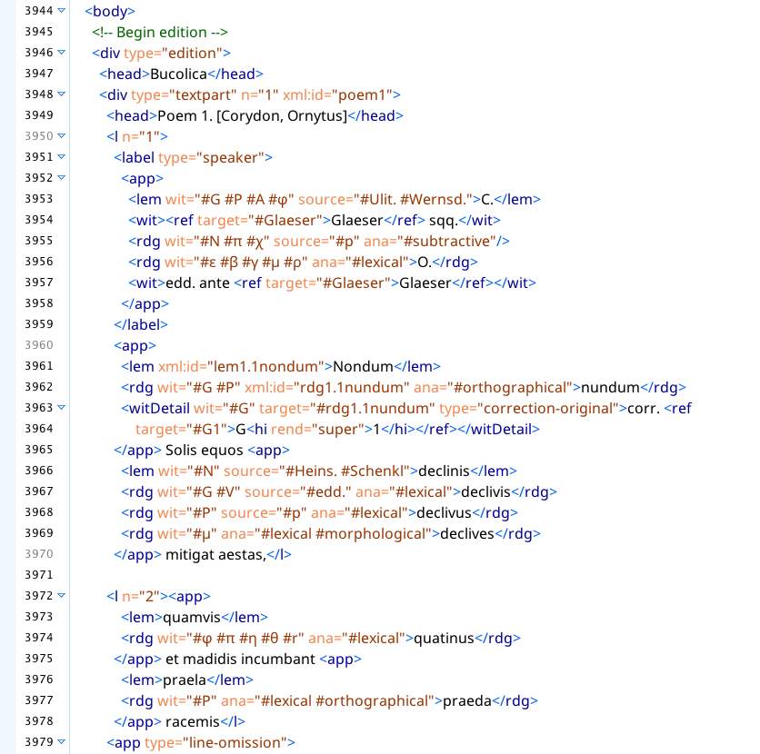

Slide 25
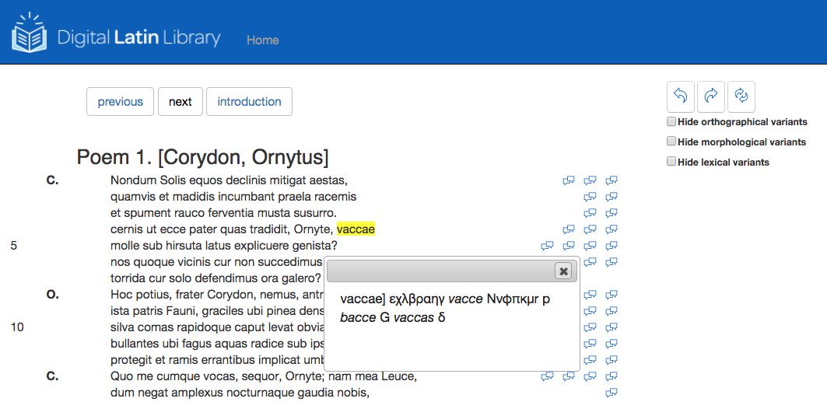
LDLT Viewer
Notes:
25

Slide 26
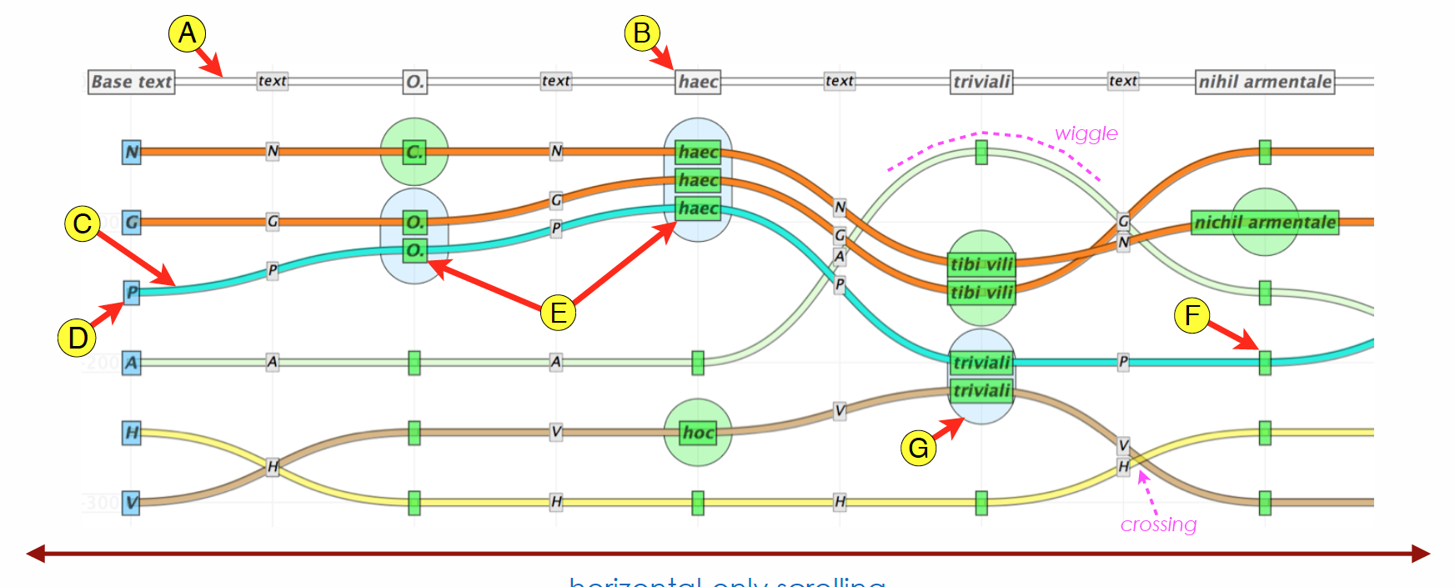
Visualizations

Slide 27
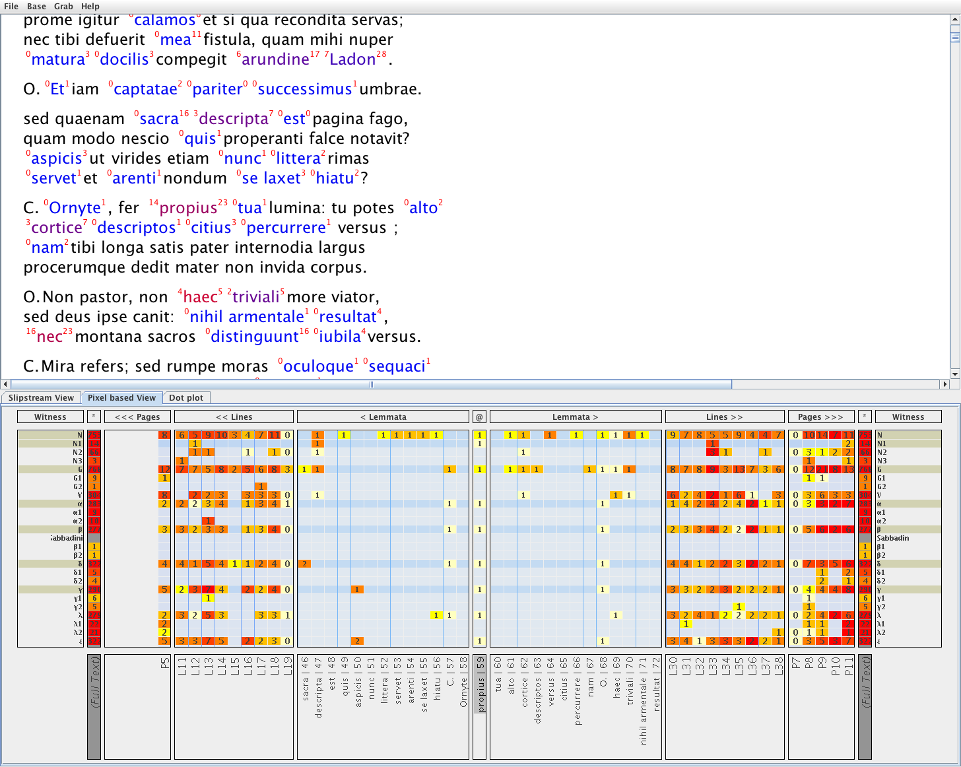

Slide 28
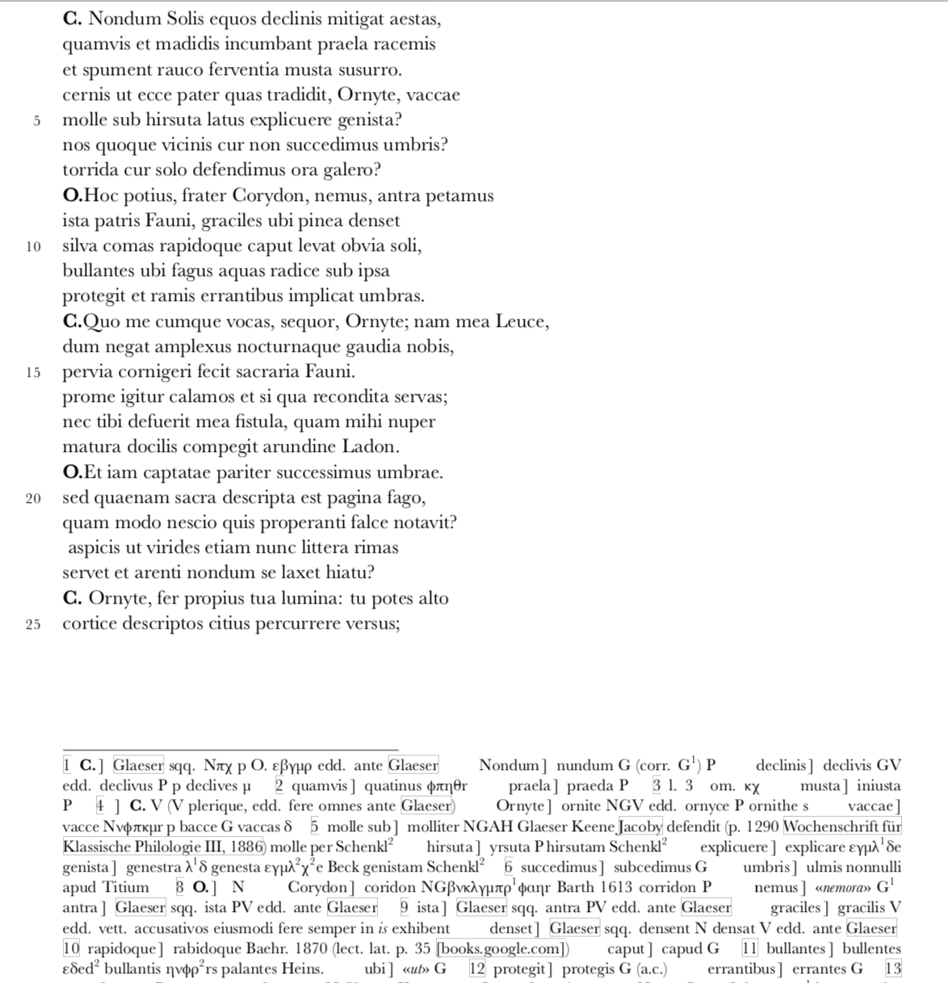
Traditional View
PDF for print on demand

Slide 29
Current Projects
Serviani in Vergili Aeneidos libros IX–XII commentarii (Robert A. Kaster et al., in progress)
Bellum Alexandrinum (Cynthia Damon, in progress)
P. Ovidii Nasonis Ibis (Tom Keeline, proposed)
Miracula sancte Frideswide (Andrew Dunning, in progress)
Bede's Bible: An Edition of the Latin Vulgate from the Codex Amiatinus (Andrew Dunning, in progress)
Peter Gracilis, Commentary on the Sentences, Book I, Question 1 (Jeff Witt and John Slotemaker, under review)
William of Hedon, Tractatus de Anima, Distinction 3, chapter 6 (Michael Christensen, under review)

Slide 30
Preproposal query to at least one of the affiliated organizations
Proposal
Development
Peer review
Publication in a version-controlled repository, with a Document Object Identifier and a “Travelling Imprimatur” (https://goo.gl/VsniJD)
Addition to the LDLT site
Publication Process

Slide 31
Also in development
Applications to facilitate and/or automate encoding of critical editions
Guidelines for evaluating digital scholarship
Workflows for sharing data with Open Greek & Latin, Dickinson Classical Commentaries, Pelagios, Pleiades, and other projects

