Slide 1
T.O.H.R
Temperature, Oxygen and Heart Rate measuring device - Team 2

Slide 2
INTRODUCTION
T.O.H.R is an advanced health monitoring system designed to measure and track vital physiological parameters in the human body, including heart rate, body temperature, and blood oxygen levels. Inspired by the continuous rhythm of the human heartbeat, this innovative system provides real-time insights into the body's vital signs.

Slide 3
TABLE OF CONTENTS
01
Objectives
03
Results Analysis
Measure vital parameters accurately and provide early diagnosis of abnormal conditions.
Enhance health monitoring, enable timely intervention, and support personalized care for proactive well-being
Visual presentation of analysis results for effective communication with the patient.
02
Methodology
04
Conclusions
Employing continuous sensing to gather real-time data on vital parameters.
Utilizing targeted analysis techniques for in-depth examination and insights.
Implementation of a soothing routine to promote patient relaxation.
Continuing the routine until the patient's vital parameters reach a stable state.

Slide 4
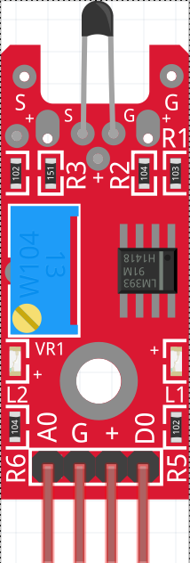
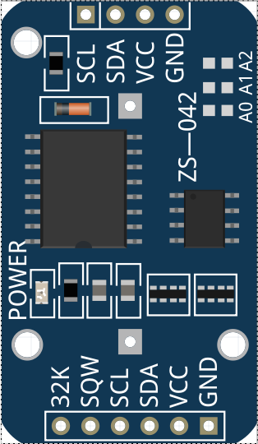
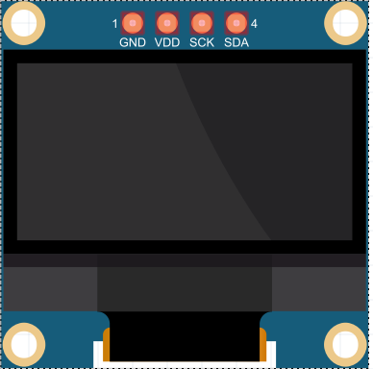
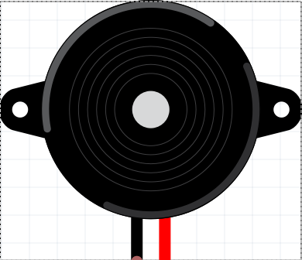
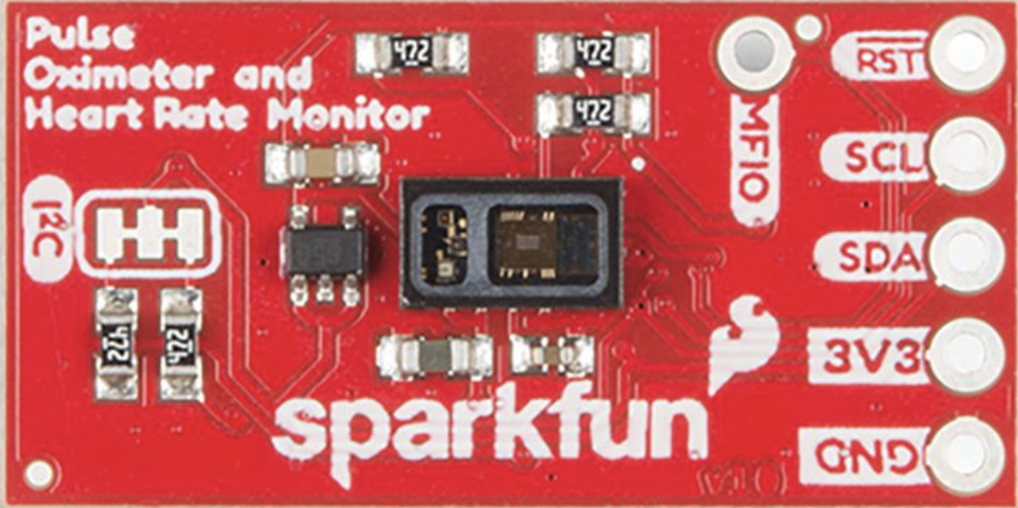

Hardware
KY-028
DS1307
SSD1306
MAX32664
Buzzer
Passive electronics

Slide 5
Data analysis

Slide 6
Parameters measured
Oxygenation
Indicator for hypoxia
Heart rate
Temperature
Indicator for stress
Indicator for fever

Slide 7
Heart rate analysis
Temperature measurement is based on the average calculated in 15 seconds of measurements. Correlated by relative accuracy.
Treshold low: 60 bpm
Treshold high: 100bpm

Slide 8
Oxygen analysis
Temperature measurement is based on the average calculated in 15 seconds of measurements.
Treshold: 95%

Slide 9
Temperature analysis
Temperature measurement is based on the average calculated in 15 seconds of measurements.
Treshold: 26°C

Slide 10
ANALYSIS RESULTS
Failure Conditions
Elaboration
c
- Null value - Outliers - Confidence
c
- Null value - Outliers
Each data is associated with an uncertainty value computed on the mean value. The relative uncertainty expresses the accuracy of the measure.
c
- Environmental temperature

Slide 11
Software protocol

Slide 12
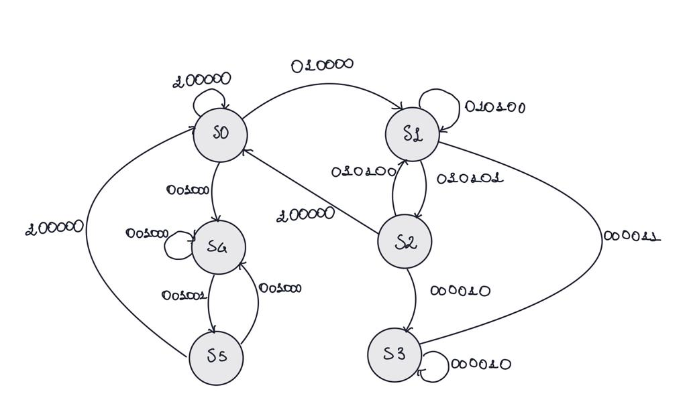
Finite state automaton
0
0
0
0
0
0
Continuous
HR/OX
MAX
Temperature
Monitoring
Breathe
TimerElapsed

Slide 13
Finite state automaton - states
S0
S1
S2
S3
S3
S3
Continuous
HR/OX
HR/OX - analysis
Breathe
Temp
T - analysis

Slide 14
Power consumption analysis
The power consumption of the sensors is based on datasheet informations and it is done in the hypothesis that the sensors are always up and running. This way we can estimate a battery life duration of 13 Hrs 32 Min*.
ssd1306
ds1307
max32664
Ky-028
*external battery supplying only sensors with 850mAh capacity at 3.3v

Slide 15
CONCLUSIONS
Our device is a valid medical aid with good future perspectives as a wearable product that performs continuous monitoring and in depth on demand analysis

