Slide 1

Liverpool Los Angeles
March 30th - April 5th

Slide 2
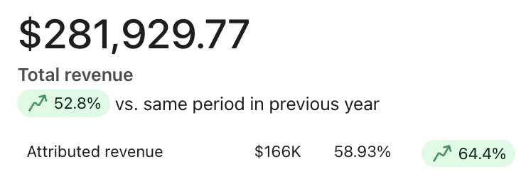
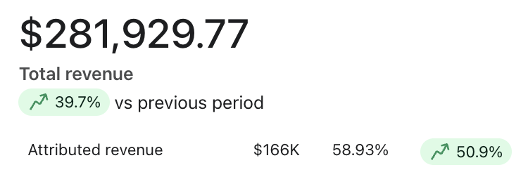
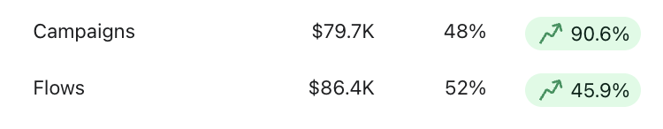
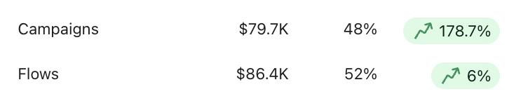
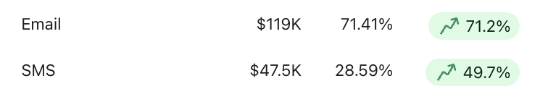
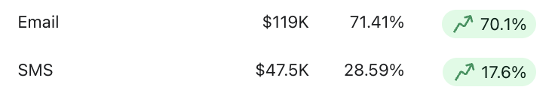
Klaviyo Performance Overview
YoY
WoW
What's Working
Total revenue up 52.8% YoY and 39.7% WoW to $281,929.77 — both comparisons are strongly positive
Campaigns had a standout week: +90.6% YoY and +178.7% WoW — the April Spring Saving Sale send volume drove this
Email remains the backbone at 71.41% of attributed revenue, up 71.2% YoY and 70.1% WoW
Needs Attention
Flows only grew 6% WoW despite strong YoY numbers (+45.9%) — campaign sends likely cannibalized flow conversions this week
SMS is 28.59% of attributed revenue; given the list growth, this share should be trending higher

Slide 3
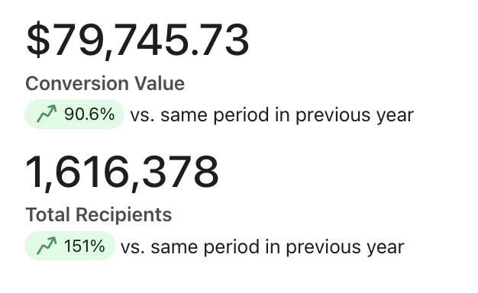
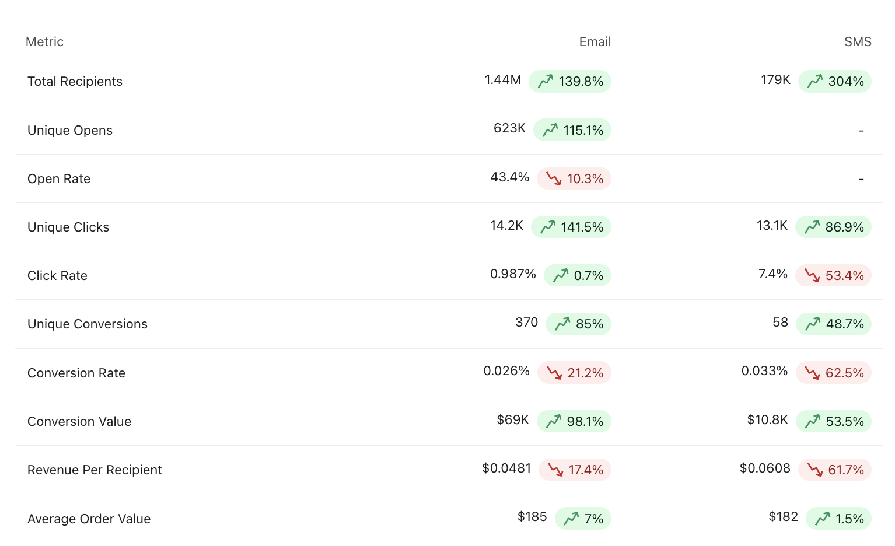
Klaviyo Campaign Review
What's Working
Audience growth is exceptional: email recipients up 139.8% and SMS up 304% YoY — strong list-building momentum
Conversion value nearly doubled YoY (+90.6%) with email revenue up 98.1% — solid growth despite list dilution
Click volume is strong at scale: email clicks +141.5% and SMS clicks +86.9%
Needs Attention
Open rate dropped 10.3% YoY to 43.4% despite the volume surge — worth monitoring inbox placement and subject line fatigue
Conversion rates declining across both channels: email CVR down 21.2%, SMS CVR down 62.5% — rapid list growth is diluting efficiency
RPR sliding: email down 17.4% ($0.0481), SMS down 61.7% ($0.0608)
Opportunities
AOV is holding strong ($185 email, $182 SMS) — segmenting higher-intent subscribers could lift CVR without sacrificing order value
SMS at 304% recipient growth with conversions still flowing — tightening targeting is the lever

Slide 4
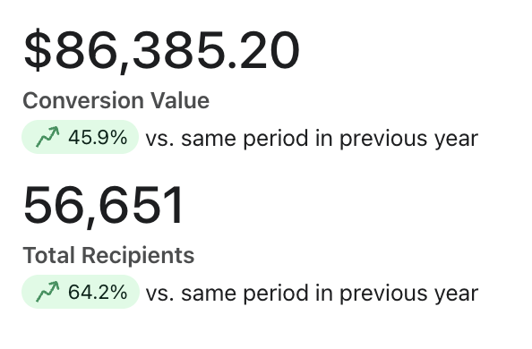
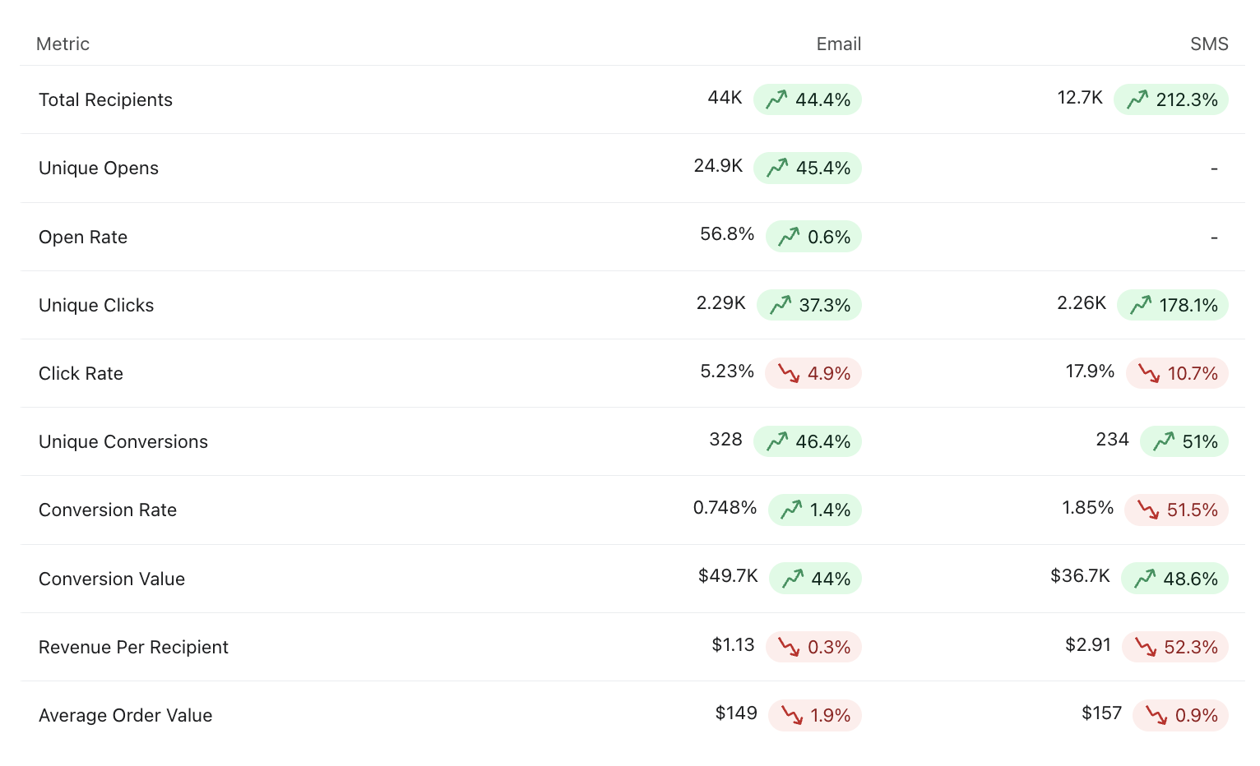
Klaviyo Flow Review
What's Working
Flow revenue up 45.9% YoY to $86.4K — automation is carrying its weight and slightly outpacing campaigns this week
Email flow health is solid: open rate holding at 56.8% (+0.6%) and CVR improving (+1.4%) — well-optimized sequences
SMS flow clicks up 178.1% and conversions up 51% YoY — strong engagement signals
Needs Attention
SMS flow CVR down 51.5% (1.85%) and RPR down 52.3% ($2.91) — the 212% audience growth is diluting efficiency significantly
SMS CTR declining 10.7% as the audience scales — segmentation refinement needed
Opportunities
SMS flows generating $36.7K at relatively small list size — as targeting tightens, upside here is significant
Email flows at $1.13 RPR with strong conversions — expanding triggered coverage (VIP, post-purchase sequences) would compound results

Slide 5
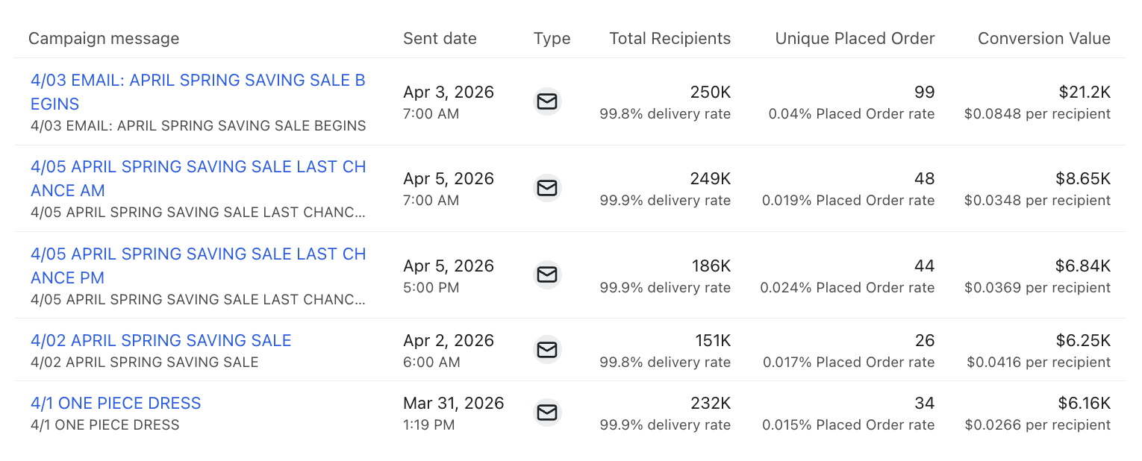
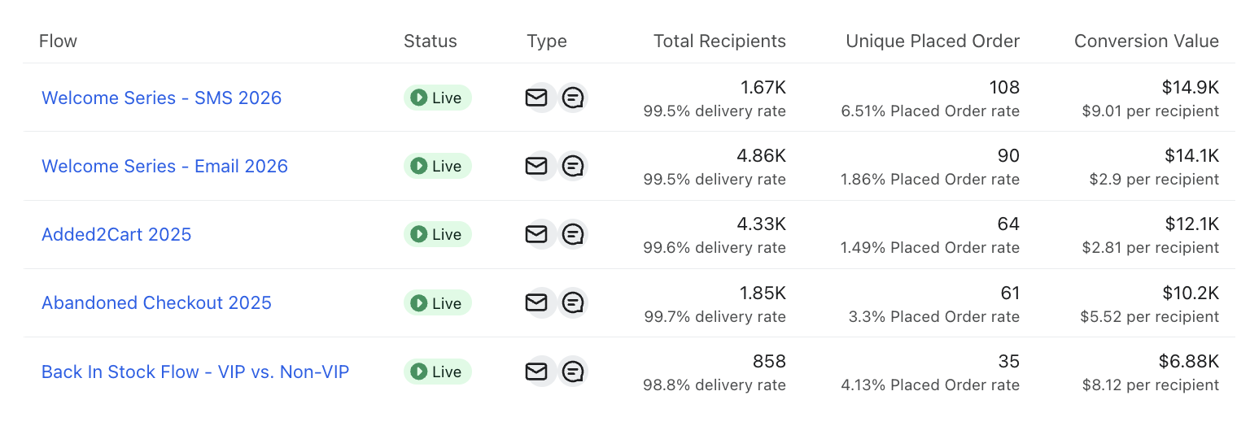
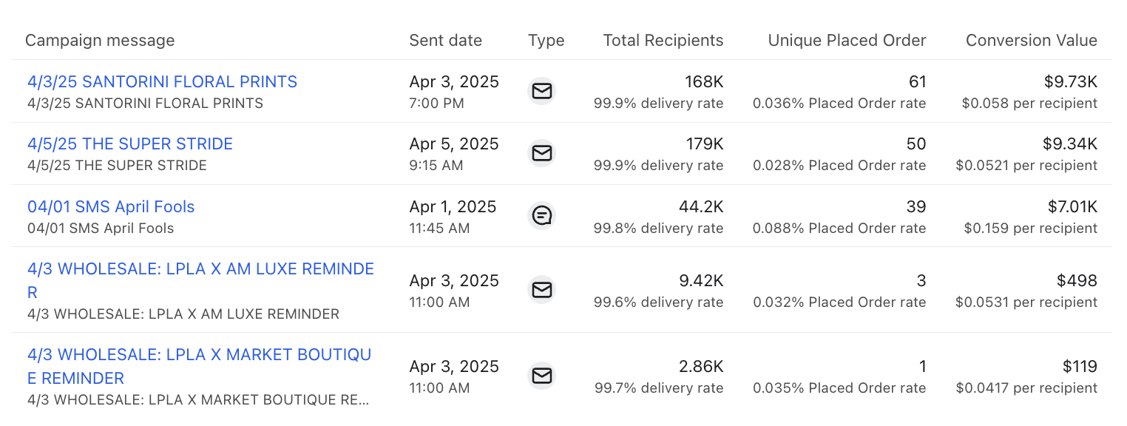
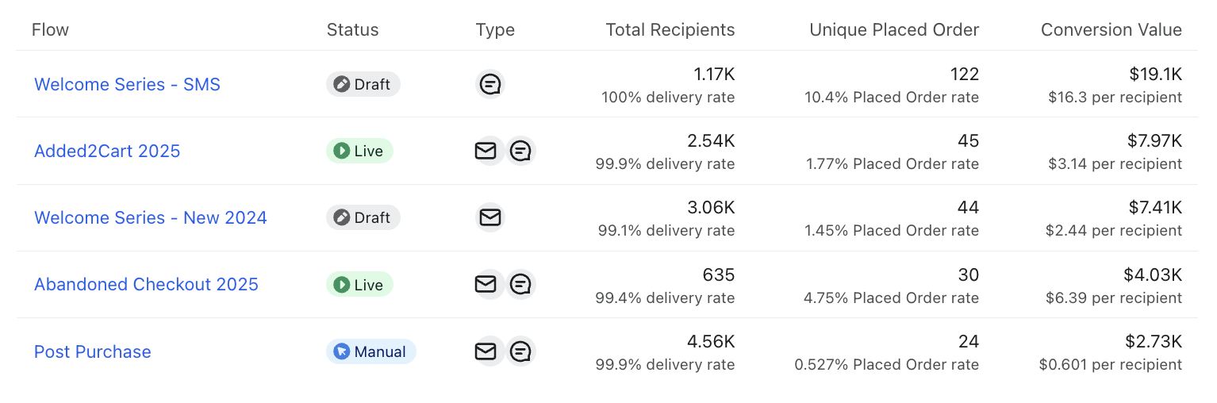
Klaviyo Top 5 Review
Campaigns 2026
Flows 2026
Campaigns 2025
Flows 2025

Slide 6
Klaviyo Top 5 Insights
Campaigns
The April Spring Saving Sale series dominated the week across all four sends, with the initial send (4/03) generating $21.2K — 2.4x the next best send. Urgency sequencing (Last Chance AM/PM) added $15.5K combined but showed diminishing returns in both open rate and RPR, which is expected. The One Piece Dress send on 4/1 performed quietly at $6.16K with strong list size (232K) but low conversion volume — a product-specific send that likely had narrow appeal.
YoY comparison: 2025's top campaigns were Santorini Floral Prints ($9.73K) and Super Stride ($9.34K) — this week's sends are already generating 2x+ the revenue of last year's comparable sends, reflecting both list growth and improved send strategy.
Automations
Welcome SMS 2026 is the highest-converting flow at $9.01/recipient with 108 orders from 1,658 deliveries — the strongest RPR across all flows. Welcome Email 2026 follows at $2.90/recipient with 90 orders — both welcome series are performing well but SMS is outperforming email significantly on a per-recipient basis.
YoY comparison: Welcome SMS 2025 generated $16.30/recipient — the current flow is underperforming its predecessor on RPR, which is worth investigating (offer change, sequence length, or list composition shift).
Back in Stock VIP vs. Non-VIP is punching above its weight at $8.12/recipient with only 858 deliveries — segmenting by VIP status is working.

Slide 7
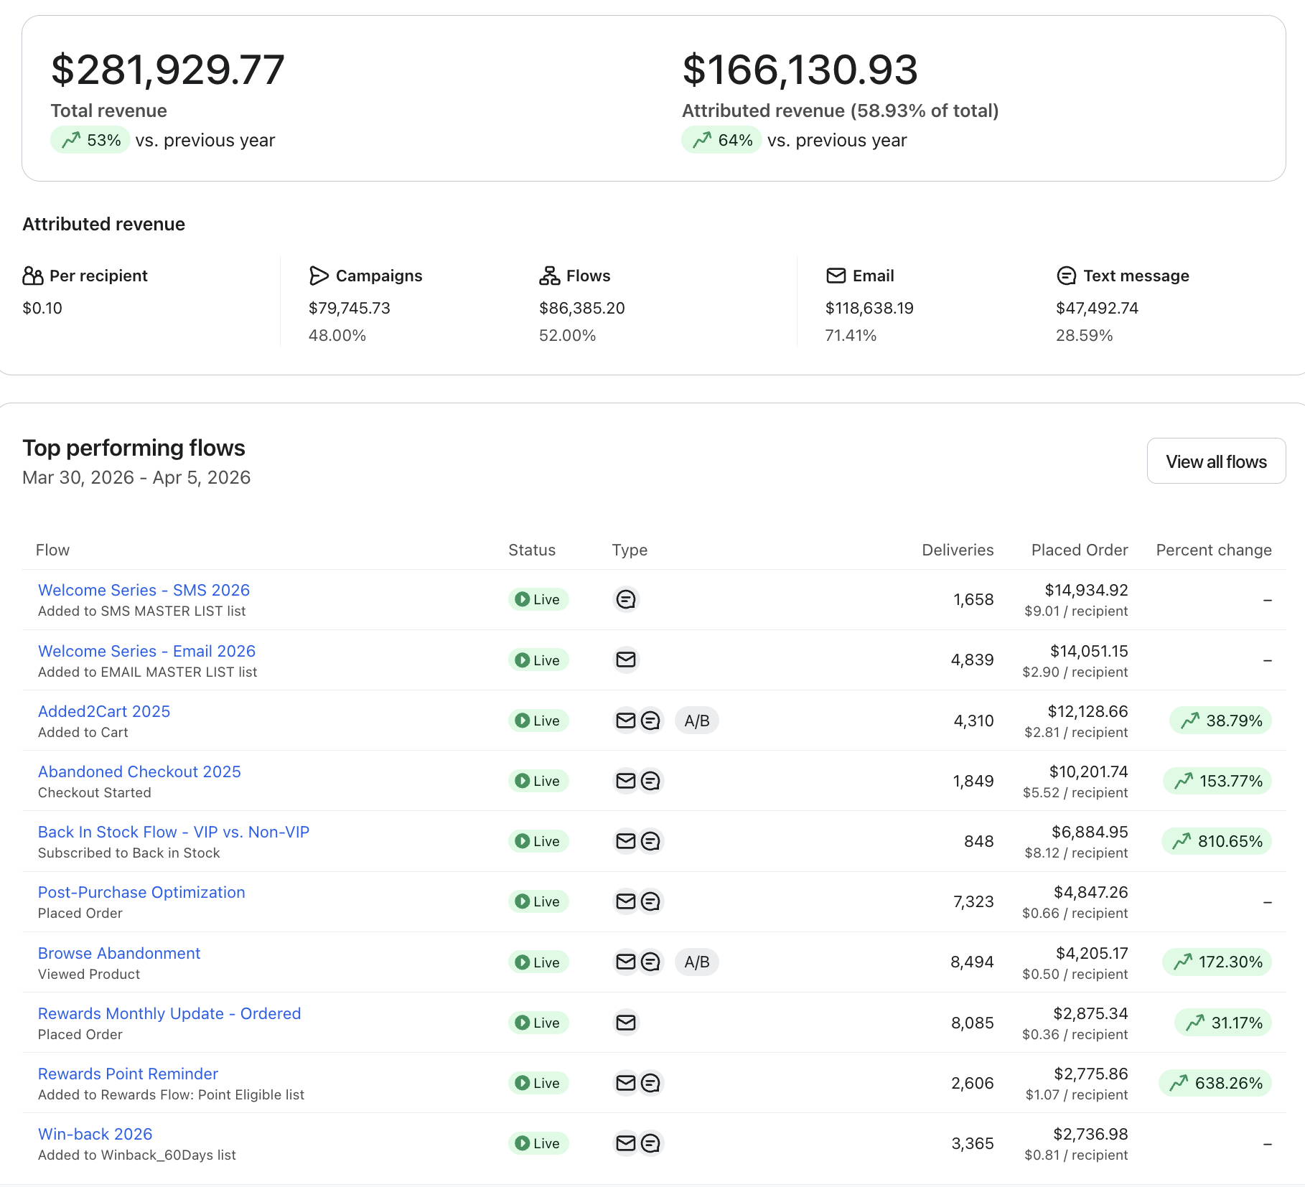
Klaviyo Last 30 Days YoY
What's Working
Total revenue up 53% YoY with Klaviyo at 58.93% attribution — strong channel performance
Flows outpacing campaigns (52% vs 48%) — automation is doing the heavy lifting
Abandoned Checkout up 153.77%, Browse Abandonment up 172.30% — recovery flows are firing well
Back in Stock +810.65% and Rewards Point Reminder +638.26% — inventory and loyalty triggers are high-ROI levers right now
Needs Attention
Per-recipient value is $0.10 overall — there's room to improve targeting and segmentation across both channels
SMS at 28.59% of attributed revenue should be trending higher given the list growth
Opportunities
Welcome SMS at $9.01/recipient is the top RPR flow — expanding or sequencing this series further has clear upside
Post-Purchase flow has 7,323 deliveries at $0.66/rec — high volume, low yield; an offer or sequence audit could meaningfully lift this

Slide 8
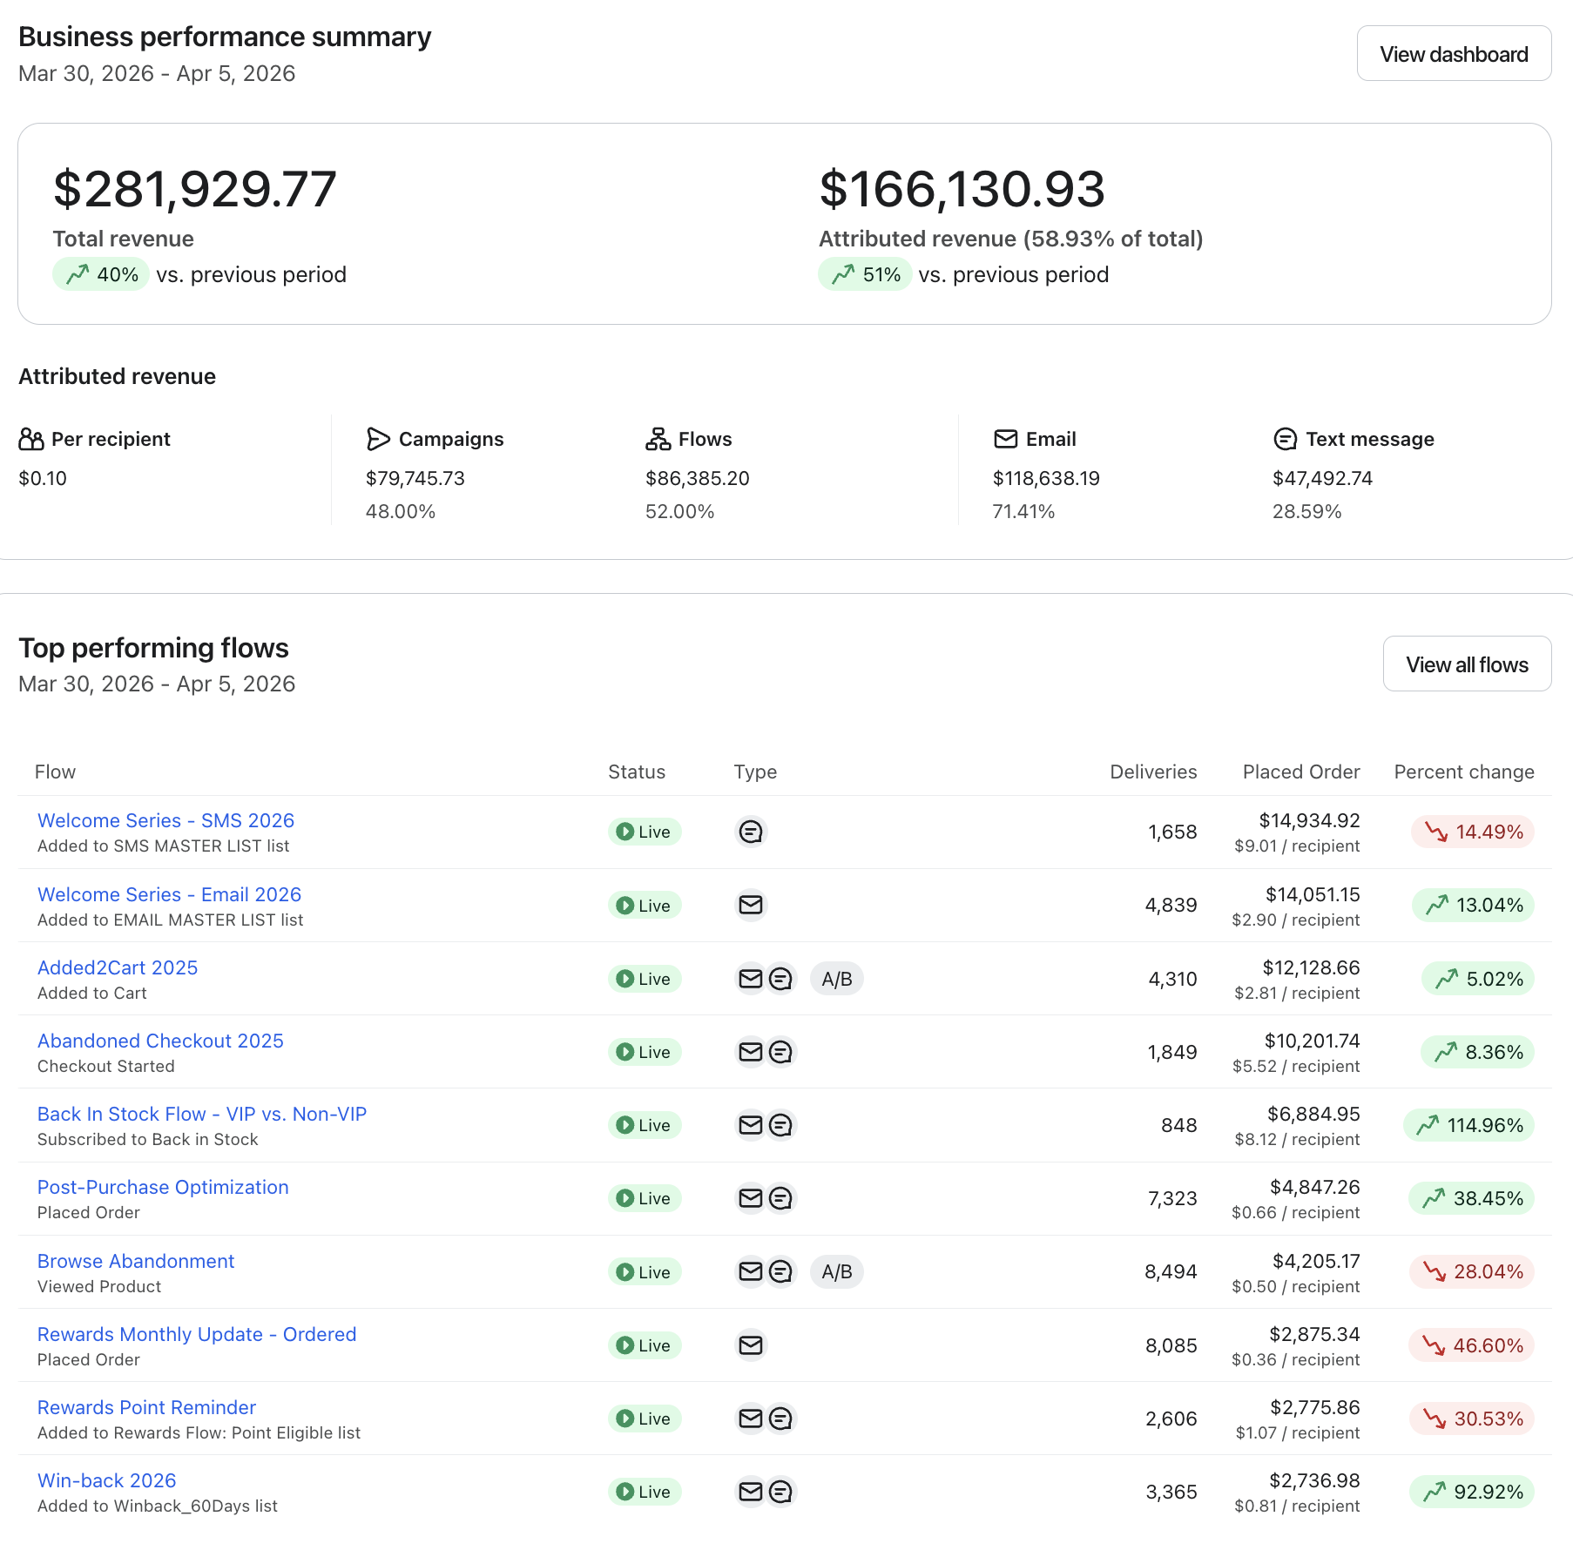
Klaviyo Last 30 Days WoW
What's Working
Total Klaviyo revenue up 40% WoW and attributed revenue up 51% — a strong week
Back in Stock surging +114.96% WoW — a restock event is driving this; capitalize while it's active
Win-back flow up 92.92% WoW — re-engagement is hitting the right lapsed contacts
Post-Purchase up 38.45% WoW — recent buyers are converting well from follow-up sequences
Needs Attention
Rewards Monthly Update down 46.60% WoW and Rewards Point Reminder down 30.53% — loyalty messaging cooling, possible cadence or offer fatigue
Browse Abandonment down 28.04% WoW after strong YoY numbers — check for a drop in browse activity or a trigger issue
Welcome SMS down 14.49% WoW despite being the top RPR flow — check send volume consistency and list intake
Opportunities
Win-back surge (+92.92%) suggests a receptive lapsed segment — a targeted reactivation push could extend the momentum
Back in Stock spike is a high-converting moment — ensure all eligible product categories have this trigger active

