Slide 1

Liverpool Los Angeles
March 23rd - 29th

Slide 2
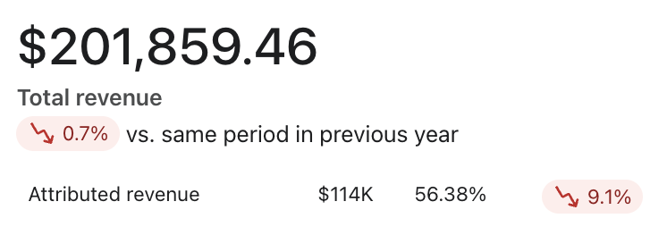
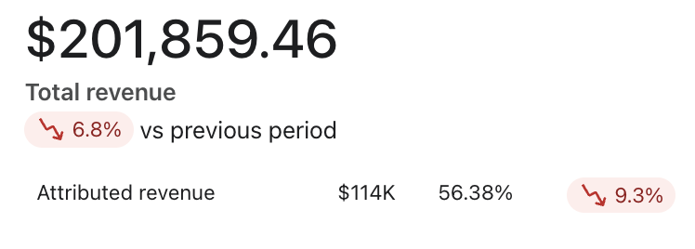
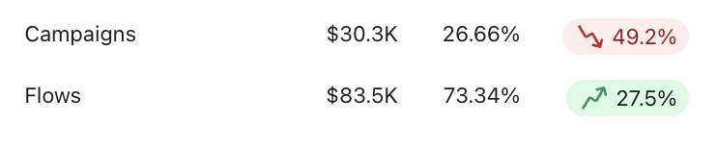
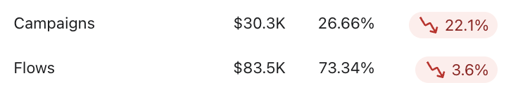
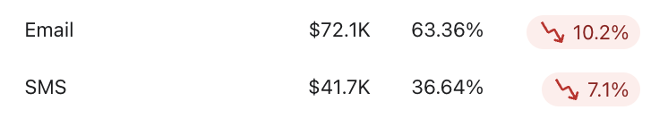
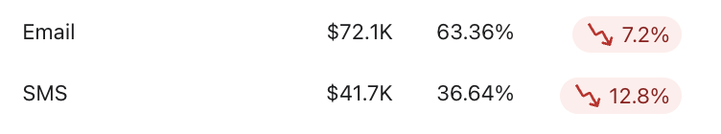
Klaviyo Performance Overview
YoY
WoW
What's Working
Flows at $83.5K generated 73.34% of all attributed revenue, up 27.5% YoY — the automation program continues to carry the week
SMS at $41.7K now represents 36.64% of the attributed mix, maintaining its share on a full-price calendar
Total Shopify revenue at $201,859.46 is down just 0.7% YoY — holding near flat against a prior year that included an active spring flash sale period
Needs Attention
Campaign revenue at $30.3K is down 49.2% YoY — the prior year comparison includes spring flash sale sends that significantly inflated conversion volume. A like-for-like read will be clearer in coming weeks as the comp normalizes
Attributed revenue at $114K is down 9.1% YoY with WoW declines across both channels — campaign performance is the primary drag and warrants continued monitoring

Slide 3
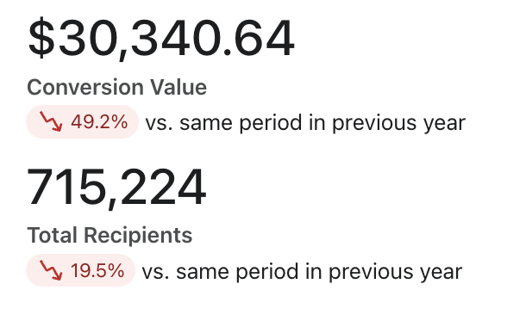
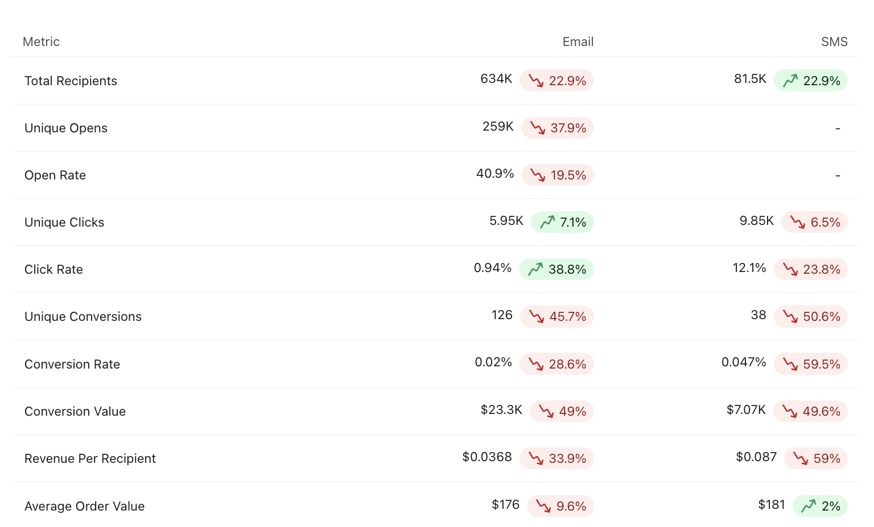
Klaviyo Campaign Review
What's Working
Email click rate up 38.8% YoY at 0.94% on 634K recipients — the list is engaging with spring editorial content at a meaningfully higher rate than last year
SMS recipient volume up 22.9% YoY at 81.5K — list growth is real and the channel reach is expanding
AOV holding at $176 email / $181 SMS — when buyers do convert from campaigns, spend per order is solid
Needs Attention
126 unique email conversions from 259K openers — click rate is up but the conversion moment isn't following. The click-to-purchase gap is the primary issue this week and worth reviewing at the landing page and offer level
Campaign conversion value at $30.3K is down 49.2% YoY — prior year included spring flash sale sends. Not a like-for-like comparison
Opportunities
3/24 Best Tops of the Season: top campaign this week with 40 orders at $0.0516 RPR and $7.85K conversion value — spring editorial content is converting at the highest rate in the lineup
20260327 NCO Welcome Offer at $0.0555 RPR — highest per-recipient revenue of any campaign this week despite the smallest send volume. Targeted sends are punching above their weight

Slide 4
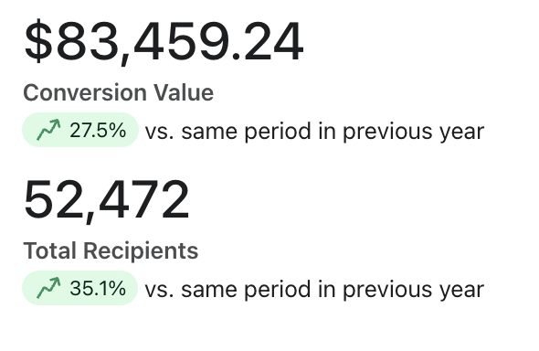
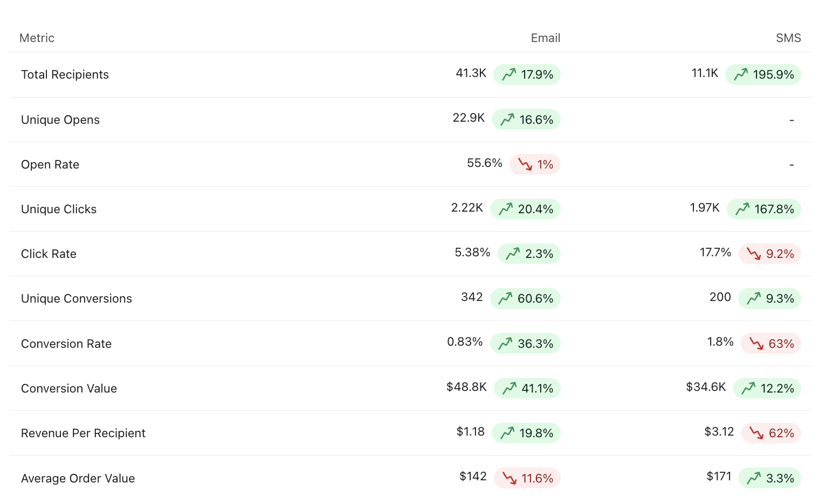
Klaviyo Flow Review
What's Working
342 unique email flow conversions (+60.6% YoY) and 200 SMS conversions (+9.3% YoY) — conversion strength is up across both channels simultaneously
SMS flow recipients up 195.9% YoY at 11.1K — audience growth is compounding and driving the $34.6K conversion value (+12.2% YoY)
Welcome Series Email 2026: 77 orders from 4.91K recipients at $2.48 RPR, outperforming 2025's Welcome Series at $1.3 RPR on a comparable audience
Needs Attention
Email AOV in flows at $142, down 11.6% YoY — conversions are up sharply but order size has compressed. Worth monitoring whether this is product mix or a flow-level offer signal
Opportunities
Welcome Series SMS 2026 at 5.91% placed order rate ($10.4 RPR) — new subscriber quality remains high and list acquisition growth feeds this directly
Abandoned Checkout 2025 at 6.86% placed order rate from 950 recipients ($10.5 RPR) — the highest RPR of any top flow this week

Slide 5
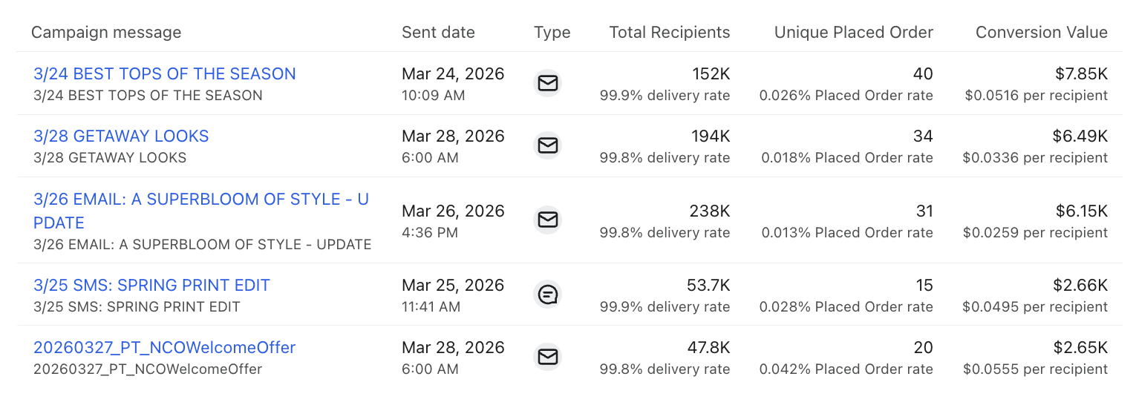
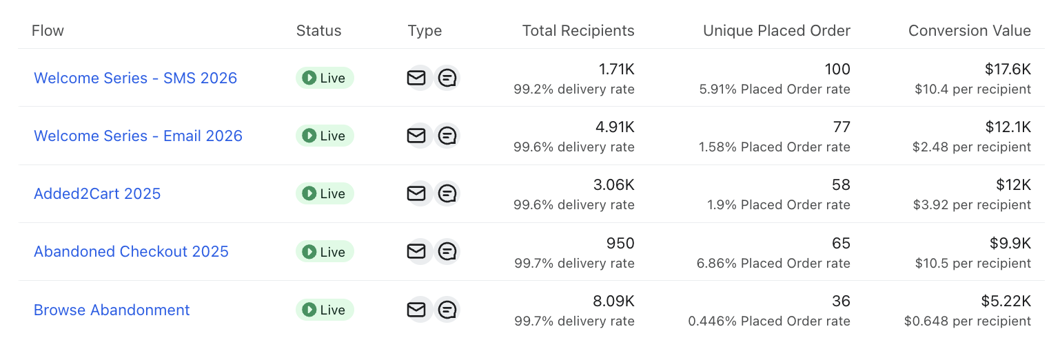
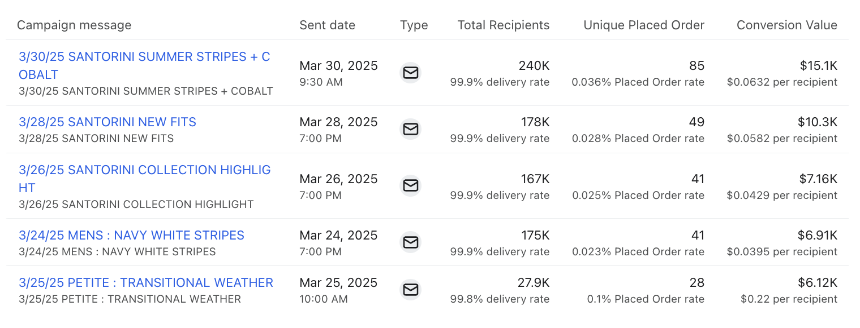
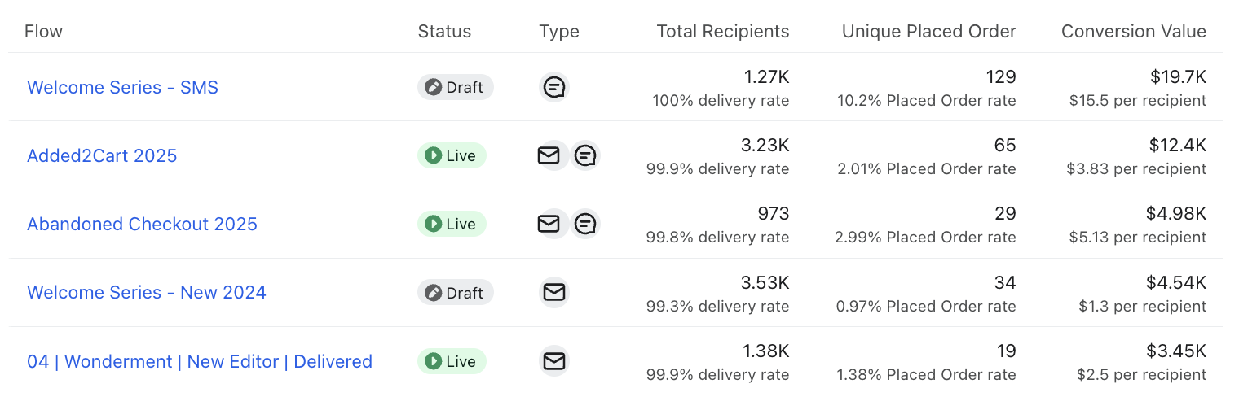
Klaviyo Top 5 Review
Campaigns 2026
Flows 2026
Campaigns 2025
Flows 2025

Slide 6

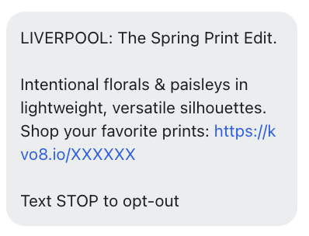
Klaviyo Top 5 Insights
Campaigns
Best Tops of the Season leads 2026 campaigns at $7.85K on 40 orders — the strongest conversion value of the week by a clear margin
The 2025 comp week (Santorini Summer Stripes + Cobalt at $15.1K / 85 orders) shows how much spring flash sale volume inflated last year's campaign numbers — context for the YoY gaps across the campaign view
NCO Welcome Offer at $0.0555 RPR is the most efficient send of the week — worth noting for segmentation strategy
Flows:
Welcome Series SMS 2026 at $10.4 RPR continues to lead all flows — no change in the story, list growth is compounding here
Abandoned Checkout 2025 at $10.5 RPR this week vs. $5.13 RPR in the 2025 comp — the 2025 rebuild is clearly outperforming
Browse Abandonment at $0.648 RPR on 8.09K recipients — volume is up and it's now a consistent top-5 contributor

Slide 7
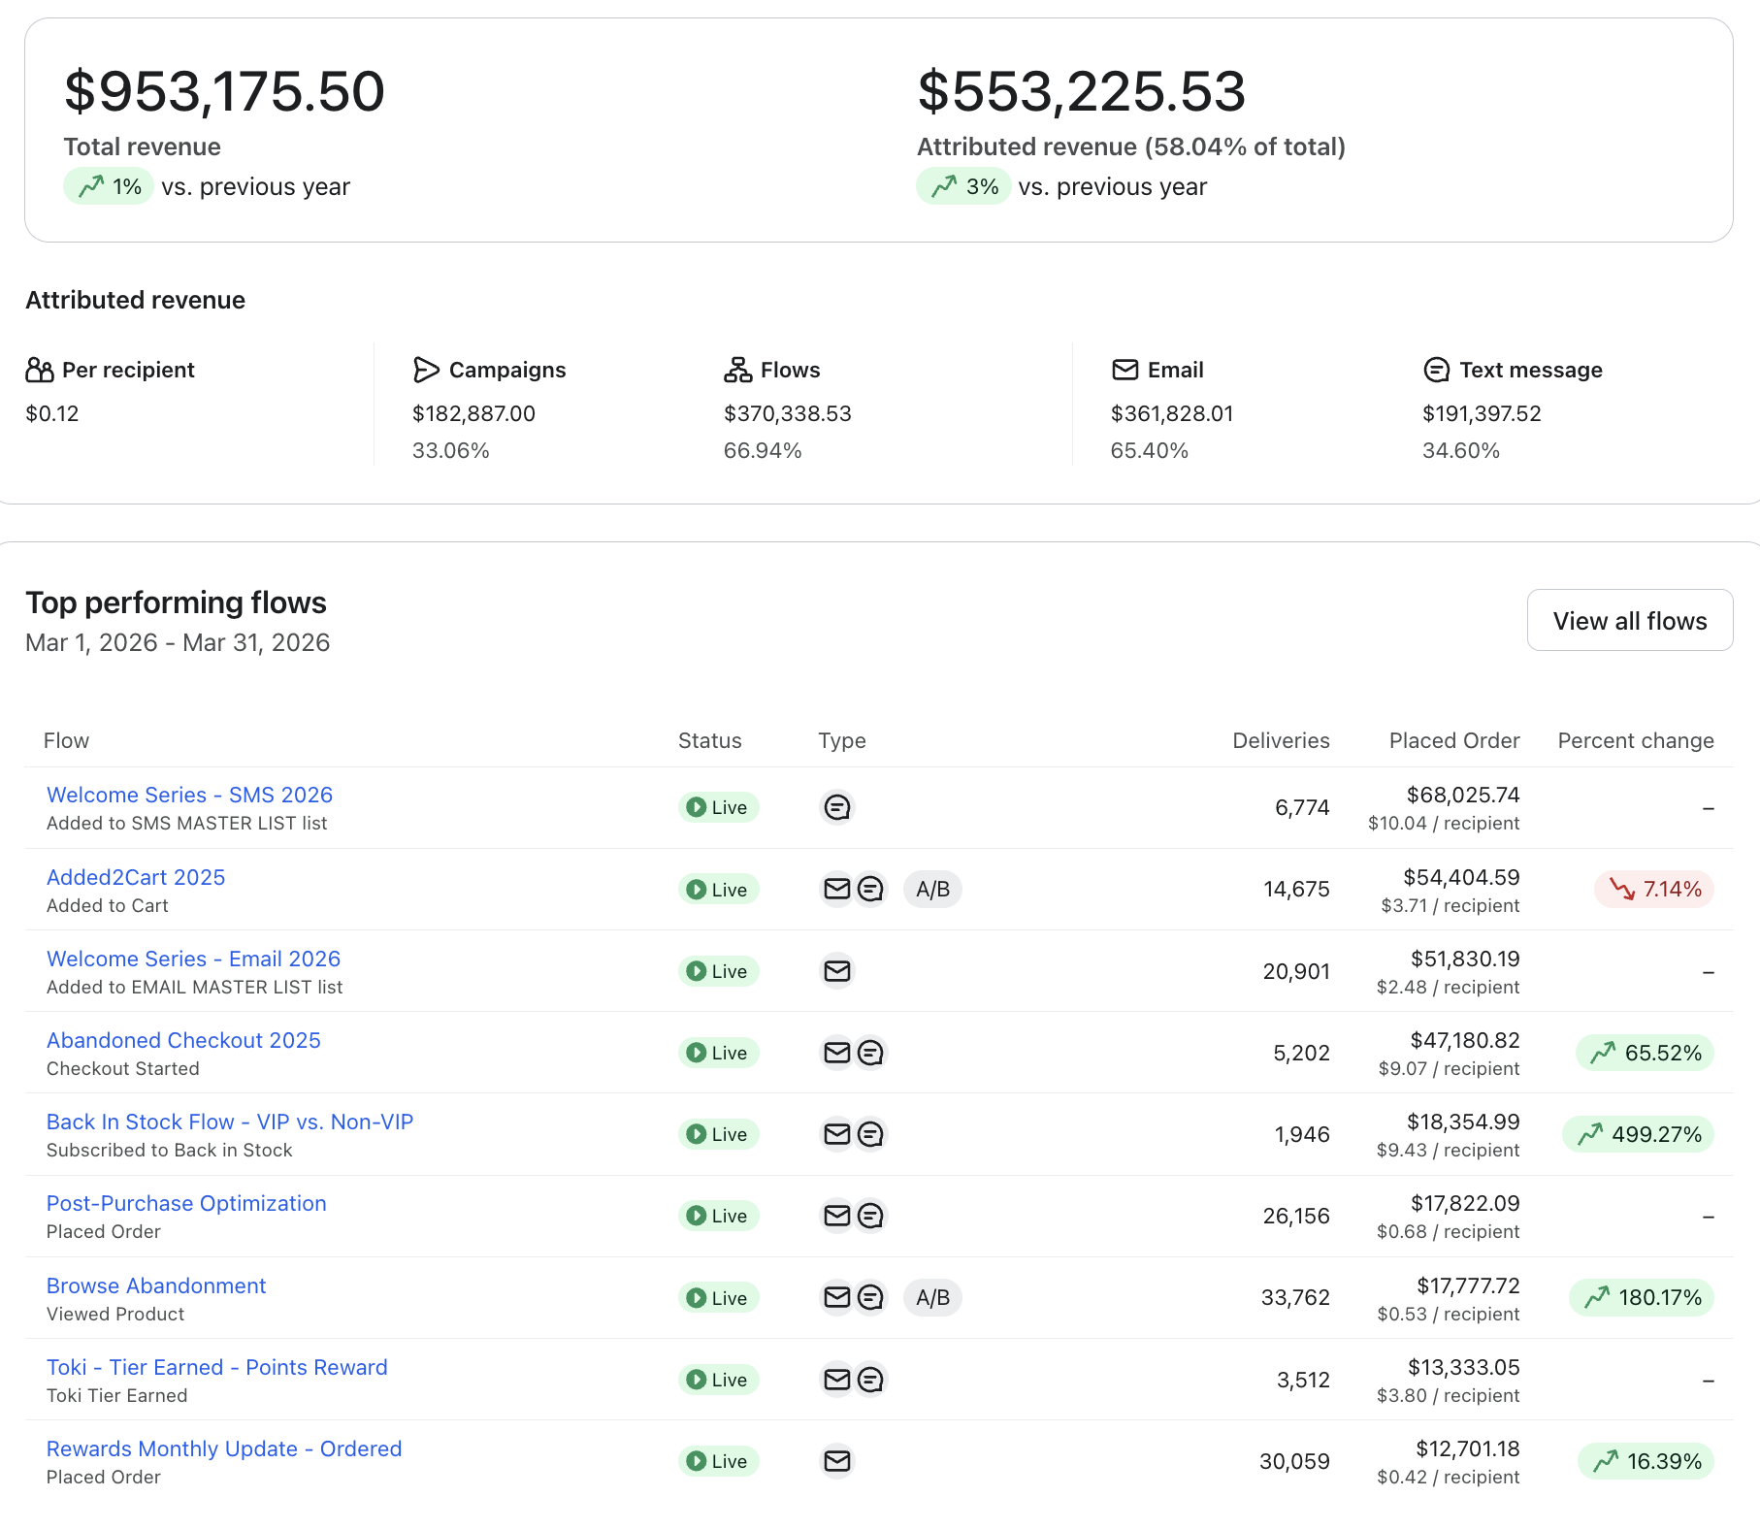
Klaviyo Last 30 Days YoY
What's Working
$553.2K attributed (+3% YoY) on flat total revenue — Klaviyo's share of the business is growing
Abandoned Checkout: $47.2K (+65.52% YoY) at $9.07 RPR — the rebuild continues to outperform
Browse Abandonment: $17.8K (+180.17% YoY) — now a top revenue flow and still scaling
Back In Stock VIP vs. Non-VIP: $18.4K (+499.27% YoY) at $9.43 RPR — auditing that it fires for every restock event remains a quick win
Needs Attention
Added2Cart down 7.14% YoY at $54.4K — still the #2 flow overall but A/B test results will drive the path to closing this gap
Opportunities
Welcome Series SMS 2026 at $68K / $10.04 RPR over 30 days — new subscriber acquisition growth compounds directly here
Rewards Monthly Update at $12.7K (+16.39% YoY) — loyalty revenue is building a consistent line month over month

Slide 8
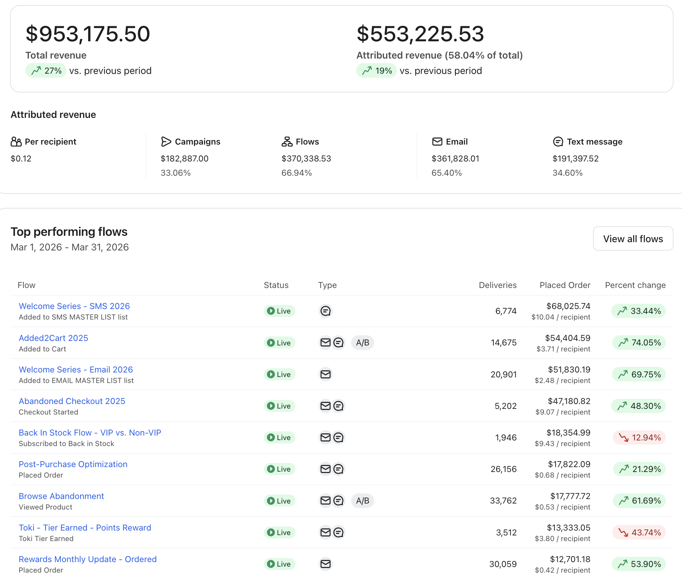
Klaviyo Last 30 Days WoW
What's Working
30-day attributed revenue at $553.2K, up 19% PoP — the full spring flash sale window is captured and flows are carrying the bulk at 66.94% of attributed mix
Added2Cart +74.05% PoP at $54.4K — the biggest mover this period, likely reflecting high-intent browse behavior during the flash sale window
Welcome Series Email 2026 +69.75% PoP at $51.8K and Browse Abandonment +61.69% PoP at $17.8K — automation is compounding across the board
Abandoned Checkout +48.30% PoP at $47.2K and Welcome Series SMS +33.44% PoP at $68K — both flows showing sustained lift as the 30-day window fills out
Needs Attention
Toki Tier Earned down 43.74% PoP at $13.3K — loyalty flow revenue pulling back WoW after the flash sale activity spike. Worth watching as the window normalizes
Opportunities
The flash sale exits the 30-day window next week — expect YoY comparisons to shift meaningfully and some WoW flow metrics to compress
Back In Stock down 12.94% PoP and Toki normalizing — both are post-sale corrections, not structural issues. Absolute revenue on both remains healthy

