Slide 1


Kili Technology
© Digivate Labs | Proprietary and Confidential
Nov 2024

Slide 2

Content
Introduction to Kili Technology
Features of Kili Technology
Architecture
Tools/Product/Hosting
Pricing
Limitations of free account
© Digivate Labs | Proprietary and Confidential

Slide 3
Kili Technology is a software platform that streamlines and speeds up data labeling.
It is particularly useful for machine learning (ML) and artificial intelligence (AI) applications.
The platform focuses on creating high-quality training datasets essential for reliable ML models.
It provides a collaborative, web-based environment for data annotation.
Users can label various types of data, including images, text, videos, and audio.
Annotations are detailed and include labels and metadata for enhanced dataset quality.
Introduction to Kili Technology
© Digivate Labs | Proprietary and Confidential

Slide 4
Features of Kili Technology
General Features:
Multi-Data Type Support: Annotate images, videos, texts, PDFs, and 3D data formats.
Custom Annotation Interfaces: Flexible interfaces tailored for different data types.
Collaboration Tools: Enables team-based annotation with progress tracking.
Integration with ML Pipelines: Seamless API integration for machine learning workflows.
Annotation Capabilities
Advanced Annotation Tools: Support for bounding boxes, polygons, semantic segmentation, and named entity recognition (NER).
Automated Labeling: Offers features like zero-shot labeling and pre-annotation for faster labeling.
Quality Monitoring: Includes instant quality review scores and quality workflows.
Version Control: Track changes and iterations of annotations.
Scalability and Deployment
Flexible Deployment: Cloud-based, on-premises, or hybrid options.
Scalable Architecture: Supports projects of various sizes, from small datasets to enterprise-grade volumes.
Watsonx.ai
© Digivate Labs | Proprietary and Confidential
© Digivate Labs | Proprietary and Confidential

Slide 5
Data Management and Integration
Data Import/Export: Upload via URL, local files, or integrated cloud storage; export data in multiple formats.
Third-Party Integrations: Connects with popular tools like AWS, Google Cloud, and Azure for easy data exchange.
Security and Compliance
Enterprise-Grade Security: Provides SSO, role-based access, and compliance with data regulations (GDPR, etc.).
On-Premises Hosting: For companies with strict security requirements.
Collaboration and Workflow
Multi-Language Support: Annotate data in multiple languages.
Task Assignment: Assign annotation tasks to specific team members.
Analytics and Reporting: Track team performance and annotation progress with detailed reports.
User Support
Comprehensive Documentation: Includes guides, tutorials, and a knowledge base.
Community and Support Channels: Access to Slack community and professional customer support.
© Digivate Labs | Proprietary and Confidential

Slide 6
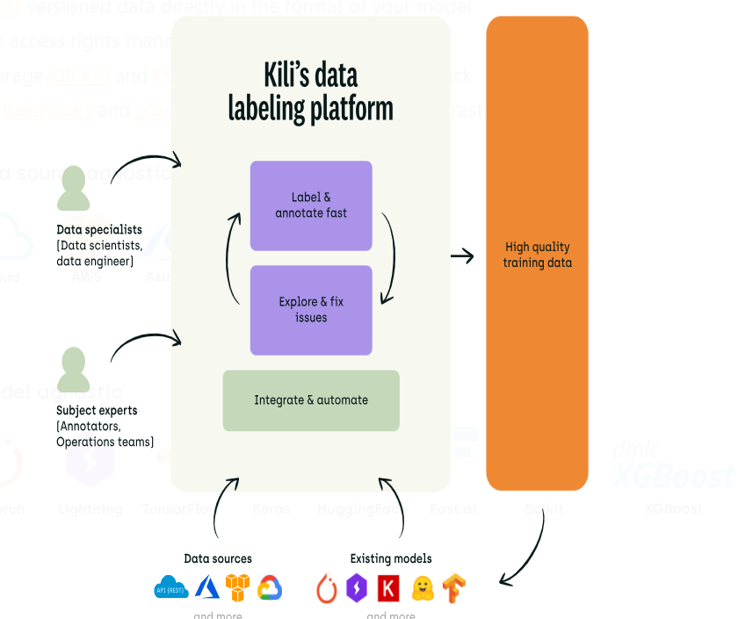
Architecture
Watsonx.ai
© Digivate Labs | Proprietary and Confidential
© Digivate Labs | Proprietary and Confidential

Slide 7
Tools
Image Annotation Tool
Video Annotation Tool
NLP Text Annotation Tool
OCR Annotation Tool
Geospatial Annotation Tool
Products
LLM Evaluation
Data Labeling
Hosting:
Kili on Cloud (SaaS) hosted on their infrastructure
Kili on Cloud (SaaS) deployed as a managed application in Azure Marketplace
Kili On-Premise
© Digivate Labs | Proprietary and Confidential

Slide 8
Available Plans
Plan | Free | Grow | Enterprise
Target | For individual contributors developing small-scale projects | For companies wishing to invest in their labeling operations | For companies with enterprise needs and specific data security requirements
Price | $0/month | *Custom price | *Custom price
Features | - Image, video, text, PDFs, large images & rich text labeling interfaces - 2 users max. - 100 annotations - Quality workflows - Quality and productivity metrics | -All Free features plus: - Zero-shot Labeling Co-pilot - Instant quality review scores - Upload via URL and Cloud - API and Python SDK (no rate limit) - Plugins - Data cloud storage | - All Grow features plus: - SSO and on-premise hosting - Custom contract & terms - Professional services - Dedicated customer success representative
© Digivate Labs | Proprietary and Confidential

Slide 9
Limitations of Free account of Kili
2 users can only work as collaborators at a time
100 annotations
We cannot pre -annotates our assets.
For video annotations it only provides bounding box feature
We cannot integrate to our ML pipelines as it does not provide any API
No connection of data cloud storage
No hosting on cloud or on-premise feature is available
© Digivate Labs | Proprietary and Confidential

Slide 10
Pricing of Upgraded Account
Volume: 50,000 annotations/year
Users: 3/year
Deployment: Cloud
Cost incur: 5000 € per year
© Digivate Labs | Proprietary and Confidential

Slide 11
Demo
© Digivate Labs | Proprietary and Confidential

Slide 12
ANY
QUESTIONS?
Watsonx.ai
Digivate Labs Pvt. Ltd. Private Limited, herein referred to as DVL provides a wide array of presentations and reports, with the contributions of various professionals. These presentations and reports are for informational purposes and private circulation only and do not constitute an offer to buy or sell any securities mentioned therein. They do not purport to be a complete description of the markets conditions or developments referred to in the material. While utmost care has been taken in preparing the above, we claim no responsibility for their accuracy. We shall not be liable for any direct or indirect losses arising from the use thereof and the viewers are requested to use the information contained herein at their own risk. These presentations and reports should not be reproduced, re-circulated, published in any media, website or otherwise, in any form or manner, in part or as a whole, without the express consent in writing of DVL. Any unauthorized use, disclosure or public dissemination of information contained herein is prohibited. Unless specifically noted, DVL is not responsible for the content of these presentations and/or the opinions of the presenters. Individual situations and local practices and standards may vary, so viewers and others utilizing information contained within a presentation are free to adopt differing standards and approaches as they see fit. You may not repackage or sell the presentation. Products and names mentioned in materials or presentations are the property of their respective owners and the mention of them does not constitute an endorsement by DVL. Information contained in a presentation hosted or promoted by DVL is provided “as is” without warranty of any kind, either expressed or implied, including any warranty of merchantability or fitness for a particular purpose. DVL assumes no liability or responsibility for the contents of a presentation or the opinions expressed by the presenters. All expressions of opinion are subject to change without notice.
© Digivate Labs | Proprietary and Confidential

