Slide 1
ID1054: Project
(Team Digijoy)
Team members:
Digjoy Nandi (AI20BTECH11007)
Dishank (AI20BTECH11011)
Perambuduri Srikaran (AI20BTECH11018)
Tanay Yadav (AI20BTECH11026)
Vaishnavi W (AI20BTECH11025)

Slide 2
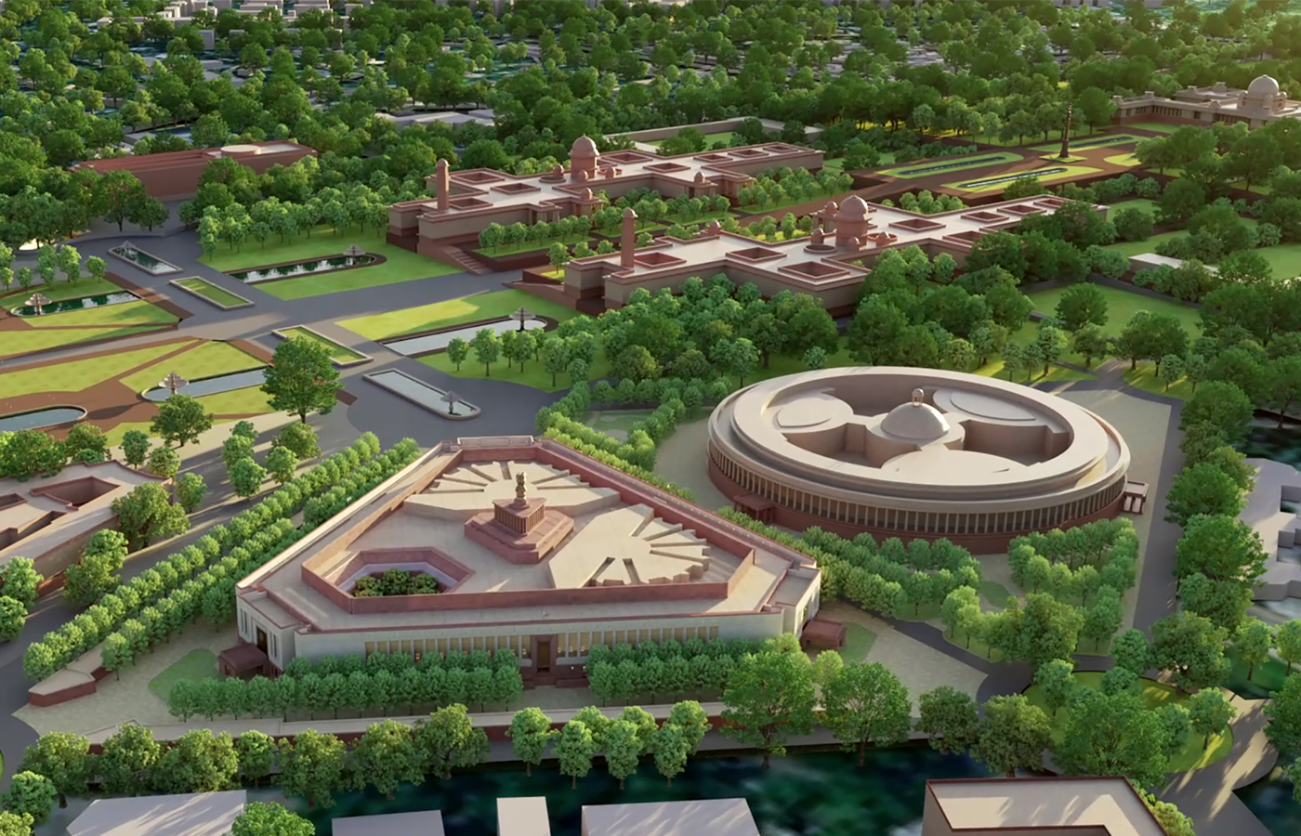
Project Idea: New Parliament Building of India
(Target Model)

Slide 3
Genesis Of Idea: Homage to a new and developing India
Applications: Can be used as a display item in museums. Can also be used to plan the ongoing construction of the new parliament building of India.

Slide 4
Challenges faced:
First task was obtaining reliable floor plan for the target model. We were able to get the same from https://www.hcp.co.in/project/new-parliament-building.
Individual structures were built by each member of the group. Assembling them was another challenge.
Ashoka emblem on top of new parliament building very complex to design. A lion was downloaded from the internet as an stl file. Then the stl file was converted into a parasolid file using CADexchanger. Solidedge can edit parasolid objects. Thus the lion was cut such that it fit in a quarter circle, and then four such copies were assembled on a cylindrical base to get the emblem.
Dividing work between each group member in order to complete the project within the given time needed planning.

Slide 5
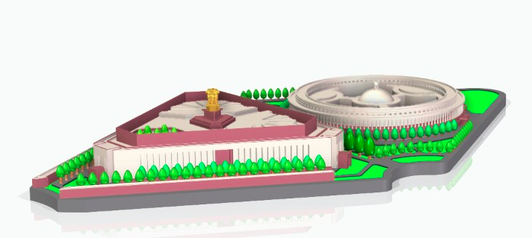
Final CAD assembly model:

Slide 6
Printing time estimate:
Material Estimate(in³):
Support Material Estimate(in³):
7h 10m
12.29
1.97

