Slide 1
SCORING ANALYSIS OF RNA BACKBONE

Slide 2
PDBs WITH GOOD VALIDATION RECORDS

Slide 3
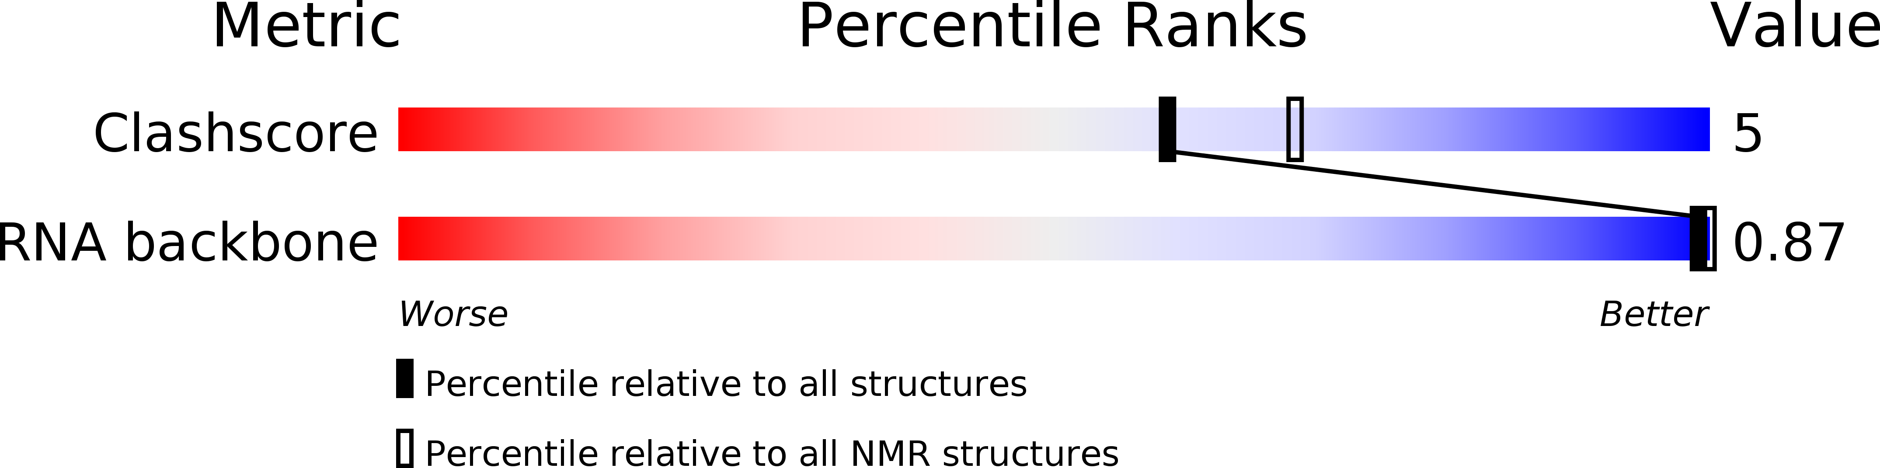
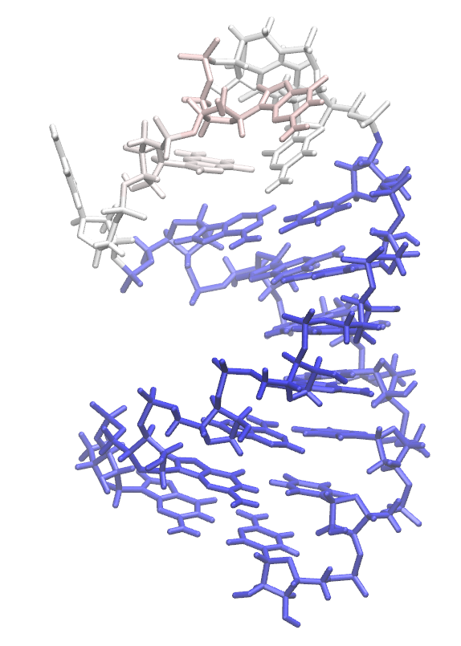
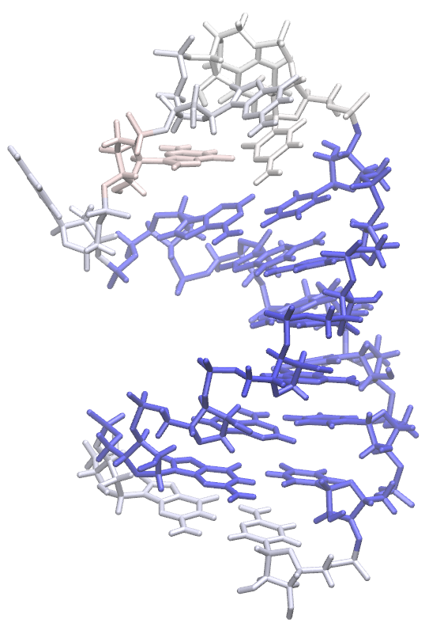
2B7G: NMR
veriNA3d + multi-gaussian scoring function
veriNA3d + multi-gaussian BN scoring function

Slide 4
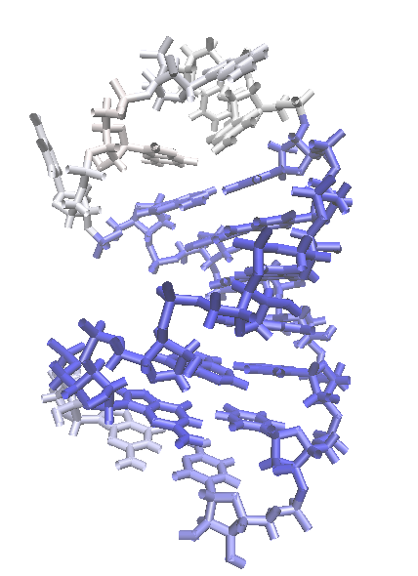
veriNA3d + multi-gaussian BN scoring function with n-1 and n+1

Slide 5
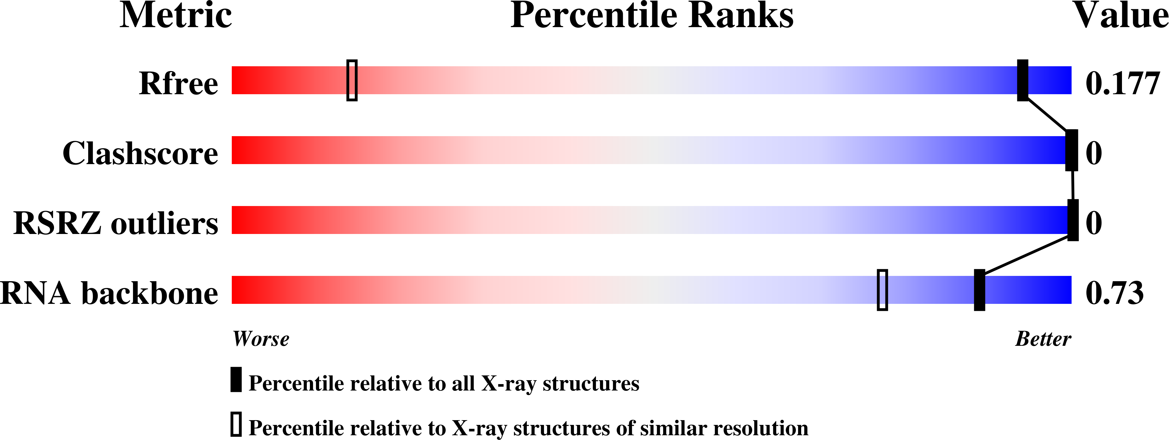
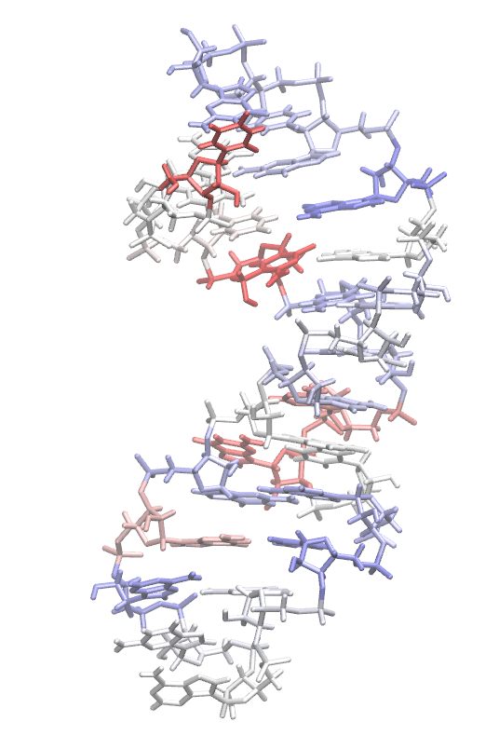
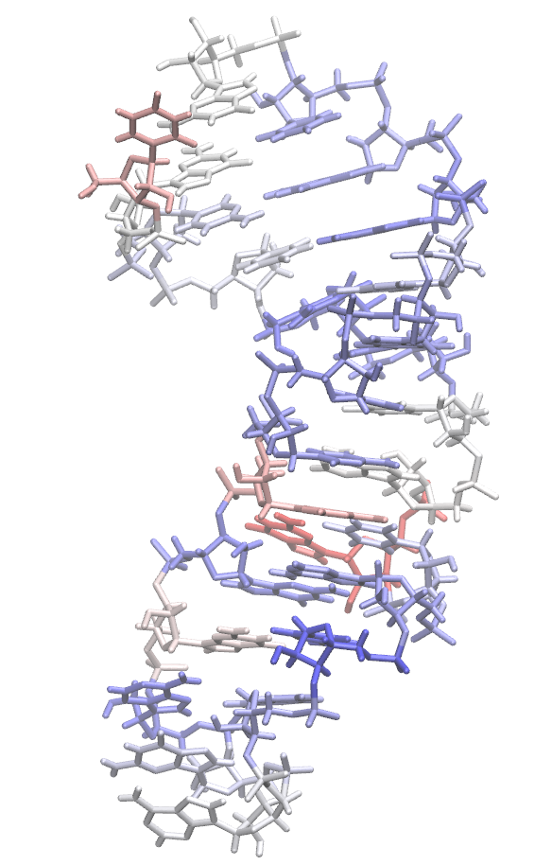
5NQI: X-RAY 0.851 Å
veriNA3d + multi-gaussian scoring function
veriNA3d + multi-gaussian BN scoring function

Slide 6
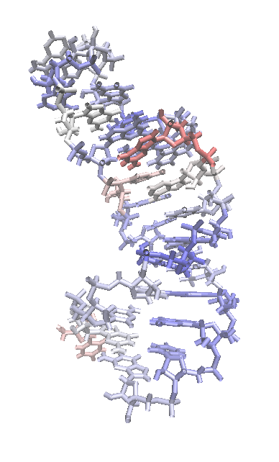
veriNA3d + multi-gaussian BN scoring function with n-1 and n+1

Slide 7
PDBs WITH BAD VALIDATION RECORDS

Slide 8
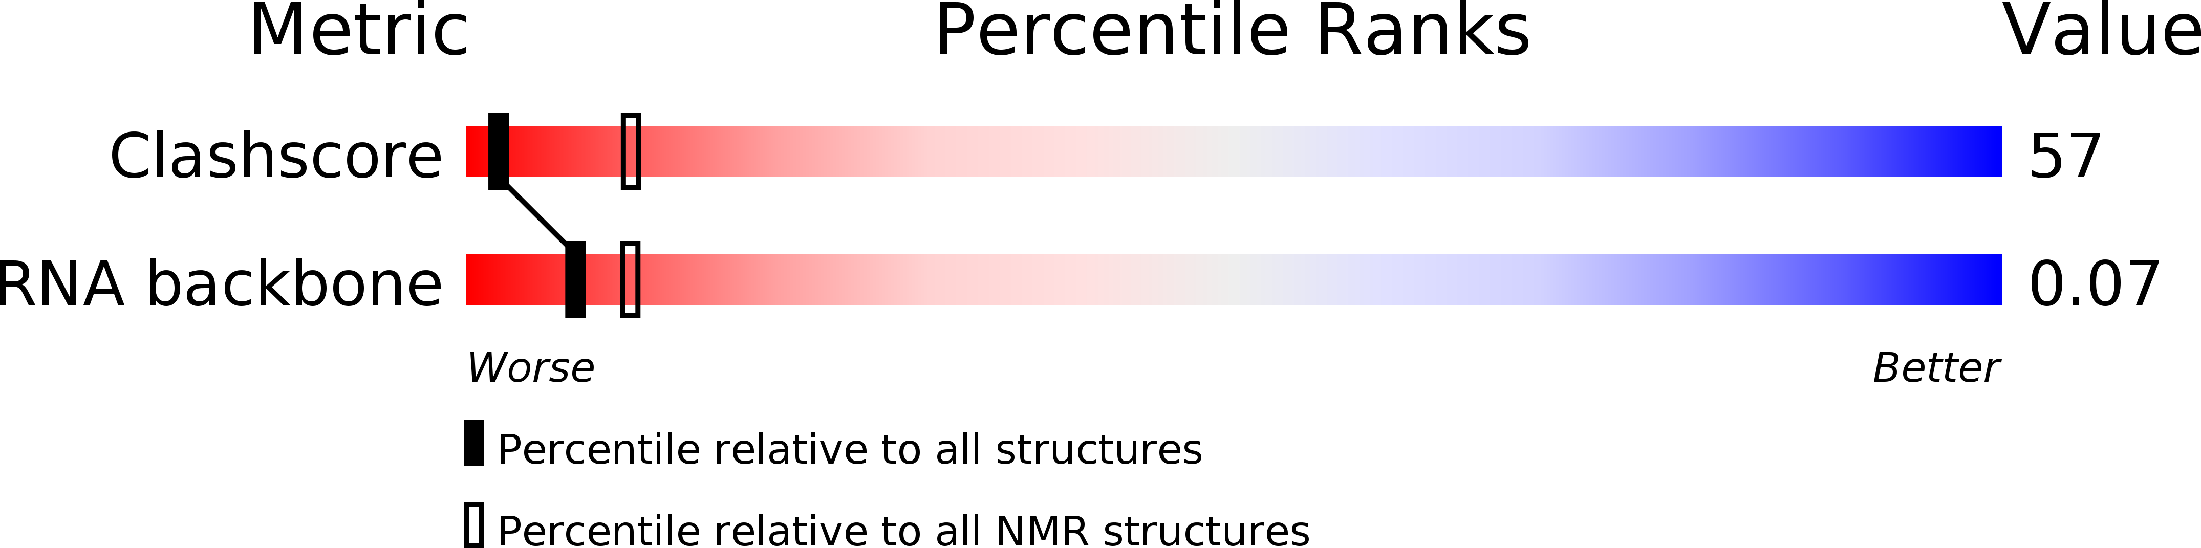
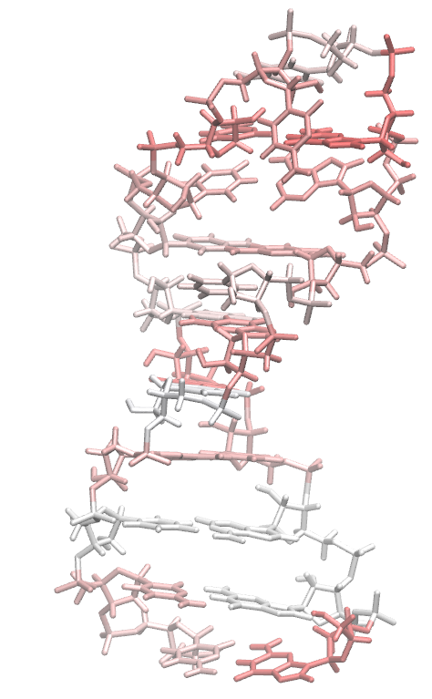
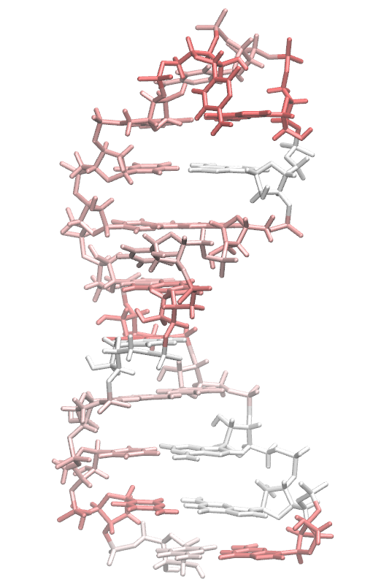
1QWA: NMR
veriNA3d + multi-gaussian scoring function
veriNA3d + multi-gaussian BN scoring function

Slide 9
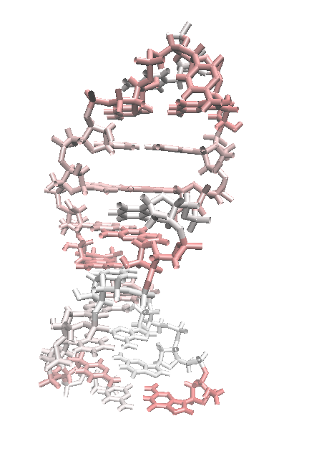
veriNA3d + multi-gaussian BN scoring function with n-1 and n+1

Slide 10
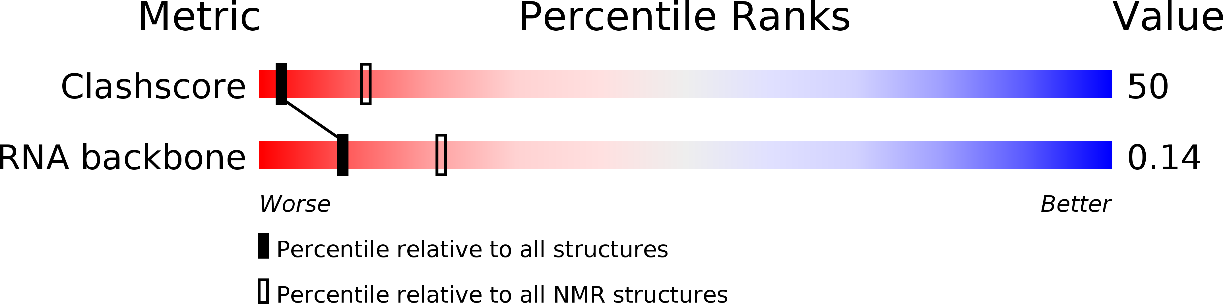
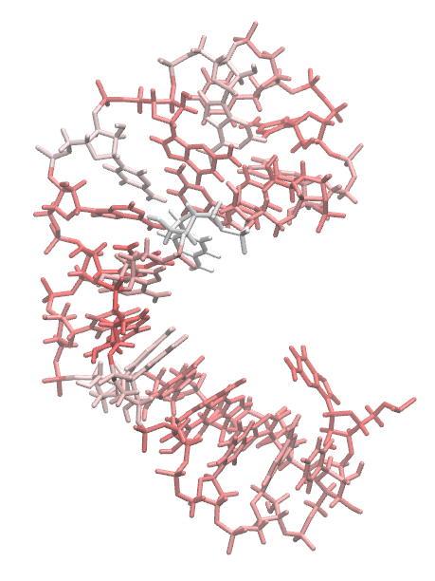
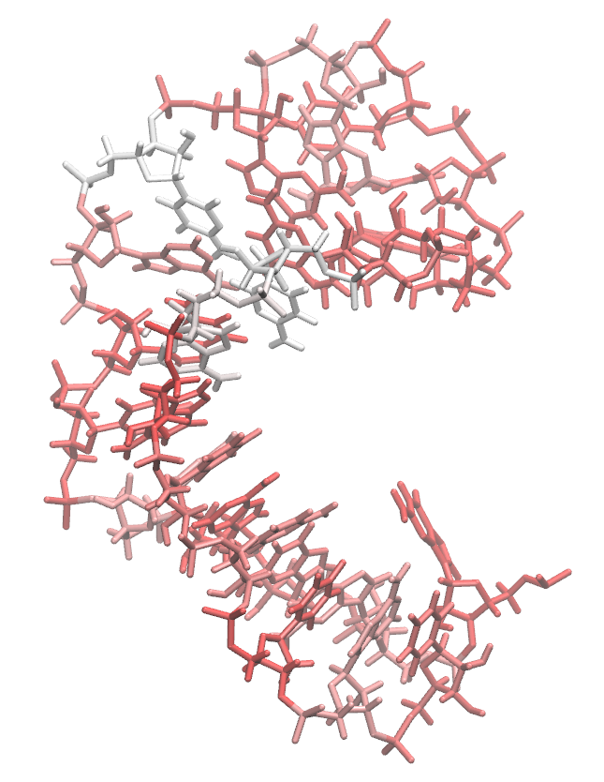
1RHT: NMR
veriNA3d + multi-gaussian scoring function
veriNA3d + multi-gaussian BN scoring function

Slide 11
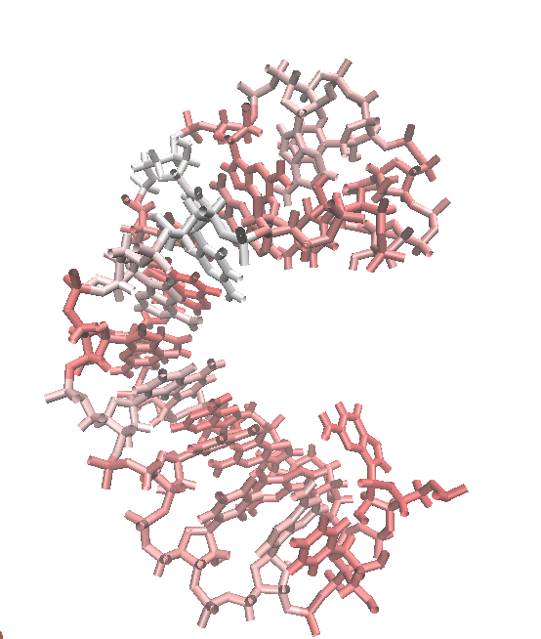
veriNA3d + multi-gaussian BN scoring function with n-1 and n+1

