Slide 1
OUTLIERS DESCRIPTION

Slide 2
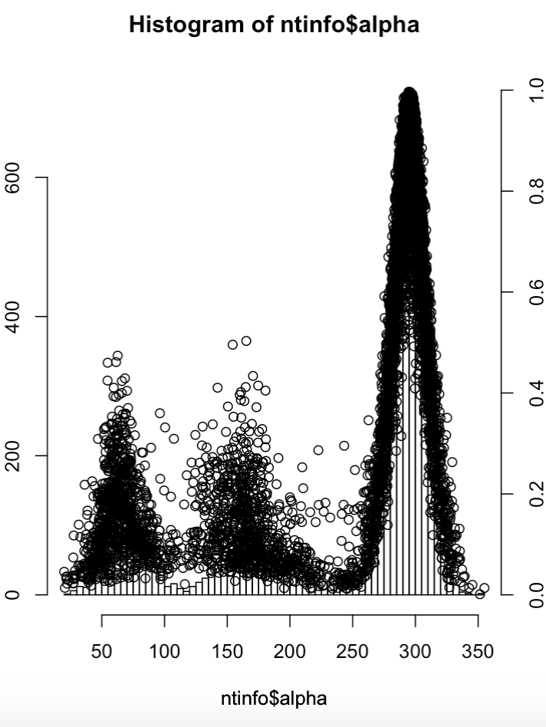
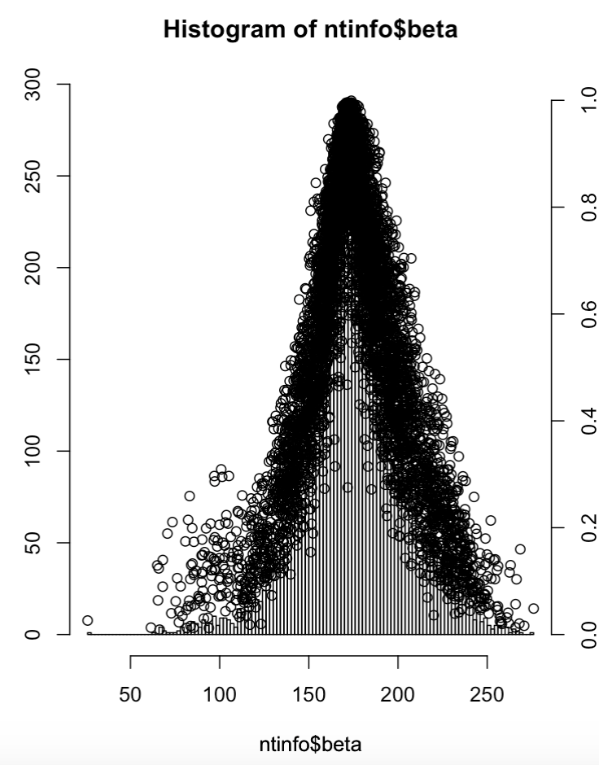
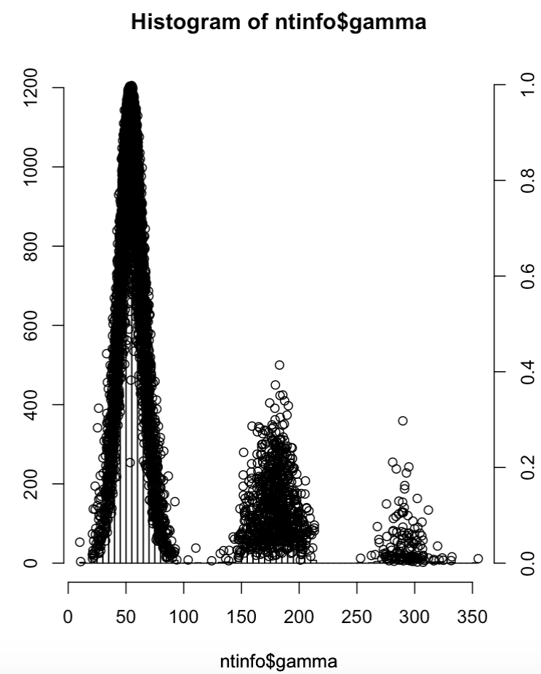
4OJI_1:A.G19
4W2F_1:CA.U84

Slide 3
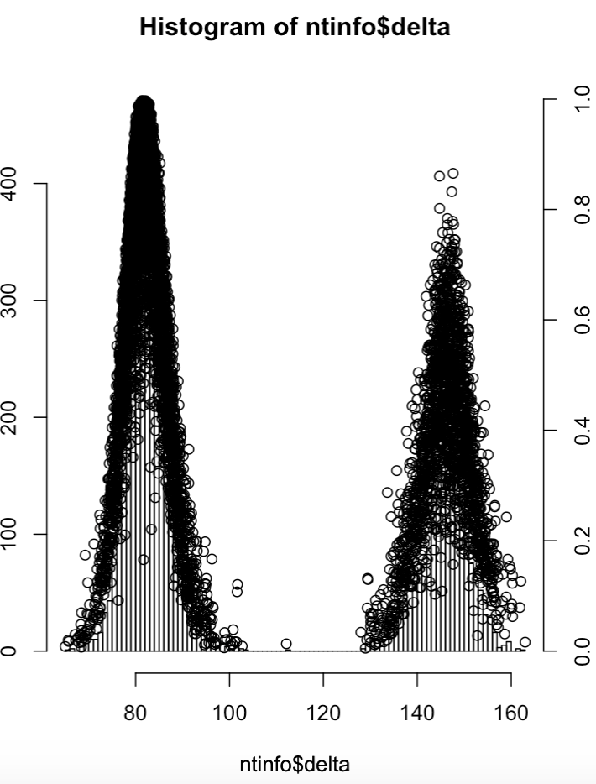
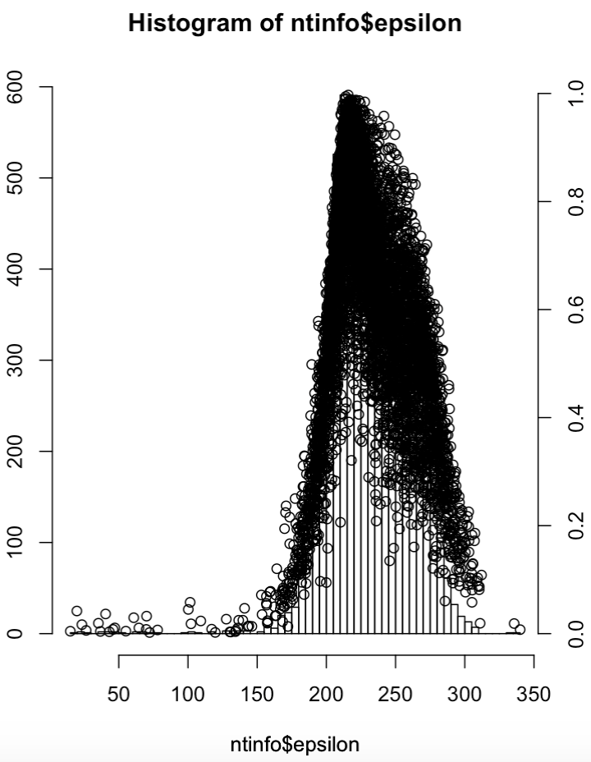
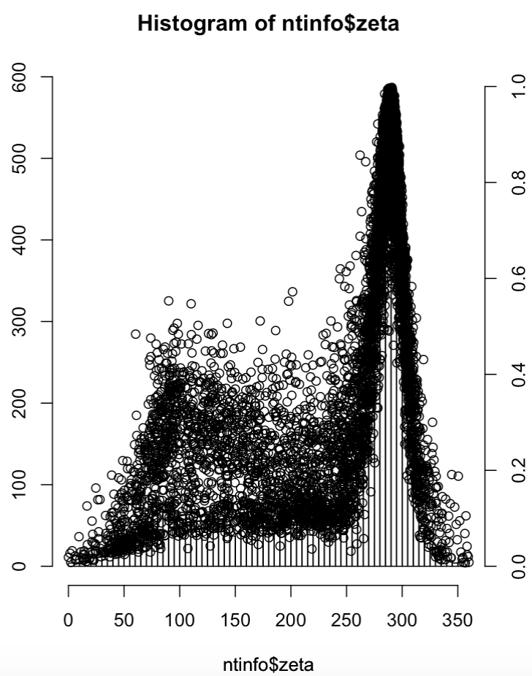
5B2P_1:B.U67
5JS1_1:B.A9
3ZJV_1:B.U47^C

Slide 4
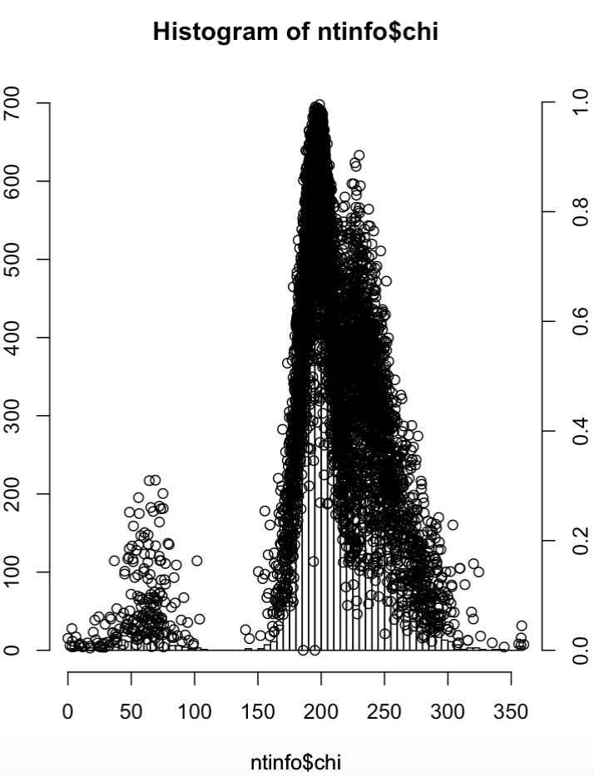

Slide 5
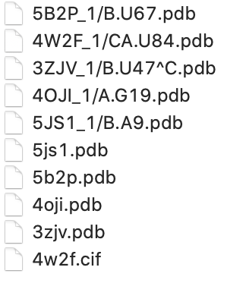
DATA PROVIDED
Trinucleotides
Original PDBs

