Slide 1
1) PLOTS WITHOUT APPLYING BAYES THEOREM
Plots of angles versus its own scoring

Slide 2
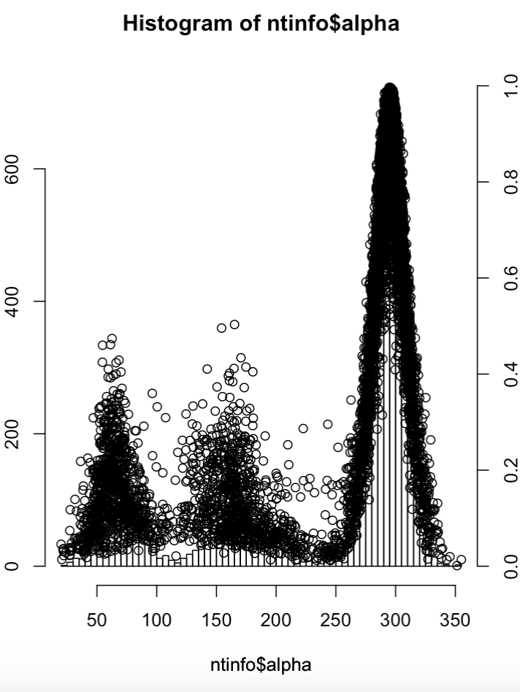
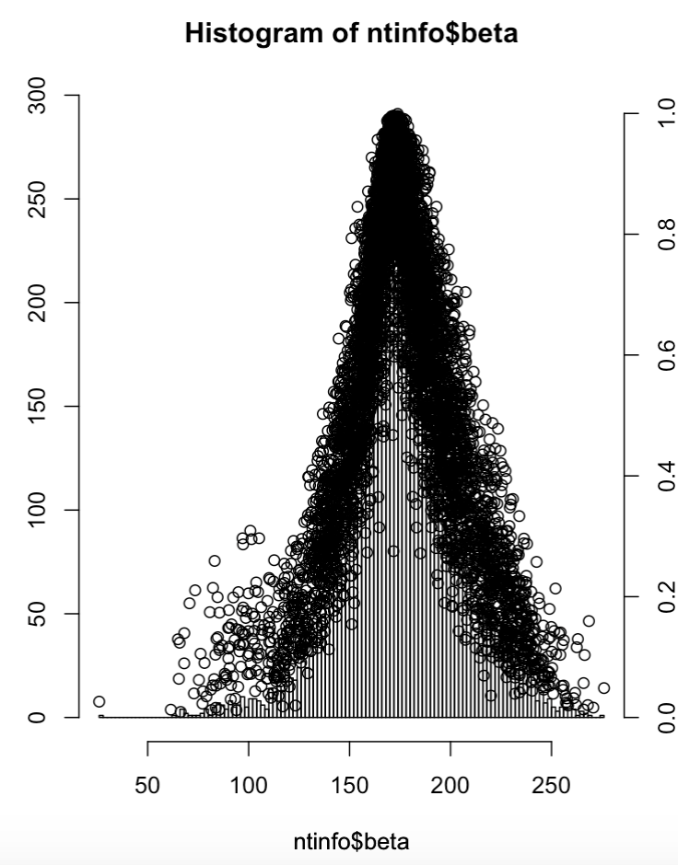
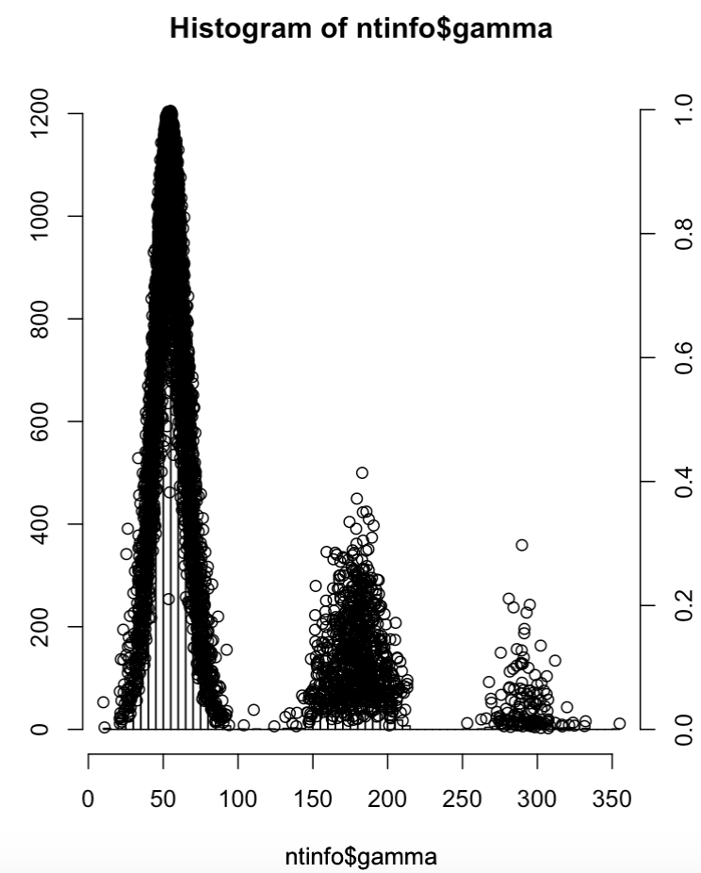
1) PLOTS WITHOUT APPLYING BAYES THEOREM

Slide 3
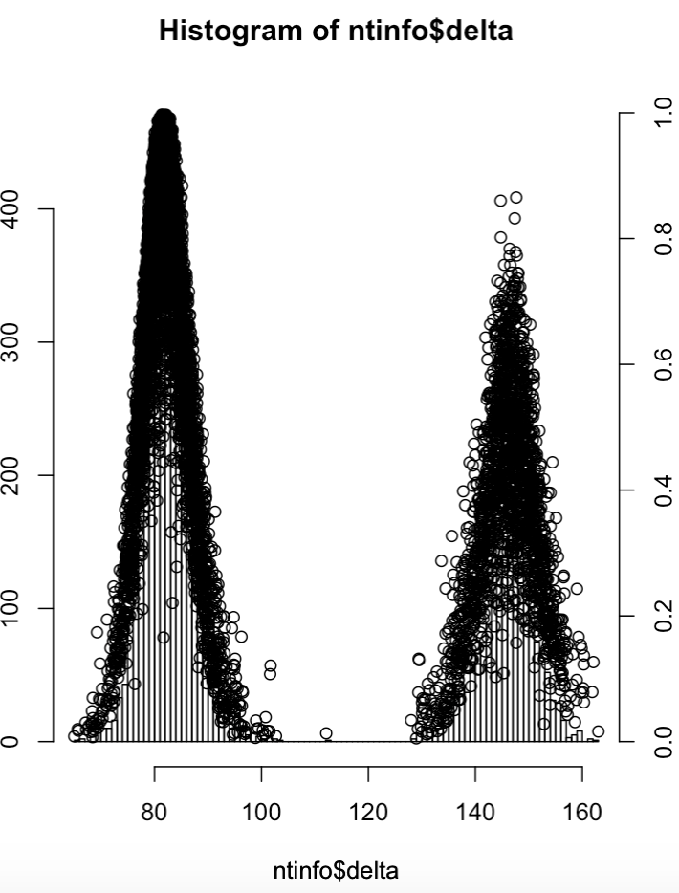
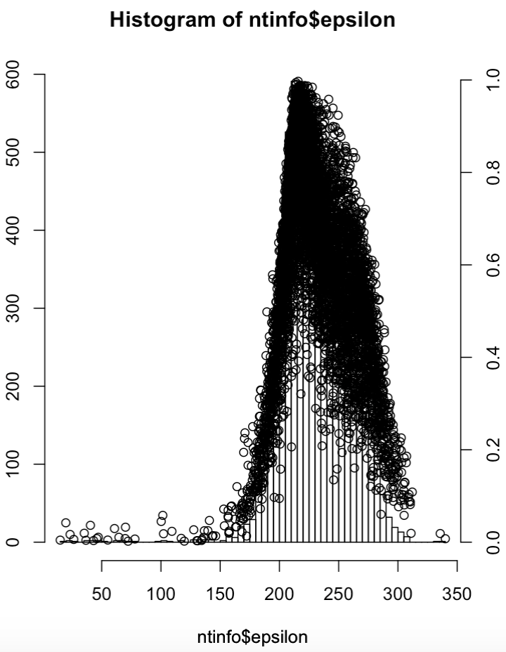
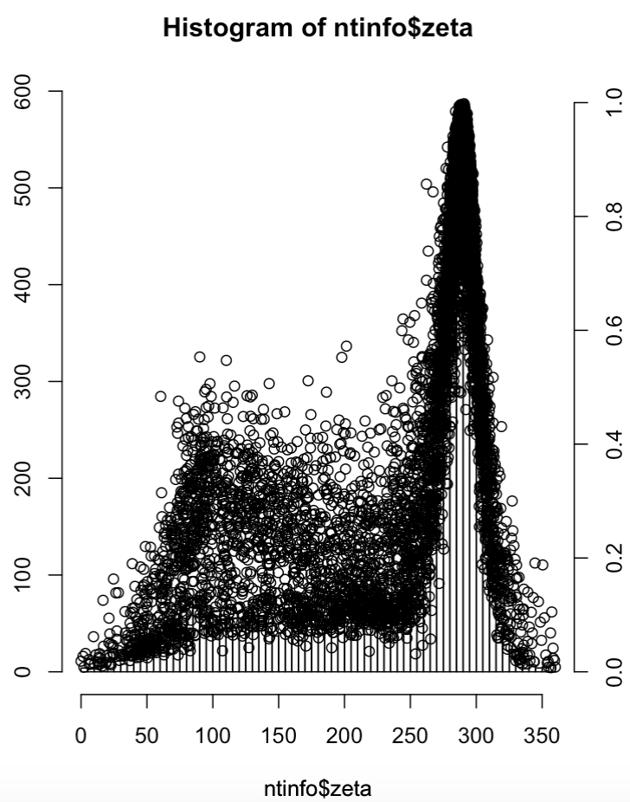
1) PLOTS WITHOUT APPLYING BAYES THEOREM

Slide 4
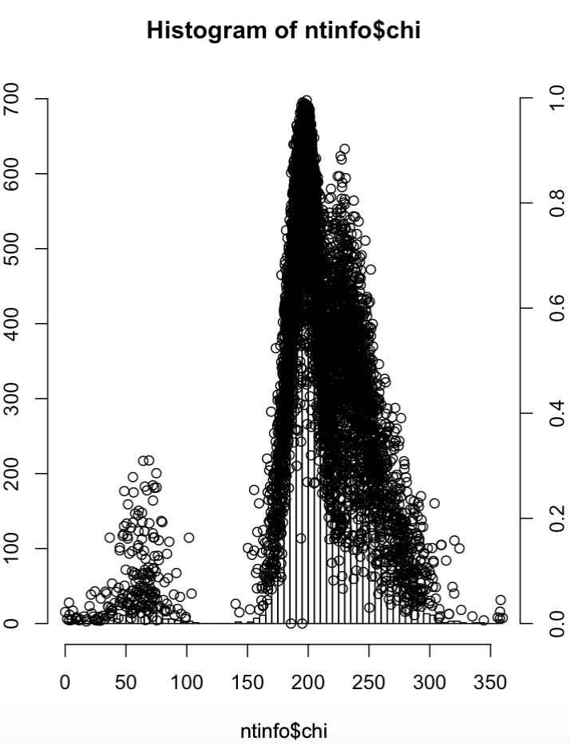
1) PLOTS WITHOUT APPLYING BAYES THEOREM

Slide 5
1) PLOTS WITHOUT APPLYING BAYES THEOREM
Plots of angles versus total score

Slide 6
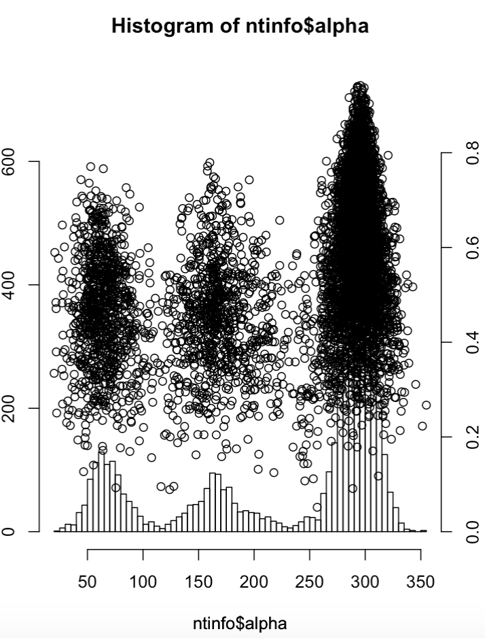
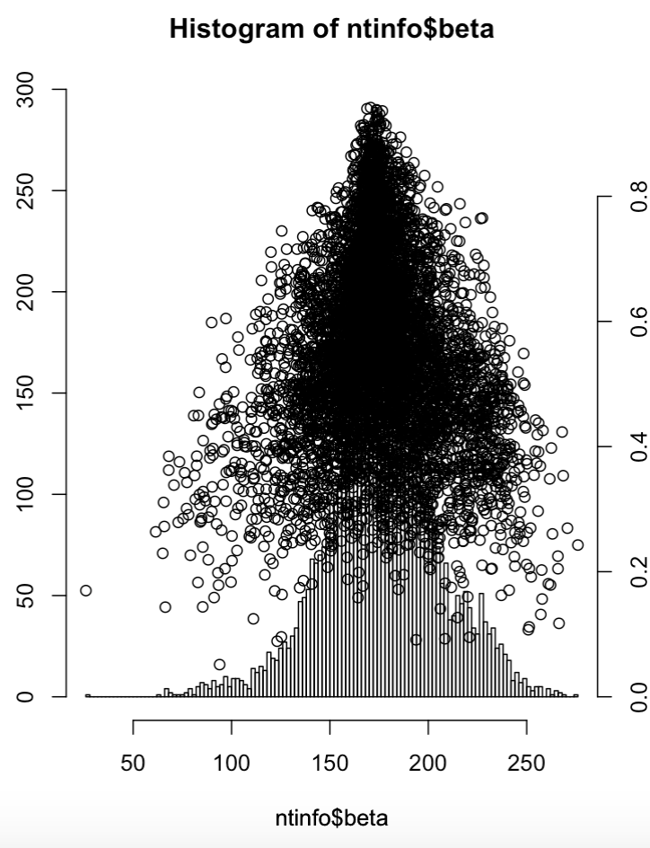
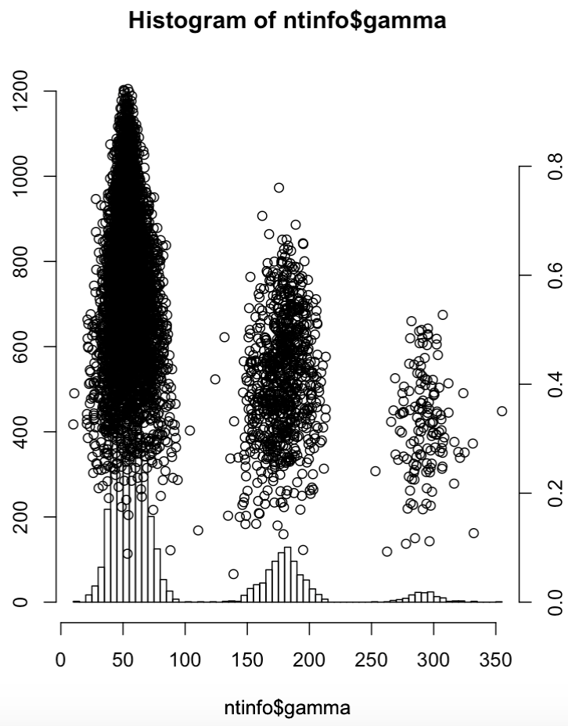
1) PLOTS WITHOUT APPLYING BAYES THEOREM

Slide 7
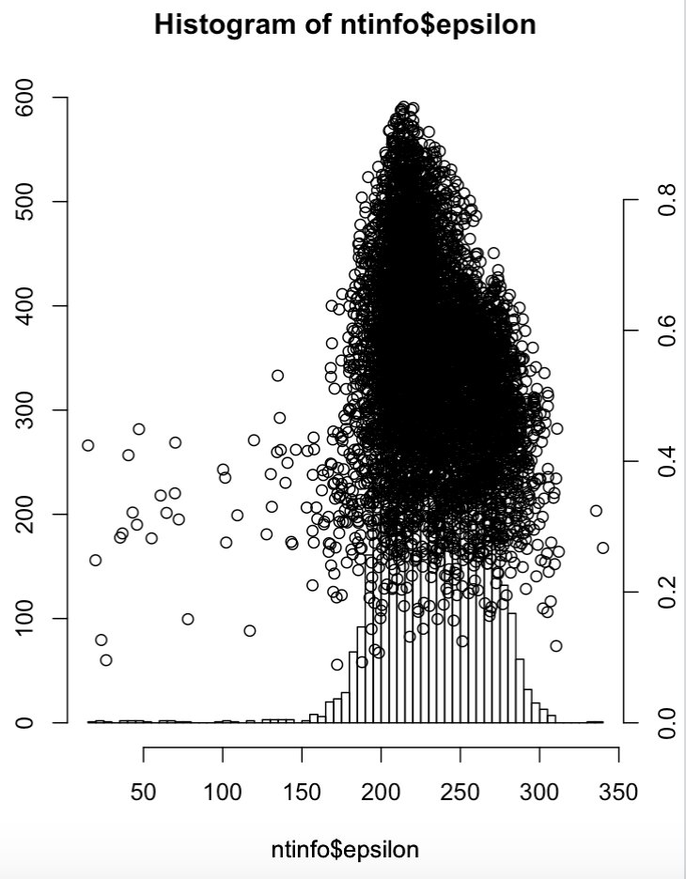
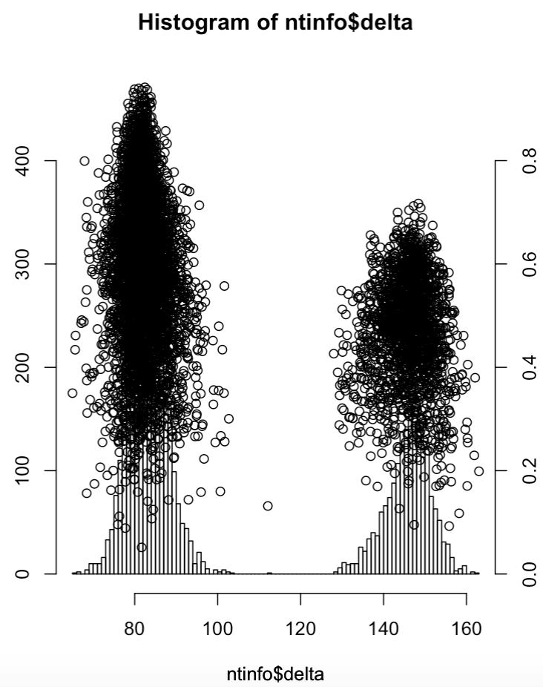
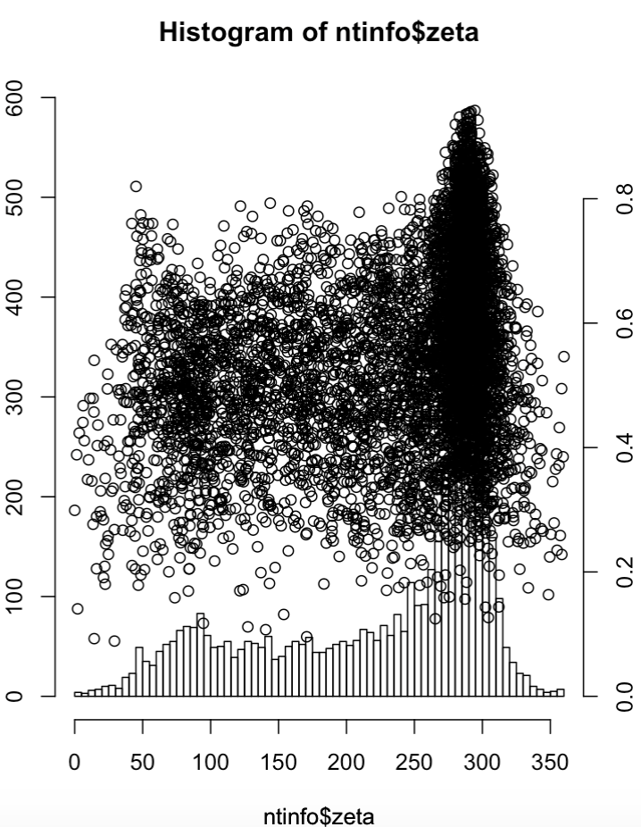
1) PLOTS WITHOUT APPLYING BAYES THEOREM

Slide 8
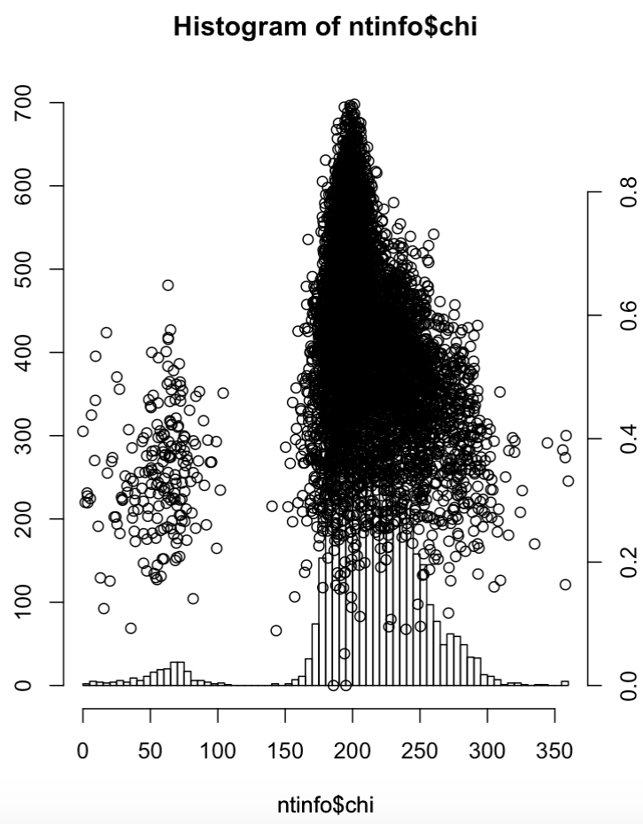
1) PLOTS WITHOUT APPLYING BAYES THEOREM

Slide 9
1) PLOTS APPLYING BAYES THEOREM
Plots of angles versus its own scoring

Slide 10
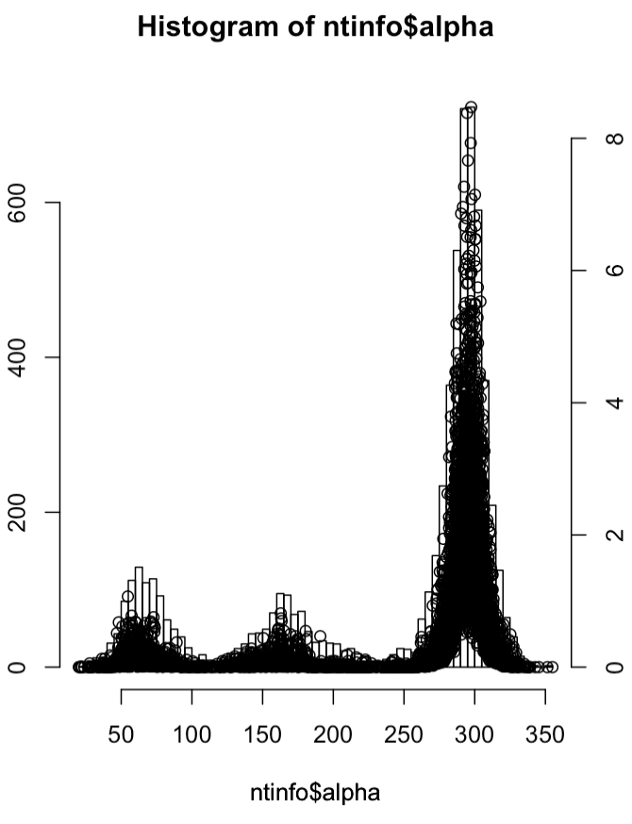
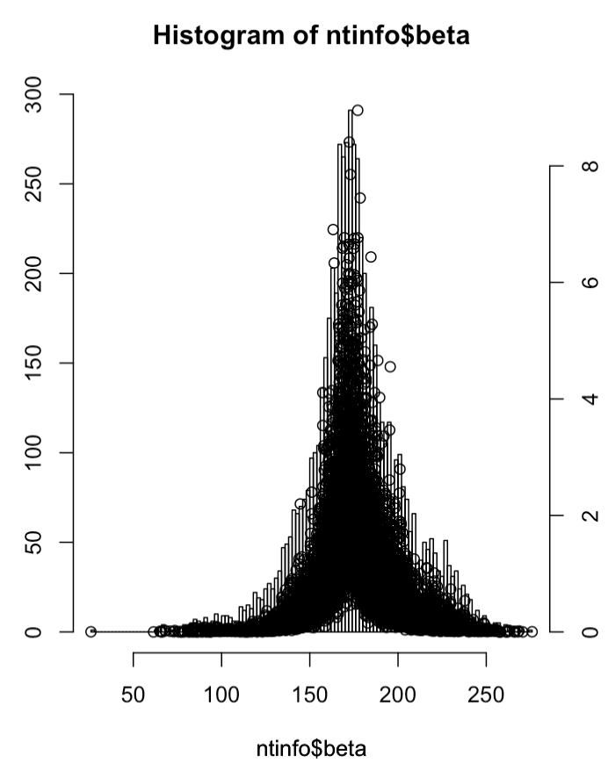
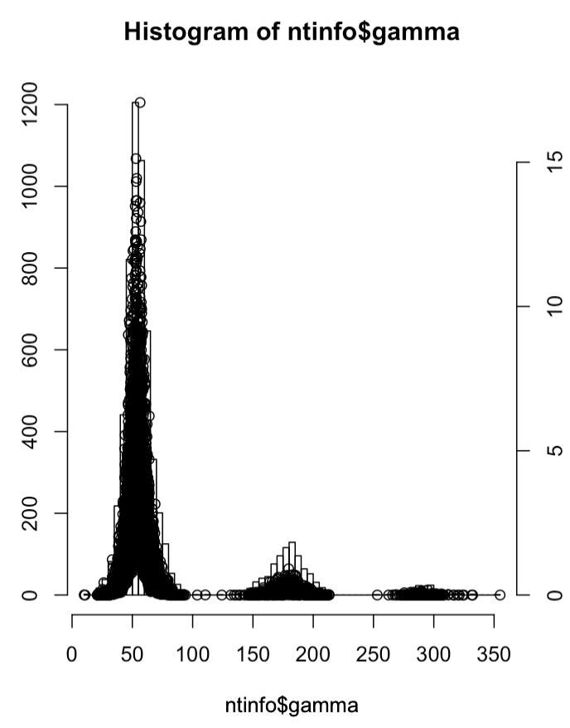
2) PLOTS APPLYING BAYES THEOREM

Slide 11
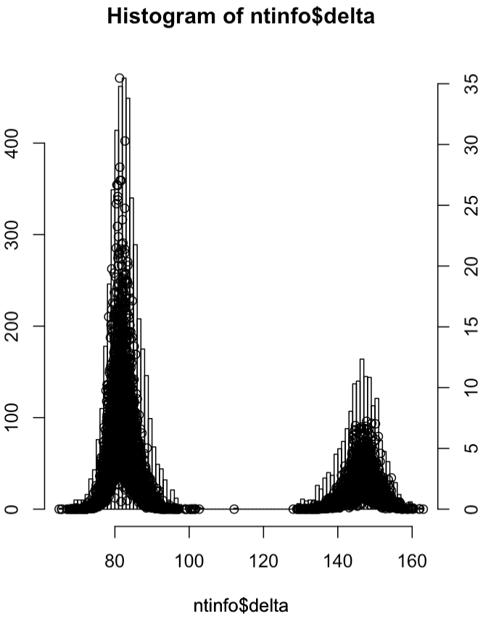
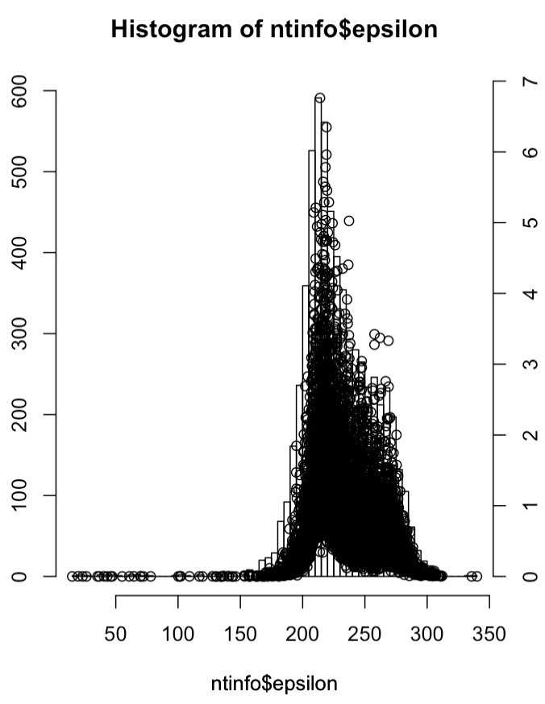
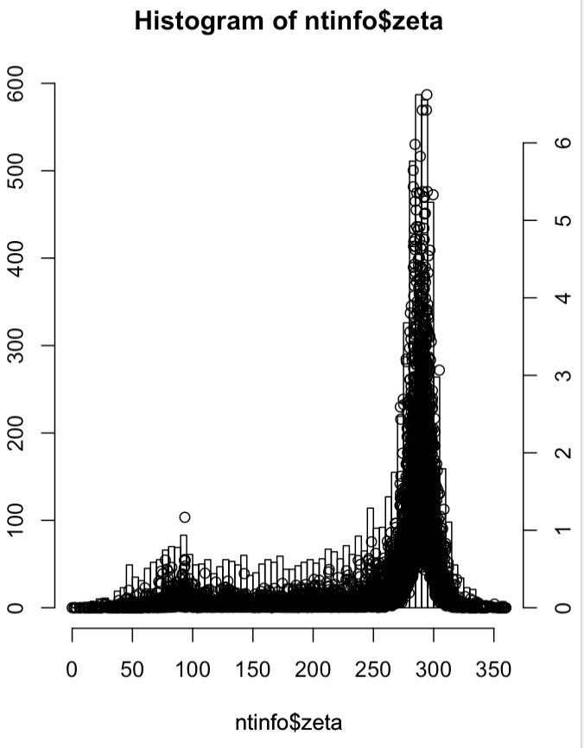
2) PLOTS APPLYING BAYES THEOREM

Slide 12
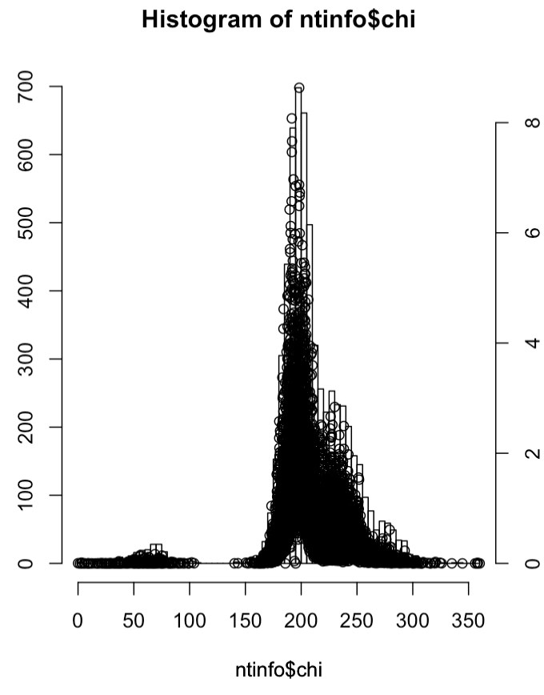
2) PLOTS APPLYING BAYES THEOREM

