Slide 1
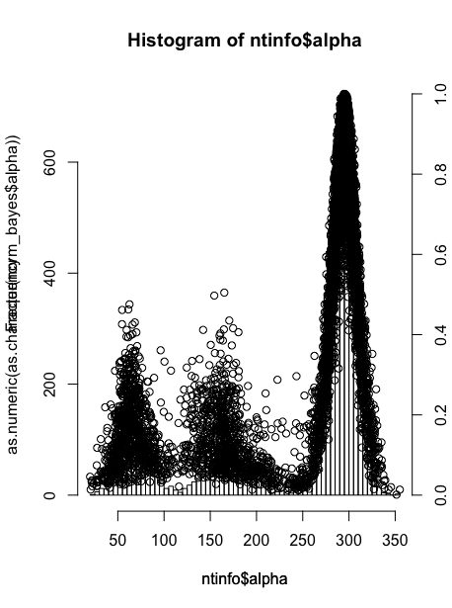
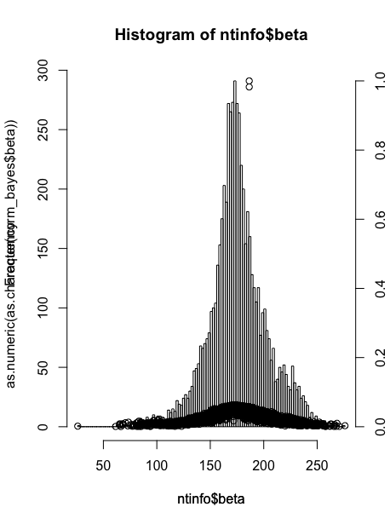
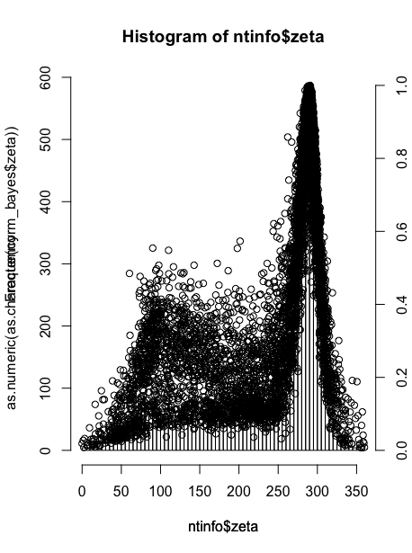
Check all the plots generated
1

Slide 2
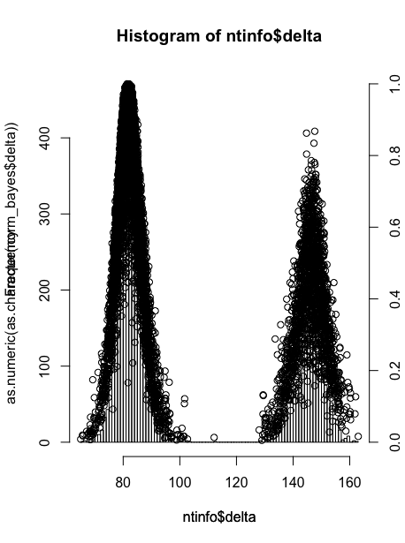
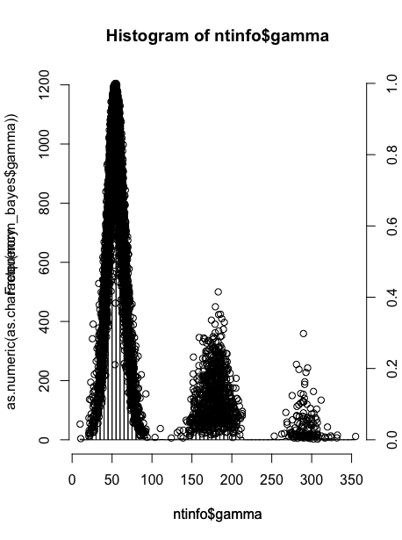
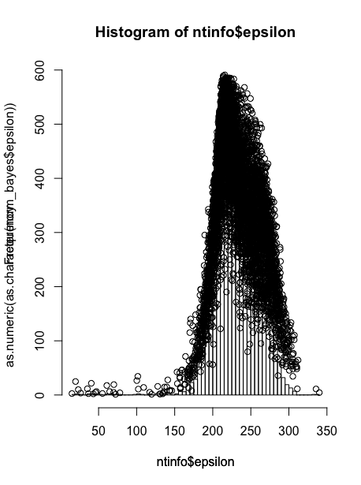
Check all the plots generated
1

Slide 3
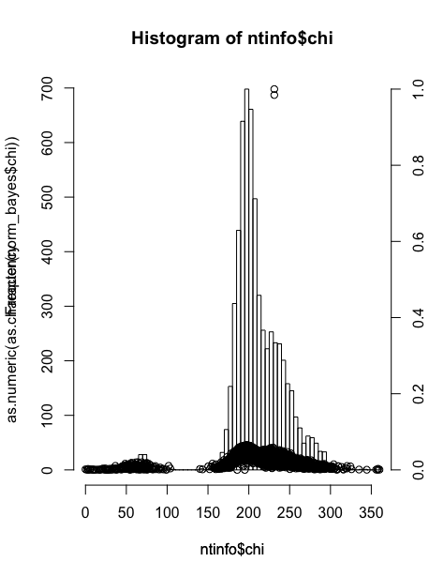
Check all the plots generated
1

Slide 4
Stripe the highest values for beta and chi scores
·IDs for BETA:
771
5031
·IDs for CHI:
1677
3233
alpha beta gamma delta epsilon zeta chi
771 289.201 186.393 64.264 144.276. 274.418 85.945 225.393
5031 305.376 186.394 57.141 159.383 292.826. 86.494 249.556
alpha beta gamma delta epsilon zeta chi
1677 270.223 201.464 67.534 135.958 246.685 304.819 232.028
3233 303.511 187.134 42.727 136.420 284.622 91.193 232.027
·Scoring by Bayes function:
·Scoring by Bayes function:
alpha beta gamma delta epsilon zeta chi total
771 0.8973062 16.05909 0.5409483 0.4490677 0.47092283 0.3226892 0.6540827 2.770586
5031 0.5285648 15.77888 0.6109064 0.1482734 0.09670432 0.1870816 0.3746445 2.532151
alpha beta gamma delta epsilon zeta chi total
1677 0.3167092 0.6932020 0.5414358 0.1373346 0.8894099 0.4993746 15.17293 2.607199
3233 0.5621434 0.6215669 0.5625761 0.1392141 0.3949913 0.3781720 15.41195 2.581517
·Scoring by cybeRNAting:
·Scoring by cybeRNAting:
alpha beta gamma delta epsilon zeta chi
0.922 0.262 0.441 0.015 0.024 0.012 0.079
0.375 0.335 0.836 0.02 0.021 0.017 0.051
alpha beta gamma delta epsilon zeta chi
0.138 0.087 0.29 0.047 0.109 0.128 0.094
0.477 0.311 0.205. 0.043 0.032. 0.018 0.073
1

Slide 5
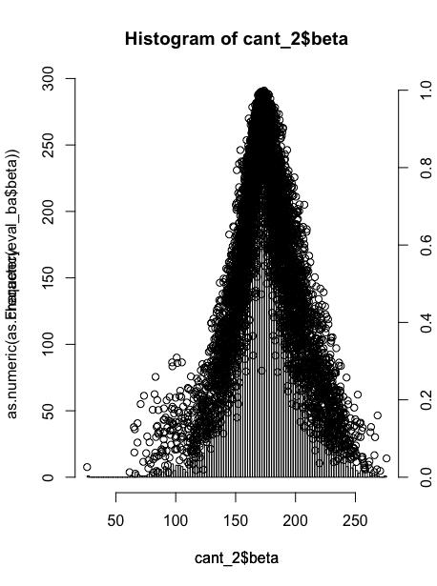
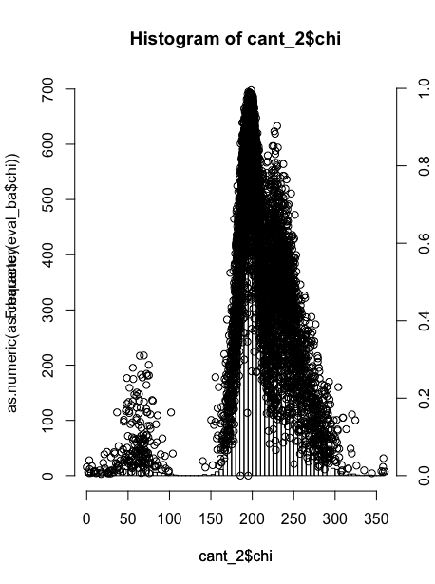
Remove those 4 nucleotides and check again plots for Beta and Chi
1

Slide 6
We are already normalizing with the max_dens dividing so that
our data fits in the range of [0,1]
alpha beta gamma delta epsilon zeta chi total
771 0.8973062 16.05909 0.5409483 0.4490677 0.47092283 0.3226892 0.6540827 2.770586
5031 0.5285648 15.77888 0.6109064 0.1482734 0.09670432 0.1870816 0.3746445 2.532151
Does not make sense > 1 values
1

Slide 7
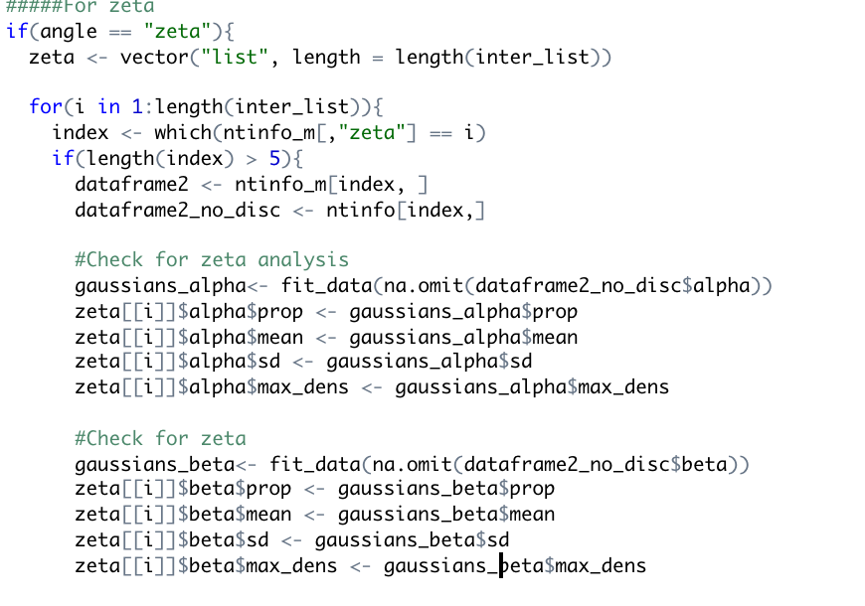
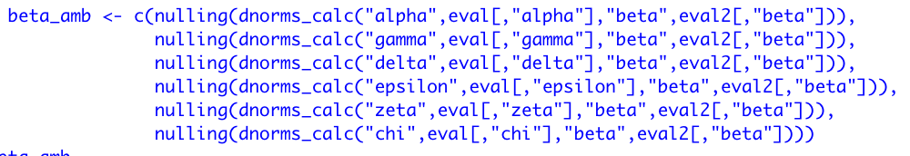
Deep analysis on the ID: 771. Solving its problem may solve problem
for the others
3) Check at the probability function for: zeta – beta pairs
alpha beta gamma delta epsilon zeta chi
771 289.201 186.393 64.264 144.276. 274.418 85.945 225.393
1) Scoring by Bayes function:
alpha beta gamma delta epsilon zeta chi total
771 0.8973062 16.05909 0.5409483 0.4490677 0.47092283 0.3226892 0.6540827 2.770586
2) Analysis of the different contributions “beta”
OUTPUT: 0.7346722 0.9257825 0.7290086 0.8479728 92.1275127 0.9895698
1

Slide 8
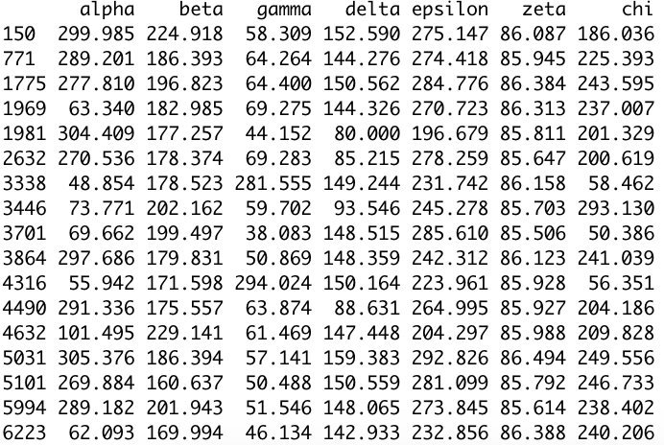
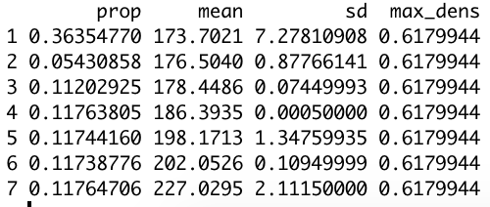
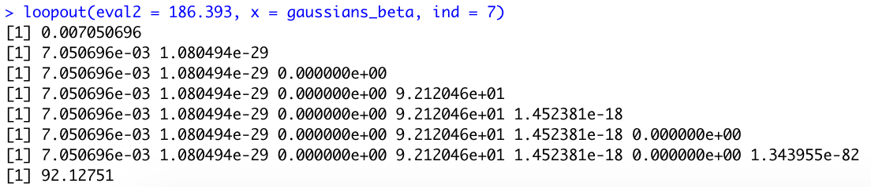
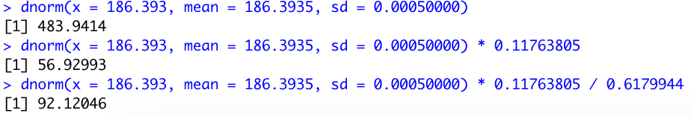
4) Dataframe subset for: zeta = 86
5) Fitted gaussians for beta when zeta = 86
6) Compute dnorm() calculus on each of them
4th Gaussian gives such bad result
7) Compute dnorm() manually on the 4th row
1

Slide 9
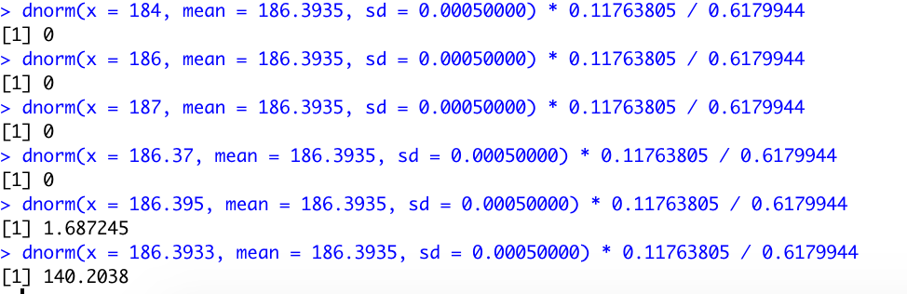
PROBLEM:
·Standard deviation is too low so minimal changes on x versus mean create a lot of change at dnorm()
SOLUTION:
·Apply filtering for sd
·Data handling
****Trying with different values on x:
1

Slide 11
New approach: Generate dataset sub-sampling with creating
Leverage North-South conformations
· Generate 100 individual probability data from each of the random sampling dataset created
· Resulting dnorm will be the mean for each of the tests within the 100 sampling probabilities.
*Use each of the conditional probabilities to model the dnorm function by doing the average.
Sample1
Bayesian_data
Original
Dataset
Sample2
Bayesian_data
Sample3
Bayesian_data
mean(dnorm(x, mean, prop)
Sample4
Bayesian_data
….
2
Sample100
Bayesian_data

Slide 12
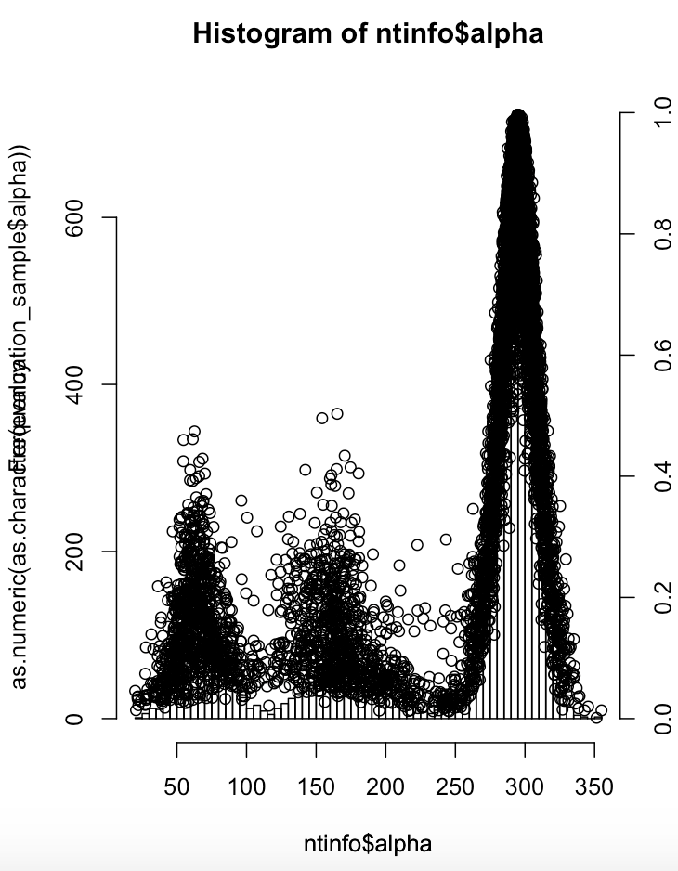
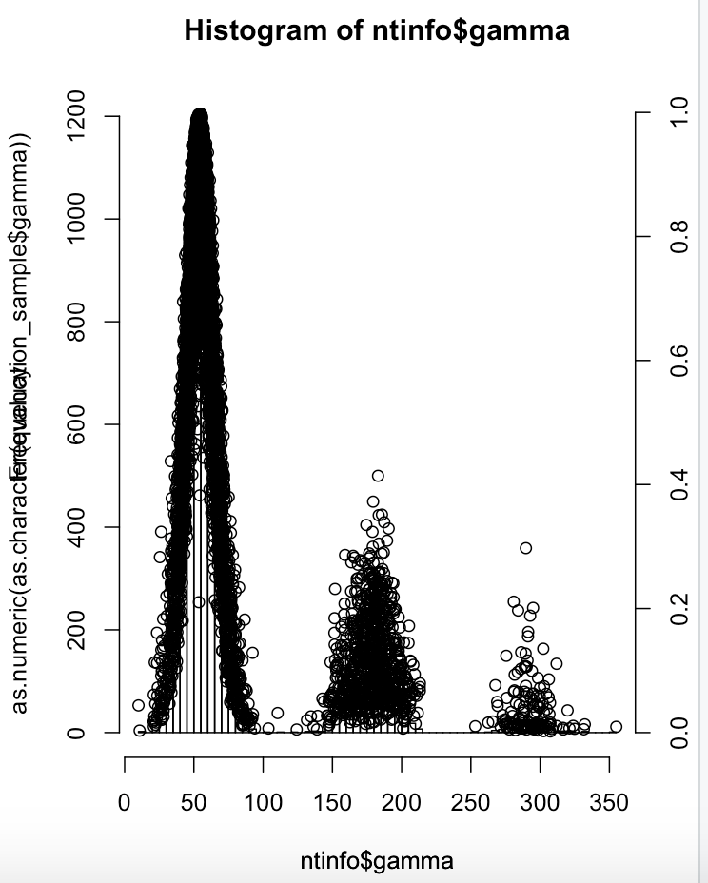
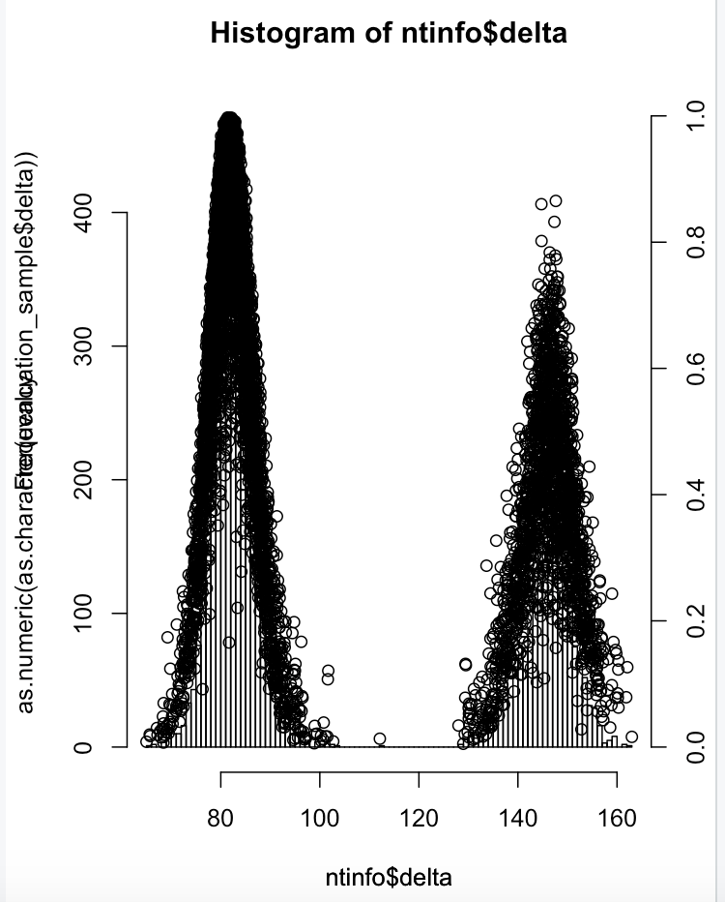
Check all the plots generated
2

Slide 13
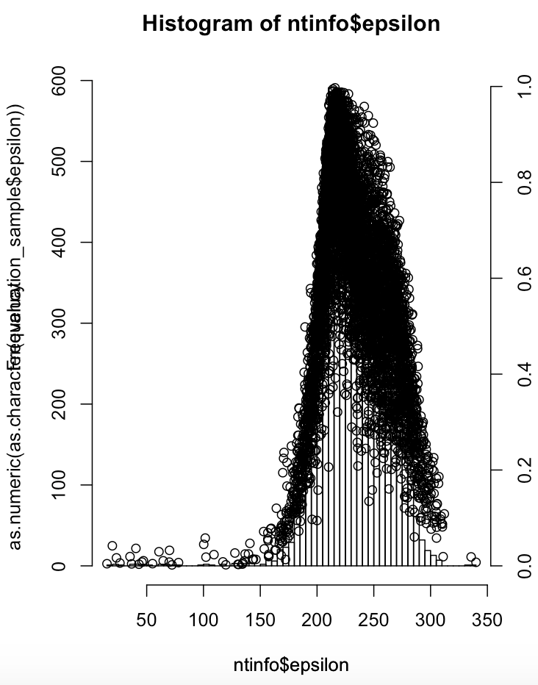
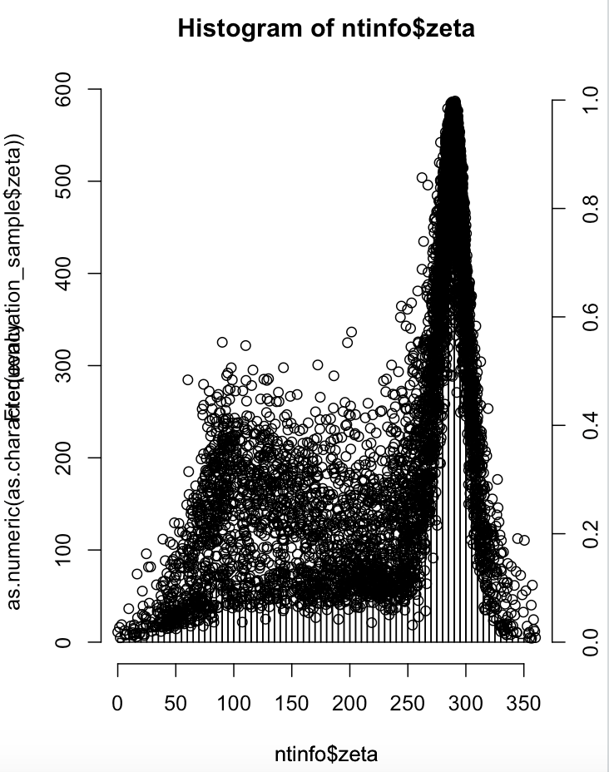
2

Slide 14
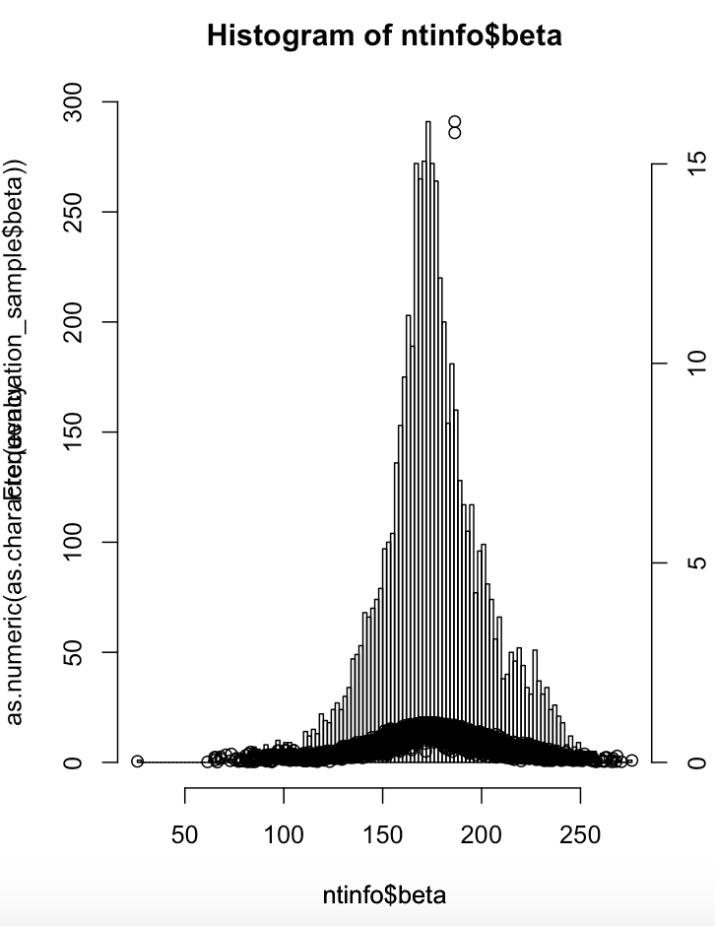
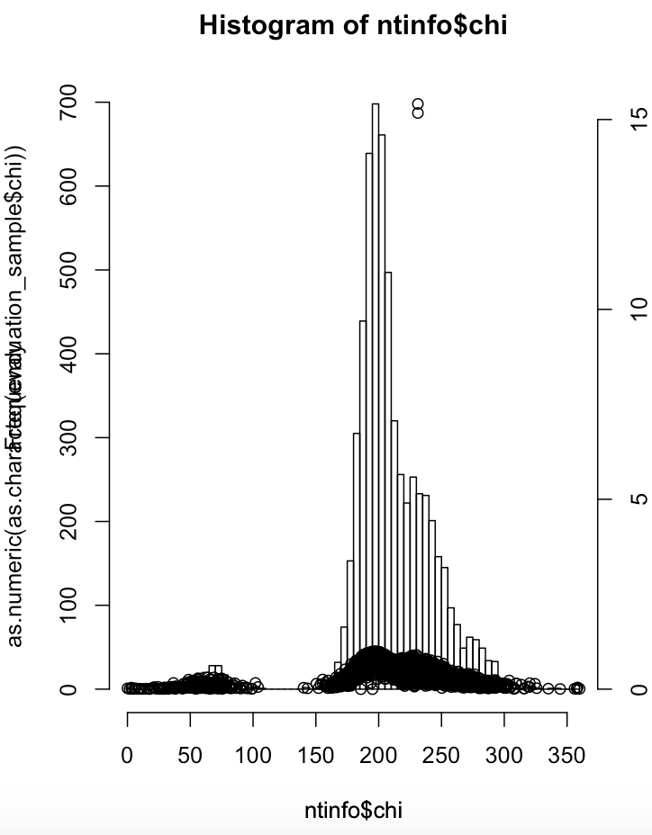
Same problem for beta and chi – South conformation angles
IDs: 1677 3233 771 5031
2

Slide 15
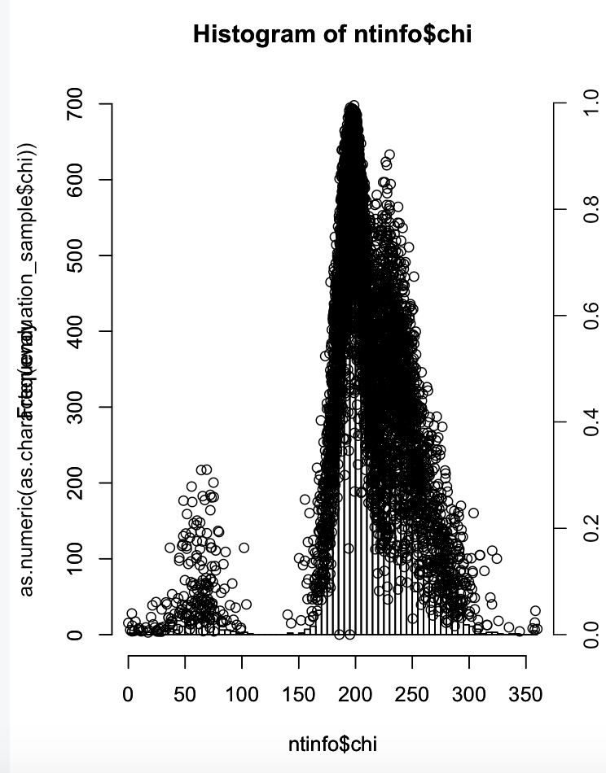
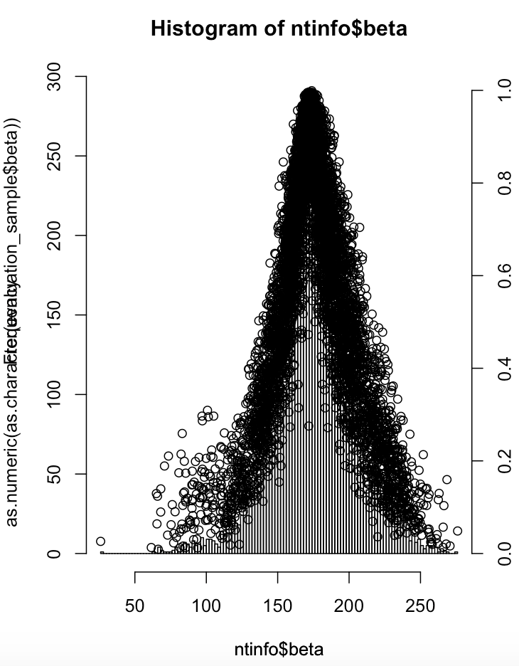
Remove nucleotides > 5 scoring on chi and beta
2

Slide 16
Plots between direct ntinfo and subsampling converge quite
good being a strong indicator of the robustness of the dataset as
minor changes occur
2

Slide 18
Ongoing: Re-scale based on local minimum and maximum for each
for each of the peaks in a plot
Eg. Gamma angle
x0
x1
Mean = (x1-x0)/2
3

Slide 19
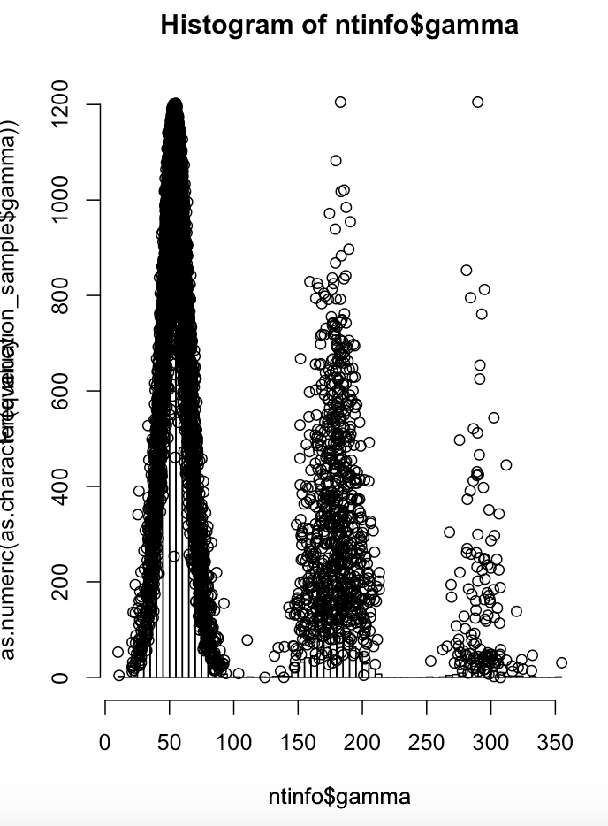
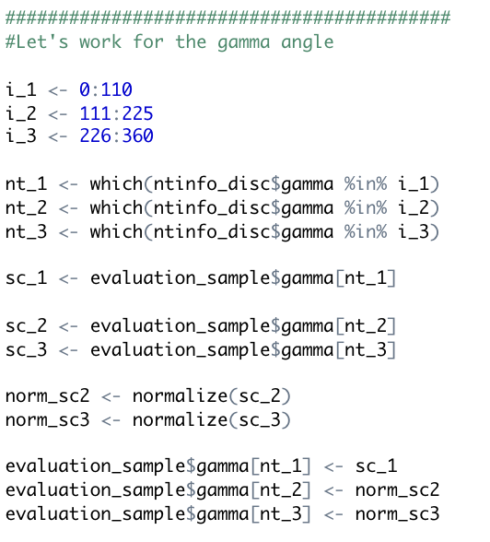
Output;
3

