Slide 1
ANALYSIS OF 1BAU

Slide 2
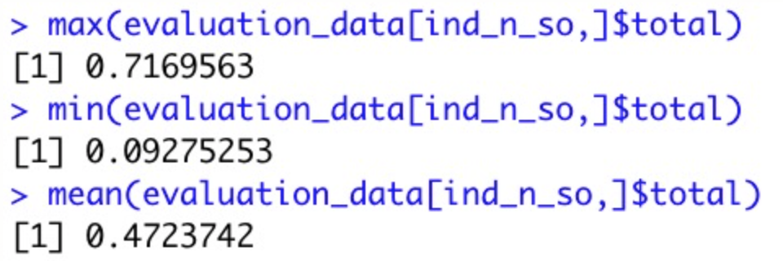
WIDE DATA EXPLORATION IN THE NTINFO OF THE SOUTH ANGLES
DISTRIBUTION
South angles have a pu distribution between 144º to 180º

Slide 3
HIGHEST SCORING ANGLE EN SOUTH – ntinfo ID = 68
Angles
alpha beta gamma delta epsilon zeta chi pu_round
68 299.258 165.397 61.142 148.099 257.194. 286.109 236.654 158
Scoring
alpha beta gamma delta epsilon zeta chi total
68 0.8970308 0.8658455 0.8112619 0.4725056 0.5948475 0.8748036 0.5023992 0.7169563

Slide 4
ANALYSE SCORING FOR SOUTH ANGLES IN PDB ID = 1bau
Angles
alpha beta gamma delta epsilon zeta chi pu_round
7 305.282 168.243 61.872 148.267 223.491 297.652 212.508 162
30 305.223. 168.209 61.856 148.268 223.503 297.705 212.583 162
Scoring
alpha beta gamma delta. epsilon zeta chi total
7 0.687 0.941. 0.612. 0.204 0.839 0.729 0.452 0.638
30 0.707 0.940 0.633 0.225 0.839 0.714 0.469 0.647

Slide 5
WIDE DATA EXPLORATION IN THE NTINFO OF THE NORTH ANGLES
DISTRIBUTION
GOOD: SELECTED ANGLES IN NORTH WITH SCORING > 0.75
BAD: SELECTED ANGLES IN NORTH WITH SCORING < 0.5
Angles
Scoring

Slide 6
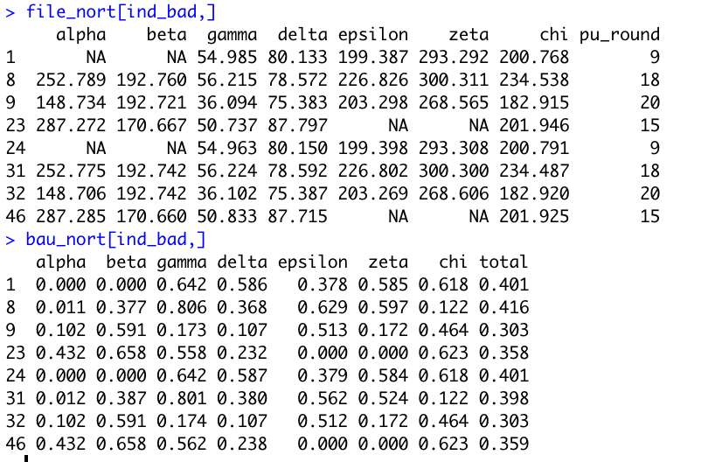
WIDE DATA EXPLORATION IN THE NTINFO OF THE NORTH ANGLES
DISTRIBUTION
Angles
Scoring

Slide 7
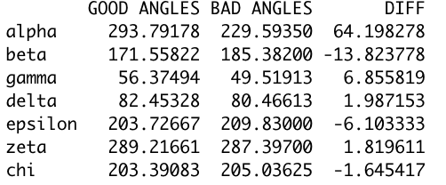
ANALYSIS OF THE MEAN FOR EVERY ANGLE AND FOR THE
GOOD-NORTH AND BAD-NORTH DISTRIBUTION

Slide 8
CONCLUSIONS
· Alpha seems to be a determinant angle between the good scored and
bad scored angles within the north distribution

