Slide 1
SCORING ANALYSIS OF PDBS

Slide 2
ANALYSIS OF PDBs WELL SCORED BY PDB BACKBONE
SCORING

Slide 3
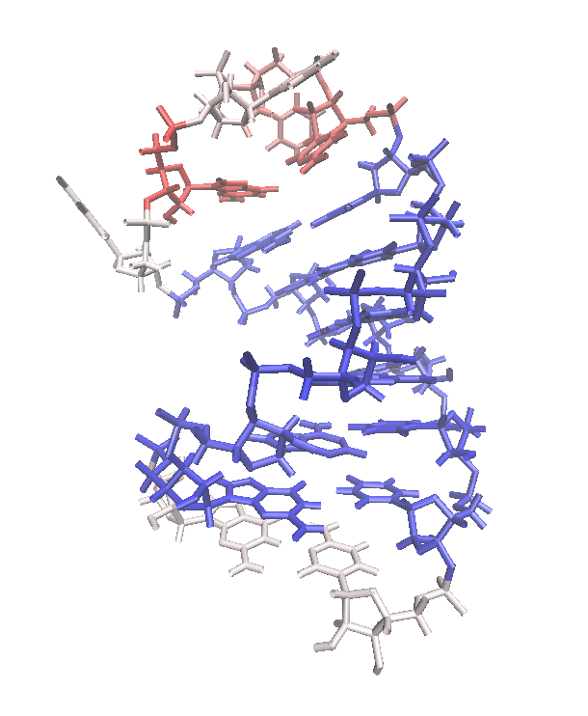
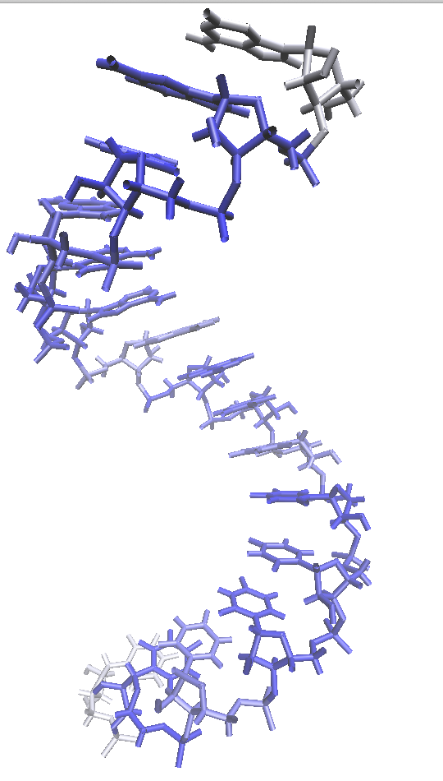
2B7G: NMR
3ND3: X-RAY 1.37 Å

Slide 4
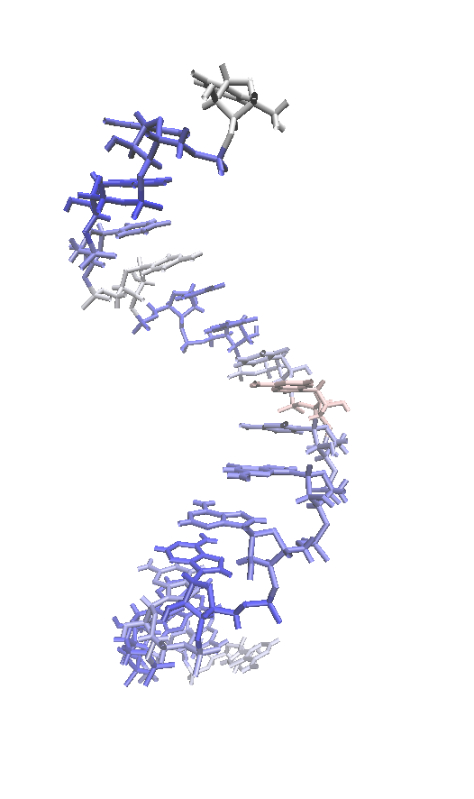
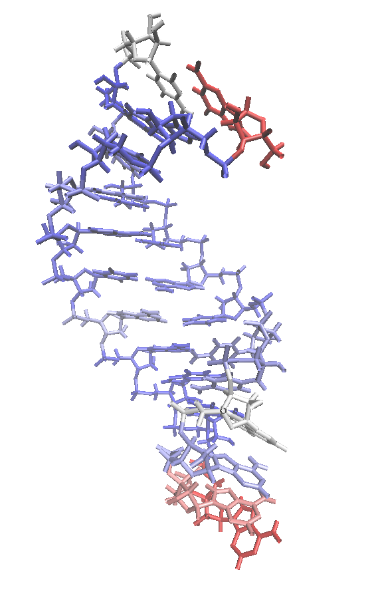
5NXT: X-RAY 1.379 Å
5UF3: NMR

Slide 5
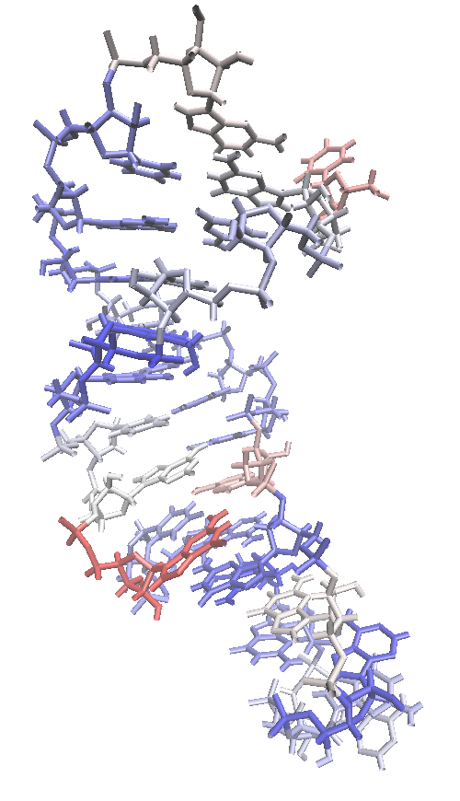
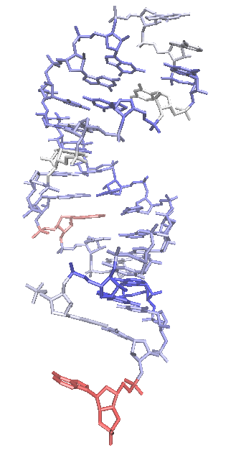
5NQI: X-RAY 0.851 Å
1JID: X-RAY 1.80 Å

Slide 6
ANALYSIS OF PDBs BAD SCORED BY PDB BACKBONE
SCORING

Slide 7
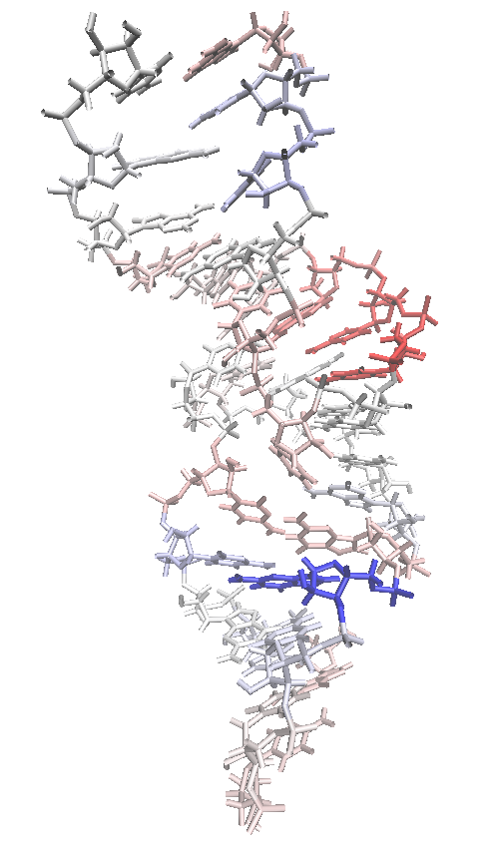
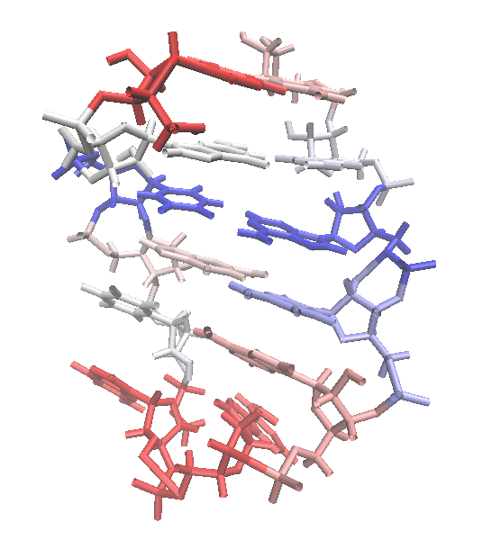
1KIS: NMR
1AFX:NMR

Slide 8
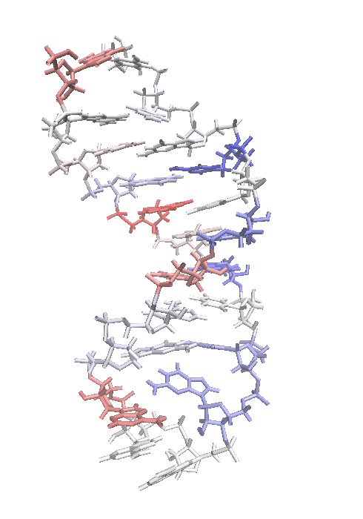
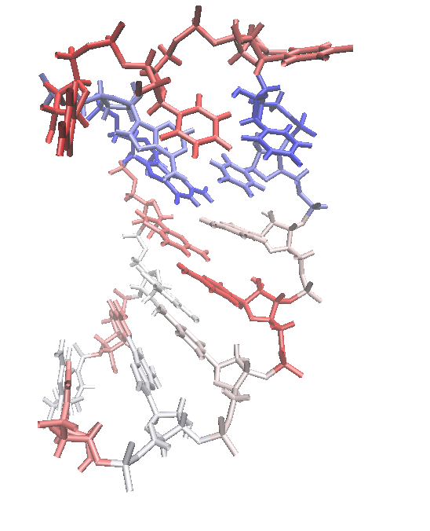
1F9L: NMR
1JWC: NMR

Slide 9
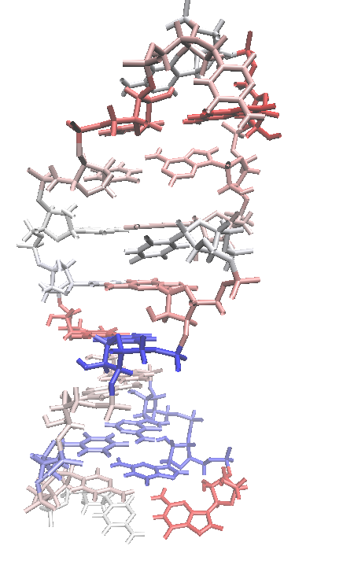
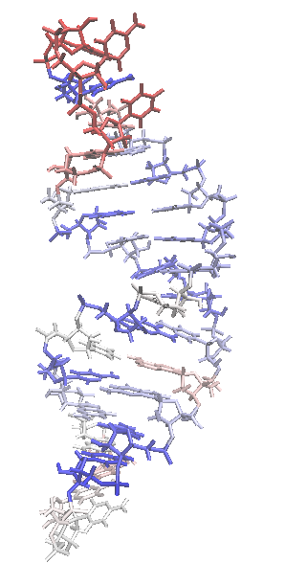
1NA2: NMR
1QWA: NMR

Slide 10
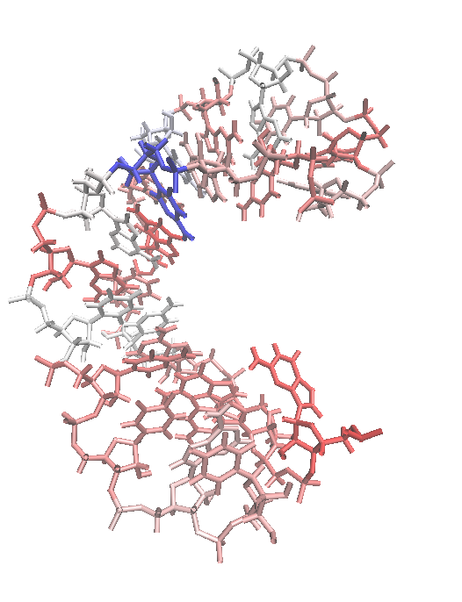
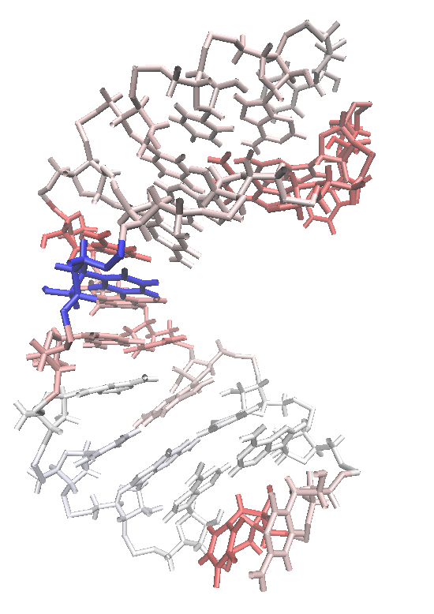
1RHT: NMR
1TFN: NMR

Slide 11
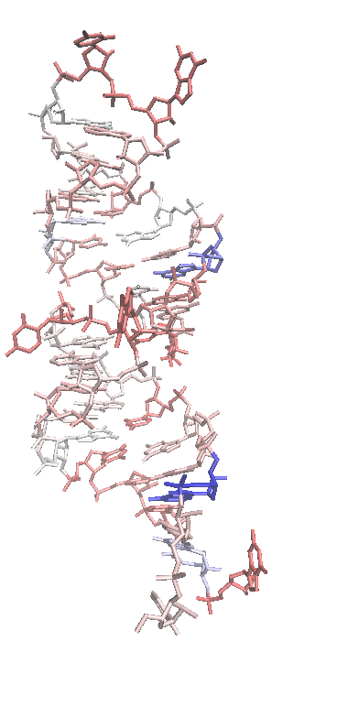
361D: NMR

