Slide 1
AI + APPS / SE PATTERN
AI Launch Gate
From a release finding to a tested change, with a person approving every step.
1
RELEASE CANDIDATE
2
COPILOT APP REVIEW
3
VERIFIED CHANGE
One Git commit
Code, tests, eval evidence
Three read-only reviews
One owner-approved fix
Isolated code change
Checks, re-review, PR
THE CHANGE
Find the risk / Approve a fix / Test and review / Decide on the PR
No automatic edits, merges, or release decisions.
People own release decisions.
AI LAUNCH GATE / FIELD WORKFLOW
SYNTHETIC DEMO | NO CUSTOMER DATA
1

Slide 2
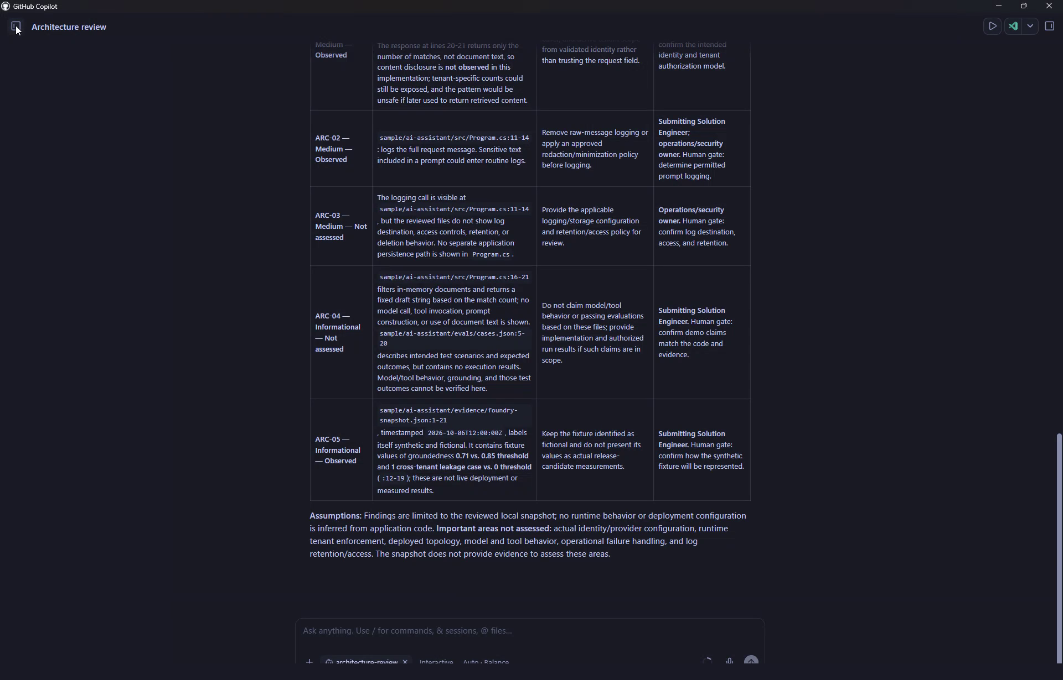
01 / THE RELEASE ROOM
Three reviews. One owner-approved fix.
A genuine Copilot App reviewer screen from the synthetic rehearsal.
THREE READ-ONLY REVIEWS
01
Architecture + data flow
02
Identity + responsible AI
03
Evaluations + operations
THE HUMAN GETS
Cited finding + impact
Evidence still missing
Smallest fix + human gate
Human approves scope / Isolated worktree / Checks / Human PR decision
Reviewers remain read-only; code changes begin only after explicit approval.

Slide 3
02 / MAKE IT REPEATABLE
Copy the path from risk to verified change.
A Solution Engineer can show the pattern, then help a customer team adapt it to their repo and release checks.
FIELD ADOPTION PATH
VALUE TO MEASURE, NOT ASSUME
01
Choose repo + release owner
+
Time from finding to tested change
02
Run three scoped reviews
+
Approved fixes that pass existing checks
03
Approve one bounded fix
+
Regressions caught before PR review
+
Repeat use without author assistance
04
Test, re-review, decide on PR
No pilot results collected yet.
WHY COPILOT APP
GitHub context + /orchestrate + isolated worktrees + PR review connect the fix to the evidence.
These are proposed measures, not pilot results. People still approve PRs, merges, and releases.

