Slide 1

Deep Learning
for Time Series

Slide 2
Section Overview
In this section of the course we will focus on learning about Neural Networks and how they can be used for Time Series Forecasting.
Let’s explore what topics this section will cover!

Slide 3
Section Overview
Perceptron Model
Neural Networks
Keras Basics for Regression Task
Recurrent Neural Networks
LSTM and GRU Neurons
Time Series Forecasting with RNN

Slide 4
Section Overview
Keep in mind Neural Networks in general tend to be “black boxes” so it’s very difficult to interpret them beyond their performance metrics.
ARIMA based models are much easier to understand and work with (and often perform better!)

Slide 5
Let’s get started!

Slide 6
Perceptron Model

Slide 7
Perceptron model
To begin understanding deep learning, we will build up our model abstractions:
Single Biological Neuron
Perceptron
Multi-layer Perceptron Model
Deep Learning Neural Network

Slide 8
Perceptron model
As we learn about more complex models, we’ll also introduce concepts, such as:
Activation Functions
Gradient Descent
BackPropagation

Slide 9
Perceptron model
If the whole idea behind deep learning is to have computers artificially mimic biological natural intelligence, we should probably build a general understanding of how biological neurons work!

Slide 10
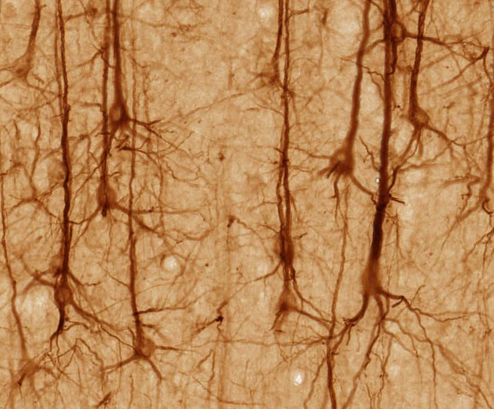
Perceptron model
Stained Neurons in cerebral cortex

Slide 11
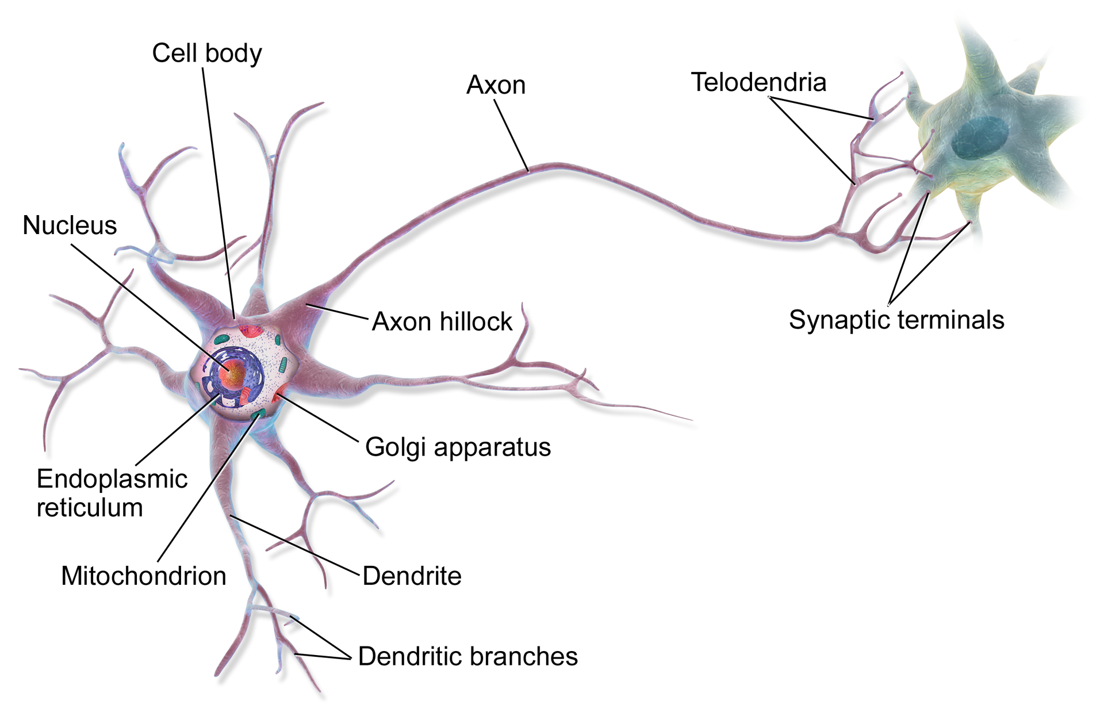
Perceptron model
Illustration of biological neurons

Slide 12
Perceptron model
Illustration of biological neurons

Slide 13
Perceptron model
Let’s really simplify this!

Slide 14
Perceptron model
Dendrites
Axon
Nucleus
Simplified Biological Neuron Model

Slide 15
Perceptron model
A perceptron was a form of neural network introduced in 1958 by Frank Rosenblatt.
Amazingly, even back then he saw huge potential:
"...perceptron may eventually be able to learn, make decisions, and translate languages."

Slide 16
Perceptron model
However, in 1969 Marvin Minsky and Seymour Papert's published their book Perceptrons.
It suggested that there were severe limitations to what perceptrons could do.
This marked the beginning of what is known as the AI Winter, with little funding into AI and Neural Networks in the 1970s.

Slide 17
Perceptron model
Fortunately for us, we now know the amazing power of neural networks, which all stem from the simple perceptron model, so let’s head back and convert our simple biological neuron model into the perceptron model.

Slide 18
Perceptron model
Dendrites
Axon
Nucleus
Perceptron Model

Slide 19
Perceptron model
Inputs
Output
Perceptron Model

Slide 20
Perceptron model
x1
Inputs
Output
x2
Let’s work through a simple example

Slide 21
Perceptron model
x1
Inputs
f(X)
Output
x2
Let’s work through a simple example

Slide 22
Perceptron model
x1
y
Inputs
f(X)
Output
x2
Let’s work through a simple example

Slide 23
Perceptron model
x1
y
Inputs
f(X)
Output
x2
If f(X) is just a sum, then y=x1+x2

Slide 24
Perceptron model
x1
y
Inputs
f(X)
Output
x2
Realistically, we would want to be able to adjust some parameter in order to “learn”

Slide 25
Perceptron model
w1
x1
y
Inputs
f(X)
Output
w2
x2
Let’s add an adjustable weight we multiply against x

Slide 26
Perceptron model
w1
x1
y
Inputs
f(X)
Output
w2
x2
Now y = x1w1 + x2w2

Slide 27
Perceptron model
w1
x1
y
Inputs
f(X)
Output
w2
x2
We could update the weights to effect y

Slide 28
Perceptron model
w1
x1
y
Inputs
f(X)
Output
w2
x2
But what if an x is zero? w won’t change anything!

Slide 29
Perceptron model
w1
x1
y
Inputs
f(X)
Output
w2
x2
Let’s add in a bias term b to the inputs.

Slide 30
Perceptron model
*w1 + b
x1
y
Inputs
f(X)
Output
x2
*w2 + b
Let’s add in a bias term b to the inputs.

Slide 31
Perceptron model
*w1 + b
x1
y
Inputs
f(X)
Output
x2
*w2 + b
y = (x1w1 + b) + (x2w2 + b)

Slide 32
Perceptron model
x1
*w1 + b
y
Inputs
f(X)
Output
x2
*w2 + b
xn
*wn + b
We can expand this to a generalization:

Slide 33
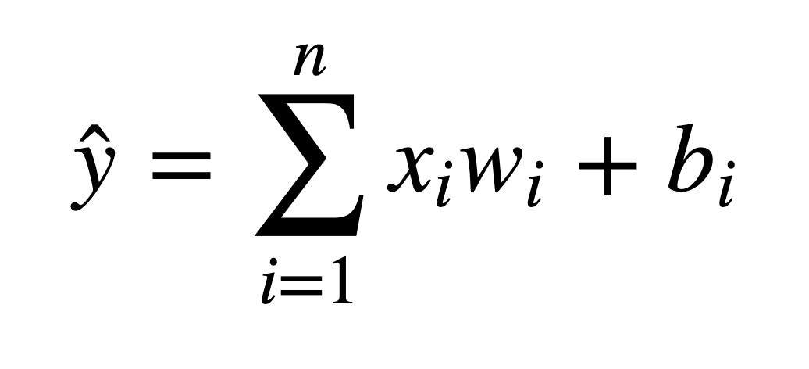
Perceptron model
We’ve been able to model a biological neuron as a simple perceptron! Mathematically our generalization was:

Slide 34
Perceptron model
Later on we will see how we can expand this model to have X be a tensor of information ( an n-dimensional matrix).

Slide 35
Perceptron model
Let’s review what we learned:
We understand the very basics of a biological neuron
We saw how we can create a simple perceptron model replicating the core concepts behind a neuron.

Slide 36
Neural Networks

Slide 37
Neural Networks
A single perceptron won’t be enough to learn complicated systems.
Fortunately, we can expand on the idea of a single perceptron, to create a multi-layer perceptron model.

Slide 38
Neural Networks
A single perceptron won’t be enough to learn complicated systems.
Fortunately, we can expand on the idea of a single perceptron, to create a multi-layer perceptron model.
We’ll also introduce the idea of activation functions.

Slide 39
Neural Networks
To build a network of perceptrons, we can connect layers of perceptrons, using a multi-layer perceptron model.

Slide 40
Neural Networks
The outputs of one perceptron are directly fed into as inputs to another perceptron.

Slide 41
Neural Networks
This allows the network as a whole to learn about interactions and relationships between features.

Slide 42
Neural Networks
The first layer is the input layer

Slide 43
Neural Networks
The last layer is the output layer.
Note: This last layer can be more than one neuron

Slide 44
Neural Networks
Layers in between the input and output layers are the hidden layers.

Slide 45
Neural Networks
Hidden layers are difficult to interpret, due to their high interconnectivity and distance away from known input or output values.

Slide 46
Neural Networks
Neural Networks become “deep neural networks” if then contain 2 or more hidden layers.

Slide 47
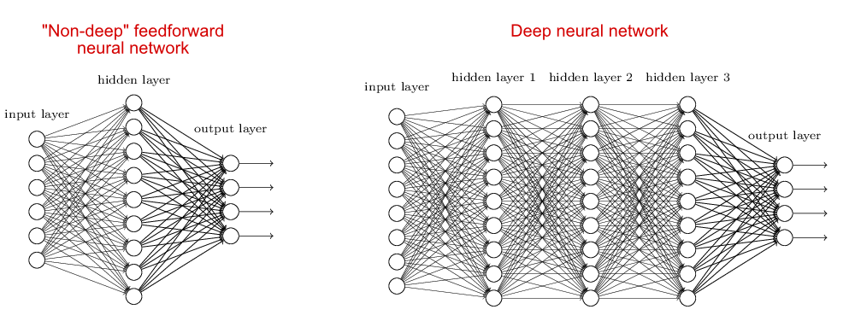
Neural Networks
Neural Networks become “deep neural networks” if then contain 2 or more hidden layers.

Slide 48
Neural Networks
Terminology:
Input Layer: First layer that directly accepts real data values
Hidden Layer: Any layer between input and output layers
Output Layer: The final estimate of the output.

Slide 49
Neural Networks
What is incredible about the neural network framework is that it can be used to approximate any function.
Zhou Lu and later on Boris Hanin proved mathematically that Neural Networks can approximate any convex continuous function.

Slide 50
Neural Networks
For more details on this check out the Wikipedia page for “Universal Approximation Theorem”

Slide 51
Neural Networks
Previously in our simple model we saw that the perceptron itself contained a very simple summation function f(x).
For most use cases however that won’t be useful, we’ll want to be able to set constraints to our output values, especially in classification tasks.

Slide 52
Neural Networks
In a classification tasks, it would be useful to have all outputs fall between 0 and 1.
These values can then present probability assignments for each class.
In the next lecture, we’ll explore how to use activation functions to set boundaries to output values from the neuron.

Slide 53
Activation Functions

Slide 54
Neural Networks
Recall that inputs x have a weight w and a bias term b attached to them in the perceptron model.
Which means we have
x*w + b

Slide 55
Neural Networks
Which means we have
x*w + b
Clearly w implies how much weight or strength to give the incoming input.
We can think of b as an offset value, making x*w have to reach a certain threshold before having an effect.

Slide 56
Neural Networks
For example if b= -10
x*w + b
Then the effects of x*w won’t really start to overcome the bias until their product surpasses 10.
After that, then the effect is solely based on the value of w.
Thus the term “bias”

Slide 57
Neural Networks
Next we want to set boundaries for the overall output value of:
x*w + b
We can state:
z = x*w + b
And then pass z through some activation function to limit its value.

Slide 58
Neural Networks
A lot of research has been done into activation functions and their effectiveness.
Let’s explore some common activation functions.

Slide 59
Perceptron model
w1
x1
y
Inputs
f(X)
Output
w2
+b
x2
Recall our simple perceptron has an f(X)

Slide 60
Perceptron model
w1
x1
y
Inputs
f(X)
Output
w2
+b
x2
If we had a binary classification problem, we would want an output of either 0 or 1.

Slide 61
Neural Networks
To avoid confusion, let’s define the total inputs as a variable z.
Where z = wx + b
In this context, we’ll then refer to activation functions as f(z).
Keep in mind, you will often see these variables capitalized f(Z) or X to denote a tensor input consisting of multiple values.

Slide 62
Deep Learning
The most simple networks rely on a basic step function that outputs 0 or 1.
1
Output
0
0
z = wx + b

Slide 63
Deep Learning
Regardless of the values, this always outputs 0 or 1.
1
Output
0
0
z = wx + b

Slide 64
Deep Learning
This sort of function could be useful for classification (0 or 1 class).
1
Output
0
0
z = wx + b

Slide 65
Deep Learning
However this is a very “strong” function, since small changes aren’t reflected.
1
Output
0
0
z = wx + b

Slide 66
Deep Learning
There is just an immediate cut off that splits between 0 and 1.
1
Output
0
0
z = wx + b

Slide 67
Deep Learning
It would be nice if we could have a more dynamic function, for example the red line!
1
Output
0
0
z = wx + b

Slide 68
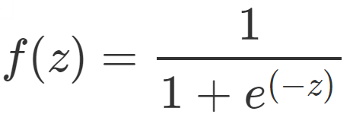
Deep Learning
Lucky for us, this is the sigmoid function!
1
Output
0
0
z = wx + b

Slide 69
Deep Learning
Changing the activation function used can be beneficial depending on the task!
1
Output
0
0
z = wx + b

Slide 70
Deep Learning
This still works for classification, and will be more sensitive to small changes.
1
Output
0
0
z = wx + b

Slide 71
Deep Learning
Let’s discuss a few more activation functions that we’ll encounter!
1
Output
0
0
z = wx + b

Slide 72
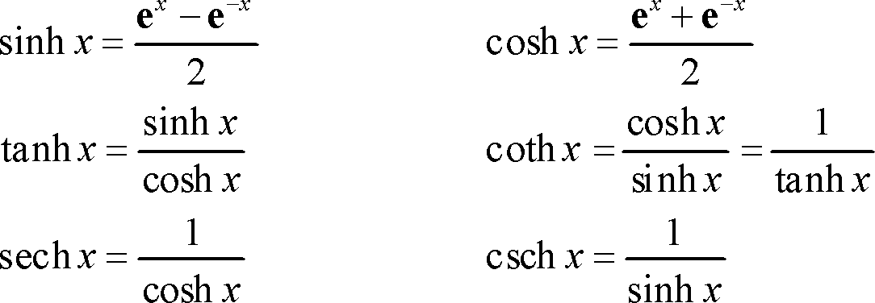
Deep Learning
Hyperbolic Tangent: tanh(z)
1
Output
-1
0

Slide 73
Deep Learning
Hyperbolic Tangent: tanh(z)
Outputs between -1 and 1 instead of 0 to 1
1
Output
-1
0

Slide 74
Deep Learning
Rectified Linear Unit (ReLU): This is actually a relatively simple function: max(0,z)
Output
0
z = wx + b

Slide 75
Deep Learning
ReLu has been found to have very good performance, especially when dealing with the issue of vanishing gradient.
We’ll often default to ReLu due to its overall good performance.

Slide 76
Deep Learning
For a full list of possible activation functions check out:
en.wikipedia.org/wiki/Activation_function

Slide 77
Cost Functions and Gradient Descent

Slide 78
Deep Learning
We now understand that neural networks take in inputs, multiply them by weights, and add biases to them.
Then this result is passed through an activation function which at the end of all the layers leads to some output.

Slide 79
Deep Learning
This output ŷ is the model’s estimation of what it predicts the label to be.
So after the network creates its prediction, how do we evaluate it?
And after the evaluation how can we update the network’s weights and biases?

Slide 80
Deep Learning
We need to take the estimated outputs of the network and then compare them to the real values of the label.
Keep in mind this is using the training data set during the fitting/training of the model.

Slide 81
Deep Learning
The cost function (often referred to as a loss function) must be an average so it can output a single value.
We can keep track of our loss/cost during training to monitor network performance.

Slide 82
Deep Learning
We’ll use the following variables:
y to represent the true value
a to represent neuron’s prediction
In terms of weights and bias:
w*x + b = z
Pass z into activation function σ(z) = a

Slide 83
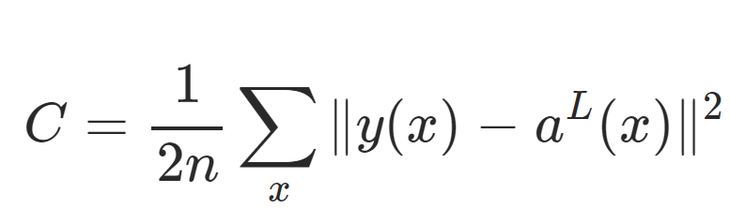
Deep Learning
One very common cost function is the quadratic cost function:

Slide 84
Deep Learning
We simply calculate the difference between the real values y(x) against our predicted values a(x).

Slide 85
Deep Learning
Note: The notation shown here corresponds to vector inputs and outputs, since we will be dealing with a batch of training points and predictions.

Slide 86
Deep Learning
Notice how squaring this does 2 useful things for us, keeps everything positive and punishes large errors!

Slide 87
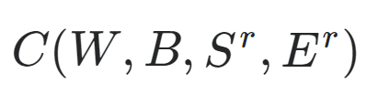
Deep Learning
We can think of the cost function as:

Slide 88
Deep Learning
W is our neural network's weights, B is our neural network's biases, S^{r} is the input of a single training sample, and E^{r} is the desired output of that training sample.

Slide 89
Deep Learning
Notice how that information was all encoded in our simplified notation.
The a(x) holds information about weights and biases.

Slide 90
Deep Learning
This means that if we have a huge network, we can expect C to be quite complex, with huge vectors of weights and biases.

Slide 91
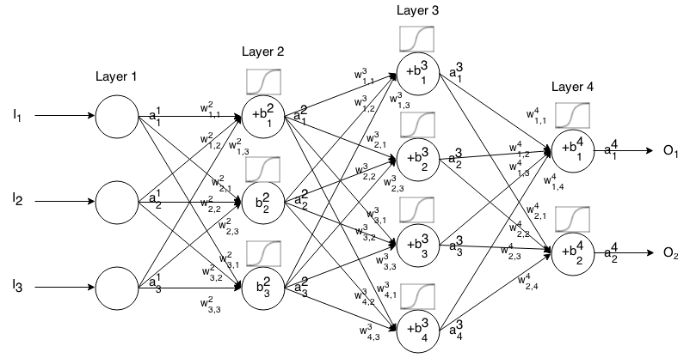
Deep Learning
Here is a small network with all its parameters labeled:

Slide 92
Deep Learning
That is a lot to calculate!
How do we solve this?

Slide 93
Deep Learning
In a real case, this means we have some cost function C dependent lots of weights!
C(w1,w2,w3,....wn)
How do we figure out which weights lead us to the lowest cost?

Slide 94
Deep Learning
For simplicity, let’s imagine we only had one weight in our cost function w.
We want to minimize our loss/cost (overall error).
Which means we need to figure out what value of w results in the minimum of C(w)

Slide 95
Deep Learning
Our “simple” function C(w)
C(w)
w

Slide 96
Deep Learning
What value of w minimizes our cost?
C(w)
w

Slide 97
Deep Learning
What value of w minimizes our cost?
C(w)
w

Slide 98
Deep Learning
What value of w minimizes our cost?
C(w)
w
wmin

Slide 99
Deep Learning
Students of calculus know we could take a derivative and solve for 0.
C(w)
w
wmin

Slide 100
Deep Learning
But recall our real cost function will be very complex!
C(w)
w

Slide 101
Deep Learning
And it will be n-dimensional!
C(w)
w

Slide 102
Deep Learning
And it will be n-dimensional since our networks will have 1000s of weights
C(w)
w

Slide 103
Deep Learning
We can use gradient descent to solve this problem.
C(w)
w

Slide 104
Deep Learning
Let’s go back to our simplified version to see how this works.
C(w)
w
wmin

Slide 105
Deep Learning
We can calculate the slope at a point
C(w)
w
wmin

Slide 106
Deep Learning
We can calculate the slope at a point
C(w)
w
wmin

Slide 107
Deep Learning
Then we move in the downward direction of the slope.
C(w)
w
wmin

Slide 108
Deep Learning
Then we move in the downward direction of the slope.
C(w)
w
wmin

Slide 109
Deep Learning
Then we move in the downward direction of the slope.
C(w)
w
wmin

Slide 110
Deep Learning
Until we converge to zero, indicating a minimum.
C(w)
w
wmin

Slide 111
Deep Learning
We could have changed our step size to find the next point!
C(w)
w
wmin

Slide 112
Deep Learning
Our steps:
C(w)
w
wmin

Slide 113
Deep Learning
Smaller steps sizes take longer to find the minimum.
C(w)
w
wmin

Slide 114
Deep Learning
Larger steps are faster, but we risk overshooting the minimum!
C(w)
w
wmin

Slide 115
Deep Learning
This step size is known as the learning rate.
C(w)
w
wmin

Slide 116
Deep Learning
The learning rate we showed in our illustrations was constant (each step size was equal)
But we can be clever and adapt our step size as we go along.

Slide 117
Deep Learning
We could start with larger steps, then go smaller as we realize the slope gets closer to zero.
This is known as adaptive gradient descent.

Slide 118
Deep Learning
In 2015, Kingma and Ba published their paper: “Adam: A Method for Stochastic Optimization“.
Adam is a much more efficient way of searching for these minimums, so you will see us use it for our code!

Slide 119
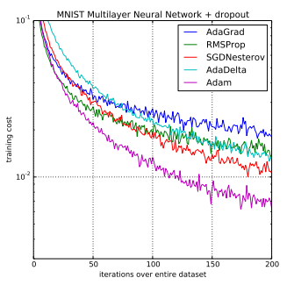
Deep Learning
Adam versus other gradient descent algorithms:

Slide 120
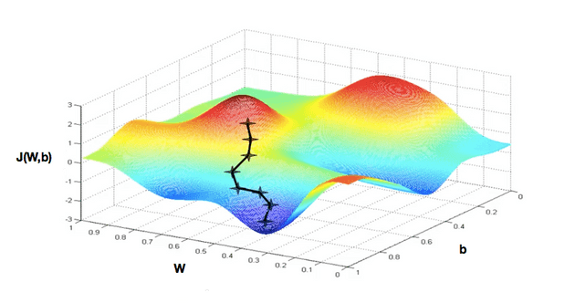
Deep Learning
Realistically we’re calculating this descent in an n-dimensional space for all our weights.

Slide 121
Deep Learning
When dealing with these N-dimensional vectors (tensors), the notation changes from derivative to gradient.
This means we calculate ∇C(w1,w2,...wn)

Slide 122
Deep Learning
For classification problems, we often use the cross entropy loss function.
The assumption is that your model predicts a probability distribution p(y=i) for each class i=1,2,…,C.

Slide 123

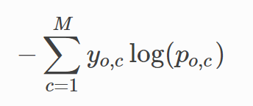
Deep Learning
For a binary classification this results in:
For M number of classes > 2

Slide 124
Deep Learning
Review:
Cost Functions
Gradient Descent
Adam Optimizer
Quadratic Cost and Cross-Entropy

Slide 125
Deep Learning
So far we understand how networks can take in input , effect that input with weights, biases, and activation functions to produce an estimated output.
Then we learned how to evaluate that output.

Slide 126
Deep Learning
The last thing we need to learn about theory is:
Once we get our cost/loss value, how do we actually go back and adjust our weights and biases?
This is backpropagation, and it is what we are going to cover next!

Slide 127
Backpropagation

Slide 128
Deep Learning
The last theory topic we will cover is backpropagation.
We’ll start by building an intuition behind backpropagation, and then we’ll dive into the calculus and notation of backpropagation.

Slide 129
Deep Learning
Fundamentally, we want to know how the cost function results changes with respect to the weights in the network, so we can update the weights to minimize the cost function

Slide 130
Deep Learning
Let’s begin with a very simple network, where each layer only has 1 neuron

Slide 131
Deep Learning
Each input will receive a weight and bias
w1 +b1
w2 +b2
w3 +b3

Slide 132
Deep Learning
This means we have:
C(w1,b1,w2,b2,w3,b3)
w1 +b1
w2 +b2
w3 +b3

Slide 133
Deep Learning
We’ve already seen how this process propagates forward.
Let’s start at the end to see the backpropagation.
w1 +b1
w2 +b2
w3 +b3

Slide 134
Deep Learning
Let’s say we have L layers, then our notation becomes:
L-n
L-2
L-1
L

Slide 135
Deep Learning
Focusing on these last two layers, let’s define z=wx+b
Then applying an activation function we’ll state: a = σ(z)
L-1
L

Slide 136
Deep Learning
This means we have:
z^{L} = w^{L} a^{L-1} +b^{L}
L-1
L

Slide 137
Deep Learning
This means we have:
z^{L} = w^{L} a^{L-1} +b^{L}
a^{L} = σ(z^{L})
L-1
L

Slide 138
Deep Learning
This means we have:
z^{L} = w^{L} a^{L-1} +b^{L}
a^{L} = σ(z^{L})
C₀(...) =(a^{L} - y)²
L-1
L

Slide 139
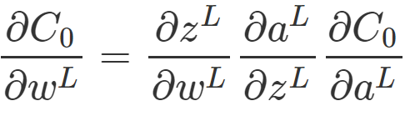
Deep Learning
We want to understand how sensitive is the cost function to changes in w:
L-1
L

Slide 140
Deep Learning
Using the relationships we already know along with the chain rule:
L-1
L

Slide 141
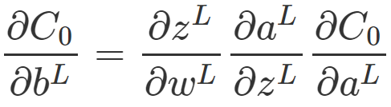

Deep Learning
We can calculate the same for the bias terms:
L-1
L

Slide 142
Deep Learning
The main idea here is that we can use the gradient to go back through the network and adjust our weights and biases to minimize the output of the error vector on the last output layer.

Slide 143
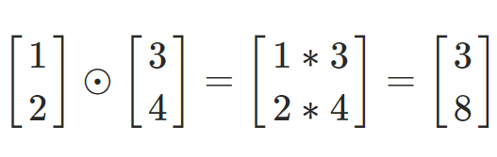
Deep Learning
Using some calculus notation, we can expand this idea to networks with multiple neurons per layer.
Hadamard Product

Slide 144
Deep Learning
Given this notation and backpropagation, we have a few main steps to training neural networks.
Note! You do not need to fully understand these intricate details to continue with the coding portions.

Slide 145
Deep Learning
Step 1: Using input x set the activation function a for the input layer.
z = w x +b
a = σ(z)
This resulting a then feeds into the next layer (and so on).

Slide 146
Deep Learning
Step 2: For each layer, compute:
z^{L} = w^{L} a^{L-1} +b^{L}
a^{L} = σ(z^{L})

Slide 147
Deep Learning
Step 3: We compute our error vector:
δ^{L}=∇_{a}C⊙σ′(z^{L})

Slide 148
Deep Learning
Step 3: We compute our error vector:
δ^{L}=∇_{a}C⊙σ′(z^{L})
∇_{a}C=(a^{L}−y)
Expressing the rate of change of C with respect to the output activations

Slide 149
Deep Learning
Step 3: We compute our error vector:
δ^{L}=(a^{L}−y)⊙σ′(z^{L})

Slide 150
Deep Learning
Step 3: We compute our error vector:
δ^{L}=(a^{L}−y)⊙σ′(z^{L})
Now let’s write out our error term for a layer in terms of the error of the next layer (since we’re moving backwards).
Font Note: lowercase L
Font Note: Number 1

Slide 151
Deep Learning
Step 4: Backpropagate the error:
For each layer: L−1,L−2,… we compute (note the lowercase L (l)):
δ^{l}=(w^{l+1})^{T}δ^{l+1}⊙σ′(z^{l})
(w^{l+1})^{T} is the transpose of the weight matrix of l+1 layer

Slide 152
Deep Learning
Step 4: Backpropagate the error:
This is the generalized error for any layer l:
δ^{l}=(w^{l+1})^{T}δ^{l+1}⊙σ′(z^{l})
(w^{l+1})^{T} is the transpose of the weight matrix of L+1 layer

Slide 153
Deep Learning
Step 4: When we apply the transpose weight matrix, (w^{l+1})^{T} we can think intuitively of this as moving the error backward through the network, giving us some sort of measure of the error at the output of the lth layer.

Slide 154
Deep Learning
Step 4: We then take the Hadamard product ⊙σ′(z^{l}). This moves the error backward through the activation function in layer l, giving us the error δ^{l} in the weighted input to layer l.

Slide 155
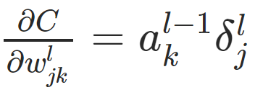
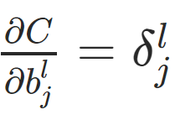
Deep Learning
The gradient of the cost function is given by:
For each layer: L−1,L−2,… we compute

Slide 156
Deep Learning
This then allows us to adjust the weights and biases to help minimize that cost function.
Check out the external links for more details!

Slide 157
Keras Basics

Slide 158
Section Overview
Let’s learn the basics of Keras and building a Neural Network.
To create an NN model with Keras, we first define the Sequential model object, then add layers to it.

Slide 159
Section Overview
Afterwards we fit the model to the training data for a chosen number of epochs.
An epoch is one full pass through all the training data. Typically the training data is split into batches, instead of being passed all at once to the Network.

Slide 160
Recurrent Neural Networks Theory

Slide 161
Deep Learning
Examples of Sequences
Time Series Data (Sales)
Sentences
Audio
Car Trajectories
Music

Slide 162
Deep Learning
Let’s imagine a sequence:
[1,2,3,4,5,6]
Would you be able to predict a similar sequence shifted one time step into the future?
[2,3,4,5,6,7]

Slide 163
Deep Learning
To do this properly, we need to somehow let the neuron “know” about its previous history of outputs.
One easy way to do this is to simply feed its output back into itself as an input!

Slide 164
Deep Learning
Normal Neuron in Feed Forward Network
Output
Activation Function
Σ
Aggregation of Inputs
Input

Slide 165
Deep Learning
Recurrent Neuron
Sends output back to itself!
Let’s see what this looks like over time!
Output
Σ
Input

Slide 166
Deep Learning
Recurrent Neuron
Output at t-1
Output
=
Σ
Σ
Input
Input
at t-1

Slide 167
Deep Learning
Recurrent Neuron
Output at t-1
Output
=
Σ
Σ
Input
Input
at t-1
Time

Slide 168
Deep Learning
Recurrent Neuron
Output at t-1
Output at t
Output
=
Σ
Σ
Σ
Input
Input
at t-1
Input at t
Time

Slide 169
Deep Learning
Recurrent Neuron
Output at t-1
Output at t
Output at t+1
Output
=
Σ
Σ
Σ
Σ
Input
Input
at t-1
Input at t
Input at t+1
Time

Slide 170
Deep Learning
Cells that are a function of inputs from previous time steps are also known as memory cells.
RNN are also flexible in their inputs and outputs, for both sequences and single vector values.

Slide 171
Deep Learning
We can also create entire layers of Recurrent Neurons...

Slide 172
Deep Learning
ANN Layer with 3 Neurons:
X
y

Slide 173
Deep Learning
RNN Layer with 3 Neurons:
X
y

Slide 174
Deep Learning
“Unrolled” layer.
Output at t=0
Output at t+1
Output at t+2
Input
at t=0
Input at t+1
Input at t+2
Time

Slide 175
Deep Learning
RNN are also very flexible in their inputs and outputs.
Let’s see a few examples.

Slide 176
Deep Learning
Sequence to Sequence (Many to Many)
Y₀
Y₁
Y₂
Y₃
Y₄
X₀
X₁
X₂
X₃
X₄

Slide 177
Deep Learning
Given 5 previous words, predict the next 5
Y₀
Y₁
Y₂
Y₃
Y₄
X₀
X₁
X₂
X₃
X₄

Slide 178
Deep Learning
Sequence to Vector (Many to One)
Y₀
Y₁
Y₂
Y₃
Y₄
X₀
X₁
X₂
X₃
X₄

Slide 179
Deep Learning
Given 5 previous words, predict next word
Y₀
Y₁
Y₂
Y₃
Y₄
X₀
X₁
X₂
X₃
X₄

Slide 180
Deep Learning
Vector to Sequence (One to Many)
Y₀
Y₁
Y₂
Y₃
Y₄
X₀
0
0
0
0

Slide 181
Deep Learning
Given 1 word predict the next 5 words
Y₀
Y₁
Y₂
Y₃
Y₄
X₀
0
0
0
0

Slide 182
Deep Learning
A basic RNN has a major disadvantage, we only really “remember” the previous output.
It would be great it we could keep track of longer history, not just short term history.

Slide 183
Deep Learning
Another issue that arises during training is the “vanishing gradient”.
Let’s explore vanishing gradients in more detail before moving on to discussing LSTM (Long Short Term Memory Units).

Slide 184
Exploding and Vanishing Gradients

Slide 185
Deep Learning
As our networks grow deeper and more complex, we have 2 issues arise:
Exploding Gradients
Vanishing Gradients
Recall that the gradient is used in our calculation to adjust weights and biases in our network.

Slide 186
Deep Learning
Let’s think about a network.
Hidden Layers

Slide 187
Deep Learning
For complex data we need deep networks
Hidden Layers

Slide 188
Deep Learning
Issues can arise during backpropagation
Hidden Layers

Slide 189
Deep Learning
Backpropagation goes backwards from the output to the input layer, propagating the error gradient.
For deeper networks issues can arise from backpropagation, vanishing and exploding gradients!

Slide 190
Deep Learning
As you go back to the “lower” layers, gradients often get smaller, eventually causing weights to never change at lower levels.
The opposite can also occur, gradients explode on the way back, causing issues.

Slide 191
Deep Learning
Let’s discuss why this might occur and how we can fix it.
Then in the next lecture we’ll discuss how these issues specifically affect RNN and how to use LSTM and GRU to fix them.

Slide 192
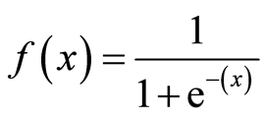
Deep Learning
Why does this happen?
1
Output
0
0
z = wx + b

Slide 193
Deep Learning
Why does this happen?
1
Output
0
0
z = wx + b

Slide 194
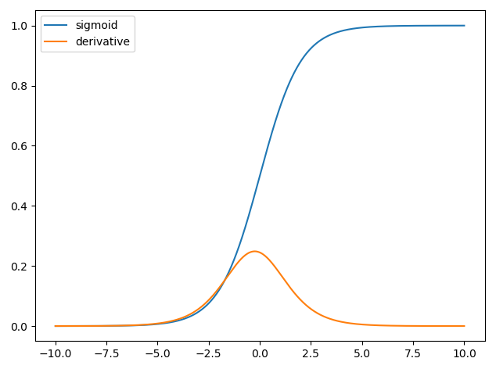
Deep Learning
The derivative can be much smaller!

Slide 195
Deep Learning
When n hidden layers use an activation like the sigmoid function, n small derivatives are multiplied together.
The gradient could decrease exponentially as we propagate down to the initial layers.

Slide 196
Deep Learning
Using Different Activation Functions
Output
0
z = wx + b

Slide 197
Deep Learning
The ReLu doesn’t saturate positive values.
Output
0
z = wx + b

Slide 198
Deep Learning
“Leaky” ReLU
Output
0
z = wx + b

Slide 199
Deep Learning
Exponential Linear Unit (ELU)
1
Output
0
-1
0
z = wx + b

Slide 200
Deep Learning
Another solution is to perform batch normalization, where your model will normalize each batch using the batch mean and standard deviation.

Slide 201
Deep Learning
Choosing different initialization of weights can also help alleviate these issues (Xavier Initialization).

Slide 202
Deep Learning
Apart from batch normalization, researchers have also used “gradient clipping”, where gradients are cut off before reaching a predetermined limit (e.g. cut off gradients to be between -1 and 1)

Slide 203
Deep Learning
RNN for Time Series present their own gradient challenges, let’s explore special LSTM (Long Short Term Memory) neuron units that help fix these issues!

Slide 204
LSTM and GRU Units

Slide 205
Deep Learning
Many of the solutions previously presented for vanishing gradients can also apply to RNN: different activation functions, batch normalizations, etc…
However because of the length of time series input, these could slow down training

Slide 206
Deep Learning
A possible solution would be to just shorten the time steps used for prediction, but this makes the model worse at predicting longer trends.

Slide 207
Deep Learning
Another issue RNN face is that after awhile the network will begin to “forget” the first inputs, as information is lost at each step going through the RNN.
We need some sort of “long-term memory” for our networks.

Slide 208
Deep Learning
The LSTM (Long Short-Term Memory) cell was created to help address these RNN issues.
Let’s go through how an LSTM cell works!

Slide 209
Deep Learning
A typical RNN
Output at t-1
Output at t
Output at t+1
Input
at t-1
Input at t
Input at t+1

Slide 210
Deep Learning
RNN
Output at t
Input at t

Slide 211
Deep Learning
RNN
Output t-1
Output t
Input t

Slide 212
Deep Learning
RNN
H_{t-1}
H_{t}
X_{t}

Slide 213
Deep Learning
RNN
H_{t-1}
H_{t}=tanh(W[H_{t-1},X_{t}]+b)
H_{t}
X_{t}

Slide 214
Deep Learning
LSTM

Slide 215
Deep Learning
LSTM
Output at time t
Long Term Memory
New Long Term Memory
Short Term Memory
New Short Term Memory
Input at time t

Slide 216
Deep Learning
LSTM
Output at time t
Long Term Memory
New Long Term Memory
Forget Gate
Output Gate
Input
Gate
Update Gate
Short Term Memory
New Short Term Memory
Input at time t

Slide 217
Deep Learning
Gates optionally let information through
σ
X
1
0

Slide 218
Deep Learning
LSTM
Output at time t
Long Term Memory
New Long Term Memory
Short Term Memory
New Short Term Memory
Input at time t

Slide 219
Deep Learning
LSTM
h_{t}
C_{t-1}
C_{t}
h_{t-1}
h_{t}
x_{t}

Slide 220
An LSTM Cell
Output at t
Here we can see the entire LSTM cell.
Let’s go through the process!
X
+
tanh
X
X
σ
σ
tanh
σ
Input at t
http://colah.github.io/posts/2015-08-Understanding-LSTMs/

Slide 221
An LSTM Cell
h_{t}
Here we can see the entire LSTM cell.
Let’s go through the process!
C_{t-1}
C_{t}
X
+
tanh
X
X
σ
σ
tanh
σ
h_{t-1}
h_{t}
x_{t}

Slide 222
An LSTM Cell
h_{t}
C_{t-1}
C_{t}
X
+
tanh
X
X
σ
σ
tanh
σ
h_{t-1}
h_{t}
x_{t}

Slide 223
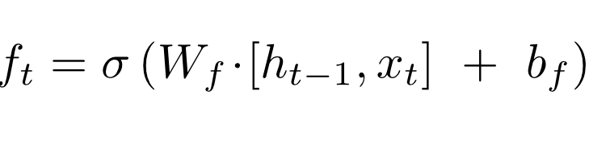
An LSTM Cell
h_{t}
C_{t-1}
C_{t}
X
+
tanh
f_{t}
X
X
σ
σ
tanh
σ
h_{t-1}
h_{t}
x_{t}

Slide 224
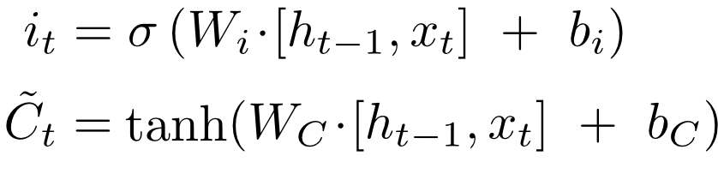
An LSTM Cell
h_{t}
C_{t-1}
C_{t}
X
+
tanh
i_{t}
X
~
C_{t}
X
σ
σ
tanh
σ
h_{t-1}
h_{t}
x_{t}

Slide 225
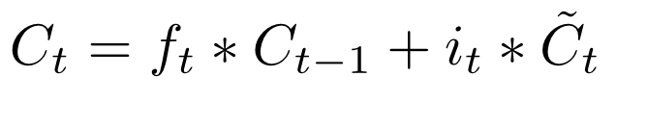
An LSTM Cell
h_{t}
C_{t-1}
C_{t}
X
+
tanh
f_{t}
i_{t}
X
~
C_{t}
X
σ
σ
tanh
σ
h_{t-1}
h_{t}
x_{t}

Slide 226
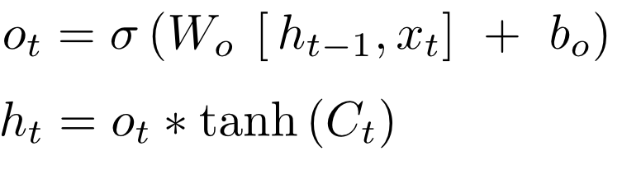
An LSTM Cell
h_{t}
C_{t-1}
C_{t}
X
+
tanh
X
X
σ
σ
tanh
σ
h_{t-1}
h_{t}
x_{t}

Slide 227
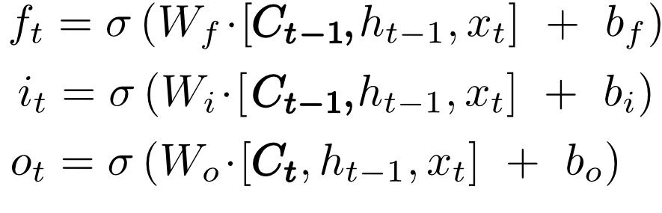
An LSTM Cell with “peepholes”
h_{t}
C_{t-1}
C_{t}
X
+
tanh
X
X
σ
σ
tanh
σ
h_{t-1}
h_{t}
x_{t}

Slide 228
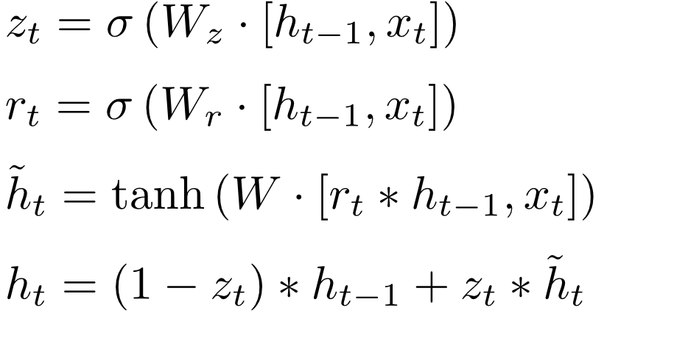
Gated Recurrent Unit (GRU)
h_{t}
h_{t-1}
C_{t}
X
+
X
r_{t}
1-
z_{t}
X
σ
σ
tanh
x_{t}

Slide 229
Deep Learning
Fortunately with our deep learning python library , we simply need to call the import for RNN or LSTM instead of needing to code all of this ourselves!
Let’s explore how to use LSTMs with Python code!

Slide 230
Basic RNN

Slide 231
Deep Learning
Let’s now explore how to use RNN on a basic time series, such as a sine wave.
Before we jump to the notebook, let’s quickly discuss what RNN sequence batches look like.

Slide 232
Deep Learning
Let’s imagine a simple time series:
[0,1,2,3,4,5,6,7,8,9]
We separate this into 2 parts:
[0,1,2,3,4,5,6,7,8] [9]
Given training sequence, predict the next sequence value.

Slide 233
Deep Learning
Keep in mind we can usually decide how long the training sequence and predicted label should be:
[0,1,2,3,4] [5,6,7,8,9]

Slide 234
Deep Learning
We can also edit the size of the training point, as well as how many sequences to feed per batch:
[0,1,2,3] [4]
[1,2,3,4] [5]
[2,3,4,5] [6]

Slide 235
Deep Learning
So how do we decide how long the training sequence should be?
There is no definitive answer, but it should be at least long enough to capture any useful trend information.

Slide 236
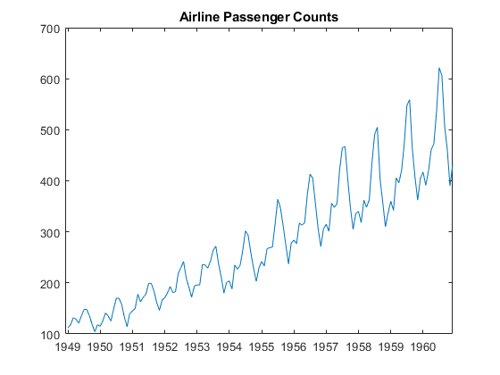
Deep Learning
For example, if dealing with seasonal data:

Slide 237
Deep Learning
If this is monthly, we should include at least 12 months in the training sequence

Slide 238
Deep Learning
This often takes domain knowledge and experience, as well as simply experimenting and using RMSE to measure error of forecasted predictions.
Typically a good starting choice for the label is just one data point into the future.

Slide 239
Deep Learning
How do we forecast with RNNs?
Let’s imagine all our data is:
[0,1,2,3,4,5,6,7,8,9]
And we trained on sequences such as:
[0,1,2,3] [4]
[1,2,3,4] [5]
[2,3,4,5] [6]

Slide 240
Deep Learning
Then our forecasting technique is to predict a time step ahead, and then incorporate our prediction into the next sequence we predict off of.
Let’s walk through a quick example!

Slide 241
Deep Learning
How do we forecast with RNNs?
Let’s imagine all our data is:
[0,1,2,3,4,5,6,7,8,9]
And we trained on sequences such as:
[0,1,2,3] [4]
[1,2,3,4] [5]
[2,3,4,5] [6]

Slide 242
Deep Learning
[6,7,8,9] [10] Forecast prediction!

Slide 243
Deep Learning
[6,7,8,9] [10] Forecast prediction!
Then to keep predicting further:

Slide 244
Deep Learning
[6,7,8,9] [10] Forecast prediction!
Then to keep predicting further:
[7,8,9,10] [11.2]

Slide 245
Deep Learning
[6,7,8,9] [10] Forecast prediction!
Then to keep predicting further:
[7,8,9,10] [11.2]
[8,9,10,11.2] [12.4]

Slide 246
Deep Learning
[6,7,8,9] [10] Forecast prediction!
Then to keep predicting further:
[7,8,9,10] [11.2]
[8,9,10,11.2] [12.4]
[9,10,11.2,12.4] [14]

Slide 247
Deep Learning
[6,7,8,9] [10] Forecast prediction!
Then to keep predicting further:
[7,8,9,10] [11.2]
[8,9,10,11.2] [12.4]
[9,10,11.2,12.4] [14]
[10,11.2,12.4,14] Completed Forecast

Slide 248
Deep Learning
Let’s explore this further with Python!

Slide 249
Let’s get started!

Slide 250
Keras and RNN
CODE ALONG PROJECT
PART ONE

Slide 251
Keras and RNN
EXERCISE PROJECT

Slide 252
Keras and RNN
EXERCISE PROJECT - SOLUTIONS

