Slide 1



JarCube AI Assistant
for myKONE
Instant, secure, 24×7 answers for every myKONE user: tenders, inspection reports and equipment, all in one chat.
Product demo · October 2026
Notes:
Open with the promise: every myKONE user gets an expert assistant that knows their tenders, reports and equipment.

Slide 2
Agenda
01
Where we are today
02
Meet JarCube
How myKONE users get help right now
An AI assistant trained on your platform
03
Use cases
04
Safe by design
Tenders · 3PI reports · Equipment · FAQs
The right answer, only to the right user
05
Support team dashboard
06
Any platform, any channel
Live inbox, takeover, tickets, insights
Train, plug in, go live
07
Impact & next steps
Before vs after, and the rollout plan
JarCube AI Assistant × myKONE
2

Slide 3
Today: getting help on myKONE is slow and manual
Every question, big or small, goes through people, phones and inboxes
👤
📞
🎫
🧑‍💻
⏳
✉️
myKONE user
Calls / emails
ServiceNow
Assigned to
Waiting…
Answer
has a question
Tender Specialist
ticket raised
agent / developer
hours to days
by email
No self-service
Slow answers
Specialists overloaded
Office hours only
Even a simple “what is my tender status?” needs a call or an email.
Users wait in inboxes and ticket queues while their work stalls.
Experts spend their day on repeat questions instead of high-value work.
No help in the evening, at weekends or across time zones.
JarCube AI Assistant × myKONE
3
Notes:
Walk through the real journey. Quick queries have no channel at all except email.

Slide 4
Meet JarCube
An AI assistant that learns your platform and talks to your users
Trained on your data
Answers instantly
Learns from myKONE guides, FAQs, process documents and website content.
Natural conversation at any hour, in seconds instead of days.
Knows the user
Knows its limits
Answers about the user’s own tenders, reports and equipment.
If it is not sure, it hands over to a specialist instead of guessing.
“Ask me anything about your tenders, reports or equipment. I’m here 24×7.”
Keeps humans in control
Works everywhere
The support team sees every chat and can take over at any moment.
Website widget today; WhatsApp, Telegram and more when needed.
JarCube AI Assistant × myKONE
4

Slide 5
How it works: four simple steps
Users keep working in myKONE as they do today; the assistant is there on every page
1
2
3
4
Train
Connect
Embed
Assist
Upload myKONE documents, FAQs and process guides, or point it at the website.
Link it to myKONE data: tenders, inspection reports and equipment.
Add the chat widget to the portal once and it shows on every page.
Users ask, JarCube answers; anything complex goes to a specialist.
Ongoing: JarCube collects the questions it could not answer, so the team can teach it and it improves every week.
JarCube AI Assistant × myKONE
5

Slide 6
Tomorrow: the new support journey
Most questions are answered on the spot; only real issues reach a specialist
No call, no email, no wait.
Specialists step in only where they add real value, and they already have the full context.
📚 General question
answered from the
knowledge base
✅ Instant answer
in seconds,
24×7
🤖 JarCube
understands the
question
👤 myKONE user
asks in chat
🔐 Account question
answered from the
user’s own data
🙋 Not sure / complex
handed to a
Tender Specialist
🎫 Ticket created
with full chat history
JarCube AI Assistant × myKONE
6

Slide 7
Use case 1 · “Where is my tender?”
Customers check tender status themselves, without calling a specialist
myKONE Assistant
Home
Equipment
Tenders
Reports
Invoices
● Online · powered by JarCube
My tenders
What is the status of my tender for Tower A?
Tender
Project
Status
TND-2041 (Modernisation – Tower A) has been In review with the KONE tender team since 28 Sep. Next step: price approval, usually 3–5 working days.
TND-2041
Modernisation – Tower A
In review
TND-2037
Service contract renewal
Approved
Do you need anything from me?
TND-2029
Escalator repair – Mall
Awaiting customer info
Not for this one. But TND-2029 is waiting for your site contact details. Shall I open that form for you?
TND-2018
New elevators – Block C
Submitted
Illustrative mock-up · sample data
Type your question…
➤
JarCube AI Assistant × myKONE
7

Slide 8
Use case 2 · Understanding 3PI inspection reports
Plain-language explanations of findings, severity and next steps
myKONE Assistant
Home
Equipment
Tenders
Reports
Invoices
● Online · powered by JarCube
Inspection report · Elevator E-03 · Third-party inspector
Explain my latest inspection report in simple words.
A-12
Car door safety contact worn
Hazardous
There are 3 findings on E-03. One is urgent: A-12, a worn door safety contact, which should be fixed before the next inspection. B-07 and C-03 are smaller fixes.
B-07
Pit lighting below required level
Needs action
Can KONE fix these?
C-03
Machine room labelling missing
Minor
Yes. I can request a repair quote for all 3 findings and share it with your tender specialist.
💬 Explain this report
Illustrative mock-up · sample data
Type your question…
➤
JarCube AI Assistant × myKONE
8

Slide 9
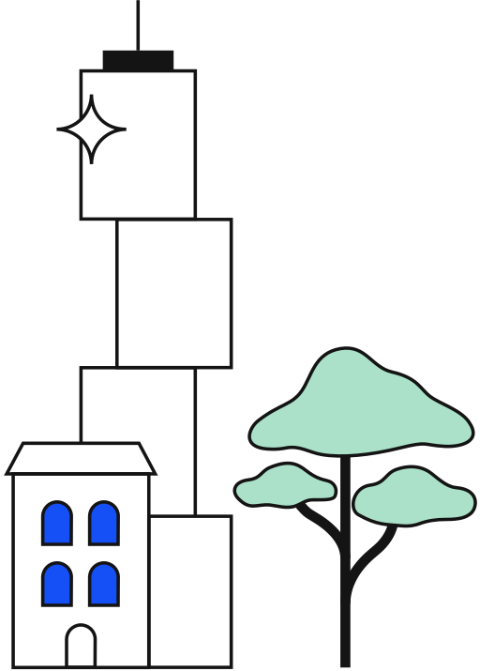
Use case 3 · Built into the Equipment page
The assistant knows which equipment the user is viewing, so there are no IDs to type
myKONE Assistant
Home
Equipment
Tenders
Reports
Invoices
● Online · powered by JarCube
Elevator E-03 · Tower A, main lobby
Why was this elevator out of service last week?
Health
Availability
E-03 was stopped for 3 hours on 29 Sep for a door-operator repair (work order WO-5512). It has been running normally since.
Good
99.2 %
Open work orders
Next visit
When is the next maintenance?
2
14 Oct
A visit is planned for 14 Oct, 09:00–11:00. Do you want me to add it to your calendar?
Illustrative mock-up · sample data
Type your question…
➤
JarCube AI Assistant × myKONE
9

Slide 10
Use case 4 · Quick questions, answered on the spot
Questions that users email about today get an instant answer instead
💬
How do I add a new user to my company account?
💬
Which documents do I need to submit a tender?
Portal how-to
Tender process
💬
Where can I download my September invoice?
💬
What does ‘Awaiting customer info’ mean?
Invoices
Status meaning
💬
How long does tender approval usually take?
💬
Who is my Tender Specialist and how do I reach them?
Timelines
Contacts
24×7
Seconds
Multi-part
Learns
always available
instead of days
answers every part of a question
from unanswered questions
JarCube AI Assistant × myKONE
10

Slide 11
Safe by design: smart answers, no sensitive leaks
JarCube is helpful, but only within what each user is allowed to see
🔐
Only your own data
🏢
Separate data per customer
🚫
Holds back sensitive data
Users only get answers about their own company’s tenders, reports and equipment.
Every organisation’s knowledge is stored separately. Nothing crosses over.
Internal notes, confidential pricing and other customers’ data are not disclosed.
🎯
Grounded, not guessed
🙋
Hands over when unsure
👥
Role-based access
Answers come only from trusted myKONE content. It never makes up policy.
When confidence is low, the chat goes to a specialist instead of risking a wrong answer.
Admins, agents and auditors each see only what their role allows.
JarCube AI Assistant × myKONE
11

Slide 12
The JarCube dashboard for the support team
One place to watch, join and improve every conversation
JarCube
Live inbox
Chats today
Solved by AI
Handed to team
Avg. reply
312
81 %
59
4 sec
Every chat in real time, across all channels
Dashboard
One-click takeover
Conversations
Acme Facilities
City Hospital · live
A specialist joins and the bot steps back
Tender TND-2041 status?
AI
Service Requests
Can we add 2 escalators to tender TND-2018?
Nordic Malls
Service requests
Bots
Explain finding A-12
AI
Connecting you to your Tender Specialist…
Tickets with priority, owner and history
Question Bank
City Hospital
Change tender scope
Agent
🎫 Ticket SR-1182 created
Question bank
Reports
Spot unanswered questions and teach the bot
Channels
Harbor Towers
Invoice copy for Sept
AI
Take over
Bot: ON
Reports
Illustrative mock-up
Volumes, AI resolution rate, response times
JarCube AI Assistant × myKONE
12

Slide 13
One brain, any platform, any channel
Train once, then plug JarCube into myKONE or any other platform
LEARNS FROM
TALKS TO USERS ON
📄 Guides & FAQs
🖥 myKONE portal widget
💬 WhatsApp
📋 Process documents
🤖 JarCube
AI Assistant
trained on your content
✈️ Telegram
🌐 Website content
📘 Facebook Messenger
🔗 Platform data
(tenders, reports, equipment)
🧩 Any other web platform
JarCube AI Assistant × myKONE
13

Slide 14
Before vs after
What changes for users, specialists and KONE
❌ Today
✅ With JarCube
Getting help
Phone call or email
Chat on any myKONE page
Tender status
Ask a Tender Specialist
Instant self-service answer
3PI reports
Read alone, or call for help
Plain-language explanation and next steps
Availability
Office hours
24×7
Response time
Hours to days
Seconds (complex cases go to a person)
Specialist workload
Repeat questions all day
Only complex, high-value cases
Tickets
Raised manually in ServiceNow
Created with the full chat context
Visibility
Scattered emails and calls
One dashboard with reports
JarCube AI Assistant × myKONE
14

Slide 15
Proposed rollout
Start small, prove the value, then scale
Phase 1
Phase 2
Phase 3
Phase 4
Pilot
Connect data
Smart handover
Scale
1
2
3
4
• Train on myKONE FAQs & guides
• Widget on the portal
• Quick-question answers
• Live tender status
• 3PI report explanations
• Equipment page assistant
• Specialist takeover in the dashboard
• Tickets with full chat context
• Hand-off to ServiceNow
• More countries & languages
• WhatsApp & other channels
• Reuse on other platforms
Success measures: share of questions solved by AI · response time · specialist hours saved · user satisfaction
JarCube AI Assistant × myKONE
15

Slide 16
Thank you
From a phone call and a ticket queue to an instant, secure answer on every myKONE page.
Questions & live demo

