Slide 1
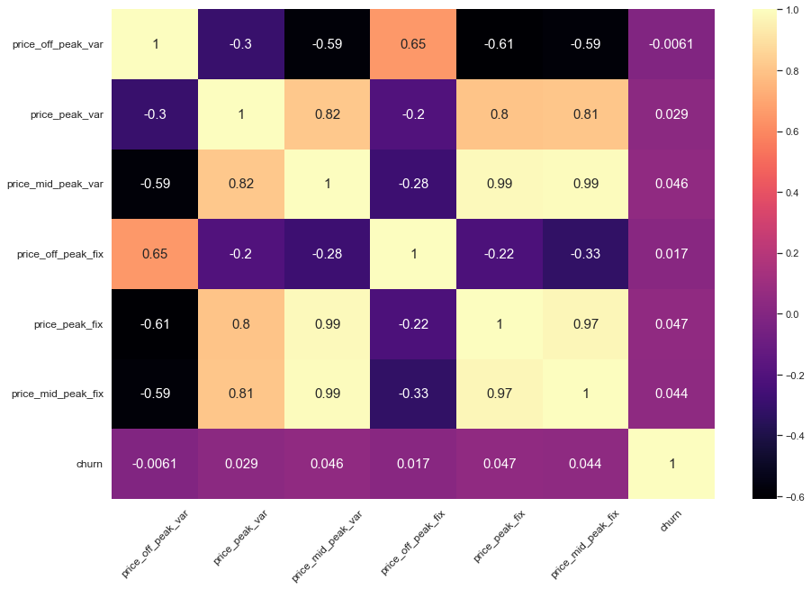
PowerCo Exploratory Data Analysis Findings
Obeservations:
1. From the data given approximately 9.7 percent customers have churned that is 1419 customers.
2. From the hypothesis testing we can see that customers are not sensitive to price changes.
3. There are some outliers in the data which we have clearn
before feeding the data to model.

