Slide 1
Lost Data Retreival
Submitted in the partial fulfillment for the award of the degree of
BACHELOR OF ENGINEERING
In
Information Security
Submitted by:
DIGVIJAY:22BIS70113
ADITI :22BIS70143
AMAN:22IIS70021
ADNAN : 22BIS70146
LIKITH : 22BIS70112
Under the Supervision of:
Ms Somdatta
Department of AIT-CSE
DISCOVER . LEARN . EMPOWER

Slide 2
Outline
Introduction to Project
Problem Formulation
Objectives of the work
Methodology used
Results and Outputs
Conclusion
Future Scope
References

Slide 3
Introduction to Project
Lost data retrieval is recovering the loss of any data due to human error or any other hazard occur due to the following.
accidental deletion
Human error
Natural disasters
virus attacks
Hardware malfunctions
Software crashes

Slide 4
1. AIDS IN
Maintains CIA triad
Recovery of financial losses, assests and sensitive data.
2. DATA RECOVERED
Documents, photos,videos, emails, databases and system files.
3. DATA RETRIEVAL METHODS
Using data recovery software, engaging professional data recovery services, utilizing backups, and employing specialized hardware tools
4. LEGAL AND COMPILANCE
sensitive or confidential information subject to legal and regulatory requirements

Slide 5
Problem Formulation
Identification of common causes of data loss: hardware failure, accidental deletion, software corruption, etc.
Challenges associated with recovering lost data, including data fragmentation and file system damage.
The need for a systematic approach to data retrieval to ensure maximum success rate and efficiency.

Slide 6
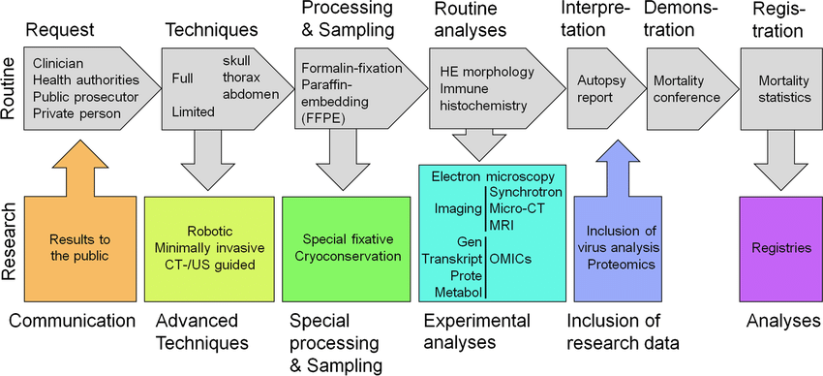
Objectives of the Work

Slide 7
Methodology used
Overview of the proposed methodology, including key steps and techniques involved.
Discussion on the selection criteria for data recovery tools and software.
Description of data recovery procedures for different types of data loss scenarios.
Implementation details and considerations for executing the methodology effectively.

Slide 8
Results and Outputs
Presentation of findings from experimentation and analysis.
Evaluation of the success rate and efficiency of the proposed methodology.
Showcase of recovered data samples and demonstration of data integrity.
Comparison with existing data recovery methods and tools.

Slide 9
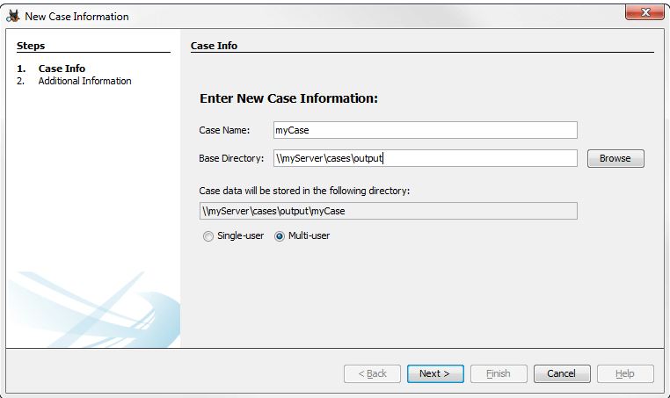
1. Launch Autopsy and click New Case from its main interface > Give a new to your new case and choose a directory you want to place your cases.

Slide 10
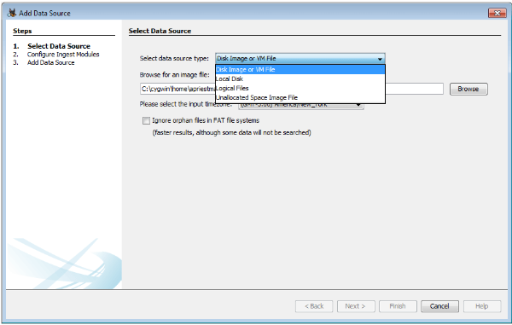
2.If you are not recovering data for law enforcement, the other information is not necessary. Therefore, type in any number and name in the additional information field. After clicking Finish in the dialog above, the Add Data Source window pops up > Select Logical disk from the drop-down list > Choose the targeted drive image whose data is to be recovered.

Slide 11
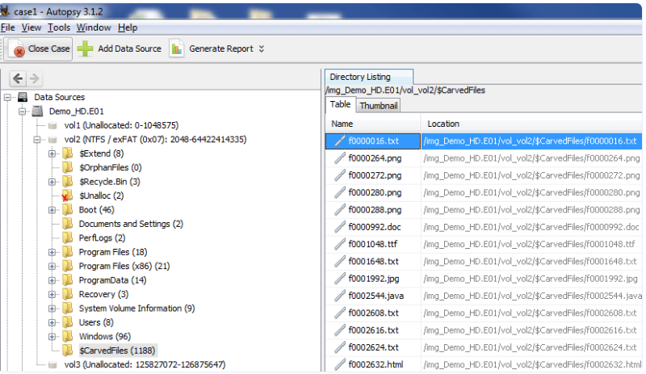
Step 3. Data restoration Click next to proceed to the second step > Ensure that you leave the default values and press next > Click Finish to close the dialog box and let the analysis proceed. Wait for the analysis to complete, and the data will be displayed in different categories. The main sections include: Data Sources, Views, Results, Tags, and Reports.

Slide 12
Conclusion
Recap of key findings and insights gained from the project.
Summary of the effectiveness of the proposed methodology in retrieving lost data.
Discussion on the implications of the findings and their relevance to the broader field of data recovery.
Suggestions for future research and improvements in data retrieval techniques.

Slide 13
Future Scope
Exploration of advanced data recovery techniques, such as machine learning-based approaches.
Integration of data recovery functionalities into existing operating systems and software.
Collaboration with hardware manufacturers to develop data loss prevention mechanisms.
Further research on data encryption and its impact on data recovery processes.

Slide 14
References
[1]. Huang Zongjie and Cai Jiuzhong, "The feature and modelling principle of the meteorological service benefits[J]", Journal of Chengdu University of Information Technology, vol. 11, no. 1, pp. 3339, 1996.
[2]. Ma Henian, Shen Guoquan and Ruan Shuigen, QIXIANG FUWU XUE JICHU[M], Beijing: China Meteorological Press, pp. 500, 2001.
[3]. Y. Wei, C. Huang, J. Li and L. Xie, "An evaluation model for urban carrying capacity: A case study of China’s mega-cities", Habitat Int., vol. 53, pp. 87-96, Apr. 2016.
[4]. H. Hu, Y. Wen, T.-S. Chua and X. Li, "Toward scalable systems for big data analytics: A technology tutorial", IEEE Access, vol. 2, pp. 652687, Jul. 2014.
[5]. Ruibo Duan and Xiong Zhang 2020 J.2007. HICSS 2007. 40th Annual Hawaii International Conference on, pp. 266b266b, 2007, January. Phys.: Conf.Ser. 1648 032025DOI 10.1088/17426596/1648/ 3/032025
[6]. Feng-Ying Nie, A value-oriented model of big datadriven knowledge management and collaborative services: A meteorological service case IEEE 2017 3rd International Conference on Information Management (ICIM), pp. 511516.

Slide 15
[7]. S. Seo, M. Nabeel, X. Ding, and E. Bertino. An efficient certificateless encryption for secure data sharing in public clouds. IEEE Transactions on Knowledge and Data Engineering, http://doi.ieeecomputersociety.org/10.1109/TKDE. 2013.138, aug 2013.
[8]. K. Yang and X. Jia. An efficient and secure dynamic auditing protocol for data storage in cloud computing. IEEE Transactions on Dependable and Secure Computing, 24(9):1717-1726, sep 2013.
[9]. .Open Security Foundation. DataLossDB. http://datalossdb.org/, Last accessed November 26, 2013.
[10]. M. Ali, S. U. Khan and A. V. Vasilakos, "Security in cloud computing: Opportunities and challenges", Information Sciences, vol. 305, pp. 357-383, 2015.
[11]. Roberto Beraldi, Khalil Massri and Hussein Alnuweiri,"Erasure-Coding Based Dissemination Protocol for Mobile Clouds", Eighth International Conference on P2P Parallel Grid Cloud and Internet Computing, 2013.
[12]. Tang, P.P.Lee,J.C.S.Lui and R.Perlman,"Secure Overlay Cloud Storage with Access Control and Assured Deletion", IEEE Transactions on Dependable and Secure Computing, vol. 9, no. 6, pp. 903-916, Nov. 2012
[13]. W.A. Conklin, R.E. Cline and T. Roosa, "Reengineering Cybersecurity Education in the US: An Analysis of the Critical Factors", HICSS, 2014.
[14]. D. Manson, A. Carlin, S. Ramos, A. Gyger, M. Kaufman and J. Treichelt, "Is the open way a better way? Digital forensics using open source tools", System Sciences
[15]. L. Gottschalk et al.,"Computer Forensics Programs in Higher Education: A Preliminary Study", the proceedings of the 36th SIGCSE Technical Symposium on Computer Science Education, pp. 147-151, Feb

