Slide 1
SAMS
Student Attendance Management System
As per the name, this CRUD based project to use for manage student's attendance details.
It has Add, Read, Update, and delete functionality.
This project useful for facilities. The use of this project is very easy.
You can add student, take attendance of class, and also later you can update it.

Slide 2
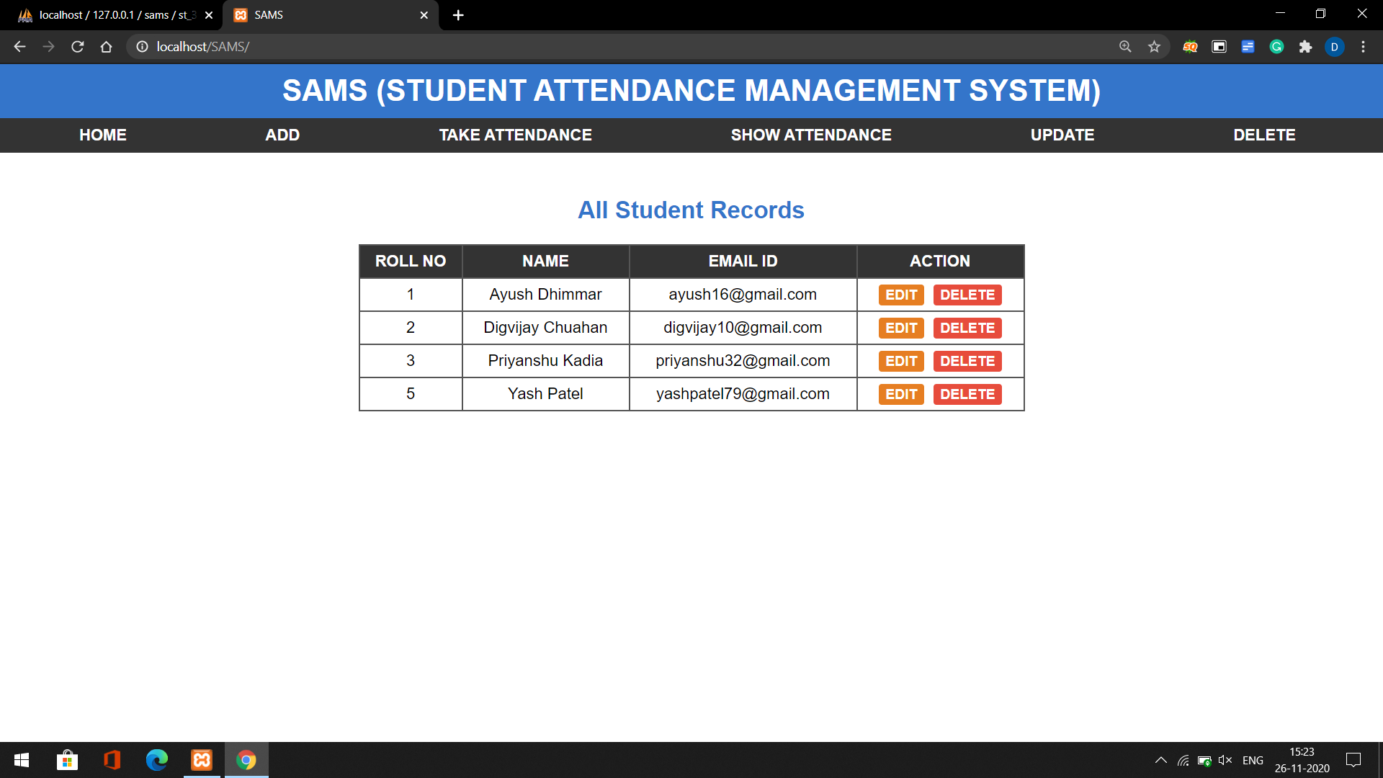
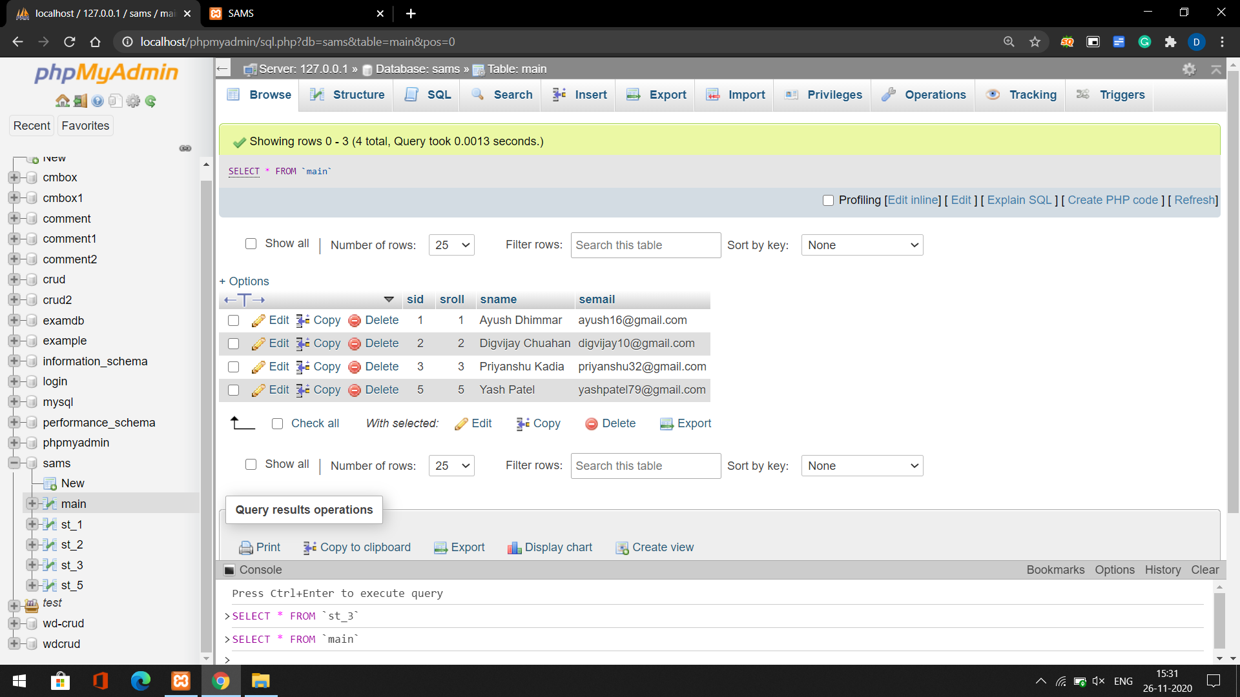
Home page
On this page, we can show general information about students.
All page contains a navigation bar, so the user can navigate easily.
This page connects with the database, so when you update any data it's updated in the main table of the database.
In this table general information store of students like Name, Roll Number, Email Address.

Slide 3
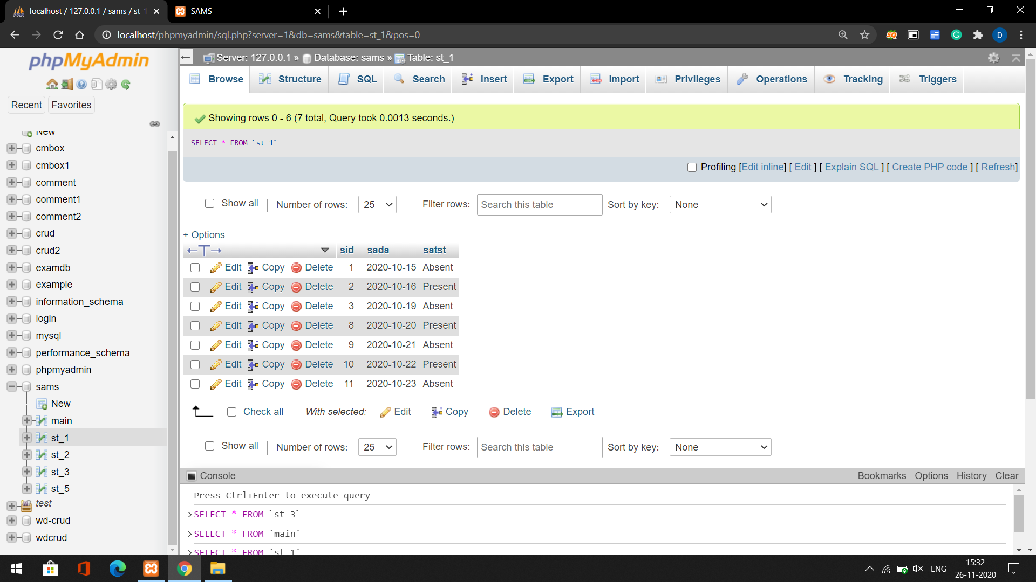
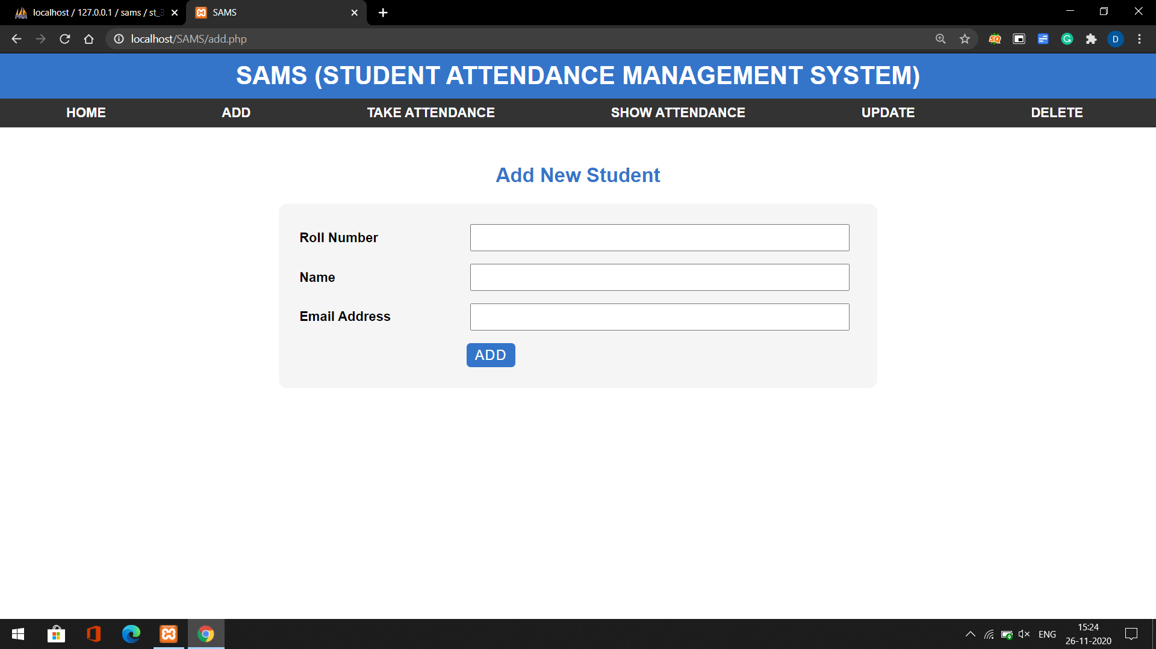
Add page
On this page, we can add students.
This page connects with the database, so when you submit data it's updated in the main table of the database.
Also it's create new table st_1. Here 1 is presents roll number.
This table contains date and Attendance status.

Slide 4
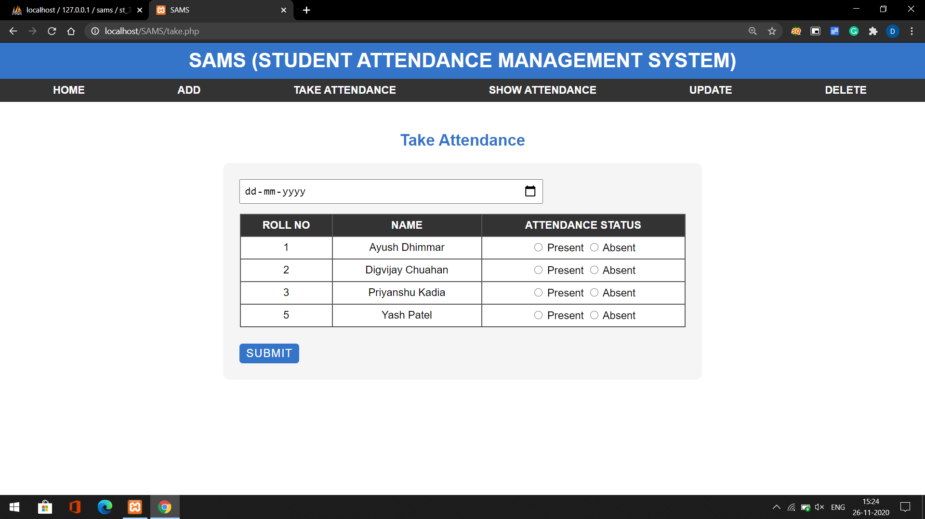
Take Attendance page
On this page, we can add the student's attendance details.
This page connects with the database, so when you submit data it's updated in the [st_rollno] table of the database.

Slide 5
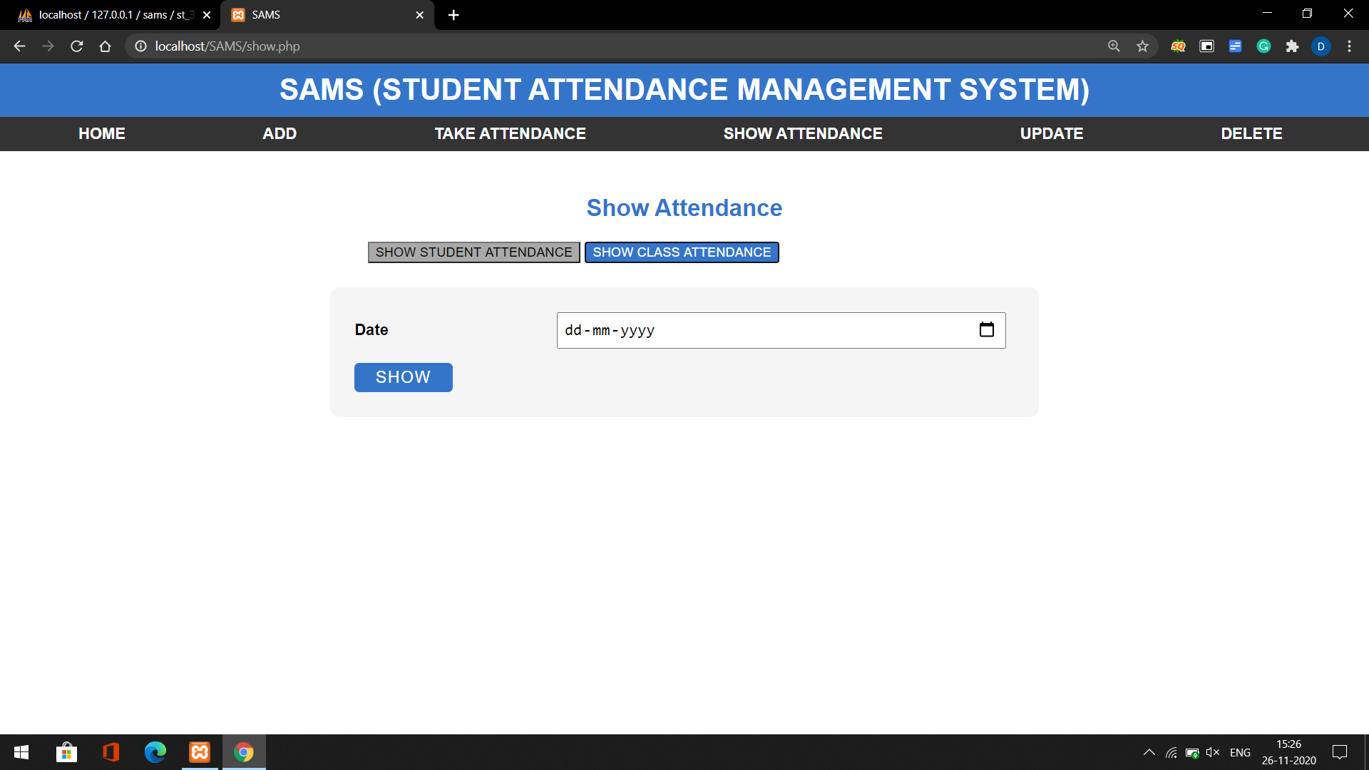
READ Show Attendance page
Show class attendance
On this page, we can show the class attendance details on a particular date.
Ex, you want to show the attendance detail of class on 12th January, so just enter the date.

Slide 6
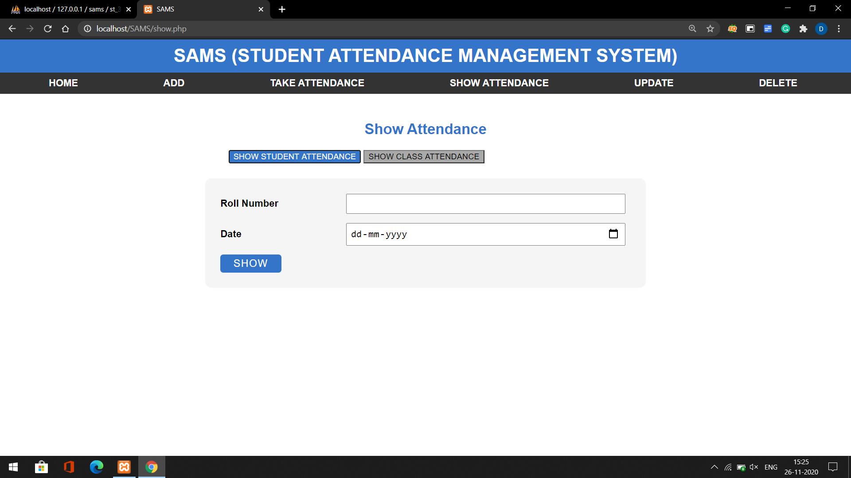
READ Show Attendance page
Show Student attendance
On this page, we can show the student attendance details on a particular date.
Ex, you want to show the attendance detail of student on 12th January, so just enter the date and roll number of student.

Slide 7
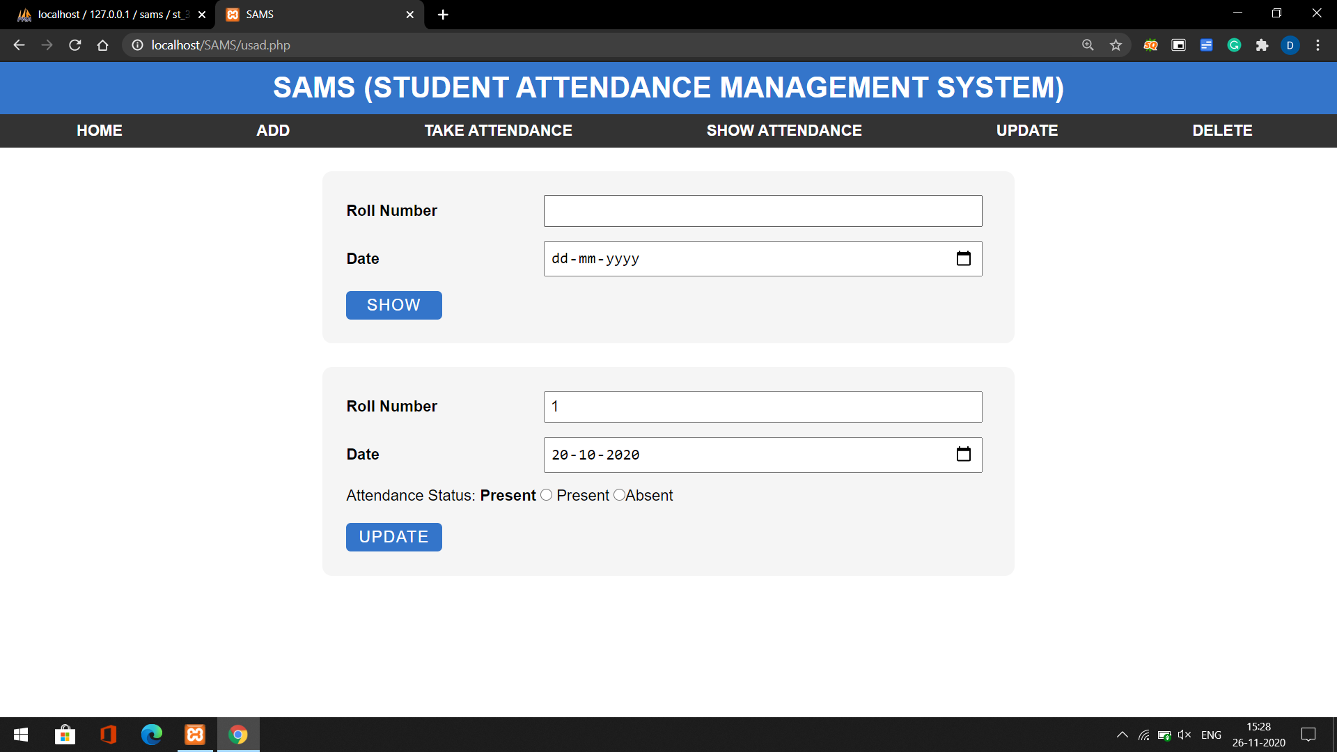
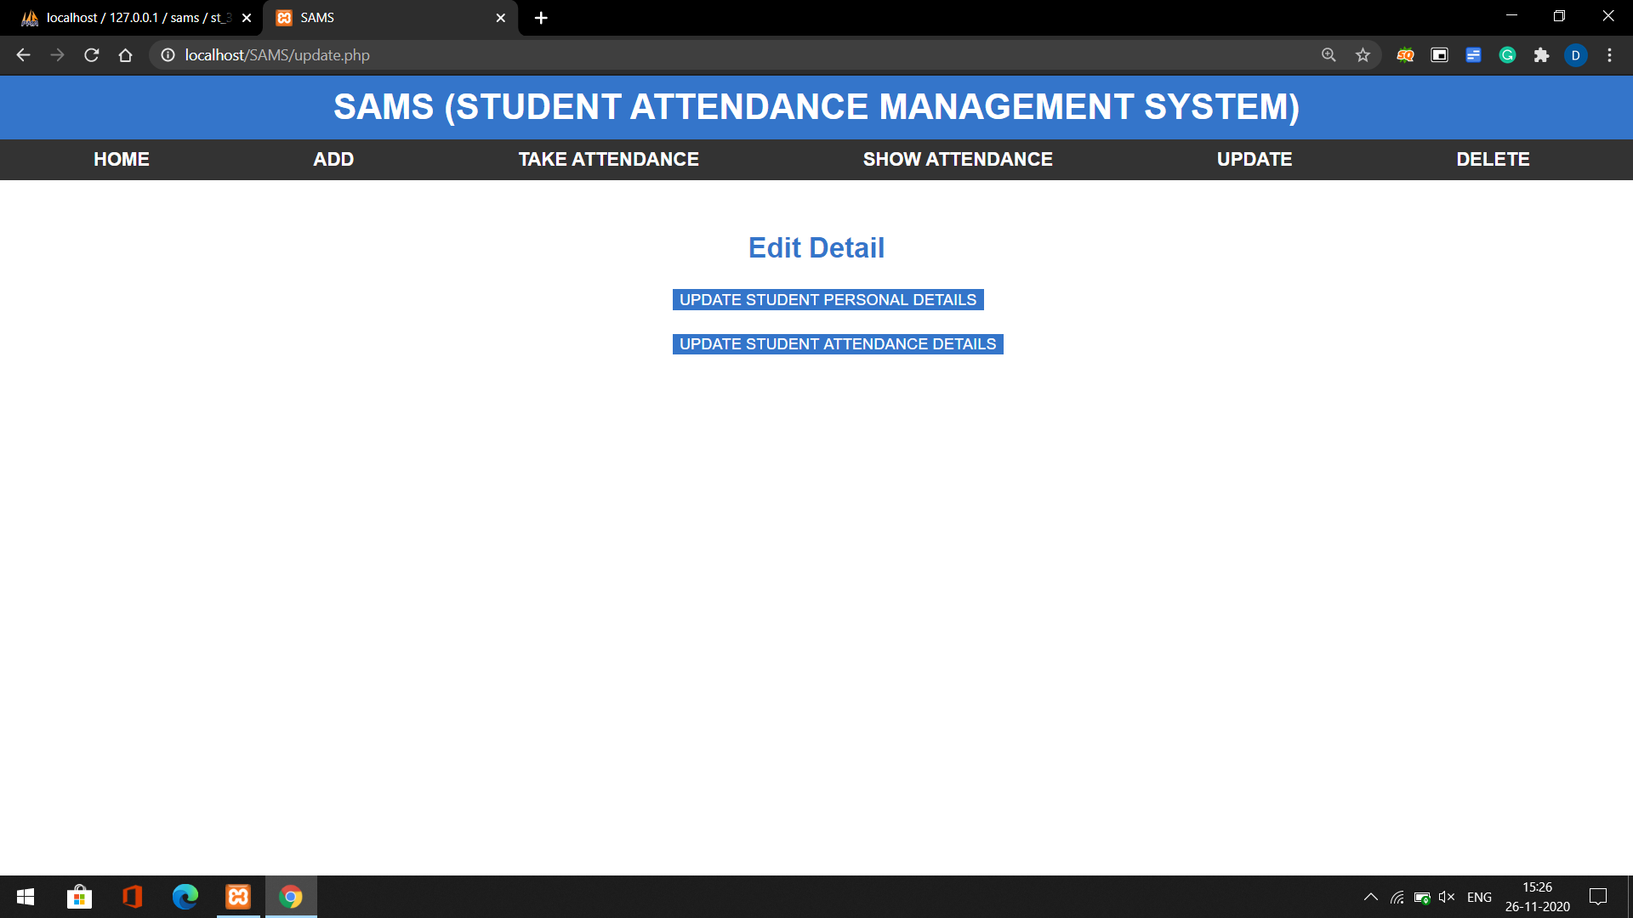
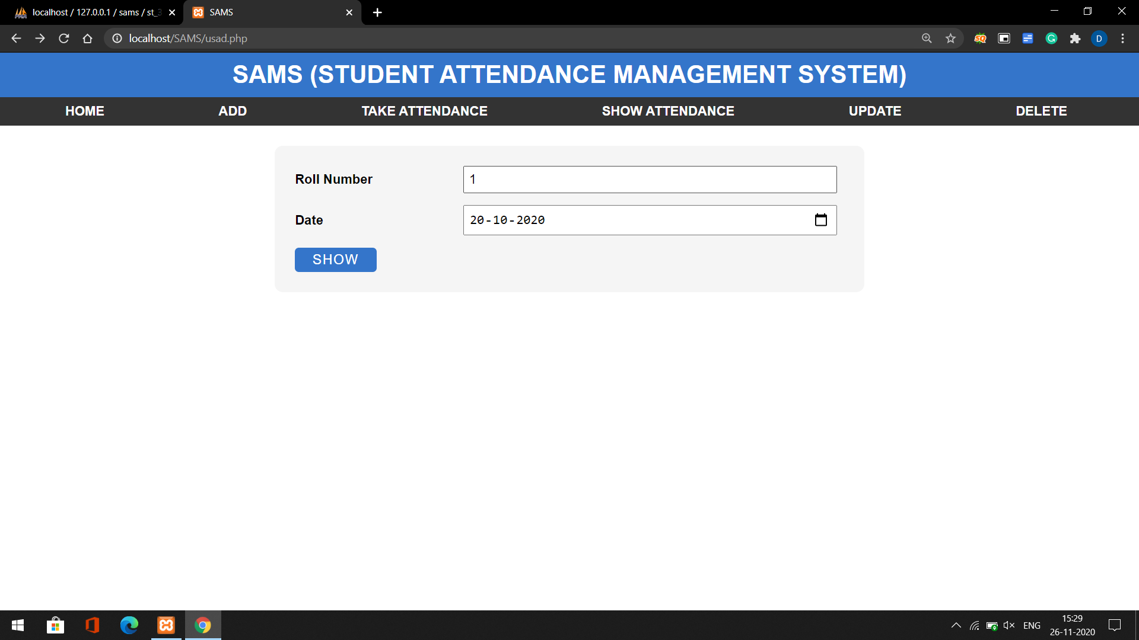
UPDATE
Update Student attendance details
On the first page, you can see 2 buttons. One for Update Student attendance details and second for Update Student personal details .
After selecting the first button as you show it redirects to another page. On this page, you enter the student roll number and date and so, you can see in the third-page student's old details and you reenter new detail and submit it.

Slide 8
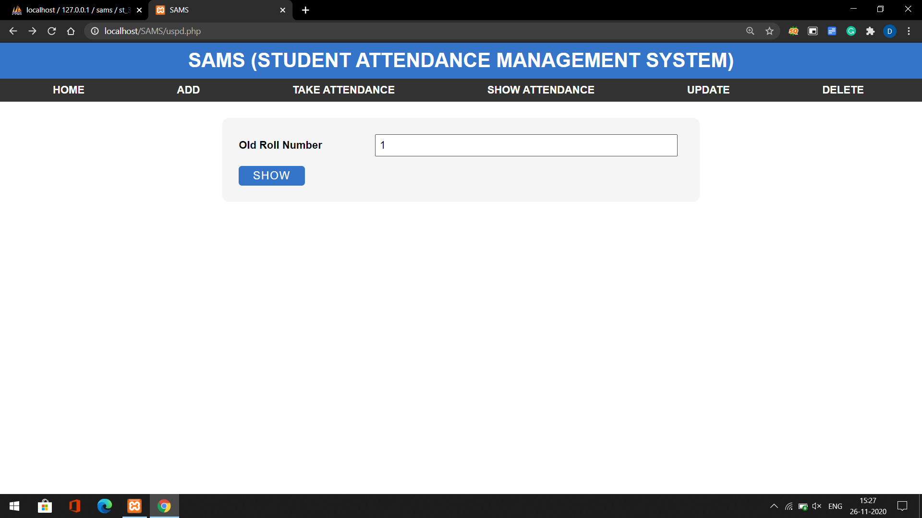
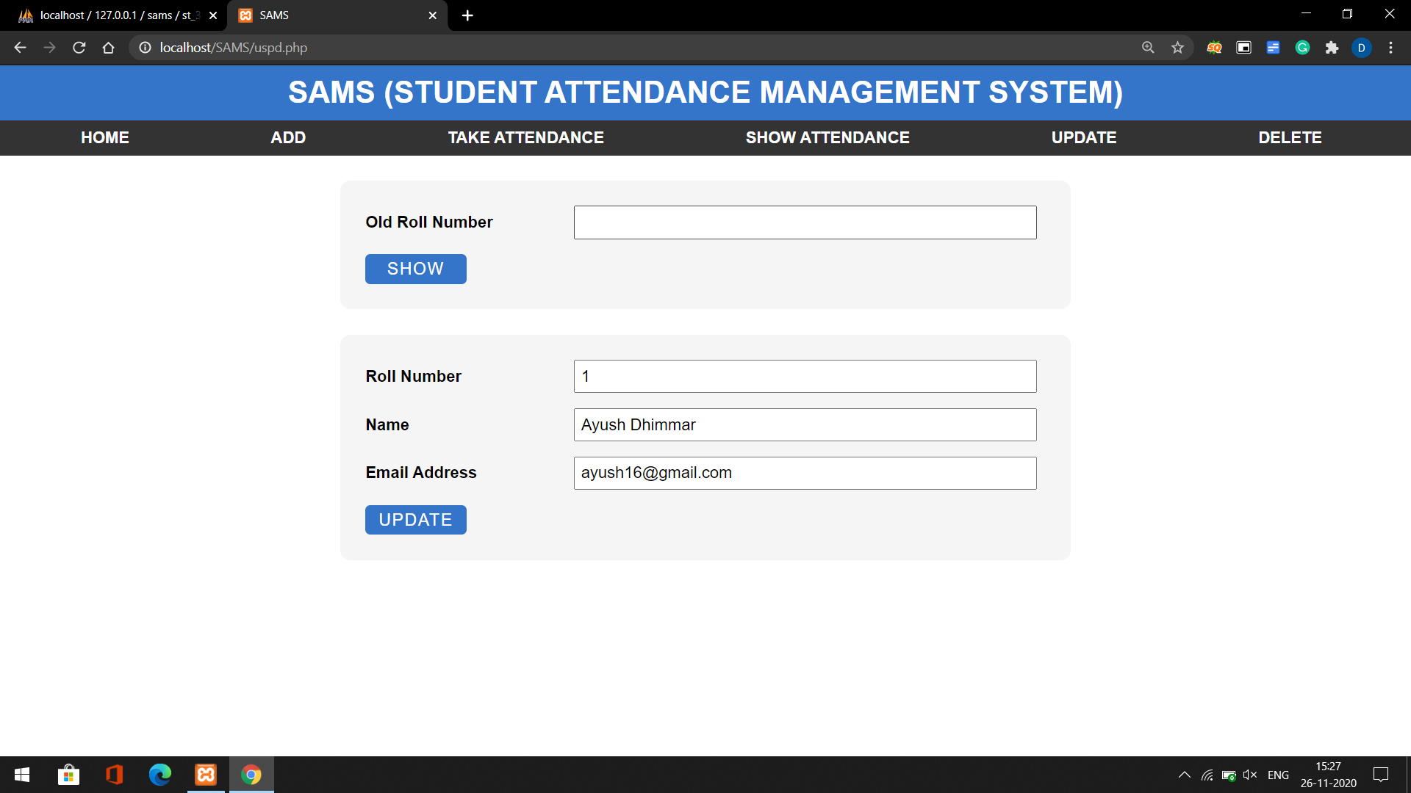
UPDATE
Update Student Personal details
On the first page, you enter the student's roll number.
After you enter roll no, it shows student details and here you reenter details and submit it.

Slide 9
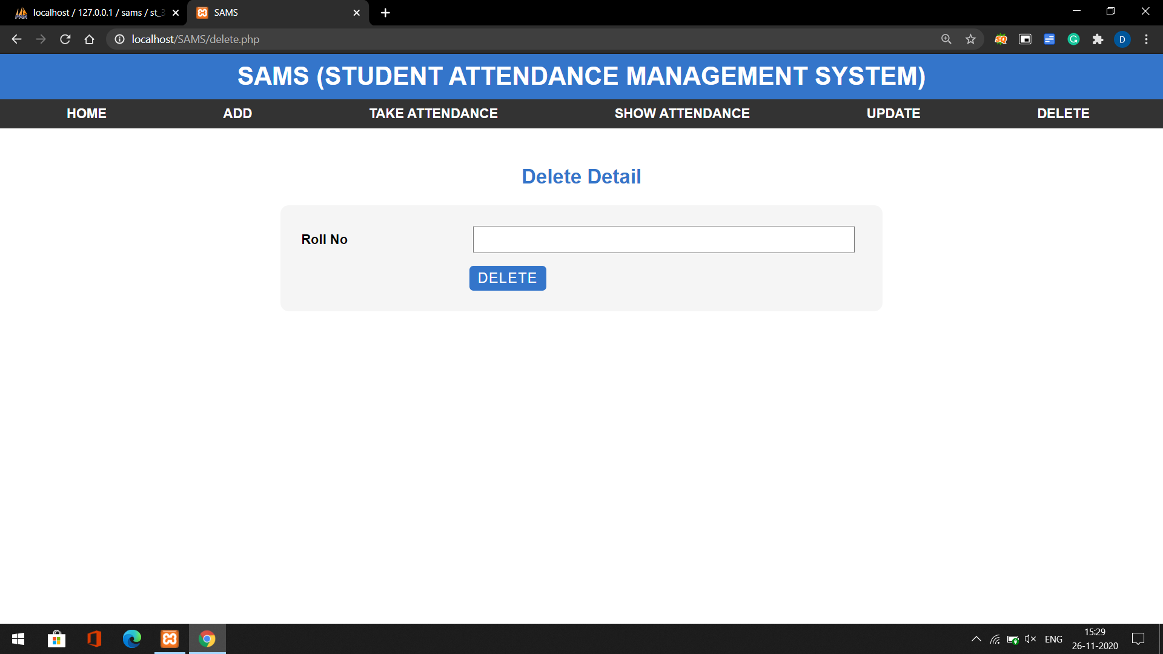
Delete page
On this page, we can delete student's details.
This page connects with the database, so when you submit roll number it delete student details.

