Slide 1

Virtual Ballot System for Voting
Advanced Object-Oriented Programming Project
DHROOV SINGH 2310030150
SHUBHAM DESHPANDE 2310030004
VISWANATH V 2310030401
DIGVIJAY RAJONIA 2310030210

Slide 2
Project Specification (Features)
GUI-based secure voting system
Role-based access: Admin and Voters
OTP and biometric authentication for enhanced security
Candidate management by Admin
Voter restriction to single vote
Secure vote storage and count mechanism
VOTE

Slide 3

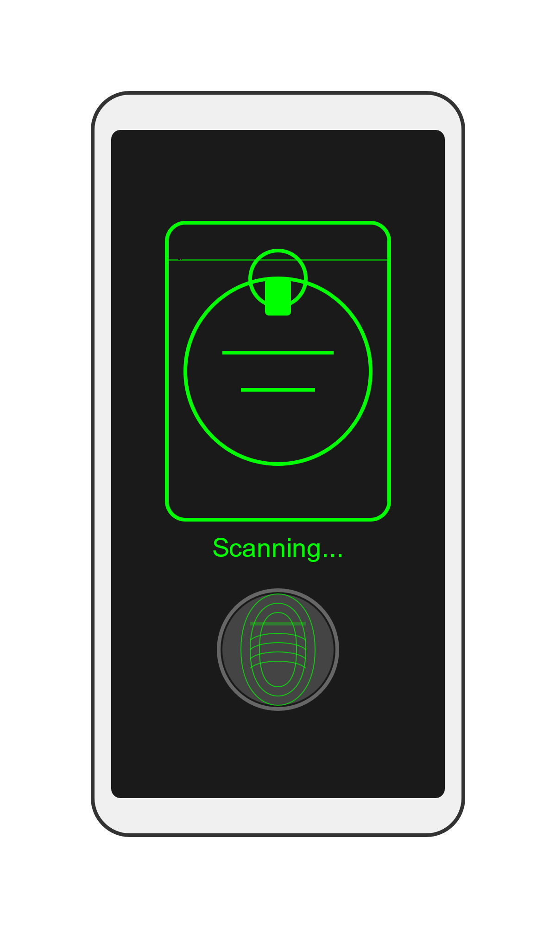

Project Feasibility Analysis
Technically feasible with Java, GUI tools, and databases
Secure with encryption (e.g., AES, RSA) and APIs for OTP/biometric validation
Economically viable for scalable infrastructure on cloud platforms
Legally compliant with data protection laws and election standards

Slide 4
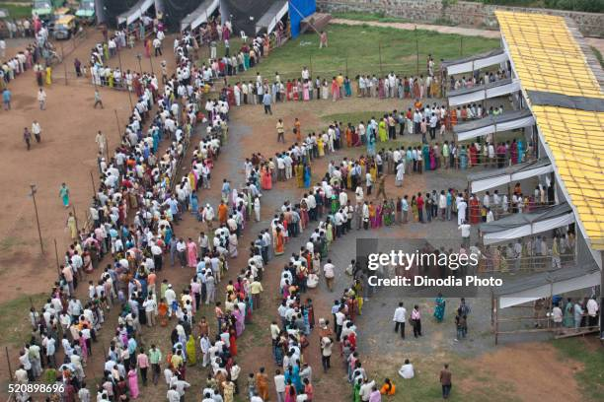
Oriented with Societal Needs
Encourages voter participation through convenience
Reduces administrative overhead in traditional voting
Enhances security to eliminate fraud and malpractice
Accessible for diverse demographics with easy-to-use interface

Slide 5

Novelty of the Project Title
Integration of modern technology with traditional voting
Use of biometrics and OTP for dual-layer authentication
Potential for real-time vote monitoring and transparency
Aligns with 'Digital India' initiatives for e-governance

Slide 6


