Slide 1
Chapter 9: Control Systems

Slide 2
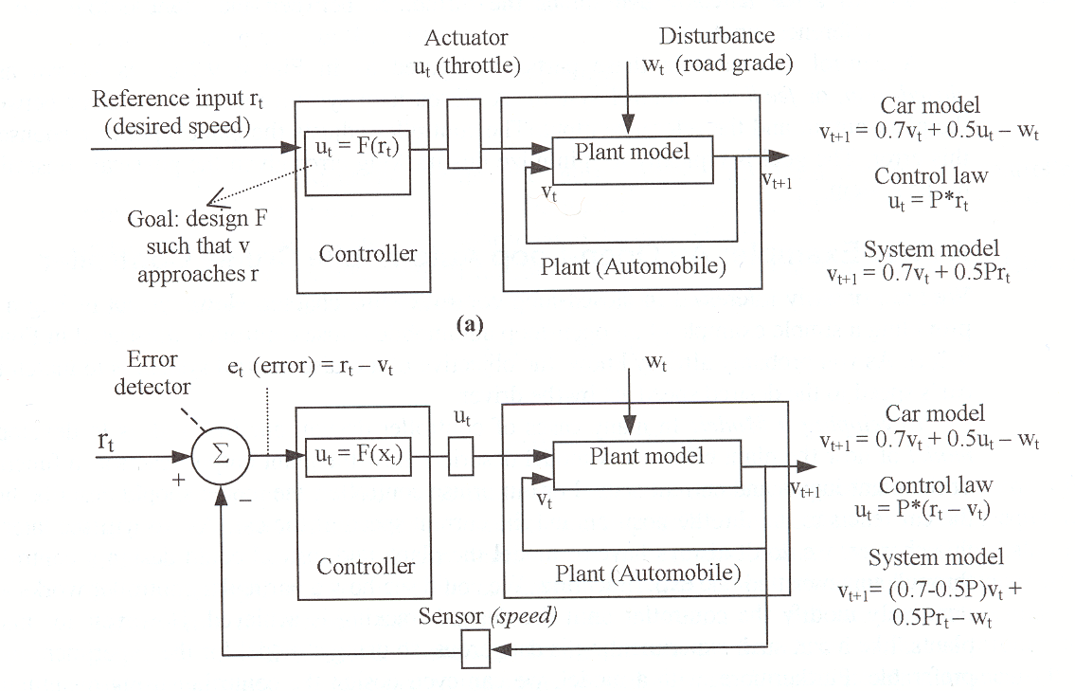
Control System
Control physical system’s output
  By setting physical system’s input
Tracking
E.g.
  Cruise control
  Thermostat control
  Disk drive control
  Aircraft altitude control
Difficulty due to
  Disturbance: wind, road, tire, brake; opening/closing door…
  Human interface: feel good, feel right…

Slide 3
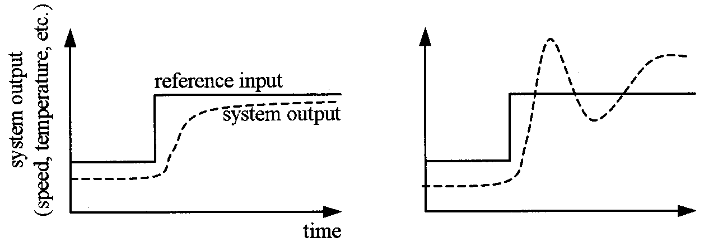
Tracking

Slide 4
Open-Loop Control Systems
Plant
  Physical system to be controlled
    Car, plane, disk, heater,…
Actuator
  Device to control the plant
    Throttle, wing flap, disk motor,…
Controller
  Designed product to control the plant

Slide 5
Open-Loop Control Systems
Output
  The aspect of the physical system we are interested in
    Speed, disk location, temperature
Reference
  The value we want to see at output
    Desired speed, desired location, desired temperature
Disturbance
  Uncontrollable input to the plant imposed by environment
    Wind, bumping the disk drive, door opening

Slide 6
Other Characteristics of open loop
Feed-forward control
Delay in actual change of the output
Controller doesn’t know how well thing goes
Simple
Best use for predictable systems

Slide 7
Close Loop Control Systems
Sensor
  Measure the plant output
Error detector
  Detect Error
Feedback control systems
Minimize tracking error

Slide 8
Designing Open Loop Control System
Develop a model of the plant
Develop a controller
Analyze the controller
Consider Disturbance
Determine Performance
Example: Open Loop Cruise Control System

Slide 9
Model of the Plant
May not be necessary
  Can be done through experimenting and tuning
But,
  Can make it easier to design
  May be useful for deriving the controller
Example: throttle that goes from 0 to 45 degree
  On flat surface at 50 mph, open the throttle to 40 degree
  Wait 1 “time unit”
  Measure the speed, let’s say 55 mph
  Then the following equation satisfy the above scenario
    v_{t+1}=0.7*v_{t}+0.5*u_{t}
    55 = 0.7*50+0.5*40
  IF the equation holds for all other scenario
    Then we have a model of the plant

Slide 10
Designing the Controller
Assuming we want to use a simple linear function
  u_{t}=F(r_{t})= P * r_{t}
  r_{t} is the desired speed
Linear proportional controller
v_{t+1}=0.7*v_{t}+0.5*u_{t} = 0.7*v_{t}+0.5P*r_{t}
Let v_{t+1}=v_{t} at steady state = v_{ss}
v_{ss}=0.7*v_{ss}+0.5P*r_{t}
At steady state, we want v_{ss}=r_{t}
P=0.6
  I.e. u_{t}=0.6*r_{t}

Slide 11
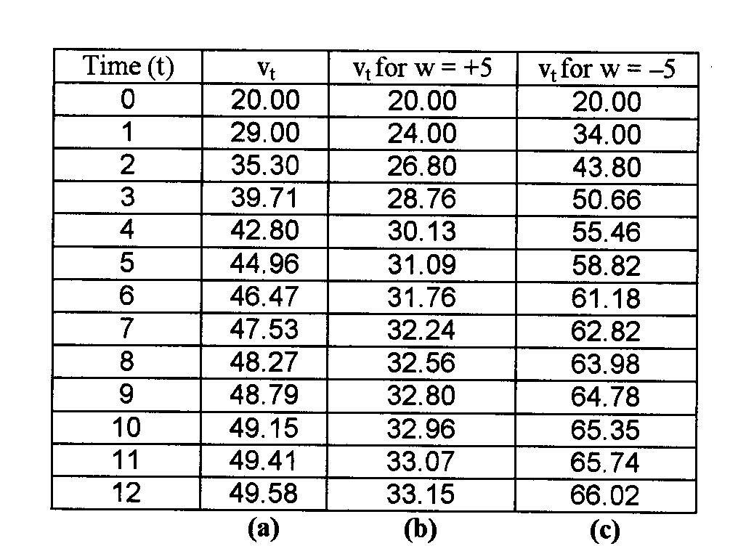
Analyzing the Controller
Let v₀=20mph, r₀=50mph
v_{t+1}=0.7*v_{t}+0.5(0.6)*r_{t} =0.7*v_{t}+0.3*50= 0.7*v_{t}+15
Throttle position is 0.6*50=30 degree

Slide 12
Considering the Disturbance
Assume road grade can affect the speed
  From –5mph to +5 mph
  v_{t+1}=0.7*v_{t}+10
  v_{t+1}=0.7*v_{t}+20

Slide 13
Determining Performance
V_{t+1}=0.7*v_{t}+0.5P*r₀-w₀
v₁=0.7*v₀+0.5P*r₀-w₀
v₂=0.7*(0.7*v₀+0.5P*r₀-w₀) +0.5P*r₀-w₀ =0.7*0.7*v₀+(0.7+1.0)*0.5P*r₀-(0.7+1.0)w₀
v^{t}=0.7^{t}*v₀+(0.7^{t-1}+0.7^{t-2}+…+0.7+1.0)(0.5P*r₀-w₀)
Coefficient of v_{t} determines rate of decay of v₀
  >1 or <-1, v_{t} will grow without bound
  <0, v_{t} will oscillate

Slide 14
Designing Close Loop Control System

Slide 15
Stability
u_{t} = P * (r_{t}-v_{t})
v_{t+1} = 0.7v_{t}+0.5u_{t}-w_{t} = 0.7v_{t}+0.5P*(r_{t}-v_{t})-w
  =(0.7-0.5P)*v_{t}+0.5P*r_{t}-w_{t}
v^{t}=(0.7-0.5P)^{t}*v₀+((0.7-0.5P)^{t-1}+(0.7-0.5P)^{t-2}+…+0.7-0.5P+1.0)(0.5P*r₀-w₀)
Stability constraint (I.e. convergence) requires
|0.7-0.5P|<1
-1<0.7-0.5P<1
-0.6<P<3.4

Slide 16
Reducing effect of v₀
u_{t} = P * (r_{t}-v_{t})
v_{t+1} = 0.7v_{t}+0.5u_{t}-w_{t} = 0.7v_{t}+0.5P*(r_{t}-v_{t})-w
  =(0.7-0.5P)*v_{t}+0.5P*r_{t}-w_{t}
v^{t}=(0.7-0.5P)^{t}*v₀+((0.7-0.5P)^{t-1}+(0.7-0.5P)^{t-2}+…+0.7-0.5P+1.0)(0.5P*r₀-w₀)
To reduce the effect of initial condition
  0.7-0.5P as small as possible
  P=1.4

Slide 17
Avoid Oscillation
u_{t} = P * (r_{t}-v_{t})
v_{t+1} = 0.7v_{t}+0.5u_{t}-w_{t} = 0.7v_{t}+0.5P*(r_{t}-v_{t})-w
  =(0.7-0.5P)*v_{t}+0.5P*r_{t}-w_{t}
v^{t}=(0.7-0.5P)^{t}*v₀+((0.7-0.5P)^{t-1}+(0.7-0.5P)^{t-2}+…+0.7-0.5P+1.0)(0.5P*r₀-w₀)
To avoid oscillation
  0.7-0.5P >=0
  P<=1.4

Slide 18
Perfect Tracking
u_{t} = P * (r_{t}-v_{t})
v_{t+1} = 0.7v_{t}+0.5u_{t}-w_{t} = 0.7v_{t}+0.5P*(r_{t}-v_{t})-w
  =(0.7-0.5P)*v_{t}+0.5P*r_{t}-w_{t}
v_{ss}=(0.7-0.5P)*v_{ss}+0.5P*r₀-w₀
(1-0.7+0.5P)v_{ss}=0.5P*r₀-w₀
v_{ss}=(0.5P/(0.3+0.5P)) * r₀ - (1.0/(0.3+0.5P)) * w_{o}
To make v_{ss} as close to r₀ as possible
  P should be as large as possible

Slide 19
Close-Loop Design
u_{t} = P * (r_{t}-v_{t})
Finally, setting P=3.3
  Stable, track well, some oscillation
  u_{t} = 3.3 * (r_{t}-v_{t})

Slide 20
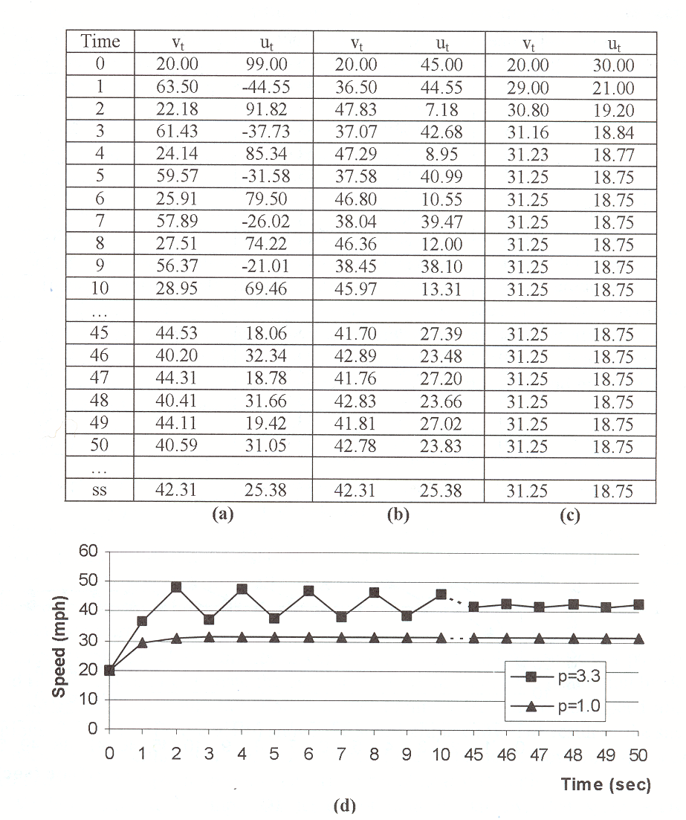
Analyze the controller
v₀=20 mph, r₀=50 mph, w=0
v_{t+1} = 0.7v_{t}+0.5P*(r_{t}-v_{t})-w
  = 0.7v_{t}+0.5*3.3*(50-v_{t})
u_{t} = P * (r_{t}-v_{t})
  = 3.3 * (50-v_{t})
But u_{t} range from 0-45
Controller saturates

Slide 21
Analyze the controller
v₀=20 mph, r₀=50 mph, w=0
v_{t+1} = 0.7v_{t}+0.5*u_{t}
u_{t} = 3.3 * (50-v_{t})
  Saturate at 0, 45
Oscillation!
  “feel bad”

Slide 22
Analyze the controller
Set P=1.0 to void oscillation
  Terrible SS performance

Slide 23
Analyzing the Controller

Slide 24
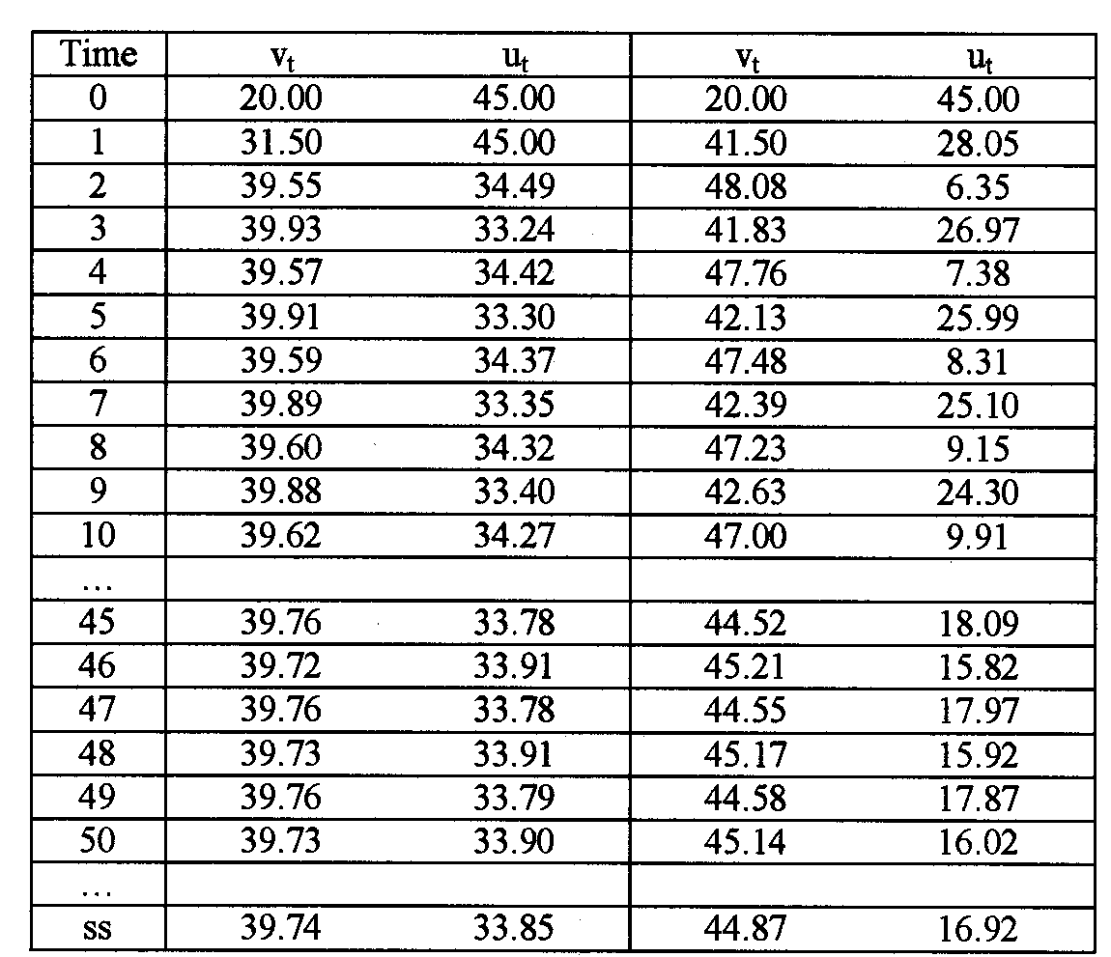
Minimize the effect of disturbance
v_{t+1} = 0.7v_{t}+0.5*3.3*(r_{t}-v_{t})-w
  w=-5 or +5
39.74
  Close to 42.31
  Better than
    33
    66
Cost
  SS error
  oscillation

Slide 25
General Control System
Objective
  Causing output to track a reference even in the presence of
    Measurement noise
    Model error
    Disturbances
Metrics
  Stability
    Output remains bounded
  Performance
    How well an output tracks the reference
  Disturbance rejection
  Robustness
    Ability to tolerate modeling error of the plant

Slide 26
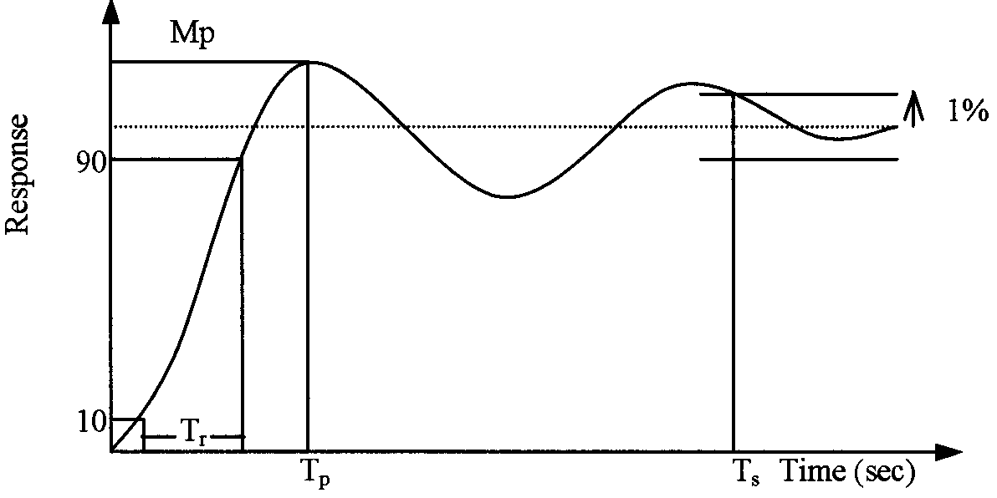
Performance (generally speaking)
Rise time
  Time it takes form 10% to 90%
Peak time
Overshoot
  Percentage by which Peak exceed final value
Settling time
  Time it takes to reach 1% of final value

Slide 27
Plant modeling is difficult
May need to be done first
Plant is usually on continuous time
  Not discrete time
    E.g. car speed continuously react to throttle position, not at discrete interval
  Sampling period must be chosen carefully
    To make sure “nothing interesting” happen in between
    I.e. small enough
Plant is usually non-linear
  E.g. shock absorber response may need to be 8th order differential
Iterative development of the plant model and controller
  Have a plant model that is “good enough”

Slide 28
Controller Design: P
Proportional controller
  A controller that multiplies the tracking error by a constant
    u_{t} = P * (r_{t}-v_{t})
  Close loop model with a linear plant
    E.g. v_{t+1} = (0.7-0.5P)*v_{t}+0.5P*r_{t}-w_{t}
P affects
  Transient response
    Stability, oscillation
  Steady state tacking
    As large as possible
  Disturbance rejection
    As large as possible

Slide 29
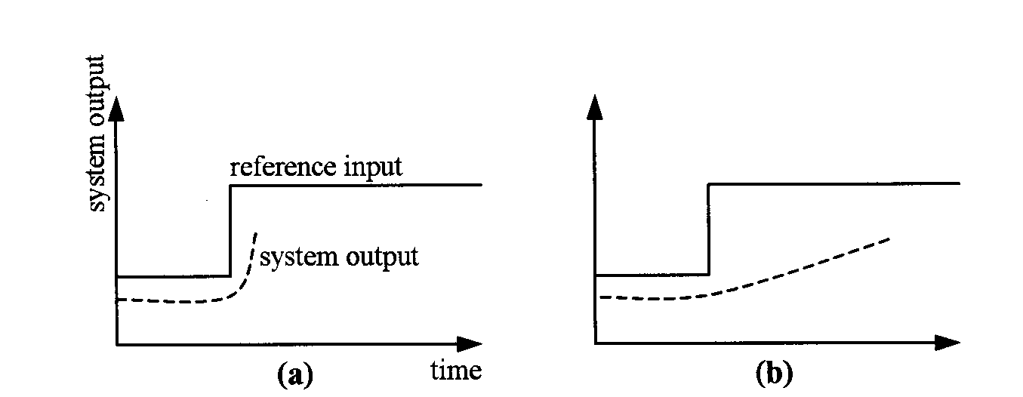
Controller Design: PD
Proportional and Derivative control
    u_{t} = P * (r_{t}-v_{t}) + D * ((r_{t}-v_{t})-(r_{t-1}-v_{t-1})) = P * e_{t}+ D * (e_{t}-e_{t-1})
Consider the size of error over time
Intuitively
  Want to “push” more if the error is not reducing fast enough
  Want to “push” less if the error is reducing really fast

Slide 30
PD Controller
Need to keep track of error derivative
E.g. Cruise controller example
  v_{t+1} = 0.7v_{t}+0.5u_{t}-w_{t}
  Let u_{t} = P * e_{t} + D * (e_{t}-e_{t-1}), e_{t}=r_{t}-v_{t}
  v_{t+1}=0.7v_{t}+0.5*(P*(r_{t}-v_{t})+D*((r_{t}-v_{t})-(r_{t-1}-v_{t-1})))-w_{t}
  v_{t+1}=(0.7-0.5*(P+D))*v_{t}+0.5D*v_{t-1}+0.5*(P+D)*r_{t}-0.5D*r_{t-1}-w_{t}
  Assume reference input and distribance are constant, the steady-state speed is
    V_{ss}=(0.5P/(1-0.7+0.5P)) * r
    Does not depend on D!!!
P can be set for best tracking and disturbance control
Then D set to control oscillation/overshoot/rate of convergence

Slide 31
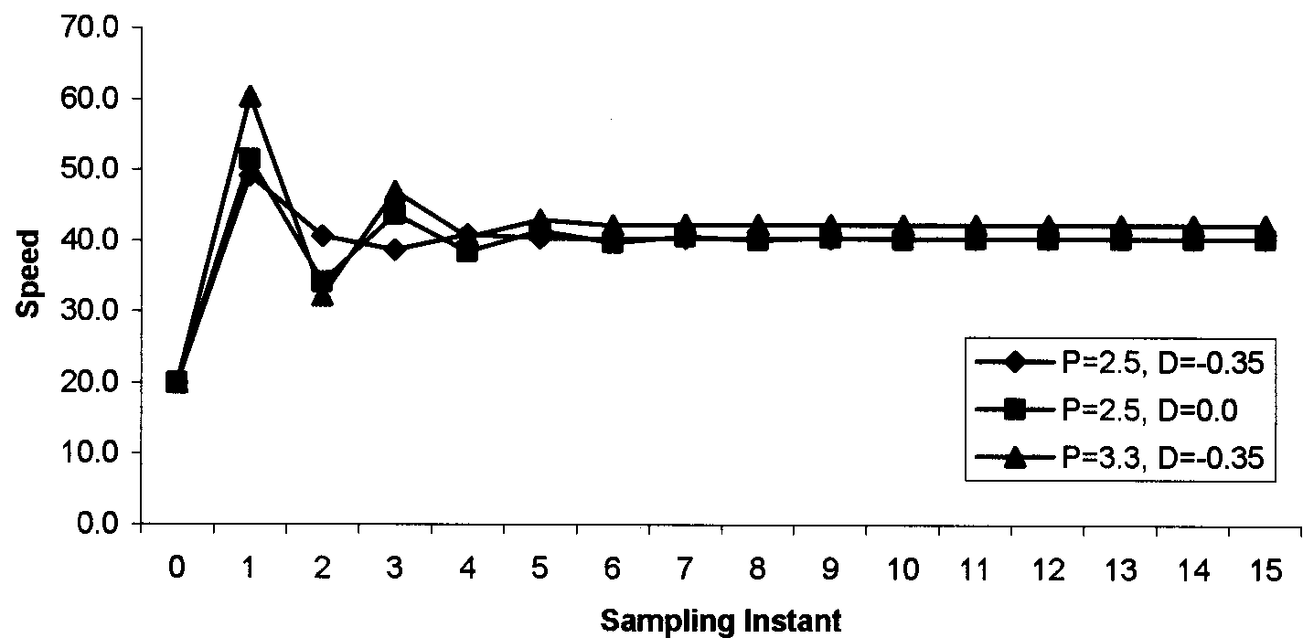
PD Control Example

Slide 32
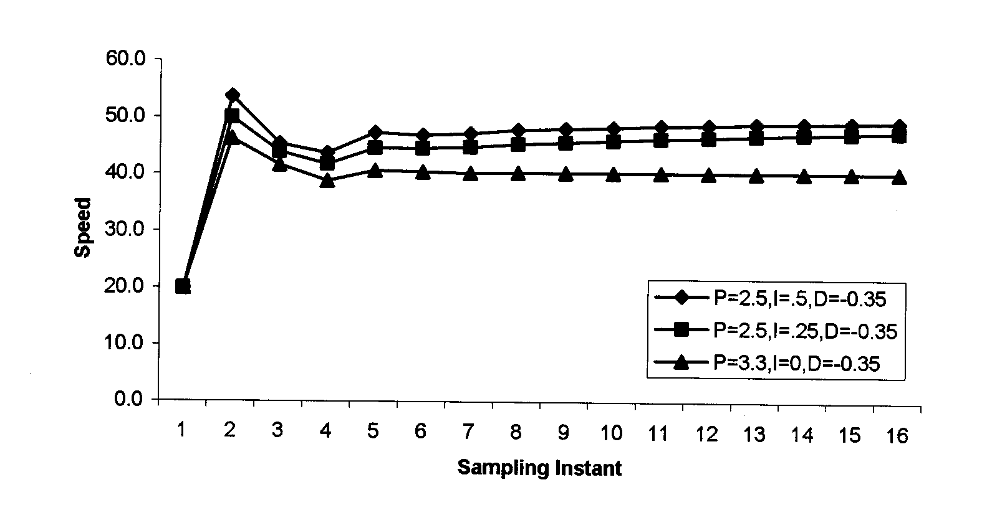
PI Control
Proportional plus integral control
  u_{t}=P*e_{t}+I*(e₀+e₁+…+e_{t})
Sum up error over time
  Ensure reaching desired output, eventually
  v_{ss} will not be reached until e_{ss}=0
Use P to control disturbance
Use I to ensure steady state convergence and convergence rate

Slide 33
PID Controller
Combine Proportional, integral, and derivative control
  u_{t}=P*e_{t}+I*(e₀+e₁+…+e_{t})+D*(e_{t}-e_{t-1})
Available off-the shelf

Slide 34
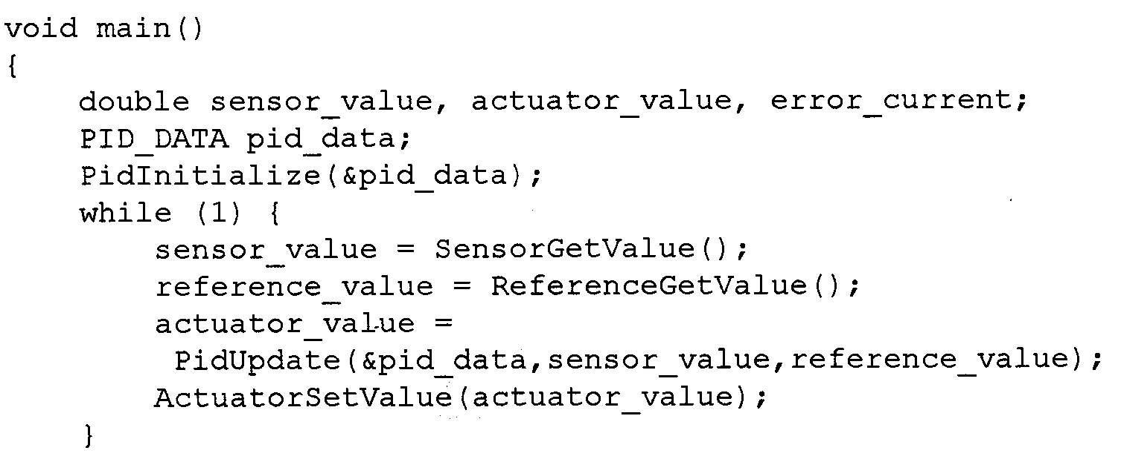
Software Coding
Main function loops forever, during each iteration
  Read plant output sensor
    May require A2D
  Read current desired reference input
  Call PidUpdate, to determine actuator value
  Set actuator value
    May require D2A

Slide 35
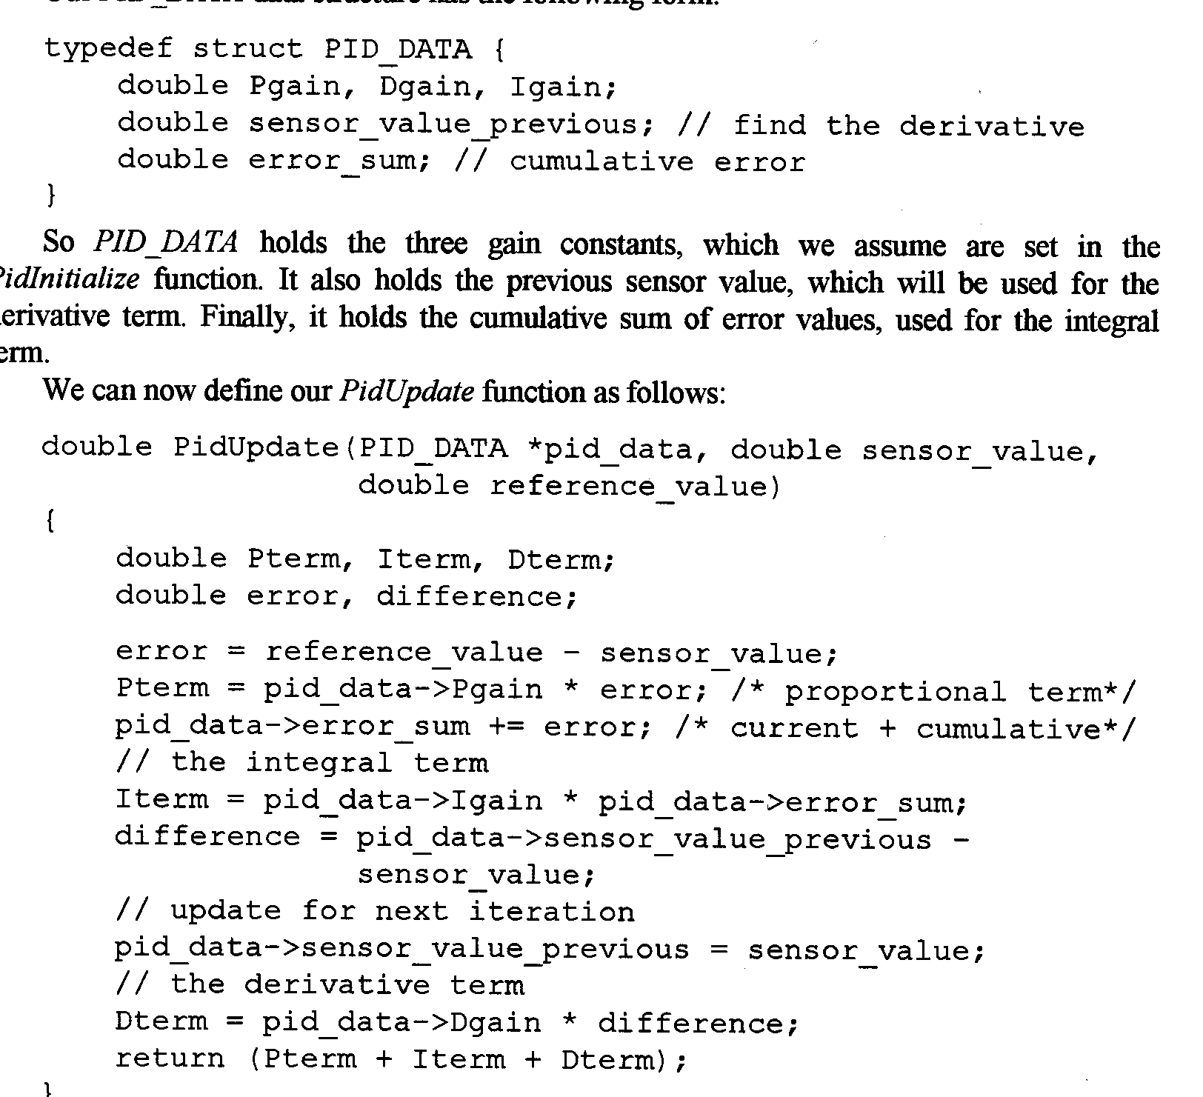
Software Coding (continue)
Pgain, Dgain, Igain are constants
sensor_value_previous
  For D control
error_sum
  For I control

Slide 36
Computation
u_{t}=P*e_{t}+I*(e₀+e₁+…+e_{t})+D*(e_{t}-e_{t-1})

Slide 37
PID tuning
Analytically deriving P, I, D may not be possible
  E.g. plant not is not available, or to costly to obtain
Ad hoc method for getting “reasonable” P, I, D
  Start with a small P, I=D=0
  Increase D, until seeing oscillation
    Reduce D a bit
  Increase P, until seeing oscillation
    Reduce D a bit
  Increase I, until seeing oscillation
Iterate until can change anything without excessive oscillation

Slide 38
Practical Issues with Computer-Based Control
Quantization
Overflow
Aliasing
Computation Delay

Slide 39
Quantization & Overflow
Quantization
  Can’t store 0.36 as 4-bit fractional number
  Can only store 0.75, 0.59, 0.25, 0.00, -0.25, -050,-0.75, -1.00
  Choose 0.25
    Result in quantization error of 0.11
Sources of quantization error
  Operations, e.g. 0.50*0.25=0.125
    Can use more bits until input/output to the environment/memory
  A2D converters
Overflow
  Can’t store 0.75+0.50 = 1.25 as 4-bit fractional number
Solutions:
  Use fix-point representation/operations carefully
    Time-consuming
  Use floating-point co-processor
    Costly

Slide 40
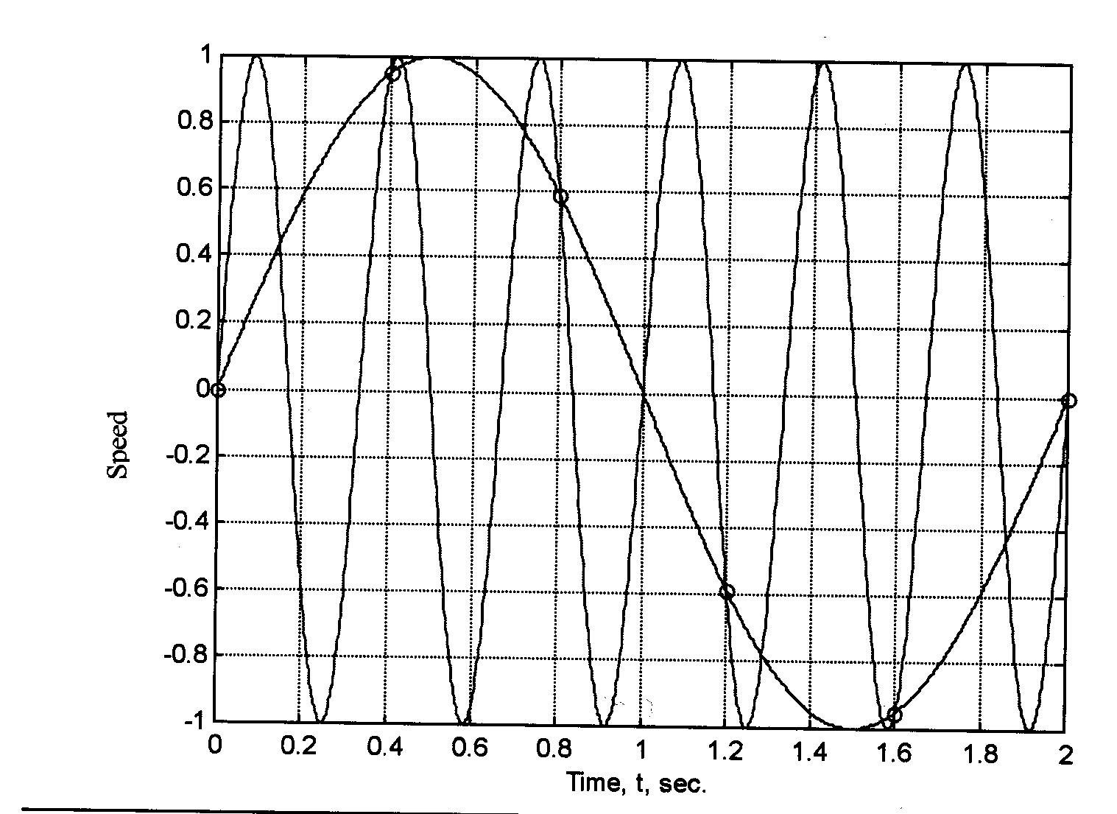
Aliasing
Quantization/overflow
  Due to discrete nature of computer data
Aliasing
  Due to discrete nature of sampling

Slide 41
Aliasing Example
Sampling at 2.5 Hz, period of 0.4, the following are indistinguishable
  y(t)=1.0*sin(6πt), frequency 3 Hz
  y(t)=1.0*sin(πt), frequency of 0.5 Hz
In fact, with sampling frequency of 2.5 Hz
  Can only correctly sample signal below Nyquist frequency 2.5/2 = 1.25 Hz

Slide 42
Computation Delay
Inherent delay in processing
  Actuation occurs later than expected
Need to characterize implementation delay to make sure it is negligible
Hardware delay is usually easy to characterize
  Synchronous design
Software delay is harder to predict
  Should organize code carefully so delay is predictable and minimized
  Write software with predictable timing behavior (be like hardware)
    Time Trigger Architecture
    Synchronous Software Language

Slide 43
Benefit of Computer Control
Cost!!!
  Expensive to make analog control immune to
    Age, temperature, manufacturing error
  Computer control replace complex analog hardware with complex code
Programmability!!!
  Computer Control can be “upgraded”
    Change in control mode, gain, are easy to do
  Computer Control can be adaptive to change in plant
    Due to age, temperature, …etc
  “future-proof”
    Easily adapt to change in standards,..etc

