Slide 1
FSM Online Internship
Remaining Usable Life Estimation using Bearing dataset
S Digvijaya Patro
National Institute of Science and Technology, Berhampur
Under Mentorship of
Mr. Devesh Tarasia
IITD-AIA FOUNDATION FOR SMART MANUFACTURING

Slide 2
Project Background
Problem Statement: The project aims to address the challenge of accurately predicting the remaining usable life of industrial bearings in smart manufacturing.
Physical Equipment Implementation: The project focuses on implementing the predictive model on essential rotating machinery found in smart manufacturing setups, including conveyor systems, robotic arms, and assembly line equipment.
Unique Challenges:
Variability in Manufacturing
Real-time Monitoring
Continuous Learning
Limited Failure Data

Slide 3
Objective
The primary objective of the "Remaining Usable Life Estimation using Bearing Dataset for Smart Manufacturing" project is to develop a robust and accurate predictive model that utilizes advanced data analytics and machine learning techniques to estimate the remaining usable life of industrial bearings in a smart manufacturing environment. This model aims to enhance maintenance strategies by providing timely and actionable insights, ultimately leading to improved operational efficiency, reduced downtime, and optimized resource utilization. Through the analysis of bearing data, the project seeks to achieve a deeper understanding of the degradation patterns, failure modes, and influencing factors, thereby enabling proactive maintenance decisions and contributing to the overall advancement of predictive maintenance practices in modern manufacturing processes.

Slide 4
Methodology
Data Collection and Exploration
Data Preprocessing
Data Splitting
Feature Selection
Model Selection
Model Training
Model Evaluation
Hyperparameter Tuning
Prediction
Monitoring and Maintenance

Slide 5
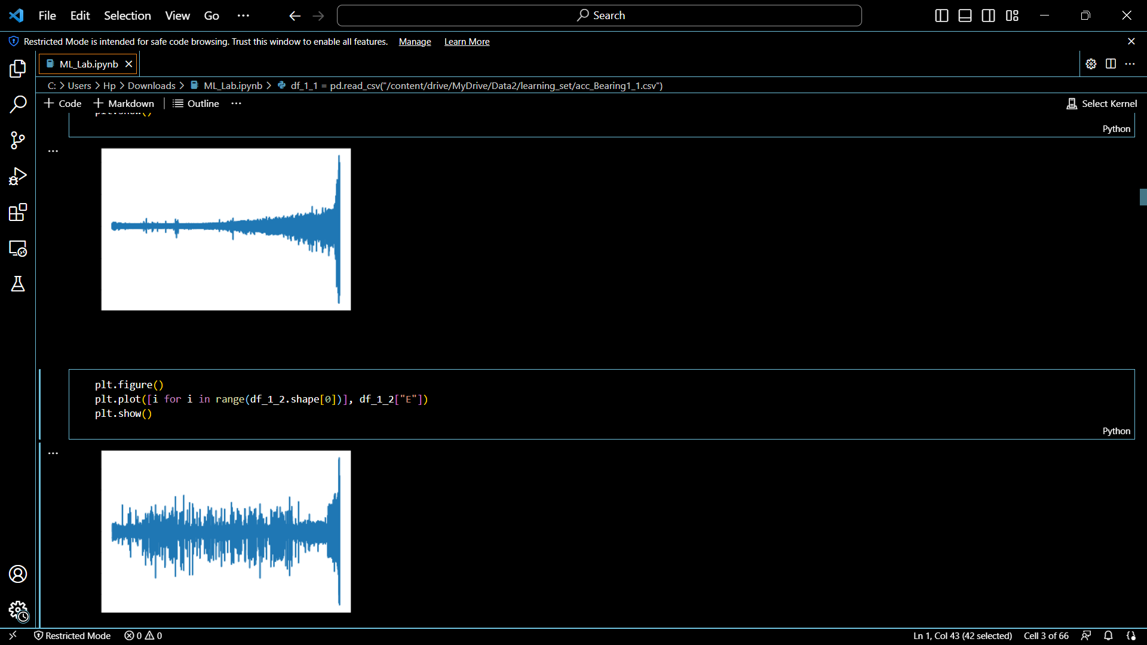
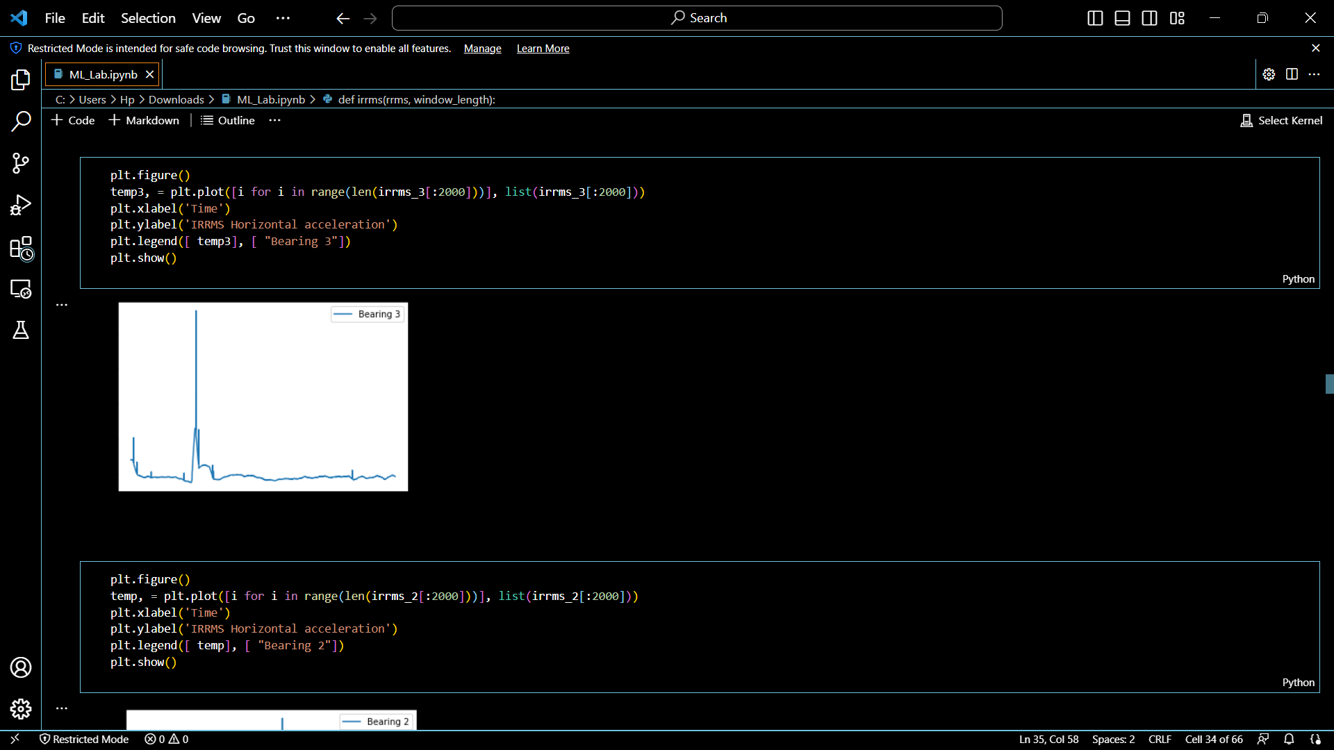
Implementation

Slide 6
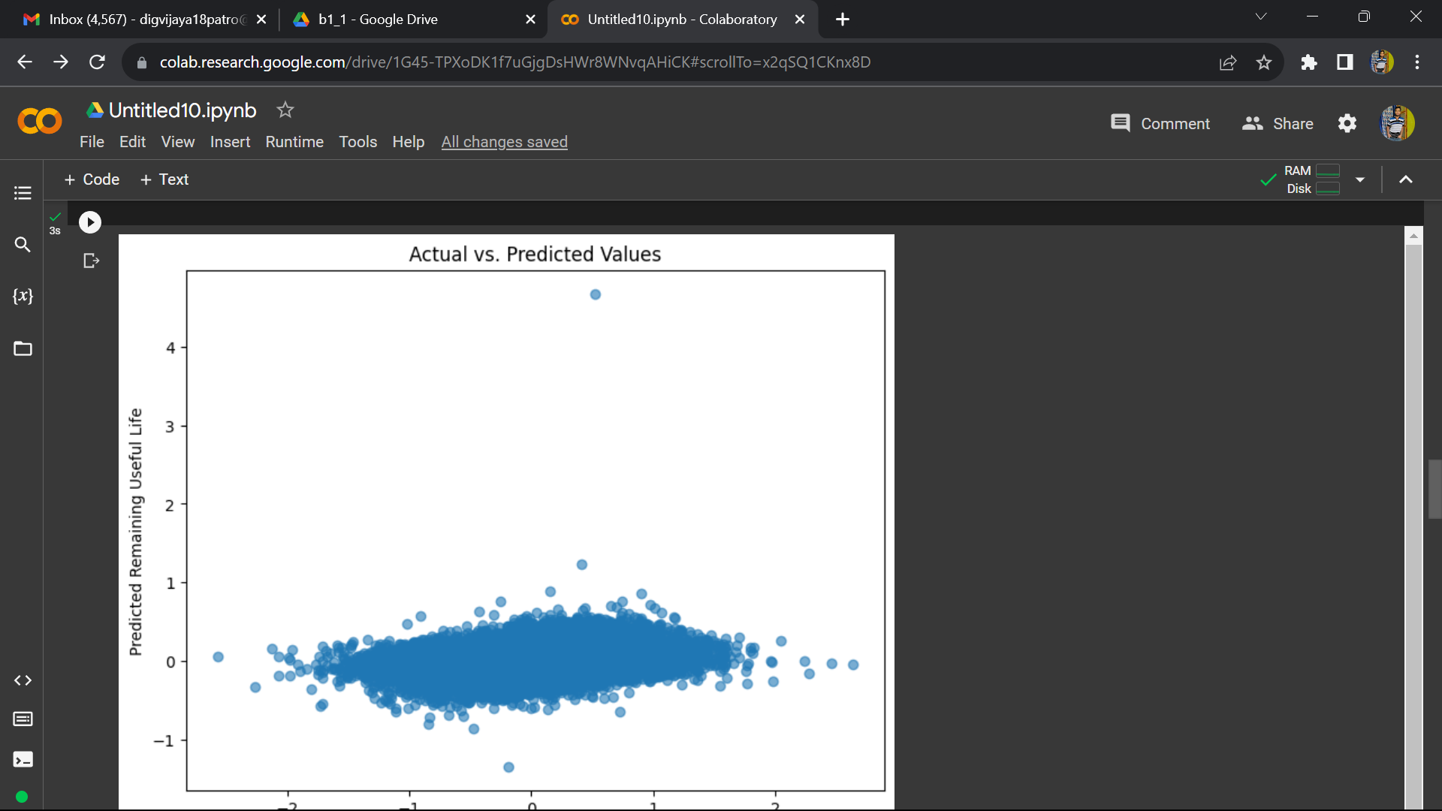
Implementation

Slide 7
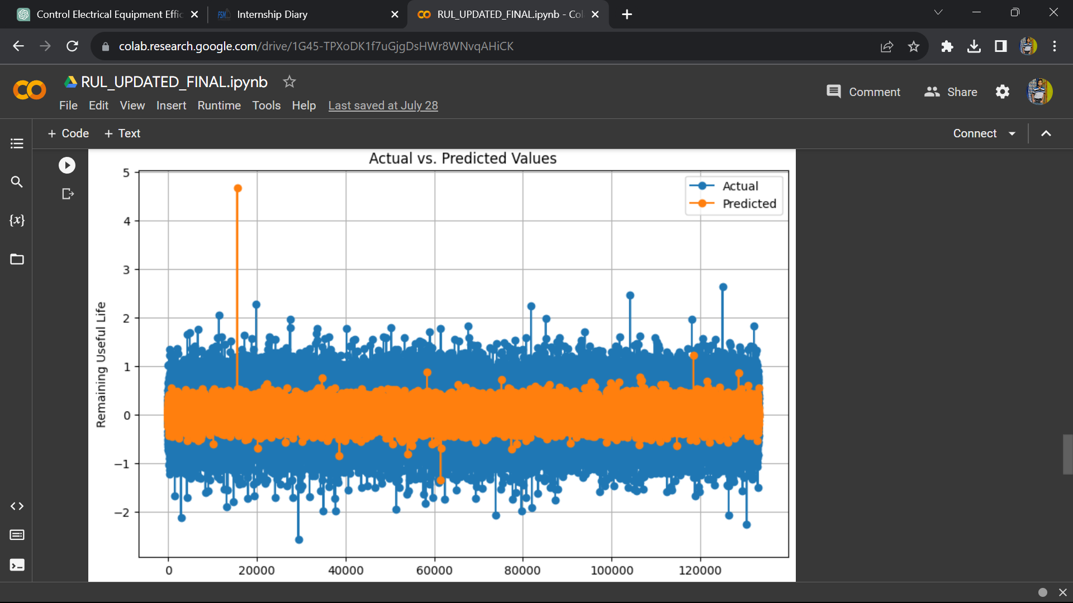
Implementation

Slide 8
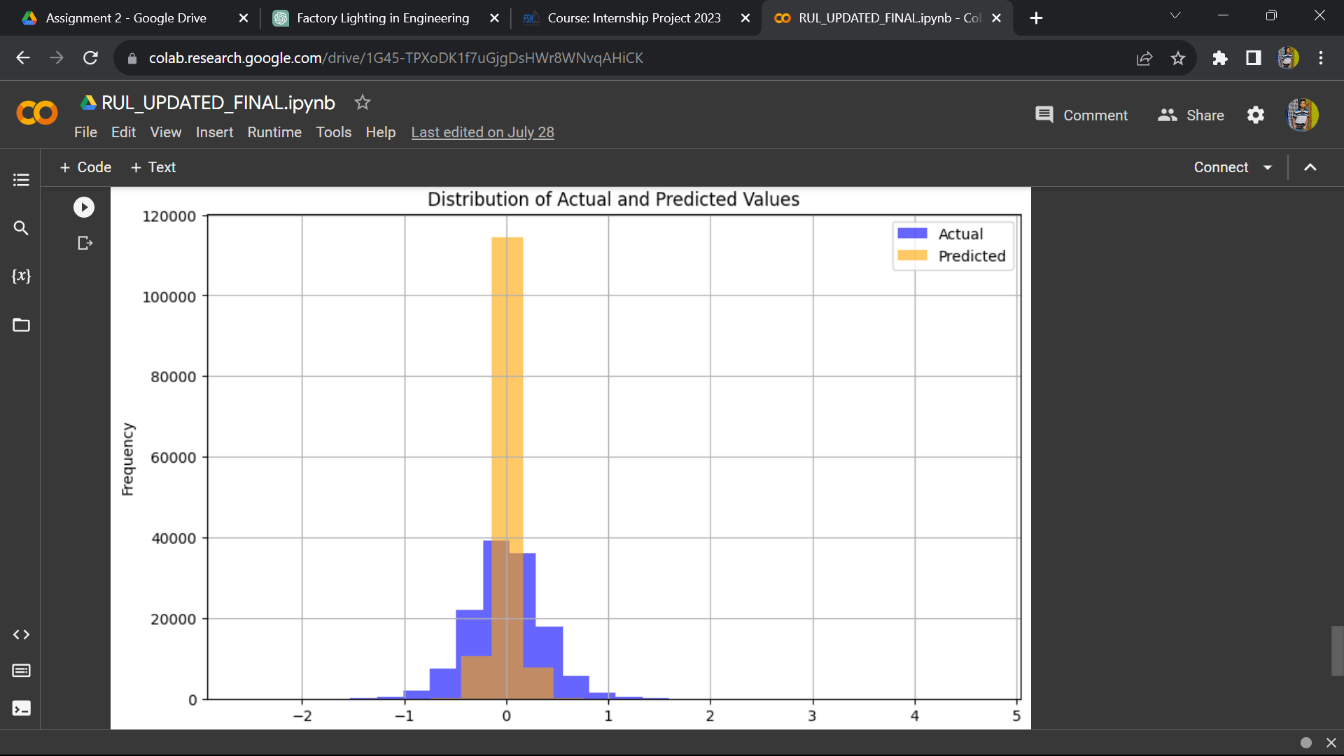
Implementation

Slide 9
Innovation in Implementation
One innovative method used in the implementation of remaining usable life estimation using bearing dataset involves the integration of a hybrid machine learning approach that combines deep learning techniques with domain-specific feature engineering.
Explanation:
Hybrid Architecture
Domain-Specific Features
Transfer Learning
Anomaly Detection and Early Warning
Explainability and Interpretability

Slide 10
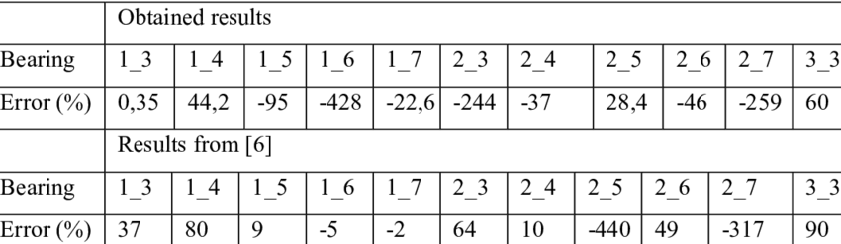
Outcome

Slide 11
Scalability
It is a crucial aspect of the "Remaining Usable Life Estimation using Bearing Dataset for Smart Manufacturing" project, as it ensures that the developed solution can effectively address industrial challenges across diverse manufacturing environments and scales.
Here's how scalability is achieved to solve the industrial problem:
Diverse Equipment Types
Large-Scale Data Handling
Edge Computing
Automated Deployment and Updates
Continuous Improvement

Slide 12
Thank You
spb120@nist.edu

