Slide 1


NoteSwap
online unique currency note and vintage item selling platform

Slide 2
TEAM
Patel Vishv (B-38)
(Admin panel - UI)
Harkhani Bhavdip (B-15)
(Admin panel - UI)
Patel Utsav (B-37)
(Admin panel – Data integration)
Jakhaniya Digvijay (B-37)
(Admin panel – Data integration & Mobile App)

Slide 3
AGENDA
Abstract of definition
Market research & Study of conducted surveys
Expected Outcome
Data Dictionary
Diagrams(Use Case, Activity, Class)
Wireframes of UI Design & Logic
Future directions
References

Slide 4
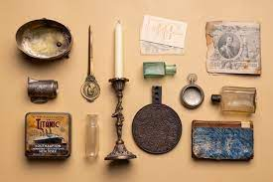
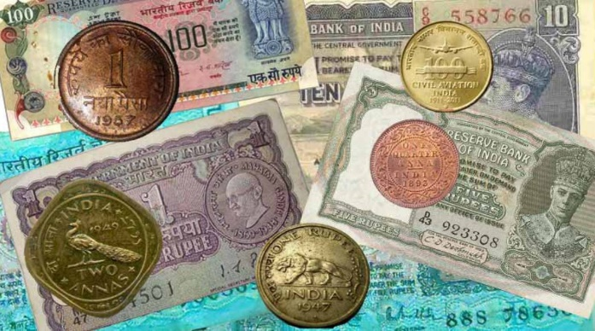
ABSTRACT DEFINITION
An "Old Currency Notes and Vintage Item Selling and Purchase App" is a digital platform that connects collectors and sellers of historical paper currency and vintage items. It enables users to create listings for currency notes, search for specific notes, securely communicate, and conduct both buying and selling transactions. The app aims to provide a convenient and secure environment for trading old currency notes and vintage items with historical and cultural value, fostering a vibrant marketplace for enthusiasts and collectors.

Slide 5
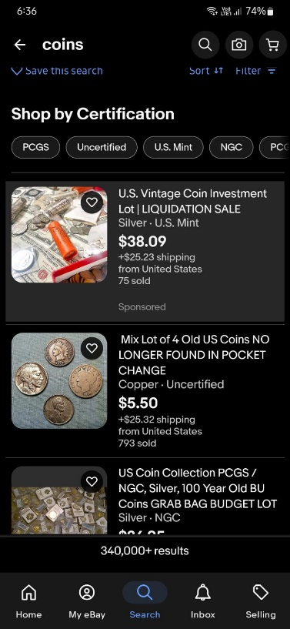
STUDY OF SIMILAR IDEAS
eBay
Description: Users can buy and sell a wide range of collectible items, including currency notes, coins, stamps, and vintage items.
Key Features: Bidding and auction-style listings. Robust search and filtering options for specific collectibles.
limitations: Competitive Fees Complex User Interface Reach limitation (Foreign coins and items)

Slide 6
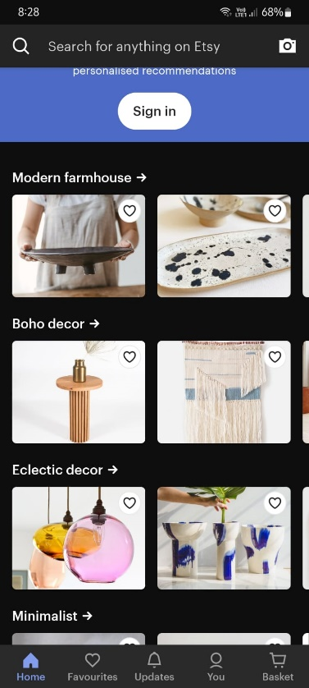
STUDY OF SIMILAR IDEAS
Etsy
Description: Etsy is known for handmade and artisanal products, it also hosts a substantial market for vintage items and collectibles.
Key Features: Extensive vintage and antique item categories. User-friendly storefronts for sellers.
limitations: Focus on handmade items Create seller account for selling and Seller Fees Fix price (No Negotiations)

Slide 7
MARKET RESEARCH
Collectors and Enthusiasts, Sellers and Dealers, Numismatists, Philatelists, Auctioneers, Historians and Researchers, Appraisers and Authentication Experts, Artists and Craftsmen, Government Officials, Online Marketplace Operators in this industry.
the trend of buying and selling old coins and currency notes has been going up for the past few years. People are frequently selling antique coins and notes and earning money for them through various online and offline platforms.
some old notes and coins can be sold for high prices, such as Rs. 2 satellite issue note for Rs. 24000, Rs. 10 peacock note for Rs. 22000, and Rs. 5 tractor note.

Slide 8
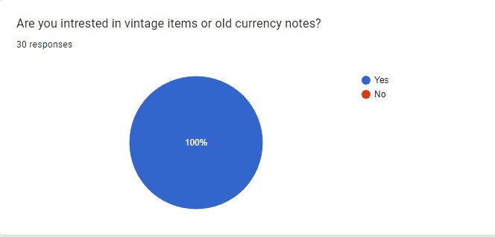
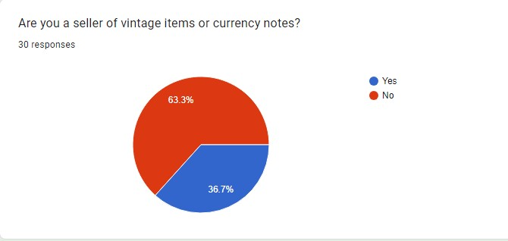
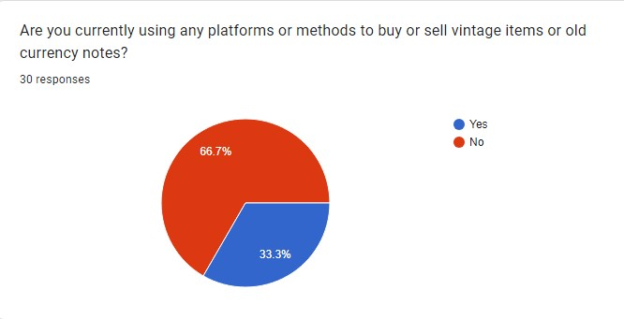
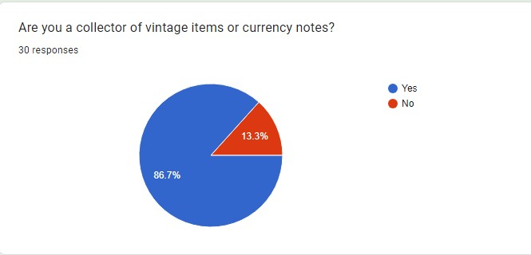
SURVEY

Slide 9
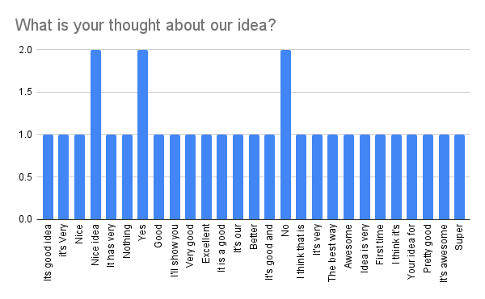
SURVEY

Slide 10
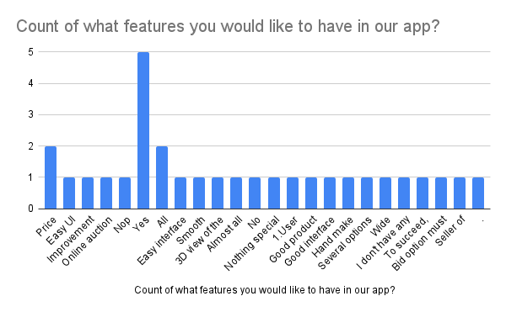
SURVEY

Slide 11
EXPECTED OUTCOME
Connections
cultural value
Listings
Brand Reputation
Revenue Generation

Slide 12
Data Dictionary
User Table
Fields | Data Type (Size) | Constraints | Description
User_id | Int | Primary Key | User id
User_name | VARCHAR(50) | NOT NULL | User name
Email | VARCHAR(100) | NOT NULL | Email
Password | VARCHAR(60) | NOT NULL | Password
Profile_picture | VARCHAR(255) |  | Profile picture
Contact_info | VARCHAR(15) |  | Contact info
Building_no | Varchar(50) | NOT NULL | Building no
Landmark | Varchar(20) | NOT NULL | Landmark
City | Varchar(20) | NOT NULL | City
Postal_code | Int(6) | NOT NULL | Postal code

Slide 13
Data Dictionary
Product Table
Fields | Data Type (Size) | Constraints | Description
Product_id | Int | Primary Key | Product id
Title | VARCHAR(255) | NOT NULL | Title
Product_image | VARCHAR(100) | NOT NULL | Product Image
Price | DECIMAL(10, 2) | NOT NULL | Price
Description | TEXT |  | Description
Post_date | DATETIME |  | Post data
Seller_iD | INT | FOREIGN KEY | Seller id
Building_no | int(10) | FOREIGN KEY | Building no
Landmark | Varchar(20) | FOREIGN KEY | Landmark
City | Varchar(20) | FOREIGN KEY | City
Postal_code | int(6) | FOREIGN KEY | Postal code

Slide 14
Data Dictionary
Category Table
Fields | Data Type (Size) | Constraints | Description
Category_id | Int | Primary Key | Category id
Category_name | VARCHAR(50) | NOT NULL | Category name

Slide 15
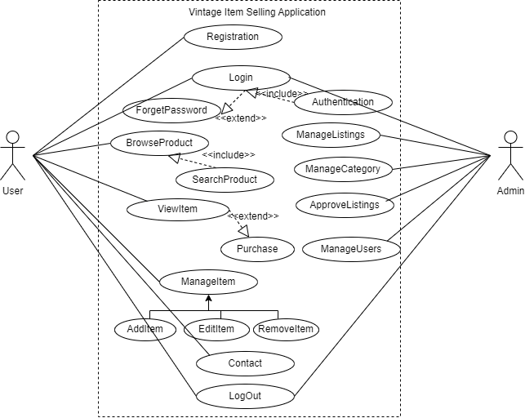
USE CASE

Slide 16
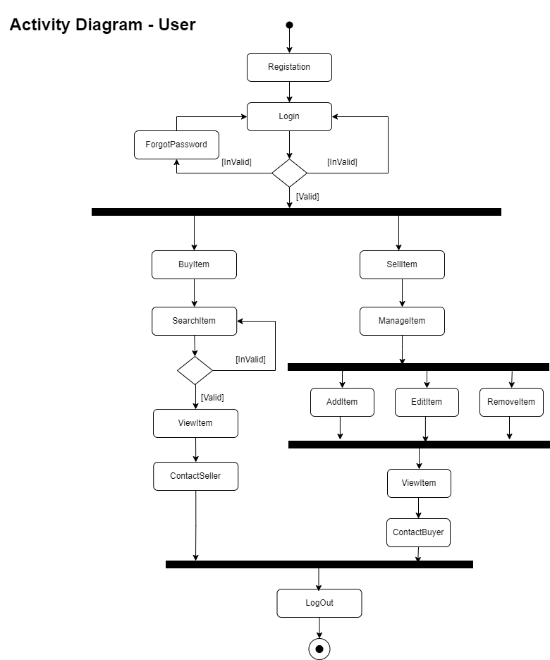
Activity Diagram-User

Slide 17
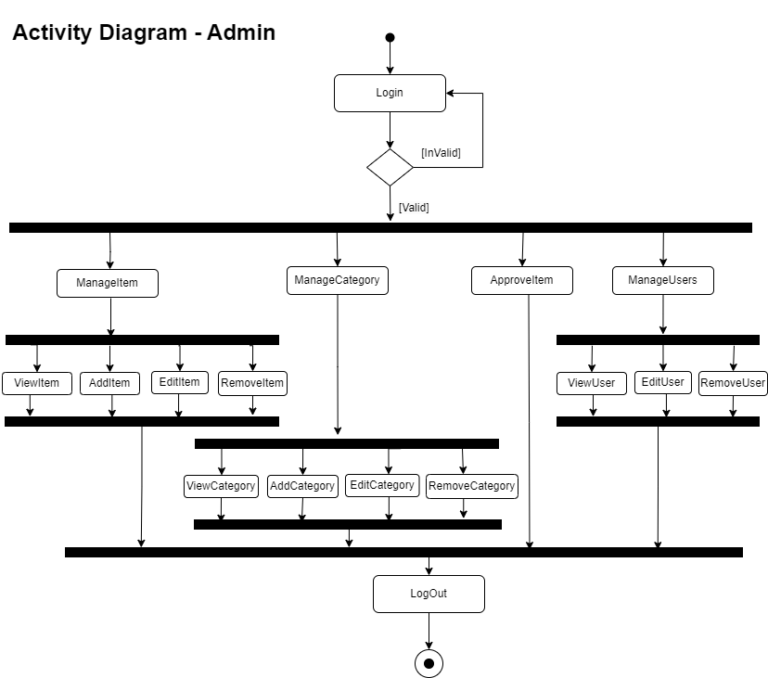
Activity Diagram-Admin

Slide 18
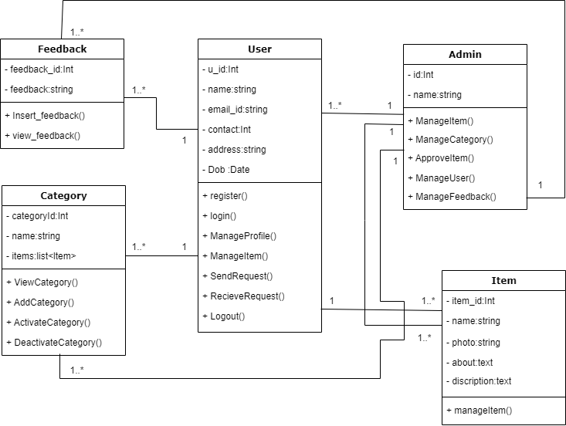
Class Diagram

Slide 19
Wireframe & Logic

Slide 20
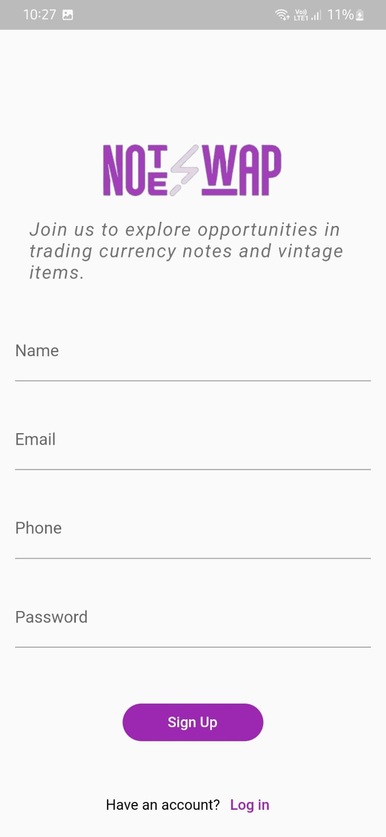
Sign Up
User Initiation:
Users begin their vintage journey by ‘signing up’, providing essential details for account creation.
Login:
If already a member, effortlessly access your vintage haven by clicking 'Login' and enjoy a seamless entry into your cherished account..

Slide 21
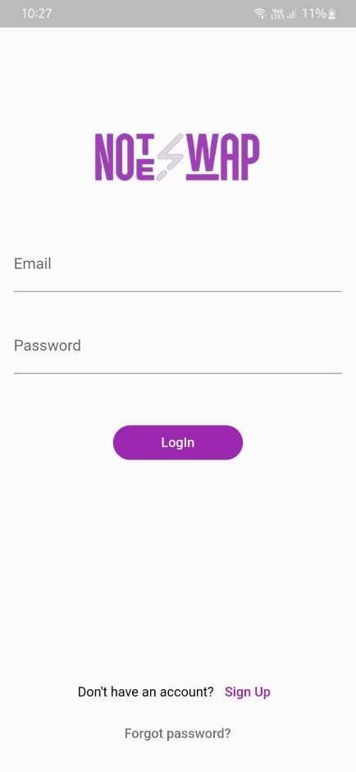
Log In
User Login:
Users enter their credentials (email and password) to access their account.
Sign Up Redirection:
For new users, a "Sign Up" redirection button is provided.
Forgot Password:
A "Forgot Password" link offers users a quick solution for password recovery.

Slide 22
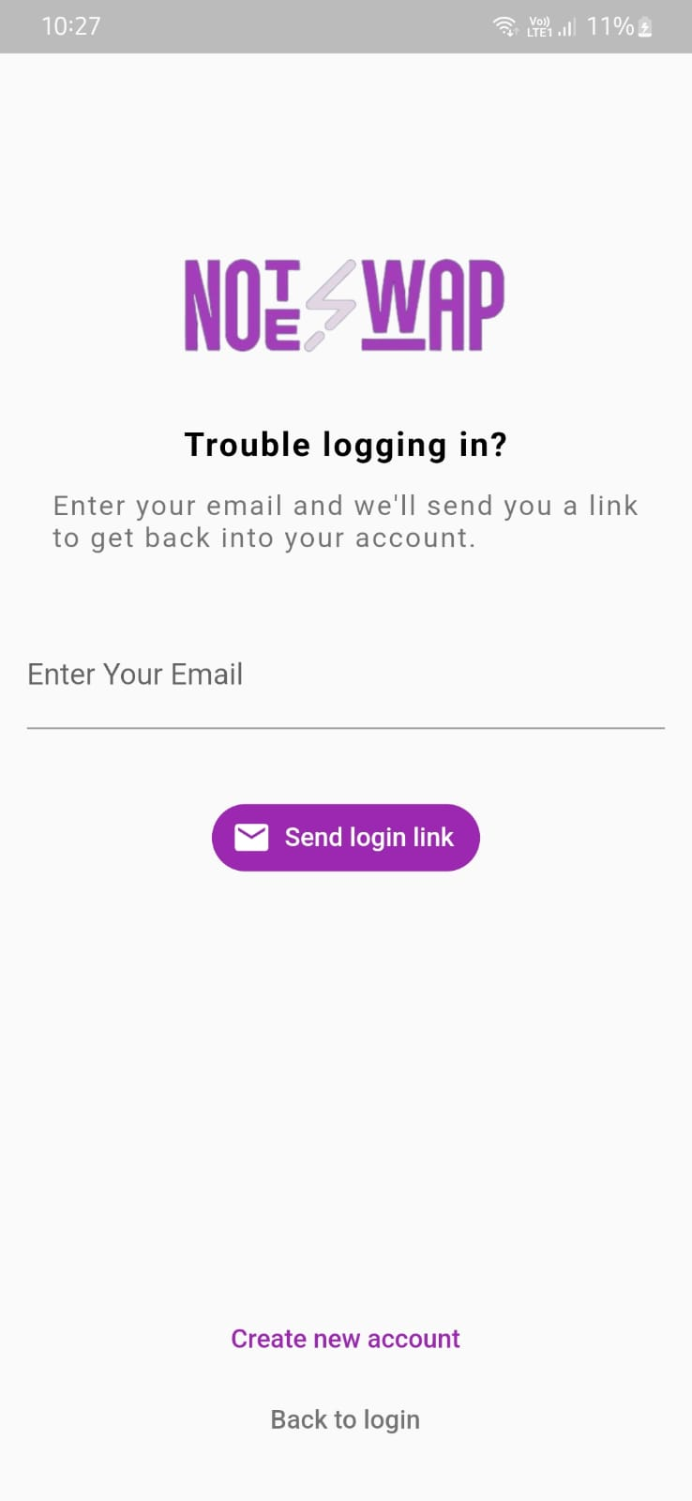
Forgot Password
Password Reset:
Users enter their registered email to receive a secure link for password reset.
Create New Account:
For new users or those wishing to create a fresh account, a "Create Account" button is provided.
Back to Login:
A "Back to Login" button allows users to return to the Login page quickly.

Slide 23
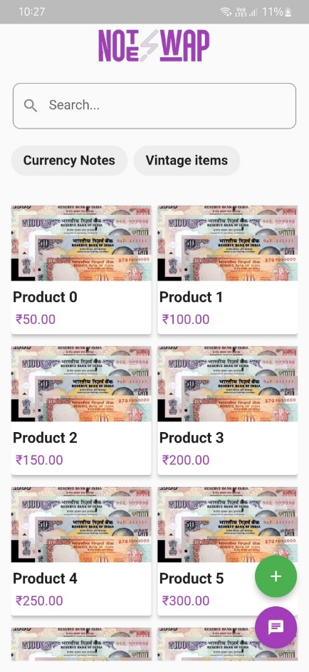
Home
Products & Category Display:
A dynamic showcase of featured products captures users' attention, providing a snapshot of the unique and rare items within each category.
Product Details
Search Functionality
Category Selection
Chat Interaction
Add New Product

Slide 24
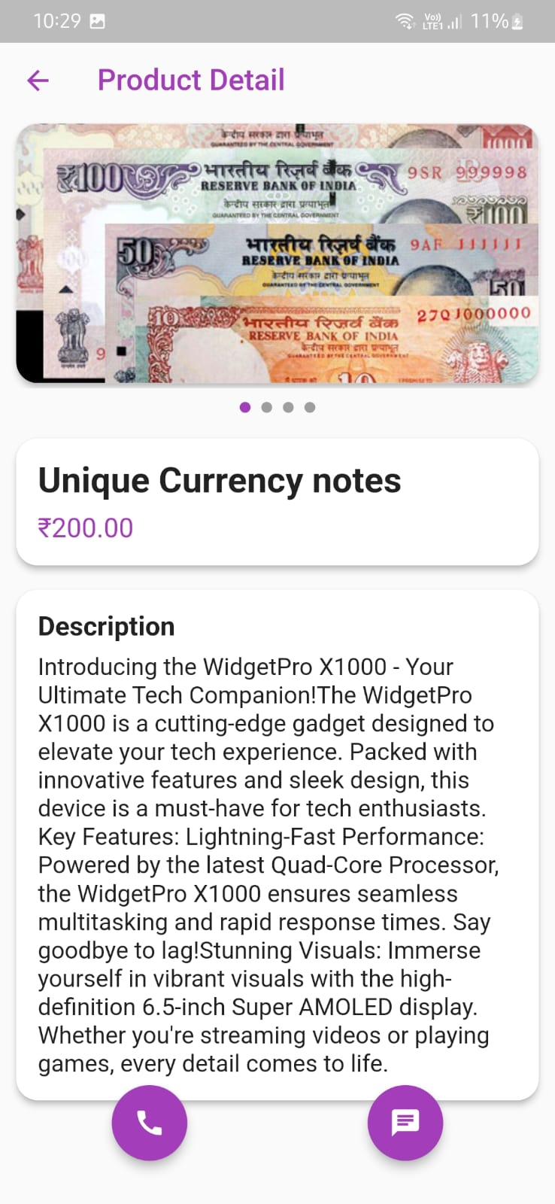
Product Details
Products Details:
Dive into an immersive showcase with a slider of high-res images, presenting vital details like product name, description, and price for a comprehensive view of the vintage item.
Call Seller
Chat with Seller

Slide 25
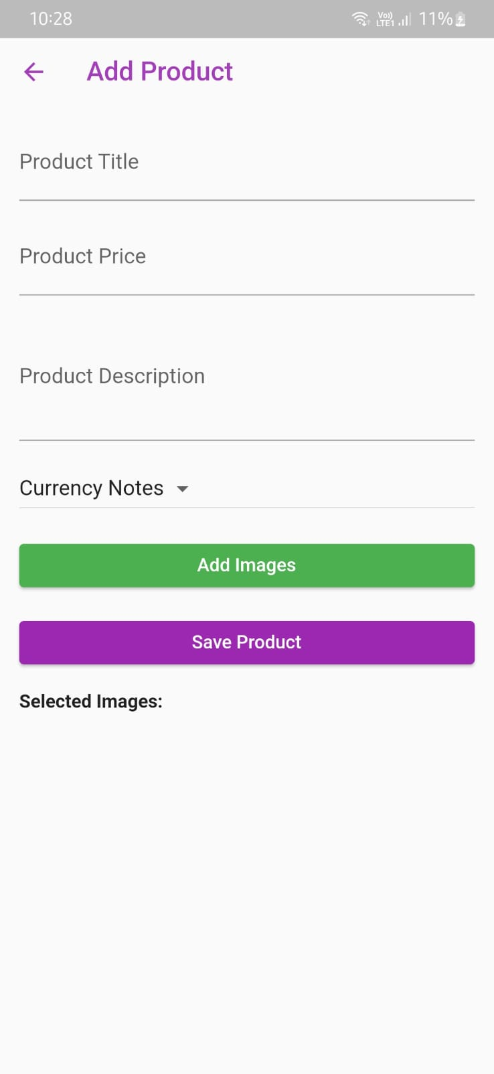
Add Product
Products Details:
Sellers effortlessly contribute to the vintage marketplace by navigating the intuitive "Add Product" page.
A streamlined process allows for the submission of essential details including product name, category, description, images, and pricing.
Selected Images

Slide 26

Chat List
Chat List:
The Chat List Home serves as a central hub, displaying an organized list of ongoing conversations between buyers and sellers.
Users can effortlessly track and manage their communications, ensuring a seamless and responsive interaction experience.
Search sellers and buyers

Slide 27
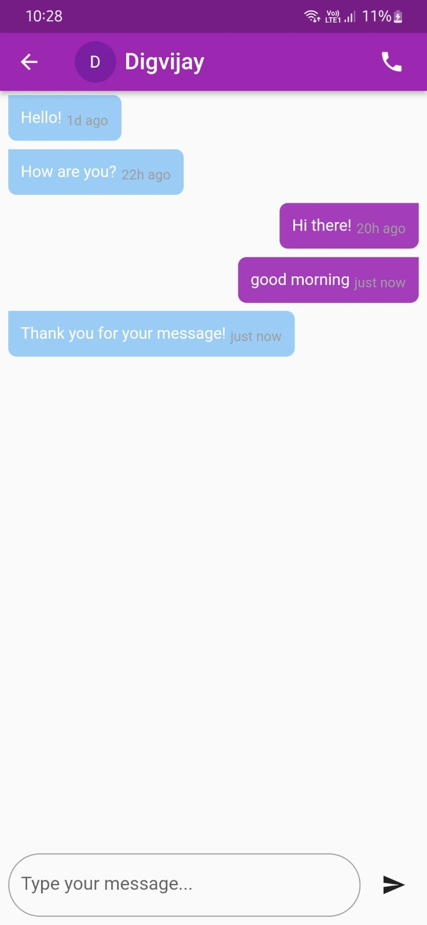
Chat
One to One Chat:
Step into a personalized space where buyers and sellers engage in direct, real-time conversations about vintage treasures.
The chat interface features a user-friendly design, supporting the exchange of messages, negotiation details, and additional product information.
Call seller or buyer

Slide 28
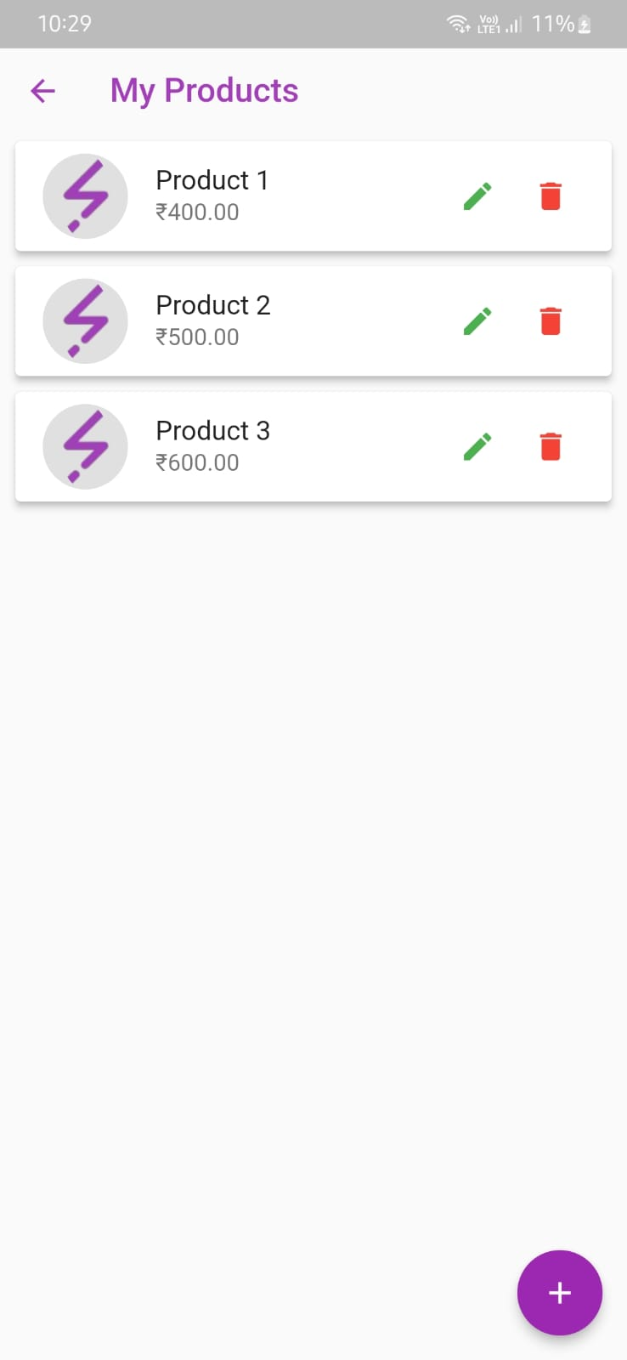
My Products
User Products:
The "My Product" page empowers sellers to effortlessly upload, manage, and showcase their curated vintage items for sale.
A user-friendly interface guides the process, allowing seamless addition of product details, captivating images, and pricing information.
Edit products
Delete products
Add products

Slide 29
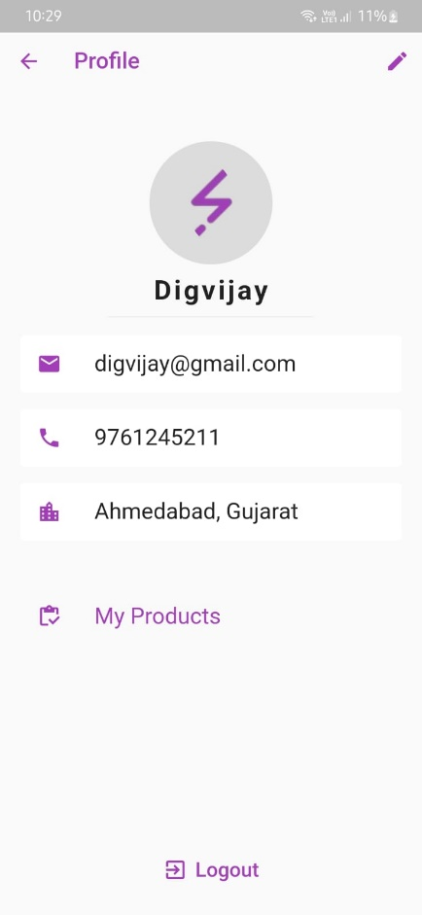
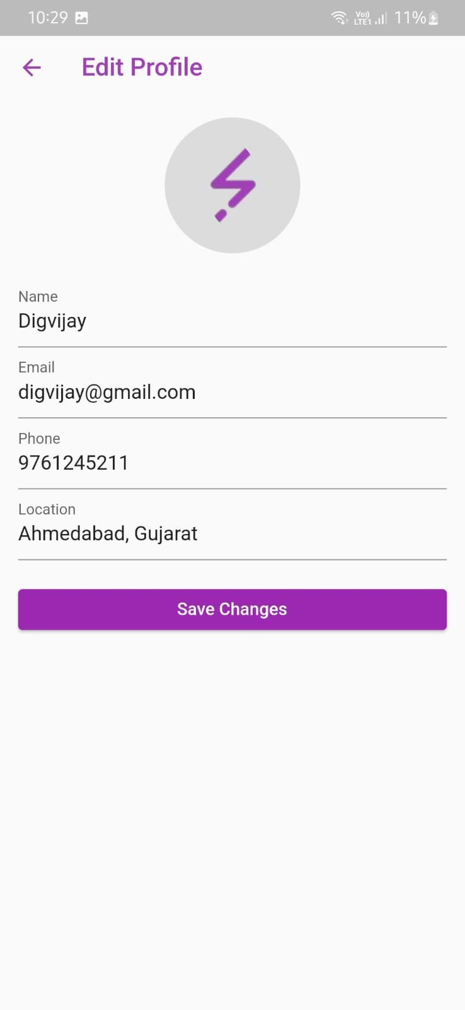
Profile
Edit Profile
User Profile:
Explore your vintage persona on the Profile Page, featuring a snapshot of your identity with a profile picture, chosen username, contact number, email and location.
Edit profile
User products
Log out

Slide 30
Backend Website:- https://noteswap.rf.gd

Slide 31
FUTURE DIRECTIONS
Collection list
Global Expansion
3D viewing capabilities
Online auction functionality
And additional features……..

Slide 32
REFERENCES
Similar Apps
App Store Reviews
Contact with experts
Social media communities
Conducted surveys.
Survey :- Google Forms
Diagrams :- draw.io

Slide 33
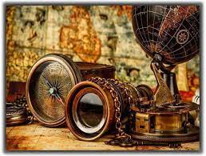
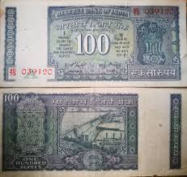
THANK YOU
Jakhaniya Digvijay (B-16)
Patel Utsav (B-37)
Patel Vishv (B-38)
Harkhani Bhavdip (B-15)

