Slide 1
CSE523 Machine Learning
Group 4- Optimizers
Topic- Optiver Realized Volatility prediction
Faculty: Professor Mehul Raval
Name | Roll Number
DIGVIJAYSINH GOHIL | AU1940199
SMIT SHAH | AU1940291
SATYA SHAH | AU1940288
TIRTH KANANI | AU1920144

Slide 2

Introduction
Our main goal is to predict volatility of stocks based on the dataset which we took from Kaggle.
Optiver is a leading global electronic market maker and is dedicated to continuously improving financial markets.
What is volatility?
It is a statistical measure of the dispersions of a return for given security or market index.

Slide 3
Problem Statement
In financial markets, volatility captures the amount of fluctuation in prices.
Accurately predicting the volatility of stocks helps investors and individuals make better decisions.
Projecting future volatility using past data is key to determine the volatility of the markets in the upcoming periods of time.
Thus, we are trying to build a machine learning model that predicts the volatility of various stocks based on the input dataset provided.

Slide 4
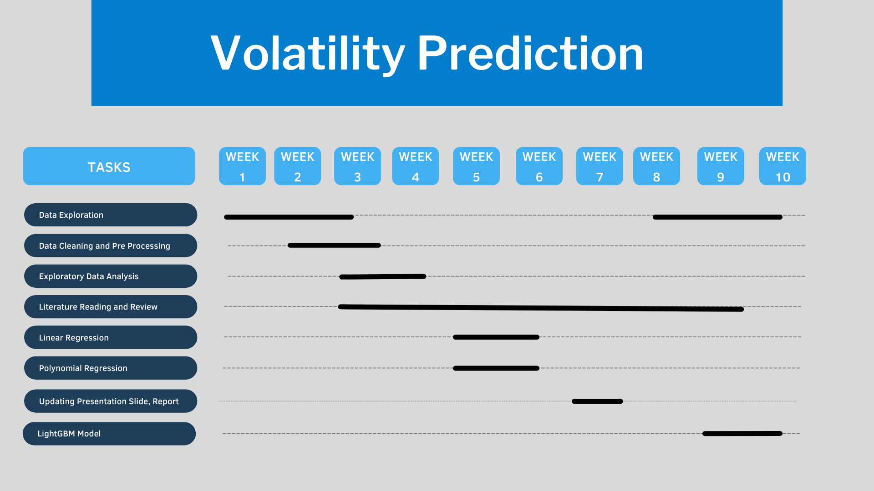
GANTT Chart

Slide 5
Existing Body of Work
The following are the advanced models used in time series research for Volatility:
Autoregressive Conditional Heteroskedasticity
GBDT (Gradient Boosting Decision Tree)
generalized Polynomial Chaos (gPC)
A machine learning approach to volatility ... - pure.au.dk. (n.d.). Retrieved March 19, 2022, from https://pure.au.dk/portal/files/208284743/rp21_03.pdf

Slide 6
Existing Body of Work
Various models and approaches have been done in order to predict fluctuations in the volatility of stocks.
[1] has implemented LightGBM (Light Gradient Boosting Machine) prediction model which is a better model as compared to XGBoost (Extreme Gradient Boosting). LightGBM works faster and has more accuracy than the XGBoost model.
[2] proposes that ARCH (Autoregressive Conditional Heteroskedasticity) based models are unable to predict volatility accurately as the stocks data are non-linear. This paper applies SVR (Support Vector Regression) for volatility prediction.
Y. Wu and Q. Wang, "LightGBM Based Optiver Realized Volatility Prediction," 2021 IEEE International Conference on Computer Science, Artificial Intelligence and Electronic Engineering (CSAIEE), 2021, pp. 227-230, doi: 10.1109/CSAIEE54046.2021.9543438
S. Choudhury, S. Ghosh, A. Bhattacharya, K. J. Fernandes, and M. K. Tiwari, “A real time clustering and SVM based price-volatility prediction for optimal trading strategy,” Neurocomputing, 29-Oct-2013. [Online]. Available: https://www.sciencedirect.com/science/article/abs/pii/S0925231213009296. [Accessed: 27-Mar-2022].

Slide 7
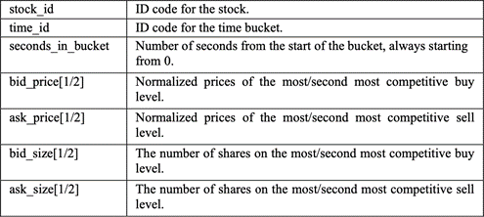
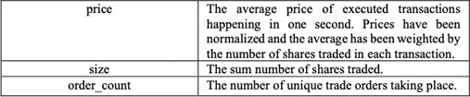
Data
→ Book data
Trade Data →

Slide 8



Work Done So Far
We performed Exploratory Data Analysis on our data.
We calculated the Weighted Average Price (WAP).
Raw return = (Selling price- Buying price) / Buying Price
Log return Realized volatility

Slide 9
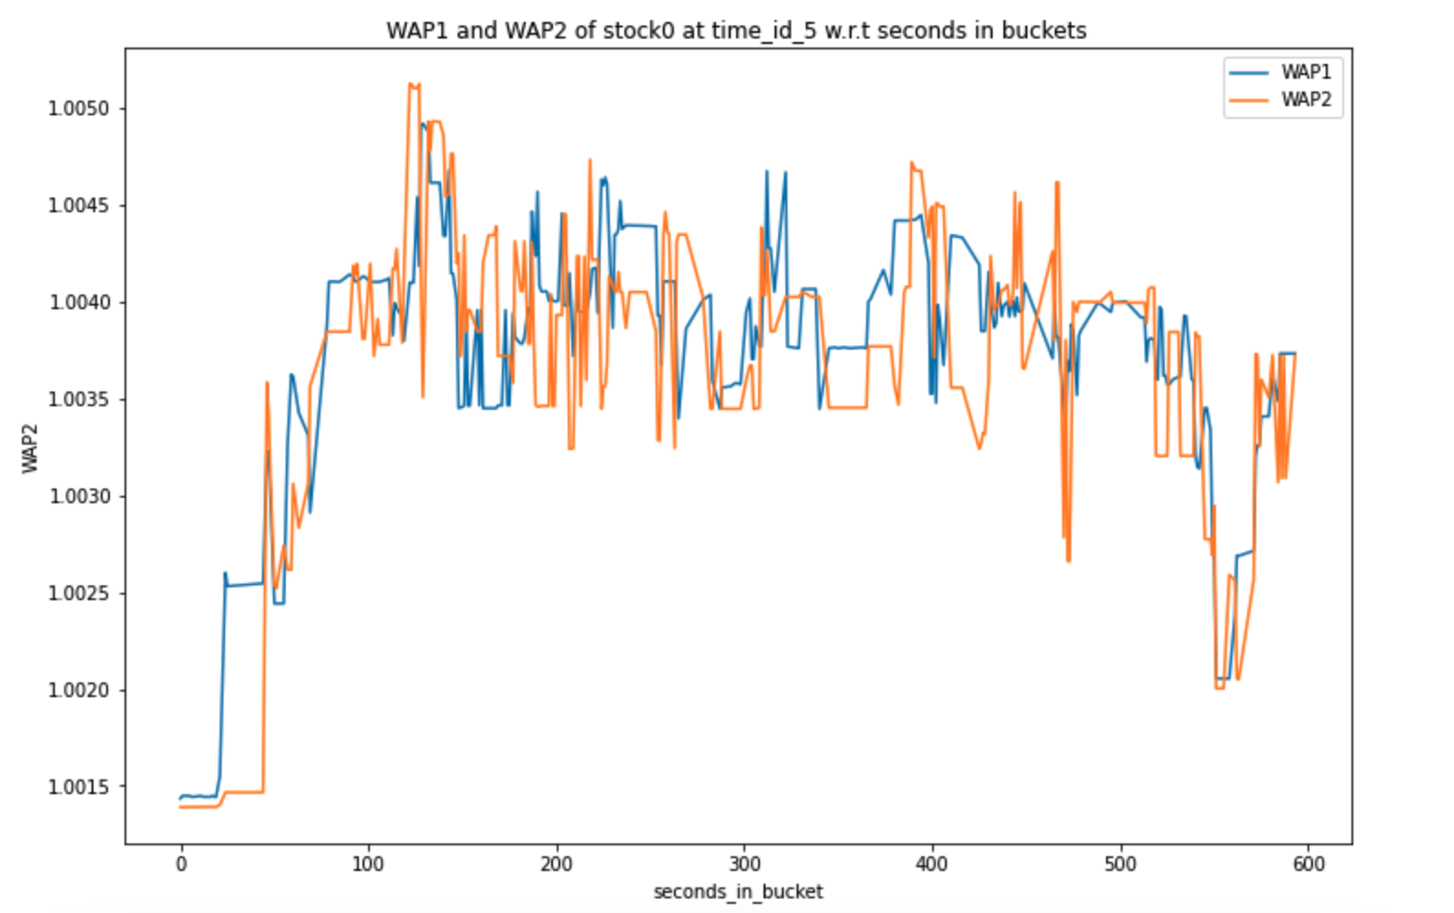
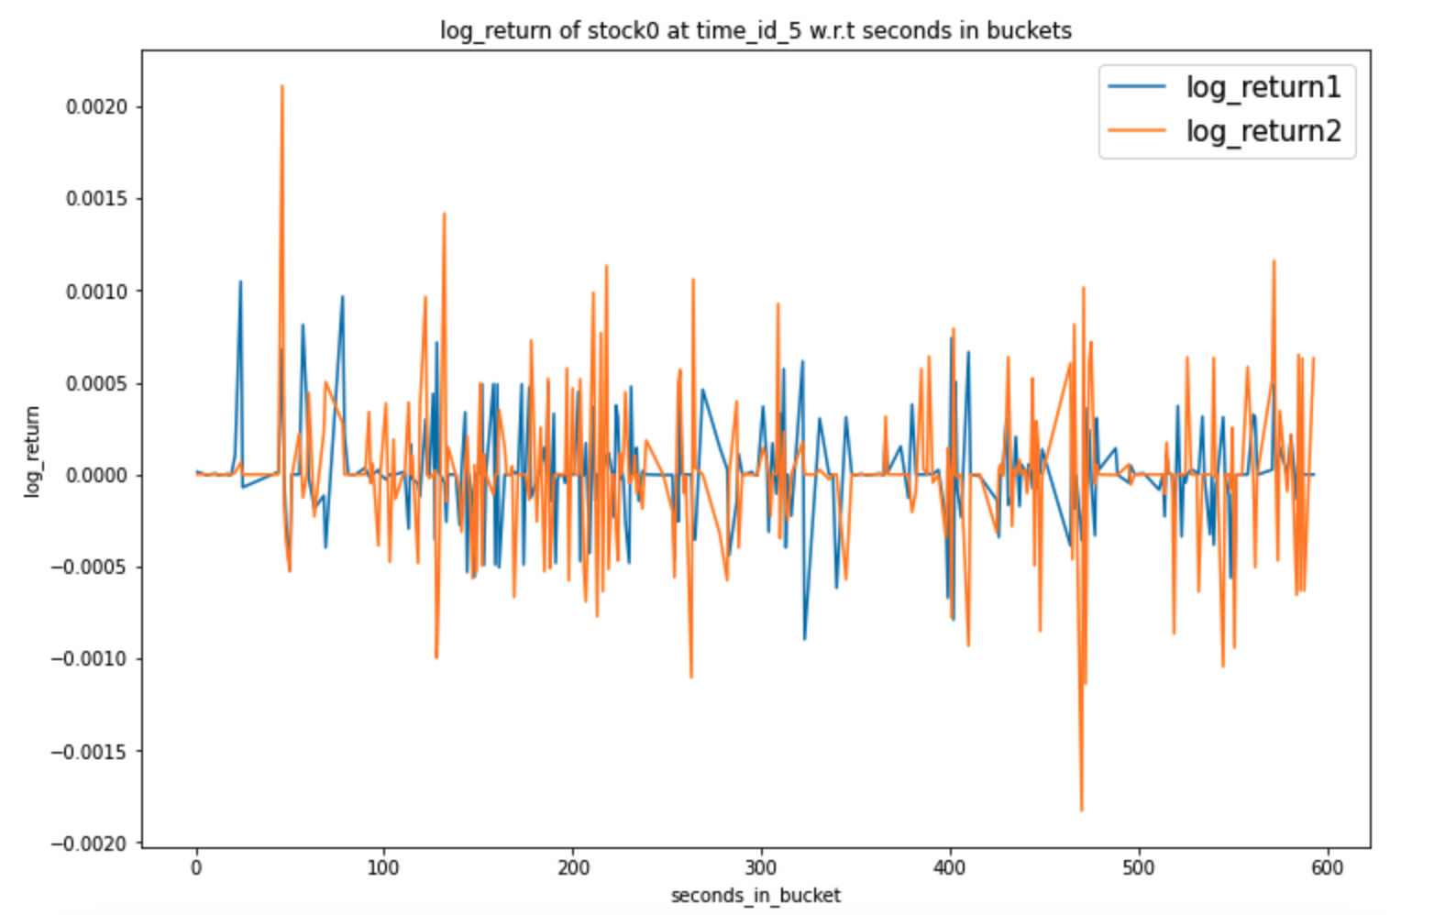
Work Done So Far
→

Slide 10
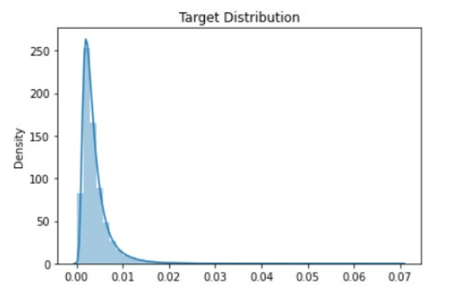
Work Done So Far
Density
Target

Slide 11
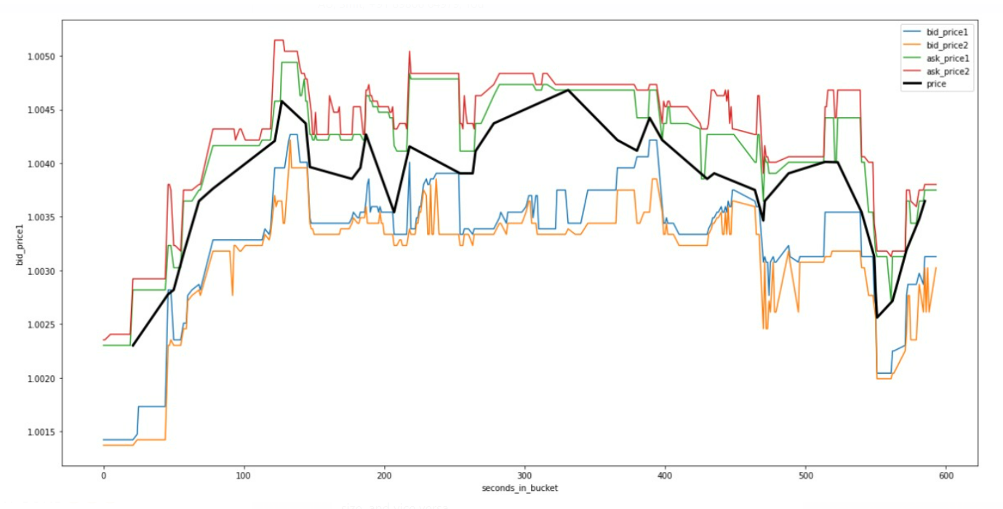
Work Done So Far
price
seconds_in_bucket

Slide 12
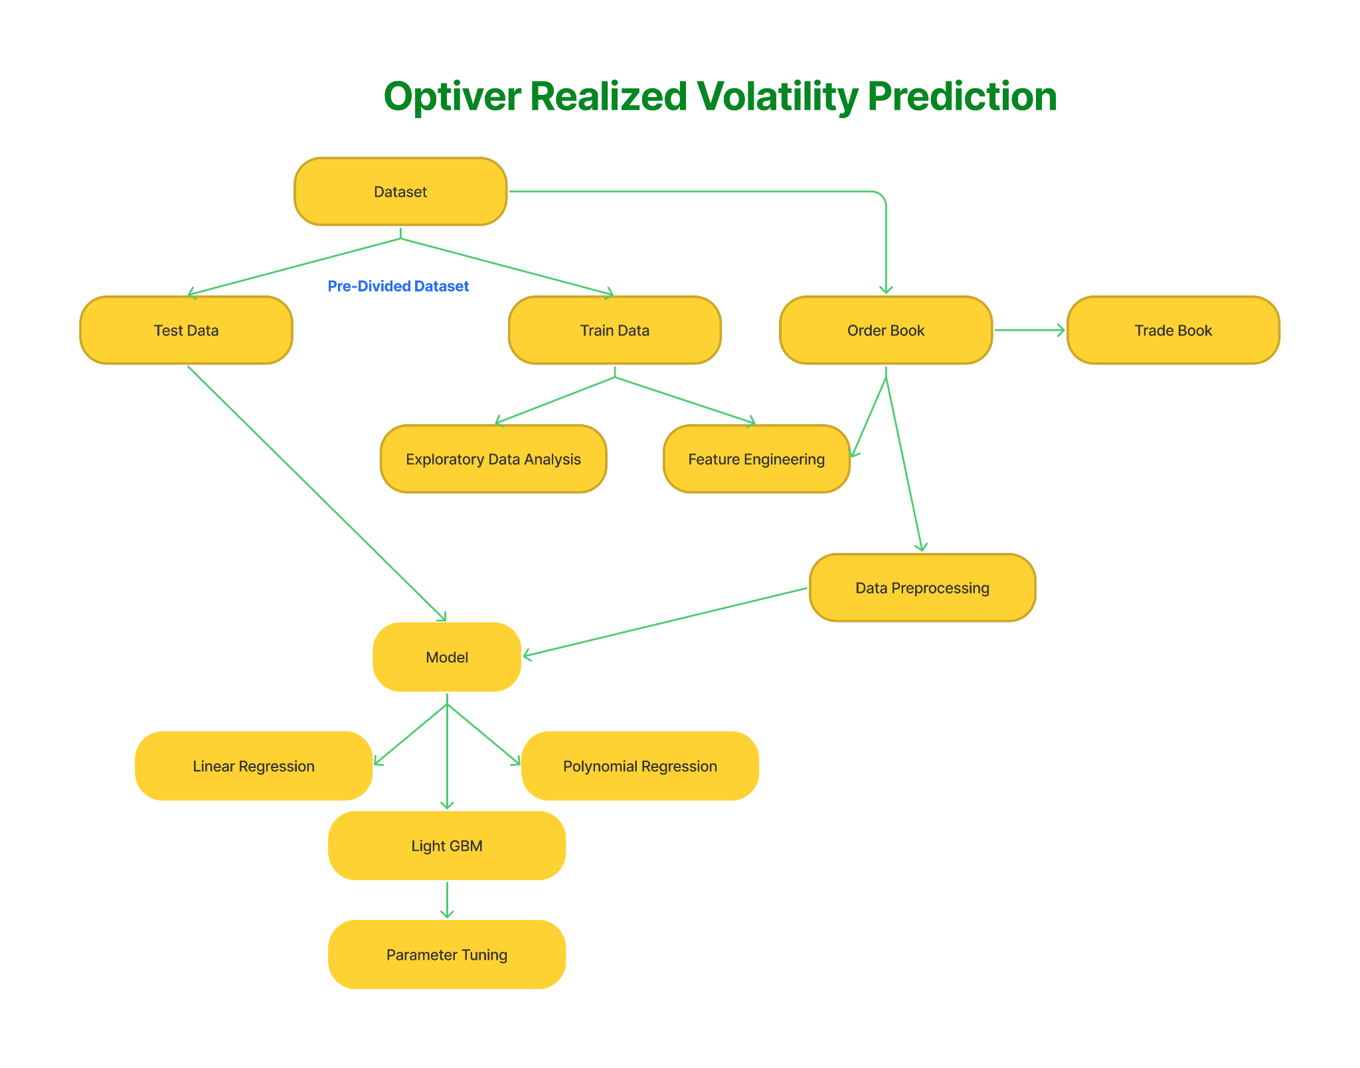
Approach

Slide 13
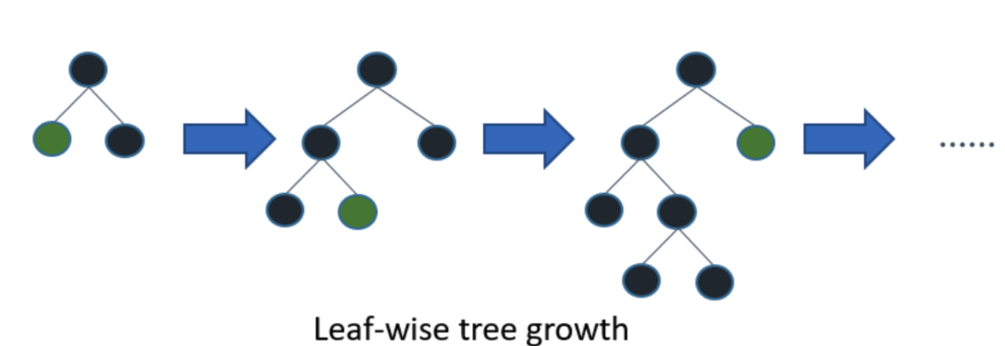
Light GBM Model
Light GBM is a tree based learning algorithm that uses gradient boosting.
Leaf Wise growth algorithm.
Parameter Tuning:
max_depth
feature_fraction
bagging_fraction
early_stopping_rounds
lambda

Slide 14
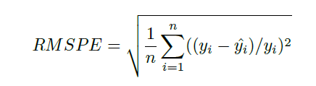
Initial Results - Accuracy Metric
After fitting the model on training data, we move towards assessing the model performance by comparing predicted target values to actual targets.
The accuracy metric that we have used to determine the model performance is RMSPE (Root Mean Square Percentage Error Loss) value.
RMSPE : The RMSPE calculates the average difference between predicted and actual value for given dataset.

Slide 15
Results
RMSPE value using Light GBM model is 0.24 on unseen data.
Top 500 in Kaggle Leaderboard
Models | RMSPE Value
LightGBM | 0.24
Polynomial Regression | 12.19
Linear Regression | 25.09

Slide 16
Results - Linear regression
First started with Linear Regression for our model.
We didn’t get good accuracy.
RMSPE value was about 25.09 which was high as compared to Polynomial Regression and LightGBM.
Time series data have autocorrelated residues so Linear Regression works poor on this type of data.

Slide 17
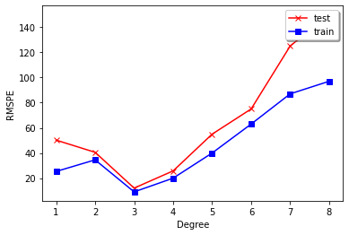
Results - Polynomial regression
RMSPE value for polynomial regression model is 12.19.
RMSPE (Polynomial regression-degree 3) < RMPSE(Linear Regression)

Slide 18
Role of Each Member
Name of the Member | Work Done
Digvijay, Tirth | Worked on Report
Satya, Smit | Worked on PPT
All members contributed equally | Coding, Simulation and Model building

Slide 19
References
Optiver Volatility Prediction Kaggle:
https://www.kaggle.com/competitions/optiver-realized-volatility-prediction
Y. Wu and Q. Wang, "LightGBM Based Optiver Realized Volatility Prediction," 2021 IEEE International Conference on Computer Science, Artificial Intelligence and Electronic Engineering (CSAIEE), 2021, pp. 227-230, doi: 10.1109/CSAIEE54046.2021.9543438.
F. Wang, L. Liu and C. Dou, "Stock Market Volatility Prediction: A Service-Oriented Multi-kernel Learning Approach," 2012 IEEE Ninth International Conference on Services Computing, 2012, pp. 49-56, doi: 10.1109/SCC.2012.35.
Tian, L., Feng, L., Yang, L. et al. Stock price prediction based on LSTM and LightGBM hybrid model. J Supercomput (2022). https://doi.org/10.1007/s11227-022-04326-5

Slide 20
Thank You

