Slide 1

DataAnalytica
One place for all IUTian goods

Slide 2

Team Members
Mirza Azwad 200042121 Rhidwan Rashid 200042149
Nazmul Hossain 200042118

Slide 3

Contents of the Presentation
01
Introduction
04
Technologies
02
Motivation
05
Proposed Timeline
03
Key Features
06
Current Timeline

Slide 4


Introduction
Data Analysis tool for technical and non-technical users alike
Get access to various preprocessing
Know your data well through visualization

Slide 5

Motivation
Power to the User
Insight on Data
Analyze data independently, without depending on data analysts.
Help users gain a clear perspective on complex data.
Data
Analytica
No-Code Machine Learning
Accessibility
Enabling users to utilize it without requiring technical expertise.
Users can apply machine learning without having technical expertise.
Data Visualization
Visualize Data to enhance comprehension

Slide 6

Key Features
01
Data Preprocessing
04
Simplistic UI
02
Data Analysis Model
05
Data Visualization
03
Customization
06
Data Security

Slide 7
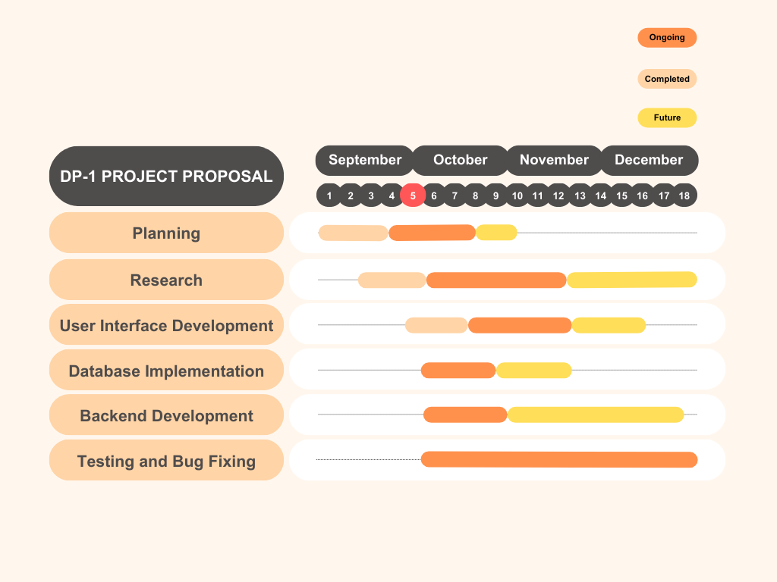
Proposal Timeline

Slide 8
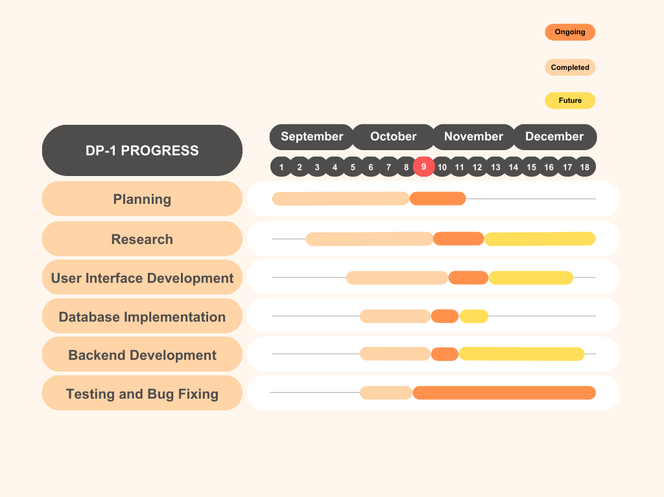
Current Timeline

Slide 9
Current Timeline
Completed
Future
Imputation
Regularization
Normalization
Binning
One-hot encoding
Dataset Imbalance Handling
…and more
File Input
Authentication & Authorization
In Progress
User Sheets Interface
Data Analysis Model
Data Visualization

Slide 10

Progress Demonstration

Slide 11


Thank you
For your Kind Attention
WE ARE NOW OPEN FOR QUESTIONS

