Slide 1
Chapter 8
Securing IoT

Slide 2
What we shall look at
History of OT Security
Common Challenges In OT Security
How IT and OT Security Practices and Systems Vary
Formal Risk Analysis Structures:
  OCTAVE and FAIR
The Phased Application of Security in an Operational Environment

Slide 3
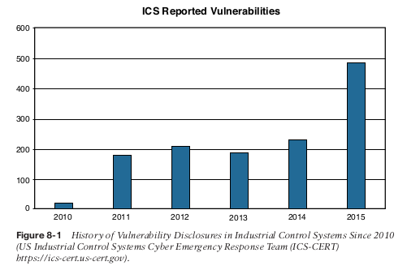
A Brief History of OT Security

Slide 4
Common Challenges in OT Security
The security challenges faced in IoT are by no means new and are not limited to specific industrial environments. The following sections discuss some of the common challenges faced in IoT.
  Erosion of Network Architecture
  Pervasive Legacy Systems
  Insecure Operational Protocols
    Modbus
    DNP3
    ICCP
    OPC
    IEC
  Device Insecurity
  Dependence on External Vendors
  Security Knowledge

Slide 5
  Erosion of Network Architecture
The challenge, and the biggest threat to network security, is standards and best practices either being misunderstood or the network being poorly maintained.
With time what seemed to be a solid design is eroded through ad hoc updates and individual changes to the hardware and machinery without consideration
These uncontrolled or poorly controlled OT network evolutions have, in many cases, over time led to weak or inadequate network and systems security.

Slide 6
Pervasive Legacy Systems
Legacy components are not restricted to isolated network segments but have now been consolidated into the IT operational environment.
From a security perspective, this is potentially dangerous as many devices may have historical vulnerabilities or weaknesses that have not been patched and updated, or it may be that patches are not even available due to the age of the equipment.
This includes switches, routers, firewalls, wireless access points, servers, remote access systems, patch management, and network management tools.

Slide 7
Insecure Operational Protocols
For the sake of interoperability, some protocols are typically published for others to implement them thus, it becomes a relatively simple matter to compromise the protocols themselves and introduce malicious actors that may use them to compromise control systems
  Modbus; Authentication of communicating endpoints was not a default operation because it would allow an inappropriate source to send improper commands to the recipient.
  DNP3 (Distributed Network Protocol); In the case of DNP3, participants allow for unsolicited responses, which could trigger an undesired response thus making the system untrustworthy
  ICCP (Inter-Control Center Communications Protocol);
    One key vulnerability is that the system did not require authentication for communication.
    Second, encryption across the protocol was not enabled as a default condition, thus exposing connections to man-in-the-middle (MITM) and replay attacks.

Slide 8
    OPC (OLE for Process Control); OPC is the dependent on the Remote Procedure Call (RPC) protocol, which creates two classes of exposure.
      The first requires you to clearly understand the many vulnerabilities associated with RPC
      second requires you to identify the level of risk these vulnerabilities bring to a specific network.
    International Electrotechnical Commission (IEC) Protocols; Authentication is embedded in MMS, but it is based on clear-text passwords, and authentication is not available in GOOSE or SV.

Slide 9
Other Protocols
There is need of understanding of the most basic protocols, transport mechanisms, and foundational elements of any network, including ARP, UDP, TCP, IP, and SNMP.
IoT networks reach all the way to the individual sensors, so protocols such as Constrained Application Protocol (CoAP) (see Chapter 6) and Datagram Transport Layer Security (DTLS) are used, and have to be considered separately from a security perspective.

Slide 10
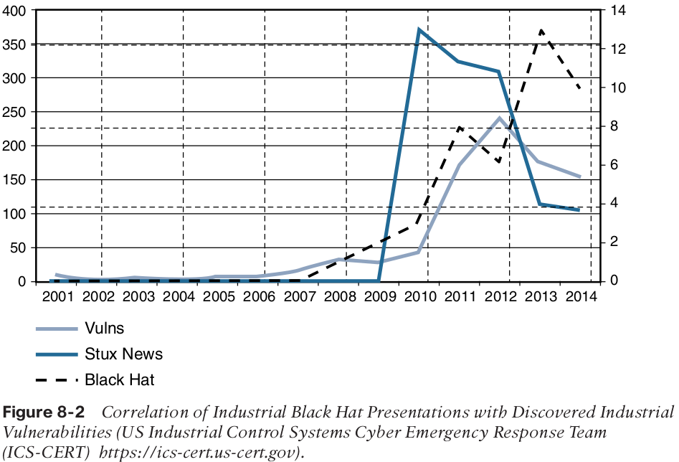
Device Insecurity

Slide 11
Dependence on External Vendors
There are sometimes written contracts between the business and the products vendors for direct or on-demand access to critical systems.
This allows vendors to remotely manage and monitor equipment and to proactively alert the customer if problems are beginning to creep in.
These contracts generally fail to address questions of shared liability for security breaches or processes to ensure communication security.

Slide 12
Security Knowledge;
OT security expertise is the comparatively higher age of the industrial workforce
New connectivity technologies are being introduced in OT industrial environments that require up-to-date skills, such as TCP/IP, Ethernet, and wireless that are quickly replacing serial-based legacy technologies.
To address this problem, Education for industrial security environments has grown steadily, particularly in the electrical utility space, where regulations such as NERC CIP (CIP 004) and IEC 62351 (01) require ongoing training.

Slide 13
How IT and OT Security Practices and
Systems Vary
The differences between an enterprise IT environment and an industrial-focused OT deployment are important to understand because they have a direct impact on the security practice applied to them.
In this Section we look at;
  The purdue Model for Control Hierarchy
  OT Network Characteristics Impacting Security
  Security Priorities: Integrity, Availability and confidentiality
  Security Focus

Slide 14
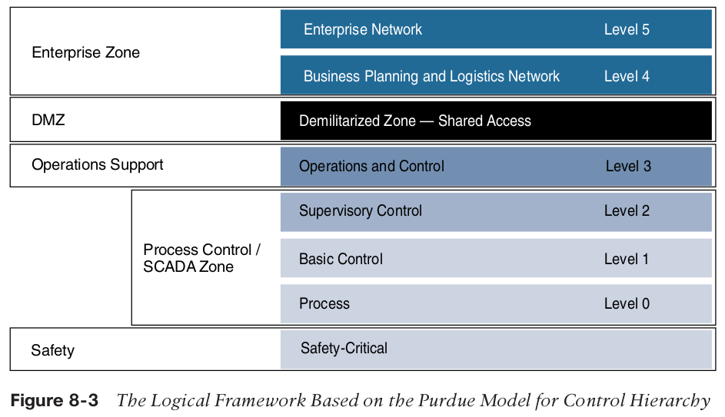
The Purdue Model for Control Hierarchy
This model identifies levels of operations and defines each level. The enterprise and operational domains are separated into different zones and kept in strict isolation via an industrial demilitarized zone (DMZ):

Slide 15
Enterprise zone
              Level 5: Enterprise network:Corporate-level applications such as Enterprise Resource Planning (ERP) and services such as Internet access and VPN entry from the outside world exist at this level.
              Level 4: Business planning and logistics network: material flow applications, optimization and planning systems, and local IT services such as phone, email, printing,and security monitoring.
Industrial demilitarized zone
              DMZ: It allows for easy segmentation of organizational control.

Slide 16
Operational zone
  Level 3: Operations and control:
  Level 2: Supervisory control:
  Level 1: Basic control:
  Level 0: Process:
Safety zone
  Safety-critical: This level includes devices, sensors, and other equipment used to
  manage the safety functions of the control system.
The Purdue model allows security to be correctly applied at each level and between levels.
IT networks typically reside at Levels 4 and 5 and use security. For example, principles common to IT networks. The lower levels are where the industrial systems and IoT networks reside.

