Slide 1
Advanced Software Engineering Processes
Assignments

Slide 2
Project 1
Conducting QFD process using HoQ Diagram

Slide 3
Code Review
Code review – an activity in which people other than the author of a software deliverable examine it for defects and improvement opportunities – is one of the most powerful software quality tools available.
Code reviews help novice developers to learn from the senior developers on best practices of writing code.

Slide 4
Code Review Best Practices
Keep the changes small and focused
Ensure logical coherence of changes
Be positive, polite and respectful

Slide 5
Yard Sticks I used when doing my Code Review
Does the new feature add value or is it a sign of feature-creep?
Is the code properly planned and designed?
Is the code well organized in terms of placement of components?
Does the code keep with the idioms and code patterns of the language?
Does the code make use of the language features and standard libraries?
Is the code clear and concise?
Does it comply with PEP-8?
Are all language and project conventions followed?
Are identifiers given meaningful and style guide-compliant names?

Slide 6
Code Review check list
Is the code self-documenting or well-documented?
Is the code free of obfuscation and unnecessary complexity?
Is the control flow and component relationship clear to understand?
Is the code free of implementation bugs that could be exploited?
Have all the new dependencies been audited for vulnerabilities?
Is the code optimized for in terms of time and space complexity?
Does it scale as per the need?
Does it have instrumentation like reporting for metrics and alerting for failures?

Slide 7
Performing Code Review
Review on github repository https://github.com/miltonpereira/Scrapper
1. README File can not be empty
Add a short description to help those interested in the project
This can help on directing them on how to run the project.
2. License Information missing
Add Licensing used in generation of your code
3. Naming Convention Structure
Instead of using main_script_file.py, it would be conventional to name this file after the project name i.e. scrapper.py
4. Reviewing requirements.txt
There are lots of packages that you don’t need, out of the 25, the program is using only 3 packages so other are misleading.
Considered having a clean and minimal requirements file.

Slide 8
Project Structure
Restructure your project such that the .gitignore

Slide 9
Review on Functions
1. main_script_file.py
The script is well structured into functions
The naming is inconsistent with conventional naming of python functions
The newlines in the functions make the code hard to read, remove them
Inconsistent spacing between functions
Using inconsistent tabs in the functions
Convert all tabs into spaces as recommended by PEP8
Split up the imports splitting the standard python imports from those that are installed(third party)
Formatting of the code, spaces between the arguments
Inconsistent on the tense used on the naming of the functions
Inconsistent assignment(spaces between equal signs)
Not clear how these functions work together

Slide 10
2. For Generate_html function()
Remove redundant code(return r.content instead of html_doc = r.content)
Change the name of the function from generate_html to fetch_html()
Add a brief description of what the function is doing(“””Fetch base_url and return Html content”””)
Rename base_url to url, because base_url in python convention stands for a prefixed url.
3. For parse_and_scrape_data()
The name is fine okay as it describes what the system is actually doing.
Splitting it into two functions one for parsing and the other for scraping but since it is a short function so let it remain as it is.
Remove the redundant variable name and use the loop direct on soup elements.
Change the loop iterator variable to singular because we are looking at one item
Since we are not creating a dictionary ahead of time, put the title and link into the product_details{} dictionary. This makes more sense and not declare an empty dictionary which is doing nothing.

Slide 11
4. Write_on_csv() function
Instead of using “data” as the argument for consistent use “product_details”
Make the ‘googleesults.csv’ a default filename to catch scenarios when there is an error in the project operation when it scales up. Alternatively, it could be made a constant in the function.
Create constants for the repeated variables that are being reused by more than one function. i.e. FIELD_TITLE=‘Title’ FIELD_LINKS=‘Link’ to avoid inconsistency in using these variables throughout the program.
5. Top level if statement
Since you have a main script, it would be better to add a main function so that if someone runs the code directly on command line using “python main_script_file.py”, they get to know where really they are.

Slide 12
Recommendations
Use formatting tool like flake8 to help in formatting your code and identify inconsistencies that would make your code unreadable to other developers and you yourself after some time lapse.
Continue with the best practice of making the functions short but also ensure to write python code following the basic python conventions specified in PEP8 standards.
I have refactored the repository cloned with all the suggested changes and I have made git pull request, if you find it worthy, you can integrate them into your repo.

Slide 14
Code Refactoring

Slide 15

What is code refactoring?
Code refactoring is a process that involves restructuring a computer code base without adding new features or changes to its external behavior.
It generally consists of carrying out a series of small changes to the code base that are minor enough to avoid introducing new errors.

Slide 16
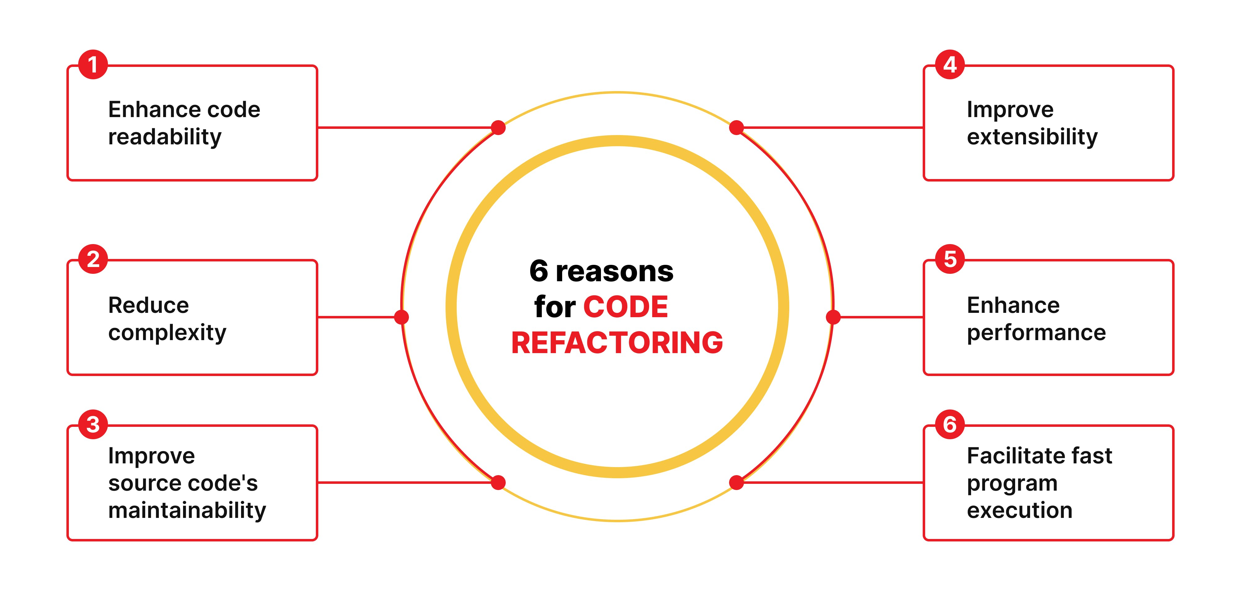
Reason for doing code refactoring

Slide 17
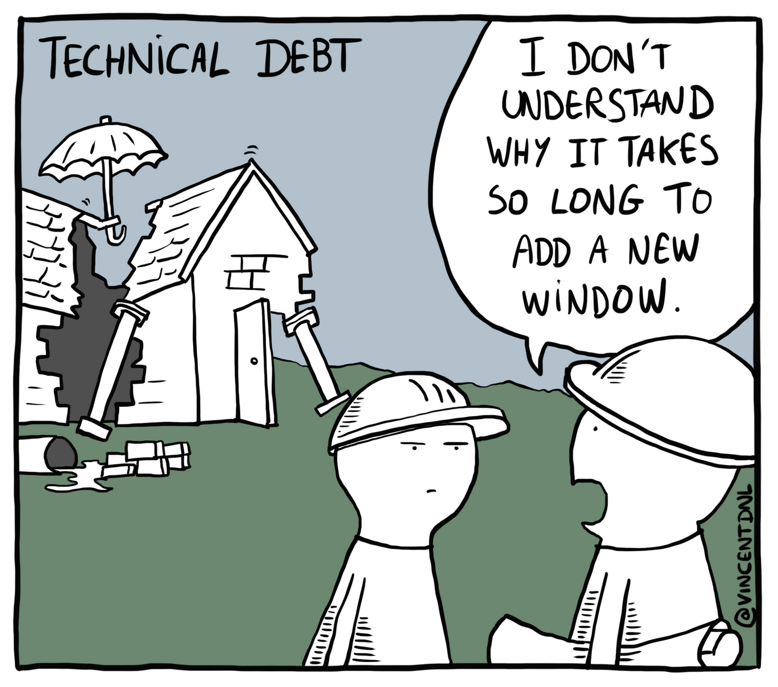
Effects of not refactoring code
Technical debt is the price a company will pay later for choosing a simpler, faster, yet less reliable option today. Any compromise you make to release products or features faster in the present will accumulate a greater volume of work to do in the future:

Slide 18
What aspects of the code is refactoring aimed at?
Unused code - unused variables or methods that are in the code base
Duplicates - identical functions or variables. And there can also be identical methods in objects but described in each of them separately.
Functions and variables with unclear names
An excessive amount of text in one method
A superfluous amount of comments
Incorrectly formatted code fragments - functions and loops not written correctly, extra spaces from the beginning of a line, etc.

