Slide 1
Application Protocols for IoT
In this chapter we look at the following;
The Transport Layer:
IP-based networks use either TCP or UDP. However, the constrained nature of IoT networks requires a closer look at the use of these traditional transport mechanisms.
IoT Application Transport Methods:
This section explores the various types of IoT application data and the ways this data can be carried across a network.

Slide 2
The Transport Layer
Protocols specified for the transport layer
1.Transmission Control Protocol (TCP):
  This connection-oriented protocol requires a session to get established between the source and destination before exchanging
  data
2. User Datagram Protocol (UDP):
  This is a connection-less protocol, data can be quickly sent between source and destination—but with no guarantee of delivery

Slide 3
Reasons why TCP is preferred to UDP
TCP is the main protocol used at the transport layer. This is largely due to its inherent characteristics, such as its ability to transport large volumes of data into smaller sets of packets.
It ensures reassembly in a correct sequence, flow control and window adjustment, and retransmission of lost packets
UDP is used in the following protocols;
  Domain Name System (DNS),
  Network Time Protocol (NTP),
  Simple Network ManagementProtocol (SNMP)
  Dynamic Host Control Protocol (DHCP)

Slide 4
IoT Application Transport Methods
The following categories of IoT application protocols and their transport methods
  Application layer protocol not present:
  Supervisory control and data acquisition (SCADA)
  Generic web-based protocols:
  IoT application layer protocols:

Slide 5
Application Layer Protocol Not Present
IoT devices are usually simple smart objects that are severely constrained. Implementing a robust protocol stack is usually not useful and sometimes not even possible with the limited available resources.
Data broker is piece of middleware that standardizes sensor output into a common format that can then be retrieved by authorized applications.
An IoT data broker is needed to scale this method of transporting application data.

Slide 6
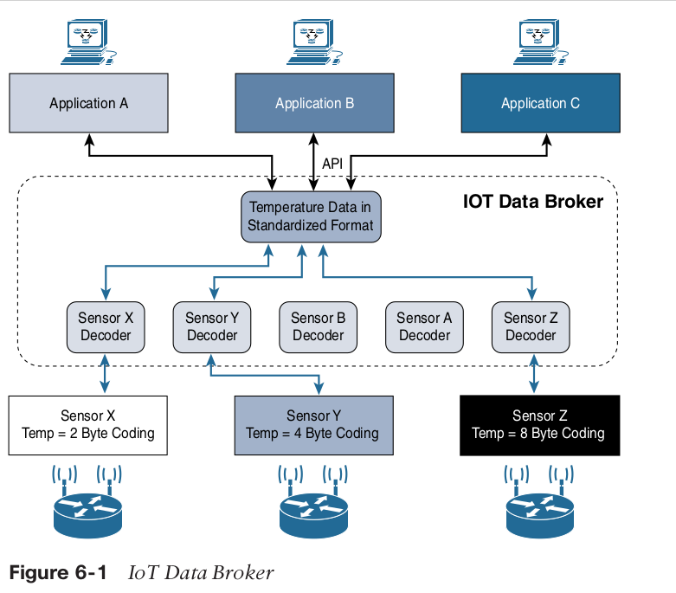

Slide 7
SCADA
The evolution of older protocols that connected sensors and actuators have adapted themselves to utilize IP and this evolution is known as Supervisory Control And Data Acquisition (SCADA)
SCADA is an automation control system that was initially implemented without IP over serial links, before being adapted to Ethernet and IPv4.
Adapting SCADA for IP
  To have the ability to leverage existing equipment and standards while integrating seamlessly the SCADA subnetworks to the corporate WAN infrastructures.
  Assigning TCP/UDP port numbers to the protocols such as
    - DNP3 (adopted by IEEE 1815-2012) specifies the use of TCP or UDP on port 20000
    - The Modbus messaging service utilizes TCP port 502.
    - IEC 60870-5-104 on port 2404.
    - DLMS User Association specified a communication profile based on TCP/IP

Slide 8
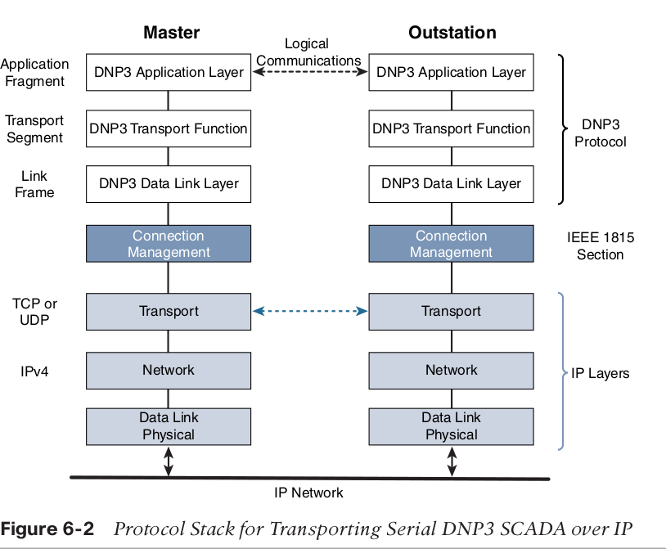

Slide 9
Tunneling Legacy SCADA over IP Networks
Transport of the original serial protocol over IP can be achieved either by tunneling using raw sockets over TCP or UDP or by installing an intermediate device that performs protocol translation between the serial protocol version and its IP implementation

Slide 10
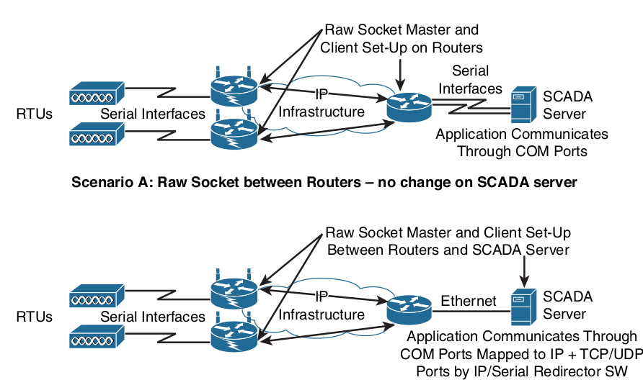

Slide 11
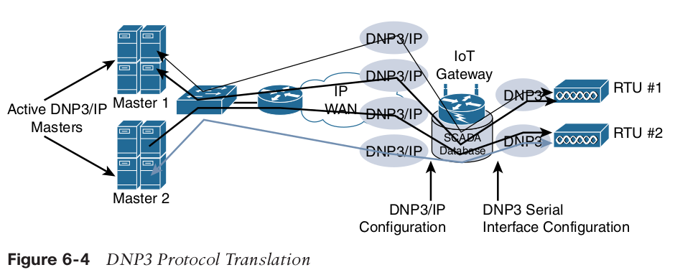
SCADA Protocol Translation
With protocol translation, the legacy serial protocol is translated to a corresponding IP version.
The IoT gateway in this figure below performs a protocol translation function that enables communication between the RTUs and servers, despite the fact that a serial connection is present on one side and an IP connection is used on the other.
This can be accomplished by offering computing resources on IoT gateways or routers, as shown in this protocol translation example

Slide 12
SCADA Transport over LLNs with MAP-T
Most of the industrial devices supporting IP today support IPv4 only. When deployed over LLN subnetworks that are IPv6 only, a transition mechanism, such as MAP-T (Mapping of Address and Port using Translation) needs to be implemented.
This allows the deployment to take advantage of native IPv6 transport transparently to the application and devices.
MAP-T makes the appropriate mappings between IPv4 and the IPv6 protocols.
This allows legacy IPv4 traffic to be forwarded across IPv6 networks.
In other words, older devices and protocols can continue running IPv4 even though the network is requiring IPv6.

Slide 13
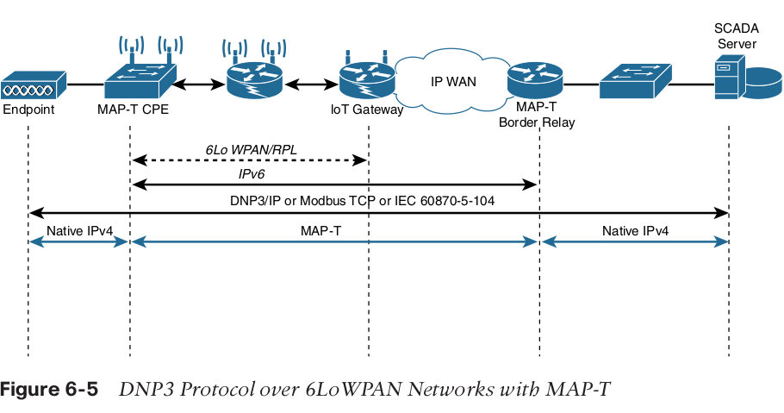

Slide 14
Generic Web-Based Protocols
The Internet of Things greatly benefits from the existing web-based protocols. These protocols, including HTTP/HTTPS and XMPP, ease the integration of IoT devices in the Internet world through well-known and scalable programming techniques.
However, to fully address constrained devices and networks, optimized IoT protocols are required.

Slide 15
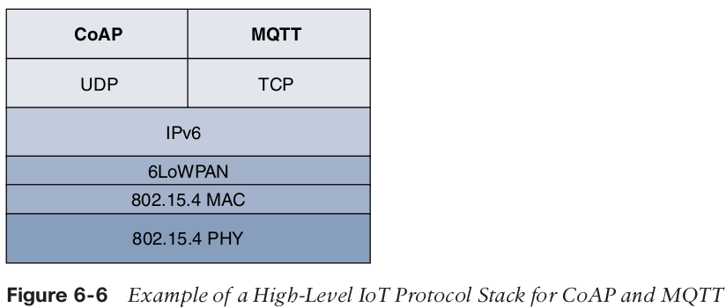
IoT Application Layer Protocols
These are lightweight protocols that are better suited to large numbers of constrained nodes and networks.
Two of the most popular protocols are ;
  CoAP
  MQTT.

Slide 16
CoAP
Constrained Application Protocol is a generic framework for
resource-oriented applications targeting constrained nodes and networks
The CoAP framework defines simple and flexible ways to manipulate sensors and actuators for data or device management.
The IETF CoRE working group has published multiple standards-track specifications for CoAP, including the following:
  RFC 6690: Constrained RESTful Environments (CoRE) Link Format.
  RFC 7252: The Constrained Application Protocol (CoAP)
  RFC 7641: Observing Resources in the Constrained Application Protocol (CoAP)
  RFC 7959: Block-Wise Transfers in the Constrained Application Protocol (CoAP)
  RFC 8075: Guidelines for Mapping Implementations: HTTP to the Constrained
  Application Protocol (CoAP)

Slide 17
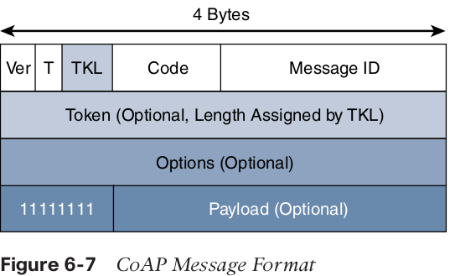
The CoAP messaging model is primarily designed to facilitate the exchange of messages
over UDP between endpoints, including the secure transport protocol Datagram Transport Layer Security (DTLS).

Slide 18
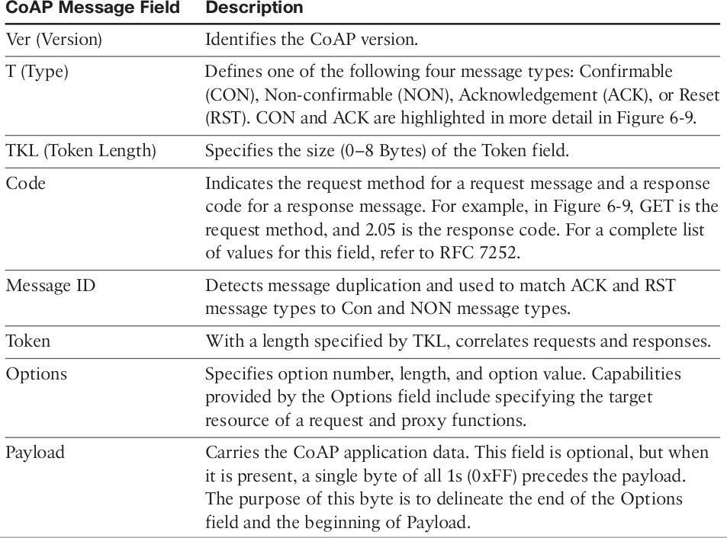

Slide 19
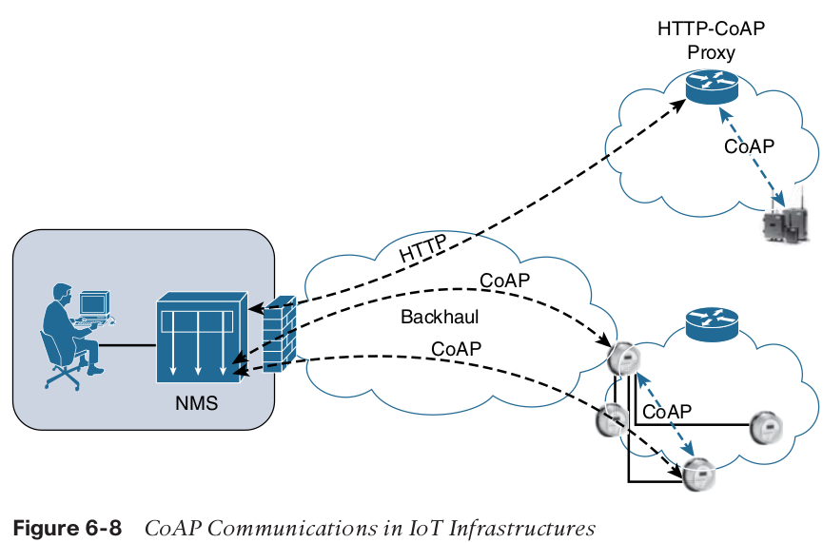
CoAP communications across an IoT infrastructure can take various paths.
Connections can be between devices located on the same or different constrained networks or between devices and generic Internet or cloud servers, all operating over IP.

Slide 20
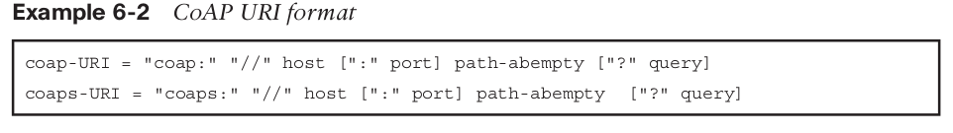
Just like HTTP, CoAP is based on the REST architecture, but with a “thing” acting as
both the client and the server.
Through the exchange of asynchronous messages, a client requests an action via a method code on a server resource.
A uniform resource identifier(URI) localized on the server identifies this resource. The server responds with a response code that may include a resource representation. The CoAP request/response semantics
include the methods GET, POST, PUT, and DELETE.

Slide 21
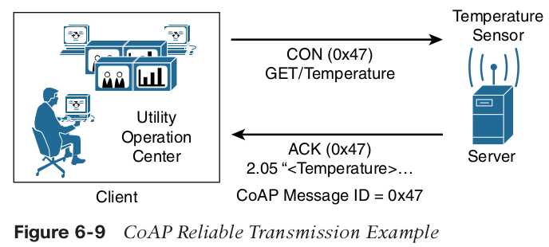
CoAP defines four types of messages: confirmable, non-confirmable, acknowledgement, and reset in a message response or a request
While running over UDP, CoAP offers a reliable transmission of messages when a CoAP
header is marked as “confirmable.”
CoAP supports basic congestion control with a default time-out, simple stop and wait retransmission with exponential back-off mechanism, and detection of duplicate messages through a message ID.

Slide 22
Much as with accessing web server resources, CoAP specifications provide a description of the relationships between resources in RFC 6690, “Constrained RESTful Environments (CoRE) Link Format.”
This standard defines the CoRE Link format carried as a payload with an assigned Internet media type.
To improve the response time and reduce bandwidth consumption, CoAP supports caching capabilities based on the response code.
CoAP is fully optimized for IoT constrained nodes and networks, while leveraging traditional web programming techniques to make it easily understandable by the development community

Slide 23
Message Queuing Telemetry Transport (MQTT)

