Slide 1
Application Protocols for IoT – Chapter 6
MUGOYA DIHFAHSIH
2021/HD05/2353U

Slide 2
Chapter Summary
Introduction
Transport Layer
IoT Application Transport Methods
  Application Layer Not Present
  SCADA;
    Adapting SCADA for IP
    Tunneling Legacy SCADA over IP Networks
    SCADA Protocol Translation
    SCADA Transport over LLNs with MAP-T
  Generic Web Based Protocols
  IoT Application Layer Protocols
  CoAP
  MQTT
  Comparing CoAP with MQTT

Slide 3
Introduction
IoT application protocols selected should be contingent on the use cases and vertical industries they apply to.
IoT application protocols are dependent on the Characteristics of lower layers themselves.
IoT applications protocolls focus on:
  Transport Layer(TCP and UDP)
  IoT application Transport Methods
There are many solutions for IoT application Transport Methods because IoT is growing and changing.

Slide 4
The Transport Layer
It is supported by TCP/IP architecture
The two Main protocols specified;
1.Transmission Control Protocol (TCP):
  Connection-oriented protocol
  Requires an established session between source and destination before exchanging data
2. User Datagram Protocol (UDP):
  Data sent to destination with no guarantee of delivery
  Acknowledgment is only sent back if request for acknowledgment is sent.

Slide 5
TCP is the main protocol used at the transport layer due to ;
  Ability to transport large data in small sets of packets
  Ability to ensure correct reassembly of data
  Ability to control the flow and window adjustment
  Ability to retransmit lost packets
The cost of overhead per packet and per session increases with TCP, increasing latency and packet per second performance

Slide 6
UDP: Is the main protocol used for network services
  E.g Domain Name System, Network Time Protocol, Simple Network Management Protocol and Dynamic Control Protocol.
  Also used for real time data traffic I.e voice and video over IP
  Performance and latency is more important than retransmissions
  When the reception of packets must be guaranteed error free, the application layer protocol takes care of the function
To choose the transport Layer, Consider both the lower and upper layers of the stack.

Slide 7
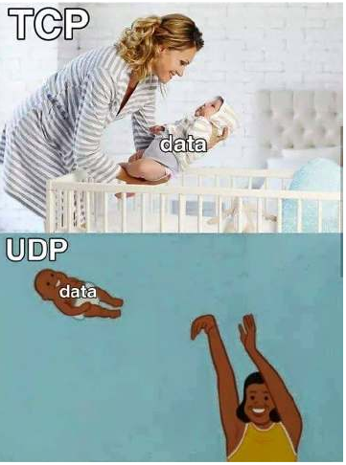
Most Industrial applications protocols are TCP
  Due to older times where error protection and reliability of data link layers were needed.
TCP may not strain generic compute platforms and high-data-rate networks but can be challenging and is often overkill on the constrained IoT devices and networks.

Slide 8
Reasons why TCP is preferred to UDP
TCP is the main protocol used at the transport layer. This is largely due to its inherent characteristics, such as its ability to transport large volumes of data into smaller sets of packets.
It ensures reassembly in a correct sequence, flow control and window adjustment, and retransmission of lost packets.
Why IoT Constrained nodes use UDP over TCP
  TCP adds 20bytes even on a few bytes transaction while UDP adds only 8 bytes
  TCP also requires the establishment and potential maintenance of an open logical channel.
  IoT nodes may also be limited by the intrinsic characteristics of the data link layers. Forexample, low-power and lossy networks (LLNs),may not cope well with supporting large numbers of TCP sessions.

Slide 9
IoT Application Transport Methods
Various means for transporting application protocols across a network
Common Issues are legacy utility and industrial IoT protocols
To make the decision of which method to use, categorize the common IoT Application Protocols and focus on the transport methods
The following categories of IoT application protocols and their transport methods
  Application layer protocol not present:
  Supervisory control and data acquisition (SCADA)
  Generic web-based protocols:
  IoT application layer protocols:

Slide 10
Method 1: Application Layer Protocol Not Present
In this method, data payload is directly transported on top of the lower layers. An IoT data broker is needed to scale this method of transporting application data
IoT devices are usually simple smart objects that are severely constrained. Implementing a robust protocol stack is usually not useful and sometimes not even possible with the limited available resources.
Data broker is piece of middleware that standardizes sensor output into a common format that can then be retrieved by authorized applications.
An IoT data broker is needed to scale this method of transporting application data.

Slide 11
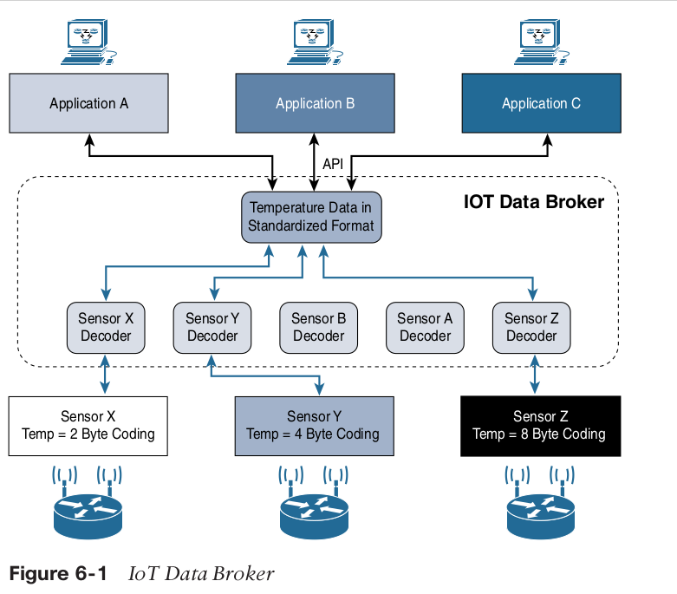

Slide 12
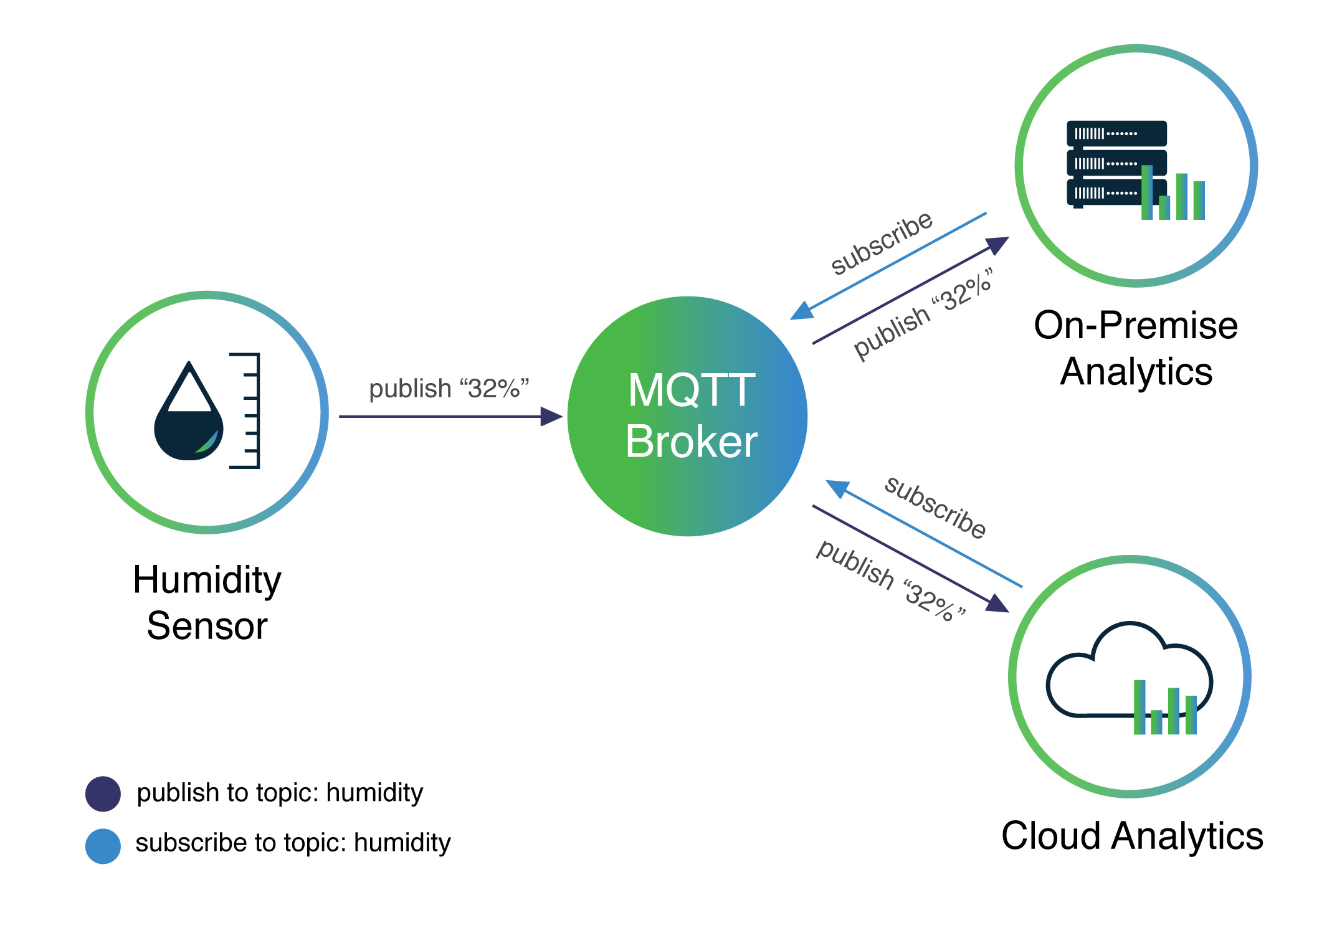
Basically the IoT broker is a middleman that can interprete various sensor data types into one format for easy picking by the applications
IoT data brokers are also utilized from a commercial perspective to distribute and sell IoT data to third parties

Slide 13
SCADA
The evolution of older protocols that connected sensors and actuators have adapted themselves to utilize IP and this evolution is known as Supervisory Control And Data Acquisition (SCADA)
SCADA is an automation control system that was initially implemented without IP over serial links, before being adapted to Ethernet and IPv4.
  Is an automation control system
  Initially implemented without IP over Serial Links
  Now adapted into Ethernet and IPv4
  Collects sensor data and telemetry from remote devices while also providing ability to control them at a high level
  Mainly concentrated in the utilities and manufacturing industrial Verticals
  SCADA systems allow global, real-time, data-driven decisions to be made about how to improve business process

Slide 14
Adapting SCADA for IP
  To have the ability to leverage existing equipment and standards while integrating seamlessly the SCADA subnetworks to the corporate WAN infrastructures.
  Assigning TCP/UDP port numbers to the protocols such as
    - DNP3 (adopted by IEEE 1815-2012) specifies the use of TCP or UDP on port 20000
    - The Modbus messaging service utilizes TCP port 502.
    - IEC 60870-5-104 on port 2404.
    - DLMS User Association specified a communication profile based on TCP/IP

Slide 15
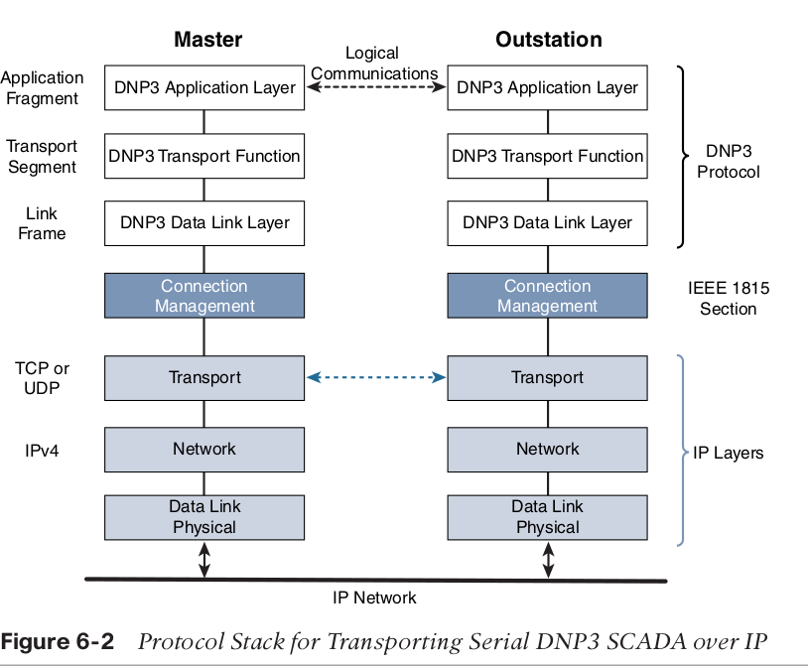

Slide 16
Tunneling Legacy SCADA over IP Networks
Transport of the original serial protocol over IP can be achieved either by:
  Tunneling using raw sockets over TCP or UDP
  Installing an intermediate device that performs protocol translation between the serial protocol version and its IP implementation.
Raw socket connection - the serial data is being packaged directly into a TCP or UDP transport.
  Socket in this instance is a standard API composed of an IP address and a TCP or UDP port that is used to access network devices over an IP network.
  Old application servers may need a device/software to convert pure serial data to serial over IPModern application servers are already capable of this

Slide 17
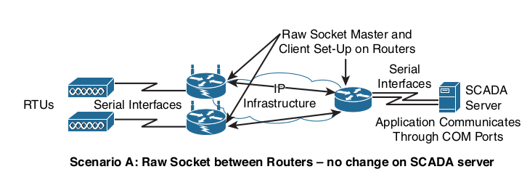
In this scenario - Raw serial data is sent with help from the router

Slide 20
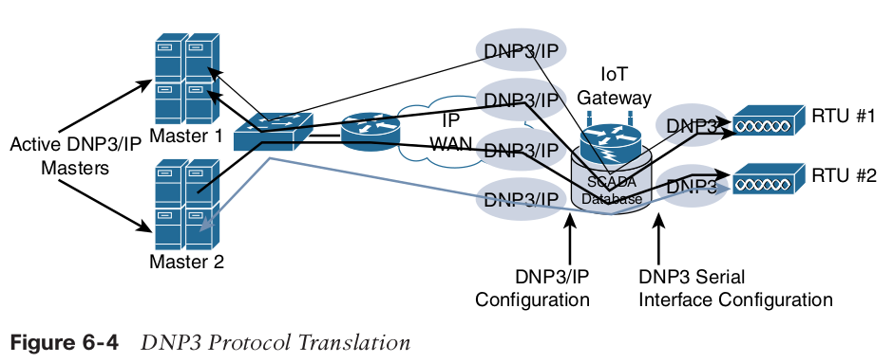
SCADA Protocol Translation
With protocol translation, the legacy serial protocol is translated to a corresponding IP version.
The IoT gateway in this figure below performs a protocol translation function that enables communication between the RTUs and servers, despite the fact that a serial connection is present on one side and an IP connection is used on the other.This can be accomplished by offering computing resources on IoT gateways or routers.

Slide 21
SCADA Transport over LLNs with MAP-T
Most of the industrial devices supporting IP today support IPv4 only. When deployed over LLN subnetworks that are IPv6 only, a transition mechanism, such as MAP-T (Mapping of Address and Port using Translation) needs to be implemented.
This allows the deployment to take advantage of native IPv6 transport transparently to the application and devices.
MAP-T makes the appropriate mappings between IPv4 and the IPv6 protocols. This allows legacy IPv4 traffic to be forwarded across IPv6 networks.
In other words, older devices and protocols can continue running IPv4 even though the network is requiring IPv6.

Slide 22
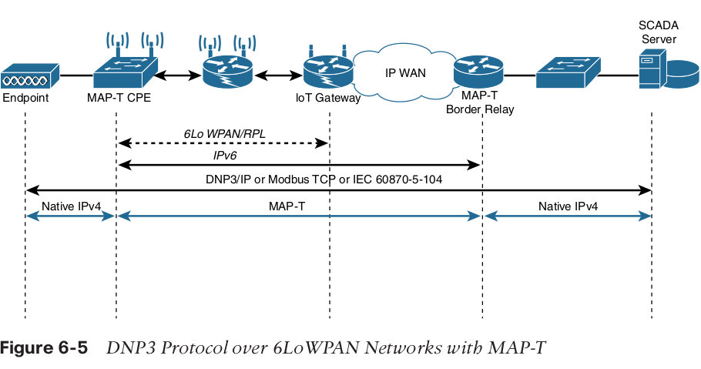

Slide 23
Method 3: Generic Web-Based Protocols
Allows Programmers with basic web programming skills to work on IoT applications
For Non-constrained networks, normal data formats e.g XML or JSON can be transported over HTTP/HTTPS or WebSocket
Web service implementation in IoT networks can either be from the client side or the server side.
  Devices that only push data would be client side implementation ( HTTP only sends info and doesn’t receive)
  Devices that would require many connections and has limited resources (e.g video surveillance) would be server side.

Slide 24
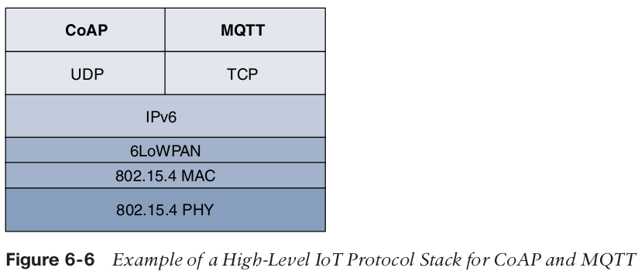
Method 4: IoT application layer protocols
Constrained network/nodes cannot handle verbose web-based and data model protocols
Lightweight protocols are needed
  .
    - CoAP (Constrained Application Protocol)
                Usually Deployed over UDP
                - MQTT(Message Queuing Telemetry Transport)
                Usually Deployed over TCP

Slide 25
CoAP
Known for Simple and flexible ways to manipulate sensors and actuators for data or device management
Constrained Application Protocol is a generic framework for resource-oriented applications targeting constrained nodes and networks.
Primarily designed to manage exchange of messages over UDP between endpoints
The IETF CoRE working group has published multiple standards-track specifications for CoAP, including the following:
  RFC 6690: Constrained RESTful Environments (CoRE) Link Format.
  RFC 7252: The Constrained Application Protocol (CoAP)
  RFC 7641: Observing Resources in the Constrained Application Protocol (CoAP)
  RFC 7959: Block-Wise Transfers in the Constrained Application Protocol (CoAP)
  RFC 8075: Guidelines for Mapping Implementations: HTTP to the Constrained
  Application Protocol (CoAP)

Slide 26
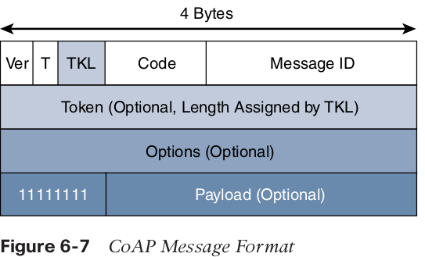
CoAP message format is relatively simple and flexible;
  Low overhead,
  Easy to parse for constrained devices,
  4bytes header field,
  Can be run over IPv4 and IPv6
  4 types of messages in CoAP:
    Confirmable
    Non-Confirmable
    Acknowledgment
    Reset

Slide 27
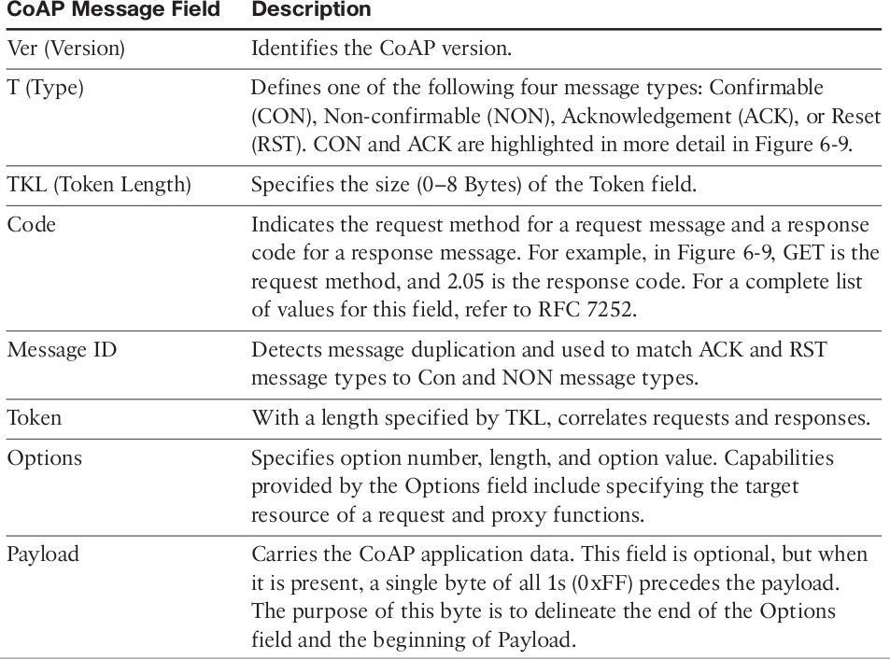

Slide 28
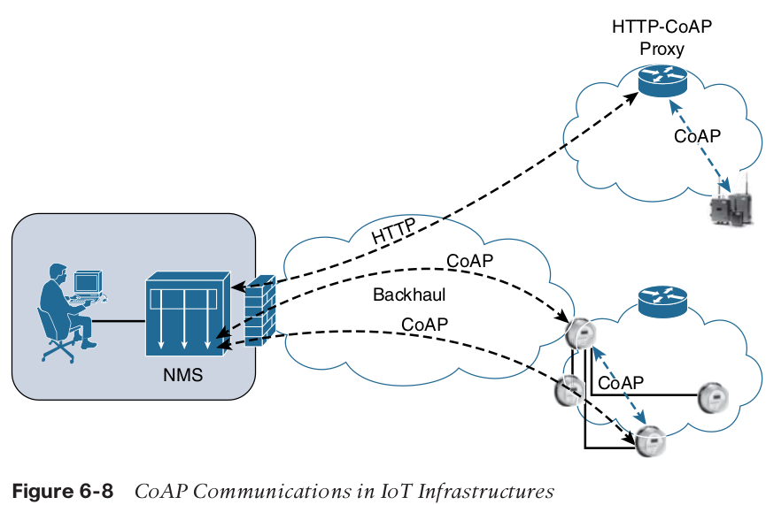
CoAP communications across an IoT infrastructure can take various paths.
Connections can be between devices located on the same or different constrained networks or between devices and generic Internet or cloud servers, all operating over IP.

Slide 29
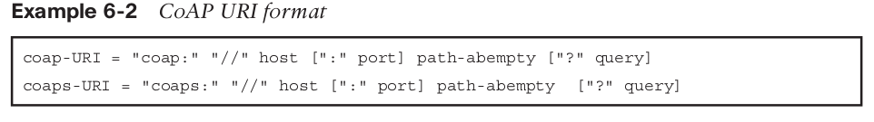
Just like HTTP, CoAP is based on the REST architecture, but with a “thing” acting as
both the client and the server.
Through the exchange of asynchronous messages, a client requests an action via a method code on a server resource.
A uniform resource identifier(URI) localized on the server identifies this resource. The server responds with a response code that may include a resource representation. The CoAP request/response semantics
include the methods GET, POST, PUT, and DELETE.

Slide 30
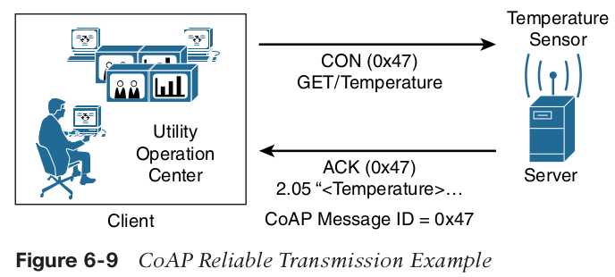
CoAP defines four types of messages: confirmable, non-confirmable, acknowledgement, and reset in a message response or a request
While running over UDP, CoAP offers a reliable transmission of messages when a CoAP
header is marked as “confirmable.”
CoAP supports basic congestion control with a default time-out, simple stop and wait retransmission with exponential back-off mechanism, and detection of duplicate messages through a message ID.

Slide 31
Much as with accessing web server resources, CoAP specifications provide a description of the relationships between resources in RFC 6690, “Constrained RESTful Environments (CoRE) Link Format.”
This standard defines the CoRE Link format carried as a payload with an assigned Internet media type.
To improve the response time and reduce bandwidth consumption, CoAP supports caching capabilities based on the response code.
CoAP is fully optimized for IoT constrained nodes and networks, while leveraging traditional web programming techniques to make it easily understandable by the development community

Slide 32
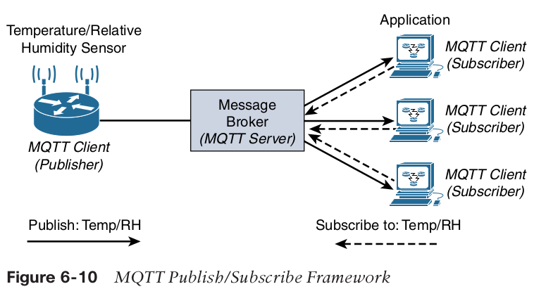
Message Queuing Telemetry Transport (MQTT)
Is an extremely simple protocol with only a few options designed with considerations for constrained nodes, unreliable WAN backhaul communications, and bandwidth constraints with variable latencies.
How does it work?
  Sorta acts like YouTube. A channel pushes out content which is only seen by the subscribers of the channel

Slide 33
Client can act as a publisher to send data to the server
Server acts as a message broker
Server accepts the network connection along with application messages from the publishers.
  Handles subscription/unsubscription process
  Pushes application data to MQTT clients acting as subscribers
  Subscribers to the data receives the information, and can subscribe to either all data or specific data
  Publishers and subscribers do not know each other and don't have to be online at the same time

Slide 34
An MQTT client can act as a publisher to send data (or resource information) to an MQTT server acting as an MQTT message broker.
The MQTT server (or message broker) accepts the network connection along with application messages, such as Temp/RH data, from the publishers.
With MQTT, clients can subscribe to all data (using a wildcard character) or specific data from the information tree of a publisher.
The presence of a message broker in MQTT decouples the data transmission between clients acting as publishers and subscribers.
A benefit of having this decoupling is that the MQTT message broker ensures that information can be buffered and cached in case of network failures.
MQTT control packets run over a TCP transport using port 1883. TCP ensures an ordered, lossless stream of bytes between the MQTT client and the MQTT server.

Slide 35
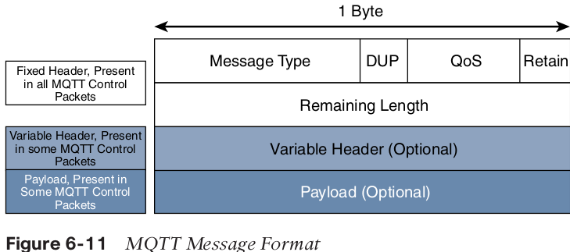
MQTT is a lightweight protocol because each control packet consists of a 2-byte fixed header with optional variable header fields and optional payload.
Note that a control packet can contain a payload up to 256 MB.
Compared to the CoAP message format, MQTT contains a smaller header of 2 bytes compared to 4 bytes for CoAP.

Slide 36
DUP (Duplication Flag);
  Checks for Duplication messages
QoS3
  Quality of Service levels:
    0 - best effort and highest priority data sent, but message is sent only once
    1 - ensures message is sent
    2 - highest QoS, makes sure exactly 1 message is sent and received
  Retain flag
    Tells server to hold on to message data
  Remaining Length
    Number of bytes in the packet

Slide 37
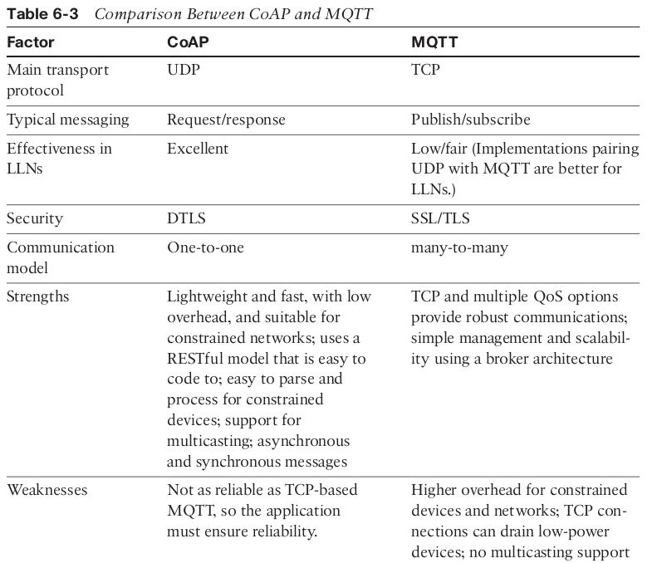

Slide 38
MQTT is different from the “one-to-one” CoAP model in its “many-to-many” subscription framework, which can make it a better option for some deployments.
MQTT is TCP-based, and it ensures an ordered and lossless connection. It has a low overhead when optionally paired with UDP and flexible message format, supports TLS for security, and provides for three levels of QoS.

