Slide 1
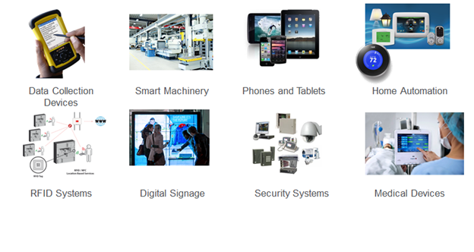
Chapter 4 Connecting Smart Objects

Slide 2
For IoT to produce data that is to be visualized, the sensors and actuators have to be connected using various protocols.
To achieve this connectivity, characteristics and communications criteria as well as The various technologies used need to be studied
The communication criteria that needs to be expounded include;
    Range, Frequency Bands, Power Consumption, Topology, Constrained Devices, Constrained-Node Networks.
Technologies for connecting smart objects include;
    IEEE 802.15.4, IEEE 802.15.4g and IEEE 802.15.4e, IEEE 1901.2a, IEEE 802.11ah, LoRaWAN, NB-IoT and Other LTE Variations.

Slide 3
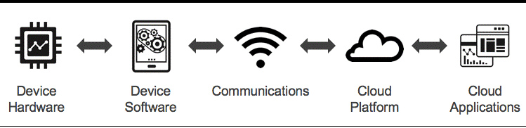
1. Communications Criteria
In connecting things both wired and wireless connections are available or under development.
[Image from Senseware blog on iot-implementations-wireless-vs-wired]
Wireless Connections is more prevalent over wired because it eases deployment and allows smart objects to be mobile, changing location without losing connectivity. But nevertheless, wired connections are used where necessary.

Slide 4
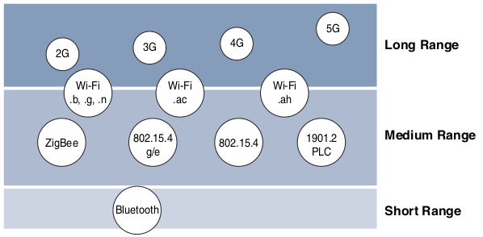
Range
Range as one of the communication criteria helps us to answer the following questions while evaluating options of wired and wireless access technologies.
  How far does the signal need to be propagated?
  That is, what will be the area of coverage for a selected wireless technology?
  Should indoor versus outdoor deployments be differentiated?
Short Range:
The classical wired example is a serial cable. Wireless short-range
technologies are often considered as an alternative to a serial cable, supporting tens
of meters of maximum distance between two devices. Signals are transmitted as low as 10 kbit/s making it not suitable for deployment
Examples include Bluetooth and Visible Light Communications

