Slide 1
Chapter 12
Smart and Connected Cities
Chapter Overview
1. An IoT strategy for smart Cities
2. Smart City IoT architecture.
3. Smart City Security Architecture
4. Smart City Use-case examples

Slide 2
An IoT Strategy for Smarter Cities
New ideas emerge, bringing different approaches to solving management issues. Scalable solutions utilizing information and communications technology (ICT) can alleviate many issues urban centers face today by increasing efficiency, which reduces costs and enhances quality of life.
We focus on two strategies for IoT smarter cities;
Vertical IoT Needs for Smarter Cities
Global vs. Siloed Strategy

Slide 3
Vertical IoT Needs for Smarter Cities
Information and communications technology connects people, data, things, and processes together in networks of billions or even trillions of connections. These connections create vast amounts of data, some of which has never been accessible before.
When this data is analyzed and used intelligently, the possibilities to correlate, analyze, and optimize services and processes that deliver a better quality of life for people are practically endless.
Economic Impact of smart cities over 10 years
  ■Smart buildings: The financial gain applies to city budgets only when a building is city owned. However, the reduced emissions benefit the city regardless of who owns the buildings.
  ■Gas monitoring: Monitoring gas could save $69 billion by reducing meter-reading costs and increasing the accuracy of readings for citizens and municipal utility agencies.
  ■Smart parking: Smart parking could create $41 billion by providing real-time visibility into parking space availability across a city.
  ■Water management: Smart water management could save $39 billion by connecting household water meters over an IP network to provide remote usage and status information.
  ■Road pricing: Cities could create $18 billion in new revenues by implementing automatic payments as vehicles enter busy city zones while improving overall traffic conditions.

Slide 4
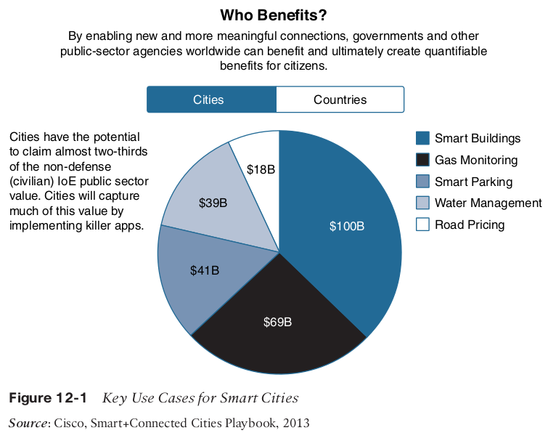

Slide 5
Global vs. Siloed Strategies
Cities attempting to upgrade their infrastructure to match the growing needs of the citizen
population often invest in one problem at a time, and they do it independently. Even
cities using IoT technology break up city assets and service management into silos that
are typically unable to communicate or rely on each other.
The independent investment model results in the following problems:
  ■ Isolation of infrastructure and IT resources
  ■ No sharing of intelligence and information, such as video feeds and data from sensors.
  ■ Waste and duplication in investment and effort
  ■ Difficulty scaling infrastructure management
This fragmented approach is not scalable, efficient, or economically viable, and it does not benefit from cross-functional sharing of data and services.

Slide 6
Multiple networks are less efficient than a single unified network. A city needs an open IoT solution that allows all public services (garbage, parking, pollution, and so on) to use a common network and, possibly, exchange data for cross-optimization.
Some of the technical challenges that need to be addressed.
■ How do you collect the data? What are the various sources of data, including hardware endpoints and software?
■ How do you make sure that any data collection devices, such as sensors, can be maintained without high costs?
■ Where do you analyze the data? What data do you carry back to the cloud, and what data do you analyze locally?
■ What kind of network connectivity is best suited for each type of data to collect?
■ What kind of power availability and other infrastructure, such as storage, is required?

Slide 7
Each smart city needs a tailored and structured computing model that allows distributed
processing of data with the level of resiliency, scale, speed, and mobility required to efficiently and effectively deliver the value that the data being generated can create when
properly processed across the network.
In that context, Data that needs to be processed locally stays at the edge of the network. In contrast, global statistics and analytics about peak times and structure can be sent to the cloud to be processed at the scale of the entire city.
This allows city planners to better organize the growth of various activity centers in the city and also plan for increases in public transportation availability, waste collection shift times, and so on.

Slide 8
Smart City IoT Architecture
A smart city IoT infrastructure has four layers in which Data flows from devices at the street layer to the city network layer and connect to the data center layer, where the data is aggregated, normalized, and virtualized.
In smart cities, multiple services may use IoT solutions for many different purposes. These services may use different IoT solutions, with different protocols and different application languages.
Therefore, data flow from sensor to application involves a translation process into a normalized language that can be exposed through APIs for other service application consumption
This translation ensures a single language for all devices in the cloud. This common language simplifies communication and data management and allows solutions to inform each other.
With a normalized language and open APIs, cities can invest in new solutions, knowing that the new solutions will easily interact with existing solutions.

Slide 9
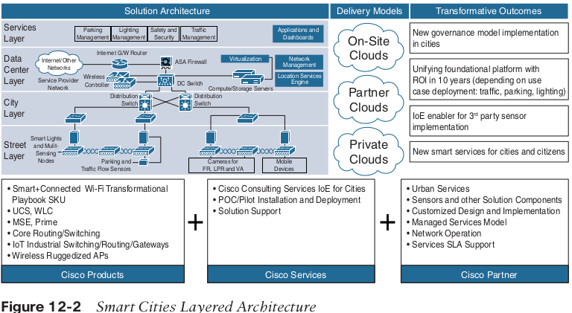

Slide 10
Smart City architecture layers
Street Layer
The street layer is composed of devices and sensors that collect data and take action based on instructions from the overall solution, as well as the networking components needed to aggregate and collect data.
A sensor is a data source that generates data required to understand the physical world.
Sensor devices are able to detect and measure events in the physical world.
Street sensors include the following;
  A magnetic sensor can detect a parking event by analyzing changes in the surrounding magnetic field when a heavy metal object
  A lighting controller can dim and brighten a light based on a combination of time-based and ambient conditions.
  Video cameras combined with video analytics can detect vehicles, faces, and traffic conditions for various traffic and security use cases
  An air quality sensor can detect and measure gas and particulate matter concentrations to give a hyper-localized perspective on pollution in a given area.
  Device counters give an estimate of the number of devices in the area, which provides a rough idea of the number of vehicles moving

Slide 11
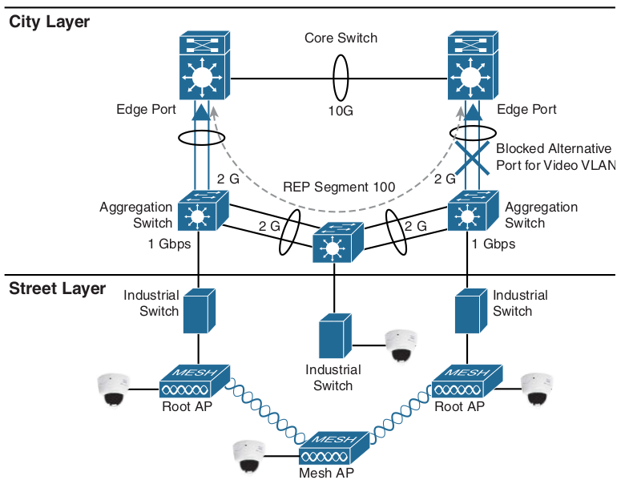
City Layer
At the city layer, which is above the street layer, network routers and switches must be deployed to match the size of city data that needs to be transported.
This layer aggregates all data collected by sensors and the end-node network into a single transport network.
The city layer may appear to be a simple transport layer between the edge devices and the data center or the Internet.

Slide 12
Data Center Layer
Ultimately, data collected from the sensors is sent to a data center, where it can be processed and correlated. Based on this processing of data, meaningful information and trends can be derived, and information can be provided back.
The key technology in creating any comprehensive smart solution with services is the cloud. With a cloud infrastructure, data is not stored in a data center owned directly or indirectly by city authorities.
Because the containers can be extended or reduced based on needs, the storage size and computing power are flexible and can adapt to changing requirements or budget conditions.
The cloud model is the chief means of delivering storage, virtualization, adaptability, and the analytics know-how that city governments require for the technological mashup and synergy of information embodied in a smart city.

Slide 13
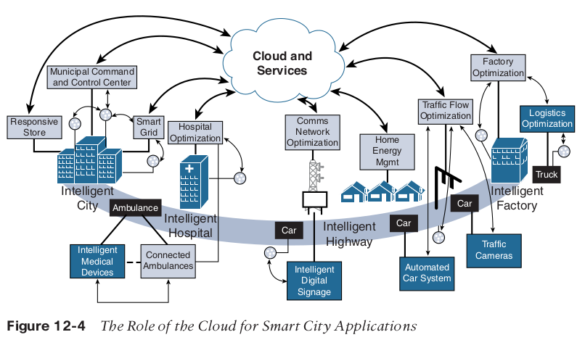

Slide 14
Services Layer
Ultimately, the true value of ICT connectivity comes from the services that the measured data can provide to different users operating within a city.
Smart city applications can provide value to and visibility for a variety of user types, including city operators, citizens, and law enforcement.
The collected data should be visualized according to the specific needs of each consumer of that data and the particular user experience requirements and individual use cases.
With the architecture described in this section, a smart city can incorporate any number of applications that can consume normalized data from a cloud-hosted platform or from fog applications.
Because the entire architecture operates with compatible APIs, these applications can even enable cross-domain benefits.

Slide 15
On-Premises vs. Cloud
Different cities and regions have different data hosting requirements based on security or legal policies.
A key consideration in developing ICT connectivity solutions is whether a city has requirements about where data should be hosted.
Data can be hosted on-premises or in the cloud. Fog architectures provide an intermediate layer.
The data resulting from fog processing can be sent to the cloud or to a data center operated locally (on-premises)
On-premises encompasses traditional networks, and all their limitations, whereas cloud hosting encompasses a whole host of security risks if the proper measures are not taken to secure citizen data.
Ideally, a smart city utilizing ICT connectivity would use the cloud in its architecture, but if this is impossible, the city would need to invest far more in the city layer’s networking components (for example, switches, routers)

Slide 16
Smart City Security Architecture
A serious concern of most smart cities and their citizens is data security. Vast quantities of sensitive information are being shared at all times in a layered, real-time architecture, and cities have a duty to protect their citizens’ data from unauthorized access, collection, and tampering.
It is up to the city and the officials who run it to determine how to utilize this data. When a private entity owns city-relevant data, the scope of the ownership may initially be very clear.
Traditionally, network deployments use a siloed approach and do not always follow
open security standards. Agencies may run applications and servers on the public cloud,
have limited security safeguards implemented, and use cloud-based collaboration
tools without proper security.

Slide 17
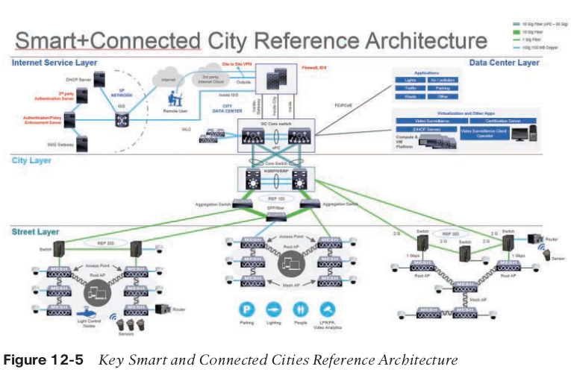

Slide 18
The city layer transports data between the street layer and the data center layer. It acts
as the network layer. The following are common industry elements for security on
the network layer:
■ Firewall: A firewall is located at the edge, and it should be IPsec- and VPN-ready,
and include user- and role-based access control. It should also be integrated with the
architecture to give city operators remote access to the city data center.
■ VLAN: A VLAN provides end-to-end segmentation of data transmission, further
protecting data from rogue intervention. Each service/domain has a dedicated VLAN
for data transmission.
■ Encryption: Protecting the traffic from the sensor to the application is a common
requirement to avoid data tampering and eavesdropping. In most cases, encryption
starts at the sensor level. In some cases, the sensor-to-gateway link uses one type of
encryption, and the

Slide 19
Smart City Use-Case Examples

