Slide 1
Chapter 9
Manufacturing

Slide 2
Overview
An Introduction to Connected Manufacturing
An Architecture for the Converged Factory
Industrial Automation Control Protocols
Connected Factory Security
Edge Computing in the Connected Factory

Slide 3
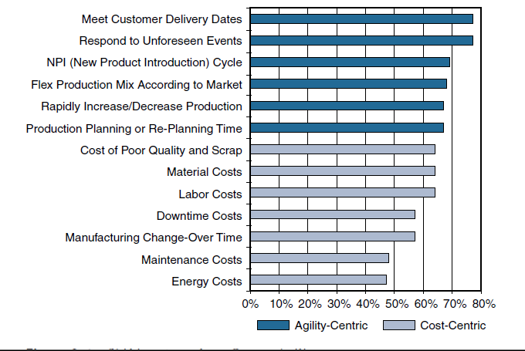
An Introduction to Connected Manufacturing
Figure 9-1 Shifting Focus from Cost to Agility
Source: SCM World /Cisco, Smart Manufacturing and the Internet of Things 2015 Survey of 418
Manufacturing Business Line and Executives and Plant Managers Across 17 Vertical Industries.

Slide 4
It is estimated that nearly 75% of US plants are more than 20 years old. Factories around the world are facing a similar challenge: Their aging assets not only slow innovation but also cost billions in unplanned downtime.
By some estimates, there are 60 million machines in factories throughout the world. Of them, 90% are not connected, and the vast majority of the machines are more than 15 years old
IoT-related technologies
Data-driven manufacturing:- Manufacturers are also exploring ways to use data generated from the machines to support rapid retooling when market fluctuations or other needs occur.
OT and IT convergence: IP networking is enabling closer integration between machines and factories and the line between factory and enterprise networks is becoming less distinct

Slide 5
Improved technology with lower costs: The convergence of compute, switching, routing, and security has the potential to drive down the cost of connecting machines.
Machine builder OEMs focused on new priorities: Original equipment manufacturers (OEMs) are facing disruption by new cloud-based providers that intend to provide Machines as a Service (MaaS). This offers remote connectivity and monitoring of the machines.
- Manufacturers are looking toward near 100% uptime and zero-touch deployments.
- They are also exploring ways to control support costs through remote connectivity and monitoring

Slide 6
An IoT Strategy for Connected Manufacturing

Slide 7
Business Improvements Driven Through IoT

Slide 8
An Architecture for the Connected Factory
Network security in the factory was typically limited to an industrial DMZ, leaving the machines mostly unprotected
Factories rarely deployed network-level security systems that included identity policies and secure remote access tools that allowed plant-level data to be securely extended to the cloud.
Companies are beginning to tie together their industrial automation and control systems (IACS) with IT applications and analytics tools to provide control and analytics capabilities that are driving operational and business benefits.

Slide 9
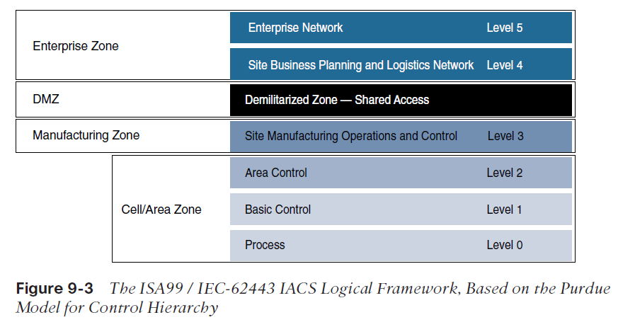
Industrial Automation and Control Systems Reference Model
Manufacturing environments heavily rely on different communication technologies which are vendor-specific.
IACS is built on hierarchical Purdue model that provides logical framework to describe network and security

Slide 10
The IACS logical framework identifies functional zones and levels of the manufacturing plant and defines operations at each level.
  Safety Zone:The safety system’s function in this zone is to provide an
IACS shutdown (a “stop” button) in case of an emergency. You can think of this as a hardwired fail-safe used to protect personnel and equipment if a dangerous event occurs.
  Manufacturing zone: It supports secure plant operations and functioning of the IACS applications, there is a secure separation of the manufacturing zone and the enterprise zone (Levels 4 and 5).
  Cell/area zone: It has three levels of activity;
    Level 0: Process: It consists of Sensors and Actuators performing activities such as moving a robot, spraying, driving a motor or welding
    Level 1: Basic Control: This is where controller that direct manufacturing live.
    Level 2: Area Supervisory Control: includes functions within the cell/area zone that require runtime supervision and operation

Slide 11
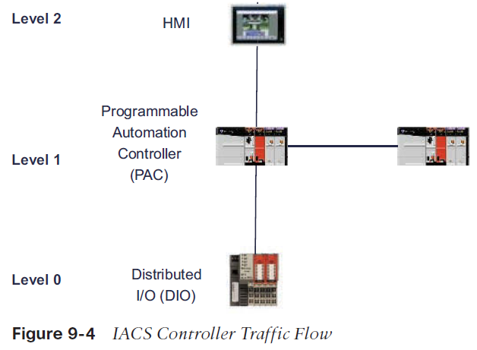

Slide 12
Level 3: Site level: The functions and applications at level 3 include SCADA Systems, file servers, control room workstations, scheduling systems, and reporting.
Demilitarized Zone – DMZ: This is the security critical to plant operations as it protects the machines at the lower level from malicious activity that may occur in the traditional enterprise network.
Enterprise Zone: Level 4 and 5 in the enterprise zone relate to traditional IT or enterprise networking functions, including file services, internet connectivity and email systems.

Slide 13
The CPwE Reference Model
The Converged Plantwide Ethernet reference model was developed by the cisco to address the need of Ethernet and TCP/IP communication protocols.
The CpwE solution is designed to enable the convergence of IACS applications with enterprise IP system
CPwE Ethernet networks come in various topologies, including redundant star, bus/star, and ring.
The distribution switches between the cell/area and industrial zones form a demarcation point
The distribution switches touch the same Ethernet segment as the access switches in the cell/area, they are also considered cell/area infrastructure devices and are typically required to be ruggedized devices
The industrial zone is analogous to Level 3 of the IACS reference model and is also very similar to a traditional campus network.
The industrial zone provides network connectivity through routed distribution switches to multiple cell/area zones as required.
The industrial zone also supports IP routing capabilities for IACS devices that require Level 3 application support

Slide 14
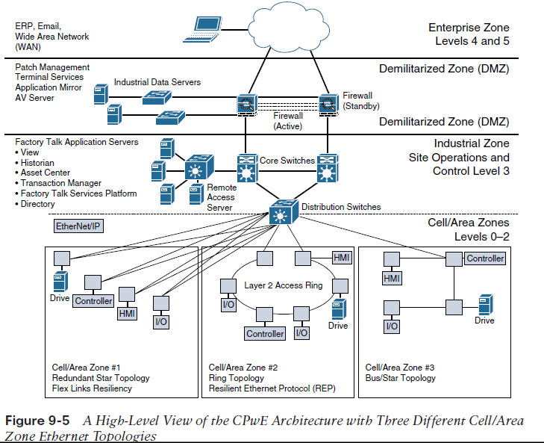

Slide 15
CPwE Resilient Network Design
Due to sensitive controller and application requirements in IACS networks, network resiliency between IACS devices is a mandatory requirement within cell/area zones.
Resilient IACS networks need to support the following capabilities:
  Availability:A fully redundant physical path in the IACS Ethernet network topology should be chosen.
  Predictable performance:Reliability and real time traffic requirements of IACS applications is a requirement for successful CpwE deployments.
  Fast network re-convergence:Typical IACS application interruption tolerance limits are on the order of less than 100 ms, with minimal jitter.
  Industrial Protocol: CPwE IACS devices and networking equipment need to support industrial application protocol requirements.

Slide 16
Communication pattern that requires network resiliency
■Controller to HMI
■ Controller to controller
■ Controller to input/output (I/O; the sensor and controller modules for machines)
■ Controller to variable frequent drives (VFDs; adjustable electromechanical drives to control a motor)
■ Controller to motor control centers (MCCs; used in factories to control a large number of motors from one central controller)
Having the ability to quickly bring new machines online and connect them to the
Ethernet network has yielded much greater flexibility and has significantly reduced new
model and new product introduction, thus improving the overall time to market.

Slide 17
Resilient Ethernet Protocol
  In the CPwE reference architecture, Resilient Ethernet Protocol (REP) is used in the cell/ area zone to achieve high-speed protection of ring topologies
  REP controls a group of ports connected to an Ethernet segment to ensure that no bridging loops exist and that the Ethernet segment is able to respond to topology changes.
  Another key advantage of REP is that it is not limited to a small number of devices on a single Ethernet segment.
  REP has no fixed upper limit on the number of nodes per segment, thus supporting large ring topologies unlike STP which limited to seven devices per segment
  For each REP segment, one switch is designated as a master node that controls the overall ring

Slide 18
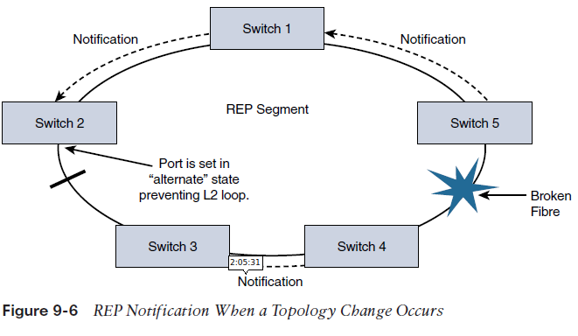
A REP segment is a chain of ports on an Ethernet segment configured with a segment ID.
When all ports in the ring segment are active, one port is identified as the alternate port, meaning it is in the blocking state, thus preventing the ring from becoming a Layer 2
If any other port in the REP segment fails, the alternate port is signaled to change state into the forwarding state, repairing the broken Ethernet ring segment and allowing communications to continue

Slide 19
Business value of Resiliency of Converged Networks
  It increases the number of devices being connected to the plant floor
  Devices such as sensors, and actuators that collect data are used as tool to help understand the complex processes.
  A resilient network design allows a single device to be taken out of service without impacting the rest of the cell/area network.
  REP based architecture support systems that connect people, processes, and data to real-time applications, even during a network disruption.

Slide 20
CPwE Wireless
While deploying CpwE, wired Ethernet access switches are used often but plantwide architectures are increasingly adapting the use of Wi-Fi for IACS applications with similar requirements like QoS with minimal latency and jitter.
CpwE wireless networks are used in;
  Managing machines
  Handheld devices
  Automated Guided Vehicles (AGVs)
  Avoiding costs involved in physical wiring of the network

Slide 21
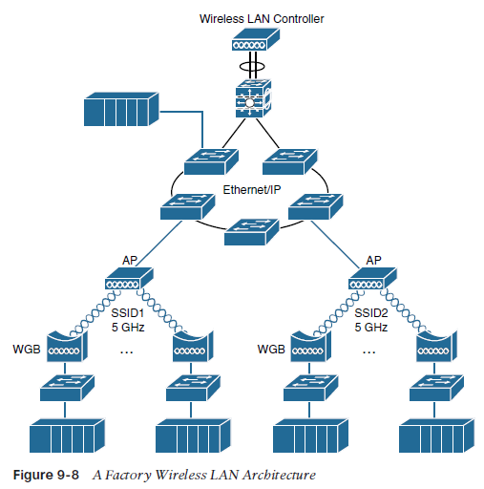
CPwE Wireless Network Architecture
While deploying a network a thought of the following is taken into account
  Bandwidth
  QoS handling
  Thoroughput
  Reliability
  Security
Latency is impacted by how many stations are associated to AP.

Slide 22
Use cases of Wi-Fi usage in Manufacturing Environments.
  Fixed-position devices: Commonly in Original equipment manufacturer (OEM) machine or skid that needs to be integrated into a production line over a wireless link.
  Nomadic devices
  Operational relocation devices

