Slide 1
Chapter 11
Utilities

Slide 2
Introduction
This chapter introduces the concept of the smart grid and explores some of the underlying IoT technologies that are transforming the way power is generated,
transmitted, and delivered. It includes the following sections:
Introduction to power utility industry
The GridBlock Reference Model
The Primary Substation GridBlock and Substation Automation:
System Control GridBlock:
The Field Area Network (FAN) GridBlock:
Securing the Smart Grid:
The Future of the Smart Grid:

Slide 3
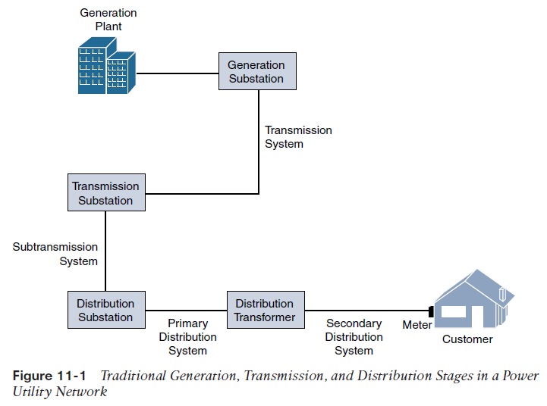
An Introduction to the Power Utility Industry
The three stages of the power supply–chain are generation, transmission, and distribution
  Generation
  Transmission
  Distribution

Slide 4
Generation: Power generation is where the electricity gets produced. Power production typically includes nuclear, hydroelectric, gas, and coal pants. Once generated, high-voltage (HV) electrical power is sent through high-voltage transmission lines into the transmission system.
Transmission: Power transmission takes the HV power over long distances—typically 115 kV and above over distances of 50 km and greater. Transmission lines include aerial lines and also submarine cables that transmit HV electrical power over long distances underwater. The transmission system is responsible for connecting HV lines from generation stations to substations throughout the service area.
Distribution: Power distribution includes the part of the utility network from the substation to your home or business. This includes the medium-voltage (12.5 kV, for example) powerlines you see on poles around your neighborhood, including pad mount transformers.

Slide 5
The IT/OT Divide in Utilities
While OT networks are not as flexible as their IT counterparts, OT engineering departments have continually adapted to take advantage of newer technologies supporting the power grid.
OT engineers are always looking for better, more cost-effective ways to do things, and this often includes utilizing IT technology whenever possible.
Challenges of concern when IT and OT are interconnected
■ How can network resiliency and redundancy be supported for mission-critical OT applications that keep the lights on?
■ Who will support remote access to distributed systems on the grid that must transit both the IT and OT networks?
■ How will security be governed in both the OT networks and the interconnection points between the IT and OT networks?
■ Will change management be governed in the same way as it is for IT systems, or does the criticality of the OT applications require a new set of rules to ensure the continuity of business?

