Slide 1

www.javapolis.com

Slide 2


Maven 2.0
Improve your build patterns
Vincent Massol
CTO
Pivolis
www.javapolis.com
Notes:
Ask who’s been using Maven 1.0? Ant? Maven 2?
Ask who’s never used a build system?
Ask if Hani is in the room!

Slide 3
Overall Presentation Goal
Discover Maven 2.0 through build patterns
www.javapolis.com
Notes:
Learn: know better what Maven 2.0 is and its capabilities
know: better understanding of what a build tool must support
Feel: maven 2.0 is almost ready for primetime (still missing some documentation but coming)

Slide 4
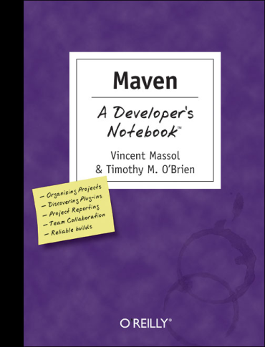
Speaker’s Qualifications
Vincent is part of the Maven dev team since 2002
Vincent is the co-author of “Maven: A Developer’s Notebook” published by O’Reilly
  And best-seller « JUnit in Action » from Manning
Vincent is co-author of a new book on Maven 2
  with Jason Van Zyl, Brett Porter and Carlos Sanchez
  will be published by Mergere
  will be made available at no cost to the community
Vincent has spoken at various conferences on the topic of build and continuous builds
  TSSS 2003/2004, JavaPolis 2004, JavaZone 2005, etc
Vincent blogs about software quality and open source at www.massol.net
www.javapolis.com

Slide 5
Making your builds boring…
Building projects should be easy and standardized. You should not be spending a substantial amount of your project time on builds. Builds should just work!
www.javapolis.com
Notes:
This is what Maven is trying to achieve
Through application of build best practices

Slide 6

Agenda
What is Maven?
Maven Architecture
Build patterns
Maven 2 plugins
Demo
Why migrate?
Maven 2 Adoption
Maven 2 future
The Maven ecosystem
www.javapolis.com

Slide 7
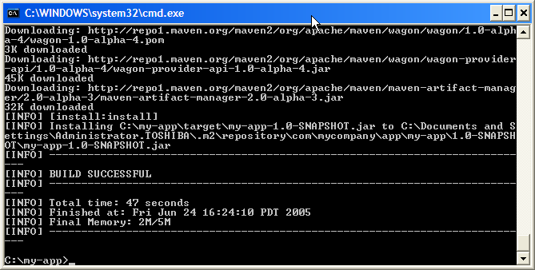
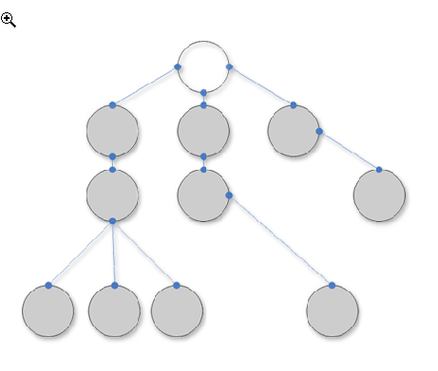
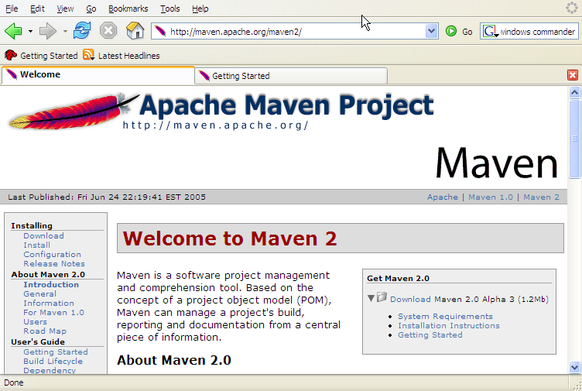
What is Maven? (1/2)
A build tool!
A dependency management tool!
A documentation tool!
www.javapolis.com

Slide 8
What is Maven? (2/2)
Maven is really a process of applying patterns to a build infrastructure in order to provide a coherent view of software projects.
Objectives
  Make the development process visible or transparent
  Provide an easy way to see the health and status of a project
  Decreasing training time for new developers
  Bringing together the tools required in a uniform way
  Preventing inconsistent setups
  Providing a standard development infrastructure across projects
  Focus energy on writing applications
www.javapolis.com
Notes:
Key values:
- Simplicity
- Uniformity
- Consistency
- Reproducibility
- Visibility
- Transparency

Slide 9
Maven Architecture
Plugin
e.g. jar
Projects
to build
Maven Core
Plugin
e.g. surefire
Plugin
e.g. release
Local machine
Remote repository or local install
www.javapolis.com
Notes:
IOC container (plexus). Might be moved to Xbean (Geronimo micro kernel)
Wagon for deployments
SCM for source repository access

Slide 10
Common project metadata format
POM = Project Object Model = pom.xml
Contains metadata about the project
  Location of directories, Developers/Contributors, Issue tracking system, Dependencies, Repositories to use, etc
Example:
<project>
<modelVersion>4.0.0</modelVersion>
<groupId>org.codehaus.cargo</groupId>
<artifactId>cargo-core-api-container</artifactId>
<name>Cargo Core Container API</name>
<version>0.7-SNAPSHOT</version>
<packaging>jar</packaging>
<dependencies/>
<build/>
[…]
Minimal POM
www.javapolis.com

Slide 11
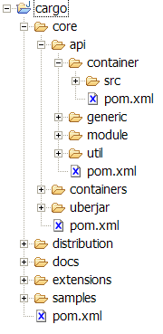
Common directory organization
src/
  main/
    java/
    resources/
    webapp/
    application/
    groovy/
  test/
    java/
    resources/
    cactus/
  site/
4 nested
projects
Other projects
www.javapolis.com
Notes:
Recommendations
Always try to use m2 defaults
Even though they can be changed
Makes the build easier to understand for others
Makes the POM smaller
Caters for potentially defective plugins using hardcoding ;-)
Modify your tests so that they only rely on the Classpath to find resources and not on the filesystem
getClass().getResource("/myfile");

Slide 12

Common way to build applications (1/2)
M2
generate-
sources
mojo
compile
mojo
test
mojo
package
plugins
integration-
test
user
mojo
install
mojo
e.g. mvn install
deploy
bindings
Well-known phases
www.javapolis.com
Notes:
- MOJO = Maven POJO = goals. For example when you call « mvn [plugin prefix]:[goal name] » it is mapped to a mojo at execution time.
- There are more phases than those represented:
<phases>
<phase>validate</phase>
<phase>initialize</phase>
<phase>generate-sources</phase>
<phase>process-sources</phase>
<phase>generate-resources</phase>
<phase>process-resources</phase>
<phase>compile</phase>
<phase>process-classes</phase>
<phase>generate-test-sources</phase>
<phase>process-test-sources</phase>
<phase>generate-test-resources</phase>
<phase>process-test-resources</phase>
<phase>test-compile</phase>
<phase>test</phase>
<phase>package</phase>
<phase>integration-test</phase>
<phase>verify</phase>
<phase>install</phase>
<phase>deploy</phase>
</phases>

Slide 13
Common way to build applications (2/2)
The lifecycle depends on the project type (packaging)
  Defined in pom.xml (pom, jar, ear, war, etc)
  Ex: <packaging>jar</packaging>
User can modify lifecycles by adding a goal to a phase:
<plugin>
<groupId>com.mycompany.example</groupId>
<artifactId>touch-maven-plugin</artifactId>
<executions>
<execution>
<phase>process-test-resources</phase>
<configuration>[…]</configuration>
<goals>
<goal>timestamp</goal>
</goals>
</execution>
</executions>
</plugin>
www.javapolis.com

Slide 14
Artifact repositories (1/3)
Used to store all kind of artifacts
  JARs, EARs, WARs, NBMs, EJBs, ZIPs, plugins, …
All project interactions go through the repository
  No more relative paths!
  Easy to share between teams
Local
Artifact
Repository
Remote
Artifact
Repository
e.g. http://ibiblio.org/maven2
<repositories>
<repository>
<id>maven2-snapshot</id>
<releases>
<enabled>true</enabled>
</releases>
<name>Maven Central Development Repository</name>
<url>http://snapshots.maven.codehaus.org/maven2</url>
<layout>legacy|default</layout>
</repository>
</repositories>
www.javapolis.com
Notes:
- In M2 this is even true for sharing build files like checkstyle configs, licenses, etc. The rule is: a project can be checked out and built without the need to check out others
- In Ant, this was done with:
A lib/ directory somewhere where the external jars were stored
In a dist/lib directory for each project leading to lots of relative paths

Slide 15
Artifact repositories (2/3)
Some public remote repositories
yesterday
today
ibiblio
m1
ibiblio
m2
Conversion + sync
JIRA upload
requests
m1
URL rewriting to preserve m1 URLs
JIRA upload
requests
m2
m1 +
+ m1
sync
sync + conversion
Codehaus
m1
ObjectWeb
m1
Apache
m1
Jetty
m1
Open
Symphony
m1
OS Java
m1
+ m2
+ m2
+ m2
+ m2
+ m2
+ m2
partners
www.javapolis.com
Notes:
- Ibiblio is the default
- In the near future there will be only a single repository (the m2 one) and the m1 will be mapped through URL rewriting

Slide 16
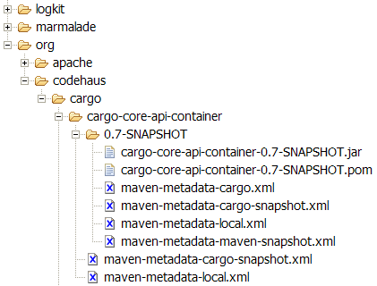
Artifact repositories (3/3)
Hierarchical structure
Automatic plugin download
Plugins are read directly from the repository
Configurable strategies for checking the remote repositories for updates
  Daily check by default for plugin and ranges updates
Remote repositories contain Metadata information
  Releases, latest, and more to come
www.javapolis.com
Notes:
- Ibiblio is the default
- In the near future there will be only a single repository (the m2 one) and the m1 will be mapped through URL rewriting

Slide 17
Dependency management (1/2)
Maven uses binary dependencies
« any version after 1.0 »
A
B
<dependencies>
<dependency>
<groupId>com.acme</groupId>
<artifactId>B</artifactId>
<version>[1.0,)</version>
<scope>compile</scope>
</dependency>
</dependencies>
C
Artifact
Repository
(Local)
Artifact
Repositories
(Remote)
Build C
Look for A & B
Look for A & B
www.javapolis.com
Notes:
Scopes = compile, runtime, provided, test

Slide 18
Dependency management (2/2)
Transitive dependencies
  Possibility to exclude some deps
  Need good metadata
  Ideally projects should be split
SNAPSHOT handling
  Always get latest
Automatic dep updates
  By default every day
A
Only need to include A
B
C
D
www.javapolis.com
Notes:
Bad published meta data – report at http://jira.codehaus.org/browse/MEV
Mvn –U to update deps

Slide 19
Multi-module builds
Integrated into Maven 2
Run « mvn » at parent level
  E.g. mvn install in cargo/core/api
  E.g. mvn install in cargo/core
  E.g. mvn install in cargo/
Declare children projects in
parents:
<modules>
<module>core</module>
<module>extensions</module>
<module>samples</module>
</modules>
www.javapolis.com

Slide 20
Environment-dependent builds (1/2)
Based on profiles
  Located in pom.xml, in profiles.xml or in settings.xml
<profiles>
<profile>
<id>tomcat5x</id>
<activation>
<activeByDefault>true</activeByDefault>
</activation>
<properties>
<containerId>tomcat5x</containerId>
<downloadUrl>…jakarta-tomcat-5.0.30.zip</downloadUrl>
</properties>
</profile>
<profile>
<id>orion2x</id>
<properties>
<containerId>orion2x</containerId>
<downloadUrl>…orion2.0.5.zip</downloadUrl>
[…]
Profile that is always active
www.javapolis.com

Slide 21
Environment-dependent builds (2/2)
Different activation conditions
  JDK version, OS, property defined, existence of file or directory
Profiles can also modify plugin configurations and other POM elements
  Merged with the main pom.xml content
Profiles can be selected on the command line:
mvn –P orion2x,resin3x install
www.javapolis.com

Slide 22
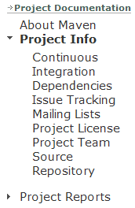
Site and reports (1/4)
Lots of reports
  Project information (mailing lists, SCM, dependencies, etc)
  PMD, Checkstyle, Javadoc, etc
<reporting>
<plugins>
<plugin>
<groupId>org.apache.maven.plugins</groupId>
<artifactId>maven-javadoc-plugin</artifactId>
</plugin>
[…]
</plugins>
</reporting>
www.javapolis.com

Slide 23
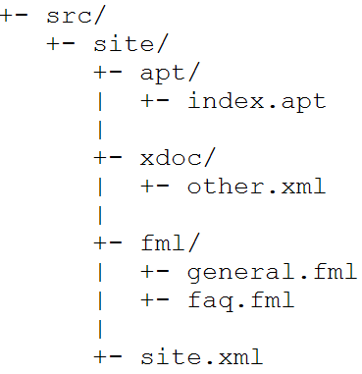
Site and reports (2/4)
Accepts several input formats
  Almost Plain Text (Wiki like)
  Xdoc (Maven 1.0 compatible)
  FAQ (Maven 1.0 compatible)
  Docbook
mvn site
www.javapolis.com

Slide 24
Site and reports (3/4)
------
Generating a Site
------
Apache Maven Team
------
13 May 2005
------
Building a Site
* Creating Content
The first step to creating your site is to create some content. In
Maven 2.0, the site content is separated by format, as there are several
available.
-------------------
+- src/
+- site/
+- apt/
| +- index.apt
+- site.xml
--------------------
The Xdoc format is the same as
{{{http://maven.apache.org/using/site.html} used in Maven 1.0}}.
However, <<<navigation.xml>>> has been replaced by the site descriptor
(see below).
www.javapolis.com

Slide 25
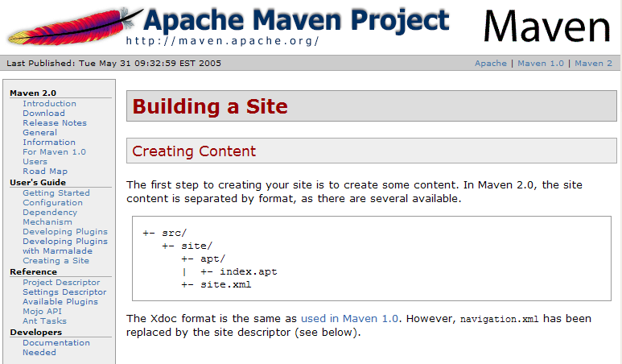
Site and reports (4/4)
www.javapolis.com

Slide 26
Maven 2 Plugins (1/2)
Antlr
Ant
AntRun
AspectJ
Assembly
Assembly-report
Cargo
Castor
Changelog
Changes
Commons-attributes
Checkstyle
Clean
Clover
Csharp
Cobertura
Compiler
Deploy
Ear
Eclipse
Ejb
Ejb3
Exec
Groovy
Help
Hibernate2
Idea
Install
Issue
It
Jalopy
Jar
Javacc
Javadoc
Javancss
Jboss
Jcoverage Jdepend
Jdiff
Jelly
Jetty
Jpox
Jspc
Jxr
MAnt
Native
One
Par
Plugin
Pmd
Project-info-reports
Rar
Release
Repository
Resources
Repository
Sablecc
Site
Slimdog
Source
Surefire
Surefire-report
Taglist
Tomcat
Verifier
Xslt
War
Wsdl2java
Xdoclet
Xmlbeans
Status: docs.codehaus.org/display/MAVEN/Maven+Plugin+Matrix
www.javapolis.com
Notes:
Talk about « Hacking Maven »: Ant, Groovy, etc

Slide 27
Maven 2 Plugins (2/2)
Plugins are downloaded on demand
  First time they are used
Updates downloaded automatically
  Opt-in notification if newer plugin found
<build>
<plugins>
<plugin>
<groupId>org.apache.maven.plugins</groupId>
<artifactId>maven-compiler-plugin</artifactId>
<configuration>
<source>1.5</source>
<target>1.5</target>
</configuration>
</plugin>
</plugins>
</build>
www.javapolis.com
Notes:
Plugins can be written in different languages (Java, Ant, Beanshell)

Slide 28
DEMO
www.javapolis.com
Notes:
- Show difference of speed between m1 and m2 by building Cargo core

Slide 29
Why migrate?
From Ant
  1000 lines of scripts per project to ~50
  Ability to benefit from all existing plugins and all future plugins!
  There are Maven 2 Ant tasks too
From Maven 1
  Faster (and smaller)
    E.g. from 2m26s to 50s to build Cargo’s core
  New features
    Easier to use (well-defined lifecycle)
    Transitive dependencies
    Profiles
    …
  New features happen in M2
    M1 is mostly in maintenance mode
  Tools are built around M2 (e.g. continuum, visual project managment, dashboards, etc)
www.javapolis.com

Slide 30
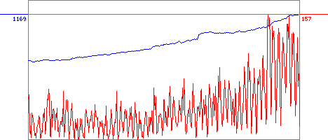
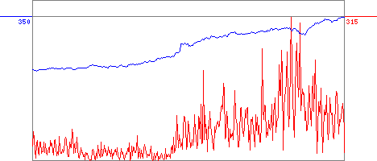
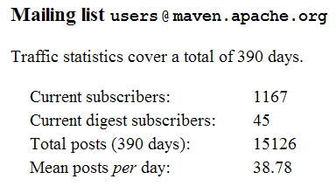
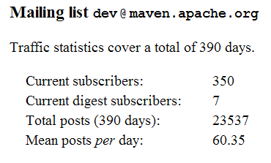
Maven 2 Adoption (1/2)
Maven 2.0 release
Source: http://people.apache.org/~coar/mlists.html
Graphs generated on 5th of December 2005
www.javapolis.com

Slide 31
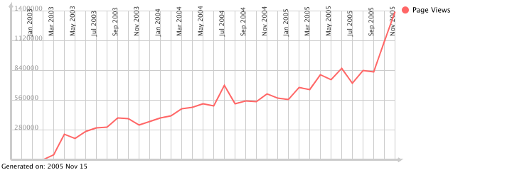
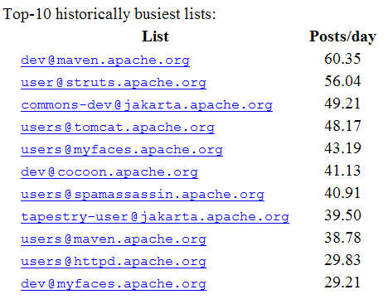
Maven 2 Adoption (2/2)
Page views on Maven web site
Source: http://people.apache.org/~vgritsenko/stats/projects/maven.html
Busiest mailing-lists at Apache
Source: http://people.apache.org/~coar/mlists.html
9200+ jars on ibiblio
www.javapolis.com
Notes:
+ irc

Slide 32
Maven 2 Future
Features for 2.1+
  Site aggregation
  Notion of Workspaces
  POM templating
  Stronger support for other languages
  Substitution of Custom Maven Components
  Reusable Resources
  Repository enhancements
  Stronger plugin version selection
  Lifecycle enhancement for plugin execution
www.javapolis.com

Slide 33
The Maven Ecosystem
Standardized Project Metadata
Builds (Maven)
Continuous integration (Continuum)
Development tools
Repository management and CPAN equivalent
Dashboards (Quality, Productivity, etc)
www.javapolis.com

Slide 34
Summary
Maven 2 architecture is better than Maven 1
Maven 2 addresses the main build patterns
Maven 2 is ready to be used (*)
(*) But be prepared to work closely with the Maven development team
www.javapolis.com

Slide 35
If You Only Remember One Thing…
Now is the right time to evaluate Maven 2 and provide feedback to the development team. We do listen and you can help shape Maven 2.
www.javapolis.com

Slide 36
Q&A
www.javapolis.com

Slide 37
www.javapolis.com

