Slide 1
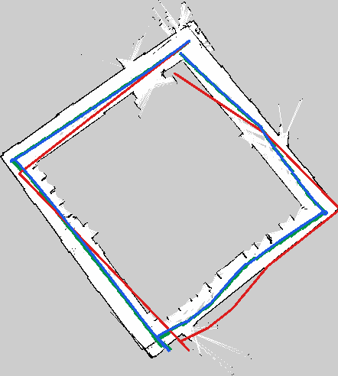
Extended Kalman Filter
Localization
Pioneer 3-DX · Odometry + LiDAR · ROS 2 / Python
Final method
EKF prediction from odometry
Correction from LiDAR scan matching against a SLAM map
green = SLAM reference
red = odometry
blue = EKF
EKF Localization for Pioneer 3-DX
01

Slide 2
MOTIVATION
Problem and objective
Indoor GPS is not available, so the robot must localize using onboard sensors.
Robot
Relative sensing
Pioneer 3-DX differential-drive platform
Wheel encoders provide odometry
Wheel odometry is smooth and frequent but accumulates drift over time.
LiDAR observes the environment and can correct the pose relative to a map.
Absolute sensing
Evaluation
Goal: estimate the robot pose (x, y, theta) in real time using EKF localization.
2D LiDAR scan matched against the map
SLAM trajectory used only as reference
Key challenge
Fuse noisy relative motion with map-based observations without using the SLAM pose as an input.
EKF Localization for Pioneer 3-DX
02

Slide 3
THEORY
Probabilistic robotics framing
Robot pose is represented as a belief, not a single perfect value.
bel(x_t) = p(x_t | z_{1:t}, u_{1:t}, m)
EKF approximation
belief ≈ N(μ_t, Σ_t)
Prediction
Use odometry motion input u_t to propagate the previous belief. Uncertainty increases because odometry drifts.
μ_t is the estimated pose
Σ_t is the pose uncertainty
Kalman Gain balances prediction vs. correction
Correction
Nonlinear motion is handled by local linearization
Use LiDAR observation z_t and the map m to reduce uncertainty and correct the pose estimate.
EKF Localization for Pioneer 3-DX
03

Slide 4
METHOD
Final localization pipeline
ROS 2 bag
slam_toolbox
Map
Scan matching
EKF
/odom + /scan
Build occupancy map
.pgm + .yaml
LiDAR scan vs map
Odom prediction + scan correction
SLAM trajectory is evaluation only, not an EKF input
This separation keeps the final localization algorithm dependent only on the map, odometry and LiDAR.
EKF Localization for Pioneer 3-DX
04

Slide 5
DEVELOPMENT
Simulation stage before real bags
The first tests were done in Python with full control over the map, trajectory and sensor noise.
Synthetic map
Planned route
Noisy sensors
Generic indoor room with corridors, walls and obstacles.
Collision-free trajectory used as known ground truth.
Gaussian odometry drift and LiDAR range noise were simulated.
Validated EKF prediction and correction in a controlled setting.
Compared weak, stable and strong odometry noise regimes.
Tested landmark, ICP and scan matching corrections before real implementation.
Useful for tuning and debugging, but not sufficient to prove real-world robustness.
EKF Localization for Pioneer 3-DX
05

Slide 6
DESIGN CHOICES
Approaches tested before the final method
Wall landmarks
Corner landmarks
Rejected: long walls do not constrain position along the wall direction and caused ambiguous updates.
More distinctive, but too sparse and unstable in noisy real bags. Associations were often ambiguous.
Final choice
Correlative scan matching uses the full LiDAR scan against the occupancy grid, avoiding fragile manual landmark association.
Local ICP
Machine learning for ICP confidence
Could help in simulation, but depended on a good initial estimate and sometimes converged to local minima.
Discarded: too little real data, simulated corrections did not generalize reliably.
EKF Localization for Pioneer 3-DX
06

Slide 7
PYTHON PIPELINE
Implementation and tuned parameters
rosbag_to_simple.py
Final corridor parameters
Extracts odometry CSV and LiDAR NPZ from ROS 2 bags.
Scan acceptance threshold
0.12 m
Correction frequency
every 5 LiDAR scans
extract_slam_tf_pose.py
Beam subsampling
every 5th beam, max 80 points
Extracts the SLAM trajectory from TF for evaluation.
Local search window
±0.35 m, ±0.18 rad
Motion noise
0.08 translation, 0.05 rotation
ekf_correlative_scanmatch.py
Measurement noise
0.25 m position, 0.10 rad heading
Runs EKF prediction and scan-to-map correction.
A correction is rejected if the scan does not fit the map well enough.
EKF Localization for Pioneer 3-DX
07

Slide 8
MAIN EXPERIMENT
Corridor result: EKF corrects odometry drift
Localization error vs. SLAM reference
0.986 m
0.179 m
Odometry mean
EKF mean
1.325 m
0.097 m
Odometry final
EKF final
Mean error reduced by ~82%
SLAM reference
Odometry
EKF
EKF Localization for Pioneer 3-DX
08

Slide 9
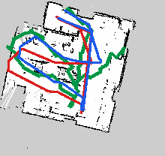
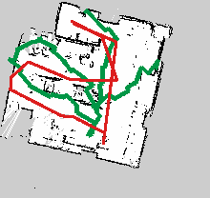
SECONDARY EXPERIMENT
Room result: useful as a limitation case
The room experiment showed possible SLAM reference/frame inconsistency, so numerical errors are less reliable.
Main lesson: map/reference consistency matters.
Odom mean 1.243 m → EKF mean 1.043 m; final error remained high.
EKF Localization for Pioneer 3-DX
09

Slide 10
WHAT WE CAN DEFEND
Conclusions
1. EKF is the localization core
Odometry performs prediction; LiDAR scan matching provides the correction measurement.
Open issues
Symmetric environments can produce false scan matches.
2. slam_toolbox has a limited role
Unknown initial pose or kidnapping needs global relocalization.
It generates the map and provides a reference trajectory for evaluation only.
Evaluation quality depends on a consistent SLAM map and frame tree.
3. Corridor results are strong
Mean error went from 0.986 m to 0.179 m; final error from 1.325 m to 0.097 m.
Final takeaway: EKF + scan matching is a practical indoor localization pipeline for the Pioneer 3-DX.
EKF Localization for Pioneer 3-DX
10

