Slide 1
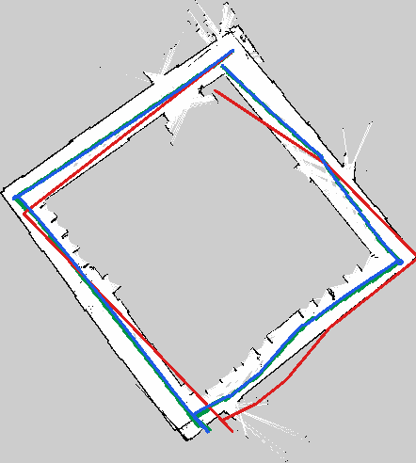
Extended Kalman Filter Localization
Pioneer 3-DX using wheel odometry and 2D LiDAR
Core idea
Use odometry for motion prediction and LiDAR scan matching against a map for EKF correction.
Main result
Corridor ATE-RMSE: 1.048 m -> 0.220 m
Autonomous Systems - IST
1

Slide 2
Problem and Motivation
Indoor localization with noisy onboard sensors
Indoor robots cannot rely on GPS.
Wheel odometry is smooth, but accumulates drift.
LiDAR observes the environment, but measurements are noisy and map-dependent.
The goal is to estimate the robot pose in a known map: x, y, theta.
Project objective
Develop an EKF localization pipeline for the Pioneer 3-DX using odometry and LiDAR data recorded in ROS 2 bags.
Robustness question
What happens when drift grows, the initial pose is uncertain, or the robot is kidnapped?
2

Slide 3
Robot and Sensors
Differential-drive robot with relative and map-based sensing
Pioneer 3-DX
Differential-drive mobile robot moving on a 2D plane.
Wheel odometry
Relative motion estimate from wheel encoders. Used in EKF prediction.
2D LiDAR
Range measurements around the robot. Used for scan-to-map correction.
State representation
Movement model
x_t = [ x, y, theta ]^T
x and y are the position in the map; theta is the robot heading.
Differential-drive planar motion
The odometry displacement and heading change are applied recursively to propagate the pose.
3

Slide 4
Sensor Uncertainty
Why sensor fusion is needed
Odometry errors
Encoder noise Wheel slip Uneven floor Calibration errors Accumulated drift
LiDAR errors
Range noise Reflections Occlusions Limited range Frame misalignment
Fusion principle
Odometry gives short-term smooth motion; LiDAR provides corrections relative to the map.
4

Slide 5
Final System Pipeline
What is used for localization and what is only used for evaluation
ROS bag
/odom + /scan
slam_toolbox
occupancy grid map
Python EKF
odom prediction + LiDAR correction
Output
EKF trajectory
->
->
->
TF from SLAM
map -> odom -> base_link
Reference CSV
SLAM-based trajectory
Evaluation
compare odom vs EKF
->
->
Important distinction
The EKF does not use the slam_toolbox trajectory as input. It uses the map, odometry and LiDAR scans. The SLAM trajectory is only an evaluation reference.
5

Slide 6
Probabilistic Localization
The robot maintains a belief, not a perfect pose
Belief
bel(x_t) = p(x_t | z_1:t, u_1:t, m)
Variables
x_t: robot pose z_t: sensor measurements u_t: odometry inputs m: known map
Interpretation
The algorithm estimates the most likely pose given all previous odometry inputs, LiDAR observations and the map.
6

Slide 7
Bayes Filter View
Localization as prediction followed by correction
Prediction
Previous belief + odometry bar bel(x_t) = integral p(x_t | u_t, x_{t-1}) bel(x_{t-1}) dx
Correction
Predicted belief + LiDAR observation bel(x_t) = eta p(z_t | x_t, m) bar bel(x_t)
Why EKF?
The state is continuous and the motion model is nonlinear, so the belief is approximated by a Gaussian mean and covariance.
7

Slide 8
EKF Prediction Step
Odometry propagates the robot pose and uncertainty
State prediction
bar mu_t = g(u_t, mu_{t-1})
Motion model
x_t = x_{t-1} + ds cos(theta + dtheta) y_t = y_{t-1} + ds sin(theta + dtheta) theta_t = theta_{t-1} + dtheta
Covariance prediction
bar Sigma_t = G_t Sigma_{t-1} G_t^T + R_t
Meaning
Each odometry increment moves the EKF estimate forward. The covariance grows because odometry is noisy.
8

Slide 9
EKF Correction Step
LiDAR scan matching becomes an absolute pose measurement
Measurement
z_scan = [ x_scan, y_scan, theta_scan ]^T
Kalman Gain
K_t = bar Sigma_t H_t^T (H_t bar Sigma_t H_t^T + Q_t)^-1
Innovation
innovation = z_scan - h(bar mu_t)
Update
mu_t = bar mu_t + K_t innovation Sigma_t = (I - K_t H_t) bar Sigma_t
Interpretation
The Kalman Gain balances trust between odometry prediction and LiDAR scan matching measurement.
9

Slide 10
LiDAR Scan Matching
How the LiDAR produces the EKF measurement
1. Scan
ranges + angles
2. Points
x = r cos a y = r sin a
3. Candidates
poses around EKF prediction
4. Score
distance to occupied map cells
5. Update
best pose -> EKF
->
->
->
->
Distance transform
The occupancy map is converted into a distance map. Candidate poses get low scores when projected LiDAR points fall close to occupied cells.
Acceptance gate
A correction is accepted only if the scan-matching score is low enough and enough LiDAR points are valid.
10

Slide 11
Implementation Scripts
Final submission code organization
01_extract_rosbag_sensor_data.py
Reads /odom and /scan from the ROS bag and writes odometry.csv + lidar_scans.npz.
02_extract_slam_reference_pose.py
Extracts map -> base_link pose by composing map -> odom and odom -> base_link TF transforms.
03_run_ekf_scan_matching_localization.py
Runs EKF prediction from odometry and LiDAR scan-to-map correction.
04_compute_localization_metrics.py
Computes ATE, RPE, heading error and generates evaluation plots.
Design choice
ROS 2 is used to record/process bags; Python is used offline for localization experiments and analysis.
11

Slide 12
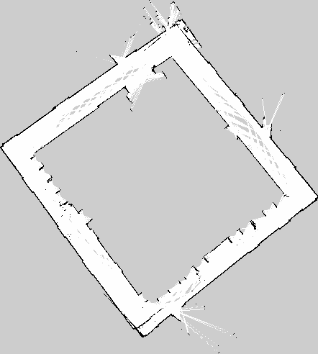
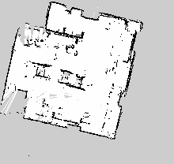
Map Generation with slam_toolbox
Map first, localization second
Corridor map
Room map
Use in final method
The occupancy grid map is used by scan matching. The SLAM pose is used only to evaluate the estimated trajectories.
12

Slide 13
Tuned Parameters
Practical choices that made the method stable
Correction rate
Correction every 5 LiDAR scans
Scan reduction
Every 4th beam, max 90 points
Search window
+/-0.35 m and +/-0.25 rad
Acceptance
score gate around 0.18 m minimum 25 points
EKF noise
motion: 0.08 trans, 0.05 rot measurement: 0.20 m, 0.08 rad
Why gates matter
Bad scan matches can be worse than no correction, especially in symmetric areas.
Important answer
The parameters control the balance between trusting odometry and trusting LiDAR. They were tuned experimentally using the corridor bag.
13

Slide 14
Approaches Tested Before the Final Method
What did not work well and why
Wall landmarks
Long walls are ambiguous along their direction, especially in corridors.
Corner landmarks
More distinctive, but too few reliable detections and difficult data association.
ICP correction
Can converge to local minima and depends strongly on a good initial estimate.
Machine learning idea
Rejected because the amount of real data was too small for robust training.
Final choice
Correlative scan matching uses the whole LiDAR scan and the map, avoiding fragile manual landmark association.
14

Slide 15
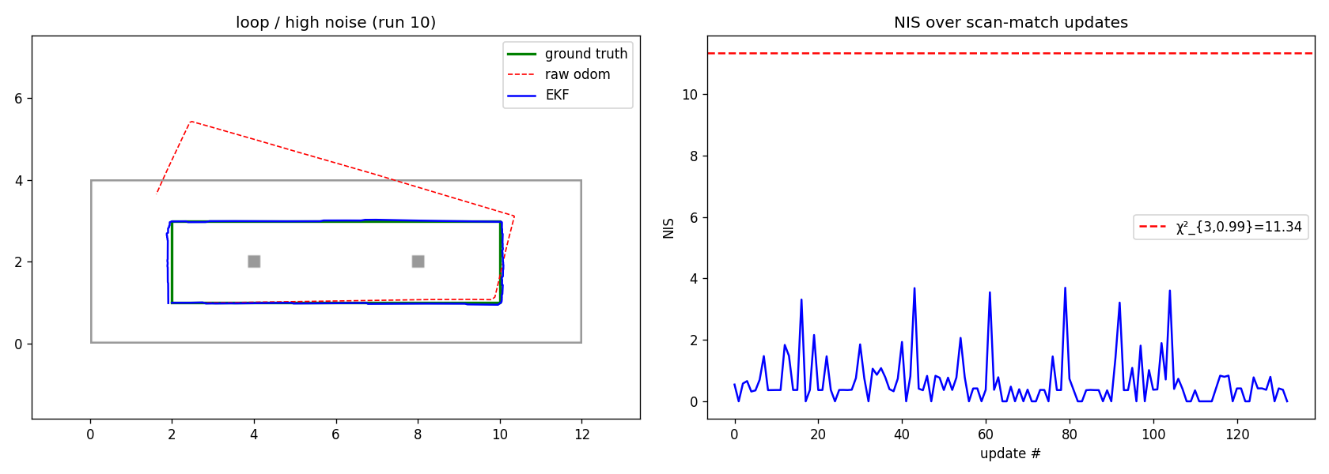
Simulation Stage
Controlled tests before real robot bags
Why simulate?
Known ground truth Controlled odometry drift Controlled LiDAR noise Fast parameter testing
Observed behavior
Loop/high noise: 1.342 m -> 0.091 m RMSE Loop/low noise: 0.221 m -> 0.072 m RMSE L-shape/medium: 0.070 m -> 0.120 m RMSE
Lesson
EKF helps most when drift is significant and the map geometry is informative.
15

Slide 16
Corridor Experiment: Main Result
Consistent map and reference trajectory
Odometry RMSE
1.048 m
EKF RMSE
0.220 m
Odometry final
1.325 m
EKF final
0.097 m
Interpretation
The red trajectory drifts away from the reference, while the blue EKF trajectory remains close to it. This is the strongest evidence that the LiDAR correction is useful.
Green: SLAM-based reference | Red: raw odometry | Blue: EKF
16

Slide 17
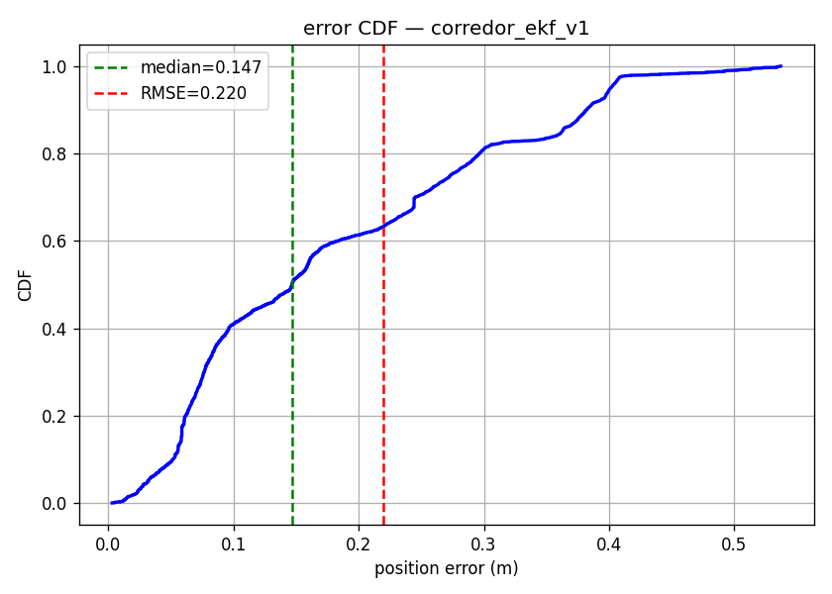
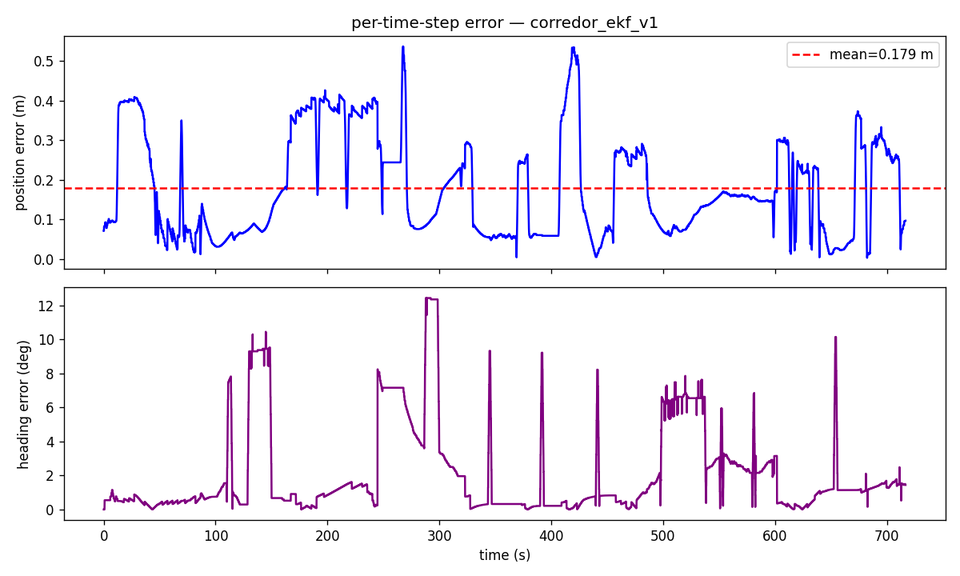
Corridor Metrics
Error over time and distribution
Metric summary
ATE mean: 0.179 m ATE-RMSE: 0.220 m ATE max: 0.537 m Heading RMSE: 3.45 deg
17

Slide 18
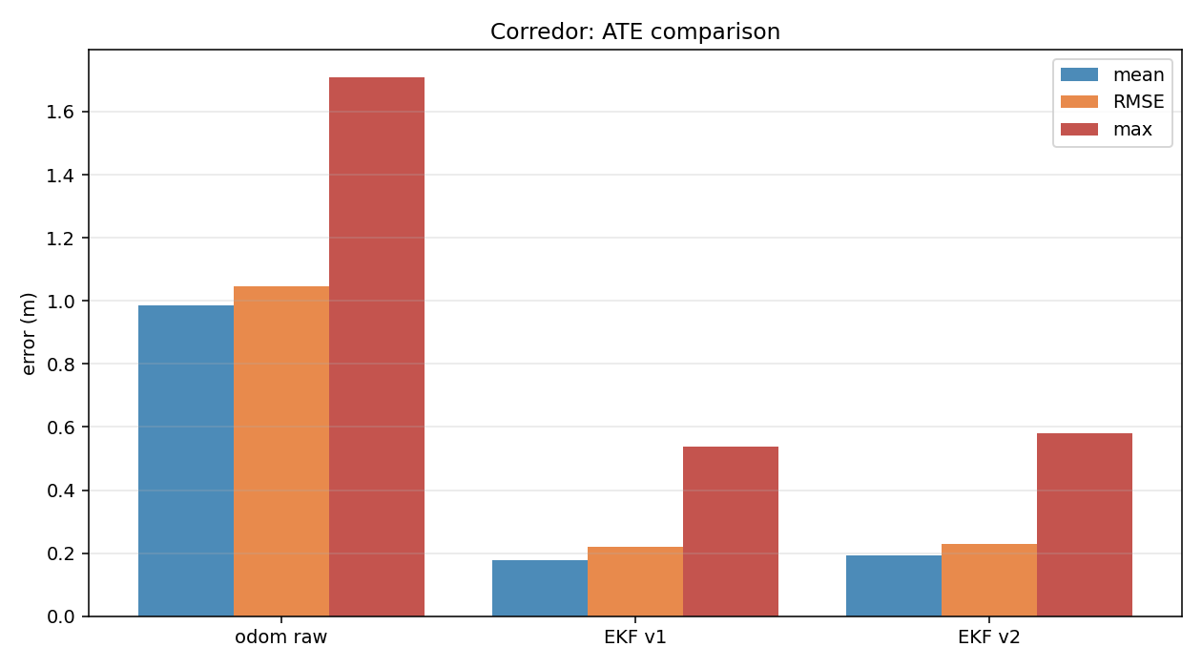
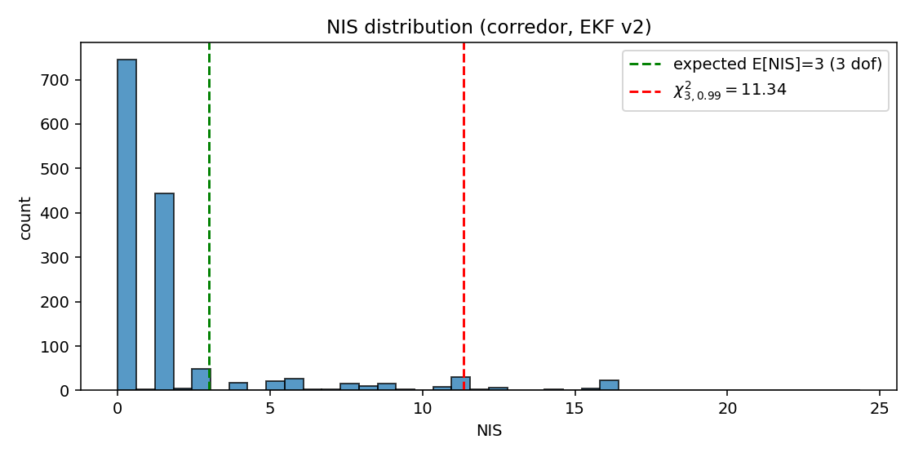
EKF v2 Consistency Check
Innovation gating and NIS analysis
Why not final?
EKF v2 rejected 66 / 1435 candidates and had mean NIS about 1.98. Final error was slightly better, but RMSE was slightly worse than v1.
18

Slide 19
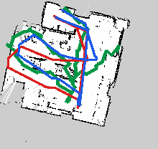
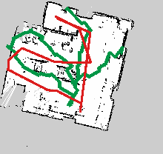
Room Experiment: Limitation Case
The result is weaker because the reference appears inconsistent
Interpretation
The room experiment should not be used as the main numerical proof. The SLAM-based reference appears misaligned with the map/odometry frame.
19

Slide 20
Kidnapping and Global Localization
What the EKF can and cannot solve
EKF strength
Local localization when the initial pose is approximately known.
EKF limitation
Single-hypothesis filter: it cannot represent multiple possible global positions.
Kidnapping detection
Large innovation or abnormal NIS can indicate that the estimate became inconsistent.
Future recovery module
Particle Filter / AMCL could provide global relocalization, then the EKF can continue local tracking.
Key answer
This project keeps EKF as the main estimator. A global module would be an auxiliary recovery mechanism, not a replacement for EKF.
20

Slide 21
Conclusions
What was achieved and what remains open
Achieved
Implemented EKF localization using odometry prediction and LiDAR scan matching correction.
Result
Corridor ATE-RMSE decreased from 1.048 m to 0.220 m.
Main lesson
Localization quality depends on the filter, the map, the sensor calibration and the measurement model.
Limitations
Room evaluation affected by reference/map inconsistency; kidnapping requires global relocalization.
Final takeaway
EKF + LiDAR scan matching is effective for local indoor localization when the map and frames are consistent.
21

Slide 22
Backup: Likely Questions
Short answers for discussion
Does the EKF use SLAM pose?
No. SLAM pose is only used for evaluation. EKF input is odometry + LiDAR + map.
Why not wall landmarks?
Long walls are ambiguous along their direction and caused unreliable associations.
Where does LiDAR enter?
The scan is matched against the occupancy map; the best pose is used as the EKF measurement.
Why EKF?
The motion model is nonlinear and the belief is represented by mean and covariance.
Does it solve kidnapping?
Not fully. EKF can detect inconsistency, but global recovery needs PF/AMCL.
22

