Slide 1





PHARMA DATA ANALYSIS
DIJIN DOMINIC
PSYLIQ

Slide 2
INTRODUCTION
During this virtual internship, I explored a Pharma Dataset detailing pharmaceutical sales in Germany and Poland. With 254,083 rows and 18 columns, the dataset formed the backbone of my analysis. Using Microsoft Workbench, I crafted SQL queries to dissect and summarize the sales data. Through this experience, I learned firsthand the importance of working with a clean and validated dataset for meaningful analysis and more evitibly I got a chance to practically work on whatever knowledge I have gained in my academics.. Join me as I share the valuable insights gained from exploring this data.

Slide 3
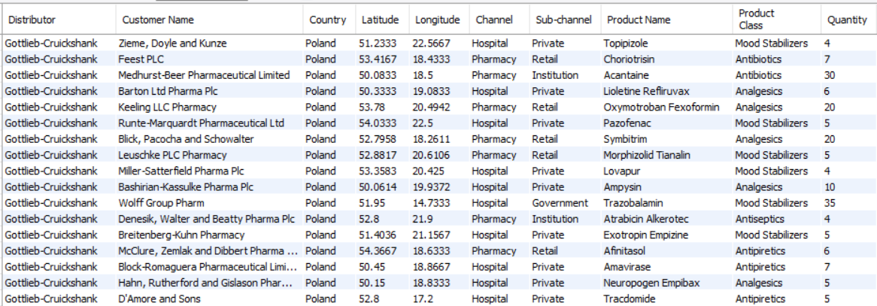
Retrieve all columns for all records in the dataset
SYNTAX
SELECT * FROM DATA;

Slide 4

How many unique countries are represented in the dataset?
SYNTAX
SELECT COUNT(DISTINCT COUNTRY) AS COUNT FROM DATA;

Slide 5
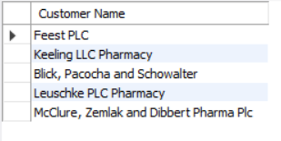
Select the names of all the customers on the 'Retail' channel.
SYNTAX
SELECT DISTINCT `CUSTOMER NAME` FROM DATA WHERE `SUB-CHANNEL` = "RETAIL" LIMIT 5;

Slide 6

Find the total quantity sold for the ' Antibiotics' product class.
SYNTAX
SELECT SUM(QUANTITY) AS `TOTAL UNITS SOLD(ANTIBIOTICS)` FROM DATA WHERE `PRODUCT CLASS` = "ANTIBIOTICS";

Slide 7
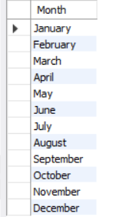
List all the distinct months present in the dataset.
SYNTAX
SELECT DISTINCT MONTH FROM DATA;

Slide 8
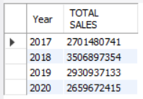
Calculate the total sales for each year.
SYNTAX
SELECT YEAR, SUM(SALES) AS `TOTAL SALES` FROM DATA GROUP BY YEAR ORDER BY YEAR;

Slide 9

Find the customer with the highest sales value.
SYNTAX
SELECT `CUSTOMER NAME`, SALES FROM DATA ORDER BY SALES DESC LIMIT 1;

Slide 10
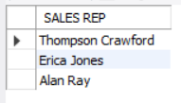
Get the names of all employees who are Sales Reps and are managed by 'James Goodwill'.
SYNTAX
SELECT DISTINCT(`NAME OF SALES REP`) AS `SALES REP` FROM DATA WHERE MANAGER = 'JAMES GOODWILL';

Slide 11
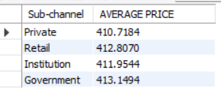
Calculate the average price of products in each sub-channel.
SYNTAX
SELECT `SUB-CHANNEL`, AVG(PRICE) AS `AVERAGE PRICE` FROM DATA GROUP BY `SUB-CHANNEL`;

Slide 12
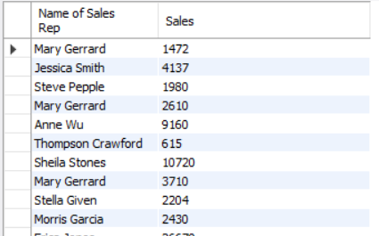
Get the name of the Sales Rep and the corresponding sales record.
SYNTAX
SELECT DISTINCT(`NAME OF SALES REP`), SALES FROM DATA
GROUP BY `NAME OF SALES REP`, SALES;

Slide 13
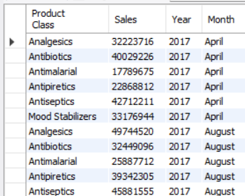
Calculate the total sales for each product class, for each month, and order the results by year, month, and product class.
SYNTAX
SELECT `PRODUCT CLASS`,SUM(SALES) AS SALES, YEAR, MONTH FROM DATA GROUP BY `PRODUCT CLASS`, YEAR, MONTH ORDER BY YEAR, MONTH, `PRODUCT CLASS`;

Slide 14
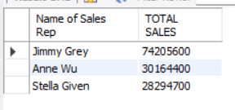
Find the top 3 sales reps with the highest sales in 2019.
SYNTAX
SELECT `NAME OF SALES REP`, SUM(SALES) AS `TOTAL SALES` FROM DATA WHERE YEAR = 2019 GROUP BY `NAME OF SALES REP`, SALES ORDER BY SALES DESC LIMIT 3;

Slide 15
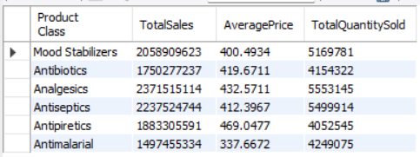
Create a summary report that includes the total sales, average price, and total quantity sold for each product class.
SYNTAX
SELECT `PRODUCT CLASS`, SUM(SALES) AS TOTALSALES,AVG(PRICE) AS AVERAGEPRICE, SUM(QUANTITY) AS TOTALQUANTITYSOLD FROM DATA GROUP BY `PRODUCT CLASS`;

Slide 16
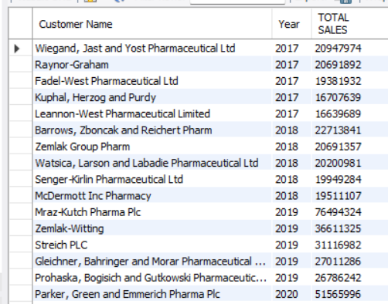
Calculate the monthly total sales for each sub-channel, and then calculate the average monthly sales for each sub-channel over the years.

Slide 17
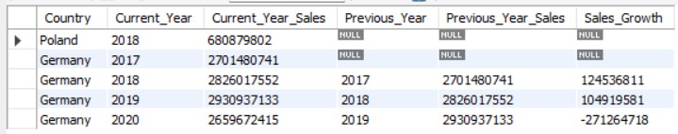
Calculate the year-over-year growth in sales for each country.
IN THE DATASET, THE COUNTRY POLAND HAVE INFO FOR 2017 ONY, BY LOOKING INTO
THE LAST COLUMN OF THE OUTPUT
WE CAN INFER THE SALES GROWTH IN GERMANY.

Slide 18
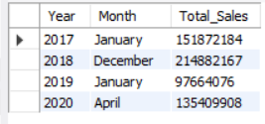
List the months with the lowest sales for each year

Slide 19
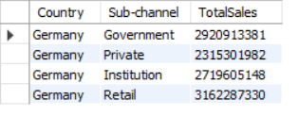
Calculate the total sales for each sub-channel in each country, and then find the country with the highest total sales for each sub-channel.

Slide 20

CONCLUSION
In conclusion, the use of SQL queries for data analysis and summarization has yielded insightful information on the pharmaceutical sales environment in Poland and Germany. It was clear from the data analysis which product categories, sub-channels fared the best. The identification of trends in sales volume, average prices, and quantity sold provides practical insights for pricing strategies, inventory control, and market targeting. This practical experience emphasises how crucial it is to work with clean and validated datasets in order to do meaningful analysis and make well-informed decisions in a variety of real-world settings across different sectors.

Slide 21

THANK
YOU

