Slide 1
CS 425 / ECE 428
Distributed Systems
Fall 2019
Indranil Gupta (Indy)
Lecture 7: Peer-to-peer Systems I
All slides © IG

Slide 2
MP2 Released Today
You will be implementing
Failure detector
Membership protocol
Using concepts you learnt last week!
Stage 2 (of 4) in building a fully-working distributed system from scratch
Stage 3 will be a distributed file system
Stage 4 will be a full distributed system
2

Slide 3
Why Study Peer to Peer Systems?
First distributed systems that seriously focused on scalability with respect to number of nodes
P2P techniques abound in cloud computing systems
Key-value stores (e.g., Cassandra, Riak, Voldemort) use Chord p2p hashing
3

Slide 4
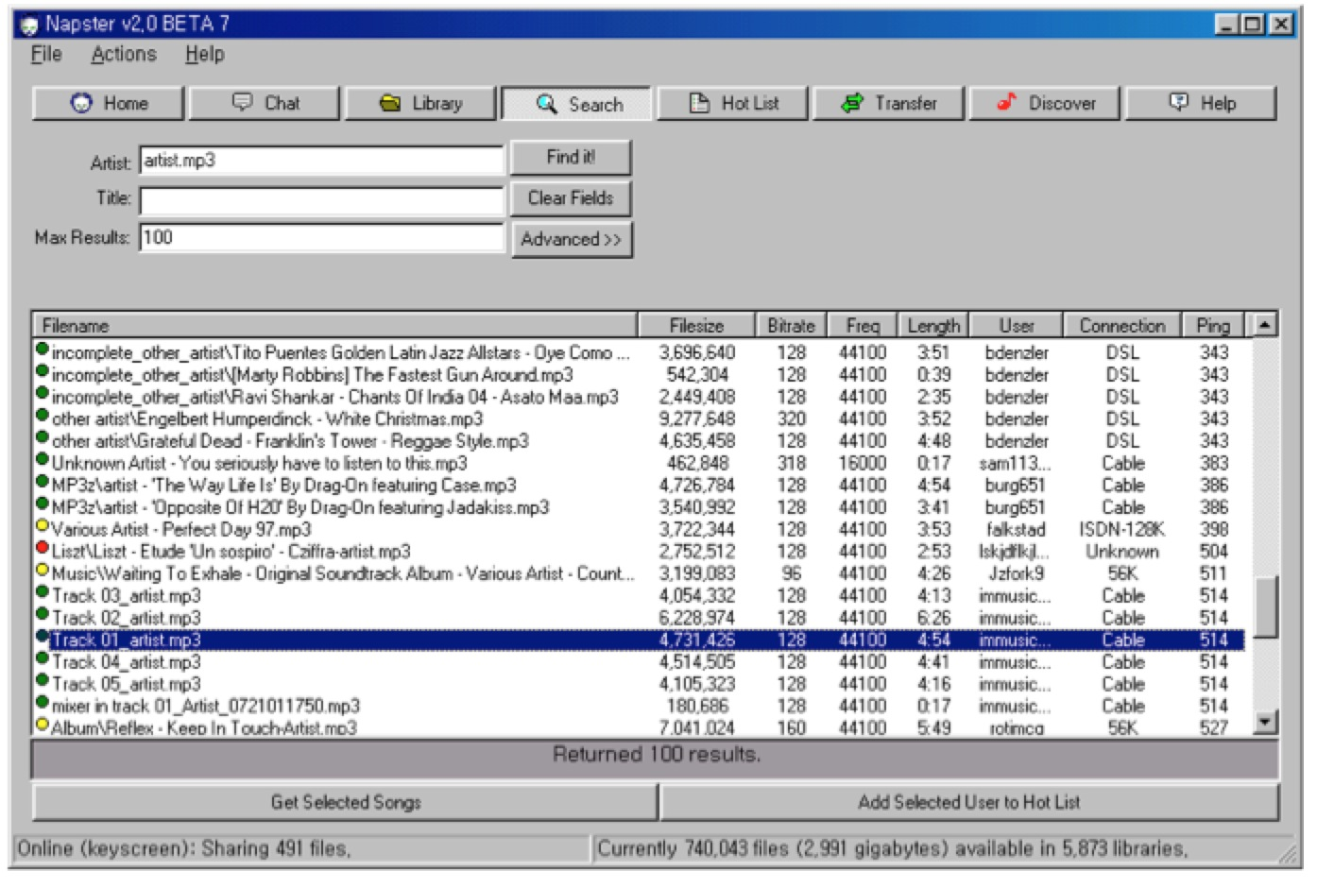
Napster UI
4

Slide 5
A Brief History
[6/99] Shawn Fanning (freshman Northeastern U.) releases Napster online music service
[12/99] RIAA sues Napster, asking $100K per download
[3/00] 25% UWisc traffic Napster, many universities ban it
[00] 60M users
[2/01] US Federal Appeals Court: users violating copyright laws, Napster is abetting this
[9/01] Napster decides to run paid service, pay % to songwriters and music companies
[Today] Napster protocol is open, people free to develop opennap clients and servers http://opennap.sourceforge.net
Gnutella: http://www.limewire.com (deprecated)
Peer to peer working groups: http://p2p.internet2.edu
5

Slide 6
What We Will Study
Widely-deployed P2P Systems (This Lecture)
Napster
Gnutella
Fasttrack (Kazaa, Kazaalite, Grokster)
BitTorrent
P2P Systems with Provable Properties (Next Lecture)
Chord
Pastry
Kelips
6

Slide 7
Napster Structure
Filename Info about
Store a directory, i.e.,
filenames with peer pointers
PennyLane.mp3 Beatles, @
128.84.92.23:1006
…..
napster.com Servers
S
S
Client machines
(“Peers”)
S
P
P
P
P
P
P
Store their own
files
7

Slide 8
Napster Operations
Client
Connect to a Napster server
Upload list of music files that you want to share
Server maintains list of <filename, ip_address, portnum> tuples. Server stores no files.
8

Slide 9
Napster Operations
Client (contd.)
Search
Send server keywords to search with
(Server searches its list with the keywords)
Server returns a list of hosts - <ip_address, portnum> tuples - to client
Client pings each host in the list to find transfer rates
Client fetches file from best host
All communication uses TCP (Transmission Control Protocol)
Reliable and ordered networking protocol
9

Slide 10
Napster Search
2. All servers search their lists (ternary tree algorithm)
Store peer pointers
for all files
napster.com Servers
S
S
Client machines
(“Peers”)
1. Query
S
P
3. Response
P
4. ping candidates
P
P
P
P
Store their own
files
5. download from best host
10

Slide 11
Joining a P2P system
Can be used for any p2p system
Send an http request to well-known url for that P2P service - http://www.myp2pservice.com
Message routed (after lookup in DNS=Domain Name system) to introducer, a well known server that keeps track of some recently joined nodes in p2p system
Introducer initializes new peers’ neighbor table
11

Slide 12
Problems
Centralized server a source of congestion
Centralized server single point of failure
No security: plaintext messages and passwds
napster.com declared to be responsible for users’ copyright violation
“Indirect infringement”
Next system: Gnutella
12

Slide 13
Gnutella
Eliminate the servers
Client machines search and retrieve amongst themselves
Clients act as servers too, called servents
[3/00] release by AOL, immediately withdrawn, but 88K users by 3/03
Original design underwent several modifications
13

Slide 14
Gnutella
Store their own
files
Servents (“Peers”)
P
P
P
Also store
“peer pointers”
P
P
P
P
Connected in an overlay graph
(== each link is an implicit Internet path)
14

Slide 15
How do I search for my Beatles file?
Gnutella routes different messages within the overlay graph
Gnutella protocol has 5 main message types
Query (search)
QueryHit (response to query)
Ping (to probe network for other peers)
Pong (reply to ping, contains address of another peer)
Push (used to initiate file transfer)
We’ll go into the message structure and protocol now
All fields except IP address are in little-endian format
Ox12345678 stored as 0x78 in lowest address byte, then 0x56 in next higher address, and so on.
15

Slide 16
How do I search for my Beatles file?
Descriptor Header
Payload
Descriptor ID Payload descriptor TTL Hops Payload length
0 15 16 17 18 22
Number of bytes of
message following
this header
Type of payload
0x00 Ping
0x01 Pong
0x40 Push
0x80 Query
0x81 Queryhit
ID of this
search
transaction
Decremented at each hop,
Message dropped when ttl=0
ttl_initial usually 7 to 10
Incremented at each hop
Gnutella Message Header Format
16
16

Slide 17
How do I search for my Beatles file?
Query (0x80)
Minimum Speed Search criteria (keywords)
0 1 …..
Payload Format in Gnutella Query Message
17

Slide 18


Gnutella Search
Query’s flooded out, ttl-restricted, forwarded only once
P
P
P
P
TTL=2
P
P
P
Who has PennyLane.mp3?
18

Slide 19
Gnutella Search
QueryHit (0x81) : successful result to a query
Num. hits port ip_address speed (fileindex,filename,fsize) servent_id
0 1 3 7 11 n n+16
Results
Info about
responder
Unique identifier of responder;
a function of its IP address
Payload Format in Gnutella QueryHit Message
19

Slide 20
Gnutella Search
Successful results QueryHit’s routed on reverse path
P
P
P
P
P
P
P
Who has PennyLane.mp3?
20

Slide 21
Avoiding excessive traffic
To avoid duplicate transmissions, each peer maintains a list of recently received messages
Query forwarded to all neighbors except peer from which received
Each Query (identified by DescriptorID) forwarded only once
QueryHit routed back only to peer from which Query received with same DescriptorID
Duplicates with same DescriptorID and Payload descriptor (msg type, e.g., Query) are dropped
QueryHit with DescriptorID for which Query not seen is dropped
21

Slide 22
After receiving QueryHit messages
Requestor chooses “best” QueryHit responder
Initiates HTTP request directly to responder’s ip+port
GET /get/<File Index>/<File Name>/HTTP/1.0\r\n
Connection: Keep-Alive\r\n
Range: bytes=0-\r\n
User-Agent: Gnutella\r\n
\r\n
Responder then replies with file packets after this message:
HTTP 200 OK\r\n
Server: Gnutella\r\n
Content-type:application/binary\r\n
Content-length: 1024 \r\n
\r\n
22

Slide 23
After receiving QueryHit messages (2)
HTTP is the file transfer protocol. Why?
Because it’s standard, well-debugged, and widely used.
Why the “range” field in the GET request?
To support partial file transfers.
What if responder is behind firewall that disallows incoming connections?
23

Slide 24
Dealing with Firewalls
Requestor sends Push to responder asking for file transfer
P
P
P
Has PennyLane.mp3
But behind firewall
P
P
P
P
24

Slide 25
Dealing with Firewalls
Push (0x40)
servent_id fileindex ip_address port
same as in
received QueryHit
Address at which
requestor can accept
incoming connections
25

Slide 26
Dealing with Firewalls
Responder establishes a TCP connection at ip_address, port specified. Sends
GIV <File Index>:<Servent Identifier>/<File Name>\n\n
Requestor then sends GET to responder (as before) and file is transferred as explained earlier
What if requestor is behind firewall too?
Gnutella gives up
Can you think of an alternative solution?
26

Slide 27
Ping-Pong
Ping (0x00)
no payload
Peers initiate Ping’s periodically
Pings flooded out like Querys, Pongs routed along reverse path like QueryHits
Pong replies used to update set of neighboring peers
to keep neighbor lists fresh in spite of peers joining, leaving and failing
Pong (0x01)
Port ip_address Num. files shared Num. KB shared
27

Slide 28
Gnutella Summary
No servers
Peers/servents maintain “neighbors”, this forms an overlay graph
Peers store their own files
Queries flooded out, ttl restricted
QueryHit (replies) reverse path routed
Supports file transfer through firewalls
Periodic Ping-pong to continuously refresh neighbor lists
List size specified by user at peer : heterogeneity means some peers may have more neighbors
Gnutella found to follow power law distribution:
P(#links = L) ~ (k is a constant)
28

Slide 29
Problems
Ping/Pong constituted 50% traffic
Solution: Multiplex, cache and reduce frequency of pings/pongs
Repeated searches with same keywords
Solution: Cache Query, QueryHit messages
Modem-connected hosts do not have enough bandwidth for passing Gnutella traffic
Solution: use a central server to act as proxy for such peers
Another solution:
➔FastTrack System (soon)
29

Slide 30
Problems (contd.)
Large number of freeloaders
70% of users in 2000 were freeloaders
Only download files, never upload own files
Flooding causes excessive traffic
Is there some way of maintaining meta-information about peers that leads to more intelligent routing?
➔ Structured Peer-to-peer systems
e.g., Chord System (coming up next lecture)
30

Slide 31
FastTrack
Hybrid between Gnutella and Napster
Takes advantage of “healthier” participants in the system
Underlying technology in Kazaa, KazaaLite, Grokster
Proprietary protocol, but some details available
Like Gnutella, but with some peers designated as supernodes
31

Slide 32
A FastTrack-like System
Peers
P
P
P
S
P
S
P
Supernodes
32

Slide 33
FastTrack (contd.)
A supernode stores a directory listing a subset of nearby (<filename,peer pointer>), similar to Napster servers
Supernode membership changes over time
Any peer can become (and stay) a supernode, provided it has earned enough reputation
Kazaalite: participation level (=reputation) of a user between 0 and 1000, initially 10, then affected by length of periods of connectivity and total number of uploads
More sophisticated Reputation schemes invented, especially based on economics (See P2PEcon workshop)
A peer searches by contacting a nearby supernode
33

Slide 34
BitTorrent
Website links to
.torrent
Tracker, per file
(keeps track of some peers;
receives
heartbeats, joins
and leaves
from peers)
1. Get tracker
2. Get peers
Peer
(seed,
has full file)
Peer
3. Get file blocks
(new, leecher)
Peer
Peer
(leecher,
has some blocks)
(seed)
34

Slide 35
BitTorrent (2)
File split into blocks (32 KB – 256 KB)
Download Local Rarest First block policy: prefer early download of blocks that are least replicated among neighbors
Exception: New node allowed to pick one random neighbor: helps in bootstrapping
Tit for tat bandwidth usage: Provide blocks to neighbors that provided it the best download rates
Incentive for nodes to provide good upload rates
Seeds do the same too
Choking: Limit number of neighbors to which concurrent uploads <= a number (5), i.e., the “best” neighbors
Everyone else choked
Periodically re-evaluate this set (e.g., every 10 s)
Optimistic unchoke: periodically (e.g., ~30 s), unchoke a random neighbor – helps keep unchoked set fresh
35

Slide 36
Announcements
MP1 reports handed back now
Sorted by group number
group 1-30 on YOUR LEFT, group 31-60 in the middle, and group 61+ on YOUR RIGHT
MP2 out already, due 10/6 (demos on 10/7)
HW1 due next Tuesday (9/24)
HW2 will be out then
36

Slide 37
CS 425 / ECE 428
Distributed Systems
Fall 2019
Indranil Gupta (Indy)
Lecture 8: Peer-to-peer Systems II
All slides © IG

Slide 38
What We Are Studying
Widely-deployed P2P Systems
Napster
Gnutella
Fasttrack (Kazaa, Kazaalite, Grokster)
BitTorrent
P2P Systems with Provable Properties
Chord
Pastry
Kelips
38

Slide 39
DHT=Distributed Hash Table
A hash table allows you to insert, lookup and delete objects with keys
A distributed hash table allows you to do the same in a distributed setting (objects=files)
Performance Concerns:
Load balancing
Fault-tolerance
Efficiency of lookups and inserts
Locality
Napster, Gnutella, FastTrack are all DHTs (sort of)
So is Chord, a structured peer to peer system that we study next
39

Slide 40
Comparative Performance
 | Memory | Lookup Latency | #Messages for a lookup
Napster | O(1) (O(N)@server) | O(1) | O(1)
Gnutella | O(N) | O(N) | O(N)
40

Slide 41
Comparative Performance
 | Memory | Lookup Latency | #Messages for a lookup
Napster | O(1) (O(N)@server) | O(1) | O(1)
Gnutella | O(N) | O(N) | O(N)
Chord | O(log(N)) | O(log(N)) | O(log(N))
41

Slide 42
Chord
Developers: I. Stoica, D. Karger, F. Kaashoek, H. Balakrishnan, R. Morris, Berkeley and MIT
Intelligent choice of neighbors to reduce latency and message cost of routing (lookups/inserts)
Uses Consistent Hashing on node’s (peer’s) address
SHA-1(ip_address,port) →160 bit string
Truncated to m bits
Called peer id (number between 0 and )
Not unique but id conflicts very unlikely
Can then map peers to one of logical points on a circle
42

Slide 43
Ring of peers
Say m=7
0
6 nodes
N112
N16
N96
N32
N80
N45
43

Slide 44
Peer pointers (1): successors
Say m=7
0
N112
N16
N96
N32
N80
N45
(similarly predecessors)
44

Slide 45
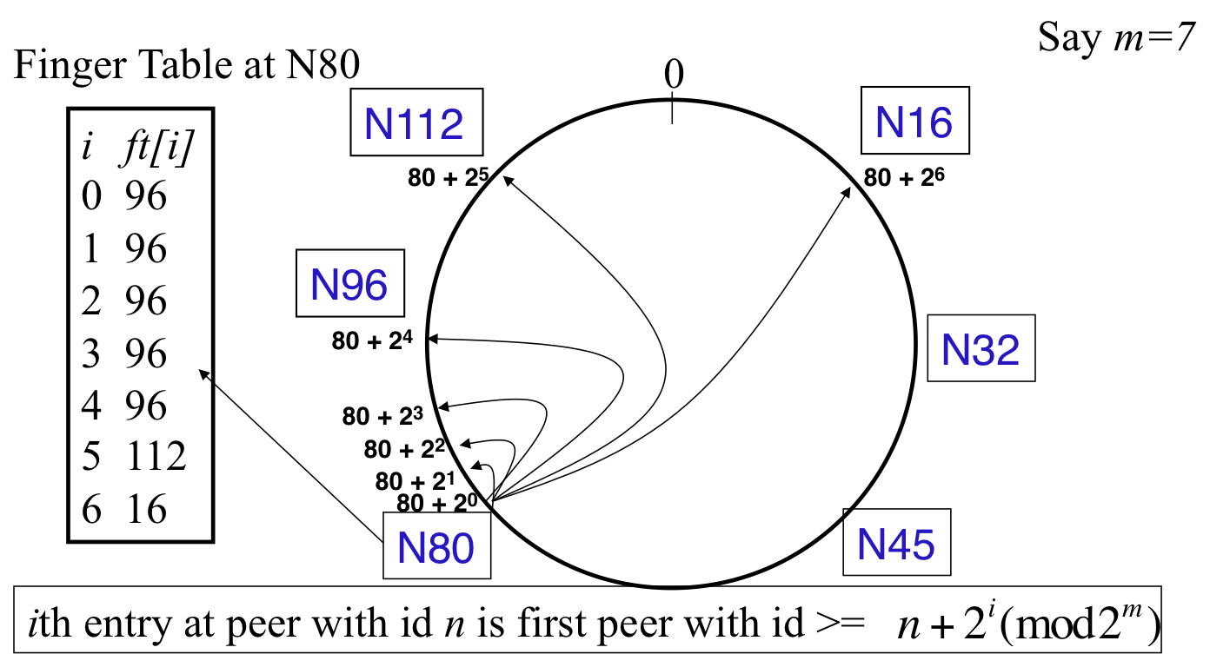
Peer pointers (2): finger tables
At or to the clockwise of
Also, use (n+2^{i}) mod 2^{m}
45

Slide 46
What about the files?
Filenames also mapped using same consistent hash function
SHA-1(filename) →160 bit string (key)
File is stored at first peer with id greater than or equal to its key (mod )
File cnn.com/index.html that maps to key K42 is stored at first peer with id at or to the clockwise of 42
Note that we are considering a different file-sharing application here : cooperative web caching
The same discussion applies to any other file sharing application, including that of mp3 files.
Consistent Hashing => with K keys and N peers, each peer stores O(K/N) keys. (i.e., < c.K/N, for some constant c)
46

Slide 47
Mapping Files
Say m=7
0
N112
N16
N96
N32
N80
N45
File with key K42
stored here
47

Slide 48
Search
Say m=7
0
N112
N16
N96
Who has cnn.com/index.html?
(hashes to K42)
N32
N80
N45
File cnn.com/index.html with
key K42 stored here
48

Slide 49
Search
At node n, send query for key k to largest successor/finger entry <= k
if none exist, send query to successor(n)
At or to the anti-clockwise of k
(it wraps around the ring)
0
N112
N16
Say m=7
N96
Who has cnn.com/index.html?
(hashes to K42)
N32
N80
N45
File cnn.com/index.html with
key K42 stored here
49

Slide 50
Search
At node n, send query for key k to largest successor/finger entry <= k
if none exist, send query to successor(n)
0
N112
N16
Say m=7
All “arrows” are RPCs
(remote procedure calls)
N96
Who has cnn.com/index.html?
(hashes to K42)
N32
N80
N45
File cnn.com/index.html with
key K42 stored here
50

Slide 51
Analysis
Here
Search takes O(log(N)) time
Proof
(intuition): at each step, distance between query and peer-with-file reduces by a factor of at least 2
(intuition): after log(N) forwardings, distance to key is at most
Number of node identifiers in a range of
is O(log(N)) with high probability (why? SHA-1! and “Balls and Bins”)
So using successors in that range will be ok, using another O(log(N)) hops
Halfway point
Next hop
Key
51

Slide 52
Analysis (contd.)
O(log(N)) search time holds for file insertions too (in general for routing to any key)
“Routing” can thus be used as a building block for
All operations: insert, lookup, delete
O(log(N)) time true only if finger and successor entries correct
When might these entries be wrong?
When you have failures
52

Slide 53
Search under peer failures
Lookup fails
(N16 does not know N45)
Say m=7
0
N112
N16
N96
X
X
Who has cnn.com/index.html?
(hashes to K42)
N32
X
N80
N45
File cnn.com/index.html with
key K42 stored here
53

Slide 54
Search under peer failures
Say m=7
One solution: maintain r multiple successor entries
In case of failure, use successor entries
0
N112
N16
N96
X
Who has cnn.com/index.html?
(hashes to K42)
N32
N80
N45
File cnn.com/index.html with
key K42 stored here
54

Slide 55
Search under peer failures
Choosing r=2log(N) suffices to maintain lookup correctness w.h.p.(i.e., ring connected)
Say 50% of nodes fail
Pr(at given node, at least one successor alive)=
Pr(above is true at all alive nodes)=
55

Slide 56
Search under peer failures (2)
Say m=7
Lookup fails
(N45 is dead)
0
N112
N16
N96
Who has cnn.com/index.html?
(hashes to K42)
N32
X
X
N80
N45
File cnn.com/index.html with
key K42 stored here
56

Slide 57
Search under peer failures (2)
Say m=7
One solution: replicate file/key at r successors and predecessors
0
N112
N16
N96
Who has cnn.com/index.html?
(hashes to K42)
N32
K42 replicated
X
N80
N45
File cnn.com/index.html with
key K42 stored here
K42 replicated
57

Slide 58
Need to deal with dynamic changes
Peers fail
New peers join
Peers leave
P2P systems have a high rate of churn (node join, leave and failure)
25% per hour in Overnet (eDonkey)
100% per hour in Gnutella
Lower in managed clusters
Common feature in all distributed systems, including wide-area (e.g., PlanetLab), clusters (e.g., Emulab), clouds (e.g., AWS), etc.
So, all the time, need to:
→ Need to update successors and fingers, and copy keys
58

Slide 59
New peers joining
Introducer directs N40 to N45 (and N32)
N32 updates successor to N40
N40 initializes successor to N45, and inits fingers from it
N40 periodically talks to neighbors to update finger table
Say m=7
0
N112
N16
Stabilization
Protocol
(followed by
all nodes)
N96
N32
N40
N80
N45
59

Slide 60
New peers joining (2)
N40 may need to copy some files/keys from N45
(files with fileid between 32 and 40)
Say m=7
0
N112
N16
N96
N32
N40
N80
N45
K34,K38
60

Slide 61
New peers joining (3)
A new peer affects O(log(N)) other finger entries in the system, on average [Why?]
Number of messages per peer join= O(log(N)*log(N))
Similar set of operations for dealing with peers leaving
For dealing with failures, also need failure detectors (you’ve seen them!)
61

Slide 62
Stabilization Protocol
Concurrent peer joins, leaves, failures might cause loopiness of pointers, and failure of lookups
Chord peers periodically run a stabilization algorithm that checks and updates pointers and keys
Ensures non-loopiness of fingers, eventual success of lookups and O(log(N)) lookups w.h.p.
Each stabilization round at a peer involves a constant number of messages
Strong stability takes stabilization rounds
For more see [TechReport on Chord webpage]
62

Slide 63
Churn
When nodes are constantly joining, leaving, failing
Significant effect to consider: traces from the Overnet system show hourly peer turnover rates (churn) could be 25-100% of total number of nodes in system
Leads to excessive (unnecessary) key copying (remember that keys are replicated)
Stabilization algorithm may need to consume more bandwidth to keep up
Main issue is that files are replicated, while it might be sufficient to replicate only meta information about files
Alternatives
Introduce a level of indirection, i.e., store only pointers to files (any p2p system)
Replicate metadata more, e.g., Kelips (later in this lecture)
63

Slide 64
Virtual Nodes
Hash can get non-uniform ➔ Bad load balancing
Treat each node as multiple virtual nodes behaving independently
Each joins the system
Reduces variance of load imbalance
64

Slide 65
Wrap-up Notes
Virtual Ring and Consistent Hashing used in Cassandra, Riak, Voldemort, DynamoDB, and other key-value stores
Current status of Chord project:
File systems (CFS,Ivy) built on top of Chord
DNS lookup service built on top of Chord
Internet Indirection Infrastructure (I3) project at UCB
Spawned research on many interesting issues about p2p systems
https://github.com/sit/dht/wiki
(Old: http://www.pdos.lcs.mit.edu/chord/)
65

Slide 66
Pastry
Designed by Anthony Rowstron (Microsoft Research) and Peter Druschel (Rice University)
Assigns ids to nodes, just like Chord (using a virtual ring)
Leaf Set - Each node knows its successor(s) and predecessor(s)
66

Slide 67
Pastry Neighbors
Routing tables based on prefix matching
Think of a hypercube
Routing is thus based on prefix matching, and is thus log(N)
And hops are short (in the underlying network)
67

Slide 68
Pastry Routing
Consider a peer with id 01110100101. It maintains a neighbor peer with an id matching each of the following prefixes (* = starting bit differing from this peer’s corresponding bit):
*
0*
01*
011*
… 0111010010*
When it needs to route to a peer, say 01110111001, it starts by forwarding to a neighbor with the largest matching prefix, i.e., 011101*
68

Slide 69
Pastry Locality
For each prefix, say 011*, among all potential neighbors with the matching prefix, the neighbor with the shortest round-trip-time is selected
Since shorter prefixes have many more candidates (spread out throughout the Internet), the neighbors for shorter prefixes are likely to be closer than the neighbors for longer prefixes
Thus, in the prefix routing, early hops are short and later hops are longer
Yet overall “stretch”, compared to direct Internet path, stays short
69

Slide 70
Summary of Chord and Pastry
Chord and Pastry protocols
More structured than Gnutella
Black box lookup algorithms
Churn handling can get complex
O(log(N)) memory and lookup cost
O(log(N)) lookup hops may be high
Can we reduce the number of hops?
70

Slide 71
Kelips – A 1 hop Lookup DHT
k “affinity groups”
k ~ √ N
Each node hashed to a group (hash mod k)
Node’s neighbors
(Almost) all other nodes in its own affinity group
One contact node per foreign affinity group
Gossip-style heartbeating
15
76
18
160
129
167
30
…
# 1
Affinity
Group # 0
# k-1
71

Slide 72
Kelips Files and Metadata
File can be stored at any (few) node(s)
Decouple file replication/location (outside Kelips) from file querying (in Kelips)
Each filename hashed to a group
All nodes in the group replicate pointer information, i.e., <filename, file location>
Spread using gossip
Affinity group does not store files
PennyLane.mp3 hashes to k-1
Everyone in this group stores
<PennyLane.mp3, who-has-file>
15
76
18
160
129
167
30
# 1
…
# k-1
72
Affinity Group # 0
72

Slide 73
Kelips Lookup
Lookup
Find file affinity group
Go to your contact for the file affinity group
Failing that try another of your neighbors to find a contact
Lookup = 1 hop (or a few)
Memory cost O(√ N)
1.93 MB for 100K nodes, 10M files
Fits in RAM of most workstations/laptops today (COTS machines)
PennyLane.mp3 hashes to k-1
Everyone in this group stores
<PennyLane.mp3, who-has-file>
15
76
18
160
129
167
30
# 1
…
73
Affinity Group # 0
# k-1
73

Slide 74
Kelips Soft State
Membership lists
Gossip-based membership
Within each affinity group
And also across affinity groups
O(log(N)) dissemination time
File metadata
Needs to be periodically refreshed from source node
Times out
PennyLane.mp3 hashes to k-1
Everyone in this group stores
<PennyLane.mp3, who-has-file>
15
76
18
160
129
167
30
…
# 1
Affinity Group # 0
# k-1
74
74

Slide 75
Chord vs. Pastry vs. Kelips
Range of tradeoffs available
Memory vs. lookup cost vs. background bandwidth (to keep neighbors fresh)
75

Slide 76
What We Have Studied
Widely-deployed P2P Systems
Napster
Gnutella
Fasttrack (Kazaa, Kazaalite, Grokster)
BitTorrent
P2P Systems with Provable Properties
Chord
Pastry
Kelips
76

Slide 77
Announcements
MP1 groups – you need to give access to ALL TAs (including online TAs).
Today! Otherwise you will lose points. (Multiple announcements on Piazza.)
MP2 out already, due 10/6 (demos on 10/7)
HW1 due next Tuesday (9/24)
HW2 will be out then
77

