Slide 1
ASSAM DOWNTOWN UNIVERSITY
FACULTY OF COMPUTER TECHNOLOGY
Bachelor of Science in Information Technology
(Mobile Application and Information Security)
Guide’s name & Designation :-
Mr. Mehboob Hassan Ben Siraj Barbhuyan
Assistant Professor
Submitted by :-
Dijumoni Ray ADTU/2020-23/BIT/002
Fahim Ahmad ADTU/2020-23/BIT/007
Sudhir Kr Gupta ADTU/2020-23/BIT/009

Slide 2
SARCASM DETECTION IN PRODUCT REVIEW FOR SENTIMENT ANALYSIS

Slide 3
INTRODUCTION
Sentiment Analysis is the process of analyzing product reviews to determine the sentiment or opinion expressed by customers.
It involves examining the text of reviews to classify them as positive, negative, or neutral.
Sarcasm detection in product reviews is a specialized aspect of sentiment analysis.
The detection of sarcasm in product reviews contributes to a better understanding of customer sentiments and preferences.
By identifying sarcasm, it ensures a more comprehensive and accurate analysis of customer opinions.

Slide 4
OBJECTIVES
The goal is to enhance the accuracy of sentiment analysis.
The goal is to identify sarcastic comments or reviews where the writer's true sentiment contradicts their expressed opinion.
Improve accuracy of sarcasm detection.
To develop a platform for analyzing the sentiment in product reviews

Slide 5
PROBLEM STATEMENT
The issue with sarcasm detection is that it can lead to inaccurate analysis and understanding of the intended meaning of the communication
The challenge is to develop techniques and models to detect sarcasm in product reviews accurately, to ensure the sentiment analysis of product reviews is reliable and reflects the true opinion of customers.

Slide 6
METHODOLOGY
Data Collection
Model Evaluation
Model Deployment
Data Pre-Processing
Feature Extraction
Model Training

Slide 7
EXPECTED OUTCOME
To improve accuracy.
To Identify Sarcastic Comments.
Help businesses understand their customer’s needs and preferences
Classify the sentiment as either positive or negative depending on the overall sentiment

Slide 8
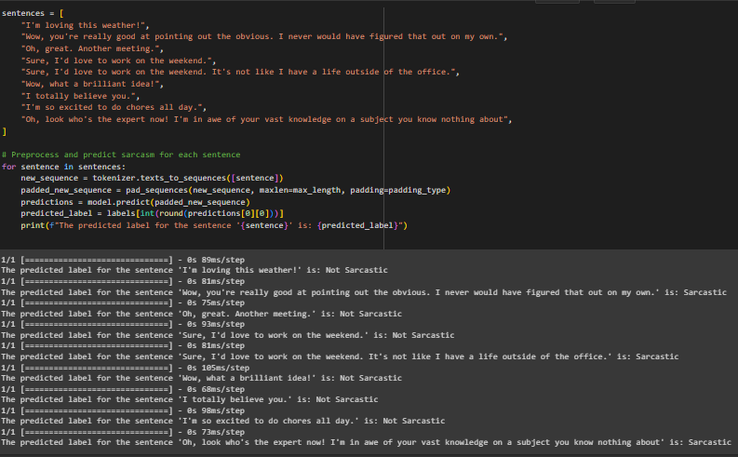
RESULT SCREENSHOTS

Slide 9
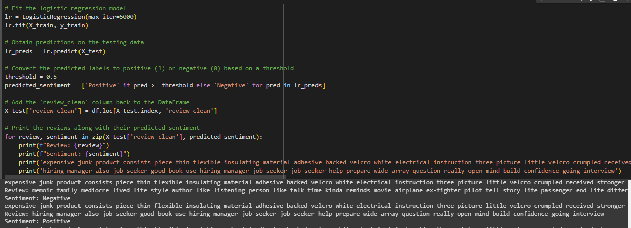

Slide 10
LITERATURE REVIEW
SENTIMENT ANALYSIS CHALLENGES : REVIEW
It explores different methodologies, including lexicon-based and machine-learning approaches, and addresses challenges such as sarcasm detection, negation handling, and sentiment analysis of code-mixed data. The paper emphasizes the need for automated and effective sentiment analysis frameworks.
E-COMMERCE PRODUCT REVIEWS USING SENTIMENTAL ANALYSIS
This literature review focuses on sentiment analysis techniques applied to e-commerce product reviews. The study proposes a system that combines Natural Language Processing (NLP), Naive Bayes classifier, and Support Vector Machine (SVM) algorithm to detect fake reviews and spam. The research highlights improved accuracy in optimizing product reviews.

Slide 11
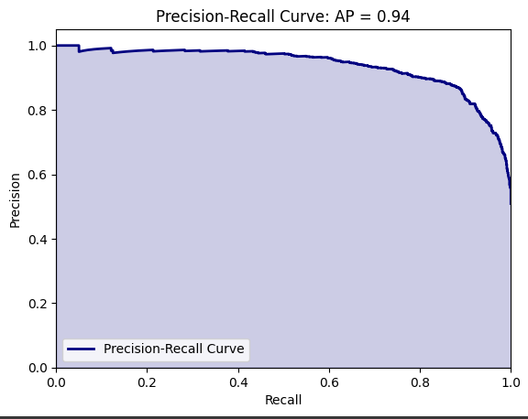
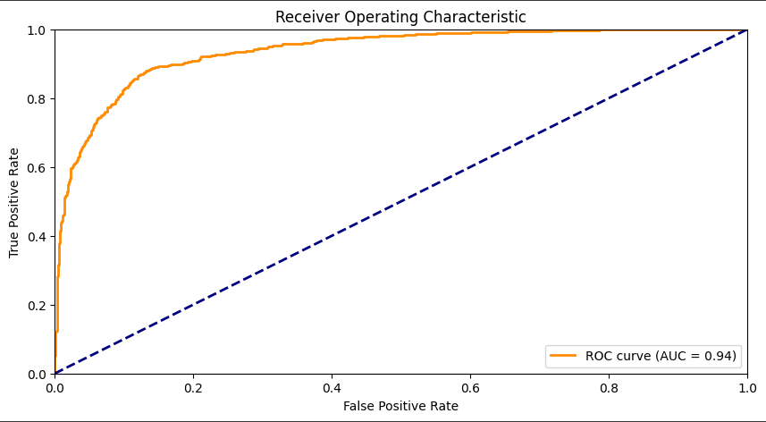
LOGISTIC REGRESSION

Slide 12
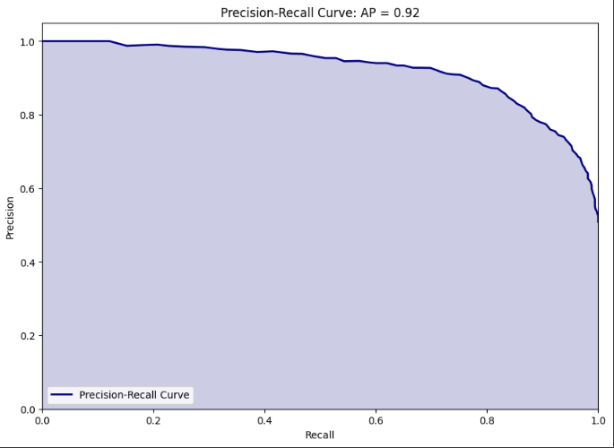
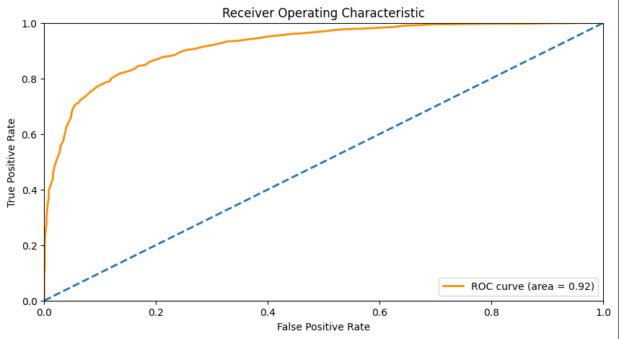
RANDOM FOREST

Slide 13
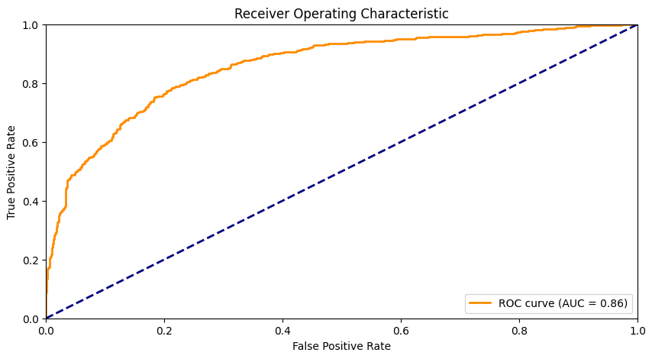
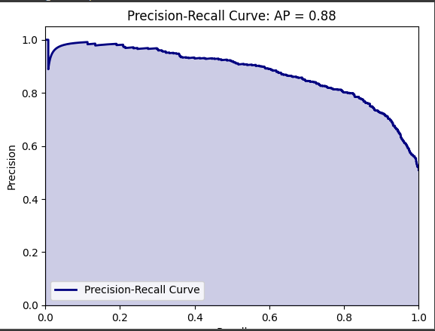
SUPPORT VECTOR MACHINE

Slide 14
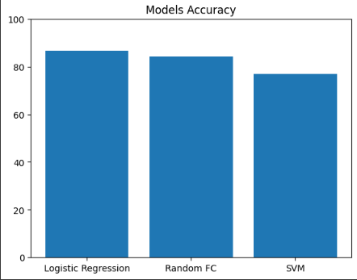
MODEL COMPARISON ACCURACY

Slide 15
PERFORMANCE ANALYSIS
LR | 85.73 | 86.74 | 86.23 | 93.13
SVM | 60.32 | 97.64 | 74.57 | 79.47
RF | 83.87 | 83.71 | 83.83 | 91.97

Slide 16
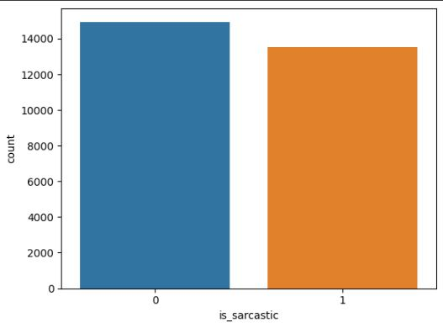
SARCASM DETECTION

Slide 17
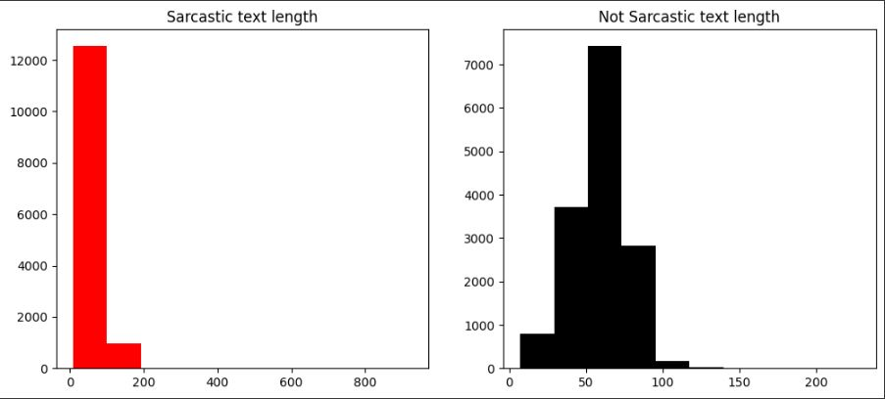

Slide 18
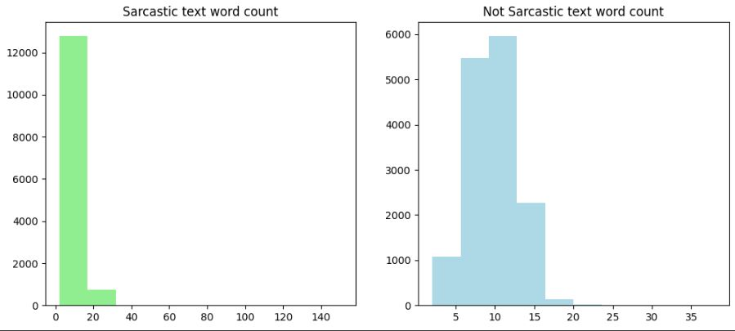

Slide 19
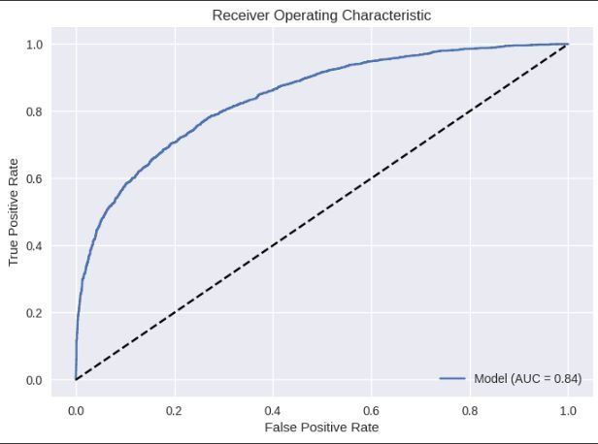
ROC Curve of Deep learning model

Slide 20
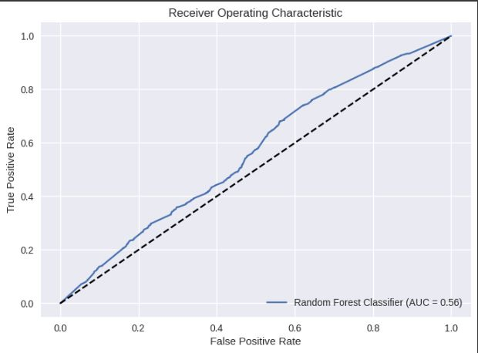
ROC Curve of Random Forest

Slide 21
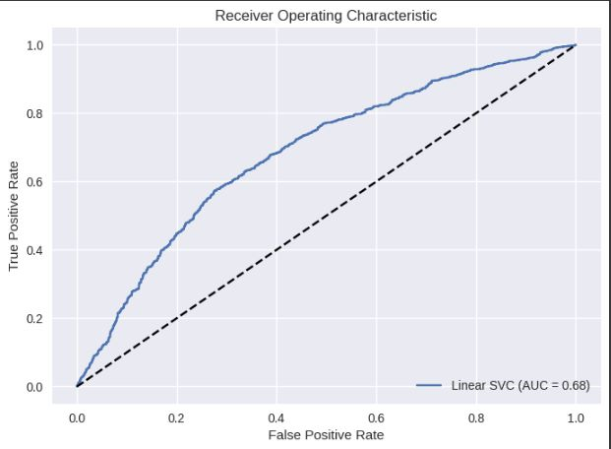
ROC Curve of SVM classifier

Slide 22
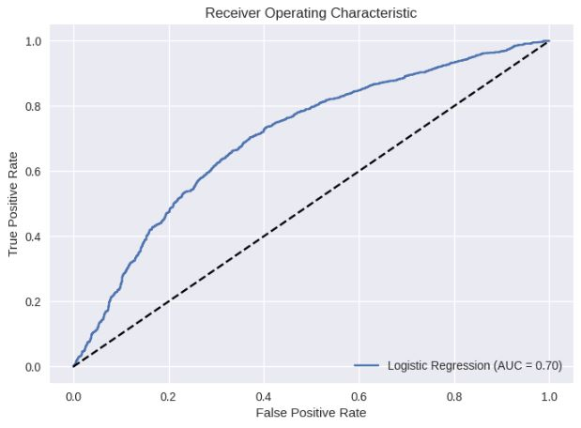
ROC Curve of Logistic Regression

Slide 23
PERFORMANCE ANALYSIS
 | Precesion | Recall | F1 Score | AUC-ROC
Deep Learning | 0.74 | 0.74 | 0.74 | 0.84
LR | 0.64 | 0.59 | 0.61 | 0.65
SVM | 0.65 | 0.59 | 0.62 | 0.66
RF | 0.65 | 0.48 | 0.49 | 0.52

Slide 24
FUTURE WORK
Develop a web-based application for submitting and analyzing product reviews
Provide a user-friendly interface and interactive dashboard for tracking sentiment analysis results.
Explore machine learning algorithms and natural language processing techniques to improve sarcasm detection accuracy.

Slide 25
CONCLUSION
Sarcasm detection is an important aspect of sentiment analysis in product reviews as it can significantly affect the overall sentiment of the review. However, detecting sarcasm in text can be challenging due to its implicit nature, making it necessary to develop advanced machine learning models that can accurately identify sarcastic language in product reviews.

Slide 26
REFERENCE
[1] Sentiment Analysis Challenges: A Review by Chandrashekhar Tople and P. B. Dhumne International Journal of Recent Technology and Engineering (IJRTE) ISSN: 2277-3878 (Online), Volume-11 Issue-6, March 2023
[2]E-COMMERCE PRODUCT REVIEWS USING SENTIMENTAL ANALYSIS by 1S.Devi , 2S.Bharath Kumar, 3S.Keerthivel ,4S.Ranjith ISSN: 2320-2882[6] S.R. Srividhya and S. Sangeetha, A Methodology to Detect Fraud Apps Using Sentiment Analysis.
[3]https://towardsdatascience.com/a-step-by-step-tutorial-for-conducting-sentiment-analysis-a7190a444366

Slide 27
THANK YOU

